Slide 1

An Enhanced Customer-market Segmentation Architecture With Optimized Clustering
Name and Reg. No. Supervisor
Neelkumar Gandhi (22MCB0002) Parthasarathy G
Arjun Krishna SR (22MCB0038) 19042
(SCOPE) (SCOPE)
Date: 10/01/2023
Venue: PRP

Slide 2
Contents
Objective
Introduction
Literature Survey
Proposed Work
Data Cleaning Techniques
Data Visualization
Experiments and Results – I
Experiments and Results – II

Slide 3
Contents
Experiments and Results - III
Conclusion
References

Slide 4
Objective
To build an efficient and enhanced and optimized clusters using an proposed system.

Slide 5
Introduction
Customer-Segmentation
Understand Customers
Increases the sales
Saving time and resources
Find Loyal customers

Slide 6
Introduction
Types :
1. Demographic Segmentation
2. RFM
3. Behavioural
4. Psychographic

Slide 7
Literature Survey - I
Author & Year | Adopted Scheme | Features | Challenges
Exploring big data opportunities for Online Customer Segmentation Georgia Fotaki, Marco Spruit, Sjaak Brinkkemper, Dion Meijer, 2013 | Online Marketing, Customer Segmentation, and Big Data. | A framework for Online Customer Engagement is the OCEM (Online Customer Engagement Management) framework, which shows the steps to achieve online customer engagement and the functional requirements of a tool for OCEM | Marketers do not provide data analysts with the appropriate information, while proceeding with valuable and effective online customer segmentation becomes difficult.
Customer online shopping experience data analytics: Integrated customer segmentation and customised services prediction model Eugene Wong, Yan Wei. (2018) | Regression Models with association rules, support and Confidence | segment high-value customers, analyse their online purchasing behaviour and predict their next purchases | Enhance Projection Accuracy with Big data streams.
Evolution of customer segmentation on the era of big data Atis Verdenhofs,Riga Technical University, Latvia, Tatjana Tambovceva, Dr. Sc., Professor, Riga Technical University, Latvia (2019) | To show interconnections between three disciplines based on literature from all three disciplines – marketing, statistics and Information Technology (IT) | Modelling and evaluation are performed in RapidMiner software since it requires an only limited amount of steps to be done. | macroeconomic factors, different marketing messages used in the offering, additional activities performed for sales promotions. Such other factors were not evaluated and observed in this research.

Slide 8
Literature Survey - II
Author & Year | Adopted Scheme | Features | Challenges
Deep Learning and Big Data in Healthcare: A Double Review for Critical Beginners by Luis Bote-Curiel,Sergio Muñoz-Romero, Alicia Gerrero-Curieses andJosé Luis Rojo-Álvarez , 2019 | Exploration of the current state of BD and DL with the objective of providing a snapshot of these two branches of Data Science. | Fundamentals of both BD and DL were presented together with the most relevant techniques and technologies used today in these fields | More improvements in prediction and accuracy can be done
Large-scale Data-driven Segmentation of Banking Customers Md Monir Hossain Mark Sebestyen (2020) | Association Rule Minning | The algorithms used in this pipeline have associated distributed implementations, distributed association rule mining | The incorporation of windowed anomaly detection and streaming data clustering. Variance Variability
Clustering optimization in RFM analysis based on k-means Rendra Gustriansyah, Nazori Suhandi, Fery Antony (2020) | K Means RFM Validity index | High accuracy Low varience | swarm optimization (PSO), medoid or maximizing-expectancy method as a comparison to get more optimal results.

Slide 9
Literature Survey - III
Author & Year | Adopted Scheme | Features | Challenges
A Quantitative Analysis of Big Data Clustering Algorithms for Market Segmentation in Hospitality Industry 2020 IEEE International Conference on Consumer Electronics (ICCE) | Implementation of density based algorithms | Implemented various density-based clustering algorithms, such as DBSCAN, OPTICS, EnDBSCAN, and their variants, and have provided a comparative performance analysis of these clustering algorithms for different data sets. | All of the contemporary clustering algorithms have their limitations in identifying clusters from datasets because of their dependency on input parameters.
Large-scale Data-driven Segmentation of Banking Customers Md Monir Hossain Mark Sebestyen (2020) | Association Rule Minning | The algorithms used in this pipeline have associated distributed implementations, distributed association rule mining | The incorporation of windowed anomaly detection and streaming data clustering. Variance Variability
Prediction of Coupon Usage Behavior Based on Customer Segmentation and XGBoost algorithm Yue Ren; Piaoyun Fu; Weihong Yu 2021 2nd International Conference on BDEIM | Customer-Based Segmented Coupon Usage Behavior Prediction Model' | Customers were segmented by combining the improved RFS model with the K-means algorithm. | Although some customers are attracted by coupons, the delivery of coupons is not so accurate that user experiences are not paid attention to.

Slide 10
Literature Survey - IV
Author & Year | Adopted Scheme | Features | Challenges
A Review of Customer Segmentation Methods: The Case of Investment Sector Ismail Utku Sayan; Melike Demirdag; Guven Yuceturk; Sare Melek Yalcinkaya (2022) | Comparison of Models | considered different clustering algorithms to segment investors | planning to use the resultant algorithms, compare their performance.
Hybrid Model for Customer Segmentation Based on RFM Framework Yichen Xiao (2022) | Gradient Boosting Decision Tree Algorithm | RFM model is used as a label construction criterion for supervised learning to transform the customer segmentation problem into a more trainable model. Solve the problem of independence and ambiguity among variables by a hybrid model consisting of entity embedding, GBDT and MLP, which can also handle high-dimensional data better. | In the future, a large amount of IoT, transportation, consumption ratio, operation, redistribution services and other data can be used a lot, the evaluation index of customer value will be more complex, and RFM model may appear some limitations.

Slide 11
Literature Survey - V
Author & Year | Adopted Scheme | Features | Challenges
A Review of Customer Segmentation Methods: The Case of Investment Sector Ismail Utku Sayan, Melike Demirdag, Guven Yuceturk, Sare Melek Yalcinkaya, 2022 | Clustering techniques are divided into various groups, according to a fundamental, but widely accepted approach | Considered different clustering algorithms to segment investors. We present information about how to perform feature extraction and data preprocessing steps in order to make the raw data appropriate for the segmentation model. | As improvement, use the resultant algorithms, compare their performance and state their advantages/disadvantages for segmenting investors.
Hybrid Model for Customer Segmentation Based on RFM Framework 2022 7th International Conference on Intelligent Computing and Signal Processing (ICSP) | hybrid model is filtered by GBDT prediction and one-hot encoding | GBDT is a machine learning technique that uses the integration of multiple weak predictive models for regression and classification. GBDT uses a multi-model ensemble strategy to fit the residuals and thus reduce the bias and variance of the model, trying to approximate f(x) by the sum of trees. | The risk of overfitting the model increases when too much data is used to train the MLP.
01/10/2023
VIT, Vellore

Slide 12
Problem Statement
Based on the Literature survey, the following issues are
still exists
1. Scalability
2. Variance
To solve the above issues, system is proposed.

Slide 13
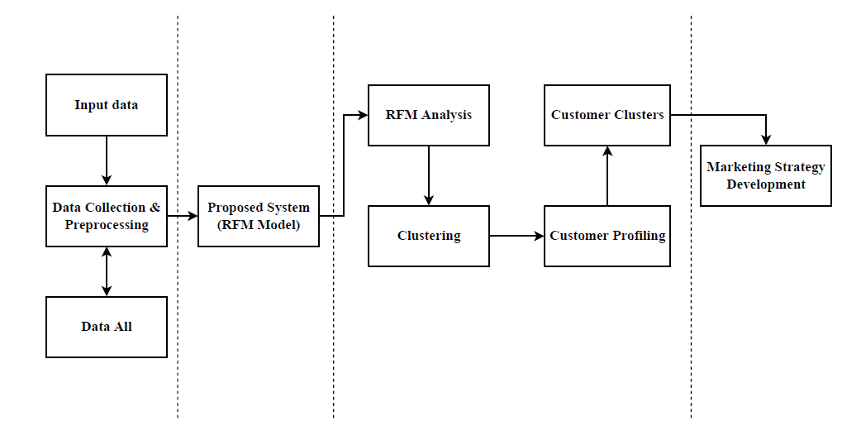
Proposed System
Figure 1. Architecture

Slide 14
Dataset
The dataset used in this study is the real-life dataset, which contained the sales data of a Online Retail Shop.
It consists,
Transactional records between December 2010 - December 2011
4372 Unique Customers
540k transactions.

Slide 15
Cont.
InvoiceNo | StockCode | Description | Quantity | InvoiceDate | UnitPrice | CustomerID | Country | Sales
536365 | 85123A | WHITE HANGING HEART T-LIGHT HOLDER | 6 | 01-12-2010 | 2.55 | 17850 | United Kingdom | 15.3
536365 | 71053 | WHITE METAL LANTERN | 6 | 01-12-2010 | 3.39 | 17850 | United Kingdom | 20.34
536365 | 84406B | CREAM CUPID HEARTS COAT HANGER | 8 | 01-12-2010 | 2.75 | 17850 | United Kingdom | 22
536365 | 84029G | KNITTED UNION FLAG HOT WATER BOTTLE | 6 | 01-12-2010 | 3.39 | 17850 | United Kingdom | 20.34
Table 1. Online Retail Dataset

Slide 16
Data Cleaning
Sl. No. | Technique | Dataset | Description
1. | Data Cleaning | Online Retail | Ignore the tuples, Fill the Missing values
2. | Data Normalization | Online Retail | Remove –ve Values, MinMax Scale
3. | Clustering | Online Retail | Noisy Data
Table 2. Data cleaning techniques

Slide 17
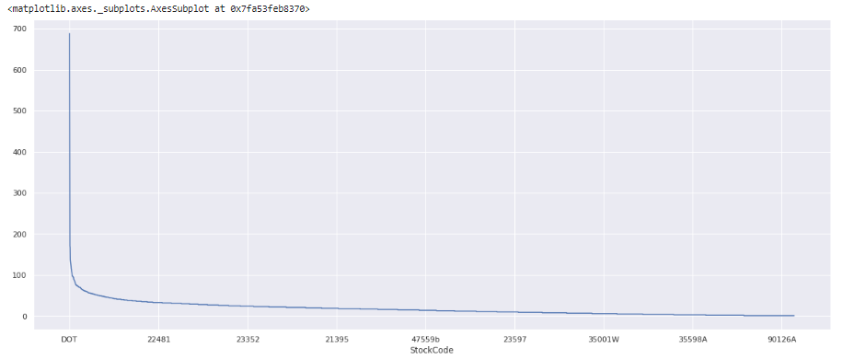
Data Visualization
Stockcode Vs Sales
Figure 2. Stockcode Vs Sales

Slide 18
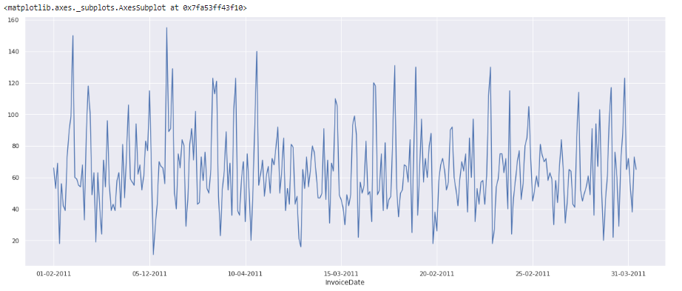
Data Visualization
InvoiceDate Vs CustomeID
Figure 3. InvoiceDate Vs CustomeID

Slide 19
Experiments and Results - I
RFM Calculation
Recency = The interval between the last action and today
Frequency = The number of actions between the user’s signup date and today
Monetary value = The sum of revenue within the user’s lifetime

Slide 20
Cont.
index | Customer ID | Recency | Frequency | Monetary
0 | 12346 | 326 | 2 | 0.0
1 | 12347 | 40 | 182 | 4310.0
2 | 12348 | 76 | 31 | 1797.24
3 | 12349 | 19 | 73 | 1757.55
4 | 12350 | 311 | 17 | 334.4
Table 3. RFM Values for each customer

Slide 21
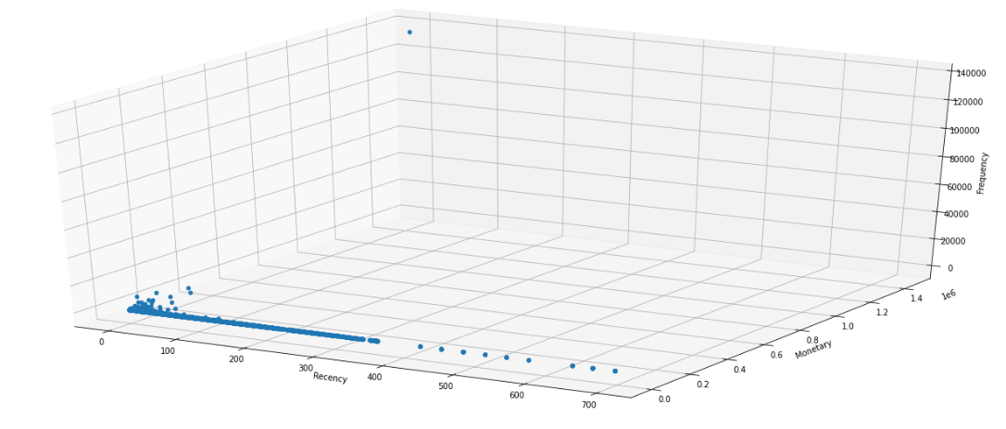
Data Visualization
Figure 4.
Consists of Outlier
Figure 10
Removed Outlier

Slide 22
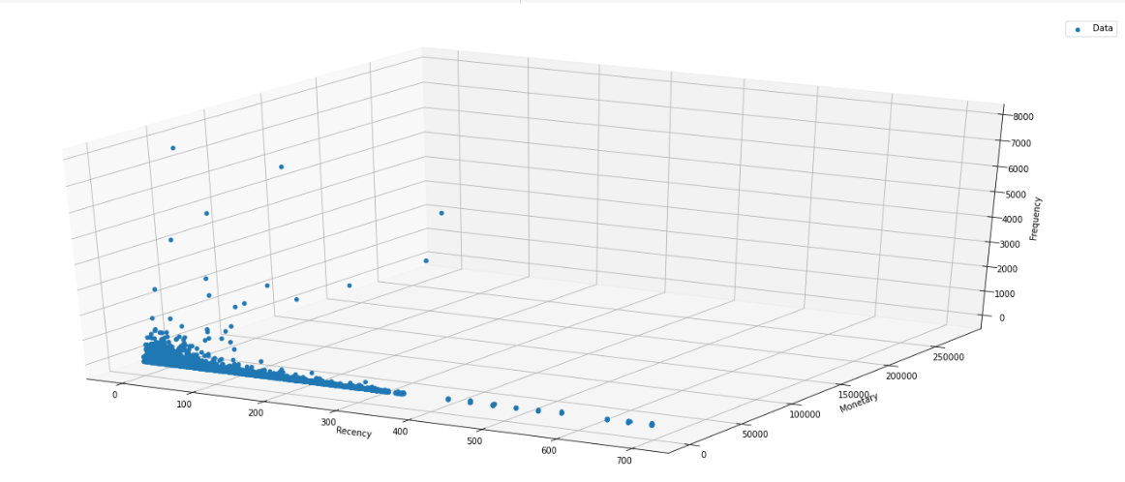
Data Visualization
Figure 5.
Removed Outlier
Figure 10
Removed Outlier

Slide 23
Cont.
Large clusters divided into groups
Clustering or data segmentation
As volume increases, difficulty of transaction increases
Resolved by applying proper data mining techniques
Group items into appropriate clusters
Values of different groups may be assessed

Slide 24
Experiments and Results - II
Data Normalization
y = (x – min) / (max – min)
CustomerID | Recency | Frequency | Monetary
12346 | 0.4677187948350072 | 7.404281155364032e-06 | 0.0
12347 | 0.05738880918220947 | 0.0013401748891208897 | 0.0029761753503407228
12348 | 0.10903873744619799 | 0.00022212843466092093 | 0.001241044405254376
12349 | 0.027259684361549498 | 0.0005331082431862103 | 0.0012136373519701477
12350 | 0.44619799139167865 | 0.00011846849848582451 | 0.00023091253762272333
Table 4. Normalization

Slide 25
Experiments and Results - III
Validation Indexes
Elbow Method
Davies Bouldin
Calinski_harabasz_score (CHI Index)
Silhoulette Score

Slide 26
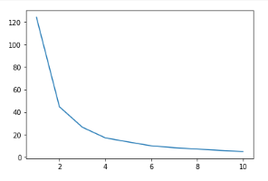
Cont.
No of Clusters
Figure 5. Elbow Method

Slide 27
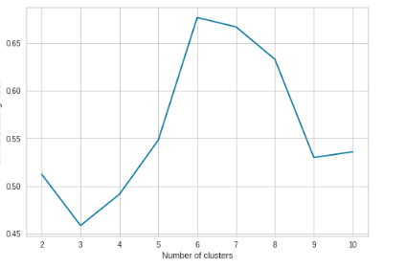
Cont.
Figure 6. Davies Bouldin Index

Slide 28
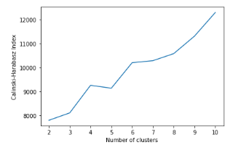
Cont.
Figure 7. Calinski_harabasz_score (CHI Index)

Slide 29
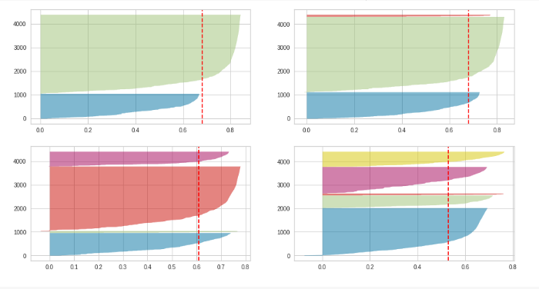
Cont.
Figure 8. Silhoulette Score

Slide 30
Cont.
From the real transactions dataset, we got all RFM Values and applied MinMaxScalar to that dataset.
after getting optimal number of cluster, we have used K-Means clustering and get optimized clusters.

Slide 31
Cont.
Step 1 | : | Clustering Algorithm
Step 2 | : | Find Recency, Frequency, and Monetary Values for each data index.
Step 3 | : | Apply normalization/standardization to newly created RFM Data frames.
Step 4 | : | Find optimal no of cluster
Step 5 | : | Apply hyper-parameters to K-means algorithm
Step 6 | : | Optimized cluster as output.
Table 5. Steps to be followed

Slide 32
Cont.
index | 0 | 1 | 2
0 | 0.1376857116427518 | 0.40550872676173766 | 0.36272620239342174
1 | 0.27372771237839794 | 0.012063726856371294 | 0.7734665727006491
2 | 0.22110715892066063 | 0.04775578950313045 | 0.7214216288341161
3 | 0.30291705899568083 | 0.03578875827304983 | 0.8032255312072237
4 | 0.11611790610304712 | 0.38391484157273964 | 0.38423957012206195
5 | 0.22553953724036085 | 0.04237020639247372 | 0.725782706253438
Table 6. Each data point’s distance from its corresponding cluster centres using Euclidean method

Slide 33
Cont.
Here First mean gives Cluster matrix points mean, second gives cluster’s mean, and third gives overall Mean (Variance)
Old Variance | 0.79
New Variance | 0.37
Table 7. Variance comparison

Slide 34
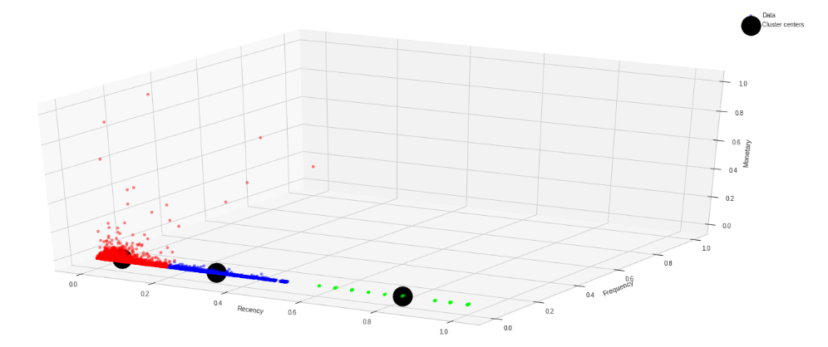
Cont.
Variance: 0.37
Figure 9. Optimized Clusters

Slide 35
Conclusion
The essential idea of RFM analysis is that datasets are split into 3 clusters of the ideal size. This work has developed a method for RFM analysis (in customer segmentation) utilizing the k-Means approach with variance of 0.37.

Slide 36
References
Eugene Wong, Yan Wei. (2018). Customer online shopping experience data analytics: Integrated customer segmentation and customised services prediction. International Journal of Retail & Distribution Management, ISSN: 0959-0552.
Md Monir Hossain, Mark Sebestyen (2020) ... A Large-scale Data-driven Segmentation of Banking Customers. 2020 IEEE International Conference on Big Data (Big Data).
Rendra Gustriansyah, Nazori Suhandi, Fery Antony (2020). Clustering optimization in RFM analysis based on k-means. Indonesian Journal of Electrical Engineering and Computer Science Vol. 18, No. 1, April 2020, pp. 470~477, ISSN: 2502-4752.
Ismail Utku Sayan; Melike Demirdag; Guven Yuceturk; Sare Melek Yalcinkaya (2022). A Review of Customer Segmentation Methods: The Case of Investment Sector. 2022 IEEE 5th International Conference on Big Data and Artificial Intelligence (BDAI).
Yichen Xiao (2022). Hybrid Model for Customer Segmentation Based on RFM Framework. 2022 7th International Conference on Intelligent Computing and Signal Processing (ICSP).

Slide 37
References
Gupta, R., Gupta, H., & Mohania, M. (2012). Cloud Computing and Big Data Analytics: What Is New from Databases Perspective?. In Big Data Analytics (pp. 42-61). Springer Berlin Heidelberg.
Agneeswaran, V. S. (2012). Big-Data :Theoretical, Engineering and Analytics Perspective. In Big Data Analytics (pp. 8-15). Berlin Heidelberg: Springer.
Brodie, R. J., Hollebeek, L. D., Juric, B., & Ilic, A. (2011). Customer Engagement: Conceptual Domain, Fundamental Propositions, and Implications for Research. Journal of Service Research, 14(3), 252–271.
Chen, H., Chiang, R., H., L., & Storey, V., C. (2012). Business Intelligence and Analytics: From Big Data to big impact, MIS Quaterly 36 (4), pp.1165-1188
Cheng, C.H., & Chen, Y.S. (2009). Classifying the segmentation of customer value via RFM model and RS theory. Expert Systems with Applications, 36(3), 4176–4184.

Slide 38
Queries

Slide 39
Thank You

