Slide 1

Process Mining Virtual Internship
by
B.NEELIMA
Roll No. 214G1A3265
Department of Computer Science and Engineering (Data Science)
Srinivasa Ramanujan Institute of Technology
(Affiliated to JNTUA & Approved by AICTE) (Accredited by NAAC with ‘A’ Grade & Accredited by NBA (EEE, ECE & CSE)
Rotarypuram Village, B K Samudram Mandal, Ananthapuramu – 515701.
2023 - 2024

Slide 2

Contents
Course Objective
Introduction
Technology
Applications
Modules
Real Time applications
Learning outcomes
GitHub Link
Queries

Slide 3
Course Objective
The objectives of the Process Mining Virtual Internship are to equip participants with a comprehensive understanding of process mining concepts and methodologies.
Collaboration and Remote Work Skills
Real Time Applications
Understand Different Process Mining Concepts

Slide 4
Introduction
Process mining is a technique designed to discover, monitor and improve real processes by extracting readily available knowledge from the event logs of information systems.
Modern Process Mining technology quickly and reliably extracts information from event and transaction logs to visually depict real-time process models for current processes.
It is important because the reality of the problem is sometimes bigger to understand to extract an exact solution, in such situations this technology helps in making the concept into the reality.

Slide 5
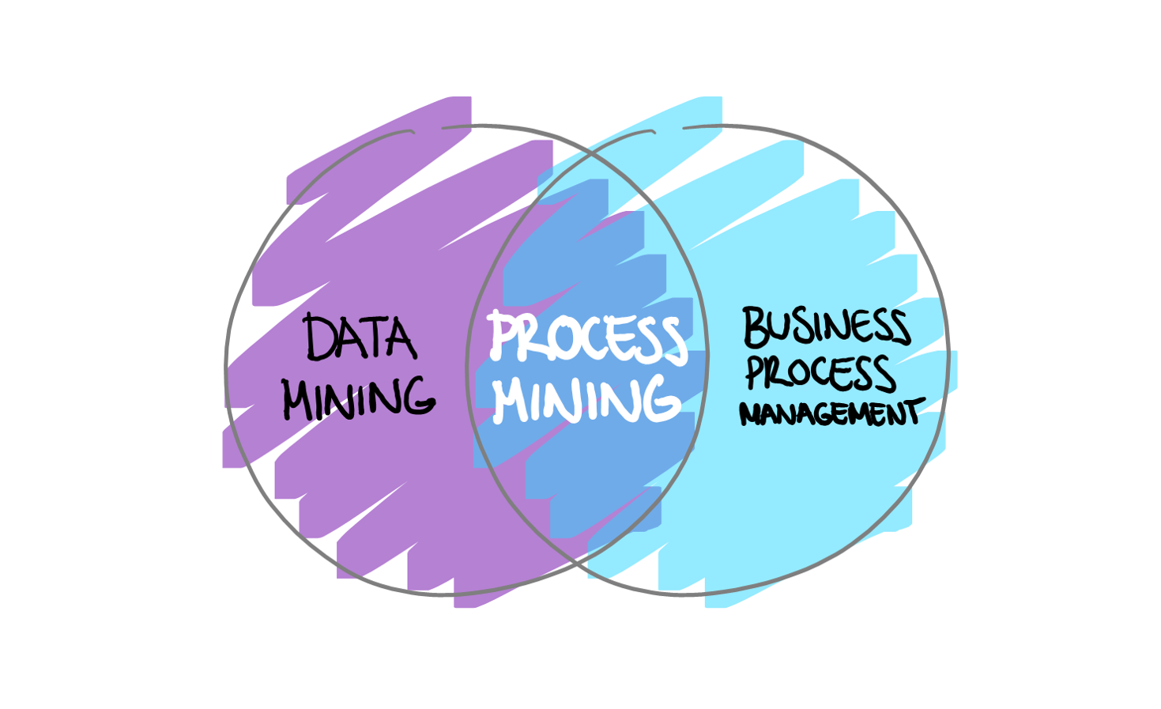
Contd..
Process Mining is the combination of two things: Data mining and Business Process Management.

Slide 6
Technology
Process mining is a technique to analyze and track processes.
Process mining is a data science technique that involves using data mining and validate and enhance workflows within organizations.
Process modeling: Process modeling is the process of representing a process in a graphical or textual form. In the context of process mining, process modeling is used to create a graphical representation of the actual process, as opposed to the as-designed process.
Data mining: Data mining is the process of extracting knowledge from data. In the context of process mining, data mining is used to identify patterns and trends in event data.

Slide 7
Applications
Telecommunication:
Process mining is like a detective tool that telecom companies can use to uncover problems in their activation processes caused by the combination of a growing number of subscribers and increased automation. By analyzing the steps from order to activation, process mining helps companies find and fix issues, prevent customer dissatisfaction, and save money in the long run.

Slide 8
Modules
Process mining involves the following key steps:
1. Data Extraction
2. Data Preprocessing
3. Process Discovery
4.Conformance Checking
5.Process Enhancement

Slide 9
Data Extraction: This is the first step in process mining. Data is collected from various sources, such as IT systems, databases. This data includes information about the activities, timestamps, users, and other relevant details of the process being analyzed.
Data Preprocessing: Raw data is often messy and complex. In this module, the data is cleaned, organized, and transformed into a suitable format for analysis. Irrelevant or incomplete data is removed, and the remaining data is structured to prepare it for further processing.
Process Discovery: This module is the heart of process mining. It involves creating a visual representation of the process flow based on the collected data. This representation is often in the form of process maps, flowcharts, or graphs that show how different activities are connected and the sequence in which they occur.

Slide 10
Conformance Checking:Conformance checking can be done manually or automatically. Manual conformance checking involves comparing the actual process to the as-designed process using a checklist. Automatic conformance checking uses process mining techniques to identify deviations from the standard process
Process Enhancement:a process mining technique that's used to extend or enhance a target model or reference model using discovered information about the actual process.

Slide 11
Real Time Applications
Logistics:
In logistics, process mining can track the movement of goods in real time, helping identify delays, optimize routes, and ensure timely deliveries. It improves optimization, Customer experience. Generally this process mining identify late deliveries and their root causes to prevent possible supply chain disruption
Healthcare:
Improve Patient care and reduce waiting times,and optimize hospital process.They identify where these are working together and what improvements need to be done.

Slide 12
Learning Outcomes
Gain an overall understanding of basic Process Mining concepts.
Able to know real time applications
Developing skills in visualization

Slide 13
Git Hub Link:
Git Hub Link: https://github.com/neelima-27

Slide 14
Any Queries?

Slide 15
Thank You!!!

