Slide 1
From Predictive Analytics to Operational
Decision Support
A practical framework for NovaBank customer outreach prioritization
Prepared by
Neelima Parupally
Analytics Methods and Frameworks Project
Quantic School of Business and Technology
July 2026

Slide 2
Introduction: the decision to support
A genuine, operational framing of the NovaBank case
BUSINESS PROBLEM
IMPORTANT LIMITATION
NovaBank needs to use limited retention/campaign capacity more effectively. The goal is not to contact everyone; it is to prioritize customers most likely to respond to proactive outreach.
The public dataset measures term-deposit campaign response, not actual churn. I use response as a proxy for retention engagement and clearly treat financial impact as an illustrative scenario.
ANALYTICS TRANSLATION
SUCCESS MEASURES
• Binary classification: estimate probability of a positive customer response
• Ranking problem: decide who is in the top outreach group.
• Decision framework: connect model scores to action tiers and pilot governance
• AUC-ROC: ranking quality across all customers
• Average precision / Precision@Top20%: usefulness under class imbalance
• Pilot lift vs. control: the final business proof
NovaBank Analytics Methods & Frameworks | Neelima Parupally
2 / 10

Slide 3
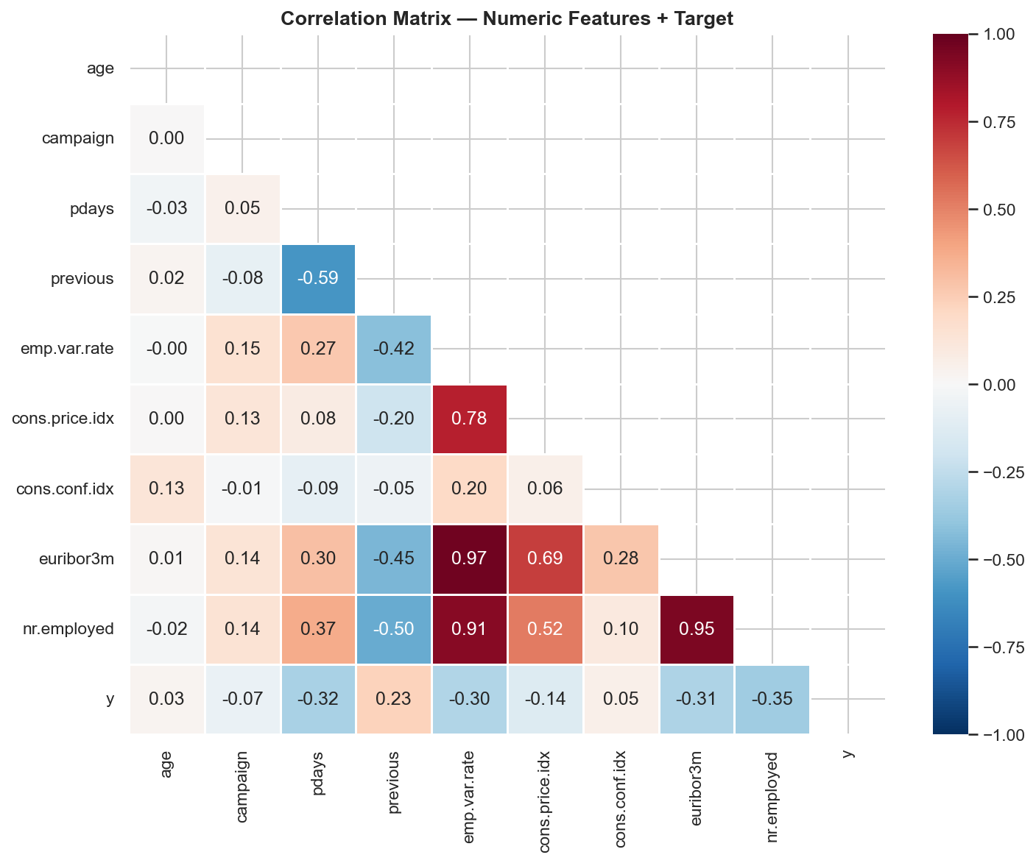
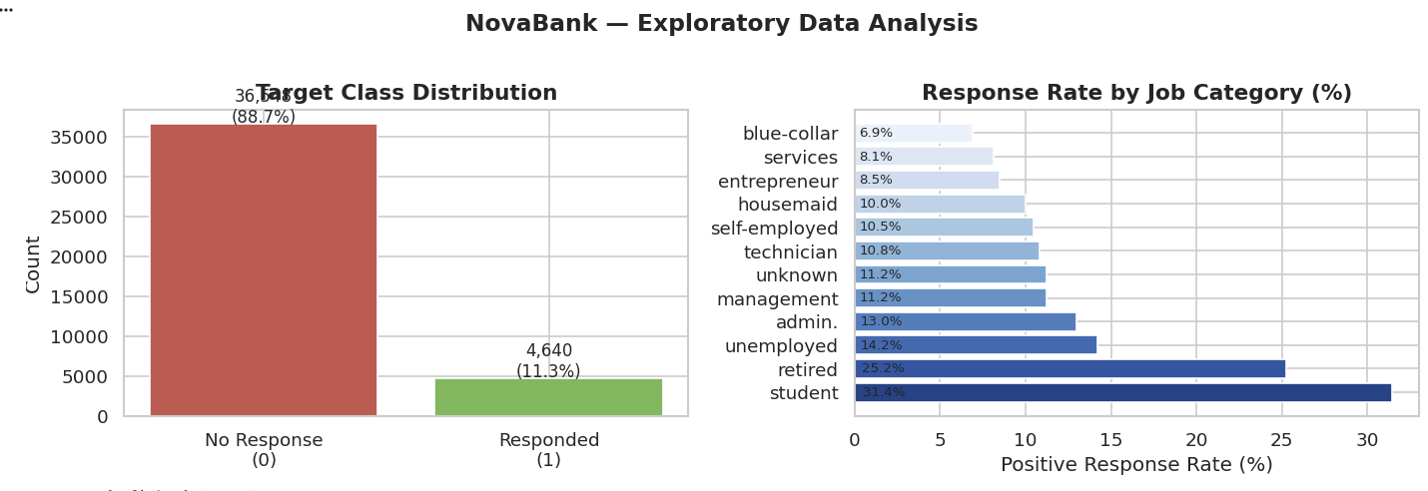
Data readiness: response is rare and uneven
UCI Bank Marketing dataset used as a proxy for NovaBank outreach response
• 41,188 records with 20 input features plus a binary target
• Only 11.3% positive response, so accuracy alone is not useful
• Duration is excluded to prevent leakage because it is only known after a call
• Macroeconomic and prior-contact variables show stronger signal than demographics alone
NovaBank Analytics Methods & Frameworks | Neelima Parupally
3 / 10

Slide 4
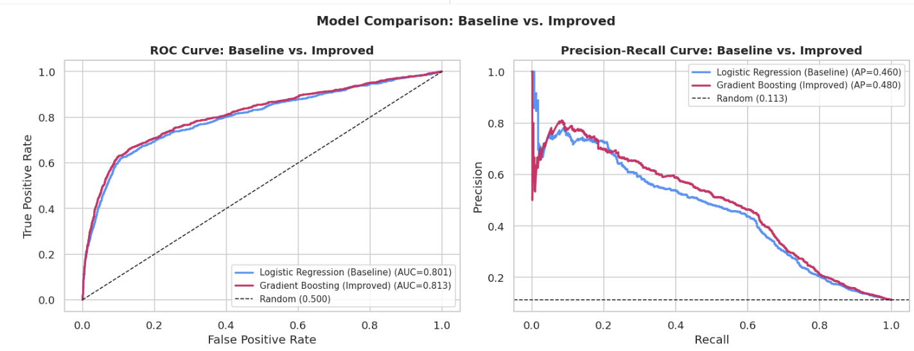
Modeling approach: baseline first, then improvement
Logistic regression establishes the floor; gradient boosting improves ranking
BASELINE
• Logistic regression with class weighting
• Easy to explain and audit
• Baseline AUC: 0.801; AP: 0.460
IMPROVED MODEL
• Gradient boosting captures non-linear patterns
• Improved AUC: 0.814; AP: 0.489
• Gain is modest but useful for prioritizing thousands of customers
3x+
Top 20%
estimated lift in top-ranked group vs. random
recommended capacity-based outreach pool
NovaBank Analytics Methods & Frameworks | Neelima Parupally
4 / 10

Slide 5
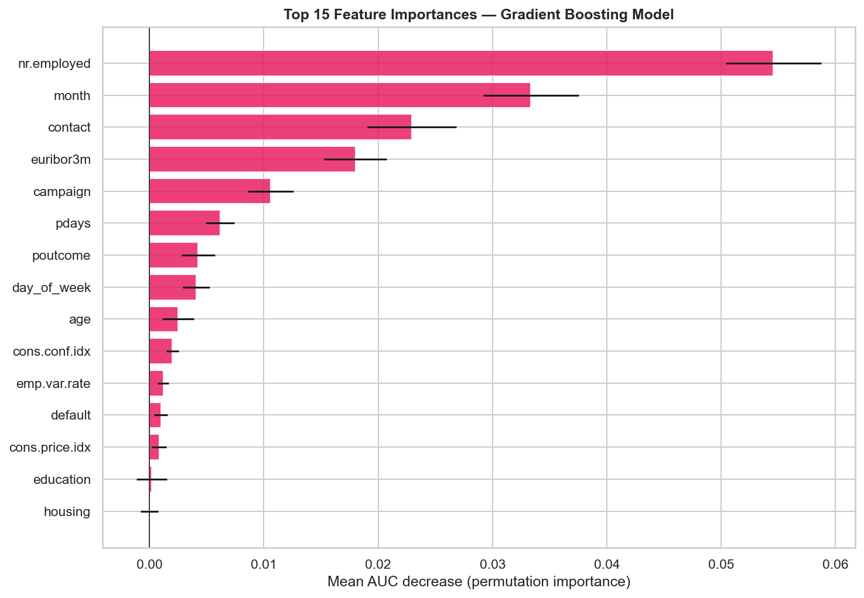
Explainability: what drives the ranking?
Permutation importance shows predictive contribution, not causation
WHAT LEADERSHIP CAN UNDERSTAND
• Economic context matters: employment and interest-rate indicators are strong drivers
• Channel, timing, and prior campaign outcome affect customer response
• Demographics are not the primary standalone drivers and should be monitored for fairness
GOVERNANCE NOTE
This model should be used as a ranking aid, not an automatic decision engine. Final production use requires monitoring, fairness review, and business-owner signoff.
NovaBank Analytics Methods & Frameworks | Neelima Parupally
5 / 10

Slide 6
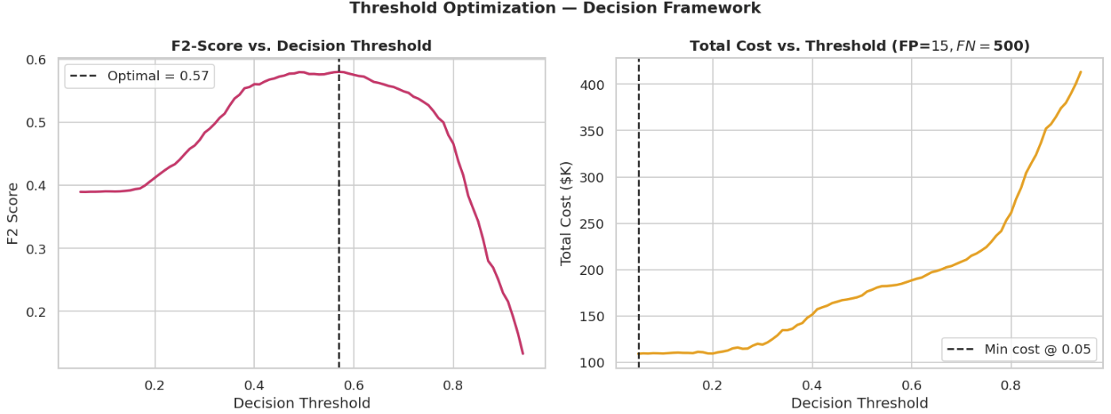
Decision framework: use capacity first, thresholds second
Avoid mixing three different decision rules
PRIMARY PRODUCTION RULE
Rank customers by predicted probability and contact the top 20%, because the quarterly campaign has limited capacity.
SUPPORTING THRESHOLD ANALYSIS
• F2-score peaks around 0.46 when recall is valued more than precision
• Minimum-cost threshold is lower under the assumed $15 FP / $500 FN cost ratio
• These thresholds are sensitivity checks, not replacements for the top-20% capacity rule
ACTION TIERS
Tier 1: highest scores, personal call
Tier 2: next-highest scores, email + follow-up
No action: hold this cycle
NovaBank Analytics Methods & Frameworks | Neelima Parupally
6 / 10

Slide 7
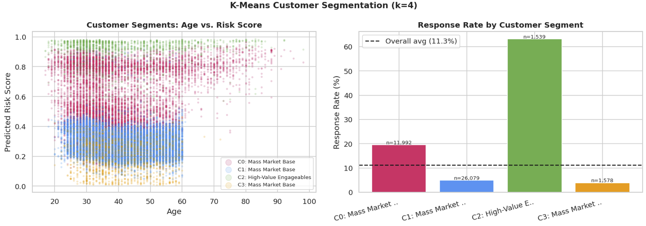
Segmentation: useful for messaging, not proof of model performance
K-means highlights one high-response group and several lower-response groups
CORRECTED INTERPRETATION
• The segment chart does not support four sharply distinct customer personas
• It supports a simpler message: one cluster has much higher response, while the other groups are lower-response mass-market segments
• Segment labels should be finalized only after reviewing cluster profiles and sizes
HOW TO USE THIS
Use segmentation to tailor outreach scripts and offers. Do not use it as independent proof that the predictive model works; performance must be validated on the test set and pilot control group.
NovaBank Analytics Methods & Frameworks | Neelima Parupally
7 / 10

Slide 8
Validation plan: prove lift, fairness, and operational fit
The model should not go directly into full production
RISKS CONTROLLED
90-DAY PILOT DESIGN
• Proxy-target risk: campaign response is not actual churn
• Leakage risk: call duration is removed
• Drift risk: macro indicators can change
• Customer-fatigue risk: outreach volume must be capped
• 5,000 customers total: 2,500 model-selected and 2,500 randomized control
• Measure incremental response / retention lift, cost per successful contact, and customer complaints
• Track results by age group and job category for fairness review
FAIRNESS CHECKS TO INCLUDE
GO / NO-GO CRITERIA
• Selection rate by group
• Precision by group among contacted customers
• Recall / missed-positive rate by group
• Escalation review if gaps are large or sample sizes are too small
Scale only if the pilot shows commercially meaningful lift vs. control, acceptable fairness metrics, and manageable Tier 1 call volume.
NovaBank Analytics Methods & Frameworks | Neelima Parupally
8 / 10

Slide 9
Recommendation: pilot the ranking model, then scale carefully
A clear decision, with transparent assumptions
RECOMMENDED DECISION
Approve a 90-day pilot using the gradient boosting score to rank customers. Contact the highest-scored 20% using two outreach tiers, while holding out a randomized control group.
WHY THIS IS CREDIBLE
FINAL ANSWER
• Baseline and improved model are both shown
• Decision threshold is tied to business capacity and cost sensitivity
• Unsupported ROI claims are avoided; financial impact is treated as a pilot-tested scenario
• Reproducible notebook and dataset are included for review
Use the model to prioritize action, not to automate judgment.
WHAT LEADERSHIP GETS
• A prioritized outreach list
• A defensible reason for who gets contacted first
• A test plan before spending the full budget
• A governance path for fairness and drift monitoring
NovaBank Analytics Methods & Frameworks | Neelima Parupally
9 / 10

Slide 10
References and AI usage transparency
Sources and reproducibility notes
DATASET AND CITATION
Moro, S., Cortez, P., & Rita, P. (2014). A data-driven approach to predict the success of bank telemarketing. Decision Support Systems. UCI Bank Marketing dataset, bank-additional-full.csv.
• AI was used to improve narrative structure, identify gaps, and polish executive wording
• Analysis assumptions, code review, and final recommendations were checked and owned by the analyst
• AI-generated suggestions were revised to avoid unsupported claims and to align with the project rubric
AI USAGE LOG
FINAL SUBMISSION LINKS
Slide appendix link: [insert after uploading]
GitHub notebook link: [insert after uploading]
NovaBank Analytics Methods & Frameworks | Neelima Parupally
10 / 10

