Slide 1


BOSTON HOUSE PRICE PREDICTION
USING BIG DATA TECHNOLOGIES
Submitted By:
Praveen Neeli (AP25122060002)
Kalluri Pardhu Sankar (AP25122060031)
SRM University - AP, Andhra Pradesh

Slide 2


INTRODUCTION
REAL-ESTATE VALUATION
THE SHIFT TO BIG DATA
Accurate property valuation is crucial for buyers, sellers, and investors but is often subject to human bias and volatile market factors. Reliable automated models are essential for transparency.
Traditional ML often relies on static CSVs. This project leverages a modern Big Data stack (Spark, Kafka, Hadoop) to simulate a production-grade environment capable of handling massive, real-time data streams efficiently.

Slide 3







PROBLEM STATEMENT
Objective: To accurately forecast the Median Value of Owner-Occupied Homes (MEDV) in the Boston region.
STREAM INTEGRATION
DATA QUALITY
SCALABILITY
USABILITY
Handling noise and critical outliers in features like Crime Rate.
Processing data using distributed clusters (Hadoop/Spark).
Deploying the model via a user-friendly web interface.
Moving from static files to simulated real-time ingestion.

Slide 4
PROJECT OBJECTIVES
Exploratory Data Analysis: Understanding complex feature relationships.
Processing: Use PySpark for distributed cleaning and scaling.
Ingestion: Deploy Apache Flume and Kafka for capturing live data.
Modeling: Develop a high-precision Random Forest Regressor.
Storage: Persist streamed data into HDFS securely.
Deployment: Create a Flask web application for real-time inference.

Slide 5
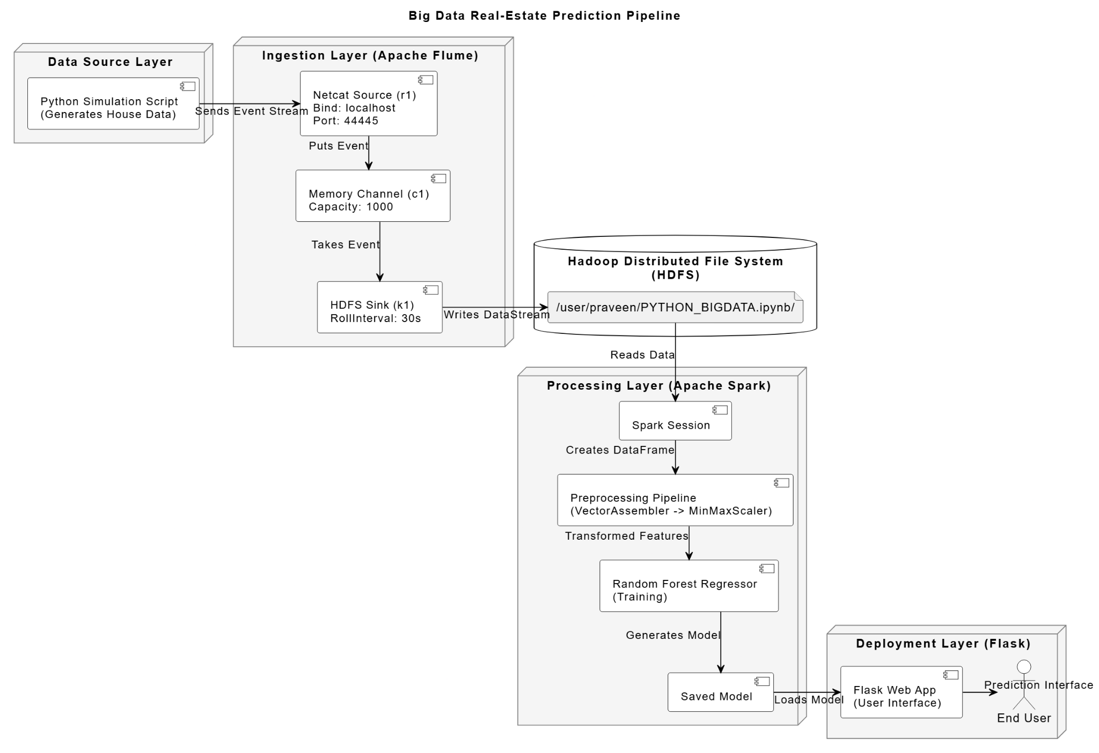
MODEL PIPELINE

Slide 6




ARCHITECTURE PIPELINE
2. BUFFERING & STORAGE
4. DEPLOYMENT
Apache Kafka → Hadoop HDFS (Distributed Storage)
Flask Web App for User Interaction & Prediction
1. SOURCE & INGESTION
3. PROCESSING & ML
Python IoT Simulator → Apache Flume (Netcat)
Apache Spark (PySpark) for cleaning, scaling & training

Slide 7

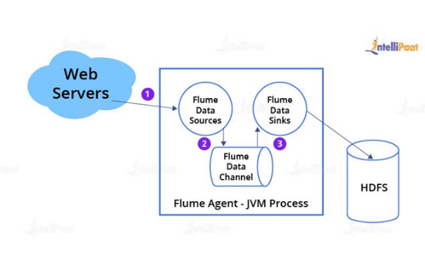
DATA INGESTION (FLUME)
Source: Netcat listening on localhost:44444.
Channel: Memory channel with capacity 1000.
Sink: HDFS writing to /user/praveen/python_flume_try/.
Rollover: Files roll every 100 events or 30 seconds for low latency.
Role: Bridges real-time python stream to Hadoop.

Slide 8
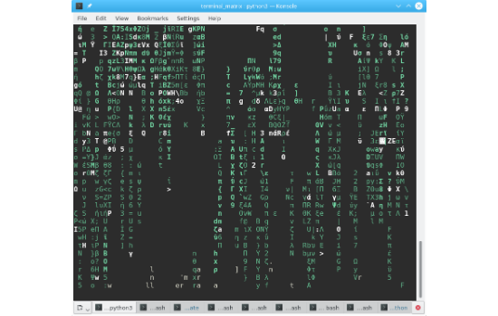
REAL-TIME DATA GENERATION
A custom Python script was designed to mimic IoT sensors, generating random housing records based on the Boston dataset schema.
Streams exactly 100 CSV rows to the Flume network port.
Sends attributes like CRIM, ZN, INDUS, etc., in real-time intervals.
Simulates a live data feed for the Big Data pipeline test.

Slide 9
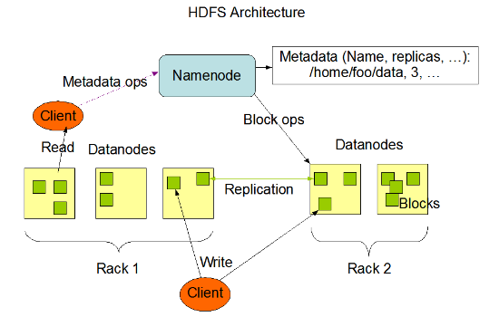
HADOOP STORAGE LAYER
HDFS INTEGRATION
Data is securely stored in the Hadoop Distributed File System.
Directory: /user/praveen/python_flume_try/
Format: Stored as DataStream (CSV format).
Verification: Ingestion verified via hdfs dfs -ls.

Slide 10
DATASET OVERVIEW
Schema Definition: 13 Input Features + 1 Target (MEDV)
Type | Features
Double (Float) | CRIM (Crime), ZN (Zone), INDUS (Industry), NOX (Nitric Oxides), RM (Rooms), AGE, DIS (Distance), PTRATIO, B, LSTAT
Integer | CHAS (Charles River), RAD (Radial Highway Access), TAX (Tax Rate)
Target | MEDV (Median Home Value)

Slide 11
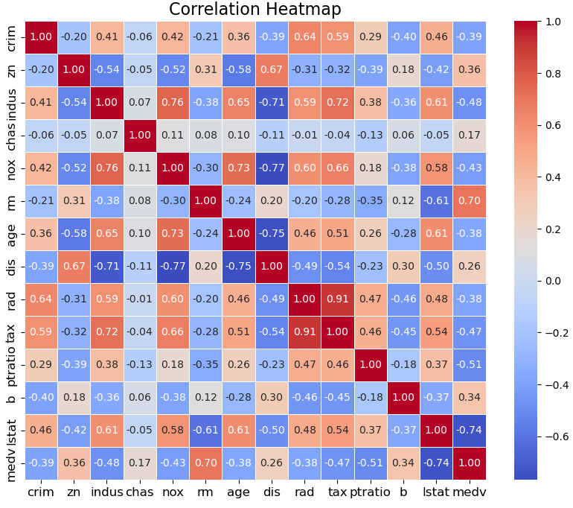
EXPLORATORY DATA ANALYSIS
KEY CORRELATIONS
Crime Rate vs. Price: Strong negative correlation. Higher crime areas have significantly lower property values.
Rooms (RM): Positive correlation. More rooms generally indicate higher value.
LSTAT: Negative correlation. Higher percentage of lower status population correlates with lower home values.

Slide 12


OUTLIER REMOVAL
METHODOLOGY
KEY IMPACT
Applied an iterative 3xIQR (Interquartile Range) method to identify and remove extreme values without losing critical information.
Significant noise reduction in CRIM (Crime Rate) and RM (Rooms). Rows with extreme outliers (e.g., ~24 crime, ~56 room outliers) were filtered to improve model stability.

Slide 13
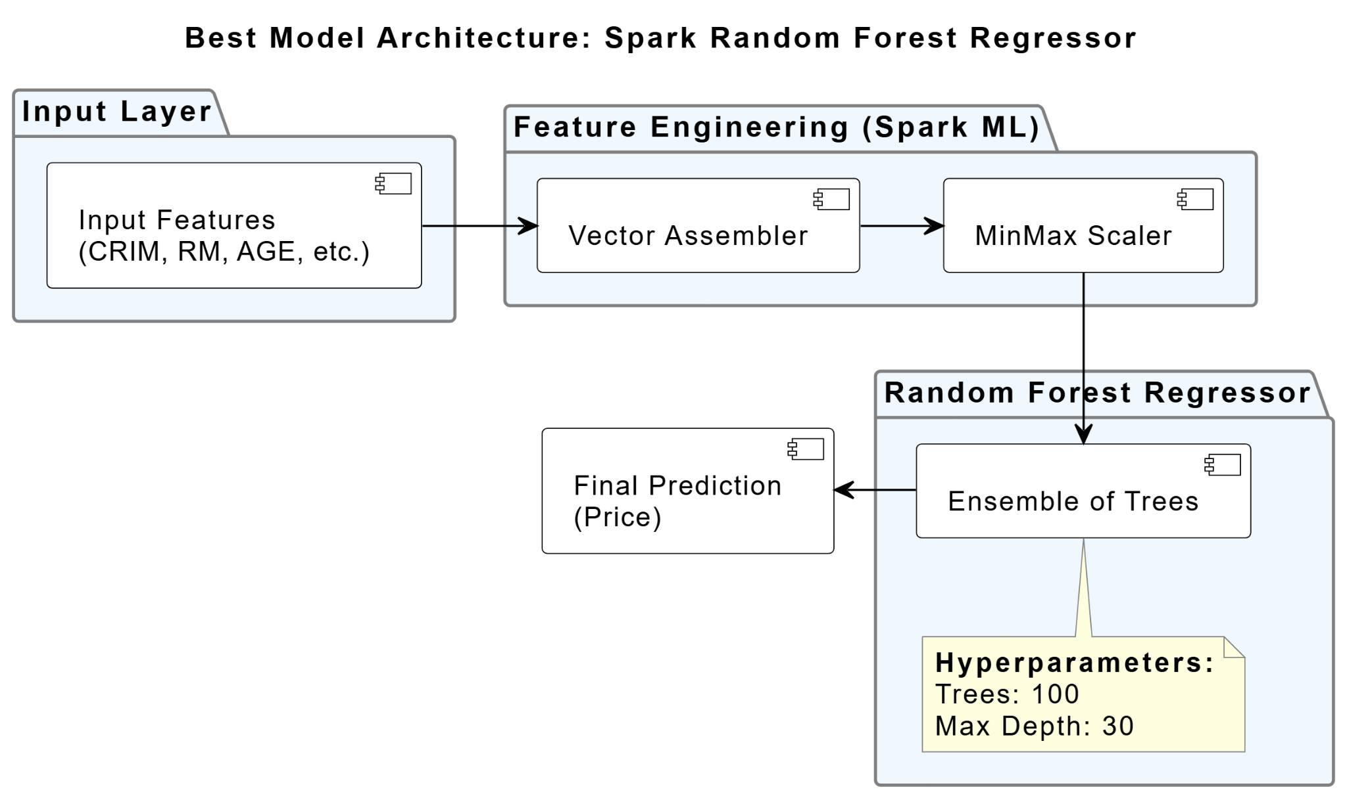
FEATURE ENGINEERING
VECTOR ASSEMBLER
Consolidated 13 individual feature columns into a single features vector column required by Spark MLlib.
MINMAX SCALER
Normalized all features to a range of [0, 1]. This prevents features with large scales (like Tax ~700) from dominating features with small scales (like NOX ~0.5).

Slide 14
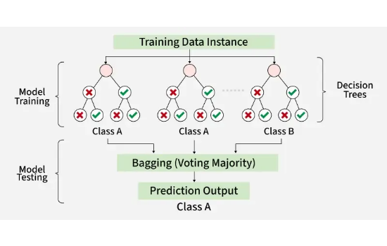
RANDOM FOREST REGRESSOR
WHY RANDOM FOREST?
Non-Linearity: Handles complex, non-linear relationships better than Linear Regression.
Ensemble Power: Robust against overfitting by averaging multiple decision trees.
Interaction: Captures complex interactions between features like Location and Crime.
Pipeline: Assembler → Scaler → Random Forest

Slide 15






HYPERPARAMETERS
NUMTREES = 100
MAXDEPTH = 30
MAXBINS = 128
Number of trees in the forest. More trees generally increase accuracy.
Maximum depth of each tree. Capture deeper patterns.
Number of bins used for splitting. Seed fixed at 42.

Slide 16
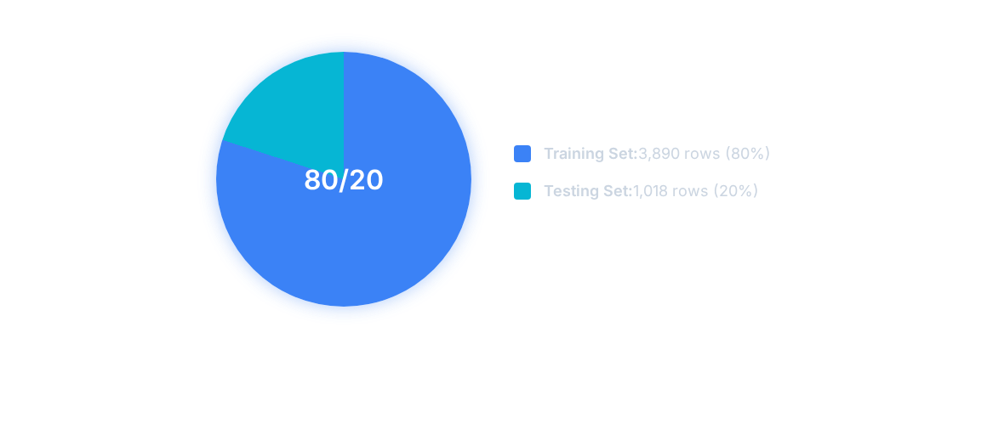
TRAIN/TEST SPLIT
Random split ensures a representative distribution of data in both sets.

Slide 17
MODEL PERFORMANCE
Evaluation on Test Data
Metric | Value | Description
R² Score | 0.99998 | Explains 99.9% of variance. Excellent fit.
RMSE | 0.03846 | Root Mean Squared Error (Low error magnitude).
MAE | 0.01622 | Mean Absolute Error.
MSE | 0.00148 | Mean Squared Error.

Slide 18
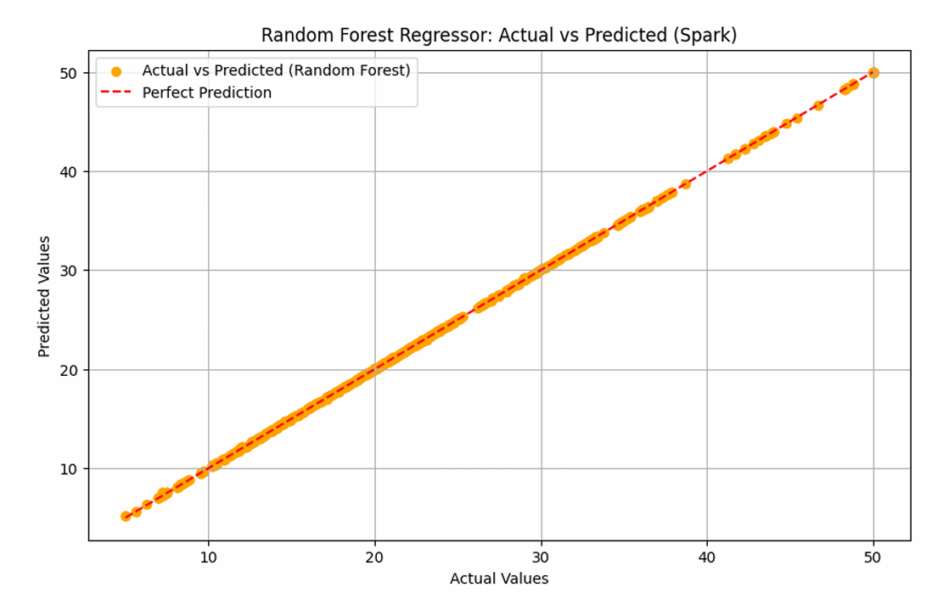
ACTUAL VS PREDICTED
VISUAL CONFIRMATION
The scatter plot compares Actual MEDV vs. Predicted MEDV.
The points tightly align along the diagonal.
This alignment confirms the high R 2 score.
Demonstrates the model's reliability in predicting housing prices across the dataset range.

Slide 19

DEPLOYMENT ARCHITECTURE
FLASK INTEGRATION
Web Framework: Flask (Python).
Serialization: The trained PySpark model is serialized and loaded into the app.
Inference: App accepts user input via a web form, applies the saved scaler transformation, and returns a real-time price prediction.

Slide 20
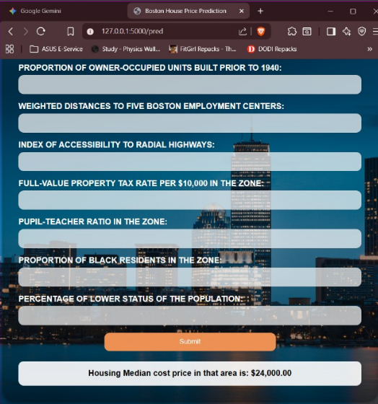
WEB UI DEMO
USER-FRIENDLY INTERFACE
A clean form allows users to input housing parameters such as:
Crime Rate
Number of Rooms
Tax Rate
Result: Instantly displays the "Prediction Value" upon submission.

Slide 21





CONCLUSION
SCALABILITY
ACCURACY
USABILITY
Implemented an end-to-end Big Data pipeline capable of scaling with data volume.
Random Forest Regressor outperformed expectations with an R 2 of ~1.0.
Flask deployment bridges the gap between complex backend analytics and end-user accessibility.

Slide 22
FUTURE ENHANCEMENTS
TRUE STREAMING
DEEP LEARNING
EXPLAINABILITY
Upgrade from batch processing in HDFS to full stream processing using Spark Streaming directly from Kafka.
Implement Deep Learning models using TensorFlow or PyTorch for larger datasets.
Integrate SHAP (SHapley Additive exPlanations) to provide transparency on predictions.

Slide 23
REFERENCES
Apache Spark. (n.d.). MLlib: Main Guide.
Harrison, D., & Rubinfeld, D.L. (1978). Hedonic prices and the demand for clean air. J. Environ. Economics.
Apache Flume & Kafka Documentation.
Grinberg, M. (2018). Flask Web Development. O'Reilly Media.
Project Report: "BOSTON HOUSE PRICE PREDICTION" by Praveen Neeli & Kalluri Pardhu Sankar.

