Slide 1
MINI PROJECT
QUIZUP
-P.NEELKANTH 160116737044 -M.PRABHAS 160116737047

Slide 2
WHAT IS QUIZUP?
As the name says,it surely does have quiz in it.
This game is developed purely from C++.
The game consists of 2 levels,inorder to reach second level minimum of 50 points are required.
An appropriate feedback is given to the user,after completion of the game.

Slide 3

Don’t panic,just hit it.
QUIT option is provided for every question the user faces,thereby making it “USER-FRIENDLY”.

Slide 4
WHAT MAKES IT DIFFERENT?
What makes it different from other quiz programmes is its impeccable reduce of time complexity,thereby providing a proper “subject based gaming environment”.
The quizup programme,promises to make the user develop knowledge in a particular subject and become proficient in it.
All the details of user and his attempts are sent to ADMIN and not just one way protected.

Slide 5
FEATURES:
As C++ is known for the security,the data is highly secured.
The use of data encapsulation,abstraction,classes,objects,message passing and all such C++ characteristic features are included.
As we know C++ has different features ,the project “QUIZUP” is undoubtedly the summation of all such features.

Slide 6
C++ IMPLEMENTATION
The use of header files,plays an important role in object oriented programming.
The QUIZUP programme,which has been designed uses only five header files.
The use of each and their importance in code,will be explained.

Slide 7
<iostream>
This is the main headerfile which controls the input as well as the output of the program.
It includes functions like cin and cout.

Slide 8
<windows.h>
This header file plays importance for the user-gaming environment.
Contains functions to pause the execution screen and clear as well.
Ex: Sleep()-to pause execution. System(“cls”)-to clear the screen.

Slide 9
<sstream>
To manipulate output by the use of function “istringstream”.
And make “\n” take you to the new line when used in a string.

Slide 10
<string>
Through this header file,one can store data of any type,which becomes a string.
This plays a vital role in data storing part,which ofcourse is checked by other functions.
Ex: string a;

Slide 11
<conio.h>
This header file consists of vital function “kbhit()” which checks whether any key on keyboard is hit or not.
Through this,the data entry is triggered and other processes are aligned to follow just after the completion of prescribed task.

Slide 12
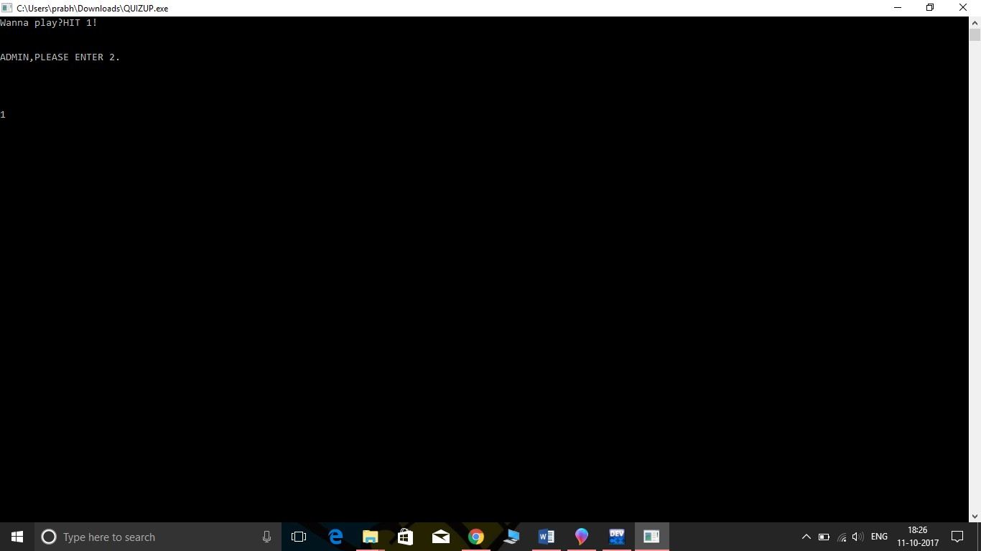
HOW IT WORKS

Slide 13
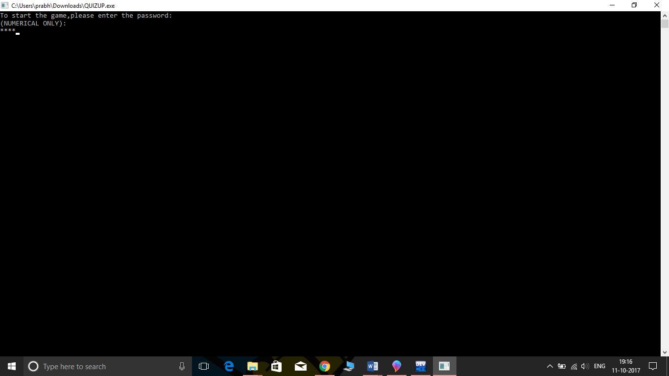

Slide 14
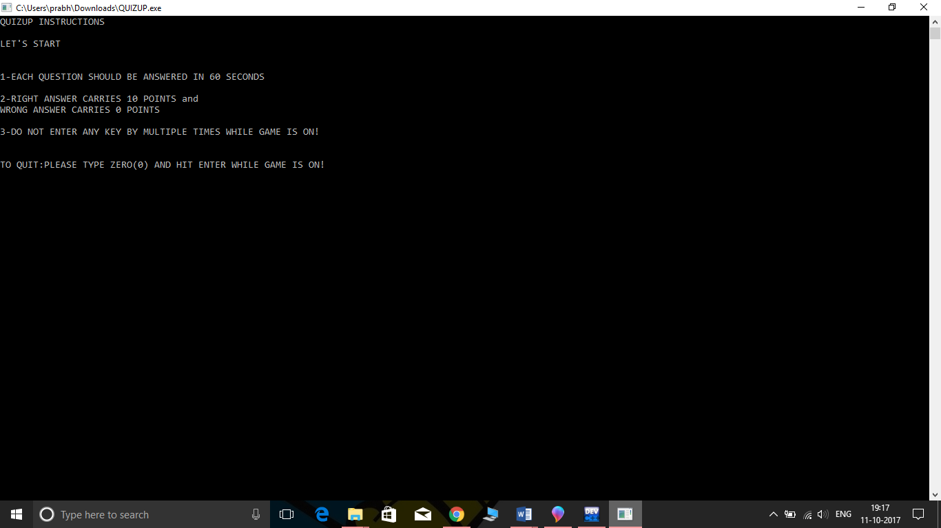

Slide 15
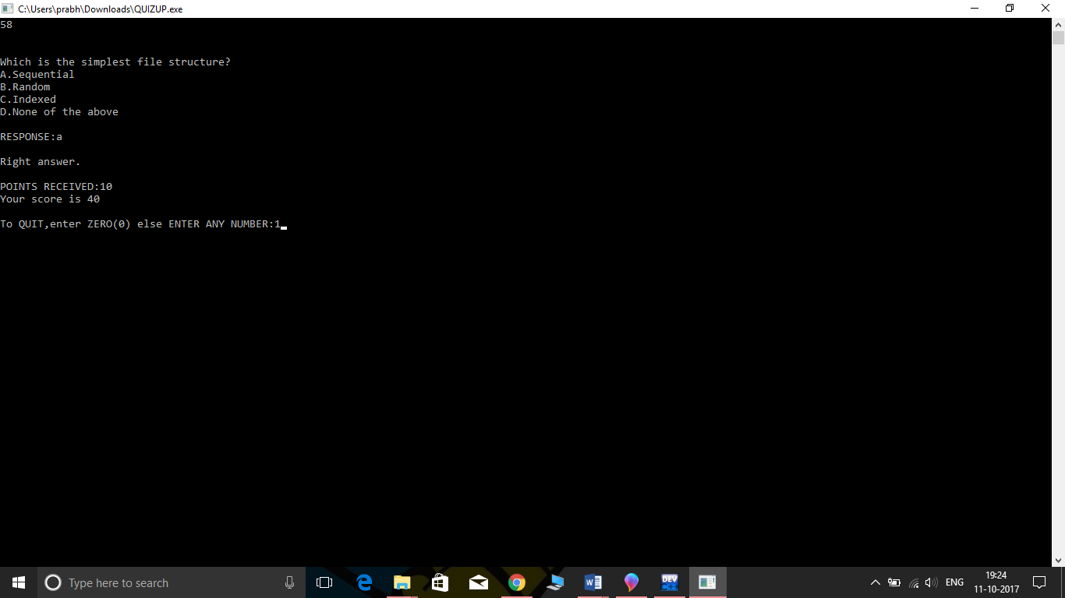

Slide 16
IMPLEMENTATION OF QUIT:
Exception-Handling in C++ gave us a new real-time application.
Well,in QUIZUP,the option pops up after every question,which redirects to home screen if user opts.

Slide 17
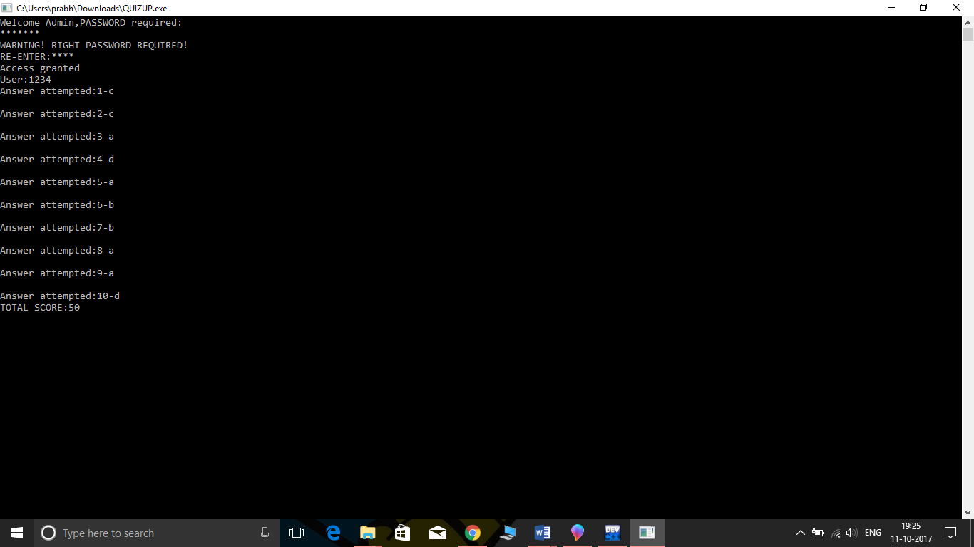
HOW ADMIN ACCESSES AFTER GETTING INTO HOME PAGE

Slide 18
FUTURE SCOPE:
This application’s prototype can be used for many quiz competitions and entrance examinations as data is very secured.
New features can constantly be added to the program so that the user has a good experience of participation in the quiz

Slide 19
THANK YOU
Hope, this project meets the expectations of user to develop himself.
Once again,thank you all.

