Slide 1
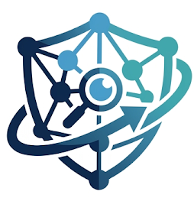
GCI World 2026 Final Assignment Name: Neel Kapadi IIT Guwahati, India
Our Company XAI presents you
Explainable AI-Powered Customer Retention & Intervention System

Slide 2
Table of Contents
Introduction………………………………………………………………………………………………………………………………..3
Telecom Industry Challenges………………………………………………………………………………………………………...4
Implementation of PDCA cycle……………………………………………………………………………………………………….5
Data Overview and Potential Hypothesis………………………………………………………………………………………….6
Key Findings from Exploratory Data Analysis…………………………………………………………………………………….7
Existing Industry Solutions and Gap Analysis……………………………………………………………………………………8
Solution Framework………………………………………………………………………………………………………………………9
Pipeline for Machine Learning Workflow…………………………………………………………………………………………10
Evaluation Metrics, Model Comparison, Important Features……………………………………………………………..11
SHAP Analysis……………………………………………………………………………………………………………………………12
Customer Risk Segmentation and Personalized Recommendations…………………………………………………..13
Quotation………………………………………………………………………………………………………………………………….14
References………………………………………………………………………………………………………………………………..15
2

Slide 3


Company A Business Problem
Our Moto: Be PROACTIVE rather than REACTIVE
Instead of reacting after customers leave, the proposed system enables proactive and targeted retention interventions.
Company A lose substantial revenue due to customer churn and decline in usage of service.
Key Results
📊 Dataset: 100,000 customers, 100 features
📈 Best Model: CatBoost
📈 ROC-AUC: 0.693
📈 Highest-Risk Segment Churn Rate: 77.9%
📈 Overall Churn Rate: 49.6%
🎯 Identified key churn drivers:
Device age
Usage decline
Overage charges
Customer lifecycle stage
Our solution
We at XAI developed an Explainable AI-Powered Customer Retention & Intervention System that:
✅ Predicts customer churn risk using CatBoost
✅ Explains churn drivers using SHAP
✅ Segments customers by risk level
✅ Recommends personalized retention actions
3

Slide 4




Telecom Industry Challenges
📱 Highly competitive telecom market
📱 Low switching barriers for customers
📱 Increasing customer acquisition costs
📱 Revenue loss due to customer attrition
📱 Generic retention campaigns lead to poor ROI
Challenges
Research consistently shows:
Retaining an existing customer is significantly cheaper than acquiring a new one.
A small improvement in retention can generate substantial revenue impact.
High-value customers contribute disproportionately to revenue.
4

Slide 5
Implementation of PDCA cycle for Reliable Business Solutions
Frame the issue, form hypothesis
Plan
Do
Check
Act
Do data analysis and train the model via Machine learning
If successful then deploy the model for production else refine the strategy, update hypothesis
Evaluate Results via Metrics like Accuracy, F1score etc.
Conventional Retention Strategy
❌ Customers contacted after dissatisfaction becomes visible
❌ No understanding of why customers leave
❌ Same retention campaign for everyone
❌ Marketing budget spent inefficiently
After Implementing our Strategy
✅ Predicts churn for high-risk customer
✅ Explains churn drivers
✅ Customer Segmentation possible
✅ Recommends personalized interventions
5

Slide 6

PLAN
DO
CHECK
ACT
Dataset Overview
Imp Data Categories
1. Customer Lifecycle
months
equipment days
Current handset price
2. Usage Behaviour
Mean number of monthly minutes of use
Percentage change in monthly minutes of use vs previous three month average
Average monthly minutes of use over the life of the customer
3. Revenue & Billing
Mean monthly revenue
Mean overage minutes of use
Mean total monthly recurring charge
4. Customer Demographics
marital, ownrent, area, ethnic
Potential Hypothesis
Company A Telecom Dataset
Metric | Value
Customers(Total rows) | 100,000
Features (Total Columns) | 100
Numerical Features | 77
Categorical Features | 21
Target Variable | Churn (0/1)
Customer churn reduces recurring revenue.
Network quality issues increase dissatisfaction.
Revenue decline occurs before customers leave.
Customer segments are not being targeted effectively.
Target Distribution
6

Slide 7
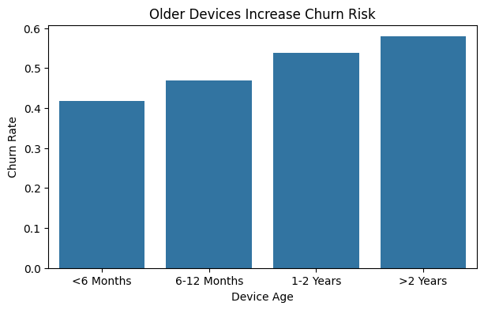
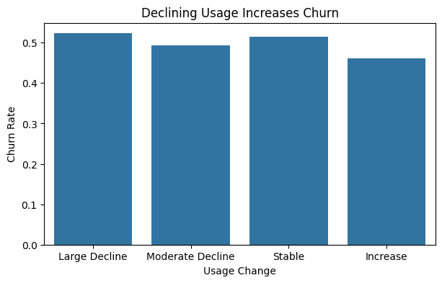
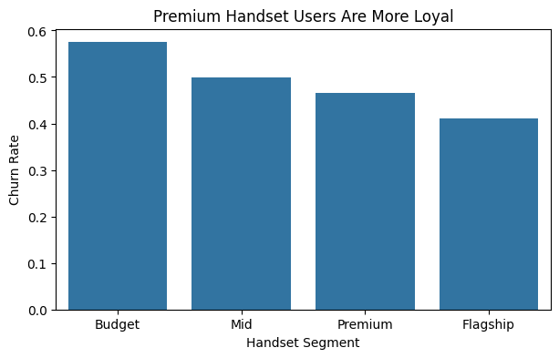
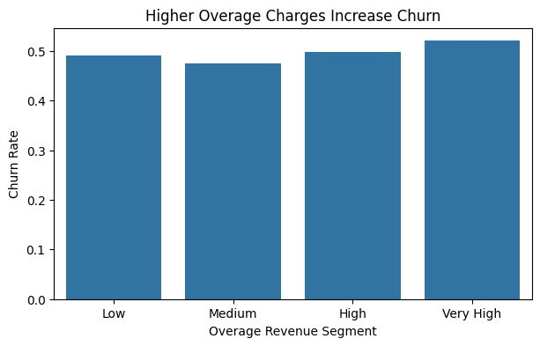
PLAN
DO
CHECK
ACT
Keys Findings from Exploratory Data Analysis (EDA)
Finding 1
📱 Older devices increase churn risk
Finding 2
📉 Declining usage is an early warning signal
Finding 3
📱 Premium handset users are more loyal
Finding 4
💰 Higher overage charges contribute to churn
Finding 5
🔄 Long-tenure customers can still churn
7

Slide 8












Existing Industry Solutions & Gap Analysis
Current Industry Gap
Major Telecom Operators
Most Existing Systems Answer
WHO is likely to churn?
Generic Retention Campaigns
But They Often Do Not Explain
WHY will the customer churn?
Device Upgrade Programs Handset replacement offers, Trade-in incentives, Device financing plans
Loyalty & Rewards Programs Long-tenure customer benefits, Premium membership rewards, Exclusive discounts
And Rarely Recommend
WHAT action should be taken?
Personalized Pricing Customized plans, Discounted bundles, Family packages
Customer Experience Monitoring NPS surveys Customer support tracking Complaint management
Also,Cross-selling OTT contents like Netflix, Amazon, JioHotstar
8

Slide 9
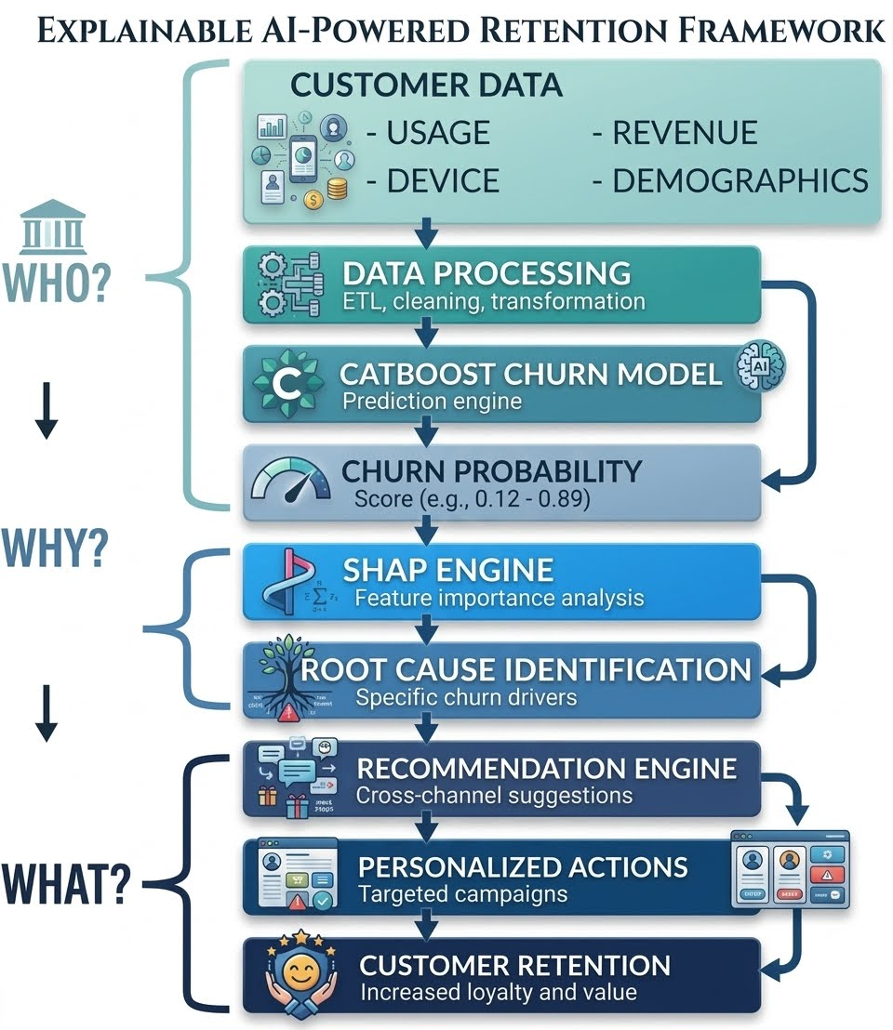
PLAN
DO
CHECK
ACT
Explainable AI-Powered Retention Framework
From market survey and gap analysis, our company XAI combines all the positive features and made an ALL IN ONE SOLUTION.
Objective
Move from reactive customer retention to proactive and personalized intervention.
Key Innovation
Instead of only predicting churn, the system explains the drivers of churn and recommends targeted interventions for each customer.
9

Slide 10
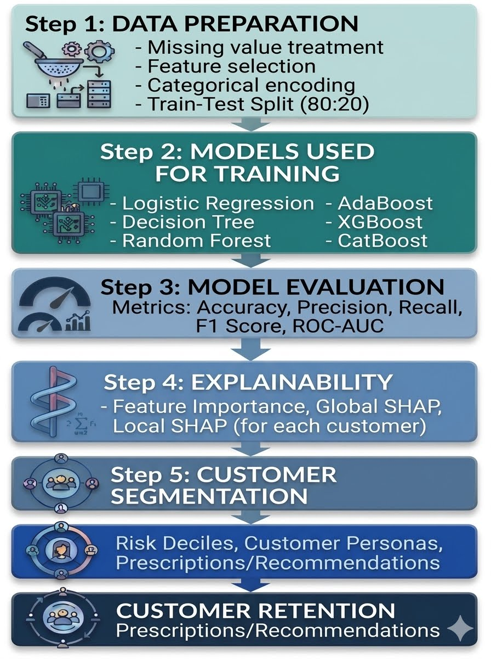
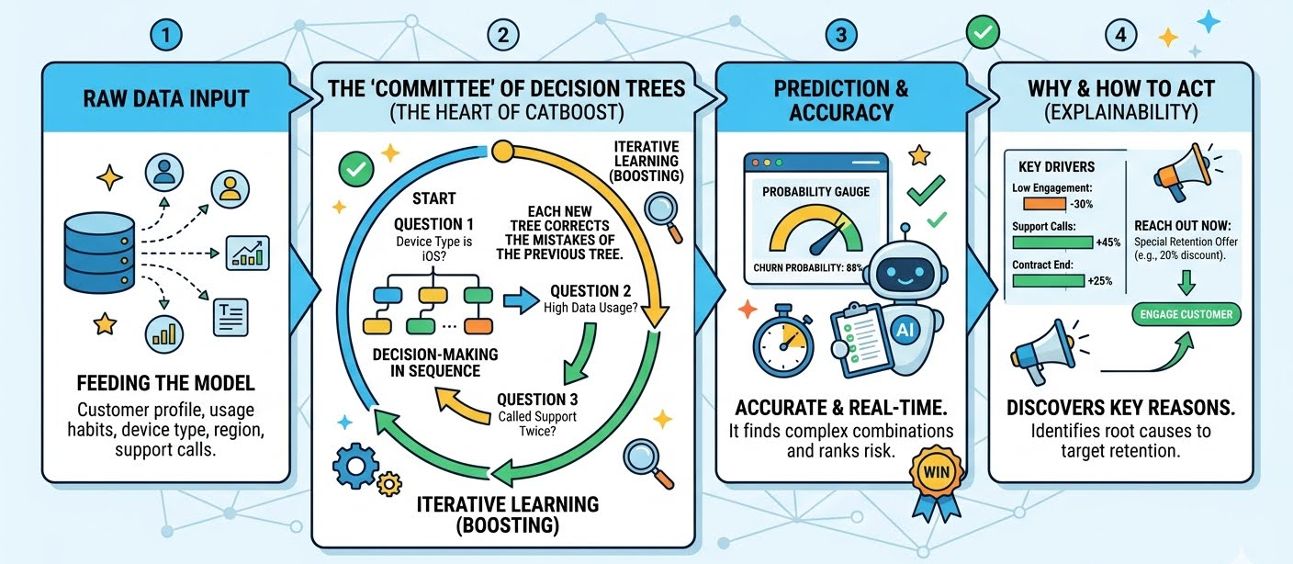
PLAN
DO
CHECK
ACT
Pipeline for ML Workflow
What is CatBoost?
Think of CatBoost as a highly disciplined committee of decision-makers. Instead of relying on one person's guess, it asks thousands of specialized questions in a structured order. Each new question specifically corrects the mistakes made by the previous ones until they reach the most accurate prediction possible.
ROC-AUC is a score used to measure how well a yes/no prediction model can tell two categories apart.
Why We Selected CatBoost model?
Exceptional Accuracy Out-of-the-Box
Built for Real-World Customer data
Speed & Efficiency
10

Slide 11
PLAN
DO
CHECK
ACT
What are the 5 Evaluation Metrics & how it relates to our business?
Model Performance Comparison
Feature Importance
Model | Accuracy | ROC-AUC
Logistic Regression | 0.582 | 0.610
Decision Tree | 0.600 | 0.638
AdaBoost | 0.608 | 0.654
Random Forest | 0.623 | 0.673
XGBoost | 0.637 | 0.693
CatBoost | 0.638 | 0.693
Top 20 Feature | Importance
num__months | 10.996072
num__eqpdays | 9.048197
num__change_mou | 7.257531
num__mou_Mean | 6.493265
num__totmrc_Mean | 5.202114
num__hnd_price | 3.360129
num__change_rev | 3.079838
num__uniqsubs | 1.984856
num__lor | 1.824522
num__avgqty | 1.819818
num__avgmou | 1.704745
num__drop_vce_Mean | 1.692911
num__avg3mou | 1.587286
num__avgrev | 1.361344
num__ovrrev_Mean | 1.355567
num__rev_Mean | 1.324330
num__mou_cvce_Mean | 1.289844
num__vceovr_Mean | 1.275038
num__adjqty | 1.142279
num__inonemin_Mean | 1.103026
🚨 Accuracy
The Scorecard: The overall percentage of right guesses.
Business Value: Gives a quick snapshot of general model reliability.
🎯 Precision
Budget Protection: How often the model is right when it flags a customer.
Business Value: High precision prevents wasting expensive offers on happy customers
🎣 Recall
The Safety Net: The percentage of actual churners the model successfully caught.
Business Value: High recall stops high-risk revenue from slipping through the cracks.
Key Message
CatBoost achieved the best performance and identified lifecycle stage, device age, engagement decline, and pricing factors as primary churn drivers.
⚖️ F1 Score
The Balanced Scale: A single score combining Precision and Recall.
Business Value: Proves the model catches maximum risk without overspending the budget.
Key Findings
✅ Older devices = ⬆️ churn risk
✅ Usage decline =⬆️ churn risk
✅ Lower handset value =⬆️ churn risk
✅ Higher overage charges = ⬆️ churn risk
✅ Customer lifecycle stage significantly influences churn
Features find by our catboost model validate our hypothesis for churn!
📈 ROC-AUC
The Sorting Ability: How effectively the AI separates high-risk from low-risk groups.
Business Value: Measures the model's true intelligence rather than lucky guesses.
11

Slide 12
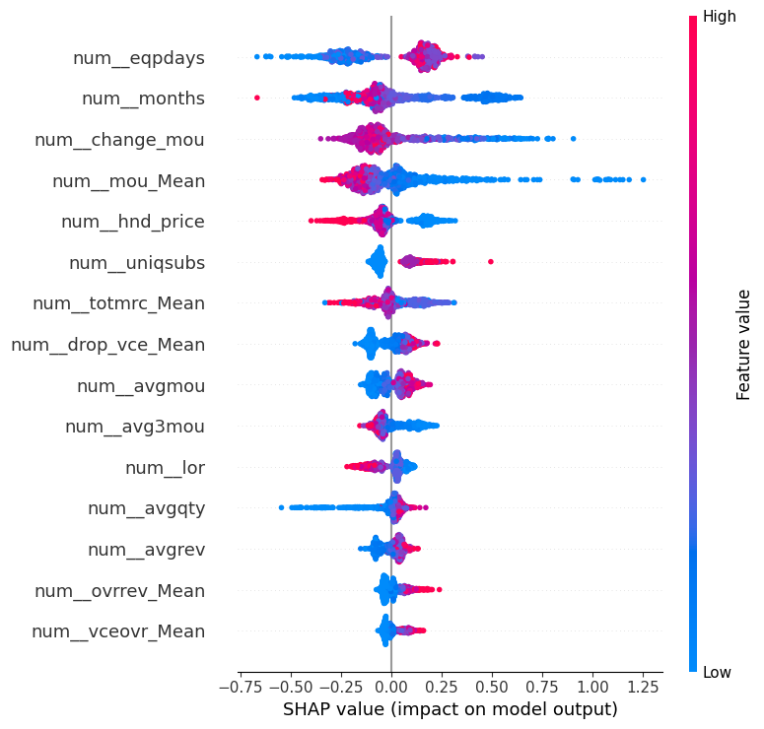
PLAN
DO
CHECK
ACT
Global SHAP Analysis
Important Nomenclature num = numerical features
Cat=categorical features roam=roaming
rev=revenue
eqp=equipment
blk=blocked vce=voice
hnd=handheld
feature | shap | abs_shap
num__roam_Mean | 0.370870 | 0.370870
num__change_rev | 0.308954 | 0.308954
num__eqpdays | -0.243799 | 0.243799
num__rev_Mean | 0.208404 | 0.208404
cat__crclscod_EA | -0.188831 | 0.188831
num__totmrc_Mean | 0.182956 | 0.182956
num__mou_Mean | -0.177654 | 0.177654
num__drop_blk_Mean | 0.089210 | 0.089210
num__drop_vce_Mean | 0.079699 | 0.079699
num__avgrev | 0.076336 | 0.076336
Index: 39170 (Highest Roaming)
Customer ID: 1039171
Actual Churn: 1
Predicted Churn Prob: 0.7162
As per Global SHAP analysis, eqpdays is the most imp factor. Red points on right side indicates high chances of churn
feature | shap | abs_shap
num__change_mou | 0.428342 | 0.428342
num__blck_dat_Mean | -0.240847 | 0.240847
num__mou_Mean | -0.216244 | 0.216244
num__eqpdays | -0.178926 | 0.178926
num__totmrc_Mean | -0.159340 | 0.159340
cat__area_DC/MARYLAND/VIRGINIA AREA | -0.143765 | 0.143765
num__hnd_price | -0.134463 | 0.134463
num__avgrev | 0.125865 | 0.125865
num__lor | 0.112255 | 0.112255
num__mou_pead_Mean | 0.106668 | 0.106668
NOTE: Data points towards right side means probability of churn increase and vice-versa for left side
Index: 55550 (Highest Data Overage)
Customer ID: 1055551
Actual Churn: 1
Predicted Churn Prob: 0.4857
12

Slide 13
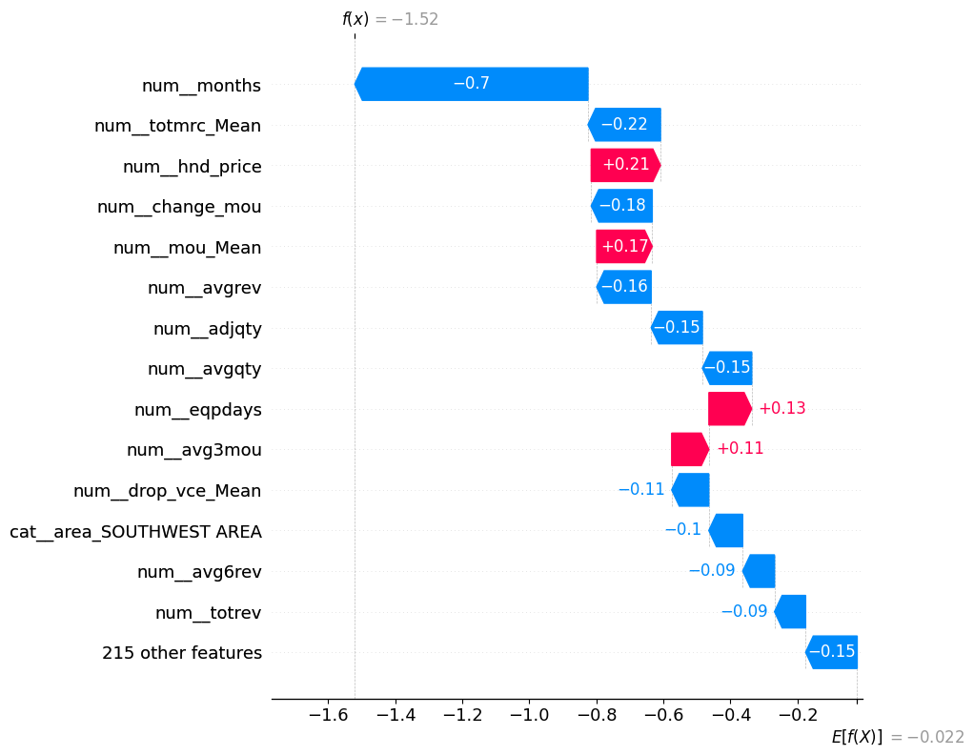
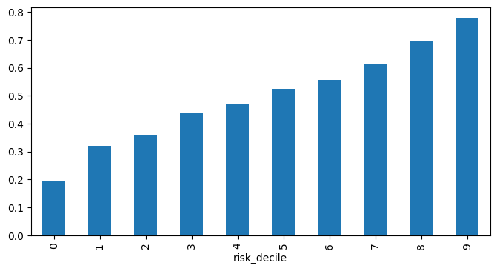
PLAN
DO
CHECK
ACT
Customer Risk Segmentation
Personalized Customer Personas (SHAP Case Studies)
Decile Analysis is a statistical method that sorts a dataset and divides it into 10 equally sized groups and identify high or low-value trends.
Customer Type | Churn Risk | Root Cause | Recommendation
High Roaming | 71.6% | Roaming Costs | Traveler Package
High Overage | 45.5% | Billing Shock | Plan Optimization
High Data Overage | 48.6% | Usage Decline | Retention Outreach
Old Device | 17.9% | Loyal & Stable | No Intervention
Segment | Churn Rate
Lowest Risk 10% | 19.5%
Highest Risk 10% | 77.9%
NOTE: Blue color shows feature is not supporting churn and for red color vice-versa
Key Insight
Customers in the highest-risk segment are approximately 4x more likely to churn than customers in the lowest-risk segment.
Business Value: Target retention resources where they matter most.
Though device is old and avg usage is reduced but customer long tenure with company shows customer will not churn
Key Message
Different customers churn for different reasons; therefore retention strategies must be personalized.
13

Slide 14
Business Impact
QUOTATION
Explainable AI-Powered Customer Retention & Intervention System – $2.6 Million
Consulting Contract
1. Initial help for system onboarding and training is FREE.
2. AI-powered Net Promoter Score (NPS) which will help to get customer feedback and can drastically reduce churn - $75,000 (valid for service of 3 months only).
3. Real time AI support customer care, it is useful for customer care team for providing personalized solution as per customer ID and also reduces interaction time - $55,000 (valid for service of 3 months only).
Our Exclusive Combo Package just for you! 1. Explainable AI-Powered Customer Retention & Intervention System – $2.6 Million
+
2. AI-powered NPS – $0.055 Million (for initial 3 months) +
3. Real time AI support customer care – $0.045 Million (for initial 3 months)
Buy together and SAVEEE more!!!
Metric | Basis | Annual Amount
Total Annual Revenue | 100k Users @ $58.71 ARPU | $70,452,000
Churn Leakage | 49.6% Annual Churn Rate | $34,944,192
Savings Potential | 30% Reduction Efficacy | $10,483,258
Proposed Annual Price | 25% Profit | $2,620,814
All for just $2.7 Million!
Assumption: Taking value from Record.csv, ARPU = Annual Revenue Per User
14

Slide 15
References of case study, tech blogs, images, icon etc.
https://blog.protiviti.com/2026/01/13/2026-and-beyond-why-telcos-must-reinvent-or-be-replaced/
https://www.deloitte.com/us/en/insights/industry/technology/technology-media-telecom-outlooks/telecommunications-industry-outlook.html
https://htec.com/insights/blogs/key-trends-shaping-the-telecommunications-industry-in-2026/
https://www.ey.com/en_gl/insights/telecommunications/how-can-telcos-navigate-a-world-of-evolving-risks
https://www.exchange4media.com/advertising-news/telecom-tussle-airtel-vi-spar-over-priority-access-advertising-155393.html https://about.att.com/story/2026/1q-earnings.html https://timesofindia.indiatimes.com/business/india-business/telecom-earnings-preview-jio-may-lead-in-revenue-growth-airtel-likely-to-top-arpu-number-vi-steadies-user-base/articleshow/122254903.cms https://customergauge.com/blog/reducing-customer-churn-in-telecommunications
https://www.verizon.com/business/resources/articles/s/how-to-integrate-ai-into-your-customer-retention-strategies/
https://chiefaiofficer.com/the-t-mobile-ai-strategy-that-increased-customer-renewals-30/
https://www.geeksforgeeks.org/machine-learning/catboost-ml/
https://www.vectorstock.com/royalty-free-vectors/problem-statement-icon-vectors
https://www.flaticon.com/free-icon/solution_9782496
https://gemini.google.com/share/bb1cfaa9b1f5
https://chatgpt.com/share/6a3493f1-7e8c-83e8-a793-81b9e43059fd
Some of the flowchart are made by google gemini nanobanana (Link not available as it is not available in chat history)
Company Logo for AT&T,Verizon,Jio,Airtel,Tmobile are taken from their official website.
Icon used are opensource.
15

