Slide 1
🛒
Online Grocery
Management System
FRESH
GROCERY
Ganpat University
B. S. Patel Polytechnic
Darji Harsh(22171371017)
Ajmeri Danish(23171371001)
Kadiya Krish(23171371030)
Kadiya Neel(23171371031)

Slide 2
Problem Statement
🏬
Physical Travel Required
⏰
Limited Store Hours
Customers must physically visit stores, wasting time and energy on commuting.
Shopping restricted to fixed hours — no convenience for busy schedules.
🧍
Crowds & Long Queues
💸
Hard to Compare Prices
Dealing with crowded aisles and long checkout queues is frustrating.
Manual price comparison across multiple stores is tedious and time-consuming.

Slide 3
Proposed Solution
FreshGrocery — A seamless web platform for ordering groceries online, anytime, from anywhere.
👤
🔍
🛒
User Registration & Login
Browse & Search Products
Add to Cart & Checkout
📦
🏠
🔧
Order Tracking
Home Delivery
Admin Product Management

Slide 4
System Objectives
01
24/7 Availability
Enable customers to shop for groceries round-the-clock without store hour restrictions.
02
Convenient Shopping
Eliminate physical travel; let users browse and order from the comfort of their homes.
03
Easy Price Comparison
Display all products with prices clearly so users can make informed purchasing decisions.
04
Secure Transactions
Ensure safe user authentication, order processing, and payment handling.
05
Admin Control
Give admins full control to manage products, orders, and user accounts efficiently.

Slide 5
Technology Stack
🖥️ Frontend
⚙️ Backend
🗄️ Database
HTML5 • CSS• JavaScript
Python / PHP
MySQL / SQLite
🛠️ Dev Tools
☁️ Hosting
🔐 Security
VS Code • wamp• Git
Local / Cloud Server
Session Auth • Password

Slide 6
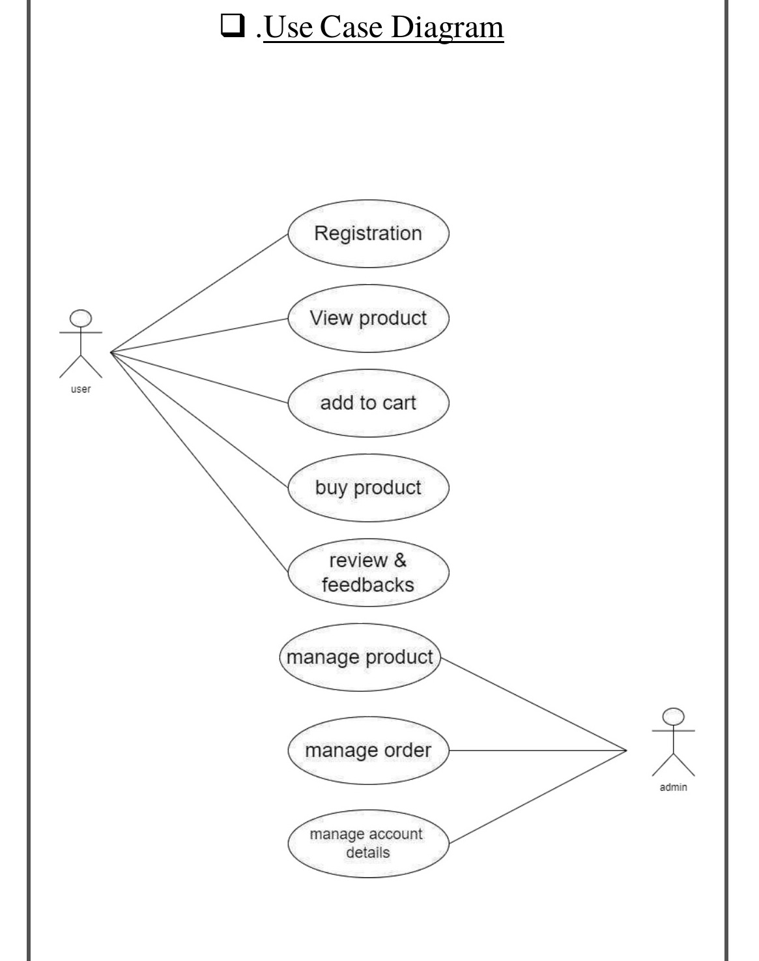
Use Case Diagram
👤 User Actions
▸ Registration & Login
▸ View Products
▸ Add to Cart
▸ Buy Product
▸ Reviews & Feedback
🔧 Admin Actions
▸ Manage Products
▸ Manage Orders
▸ Manage Account Details

Slide 7
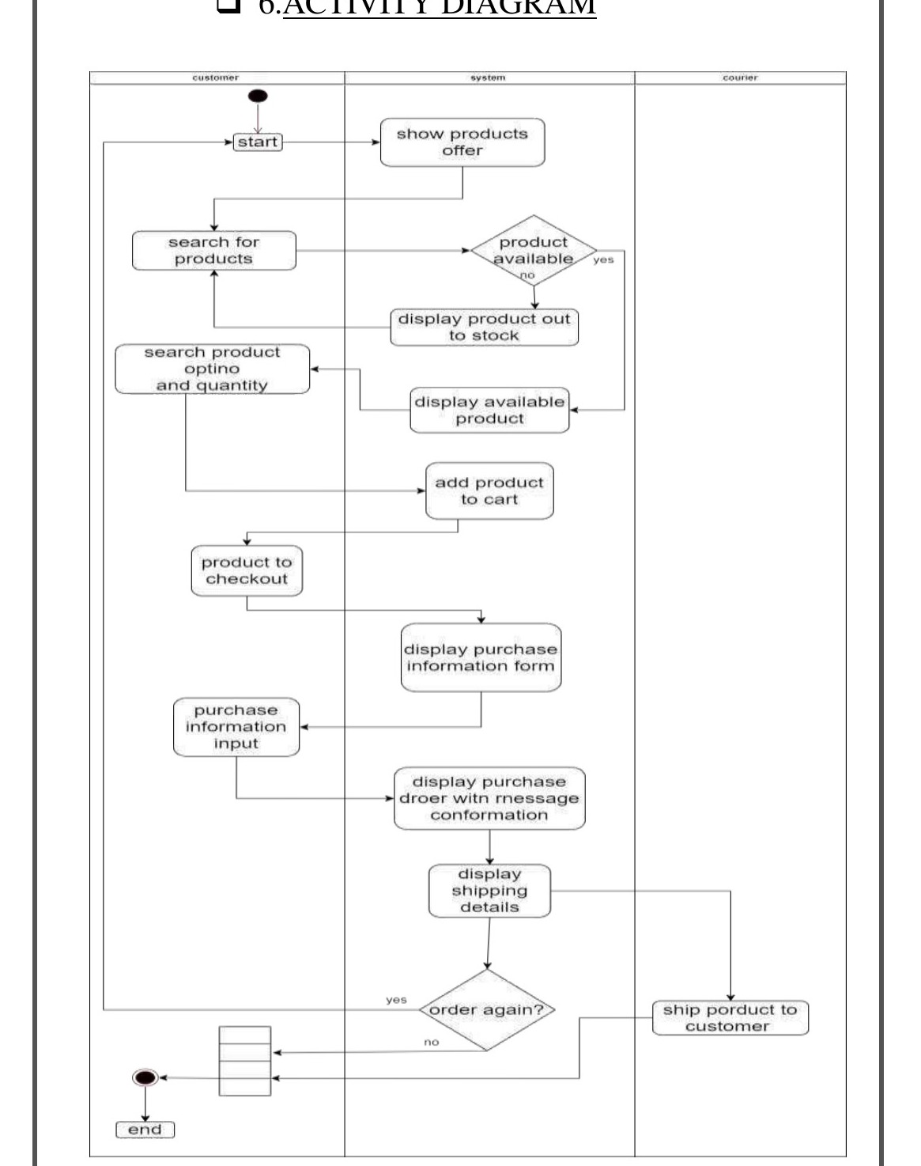
Activity Diagram
Process Flow
1
Customer Starts
System shows products & offers
2
Search Products
Check availability → show or out-of-stock
3
Add to Cart
Select product option & quantity
4
Checkout
Display purchase information form
5
Order Confirmed
Display order & shipping details
6
Delivery
Courier ships product to customer

Slide 8
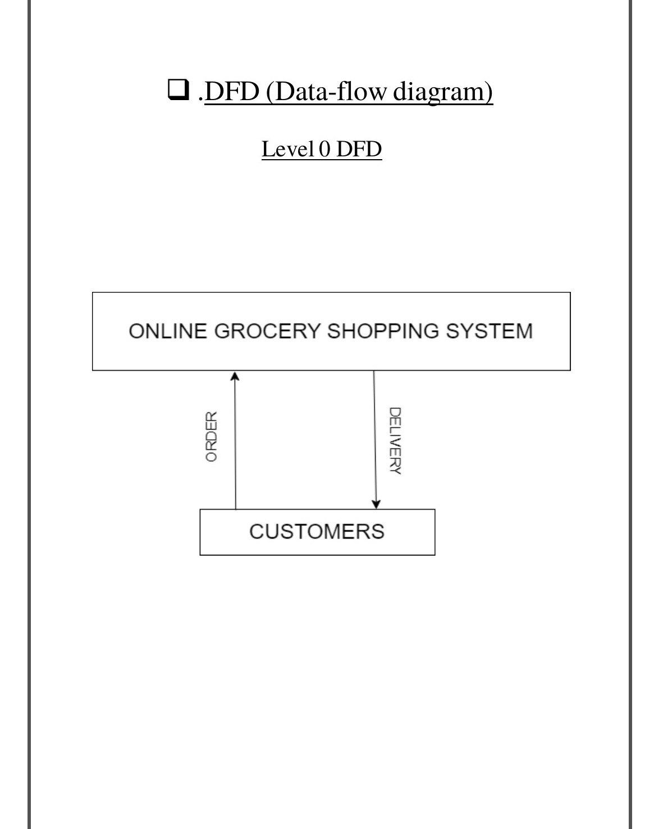
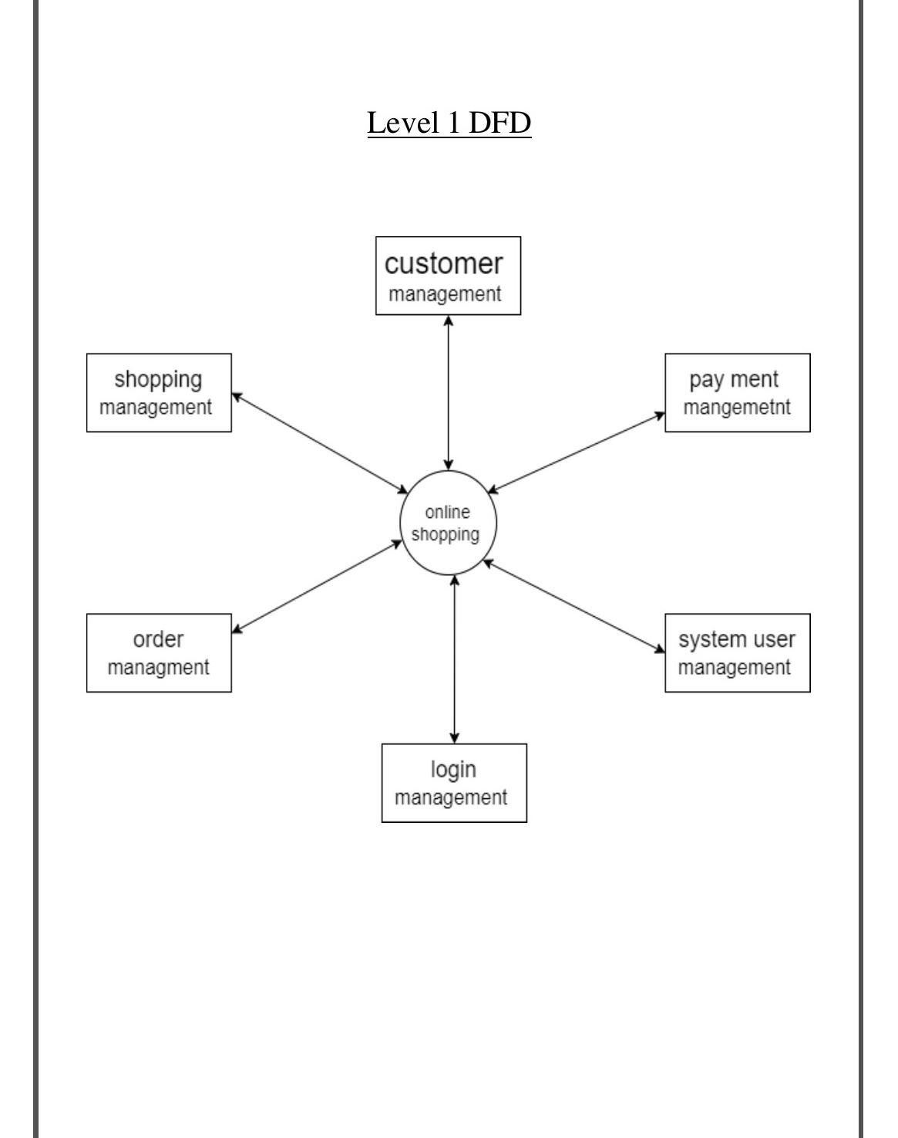
Data Flow Diagrams
Level 0 DFD — Context Diagram
Level 1 DFD — System Modules

Slide 9
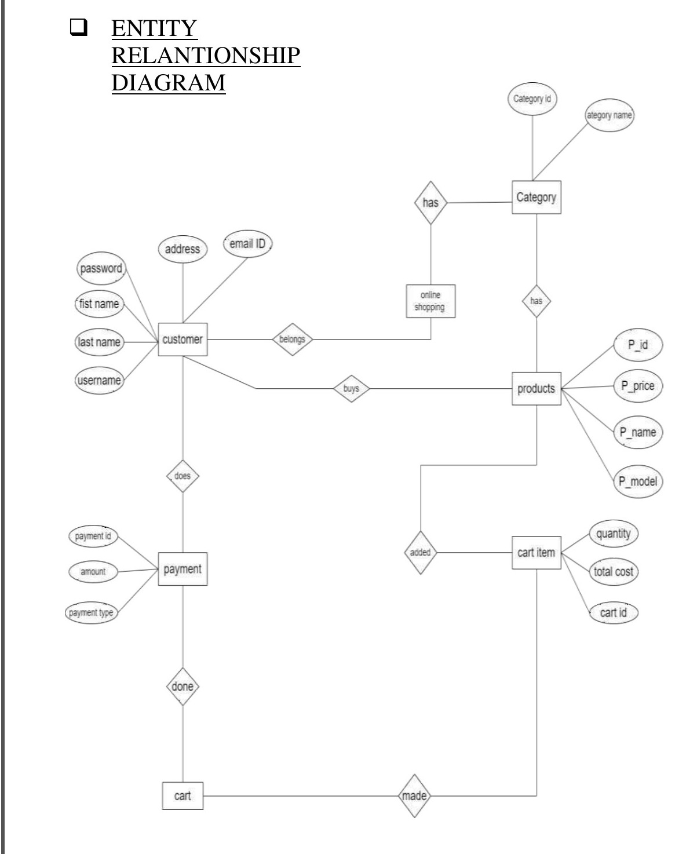
Entity Relationship Diagram
Entities & Relationships
Customer
Buys → Products
Belongs → Online Shopping
Does → Payment
Products
Has → Category
Added to → Cart Item
Payment
Done → Cart
Cart Item
Made → Cart

Slide 10
Key Modules
🔑
👤
🛍️
Login Management
Customer Management
Shopping Management
Registration, authentication, logout, forgot password
User profile, address, account details
Browse categories, search, filter products
🛒
📦
💳
Cart & Checkout
Order Management
Payment Management
Add to cart, update quantity, checkout flow
Place orders, admin verifies and tracks delivery
Cash on delivery; future: online payment gateways

Slide 11
Functional Requirements
✓
Registration & Login
✓
Admin: Add / Edit / Delete Products
✓
View & Search Products
✓
Admin: Verify & Update Orders
✓
Add to Cart
✓
Logout & Forgot Password
✓
Product Details (name, price, image)
✓
User Feedback & Reviews
✓
Checkout with Delivery Info
✓
Delivery Time Slot Selection
✓
Cash on Delivery Payment
✓
Order History & Tracking

Slide 12
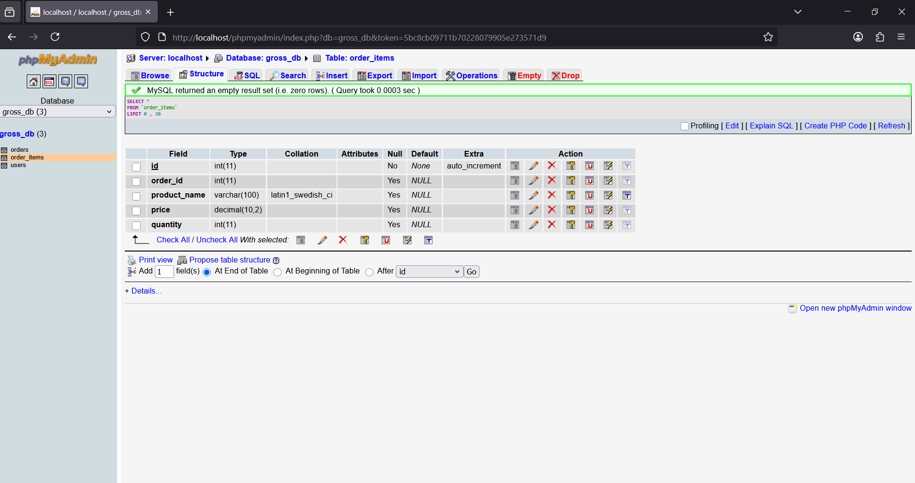
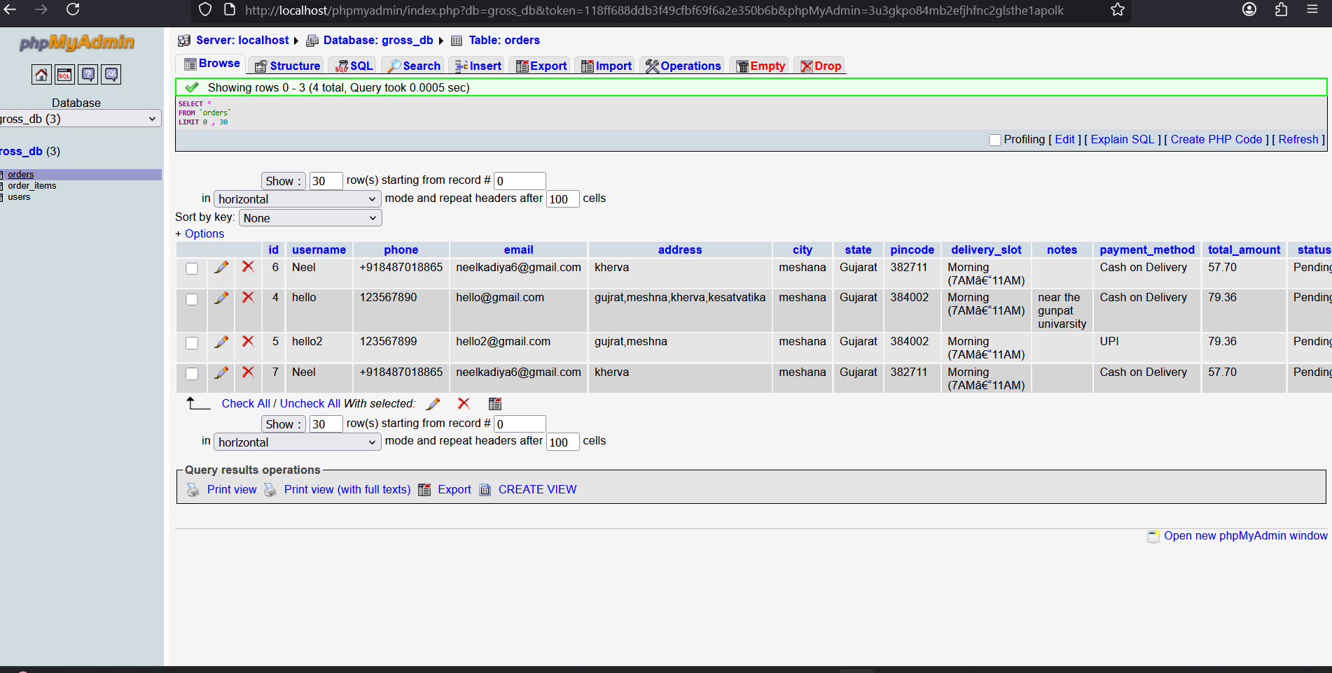
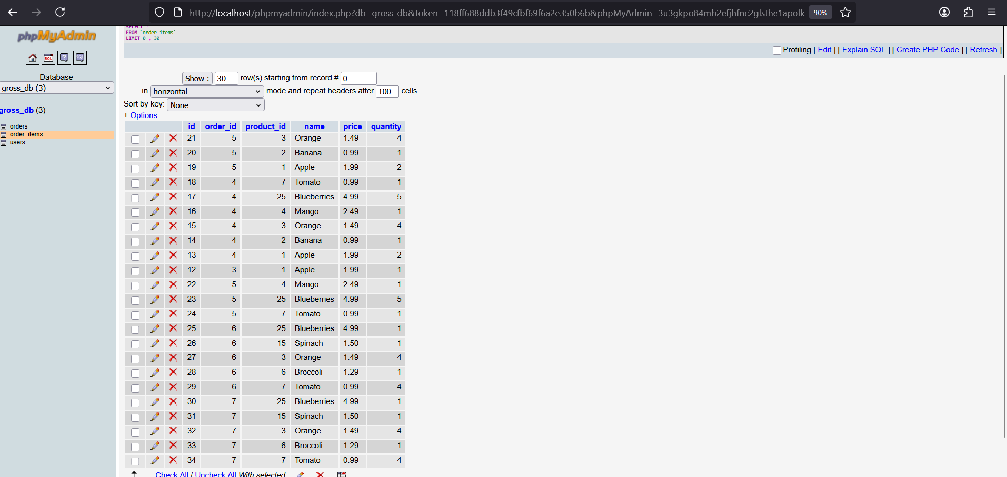
Data Dictionary

Slide 13
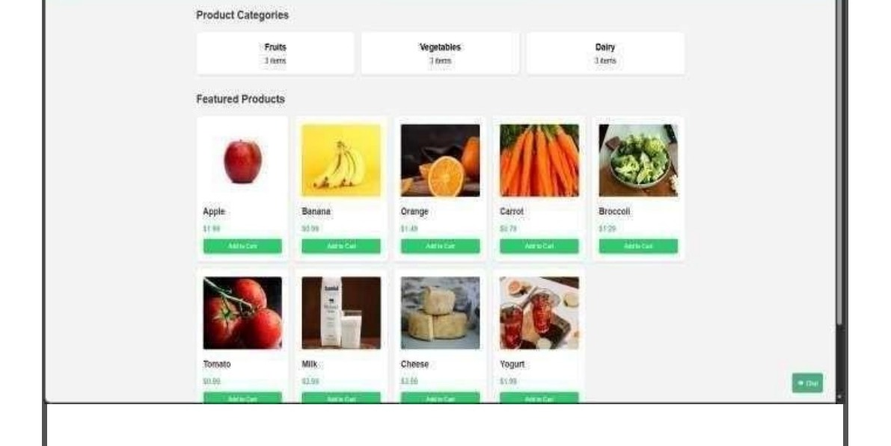
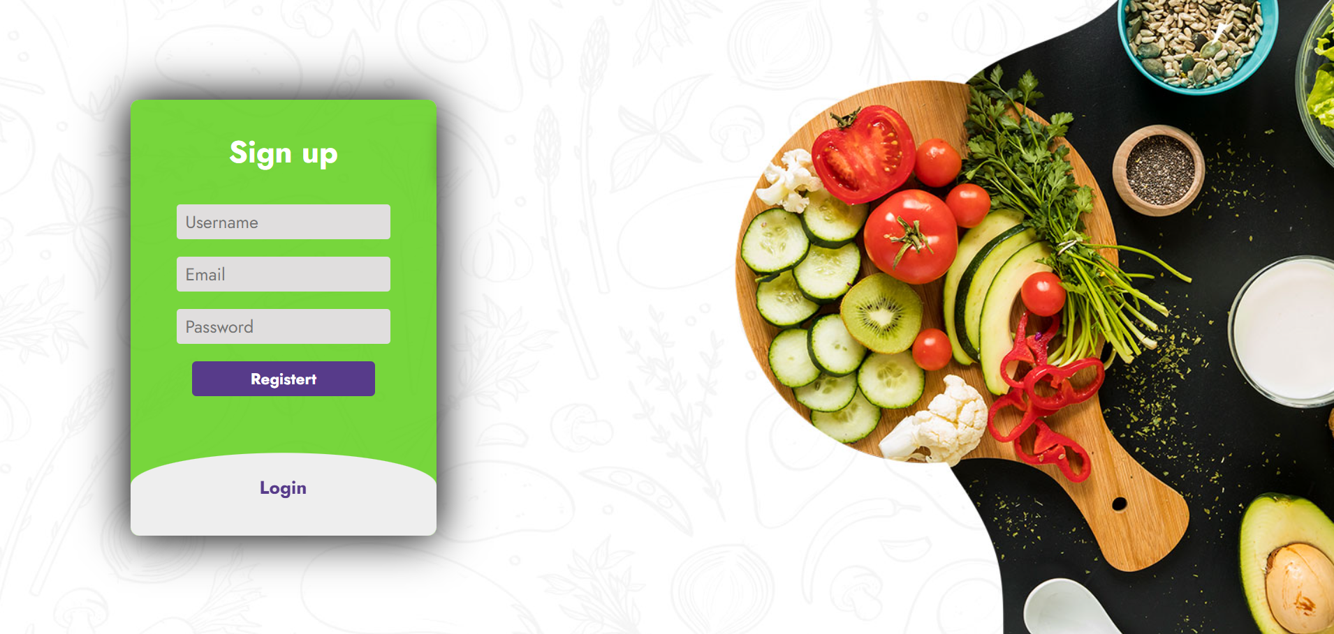
UI Design — Login & Product Catalog
🔑 Login Page
🛍️ Product Catalog

Slide 14
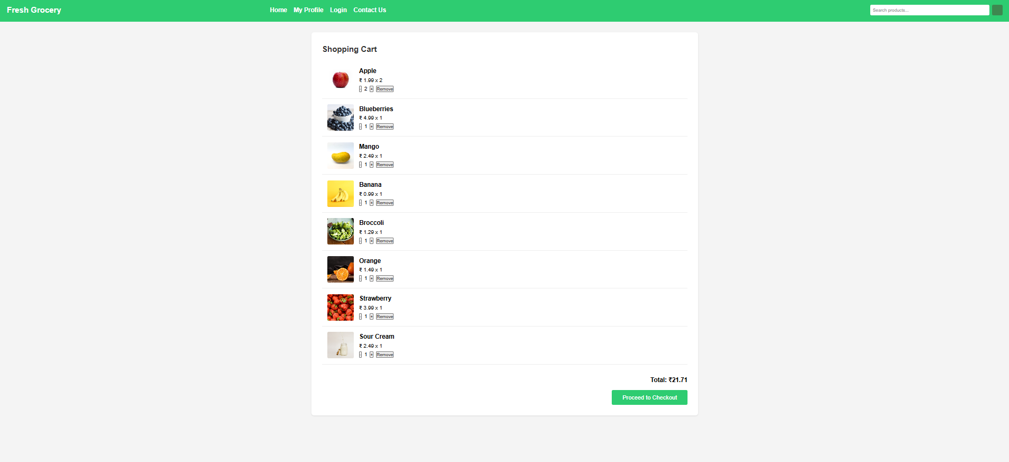
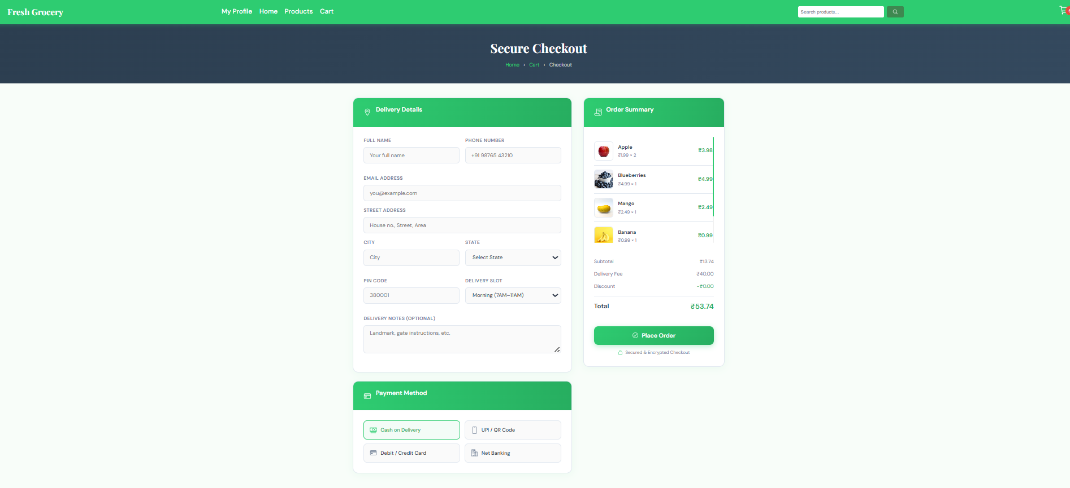
UI Design — Cart & Checkout
🛒 Shopping Cart
📋 Checkout Page

Slide 15
Future Scope & Enhancements
🔄
Subscription Services
📱
Mobile App (iOS/Android)
Recurring orders for frequently purchased items — auto-replenishment.
Native mobile app for on-the-go shopping with push notifications.
🍽️
Recipe Integration
💳
Advanced Payments
Browse recipes and auto-add required ingredients to cart.
Credit/debit cards, digital wallets, net banking beyond Cash on Delivery.
🤖
AI Recommendations
🗺️
Multi-Store Support
Personalized product suggestions based on purchase history.
Expand to manage multiple store locations, inventory, and fulfilment.

Slide 16
Conclusion
🕐 Saves time — no physical travel, crowds, or waiting in queues
🌐 24/7 availability — shop from the comfort of home, anytime
💰 Easy price comparison with just a few clicks
🚚 Reliable home delivery at selected time slots
⭐ Customers can give feedback and reviews for better service
📈 Scalable platform with a strong roadmap for future enhancements

Slide 17
🛒
Thank You!

