Slide 1
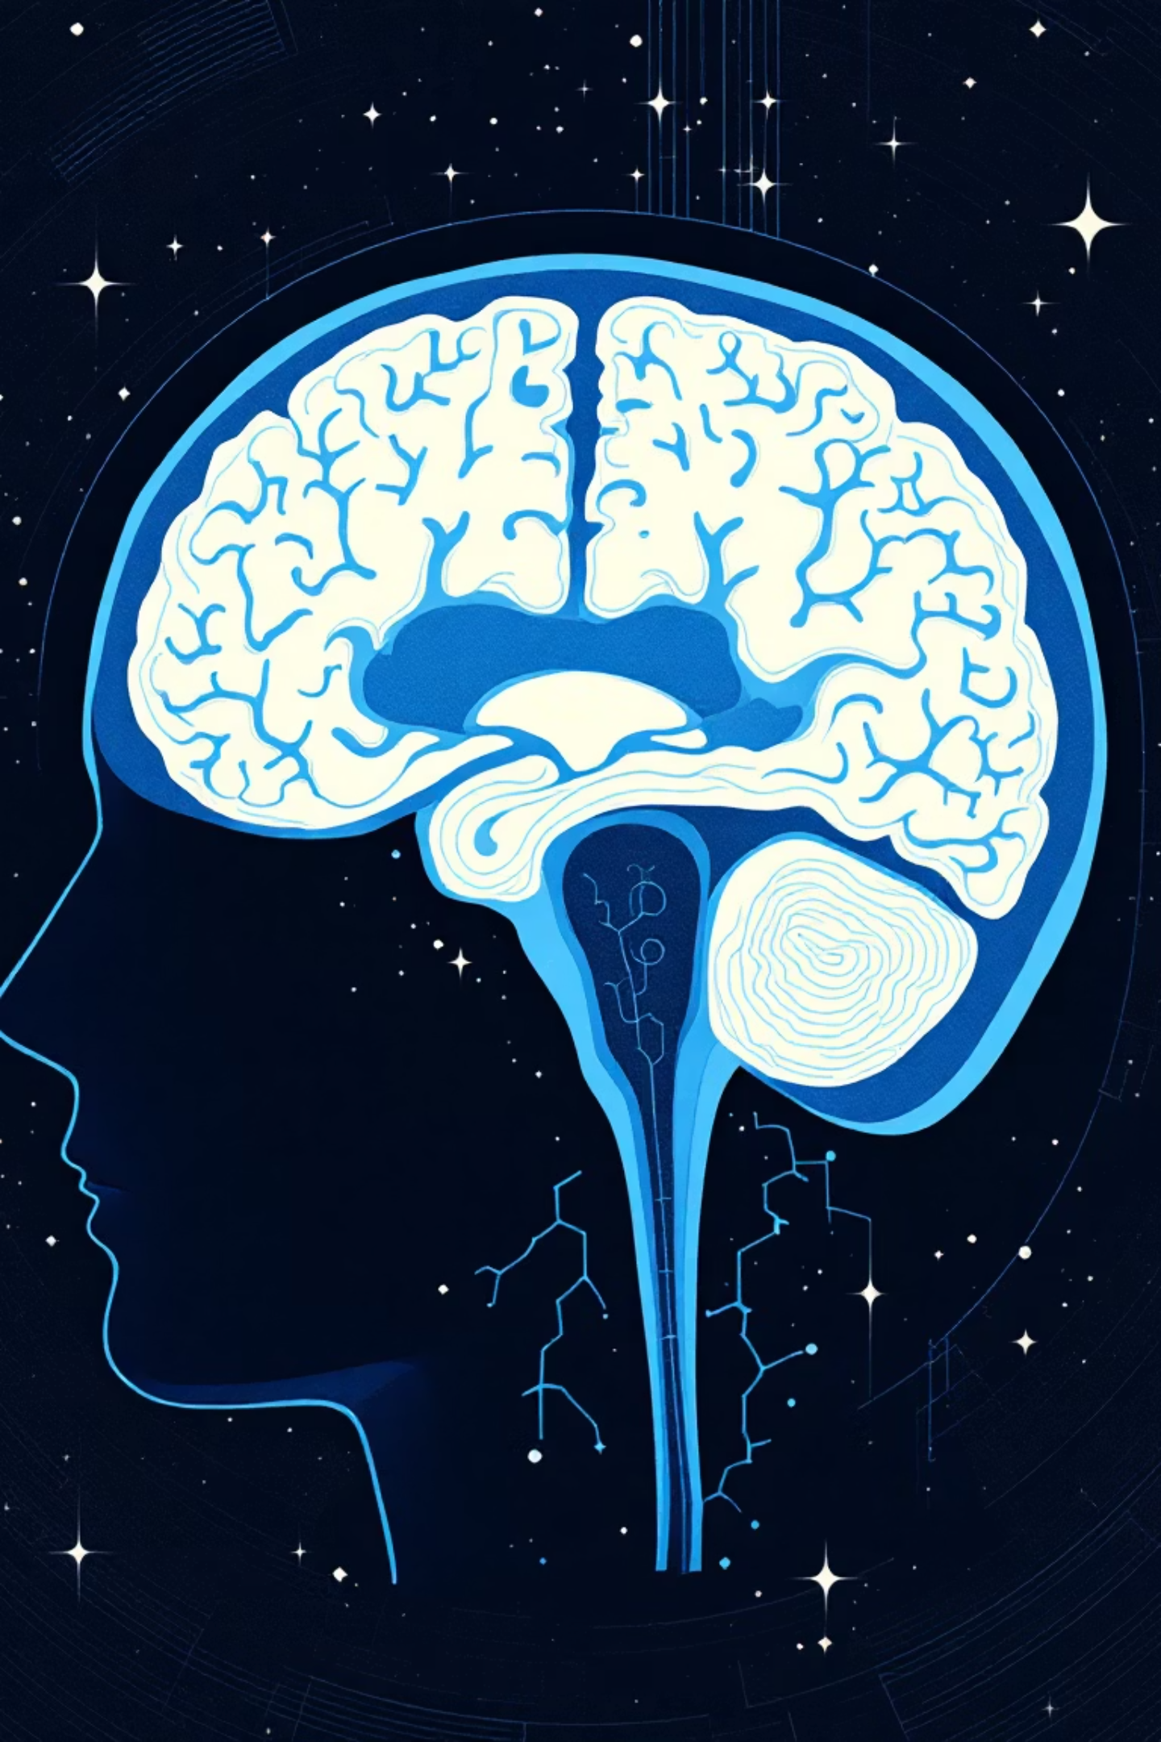


Generative Adversarial Networks in Medical
Image Reconstruction – A Systematic Literature Review
Jabbar Hussain, Magnus Båth, Jonas Ivarsson – Elsevier (Computers in Biology and Medicine Journal
Submitted to:
Dr. Mohendra Roy
Faculty Coordinator - M. Tech. AI Program
Pandit Deendayal Energy University- PDEU
Presented by :
Neel Patel

Slide 2


TABLE OF CONTENTS
Introduction
Problem Statement and Objectives
GAN
Basic Principle
DCGANs
Working Flow
Evaluation Metrics
Advantages, Disadvantages & Applications
Benchmark Results
Conclusion

Slide 3
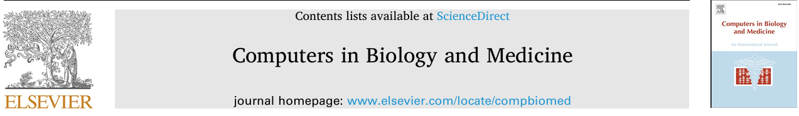

Introduction
Medical image reconstruction is an essential step in clinical diagnosis, where high-quality images are needed to support accurate interpretation by doctors and radiologists.
Traditional reconstruction techniques (such as compressed sensing and iterative reconstruction) are often slow, computationally expensive, and may produce images with noise or artifacts—especially when the input data is incomplete or corrupted.
With the growth of deep learning in healthcare, Generative Adversarial Networks (GANs) have emerged as a powerful tool for producing high-quality reconstructed medical images.
GANs learn how to generate realistic images by training two networks — a Generator that reconstructs or synthesizes images, and a Discriminator that evaluates how real or accurate they appear.

Slide 4
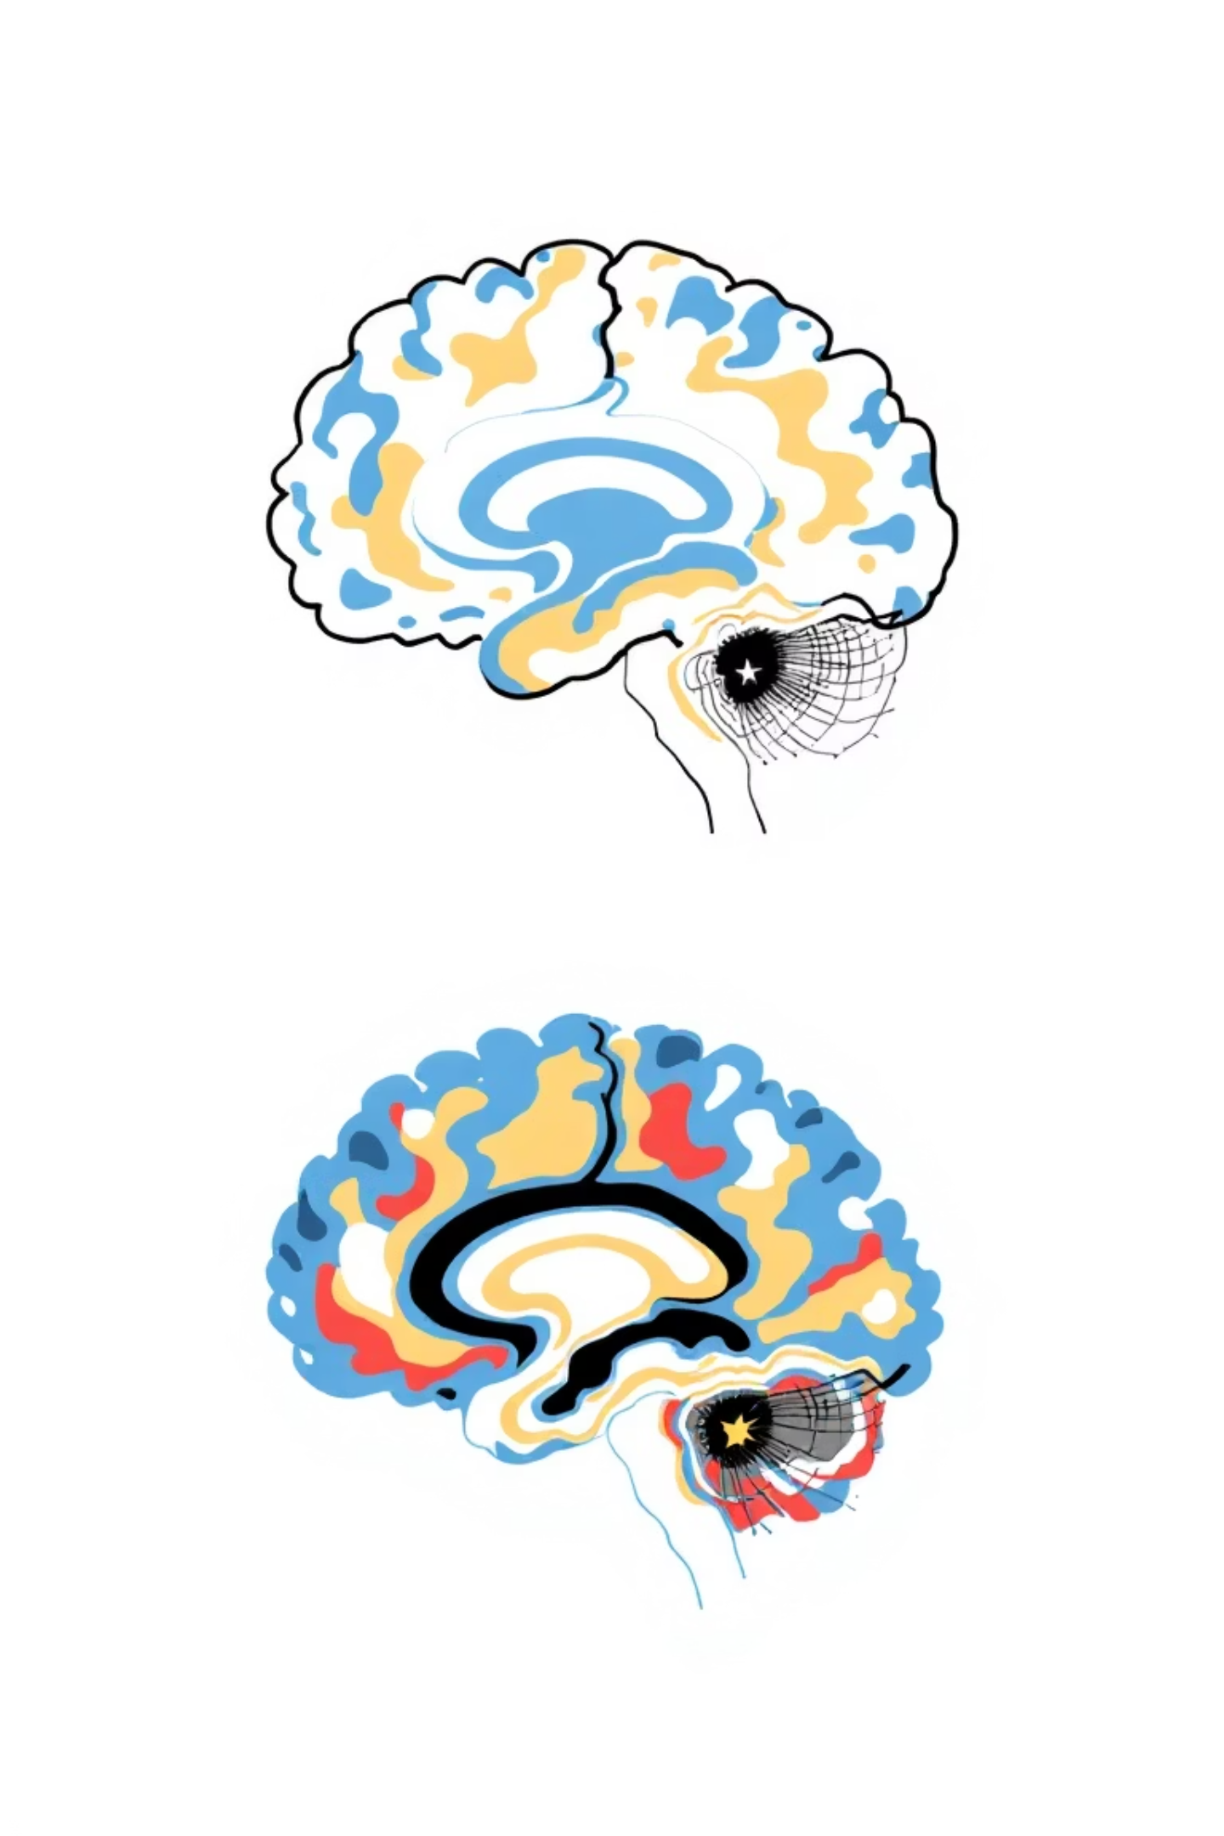
Problem Statement & Objectives
Primary Goal
Key Requirements
Reconstruct high-quality, diagnostically viable MRI images from degraded or incomplete input data using adversarial learning
Preserve fine anatomical details
Maintain image sharpness
Ensure clinical realism
Enable diagnostic interpretation
Technical Challenge
Train GANs to accurately learn and reproduce complex brain structures while balancing reconstruction fidelity with computational efficiency

Slide 5


Generative Adversarial Networks: Core Concepts
Dual Network Architecture
Adversarial Training
Both networks engage in competitive learning, with the generator improving its reconstruction quality while the discriminator enhances its detection capability.
Generator
This adversarial process drives continuous improvement until generated images become indistinguishable from real MRI scans.
Creates synthetic MRI images from noise or degraded inputs, learning to produce increasingly realistic reconstructions
This equation describes the game between the Discriminator ( D ) and the Generator ( G ).
The discriminator tries to maximize this function and correctly classify real data x and fake data G(z), while the generator tries to minimize it, essentially creating data that can fool the discriminator
Discriminator
Evaluates authenticity by distinguishing real MRI scans from generated images, providing critical feedback

Slide 6

Why DCGAN for Medical Imaging?
Traditional GAN Limitations
Conventional GANs rely on fully connected dense layers, resulting in poor spatial awareness and inability to preserve critical anatomical structures in medical images.
DCGAN Advantages
Convolutional Architecture
Discriminator uses convolutional layers for superior feature extraction from spatial data
Transposed Convolutions
Generator employs transposed convolution layers enabling effective upsampling and detail preservation
Structural Integrity
Maintains textural patterns and anatomical structures essential for diagnostic quality MRI reconstruction
Training Stability
Provides more stable training dynamics and produces highly realistic medical image reconstructions

Slide 7

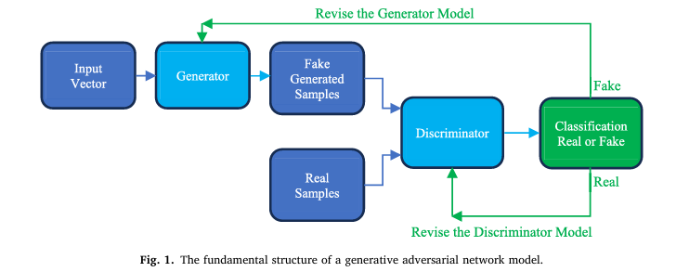
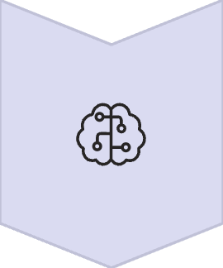



Training Workflow
Input Stage
Random noise vector or corrupted
MRI image fed into generator
Generation
Generator produces reconstructed MRI
maintaining anatomical structure
Discrimination
Discriminator evaluates authenticity
against real MRI database
Optimization
Backpropagation refines both models using error gradients
Convergence
Training continues until discriminator cannot reliably distinguish real from generated

Slide 8
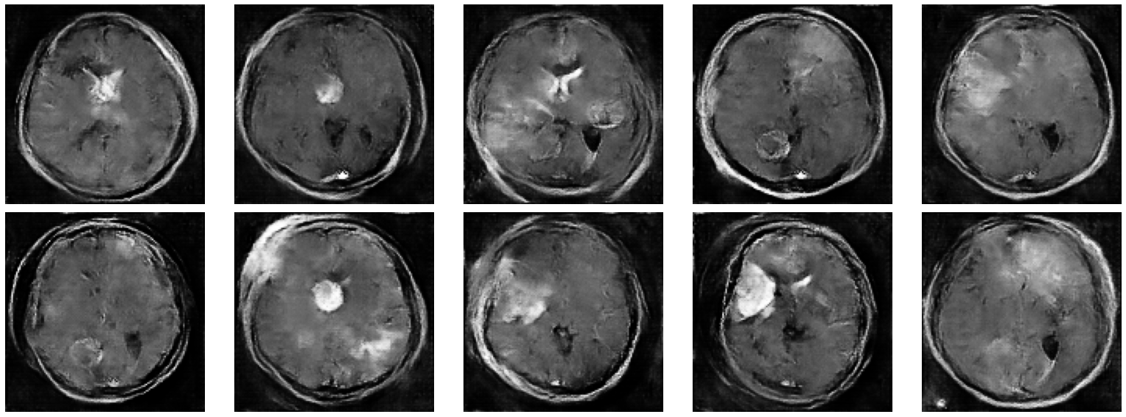
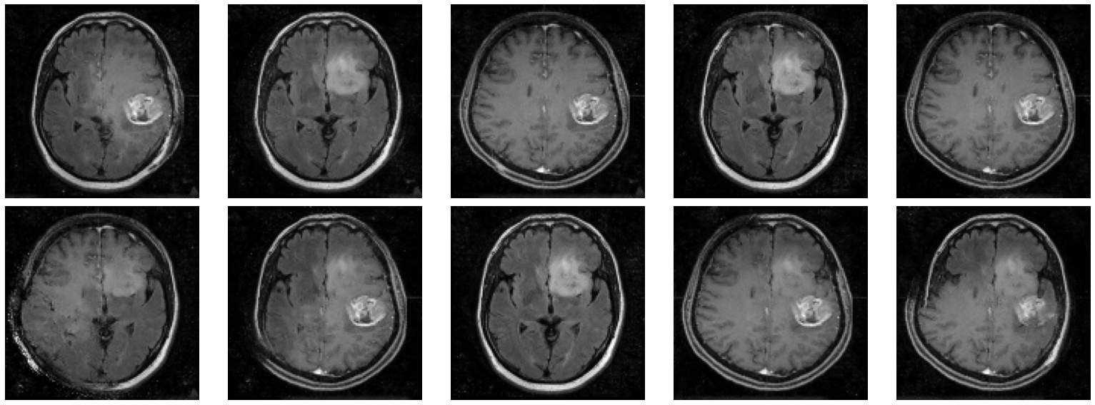

EPOCH 1:
EPOCH 10:

Slide 9



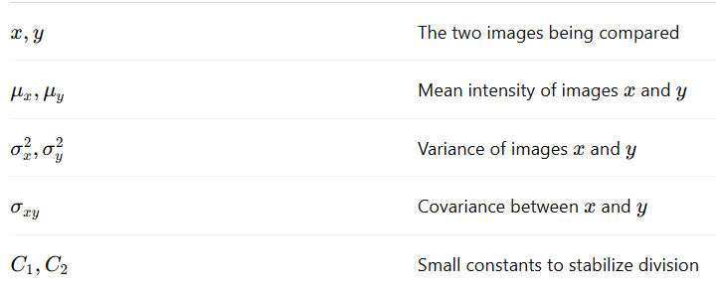

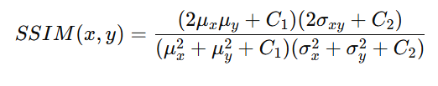


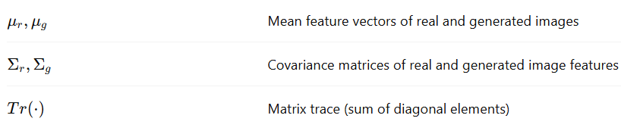
Evaluation Metrics
Performance Metrics
PSNR
|
Peak Signal-to-Noise Ratio measures pixel-level reconstruction accuracy
SSIM
|
Structural Similarity Index evaluates anatomical pattern preservation
FID
Fréchet Inception Distance quantifies perceptual realism of generated images

Slide 10
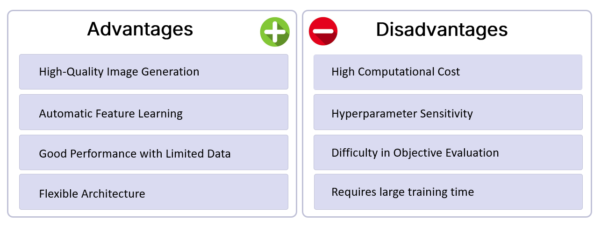






Applications
MRI Image Super-Resolution
Tumor Region Restoration and Boundary Enhancement
MRI to CT Image Translation
(Cross-Modality Conversion)
Synthetic Medical Image Generation for Data Augmentation

Slide 11

Benchmark Results
Landmark Studies
Method
Key Innovation
DCGAN (Radford)
Convolution-based architecture preserving image structure
pix2pix (Isola)
Conditional GAN for paired image-to-image translation
WGAN-GP (Arjovsky)
Wasserstein distance for stable training dynamics
CycleGAN (Zhu)
Unpaired modality conversion for flexible reconstruction

Slide 12

Conclusion:
In conclusion, GAN-based methods, especially DCGAN and its variants, are highly effective in medical image reconstruction.
They enhance image resolution, improve anatomical clarity, and reduce artifacts, making reconstructed images more suitable for diagnostic use.
However, clinical deployment still requires large dataset availability, careful validation with medical experts, and optimized training strategies.
Overall, GANs represent a promising and impactful direction for future medical imaging technologies.

