Slide 1
527 Data Analytics – Final Project
Dec 1st , 2016
DEF 14A – Filings
Hewlett Packard Inc.
Group 7

Slide 2
ILLINOIS INSTITUTE OF TECHNOLOGY School of Applied Technology
TABLE OF CONTENT
Introduction
Salary of the CEO’s for each year of HP
Stock awards of the CEO’s for each year of HP
Option awards of the CEO’s for each year of HP
Salary vs Stock Awards vs Option Awards for the CEOs of HP for all the available year
Highlights on stock trend before and after the filing date for 2015
Word Cloud for the top 10 words
Key Event Indicator
Most Frequent words in CORPORATE GOVERNANCE Sections
Key Event Indicator -COMPENSATION
SUMMARY
REFERENCES
ITM - 527

Slide 3
ILLINOIS INSTITUTE OF TECHNOLOGY School of Applied Technology
INTRODUCTION
INTRODUCTION
The Hewlett-Packard Company (commonly referred to as HP) is an American based multinational company, having its headquarters in Palo Alto, California.
HP was founded in January 1, 1939; 77 years ago by William Redington Hewlett and David Packard.
Current CEO (Chief Executive Officer) of Hewlett-Packard is Dion Weisler.
HP has been in position 80 in the Global 2000 list, called out by Forbes and number 31 in the World’s Most Valuable Brands category. Today HP is one of the leaders in the global technology provider’s space and with the significant success story behind it
Hewlett-Packard includes events of its electronic and bio-analytical measurement instruments as its Agilent Technologies in 1999, merger with Compaq in 2002, and the acquisition of EDS in 2008, which led to combined revenues of $118.4 billion in 2008 and a Fortune 500 ranking of 9 in 2009.
Hewlett-Packard is specialized in developing and manufacturing computing, data storage, and networking hardware, designing software and delivering services.
ITM - 527

Slide 4
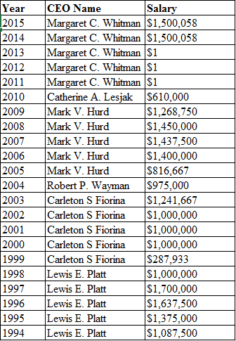
ILLINOIS INSTITUTE OF TECHNOLOGY School of Applied Technology
Salary of the CEO’s for each year of HP
ITM - 527

Slide 5
ILLINOIS INSTITUTE OF TECHNOLOGY School of Applied Technology
Stock awards of the CEO’s for each year of HP
Year | Vested Stock Awards
2015 | $7,771,200
2014 | $8,147,637
2013 | $4,394,475
2012 | $7,040,076
2011 | $0
2010 | $0
2009 | $10,256,370
2008 | $12,943,621
2007 | $6,238,795
2006 | $4,725,000
2005 | $8,684,000
2004 | $330,150
2003 | $0
2002 | $0
2001 | $0
2000 | $0
1999 | $65,557,400
1998 | $2,265,258
1997 | $2,712,071
1996 | $3,228,723
1995 | $2,088,646
1994 | $1,670,404
ITM - 527

Slide 6
ILLINOIS INSTITUTE OF TECHNOLOGY School of Applied Technology
Year | Option Awards
2015 | $5,113,585
2014 | $5,355,075
2013 | $12,713,433
2012 | $6,414,249
2011 | $16,146,331
2010 | $3,514,884
2009 | $2,520,906
2008 | $3,447,542
2007 | $3,724,919
2006 | $500,000
2005 | $1,150,000
2004 | $300,000
2003 | $700,000
2002 | $85,000
2001 | $1,000,000
2000 | $1,280,042
1999 | $600,000
1998 | $200,000
1997 | $150,000
1996 | $140,000
1995 | $80,000
1994 | $70,000
ITM - 527

Slide 7
ILLINOIS INSTITUTE OF TECHNOLOGY School of Applied Technology
ITM - 527

Slide 8
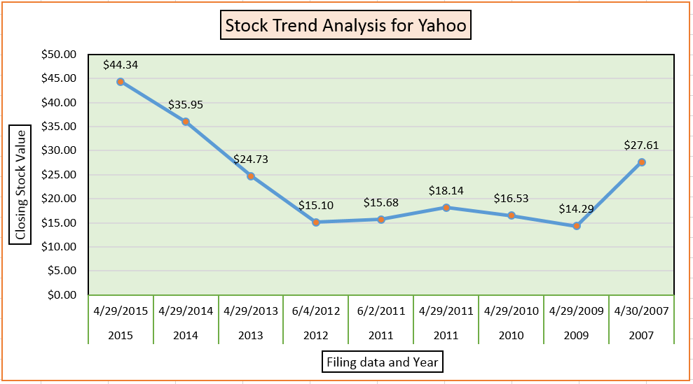
ILLINOIS INSTITUTE OF TECHNOLOGY School of Applied Technology
Highlights on Stock Trend before and after the filing date for 2015
2007 marked as Jerry yang time, has a closing stock value of 27.61 $, has the least CEO Salary that year but in 2 years, It marks a drop in the closing stock value to 14.29 $, which is almost 50 percent but had the CEO salary increasing. This period indicates a decrease in the shareholder's profit
In 2011, the filing was done twice and has a decrease in the stock value but increases when compared to the previous year 2010.
ITM - 527
2012 to 2015 marked under the governance of Marissa.A.Mayer , has a significant and consistent rise in stock value and a consistent salary of the CEO, which signifies a profit of the shareholders a.k.a investors.
The stock has nearly tripled in value since Ms. Mayer was hired as their CEO, rising from $15.65 on July 16, 2012 (her hire date) to $44.13 on April 1, 2015.

Slide 9
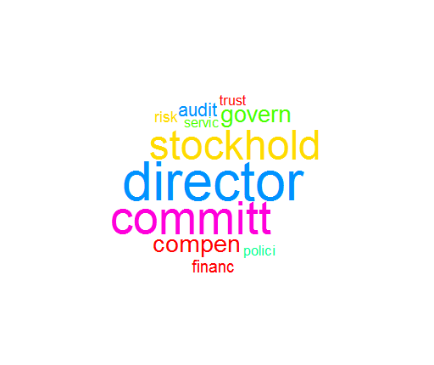
ILLINOIS INSTITUTE OF TECHNOLOGY School of Applied Technology
Word Cloud for the TOP 10 words
We extracted the Q&A section from all the DEF 14A filings.
Using the Corpus function, we combined all the Q&A and eliminated the punctuations, whitespaces, English stop words and converted all words to lower cases.
Using the TermDocumentMatrix function we created a TDM of all the words with their frequency of occurrence.
Using this TDM, we generated the word cloud using WordCloud function.
The adjacent word cloud visualizes the list of Top 10 most frequently occurring words in the CORPORATE GOVERNANCE section of the DEF 14A Filings.
Here the words “director”, “committ” and “stockhold” are the top 3 words by frequency of occurrence.
ITM - 527

Slide 10
ILLINOIS INSTITUTE OF TECHNOLOGY School of Applied Technology
KEY ELEMENT INDICATORS (KEI)
From the extracted Term Document Matrix, we found the frequency of all the words that appeared in the Q&A section of DEF 14A filings.
Below are the top 11 words with maximum frequency/occurrence.
The below words mixed are our Key Element Indicators (KEIs) as most of our Q&A discussion topics are around these words used independently or in correlation with other words.
Word | No.of Occurrence
director | 1170
committ | 961
stockhold | 829
compen | 444
govern | 411
audit | 291
finance | 247
risk | 216
polici | 190
trust | 182
servic | 176
ITM - 527

Slide 11
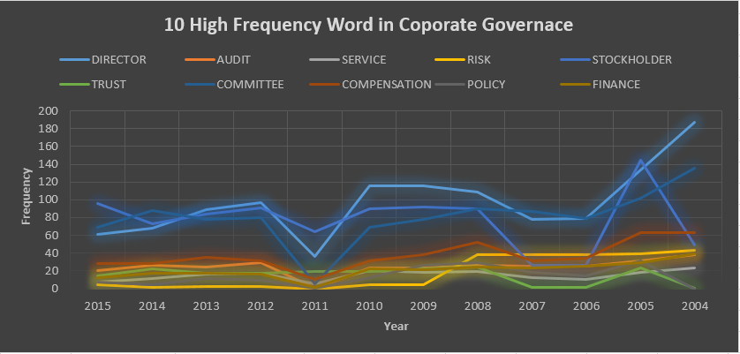
ILLINOIS INSTITUTE OF TECHNOLOGY School of Applied Technology
Most Frequent words in CORPORATE GOVERNANCE Sections
The various sections under Cooperate governance discussed mainly consist of all the keywords shown below in the graph. All the words form one of the important part of co-operate governance.
Each year the word was used with different frequencies depending on the importance and situation.
The year 2011 has less frequency of words when compared with others years as not much is discussed about directors and their compensation. The information about various policy in order to provide services and that will help to maintain the trust of various stockholders is also not discussed in detailed.
ITM - 527

Slide 12
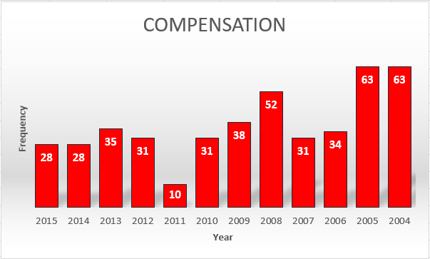
KEY EVENT INDICATOR 1
ILLINOIS INSTITUTE OF TECHNOLOGY School of Applied Technology
KEY ELEMENT INDICATOR - Compensation
The compensation varies from year 2004 – 2015 for directors because of various reasons like
The Board approval.
The salary of directors
Stock and Option awards
Annual equity retainer received. For example, in 2008 each director received annual cash retainer of $50,000 while in 2009 each non-employee director received an annual cash retainer of $100,000
Reimbursement
Number committee meeting attended in excess of a total of ten meetings of each committee per Board term.
By taking into consideration all above things the compensation of directors has continuous fluctuations in the frequency of occurrence thus making it key indicator.
ITM - 527

Slide 13
ILLINOIS INSTITUTE OF TECHNOLOGY School of Applied Technology
SUMMARY
The average percentage increase in the salary of the CEO (Wendell P. Weeks) across 2003 to 2015 is 4.7%
Maximum Stock Award received was around $65M in the year 1999.
The peak value of Option Award was around $16M in the year 2011.
The words DIRECTOR, COMMITT & STOCKHOLD are KEIs having the most number of occurrence in the Q&A section of the DEF 14A filing.
ITM - 527

Slide 14
ILLINOIS INSTITUTE OF TECHNOLOGY School of Applied Technology
REFERENCES
DEF 14A Filings: www.sec.gov
Company Information: http://www.hp.com/country/us/en/welcome.html
Stock Trading Trends: http://finance.yahoo.com
ITM - 527

Slide 15

ANY QUESTIONS WELCOMED!!
ILLINOIS INSTITUTE OF TECHNOLOGY School of Applied Technology
ITM - 527

