Slide 1
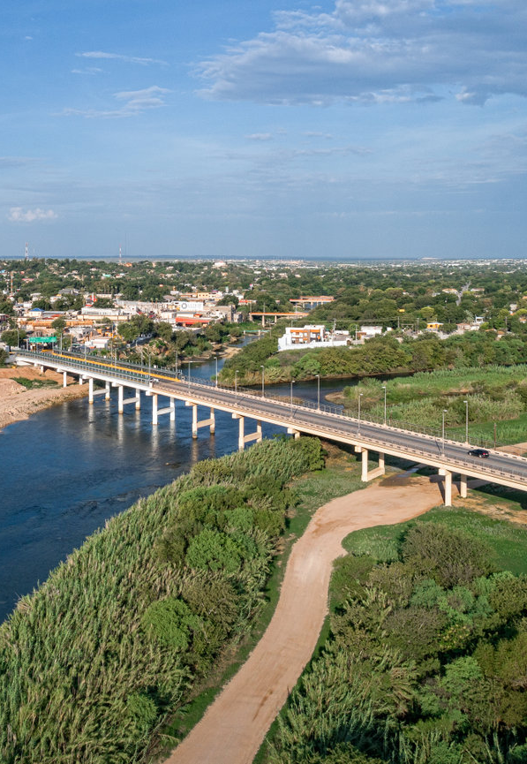
WILDFIRE ANALYSIS Neel shah DEL RIO, TEXAS
County: Val Verde
State: Texas
Population: 34,673
Climate: Hot Semi Arid
Average AQI: 40

Slide 2
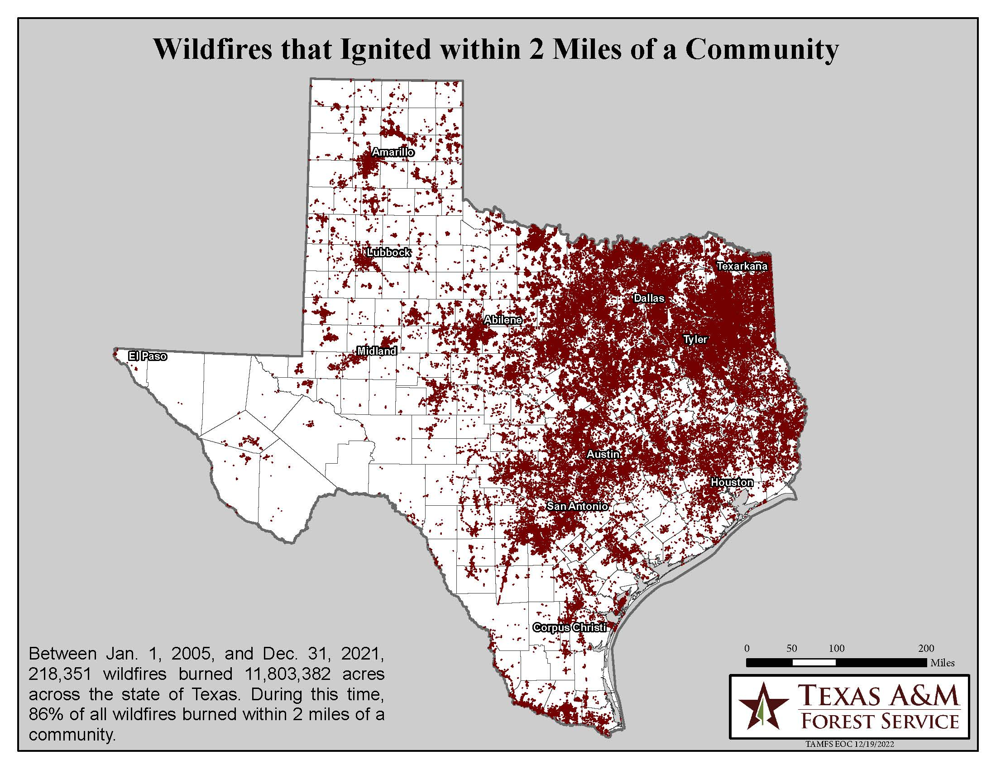
Is del rio affected by wildfires??
Is Del Rio affected by smoke from wildfires in Texas?
Does this increase the Smoke or AQI values for Del Rio?
Does smoke from wildfires affect the Health of residents of Del Rio?
Del Rio

Slide 3
METHODOLOGY
Data Extraction
Data Analysis
Modeling
Healthcare Impact
Wildfires data
AQI – Val Verde
Healthcare data (Val Verde County)
Fire Distance
Area burnt
Smoke Estimate
AQI
Time Series Forecasting
Smoke estimate prediction 2024-2049
Human centered impact
Deaths
Cancer Mortality

Slide 4
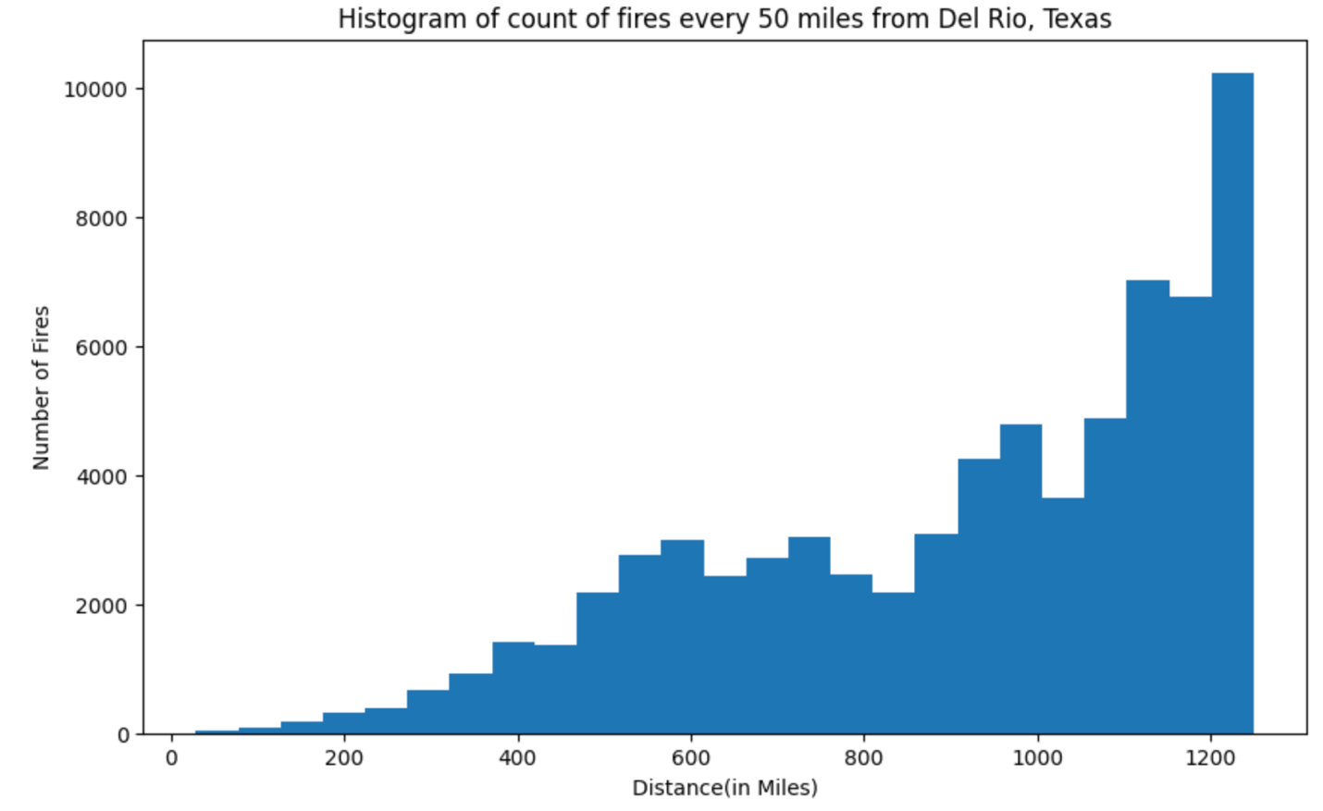
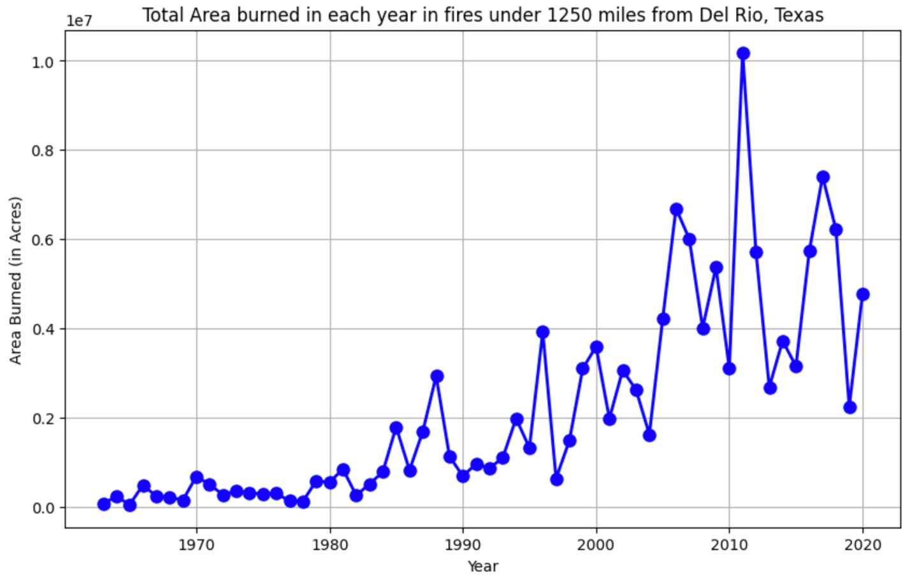
Results
Distance of Fires from Del Rio
Area burnt by wildfires

Slide 5
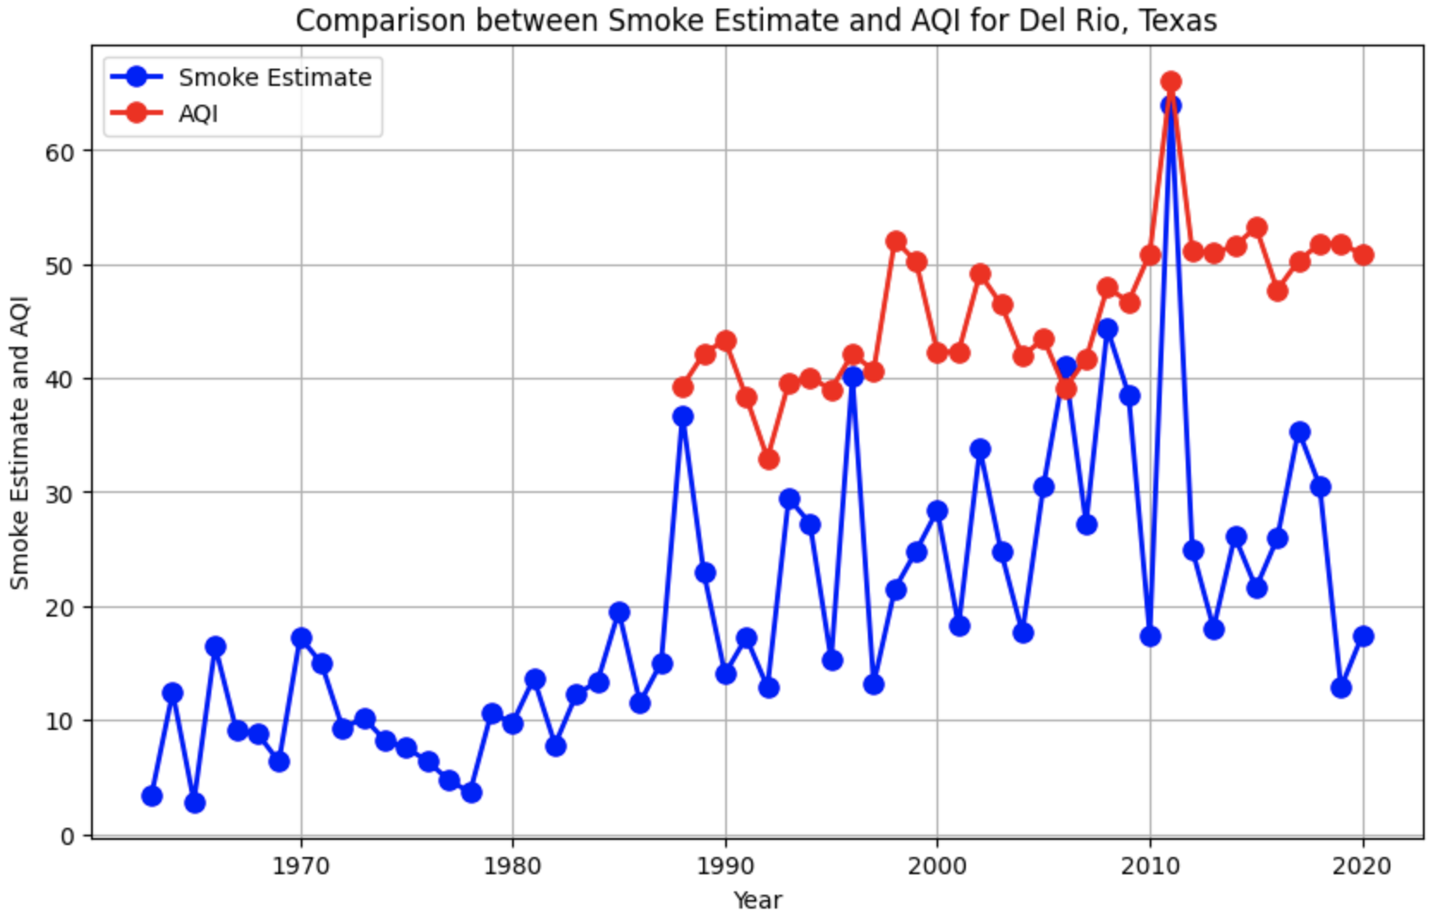
sMOKE eSTIMATE VS AQI
Calculated Smoke Estimate matches the actual AQI
Spike in 2011?? – During 2011 in Texas, around 31,453 fires had burned 4,000,000 acres of land
The trend shows higher correlation and proves the correctness of smoke estimate

Slide 6
HEATHCARE – DEL RIO (Val Verde)
Total Deaths
Respiratory problems
Val Verde County
(2006-2020)
233
Total Deaths
Val Verde County
Cancer
(2006-2020)
2120
Smoke can lead to:
Deaths
Cancer
Infant/Fetal deaths
Respiratory problems
…
Total Deaths
Del Rio
(2006-2020)
5409
Total Deaths
Val Verde County
(2006-2020)
5524
Avg treatment charges
Respiratory Diseases
(2016-2020)
69k$
Avg treatment charges
Cancer Chemotherapy
(2016-2020)
90k$

Slide 7
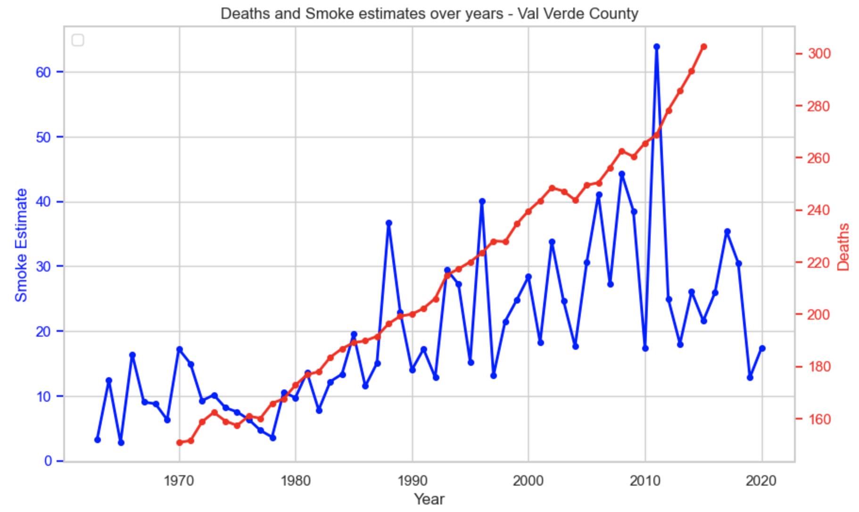
sMOKE eSTIMATE vs DEATHS
The number of deaths is +vely and constantly. increasing (1970-2015)
Overall increasing trend for smoke estimates and number of deaths
64% correlation

Slide 8
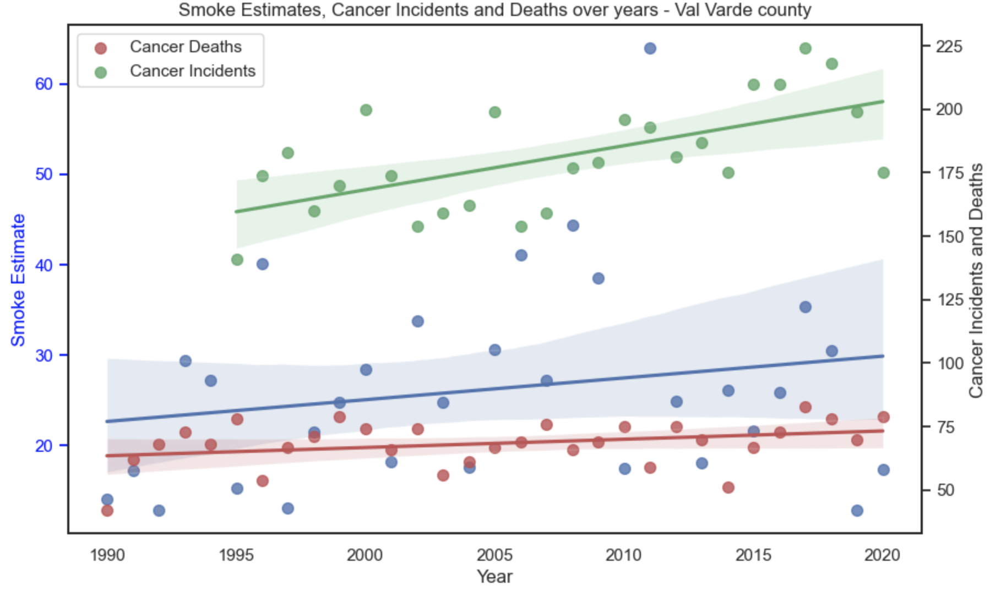
sMOKE eSTIMATE vs cancer mortality
The number of cancer incidents is +vely increasing (1995-2020)
The number of cancer deaths is +vely increasing (1990-2020)
Overall, similarly increasing trend for smoke estimates and both number of cancer incidents and deaths, BUT
12% correlation

Slide 9
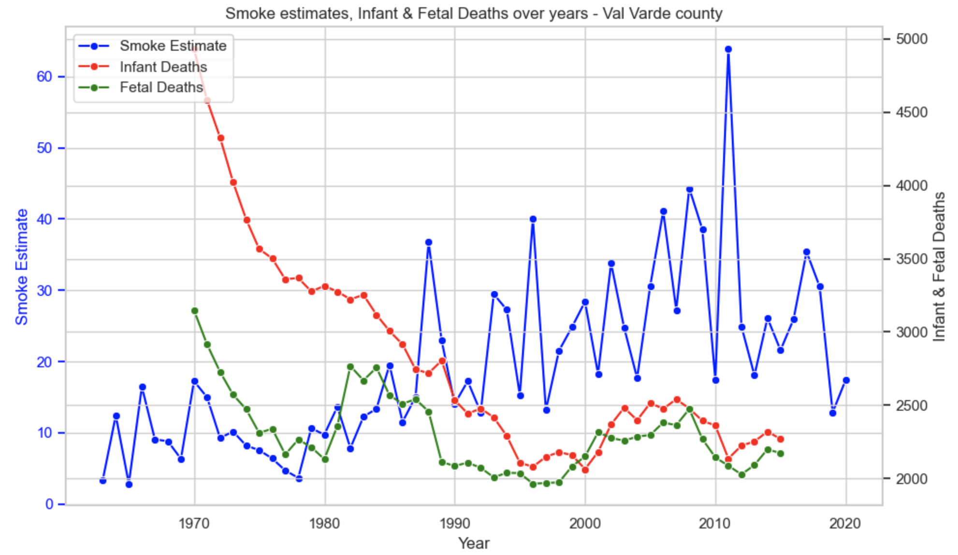
sMOKE eSTIMATE vs Infant/fetal mortality
The number of infant and fetal deaths are decreasing drastically
Overall, trend for smoke estimates is completely opposite trend for Infant/fetal deaths
-53% and -25% correlation

Slide 10
Conclusion
Del Rio is a very green city and is moderately affected by Smoke from Wildfires especially from 1990 to 2020
Smoke Estimates and Number of Deaths are correlated 64%, thus smoke is one of the factors leading to Deaths in Del Rio
Smoke Estimates and Number of Cancer Incidents/Deaths are correlated by 12%, thus smoke is not one of the factors leading to Cancer in Del Rio
Smoke Estimates and Infant/Fetal deaths are not correlated +vely. Which means smoke from wildfires do not affect infant/fetal deaths.

Slide 11
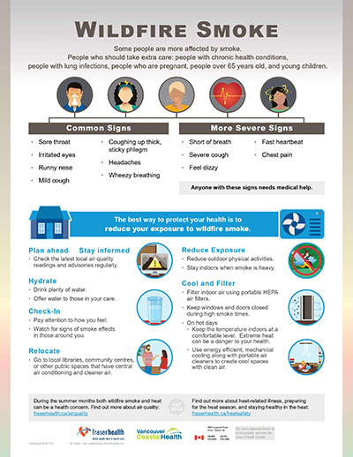
Recommendations
Smoke Awareness Campaigns
Free Smoke resistance kits
Air purifying mechanisms
Accessible Treatment and Diagnosis

