Slide 1
Market Basket Analysis for Retailers
By Neel Shrivastava
Data Analyst Intern – Hackveda
October 2025

Slide 2
Objective
Market Basket Analysis helps retailers discover associations between products frequently bought together. The goal is to use these insights for better product placement, bundling, and cross-selling opportunities.

Slide 3
Hook story
In today’s competitive retail landscape, understanding customer buying behavior is key to success. Every purchase a customer makes leaves behind valuable data — patterns that often go unnoticed. For instance, a customer purchasing bread may also tend to buy butter or jam. These associations, when analyzed effectively, can help businesses optimize product placement, create personalized recommendations, and design strategic marketing campaigns.
Through Market Basket Analysis, we uncover these hidden relationships, transforming raw transactional data into actionable insights that drive growth and customer satisfaction.

Slide 4
Problem Statement
Retailers want to uncover relationships between items often purchased together. For example, customers who buy 'bread' are also likely to buy 'butter'. Using this, supermarkets can optimize layout and increase sales.

Slide 5
Example Walkthrough
Dataset (4 transactions): 1️⃣ [Bread, Milk] 2️⃣ [Bread, Butter] 3️⃣ [Bread, Milk, Butter] 4️⃣ [Milk, Butter]
Total Transactions: 4
Step 1 — Singleton Supports
Bread = 3/4 = 0.75
Milk = 3/4 = 0.75
Butter = 3/4 = 0.75 ✅ All frequent (min_support = 0.5)
Step 2 — Pairwise Itemsets (k=2)
{Bread, Milk} → 2/4 = 0.5
{Bread, Butter} → 2/4 = 0.5
{Milk, Butter} → 2/4 = 0.5 ✅ All frequent
Step 3 — Larger Itemsets (k=3)
{Bread, Milk, Butter} → 1/4 = 0.25 ❌ (Not frequent)

Slide 6
Dataset Overview
Dataset: Online Retail II
- Contains transactional data for a Germany-based retailer.
- Fields include Invoice, StockCode, Description, Quantity, InvoiceDate, Country.
- Filtered only ‘Germany' transactions for analysis.
Dataset from Kaggle

Slide 7
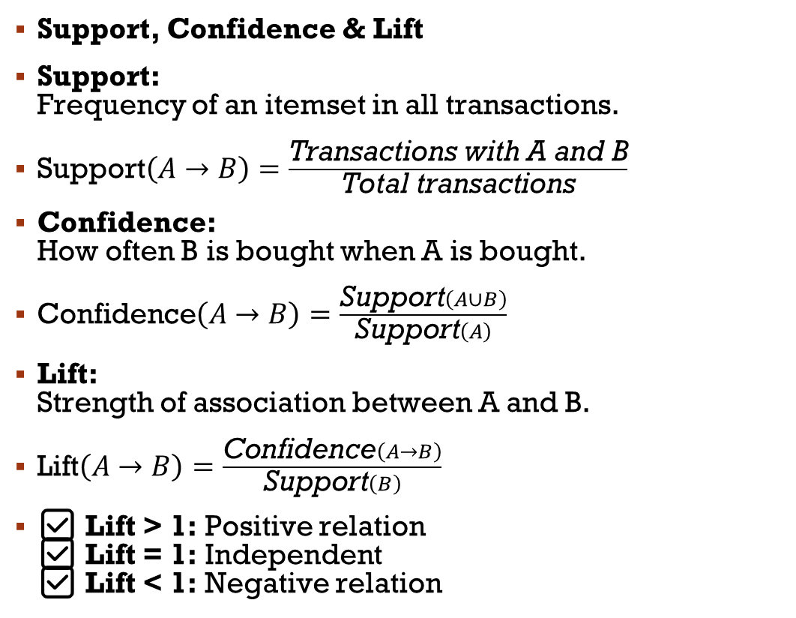
Evaluation Metrics
Support, Confidence & Lift
Support: Frequency of an itemset in all transactions.
$\text{Support}\left(A→B\right)=\frac{\text{Transactions} \text{with} \text{A} \text{and} \text{B}}{\text{Total} \text{transactions}}$
Confidence: How often B is bought when A is bought.
$\text{Confidence}\left(A→B\right)=\frac{\text{Support}\left(A∪B\right)}{\text{Support}\left(A\right)}$
Lift: Strength of association between A and B.
$\text{Lift}\left(A→B\right)=\frac{\text{Confidence}\left(A→B\right)}{\text{Support}\left(B\right)}$
✅ Lift > 1: Positive relation ✅ Lift = 1: Independent ✅ Lift < 1: Negative relation

Slide 8
Methodology – Apriori Algorithm
How Apriori Algorithm Works
1️⃣ Step 1 — Generate Candidate Itemsets
Create itemsets (groups of products) from transactions.
Start with single items, then combine them into pairs, triples, etc.
2️⃣ Step 2 — Calculate Support
Find how frequently each itemset appears in all transactions.
Keep only itemsets with support ≥ minimum support threshold.
3️⃣ Step 3 — Purify Infrequent Itemsets
Remove itemsets that don’t meet the minimum support to save computation.
4️⃣ Step 4 — Generate Association Rules
From frequent itemsets, create rules like A → B (if A is bought, B is likely bought).
5️⃣ Step 5 — Evaluate Rules
Use Support, Confidence, and Lift to measure the rule’s strength.

Slide 9
Demonstration (Python Implementation)

Slide 10
Business Insights
Thematic Buying Behavior (Spotty Collection) Customers who buy “Set/6 Red Spotty Paper Plates” also frequently buy “Set/6 Red Spotty Paper Cups” with a lift of 14.7. → These belong to the same design theme, indicating strong preference for matched sets. Recommendation: Display matching products together and create combo offers for themed sets.
Color-Based Product Pairing (Spotty Tableware) Items like “Red Spotty Cup” and “Red Spotty Bowl” show a lift over 14, suggesting customers prefer to buy matching color tableware. Recommendation: Promote same-color dining collections and bundle them as “tableware sets.”
Cross-Design Co-purchase Pattern (Harmonica Sets) “Red Harmonica in Box” and “Blue Harmonica in Box” appear together with a lift of 13.7. This means customers often buy multiple color variants of the same product, likely for gifting or collecting. Recommendation: Display color variations together and introduce multi-color discounts.
Bundling Opportunity (Snack Boxes & Woodland Series) The “Round Snack Boxes Set of 4 Woodland” repeatedly appears in frequent itemsets with items like “Charlotte Bag” and “Postage”, with high confidence (0.8+). Recommendation: Combine Woodland-themed items into promotional gift bundles or category-based display sections.

Slide 11
Conclusion
Market Basket Analysis uncovers hidden buying patterns in retail data.
By analyzing associations, businesses can improve layout, create bundles, and drive cross-selling strategies — giving a competitive edge.

Slide 12
Q & A
Thank you for listening!
Questions?
Contact: neelshrivastava1211@gmail.com
LinkedIn: linkedin.com/in/neelshrivastava

