Slide 1
Project journal

Slide 2
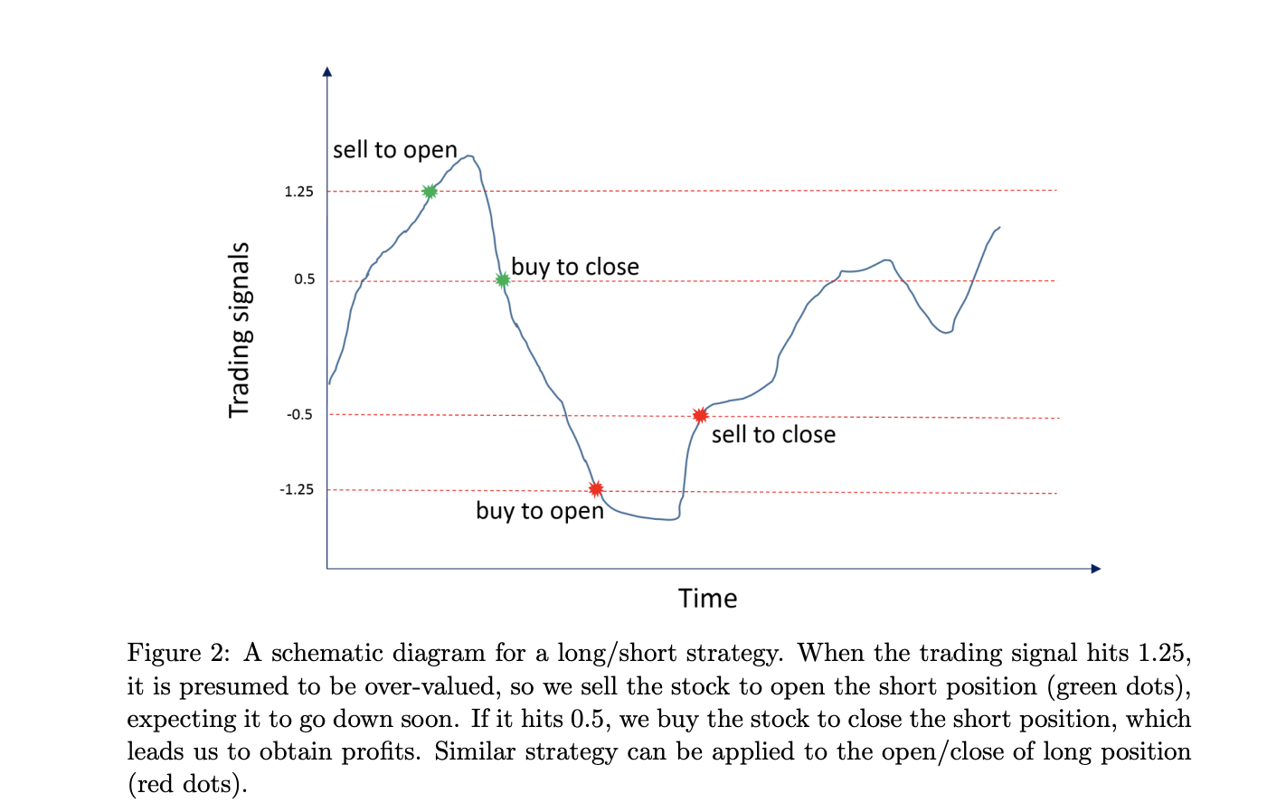
Baseline trading policy
This is the general form of optimal
Trading policy
But we want to make an RL agent learn
These thresholds
... and see if it learns stop losses policy ?
... Dynamically adapt the tresholds
(trading signal parametres are time varying)

Slide 3
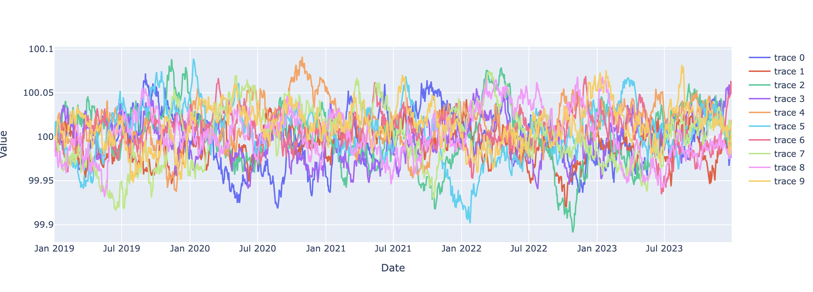
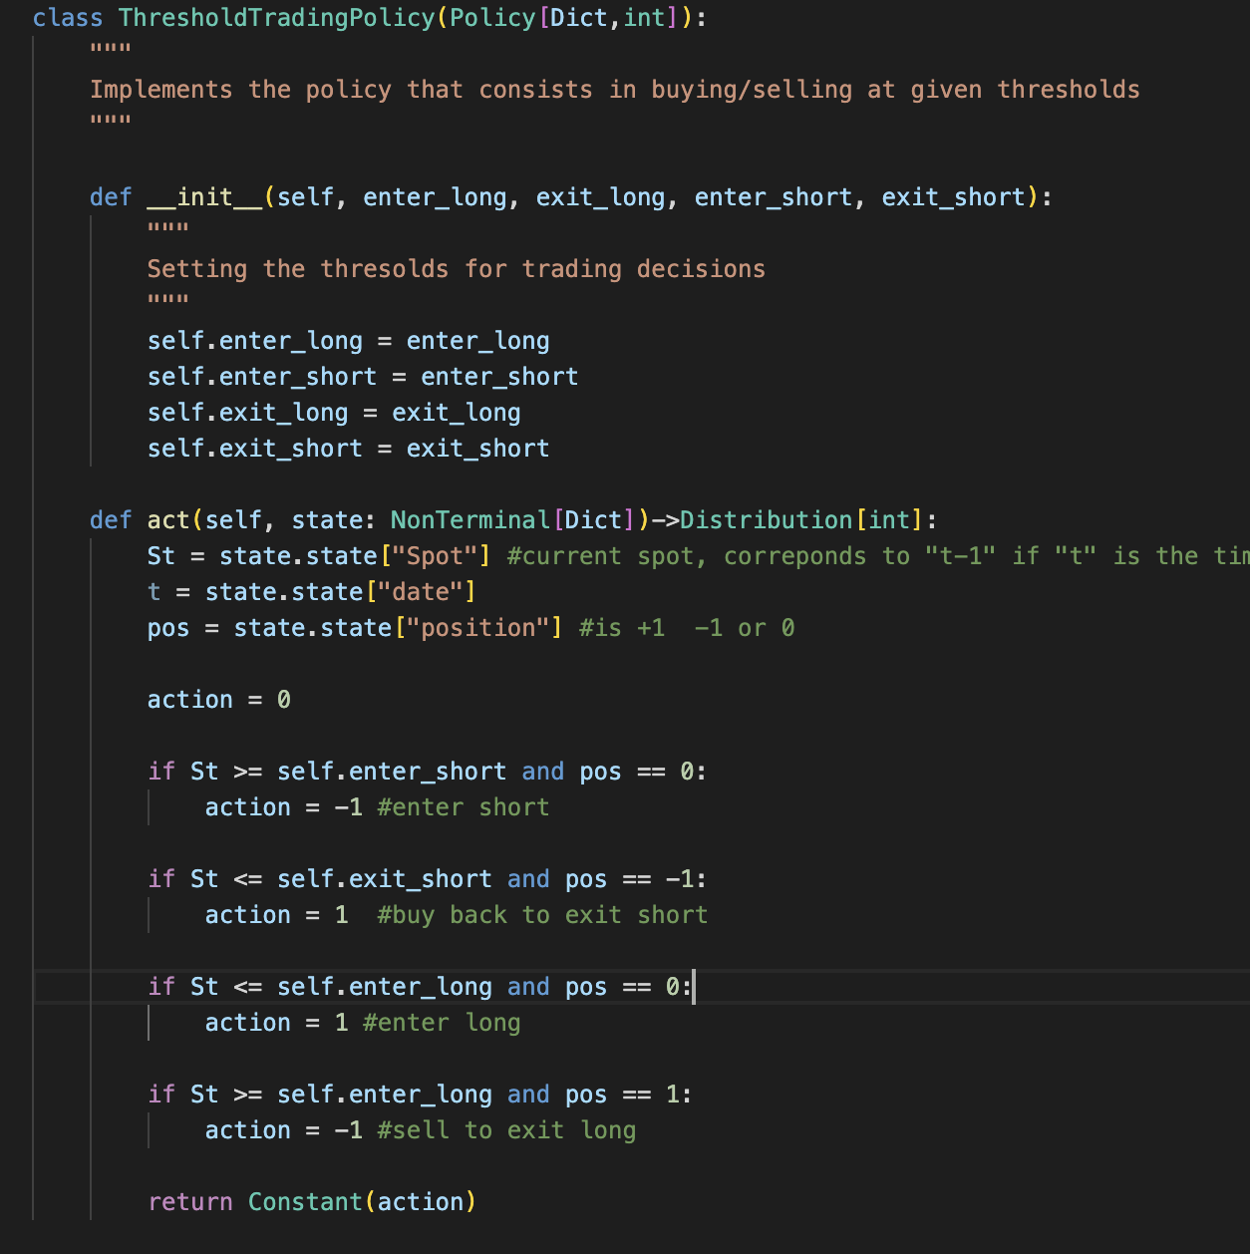
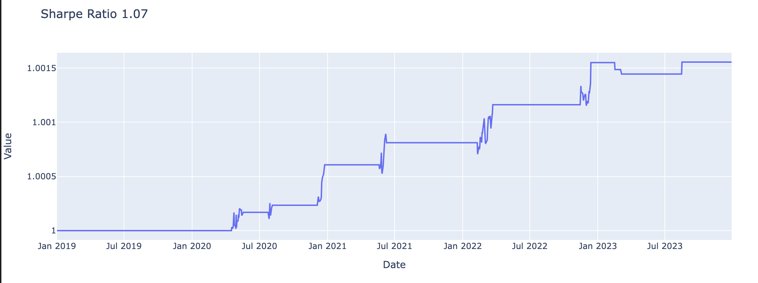
First model
Is it possible for the RL agent to at least reproduce a simple threshold policy with mean reverting OU process ?
Fixes mean rev. Level, fixed mean rev speed

Slide 4
What features would be needed to reproduce this ?
Can we find good feature functions for a linear model ?
Can simple algorithms learn the optimal weights ?
Can we then enrich it to make features time varying (and incorporate a lookback) ?

Slide 5
If we assume QVF (affine) function of spot
Position = 0
(Nothing in the portfolio)
a=1
a=-1
Q
a=0
Value of S_t
Enter long
Enter short

Slide 6
If we assume QVF (affine) function of spot
Position = 1
(We are long)
a=-1
a=-1
Q
a=0
Value of S_t
Stop loss
Take profit
(no stop loss)

Slide 7
If we assume QVF (affine) function of spot
Position = -1
(We are short)
a=1
Q
a=0
Value of S_t
Take profit

Slide 8
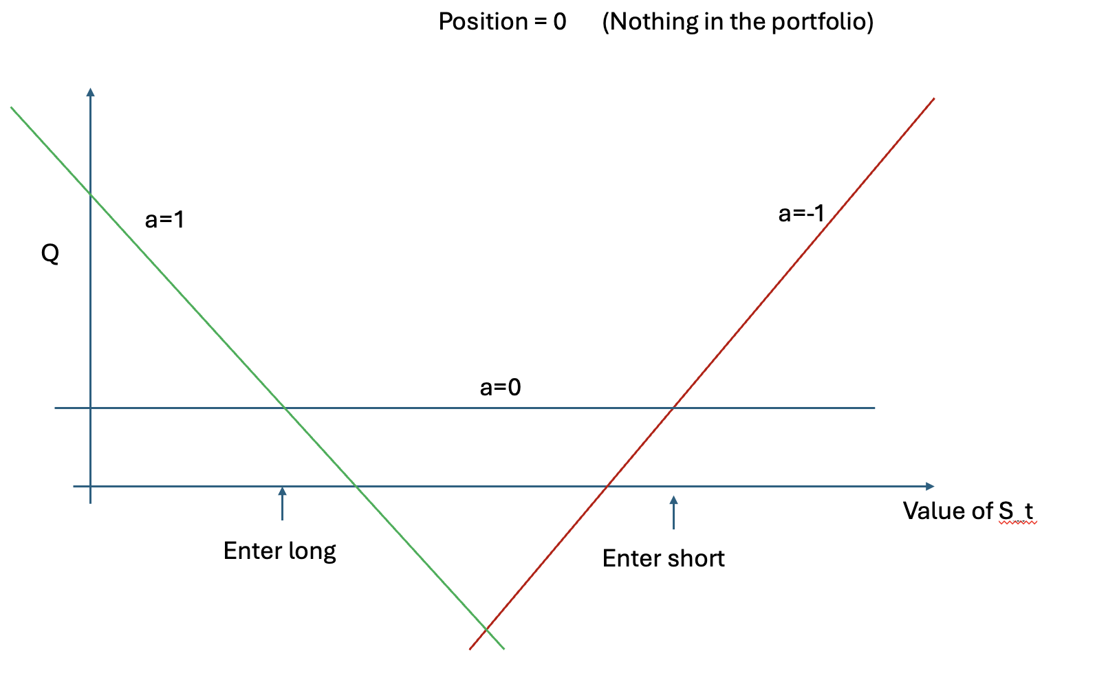
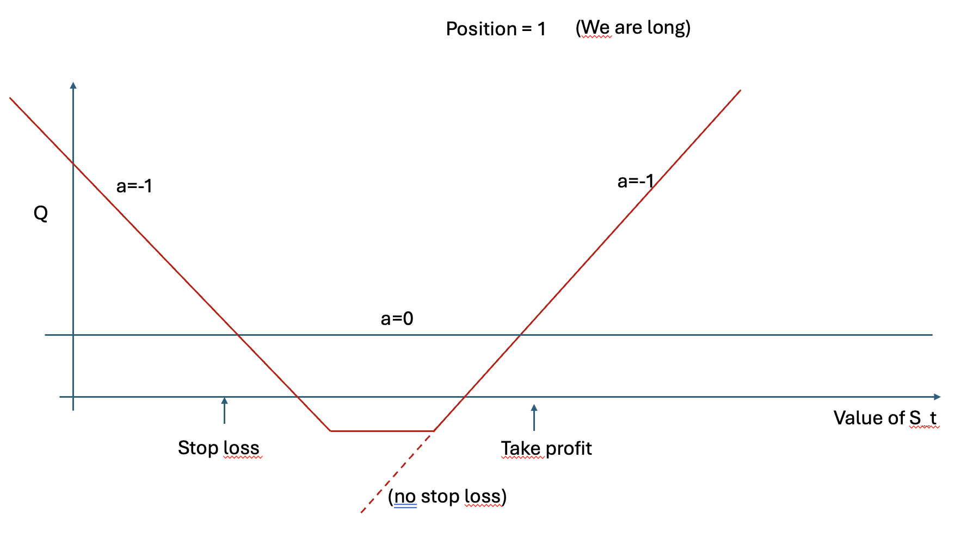
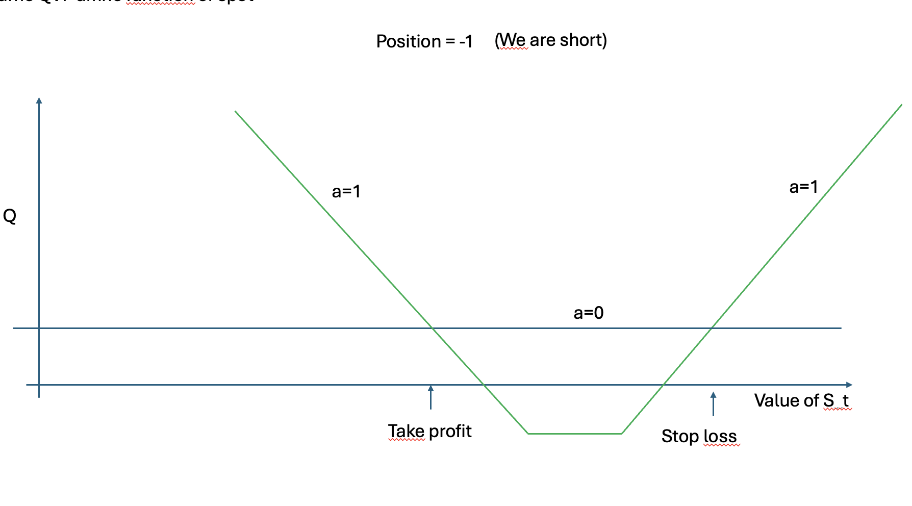


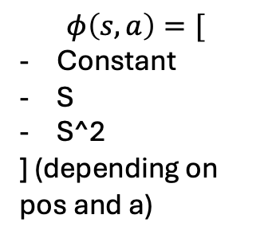





General desing of the feature functions
Q$\left(pos=0, S_{t},0\right)=b$
$$Q\left(s,a,θ\right)=θ^{T}φ(s,a)$$
Q$\left(pos=0, S_{t},−1\right)=a S+b$
s = {
-> pos = …
-> S_t = …
}
Q$\left(pos=1, S_{t},0\right)=a S+b$
$$φ\left(s,a\right)=[$$
Constant
S
S^2
] (depending on pos and a)
Q$\left(pos=1, S_{t},−1\right)=aS^{2}+bS+c$
Q$\left(pos=−1, S_{t},0\right)=a S+b$
Q$\left(pos=−1, S_{t},1\right)=aS^{2}+bS+c$

Slide 9
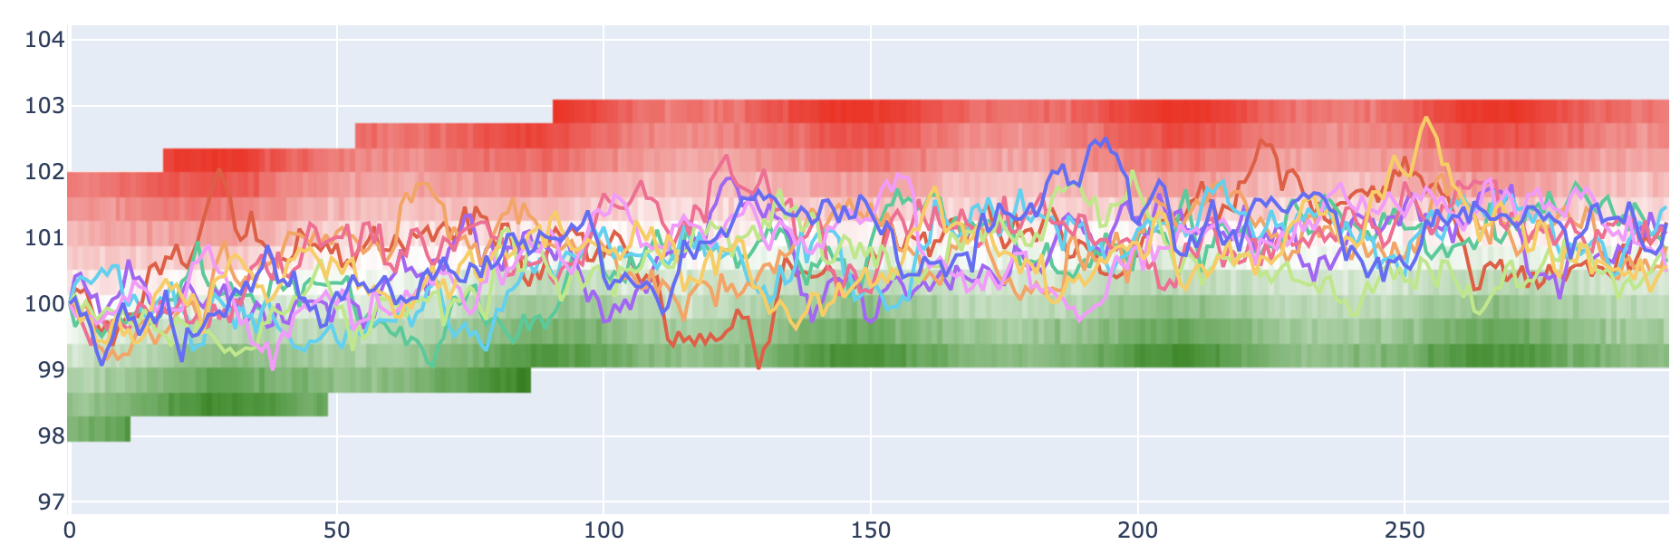
An idea : predict V(S|always hold) ➔ this would then be a feature for the control algorithm

