Slide 1

Survival models in DataSHIELD
Soumya Banerjee, Tom Bishop and DataSHIELD technical team

Slide 2
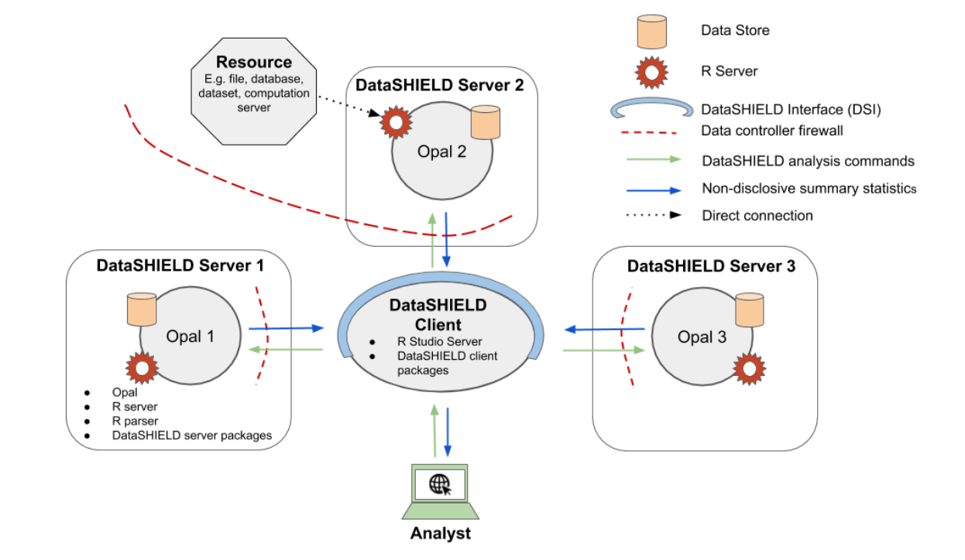
Introduction to DataSHIELD
https://www.datashield.ac.uk/about/datashielddetailedoverview/

Slide 3
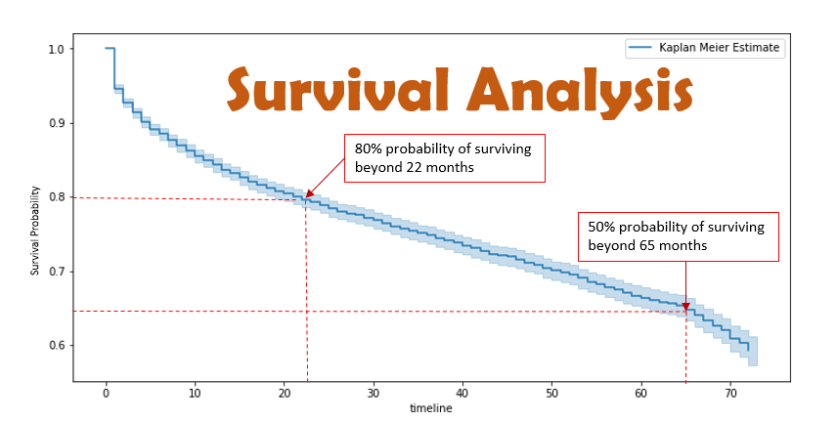
Survival models
https://towardsdatascience.com/survival-analysis-intuition-implementation-in-python-504fde4fcf8e

Slide 4
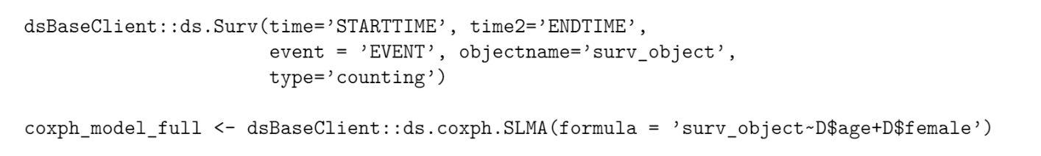
Code snippet
https://github.com/neelsoumya/datashield_testing_basic/blob/master/development_plan.pdf
Notes:
For each metacluster

Slide 5
Client
Function to create Surv object on server (assign function)
ds.Surv(start,stop,event,my_surv_obj, datasources)
Server
Surv parameters
Check for errors
Call to server side
datashield.assign(...)
Do disclosure checks
Create Surv object
Return confirmation or handle errors
Receive error or confirmation

Slide 6
Client
Function to run Cox model on server assuming Surv object created already (aggregate function)
ds.coxphSLMA(“my_surv_obj ~ age + smoking”, datasources)
Server
Formula & parameters
Check for errors, convert to string
Call to server side
Convert string to formula
Do disclosure checks
Fit model
Return summary
Receive result, optionally meta analyse

Slide 7
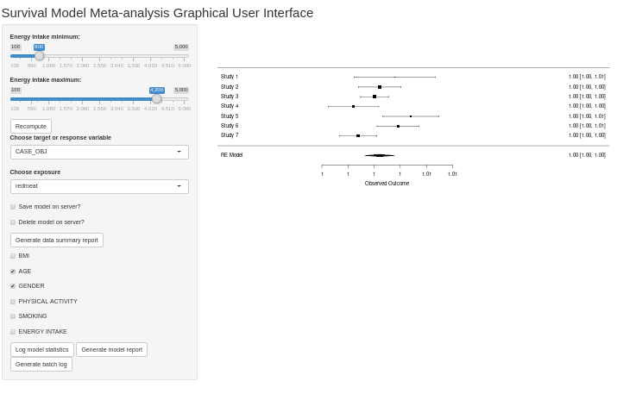
Graphical user interface
West et al., Nature Medicine, 2017

Slide 8
Functionalities
Account for missing covariates in some studies
Batch fitting
Quality control reports and model reports
Notes:
ds.helper
missing
data summaries

Slide 9
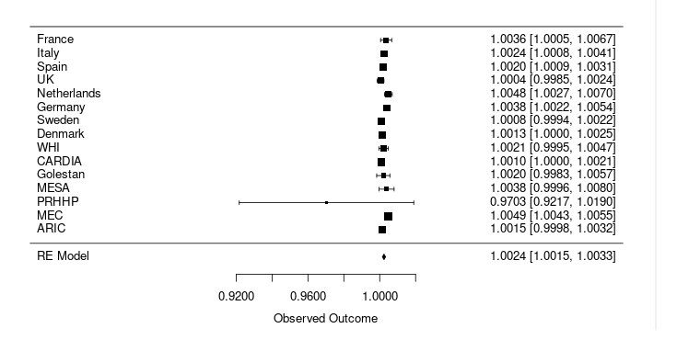
Red meat exposure and relationship with T2D (preliminary results)
Notes:
reproduicle

Slide 10
Tutorial and cookbook
https://github.com/neelsoumya/datashield_testing_basic/blob/master/development_plan.pdf
xx
xx
Notes:
reproducible

Slide 11
Acknowledgements
DataSHIELD technical team
Paul Burton, Demetris Avraam, Stuart Wheater, Patricia Ryser-Welch, Alex Westerberg
Tim Cadman, Sido Haakma
Notes:
reproduicle

