Slide 1
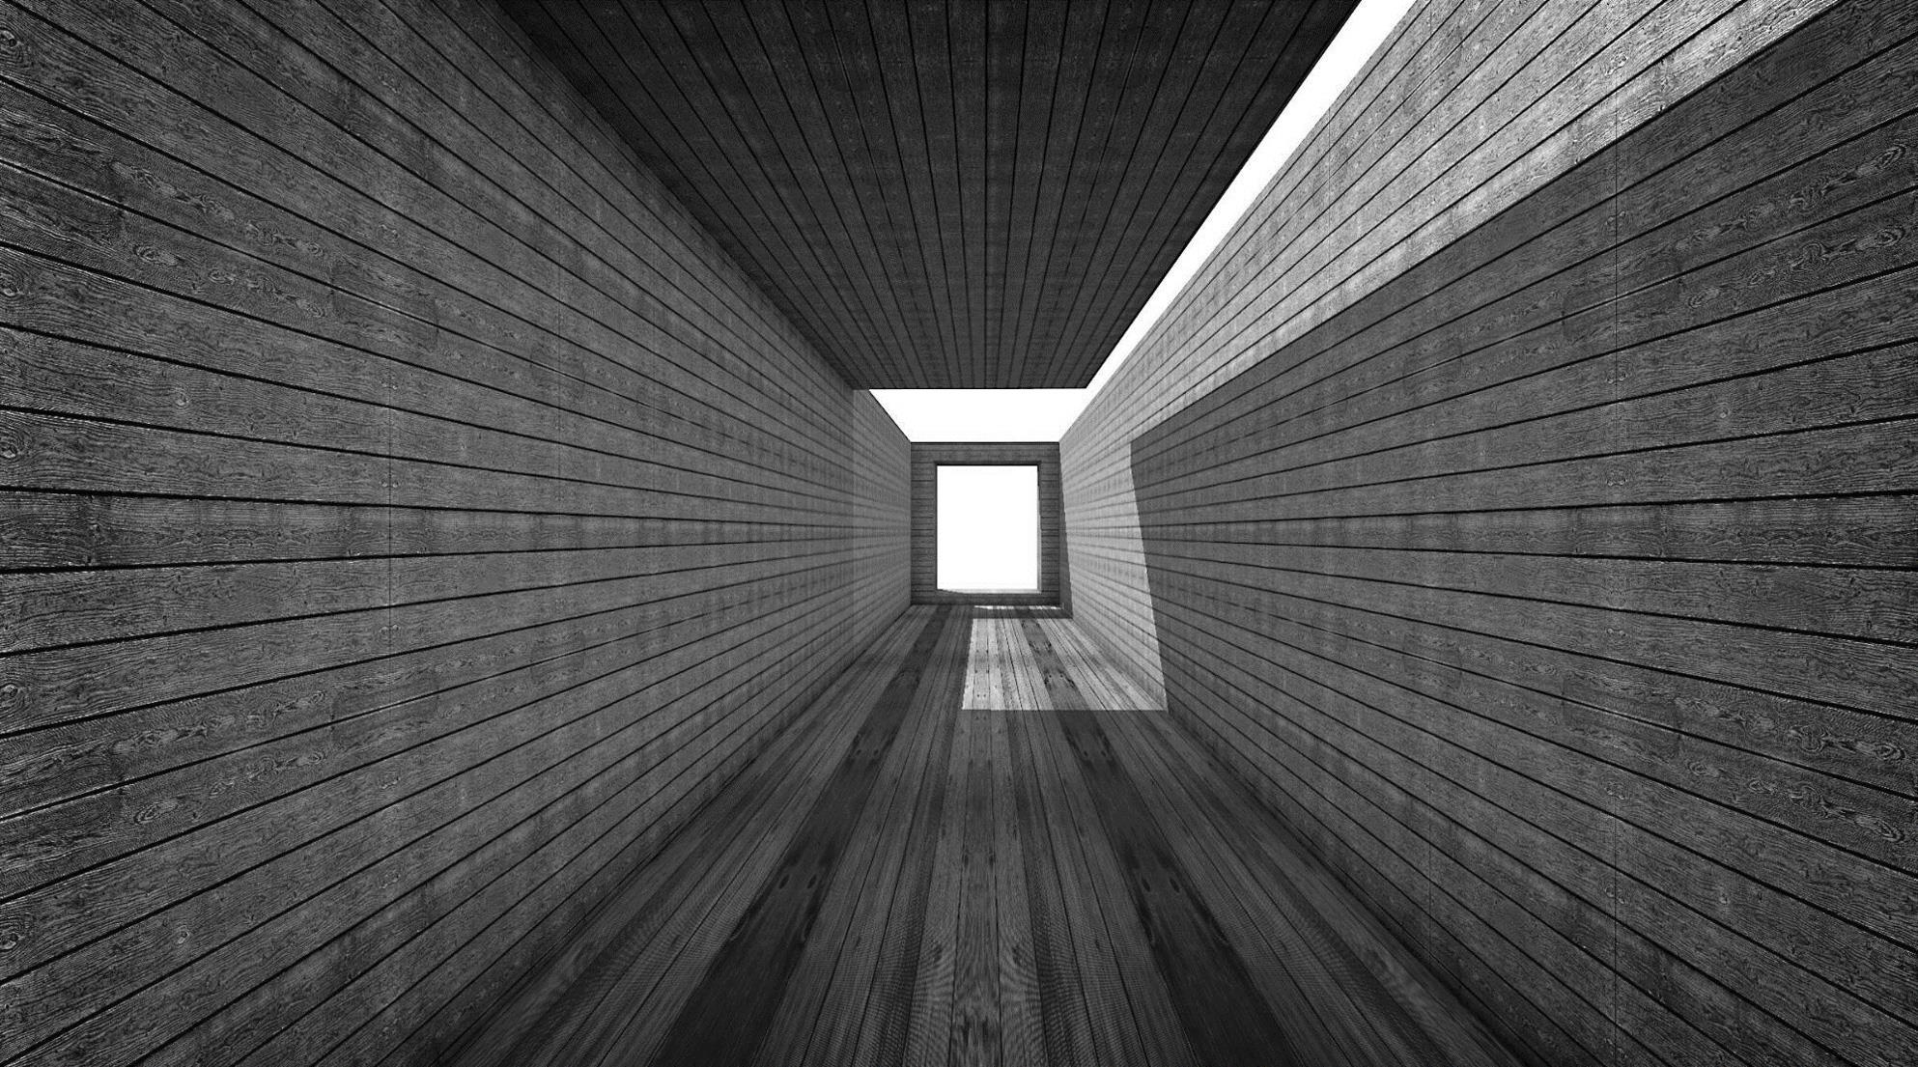
Wrap up of class
Soumya Banerjee

Slide 2
AI
Stories
Analogy
Creativity and insight
Dreams
Case based reasoning
Extreme generalization

Slide 3
AI is a deeply contextual and open-ended endeavour, not a single one-time riddle to be solved.
- Francois Chollet

Slide 4
Administrivia
WRITEUP/REPORT
on the paper you present, and the topic in general (unconventional AI).
do a literature review of other papers in the field.
reflect/write on how these techniques can be incorporated in modern AI/deep learning.
The intention is for you to
learn how to read papers
compare and contrast them to other papers
then think what this means for modern AI/deep learning.
Show me early drafts

Slide 5
Administrivia
WRITEUP/REPORT
Short report (less than 4000 words). The idea is to write a coherent narrative.
Suggest how these ideas can be incorporated in modern AI/deep learning systems
Why do you think these ideas were not successful in the 1950s/1960s?
What kind of data would we need to ensure these techniques would work today?
What lessons can we learn from the history of AI, what approaches worked and did not work in the past?
What could be the disadvantages of these approaches?
Rational reconstruction (analytical literature review/survey) of a research area
Other thoughts on the writeup
A detailed research proposal with some ground work already accomplished

Slide 6
Administrivia
HOW TO WRITE
WRITE REGULARLY
SCHEDULE TIME FOR WRITNG
https://sites.google.com/site/neelsoumya/research-resources/scientific-writing
https://www.youtube.com/watch?v=DeVjXINr5Wk
Book on writing (contact me to borrow a copy)
How to write a lot: a guide to productive academic writing (Paul Silvia)

