Slide 1
Unconventional approaches to AI
Soumya Banerjee
sb2333@cam.ac.uk
Neel.Soumya@gmail.com

Slide 2
Insights from the past
Unconventional approaches in AI: complex systems perspectives, cognitive psychology, social sciences, computational models of creativity and other unconventional models
This is AI or classical AI before big data. The time is now ripe to revisit these wonderful ideas and think about how to incorporate them in modern AI/deep learning. Insights from the past can inform future approaches to AI, especially in the age of big data.
Looking at the heritage of computing and its interdisiciplinary past can inspire new approaches for the future. We need to learn lessons from the history of AI, what approaches worked and did not work in the past and how AI went through multiple winters.
These approaches can be used to develop techniques that can inspire explainable AI.

Slide 3
Insights from the past
We are told of eureka moments (Archimedes, newton, …)
In reality we always build on the work of others
There is a preparation stage
Incubation stage
Retrieval/indexing (kekule dreaming of a snake and then linking it to benzene rings)

Slide 4
Insights from the past
Unconventional approaches in AI: complex systems perspectives, cognitive psychology, social sciences, computational models of creativity and other unconventional models
Perceptrons
Cognitive psychology
Neuroscience
linguistics

Slide 5
Approaches
Narratives and stories
Computational models of creativity and insight
Analogies
Dreams
Commonsense reasoning

Slide 6
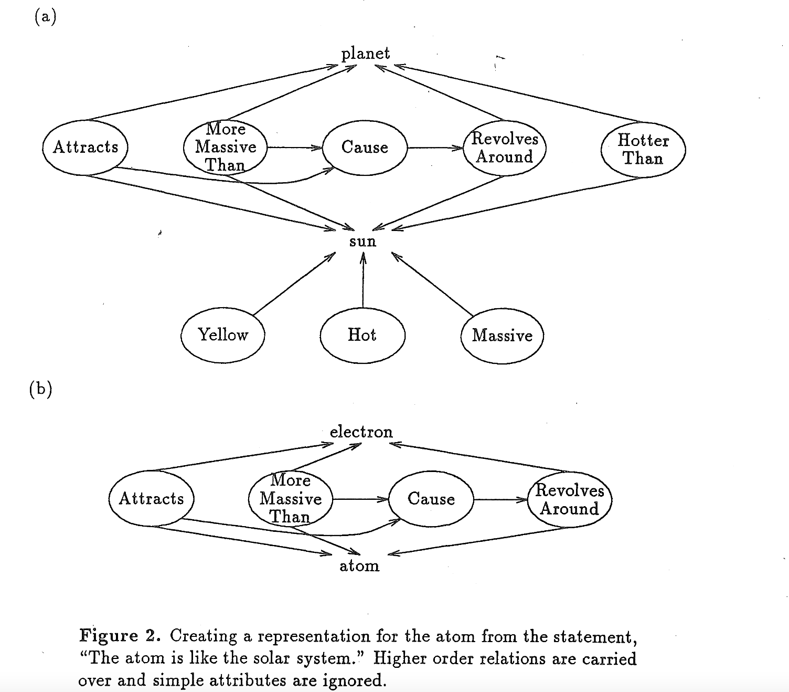
Approaches
A computational model of scientific insight, 1986, Langley et al.

Slide 7
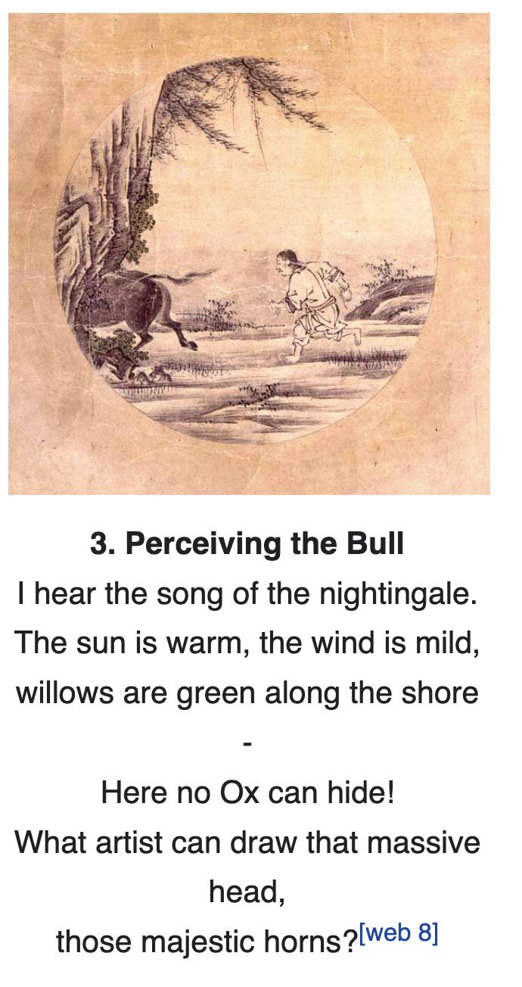
Approaches
Zen koan, ten bulls, wikipedia

Slide 8
Approaches
Explainability (insights from social sciences)
Miller, 2019
How do you generate explainable models by working with domain experts
Rudin, 2019
Important for high stakes decisions in domains like healthcare, recidivism prediction
Case based reasoning
How humans reason
We can take inspiration from other disciplines and develop new xAI approaches
Notes:
\textit{ I argue that we can take inspiration from other disciplines and develop new xAI approaches.}

Slide 9
Approaches
Abstraction and reasoning
Psychology of invention
Kekule
poincare
Notes:
We are told of eureka moments (Archimedes, Newton, etc.). In reality we always build on the work of others.
There is a preparation stage, incubation stage and retrieval/indexing (e.g. Kekule dreaming of a snake and then linking it to benzene rings).

Slide 10
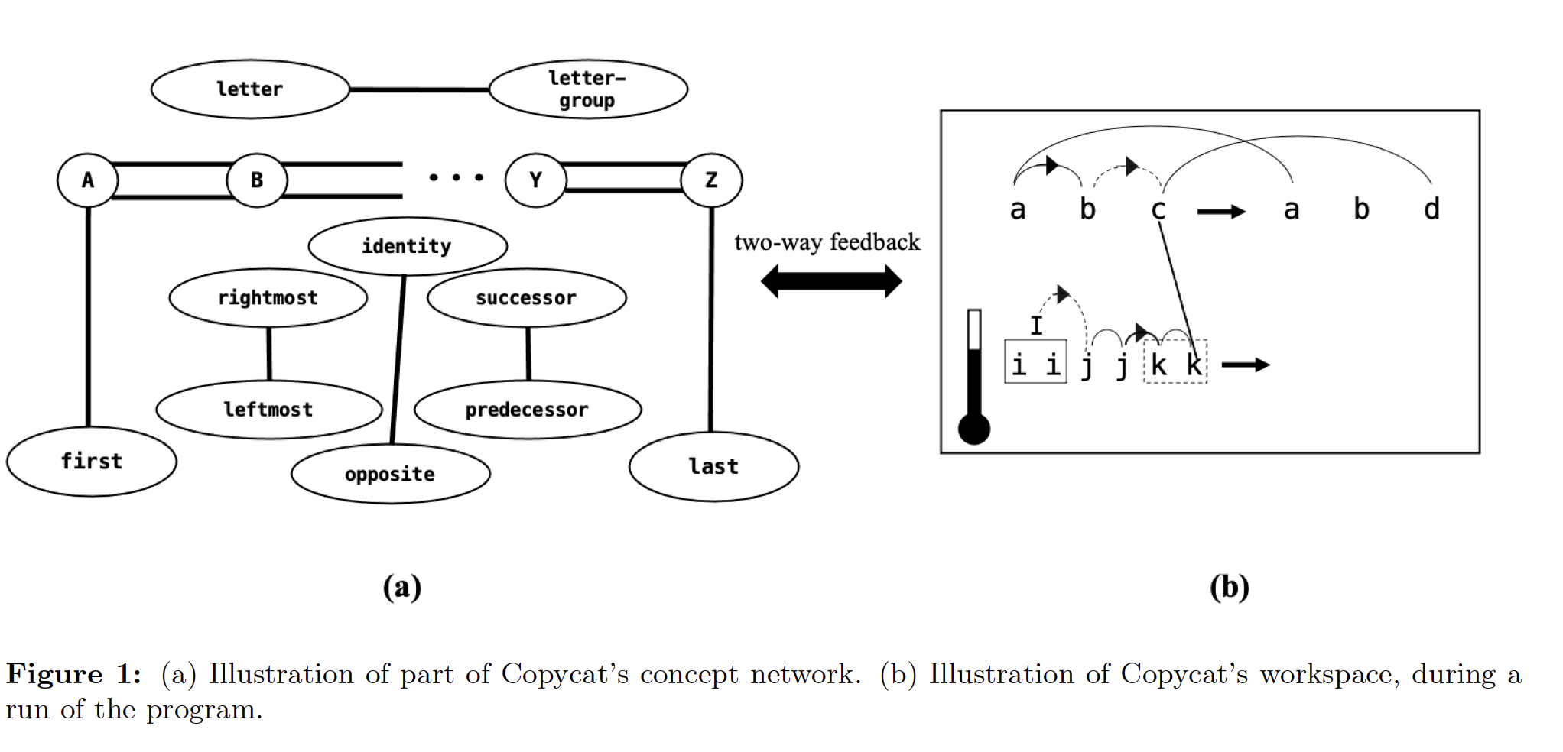
Approaches
Copy.cat

Slide 11
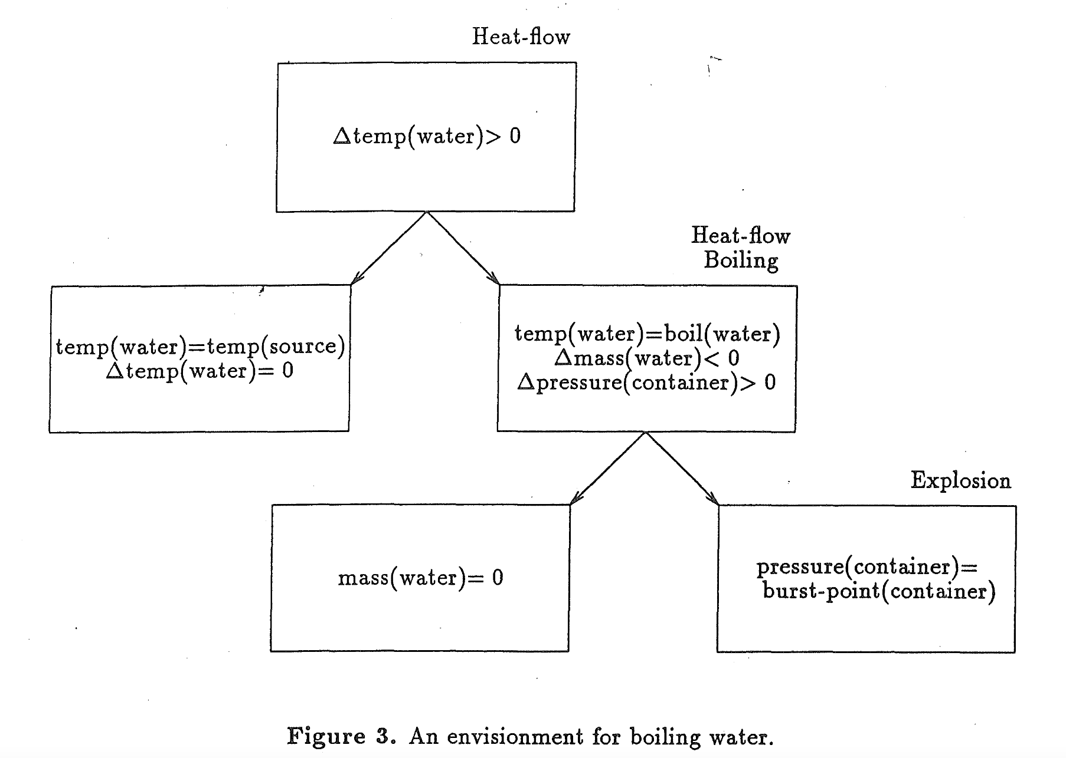
Approaches
Qualitative process models

Slide 12
Approaches
Other ideas
Other paths to intelligence (in other species)
Abstraction and reasoning corpus and challenges

Slide 13

Approaches
Abstraction and reasoning corpus

Slide 14
resources
https://github.com/neelsoumya/special_topics_unconventional_AI

