Slide 1
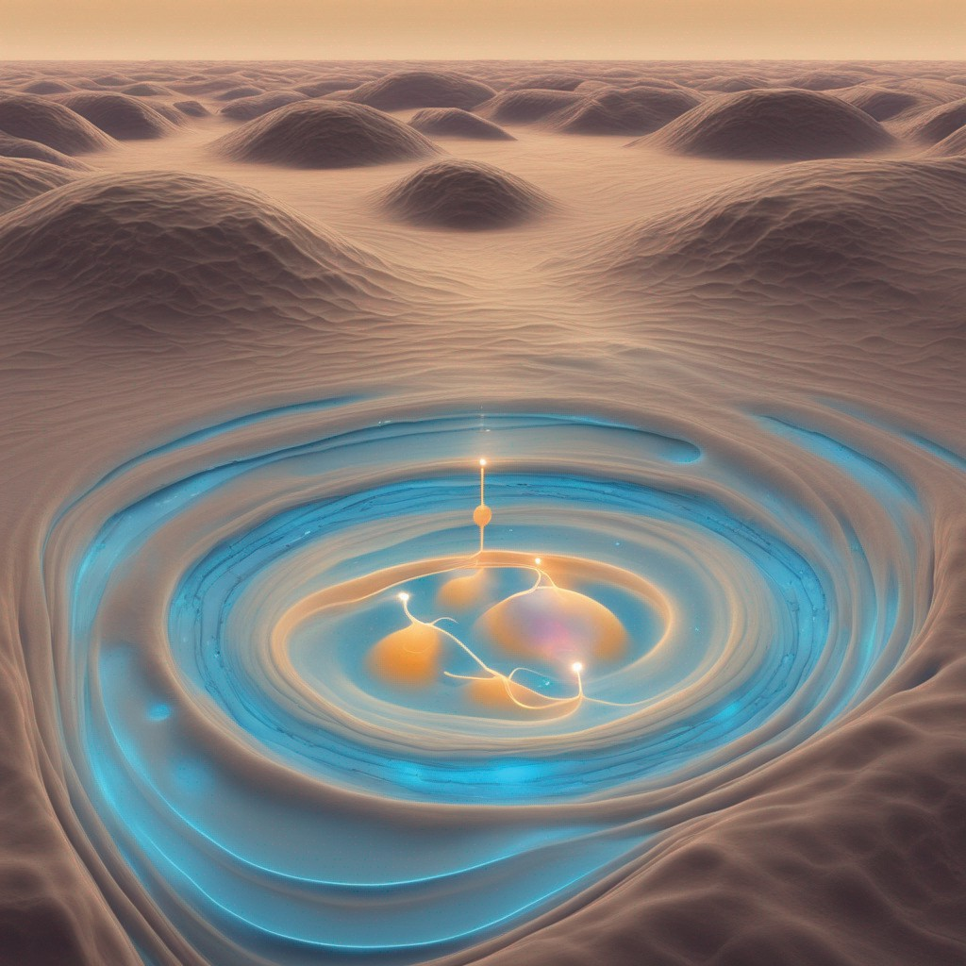
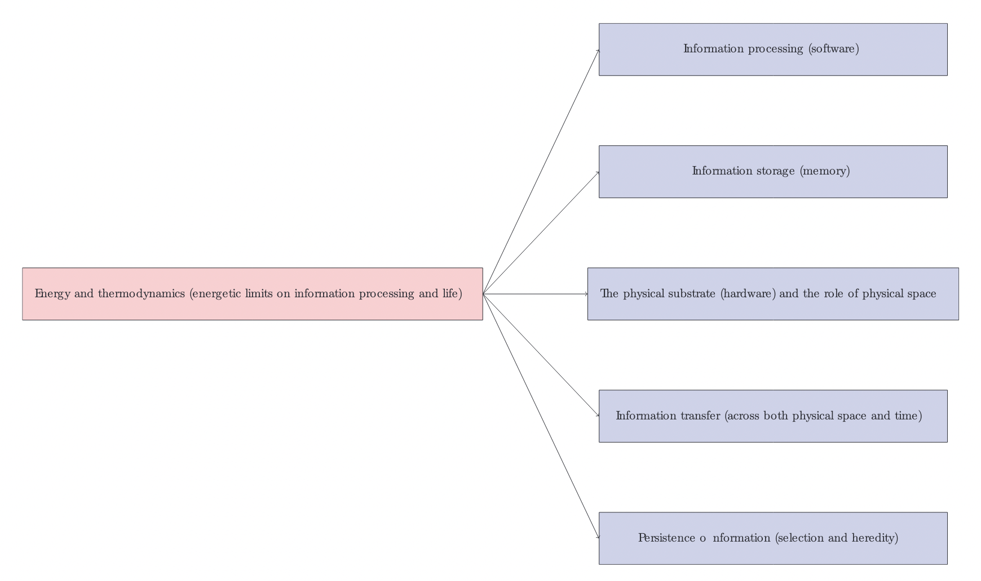
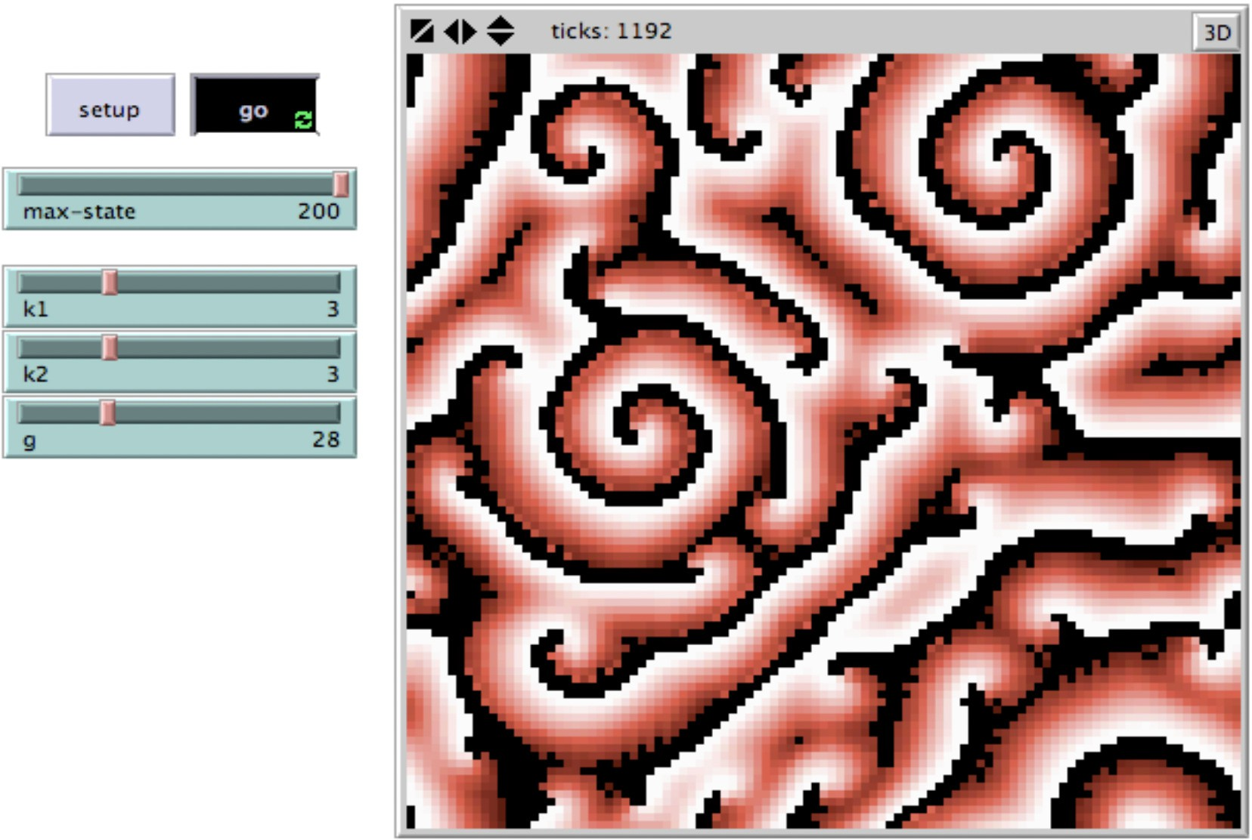
Life and Intelligence as We Do Not Know It
Soumya Banerjee
University of Cambridge, United Kingdom
Abstract
Information plays a critical role in complex biological systems. This poster explores:
▶ A computational view of life, life-like systems, and intelligence.
▶ Hypothesis: Carbon-based life is only one amongst a continuum of life-like systems.
▶ Investigating computational substrates for life-like properties.
Introduction
▶ What distinguishes life from non-life?
▶ Can life be radically different from carbon-based life forms?
Life at a computational level involves information processing, which may be a key factor distinguishing life from non-living matter.
Key Components of Life-like Systems
▶ Information processing (software)
▶ Information storage (memory)
▶ Physical substrate (hardware)
▶ Information transfer (space and time)
▶ Persistence of information (heredity)
▶ Energy availability
Life-like Systems Beyond Carbon
Life may arise from non-carbon-based substrates. Some examples of life-like systems are:
Reaction-diffusion systems like the Belousov-Zhabotinsky (B-Z) reaction are chemical oscillators and also display complex properties reminiscent of life (“life-like” systems): persistent wave-like patterns that propagate are shown in Figure 2.
Stars have an energy source and have compartments. Stars that undergo supernova (at the end of their life) cause disturbances in neighboring galactic clouds, which ultimately leads to the formation of new stars. This is conceptually similar to replication.
Weather systems like hurricanes persist for long times; even weather systems on other planets like the Great Red Spot Jupiter have persisted for a very long time and display complex behavior.
Clay (which is a crystal) can also replicate defects within it. Clay particles that are more “sticky” can preferentially attach to river beds and can attract other similar clay particles. When sheets of clay are cleaved off and then transported elsewhere, they can preferentially attract other similar clay particles and provide a template for producing similar clay particles. Hence, in this simple clay system, there may be some limited forms of “heredity” and “natural selection.”
Belousov-Zhabotinsky Reaction
Another Vision of Life
“Complex intelligent life arising from electrical currents in superconductors on a cold, seemingly
lifeless planet.”
In a story written in the 1950s, Arthur C. Clarke challenged our understanding of life, imagining intelligence based on electrical currents in liquid helium, creating neuron-like networks at temperatures close to absolute zero.
AI and Human Creativity
Figure 3: A visualization generated using generative AI of a hypothetical life-like system made of ultra-cold liquid helium on a cold seemingly lifeless planet. Created by Soumya Banerjee using the DreamUp generative AI framework. The prompt used was the following: “Ultra cold liquid helium on the surface of a planet and electrical currents flow within it; currents and eddies form in liquid helium.”
Using AI and human creativity to reimagine life can help us understand different kinds of intelligence. ALife programs and computer programs like the Game of Life can open our minds to different kinds of intelligence.
Conclusion
We know a lot about life as we know it (carbon-based life). How would we recognize life and intelligence as
we do not know it? Life elsewhere in the Universe may be very different from what we see on Earth. A computational view of life-like systems may allow us to recognize life in all its myriad forms in this Universe. There are also outreach resources that the general public and students can use to engage with some of these ideas.
Life may exist as a continuum between non-life and life, and we may have to revise our notion of life and how common it is in the Universe. Looking at life-like systems and intelligence through the lens of computation may yield a broader view of life and intelligence.
References
▶ Arthur C. Clarke, Crusade. 1950.
▶ Soumya Banerjee, A Roadmap for a Computational Theory of the Value of Information in Origin of Life Questions, Interdisciplinary Description of Complex Systems 14(3), 314-321, 2016
▶ Beauty of Life in Dynamical Systems: Philosophical Musings and Resources for Students, Soumya Banerjee, Joyeeta Ghose, Tarakeswar Banerjee, Kalyani Banerjee. Journal of Humanistic Mathematics 13(2):427-444, 2023.
Figure 2: Wave-like patterns in a chemical oscillator system.
Figure 1: An overview of our approach and framework for life-like systems.

