Slide 1
Convolutional Neural Networks (CNNs)
Soumya Banerjee

Slide 2
Why CNNs?
Images have local structure and spatially-correlated pixels.
Convolutions exploit locality and parameter sharing.
Far fewer parameters than dense networks for images.
Translation equivariance: same feature detected anywhere.

Slide 3
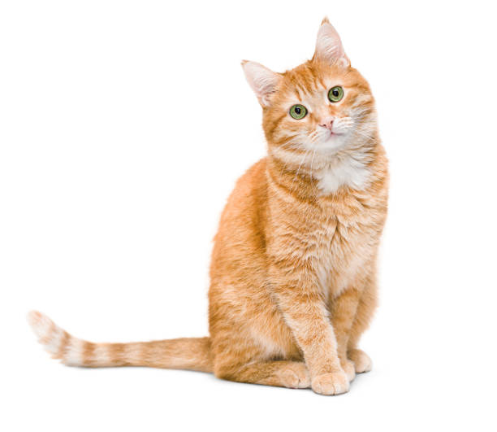
Why CNNs?

Slide 4
Convolution (intuition)
Apply a small kernel (filter) that slides over the image.
Each location computes a dot-product between kernel and image patch → one activation.
Resulting 2D map is called a feature map (activation map).
Kernel size typically 3×3 or 5×5. Depth = number of filters.

Slide 5
Convolution (math)
For 2D discrete signals (single channel):
(I * K)(i, j) = Σ_u Σ_v I(i+u, j+v) · K(u, v)
I = input image, K = kernel. Implementations handle kernel orientation.

Slide 6
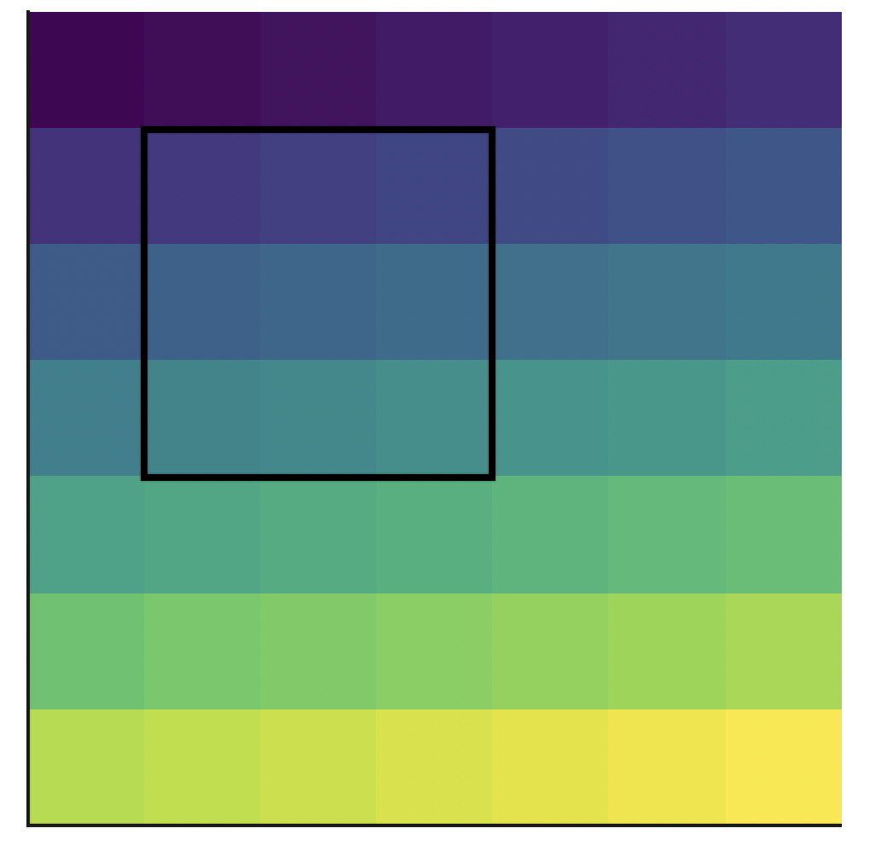
Convolution (math)

Slide 7
Convolution (math)

Slide 8
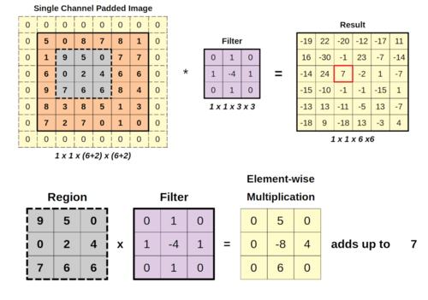
Convolution (math)

Slide 9
Padding & Stride
Padding
Padding: add border (usually zeros) so output size is controlled. 'valid' = no padding, 'same' = pad to keep same spatial dims (stride=1).
Stride
Stride: step size when sliding kernel. Larger stride → smaller output.
Output
Output spatial size (square input W, kernel k, padding p, stride s): out = floor((W - k + 2p)/s) + 1

Slide 10
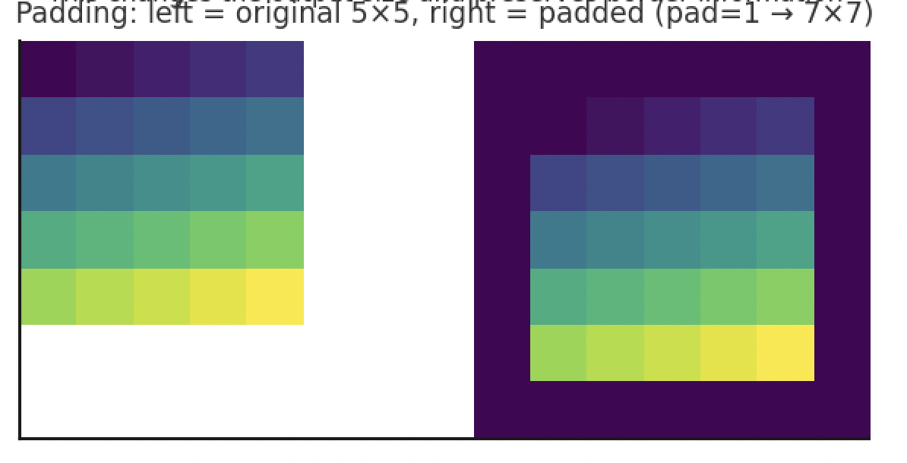
Padding & Stride

Slide 11
Multiple channels & filters
If input has C channels (e.g., RGB C=3), each filter has shape (k, k, C).
A layer with F filters produces F feature maps → output shape (H', W', F).
Parameter count per layer: F * (k*k*C) + F (biases).

Slide 12
Activation & Non-linearity
Typical: ReLU after convolution: ReLU(conv(x)).
BatchNorm often used to stabilise and speed training.

Slide 13
Pooling
Downsamples spatial dimensions: MaxPooling, AveragePooling.
Reduces computation and increases receptive field.
Typical pool size: 2×2 with stride 2.

Slide 14
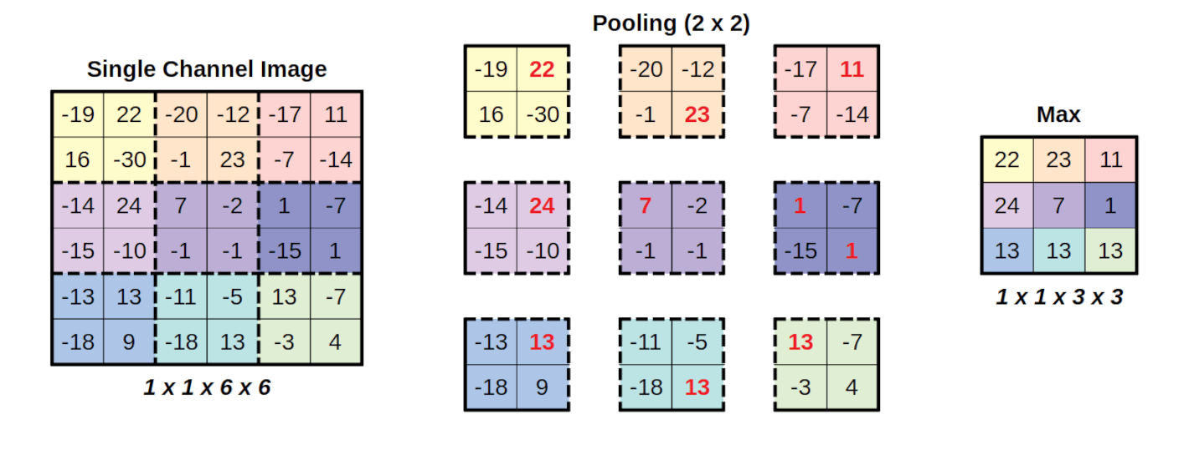
Pooling

Slide 15
Typical small CNN architecture
Input → [Conv(3×3, 32) → ReLU] → [Conv(3×3, 64) → ReLU] → MaxPool(2×2)
→ Flatten → Dense(128) → Dropout → Softmax

Slide 16
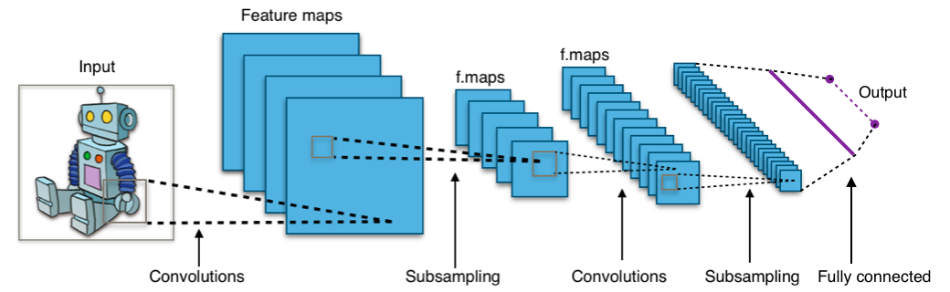
Typical small CNN architecture

Slide 17
Modern patterns
Residual connections (ResNet) allow much deeper nets.
Transfer learning: reuse pretrained conv backbones.

Slide 18
Training tips
Normalize inputs (rescale to [0,1] or mean-zero).
Use data augmentation (flips, shifts, rotations).
Start with Adam optimizer & LR ≈ 1e-3.
Monitor validation loss & use early stopping.
Labs

Slide 19
Common mistakes
Forgetting to add channel dimension for grayscale images (shape mismatch).
Using too-large fully connected layers early (huge params).
Not shuffling data, leaking test set into training.
Labs

Slide 20
Demo: tiny CNN in Keras (MNIST)
# tiny_cnn_mnist.py import tensorflow as tf from tensorflow.keras import layers, models from tensorflow.keras.utils import to_categorical # Load data (x_train, y_train), (x_test, y_test) = tf.keras.datasets.mnist.load_data() # Preprocess: reshape, scale, one-hot x_train = x_train.astype('float32') / 255.0 x_test = x_test.astype('float32') / 255.0 # add channel dimension (MNIST is grayscale) x_train = x_train[..., None] # shape (N, 28, 28, 1) x_test = x_test[..., None] y_train = to_categorical(y_train, 10) y_test = to_categorical(y_test, 10) # Build model model = models.Sequential([ layers.Input(shape=(28,28,1)), layers.Conv2D(32, (3,3), activation='relu', padding='same'), layers.MaxPooling2D((2,2)), layers.Conv2D(64, (3,3), activation='relu', padding='same'), layers.MaxPooling2D((2,2)), layers.Flatten(), layers.Dense(128, activation='relu'), layers.Dropout(0.5), layers.Dense(10, activation='softmax') ]) model.compile(optimizer='adam', loss='categorical_crossentropy', metrics=['accuracy']) model.fit(x_train, y_train, epochs=5, batch_size=128, validation_split=0.1) loss, acc = model.evaluate(x_test, y_test) print(f'Test accuracy: {acc:.4f}')

Slide 21
Code and live hands-on
https://github.com/neelsoumya/teaching_neural_networks/blob/main/cnn_simple.py

Slide 22
Exercises for students
Add data augmentation.
Replace Flatten + Dense with GlobalAveragePooling2D + Dense: compare parameters and architectures.
How to pick these hyperparameters?

Slide 23
Further reading & resources
https://www.statlearning.com/
Keras documentation: layers.Conv2D, layers.MaxPooling2D.
https://keras.io/

Slide 24
Resources
https://github.com/neelsoumya/teaching_neural_networks/blob/main/cnn_simple.py
https://github.com/neelsoumya/teaching_neural_networks

