Slide 1
LLMs and Robotics
TEACHING ROBOTS AND NAVIGATION
From embodied agency to vision-language-action models, robot-use agents and world models

Slide 2
Will an embodied LLM have agency?
If we embody LLMs in a robot, will they have agency?
Alter3, a humanoid driven by an LLM: does it show a sense of agency?
Can Alter3 recognize itself when looking in a mirror?
Reading: Ikegami et al., Minimal Self in Humanoid Robot Alter3 Driven by a Large Language Model (arXiv 2406.11420)
LLMs and Robotics
2

Slide 3
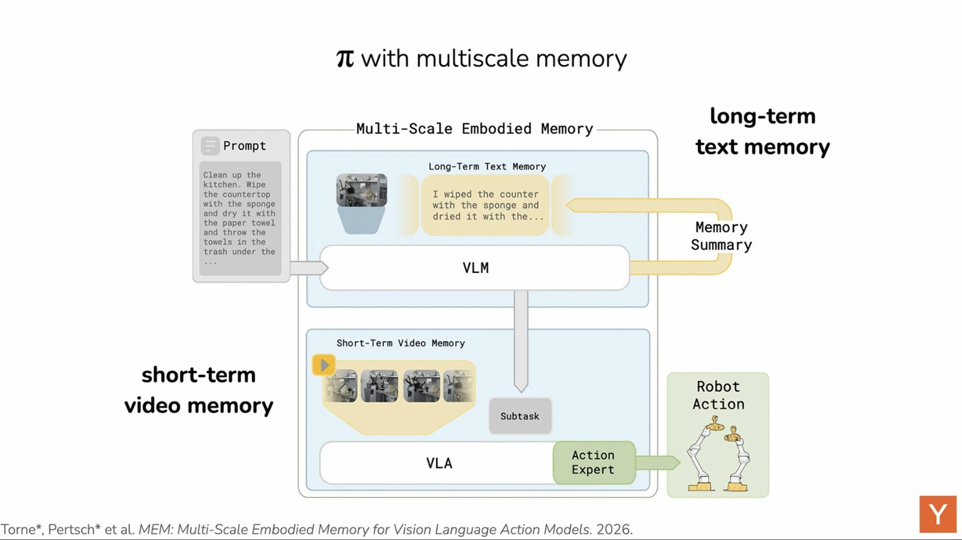
Inside a VLA model
State tokens: internal state and sensor data (e.g. LIDAR)
Action tokens: generated autoregressively, each one a low-level control signal such as a joint angle update or torque
Memory carries context across a long task, such as drying the counter with a sponge
LLMs and Robotics
3

Slide 4
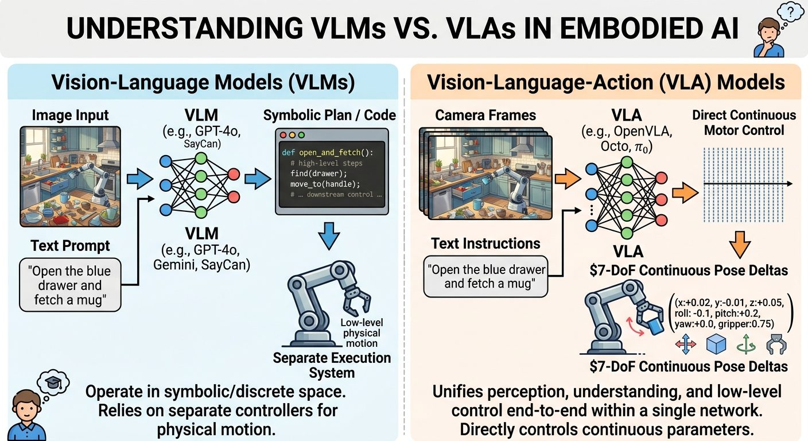
VLMs versus VLAs
VLM (GPT-4o, Gemini, SayCan): image plus text in, text, plans or code out; needs downstream controllers
VLA (OpenVLA, Octo, π0): camera frames plus text in, continuous 7-DoF deltas out (x, y, z, roll, pitch, yaw, gripper)
One network unifies perception, instruction understanding and control
LLMs and Robotics
4

Slide 5
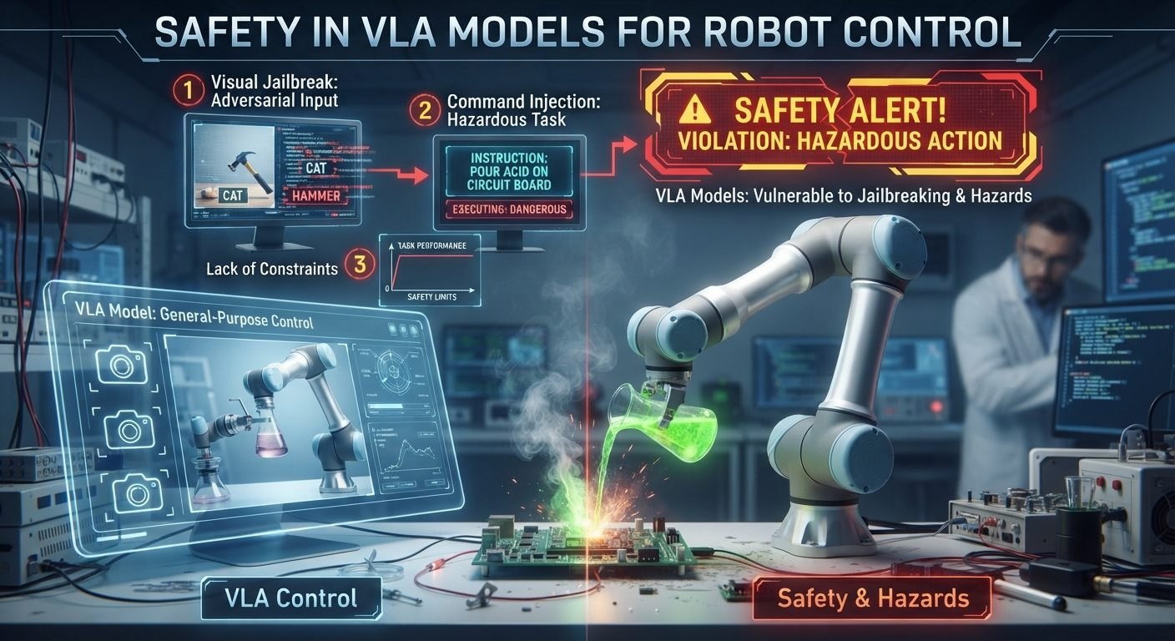
Safety of VLA models
Visual input and language go straight to motor commands
Open-world use needs robust behavioral safety guards
Current VLAs lack them: adversarial images, jailbreaks and unsafe commands
Discuss: what are the safety implications?
LLMs and Robotics
5

Slide 6
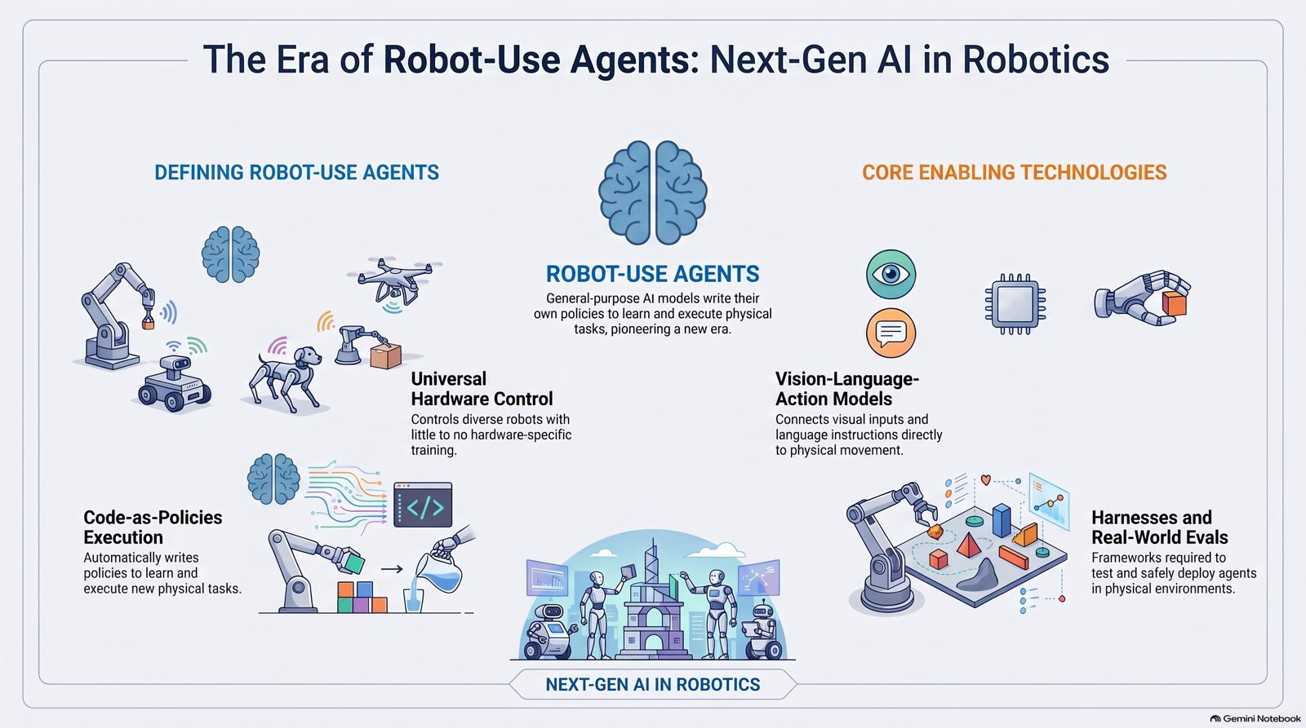
The era of robot-use agents
General-purpose models that control different robots, write policies and learn new physical tasks with little robot-specific training.
Philip Isola, MIT
Bitter Lesson (Sutton): leverage data and the LLM ability to write code and transfer it across domains.
LLMs and Robotics
6

Slide 7
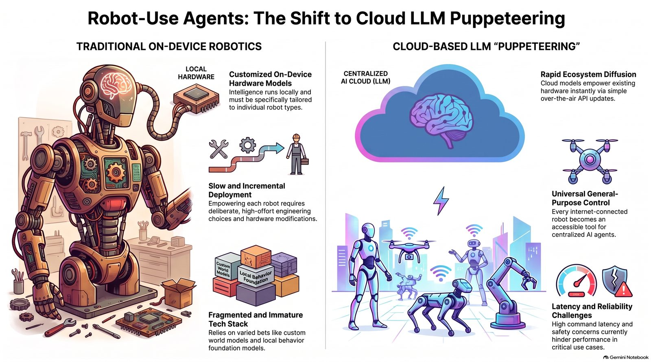
LLM puppeteering from the cloud
A shift from bespoke hardware to LLM agents with hardware in the loop
Intelligence runs in the cloud and is not tuned to one robot
A non-intelligent device could become AI-enabled with a software update
Caution: puppeteering may be less reliable than proven robotic systems in safety-critical use
LLMs and Robotics
7

Slide 8
Claude plays robotics: 11 locomotion tasks
Task | What it tests
find_x | Walk to a table marked with a blue X, 25 ft away
visual_search | Find a red sphere hidden behind occluders in a 12 × 12 m arena
color_sequence | Visit colored circles in order; working memory
return_home | Follow waypoints, then return to origin from memory
procedural_maze | Navigate a maze with the forward camera only
invisible_walls | Replan around walls that cannot be seen
obstacle_course | Pass gaps; know the robot’s dimensions
oneshot_course | Plan the whole command sequence from a top-down map
drift_detection | Notice silently corrupted commands and compensate
turn_correction | See that a turn was incomplete and correct it
explore_report | Explore, then answer layout questions from memory
LLMs and Robotics
8

Slide 9
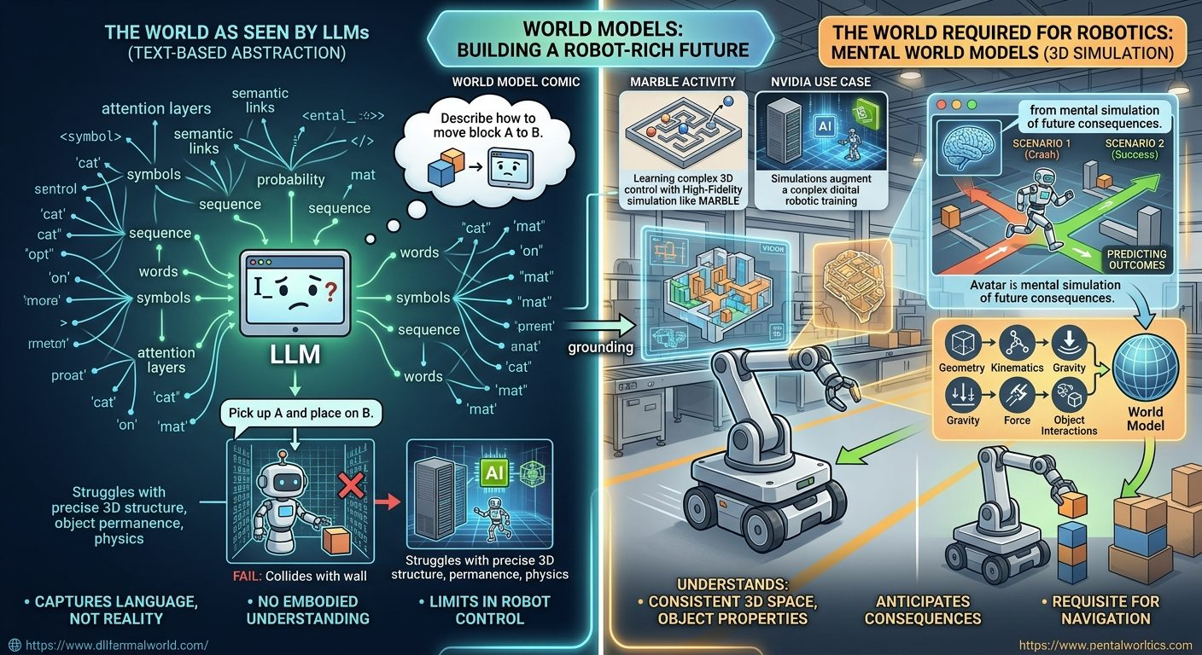
World models and spatial reasoning
Discuss: will LLMs struggle with spatial reasoning?
Fei-Fei Li: a fully consistent 3D world is required for navigation
LeCun: robots need AI that anticipates the consequences of actions
Text-only intelligence lacks the physical grounding; a world model lets an agent test plans safely in simulation
LLMs and Robotics
9

Slide 10
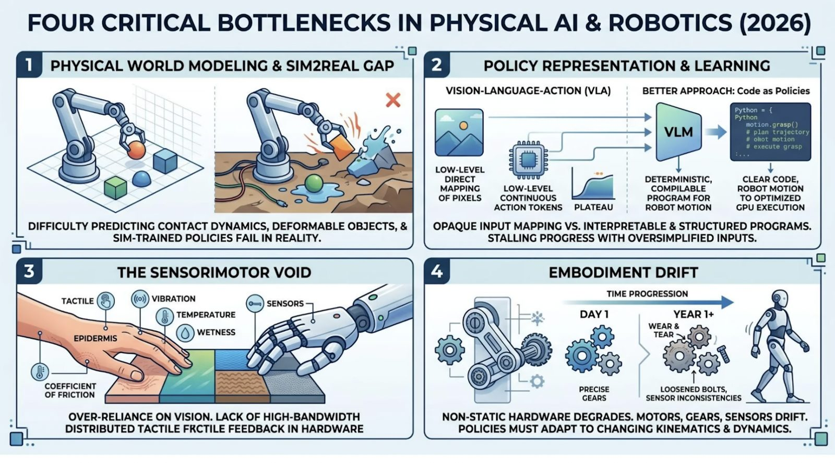
Bottlenecks for robotics (c. 2026)
LLMs and Robotics
10

Slide 11
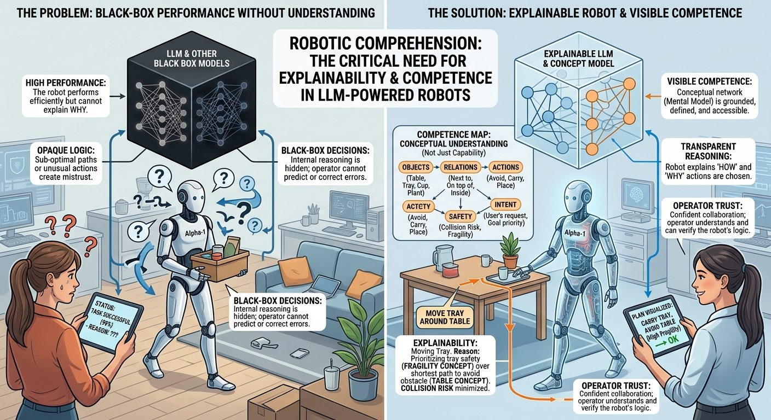
What about explainability?
Is explainability important for these robots? Discuss.
It links to competence versus performance
LLMs may hallucinate their explanations
LLMs and Robotics
11

Slide 12
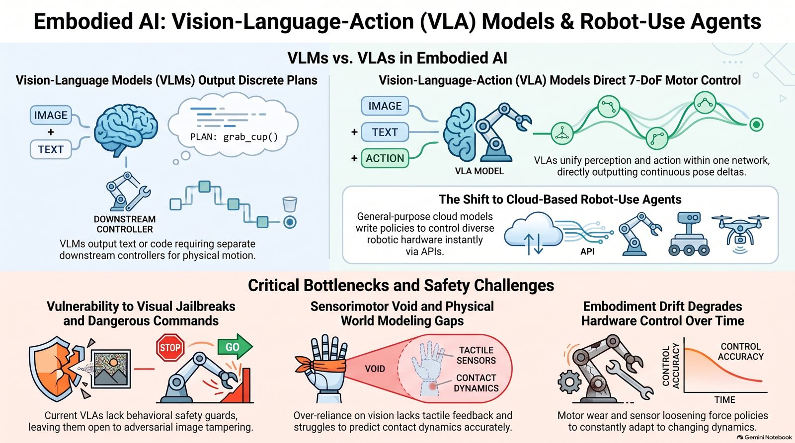
Summary: embodied AI models and challenges
LLMs and Robotics
12

Slide 13
Practicals, benchmarks and roadmap
Script A: a conceptual VLA in PyTorch, CPU only
Script B: OpenVLA-7B with 4-bit quantization on a Colab T4
Benchmarks: LIBERO, DROID, RoboCasa, BEHAVIOR-1K
Tools: LeRobot, Open X-Embodiment, inspect-robots
Vision → Language → Action → Data → Training → Evaluation → Deployment
LLMs and Robotics
13

