Slide 1
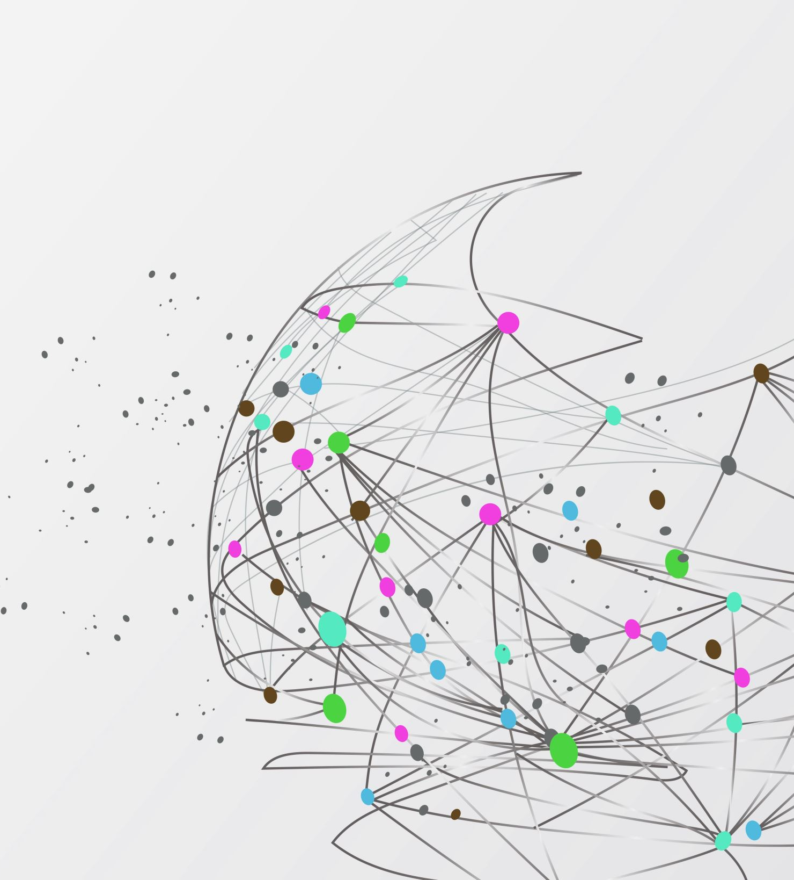
Supervisions

Slide 2
CNN

Slide 3


