Slide 1
Visualization Cheatsheet — Chart Types
Soumya Banerjee

Slide 2
Overview
Roles visualization plays: change over time, part–to–whole, distributions, group comparisons, relationships, geographic
Choose chart by task and variable types (quantitative, categorical, temporal, geographic)
Keep audience and perceptual encodings in mind (position > length > angle > area > color)

Slide 3
Quick reference — when to use
Line: trends over time (continuous)
Bar: compare categories; Grouped/Stacked for subgroups/composition
Histogram/Density: numeric distribution
Box/Violin: compare distributions across groups
Scatter/Heatmap: relationships; Choropleth: geographic

Slide 4
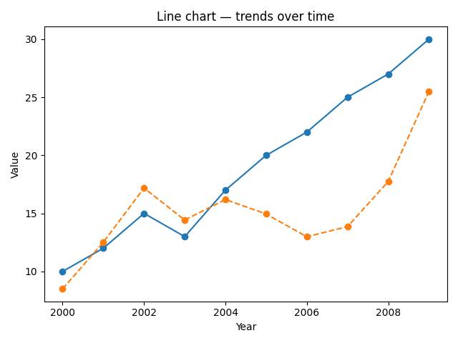
Example — Line chart
Use line charts for continuous trends and seasonality. Keep series count low; consider small multiples.

Slide 5
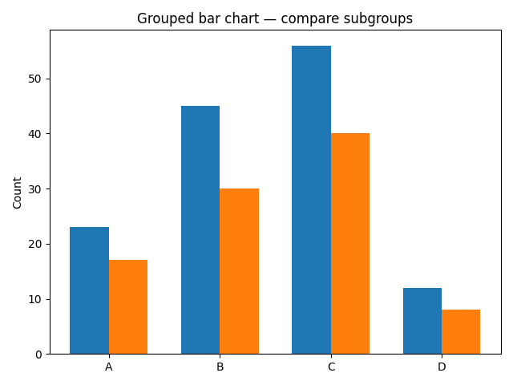
Example — Grouped bar chart
Grouped bars compare subgroups. Use stacked bars to show composition when appropriate.

Slide 6
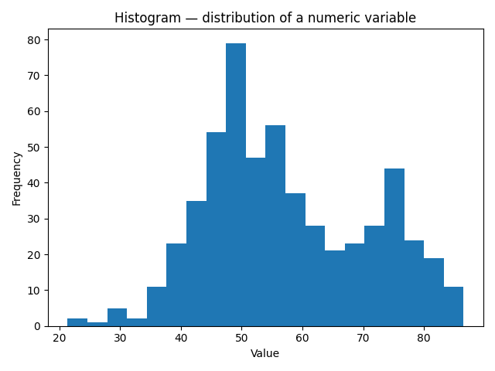
Example — Histogram
Histograms show distribution shape; discuss bin width effects.

Slide 7
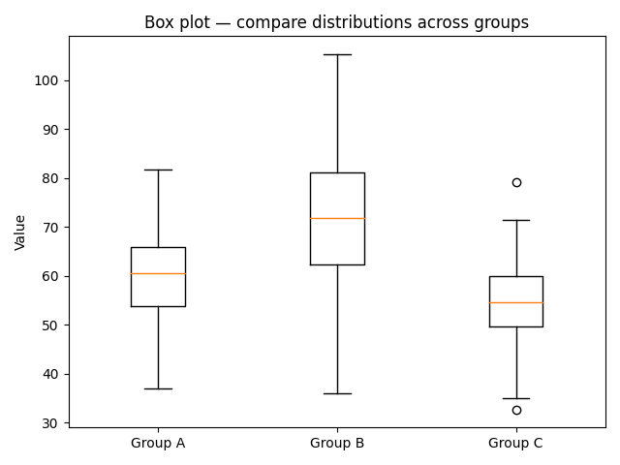
Example — Box plot
Box plots summarize center, spread, and outliers; good for comparisons.

Slide 8
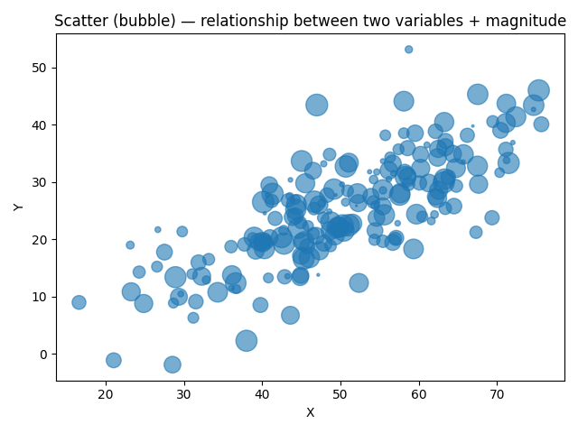
Example — Scatter (bubble)
Scatter plots show correlation and clusters; bubble encodes a third variable by area (use cautiously).

Slide 9
Best-practice checklist
Use the simplest chart that answers the question.
1
Label axes, include units, clear title and short caption.
2
Prefer position/length encodings; use color for grouping/annotation.
3
Limit series; use small multiples. Provide accessible color palettes.
4
Annotate key points; avoid unnecessary 3D effects.
5

Slide 10
Suggested classroom exercises
Pick the right chart: choose & justify for three analysis questions.
Tufte rework: simplify a messy dashboard (data-ink ratio critique).
Perception lab: bar vs pie vs donut — which yields most accurate estimates?
Small multiples: visualize many time series effectively.

Slide 11
References & further reading
Edward Tufte — The Visual Display of Quantitative Information (introduce key principles)
Color & accessibility guidelines (discuss colorblind palettes and contrast)

