Slide 1
The basics of unsupervised learning
Soumya banerjee

Slide 2

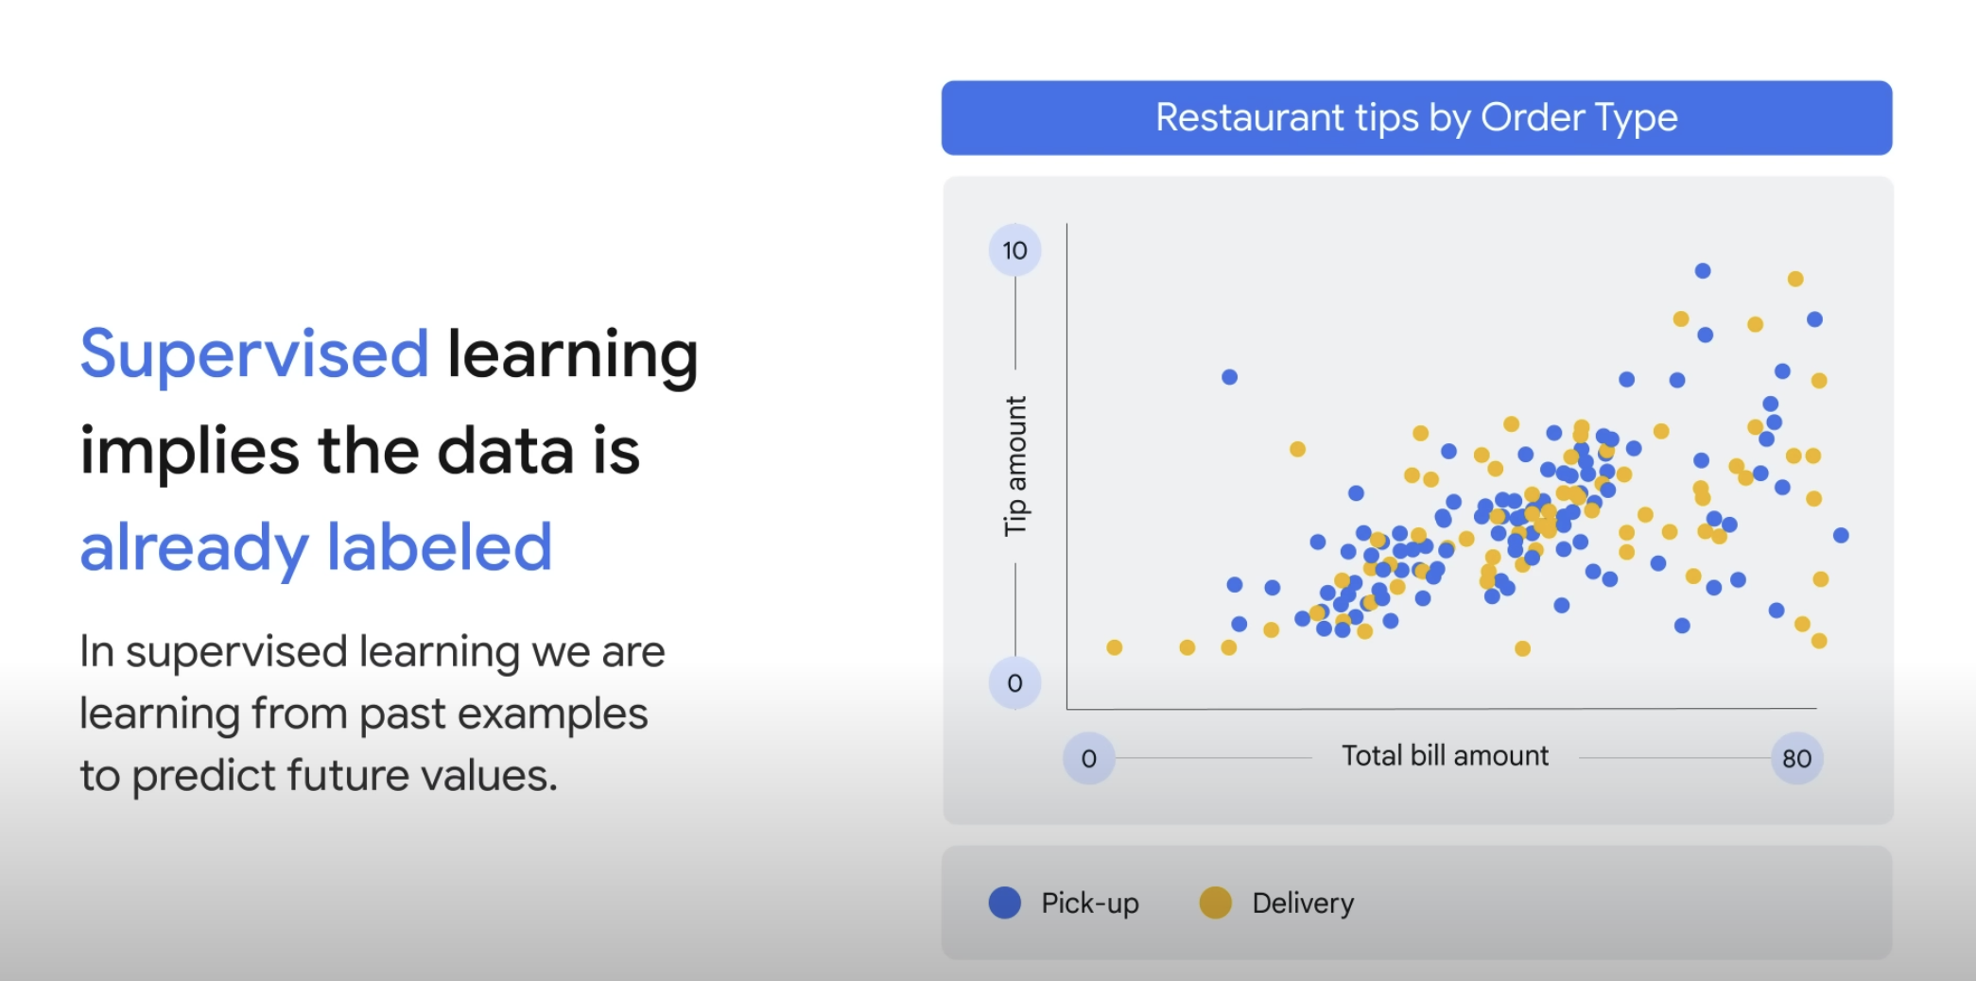

Slide 3
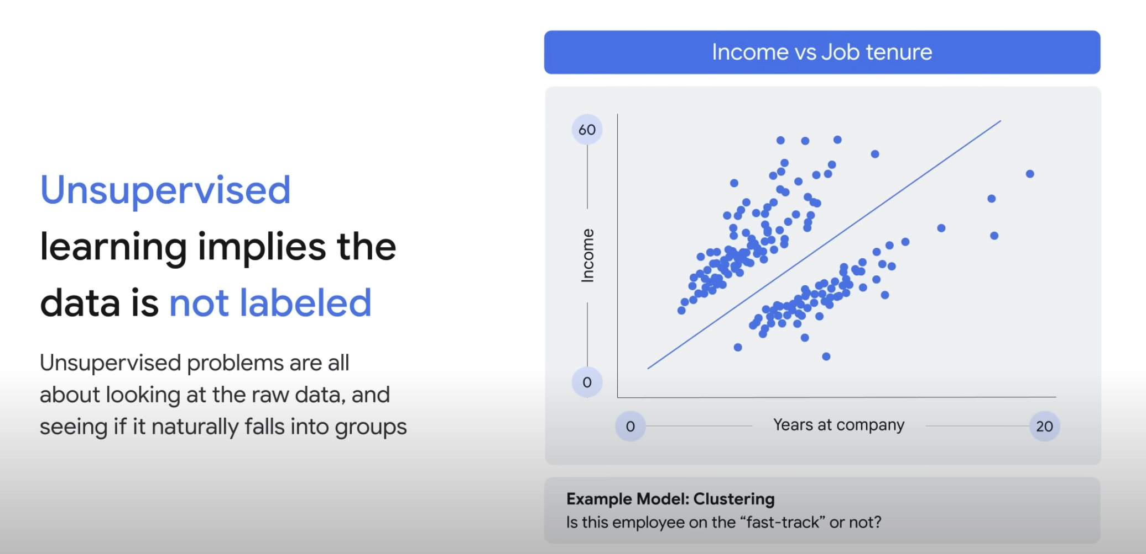

Slide 4
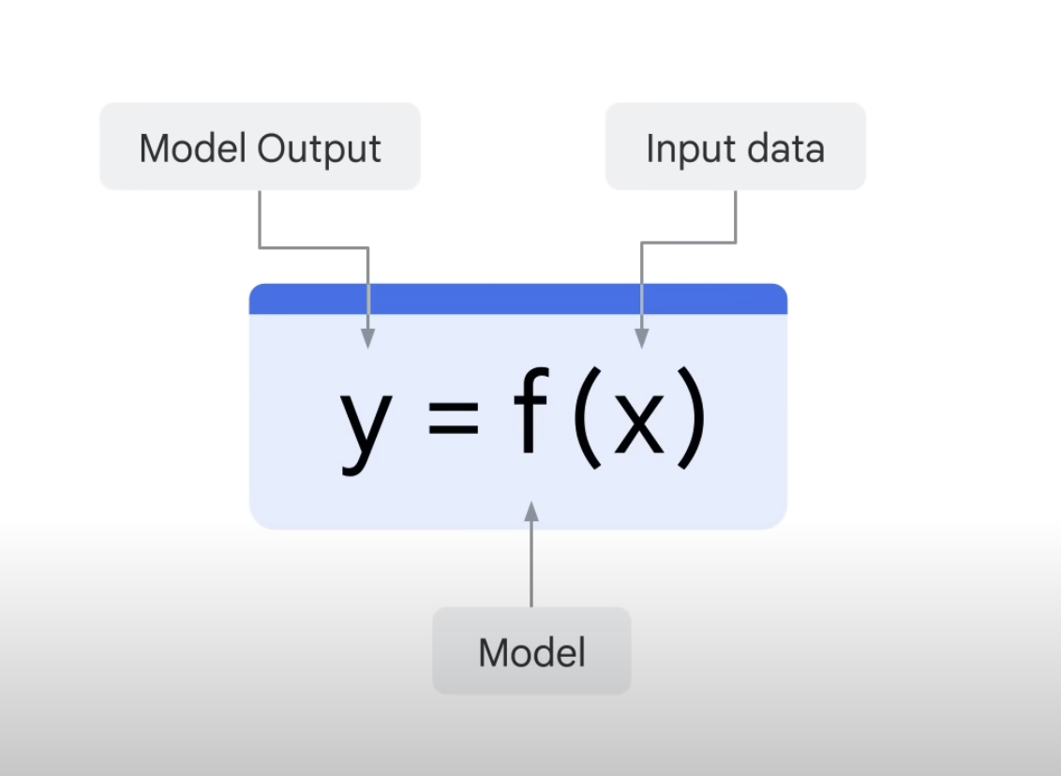

Slide 6
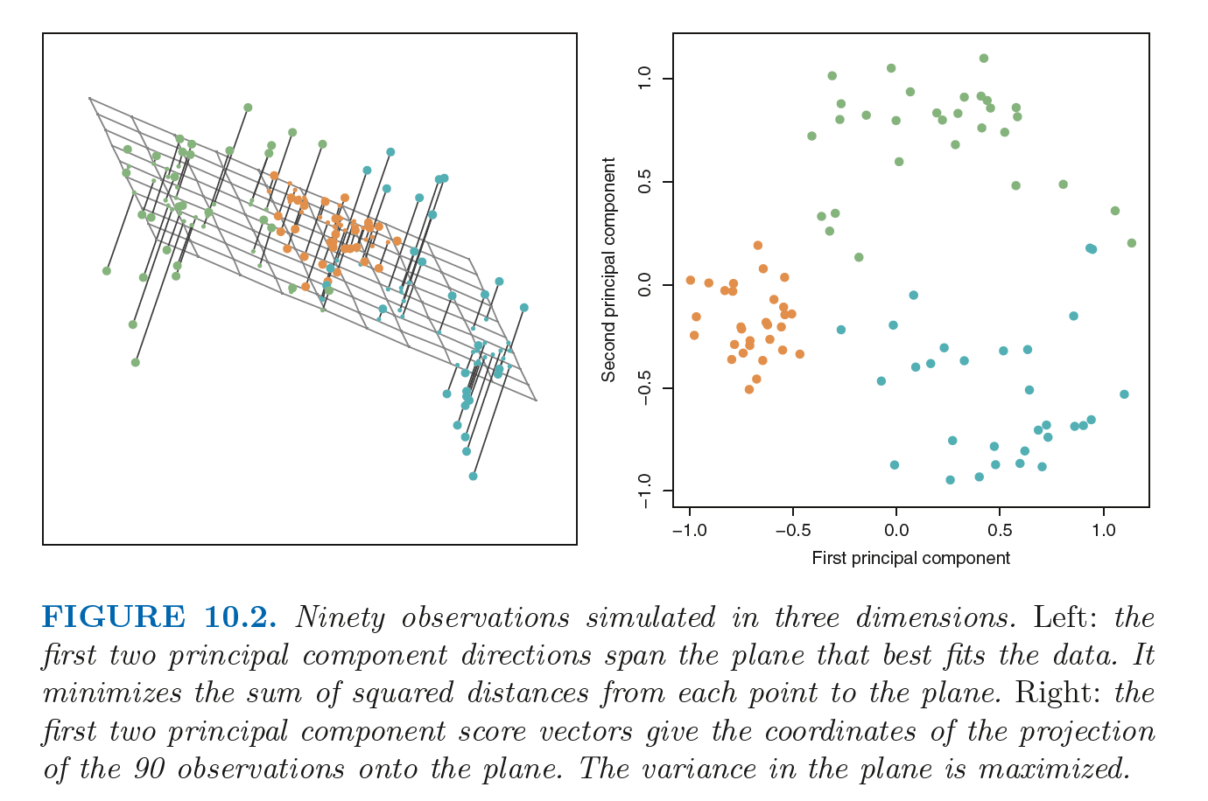

Slide 7


Slide 8
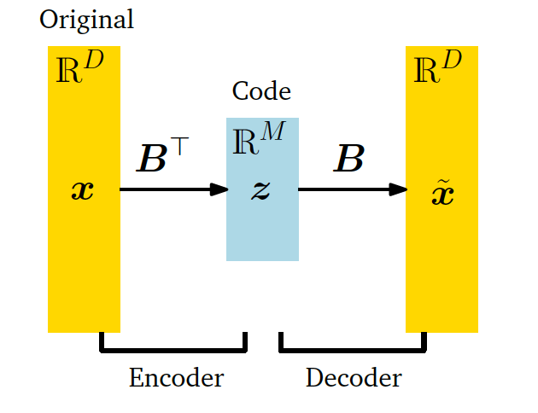

Slide 9
Finding structure in movie ratings, consumer behaviour, etc.

