Slide 1
The basics of unsupervised learning
Soumya banerjee

Slide 2

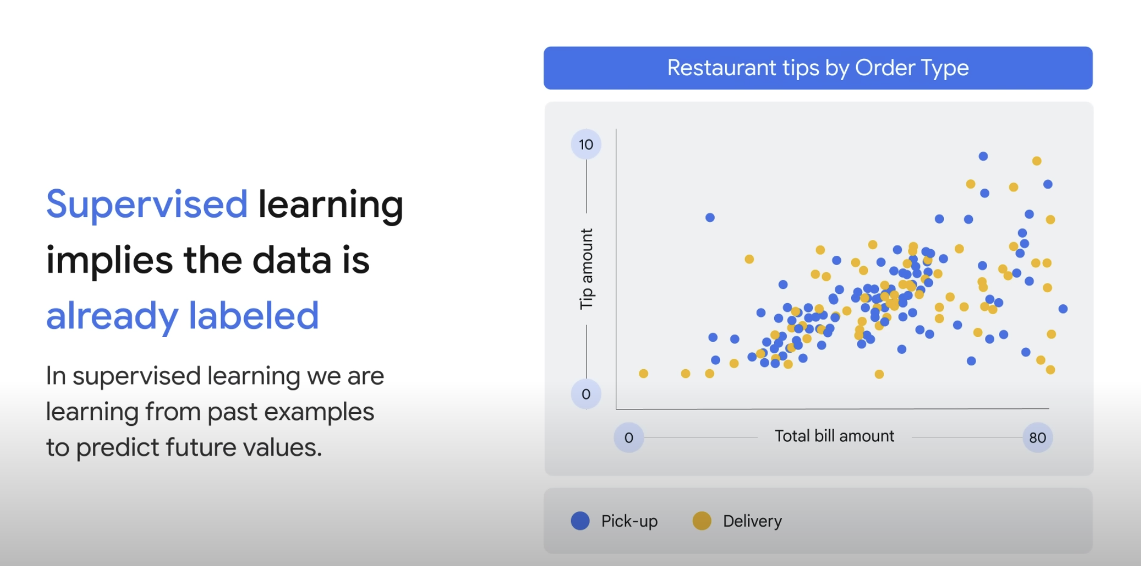
Supervised learning

Slide 3
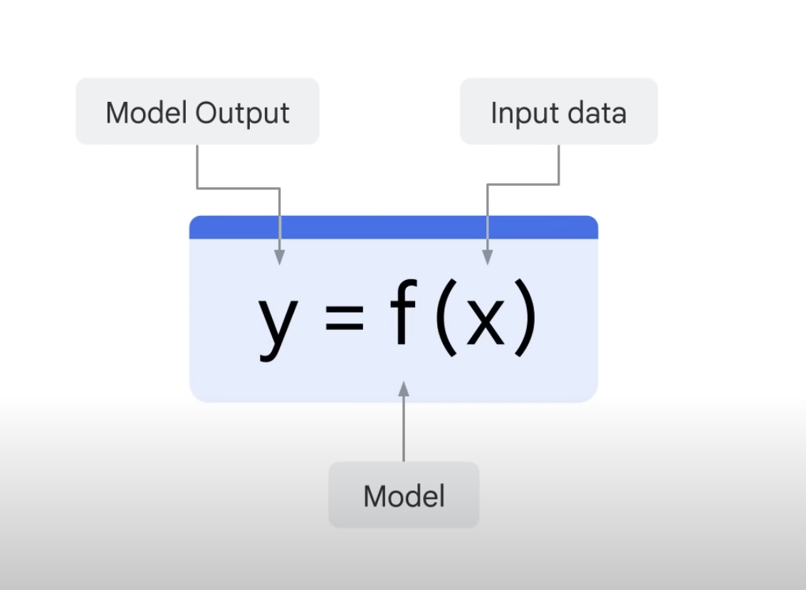
Supervised learning

Slide 4
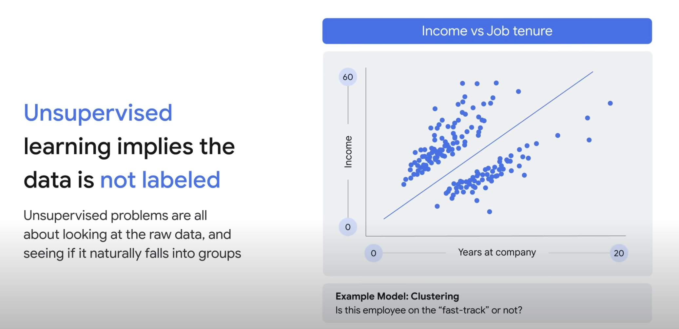
unSupervised learning

Slide 5
unSupervised learning

Slide 6
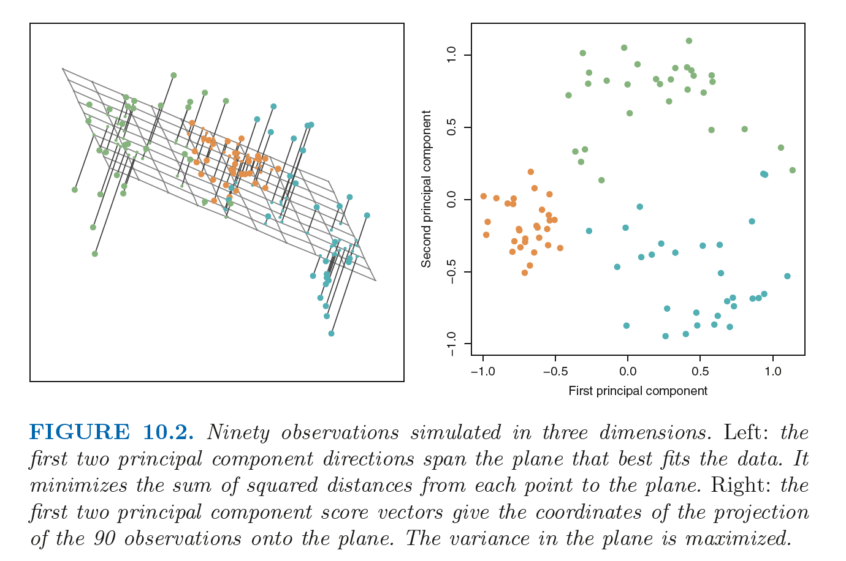
unSupervised learning

Slide 7

unSupervised learning

Slide 8
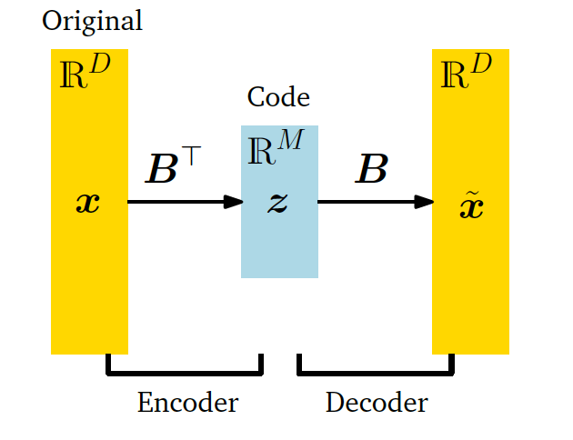
Important concept

Slide 9
Generalizations of this idea
Finding structure in movie ratings, consumer behaviour, etc.

Slide 10
assumptions
linear

Slide 11
extensions
tSNE, autoencoders, etc.

Slide 12
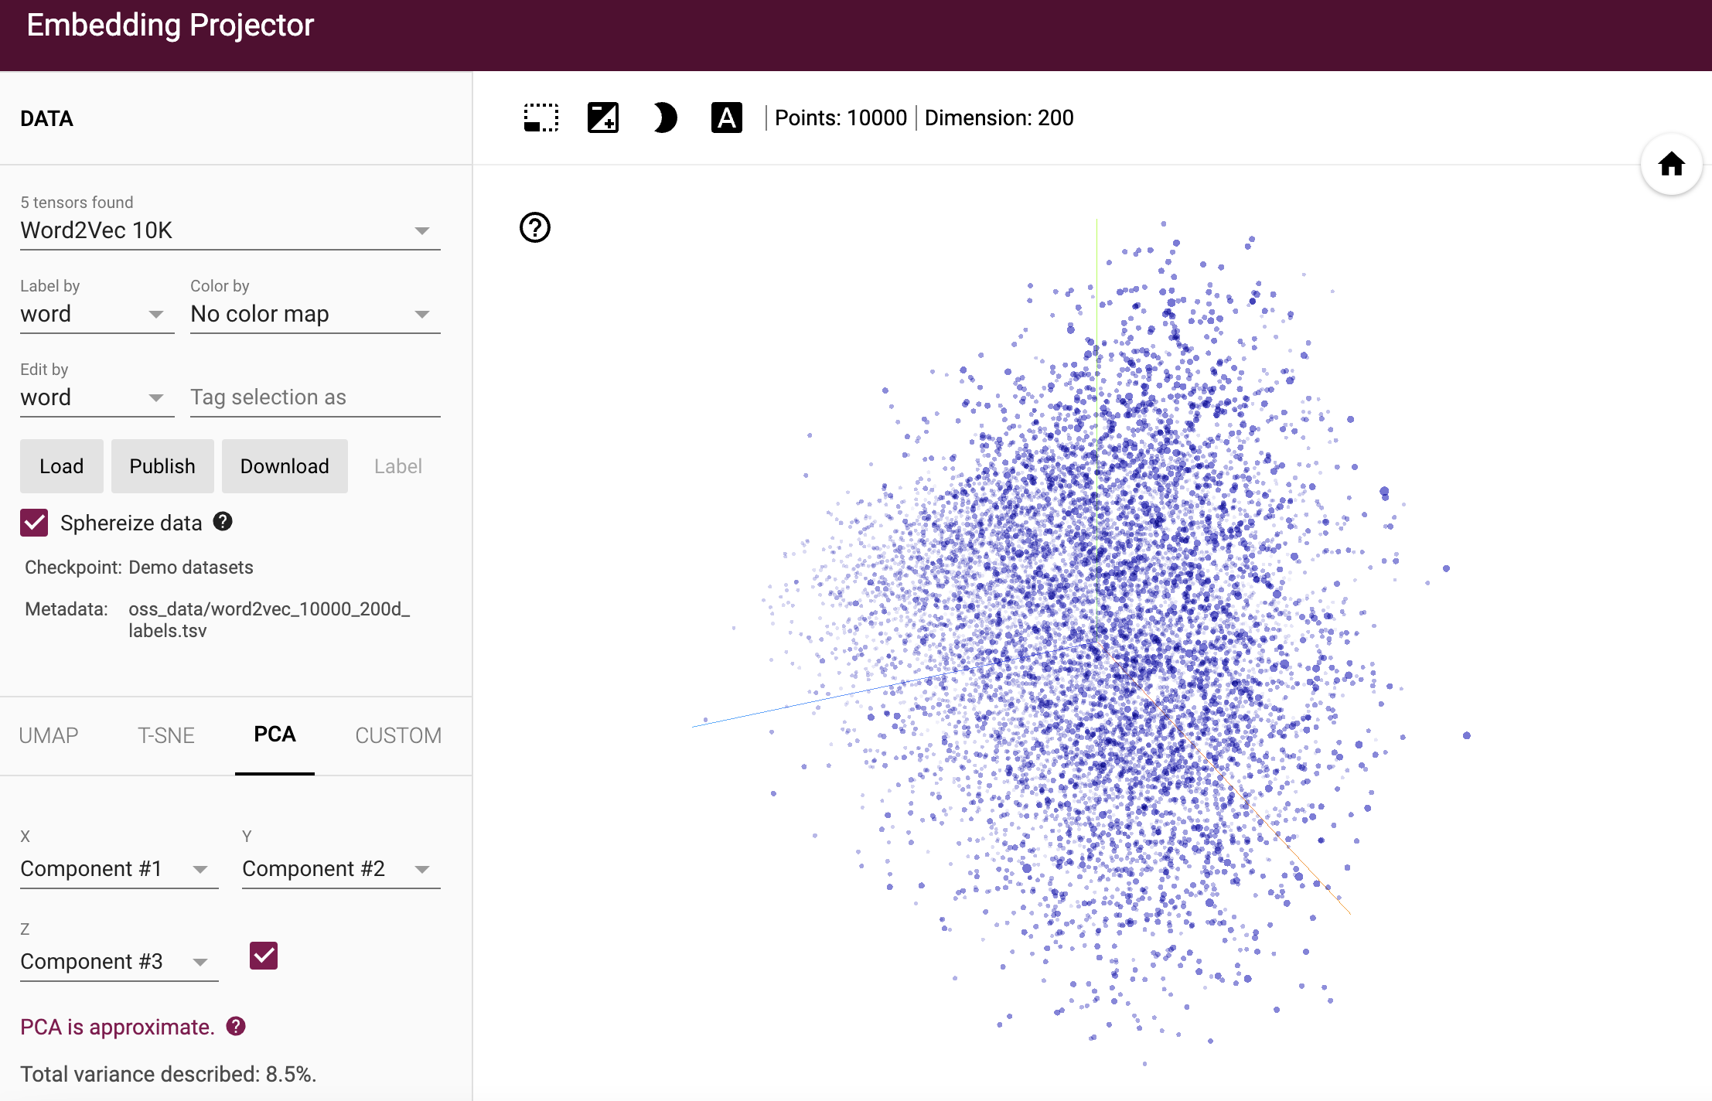
activities
http://projector.tensorflow.org/

Slide 13
material
https://github.com/neelsoumya/visualization_lecture
https://github.com/neelsoumya/visualization_lecture/blob/main/mathematics_data_science.pdf

