Slide 1
The basics of unsupervised learning
Soumya banerjee

Slide 2

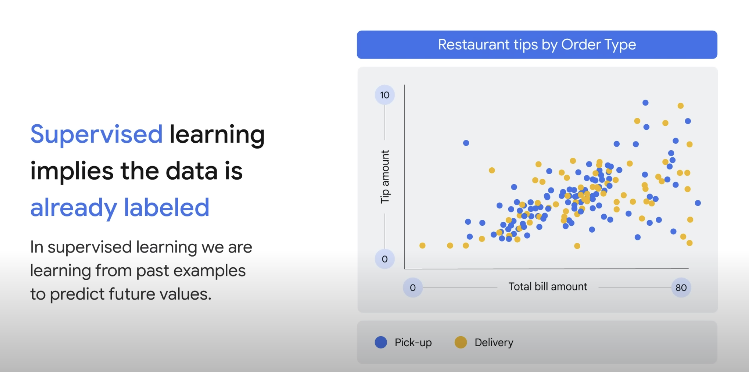

Slide 3
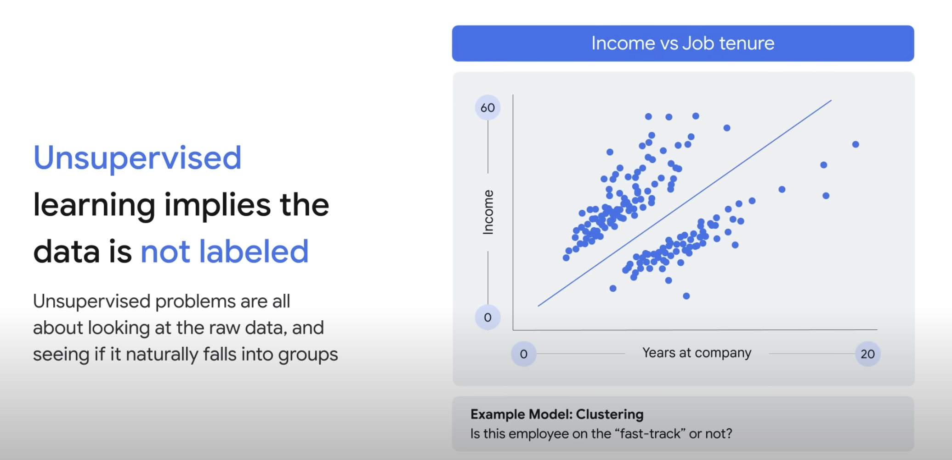

Slide 4
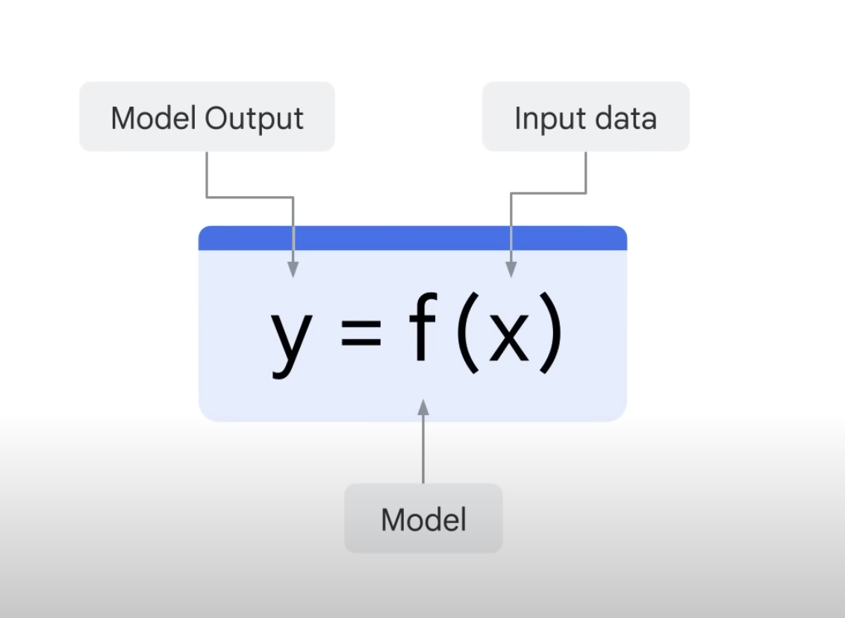

Slide 6
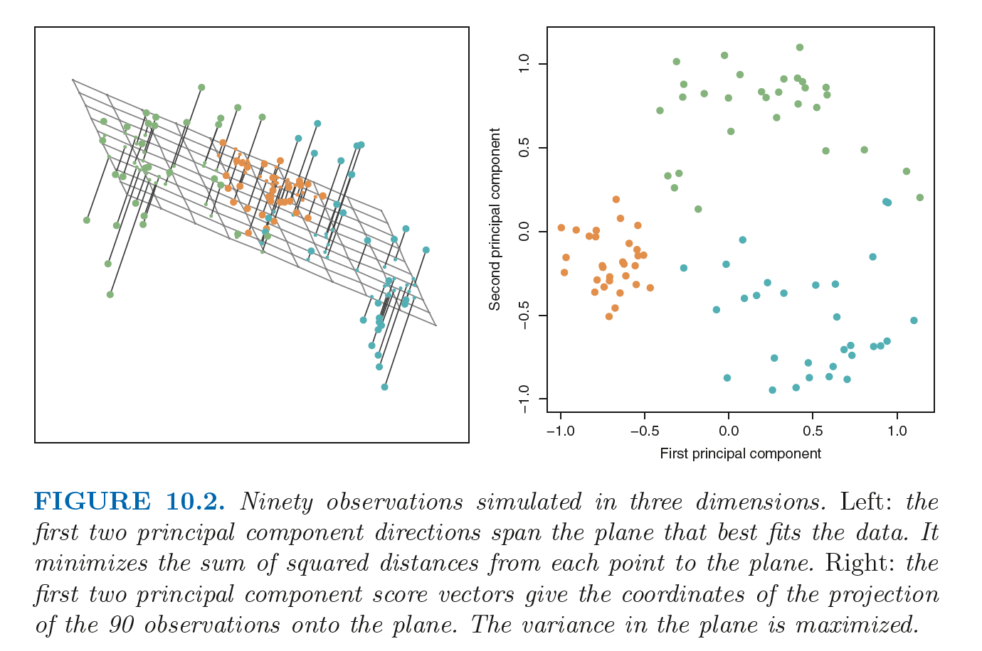

Slide 7


Slide 8
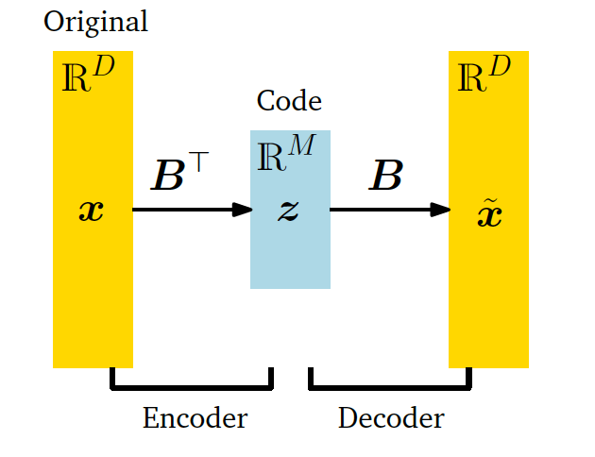

Slide 9
Finding structure in movie ratings, consumer behaviour, etc.

Slide 10
assumptions
linear

Slide 11
extensions
tSNE, autoencoders, etc.

Slide 12
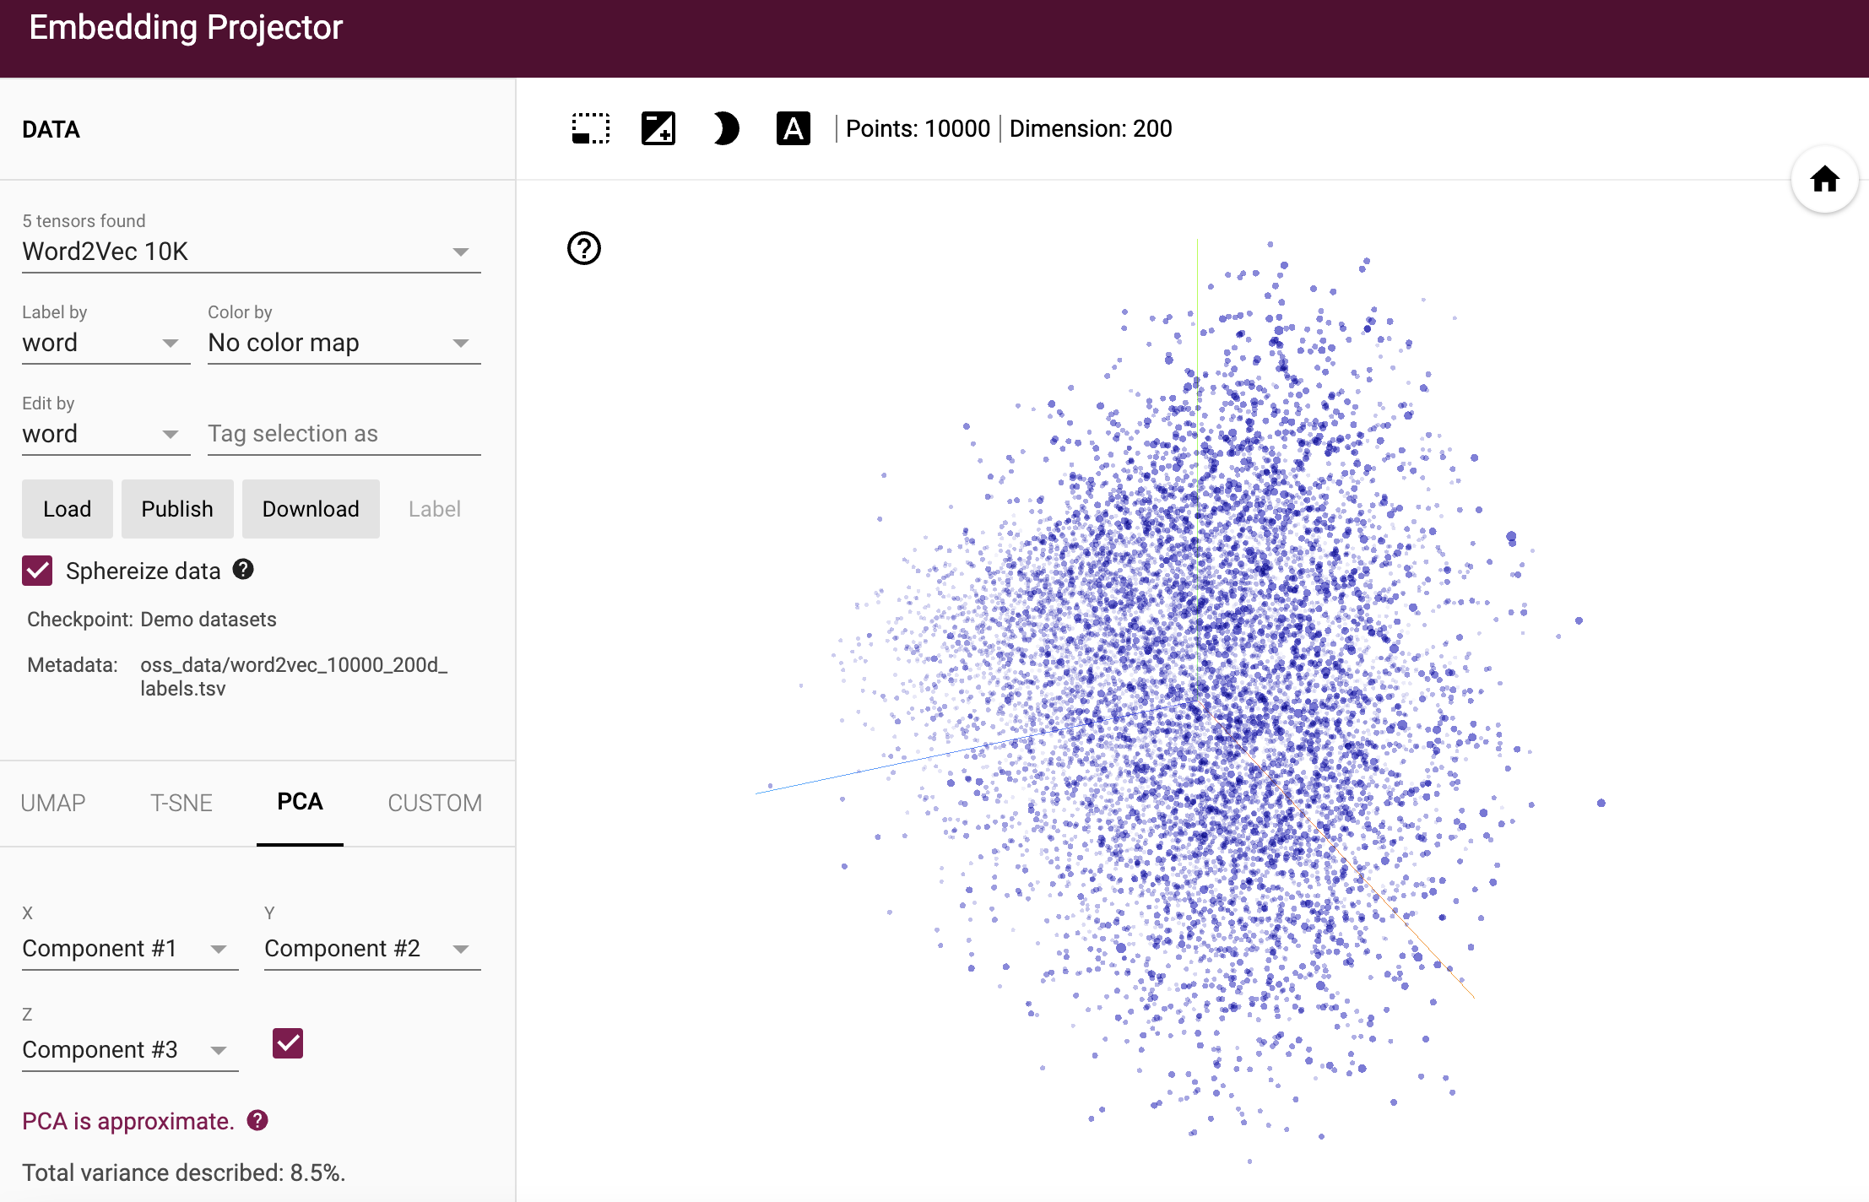
activities
http://projector.tensorflow.org/

Slide 13
activities
browser

Slide 14
https://github.com/neelsoumya/visualization_lecture
https://github.com/neelsoumya/visualization_lecture/blob/main/mathematics_data_science.pdf

