Slide 1
The basics of unsupervised learning
Soumya banerjee

Slide 2

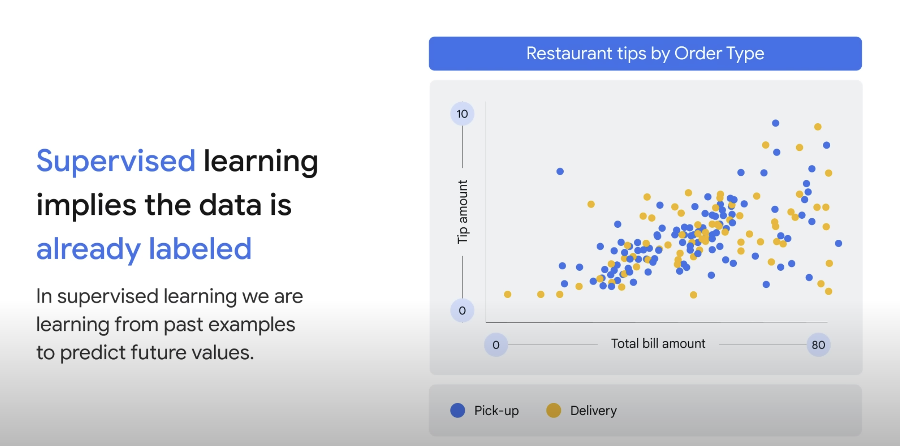
Supervised learning

Slide 3
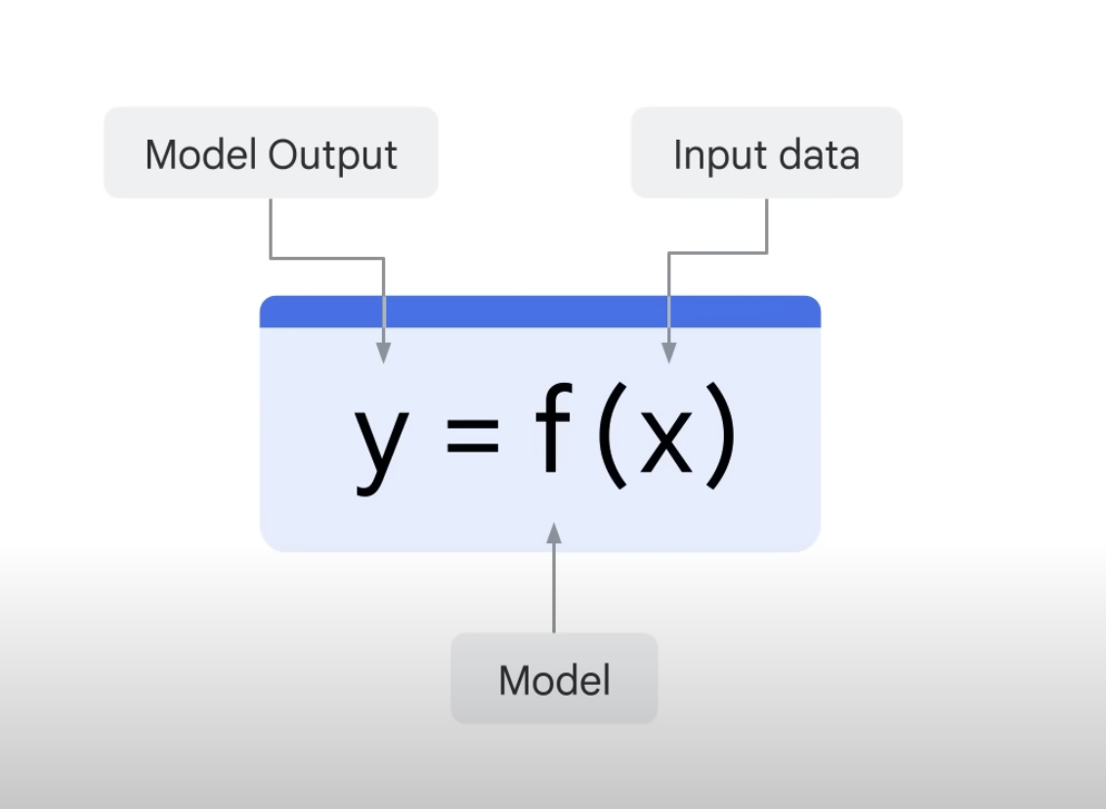
Supervised learning

Slide 4
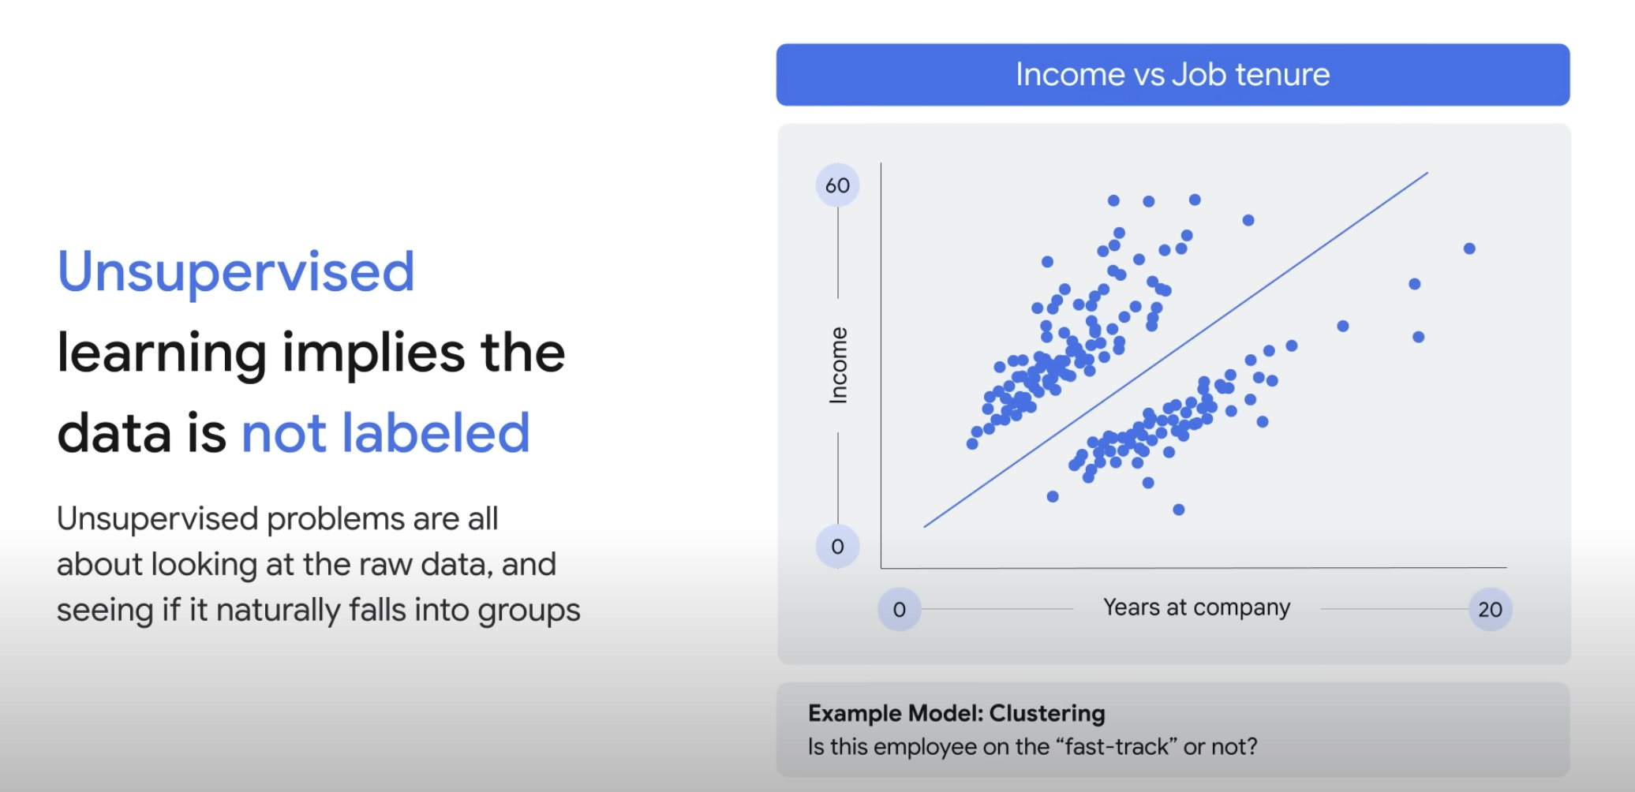
unSupervised learning

Slide 5
unSupervised learning

Slide 6
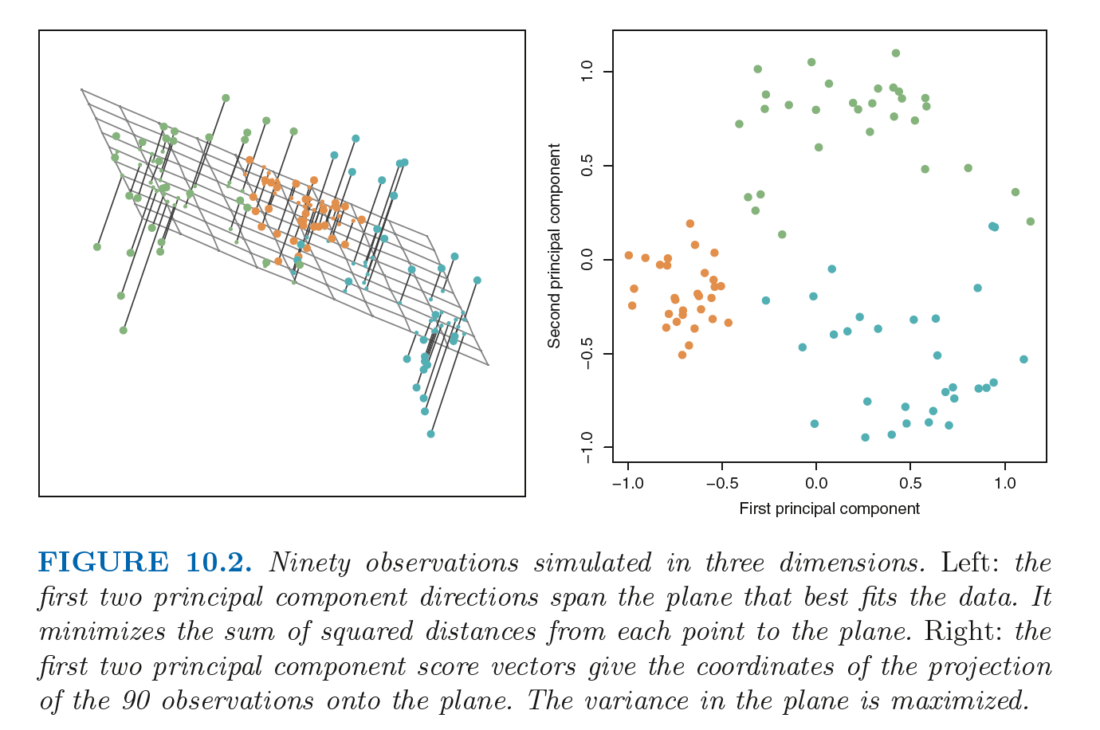
unSupervised learning

Slide 7

unSupervised learning

Slide 8
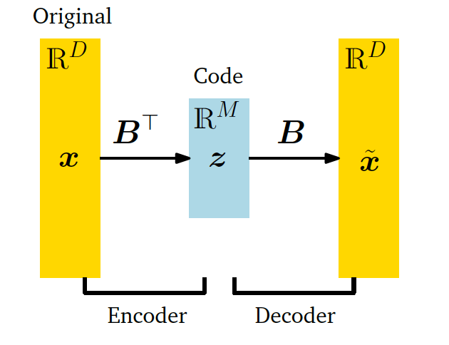
Important concept
Information bottleneck

Slide 9
applications of this idea
Finding structure in movie ratings
Patterns in consumer behaviour
Stratifying patients
Notes:
Segue into SVD, movie recommendation, low rank approximation
https://www.google.com/search?sca_esv=567212709&sxsrf=AM9HkKmE-kwKrMhveThIVW6Y-juk-QAoNg:1695290052959&q=movie+recommendations+svd&tbm=isch&source=lnms&sa=X&ved=2ahUKEwjMhpfLt7uBAxU7UUEAHQVuDY4Q0pQJegQIDRAB&biw=1292&bih=670&dpr=2.2#imgrc=U1BqzLZvwC9O3M

Slide 10
assumptions
Linearity (linear relationship between data points and lower dimensional representation)
Loss function/reconstruction error (squared loss)
Uses the dot product (one type of inner product)

Slide 11
generalizations of this idea
tSNE
Autoencoder (non-linear loss function)

Slide 12
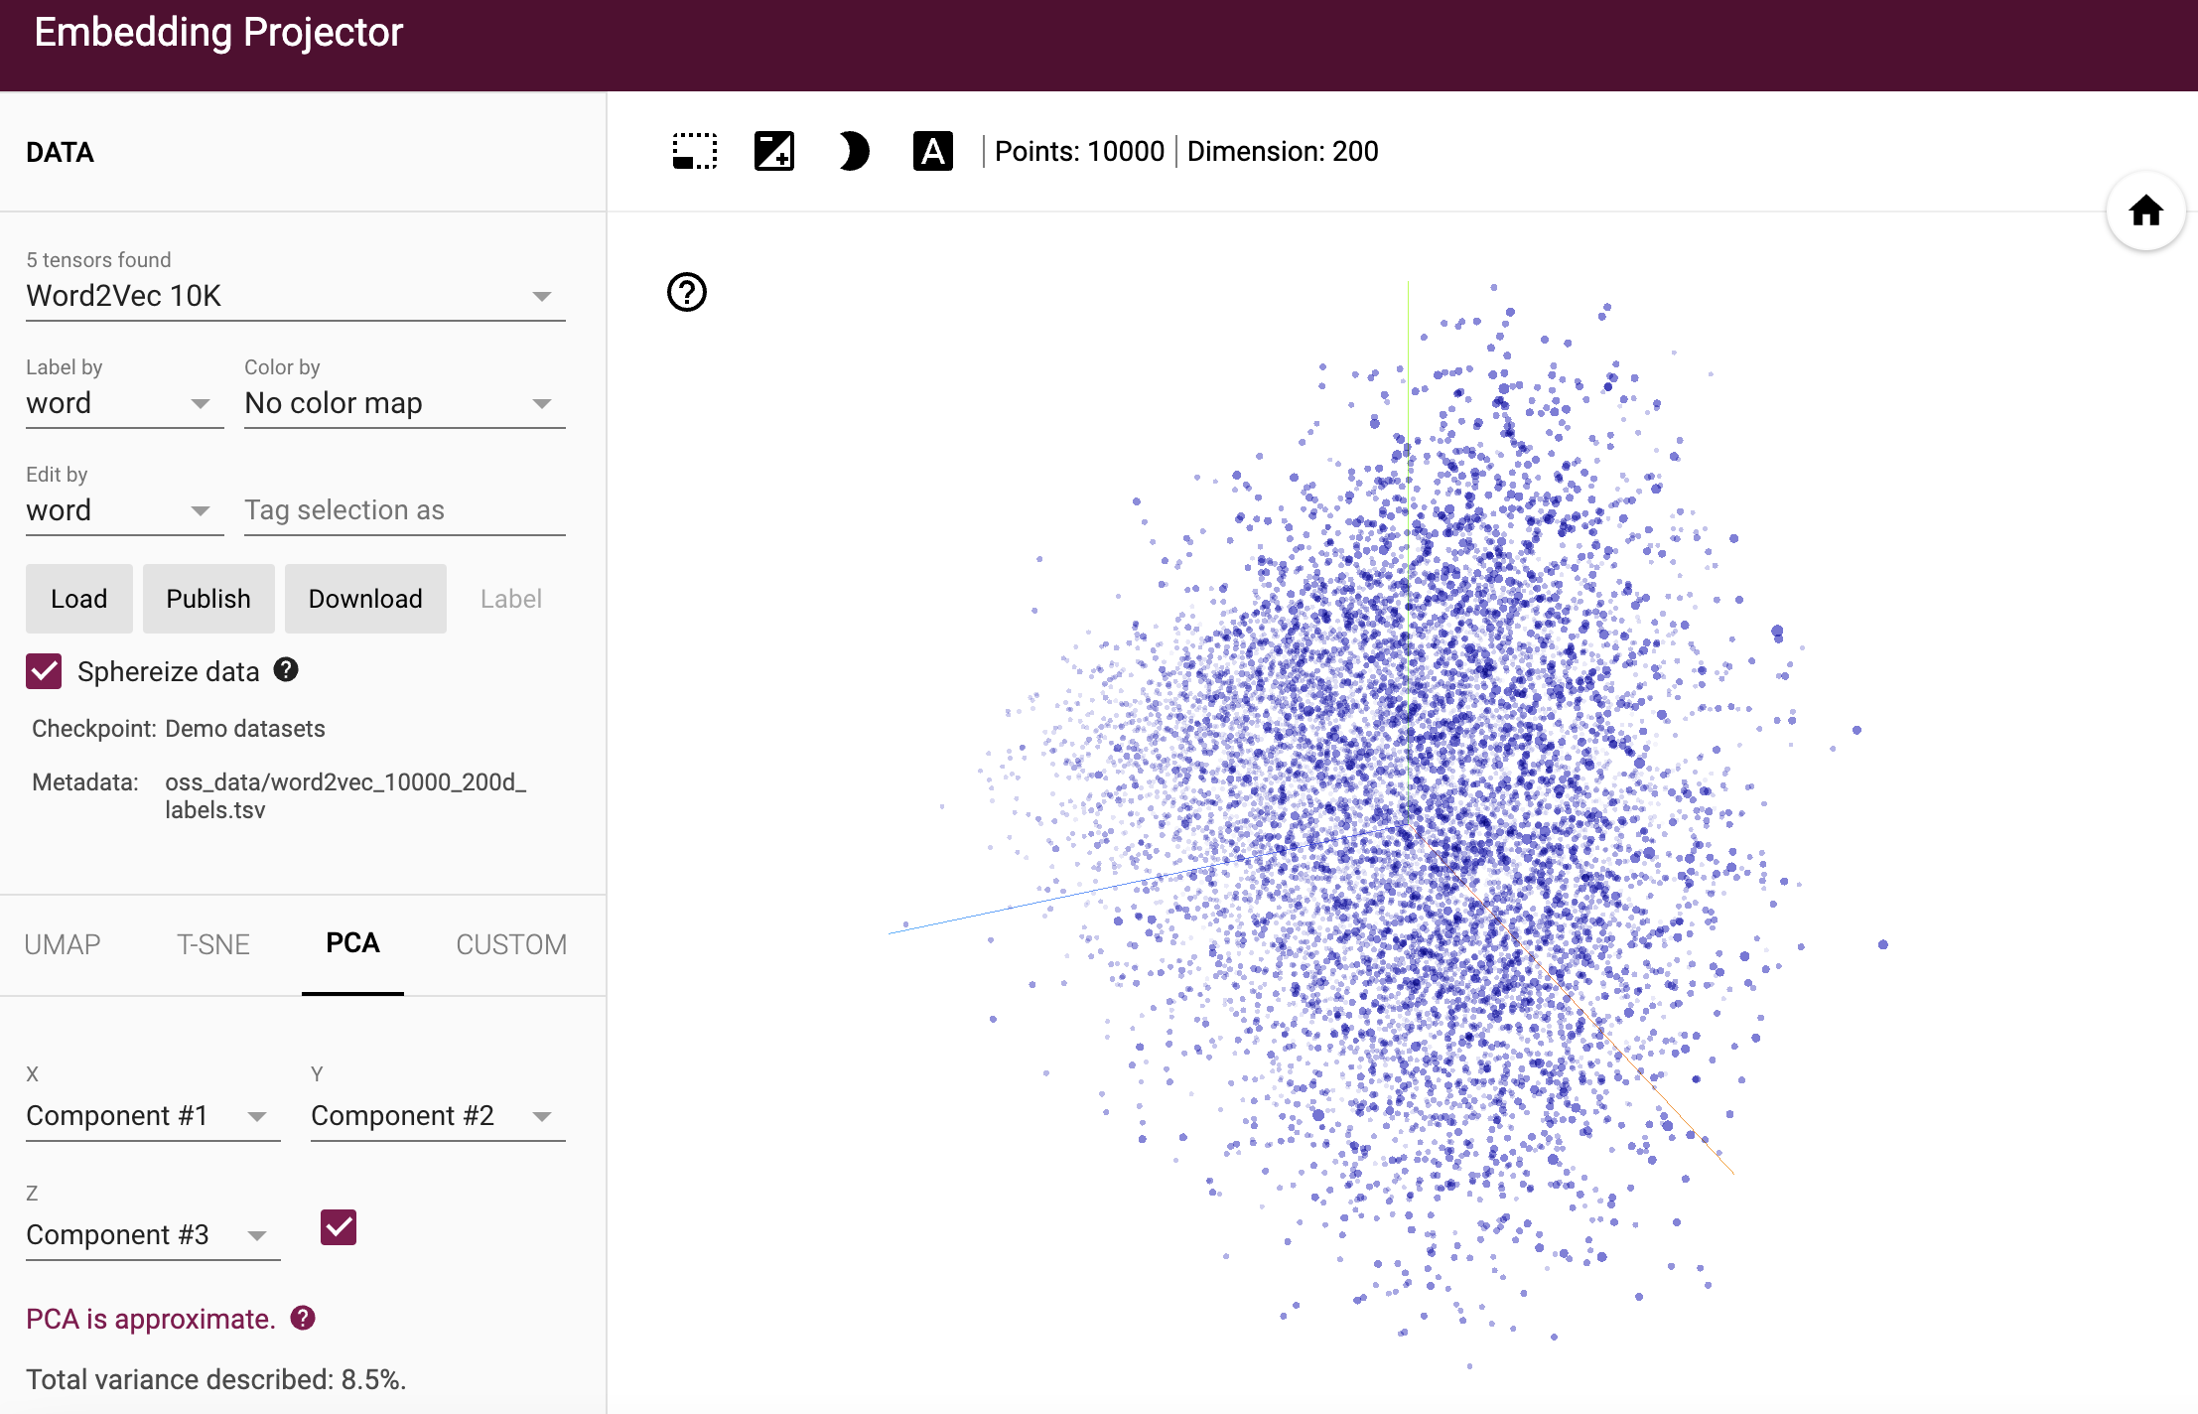
activities
http://projector.tensorflow.org/

Slide 13
material
Material, code, exercises, activities
https://github.com/neelsoumya/visualization_lecture
Derivations and technical details
https://github.com/neelsoumya/visualization_lecture/blob/main/mathematics_data_science.pdf

