Slide 1
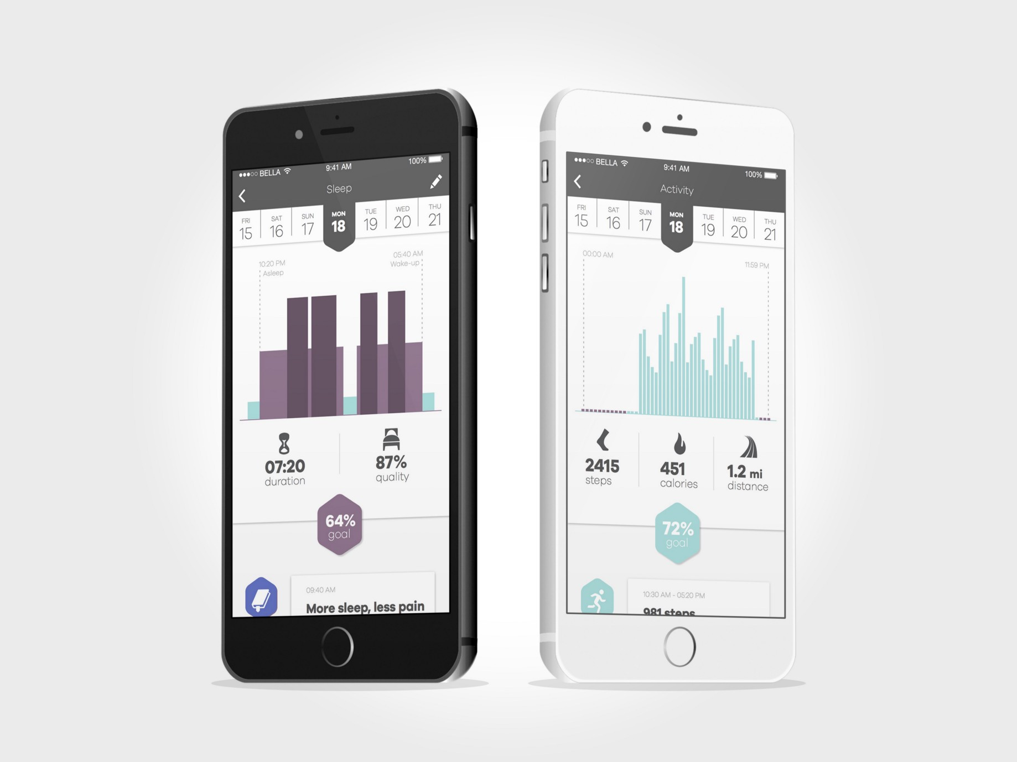
Bellabeat Competitor Analysis: Usage trends for fitness bands
Presented by: Neel Srejan
Last Updated: 8/10/2021

Slide 2
Table of Contents
Bellabeat Competitor Analysis: Device usage
Purpose Of Analysis
Data’s Trends
Summary
Appendix

Slide 3
Objective: Identify new features to add to the Bellabeat App based off current fitness band analytics

Slide 4
Data Information
Data is from Fitbit bands
Data spans 1 month from 4/12/2016 to 5/12/2016
Data consists of 33 individuals of unknown age and gender
Watch was probably not continually used for all time based on charge and usage, missing data has 0 entered for data points and has been omitted from the following analysis.

Slide 5
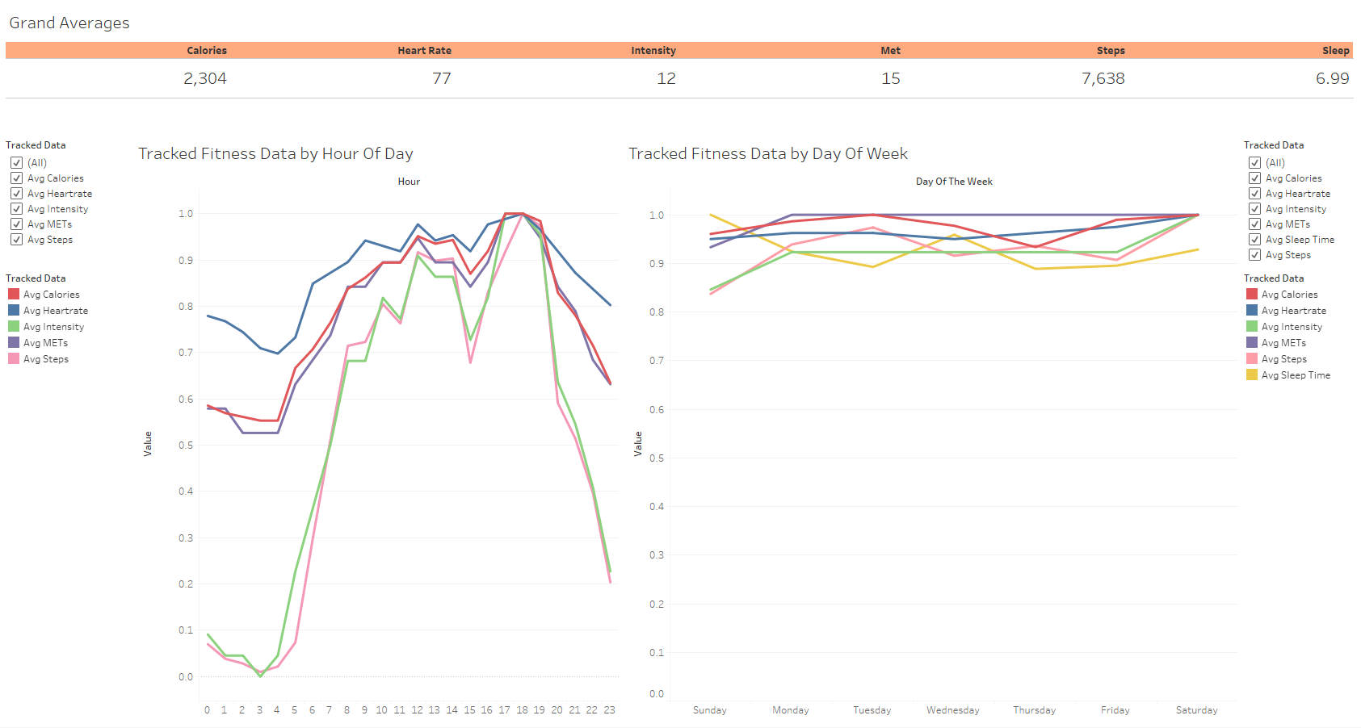
Active Hours and Days of the Week
After waking up many people begin being active
After the workday at 5pm activity spikes. Most workouts and activity occur after work and before dinner time around 8pm.
Day of the week has little indication of activity level.

Slide 6
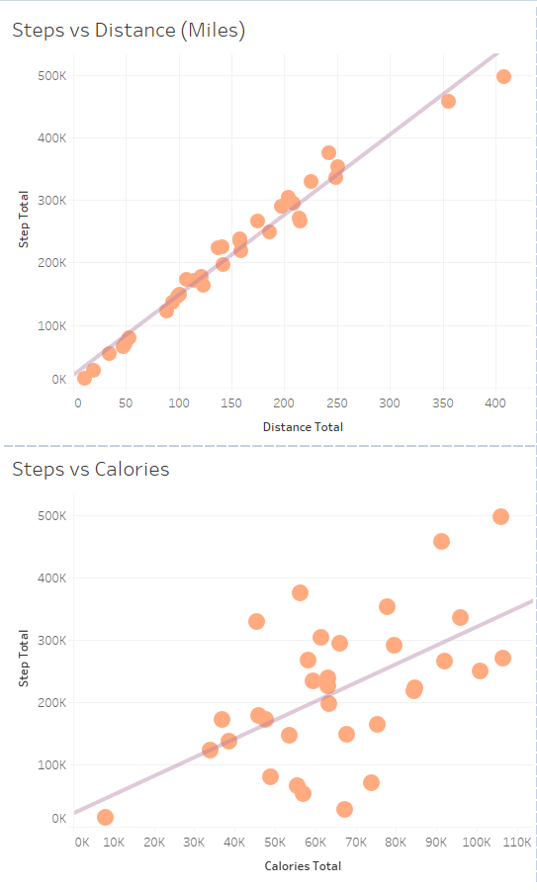
Importance of Steps
Steps taken is a very strong indicator of distance traveled. (R²=0.97)
Steps is a moderately strong indicator of Calories burnt. (R²=0.33)
Insight: Indications/reminders to walk would increase chances of greater fitness level for all Bellabeat users.

Slide 7
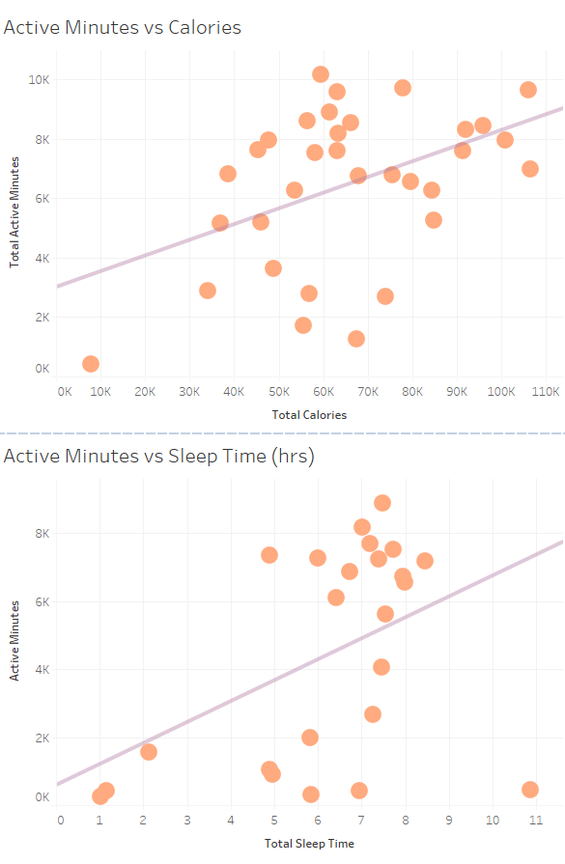
Importance of Active Minutes
Active Minutes is a moderate indicator of Calories expended and sleep duration through the night. (R²=0.20)
Insight: Encouraging activity throughout the day would encourage and promote healthy sleeping and calorie expenditure for Bellabeat users.

Slide 8
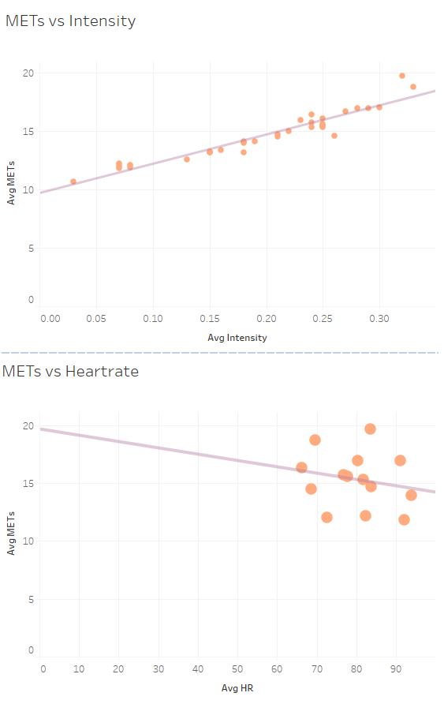
Importance of METs
METs is a very strong indicator of Intensity through the day. (R²=0.91)
METs have no significance on Heartrate. (R²=0.04)
Insight: Encouraging movement and various activity can increase intensity and raise METs for Bellabeat users.

Slide 9
What does this mean to Bellabeat?

Slide 10
Summary
Activity is seen increasing in the morning with peak activity occurring after work and before dinner time.
Days of the week have no importance over generic fitness
Steps, Active Minutes, METs, Calories, Sleep all play important roles in fitness.
Promotion of the above in the Bellabeat app will be key to enhancing the Bellabeat experience for users.

Slide 11
How to improve the Bellabeat experience?

Slide 12
Actionables
Tracking steps, calories: Allow users the option to set the Bellabeat global average steps/calories as a goal or a user defined goal for steps/calories.
Ask the user to input what times of the day/week they are free based on daily/weekly schedule.
Ask user to set a time to wake up for the next day.
Ask user if they want a daily/weekly reminder to log weight.
Create reward/badge system for health milestones (e.g., 1, 1.5, 2x global/user defined goal, top 10 calorie/step burners of the week/month, weight loss)
Send notifications leading up to user set free time to motivate for activity/workout
Send notification if wake up time is set and they are staying up and will not get enough sleep
Community tab where people can share their achievements/journey and users can interact with one another to build a positive attitude towards physical activity.

Slide 13
Thank You

