Slide 1
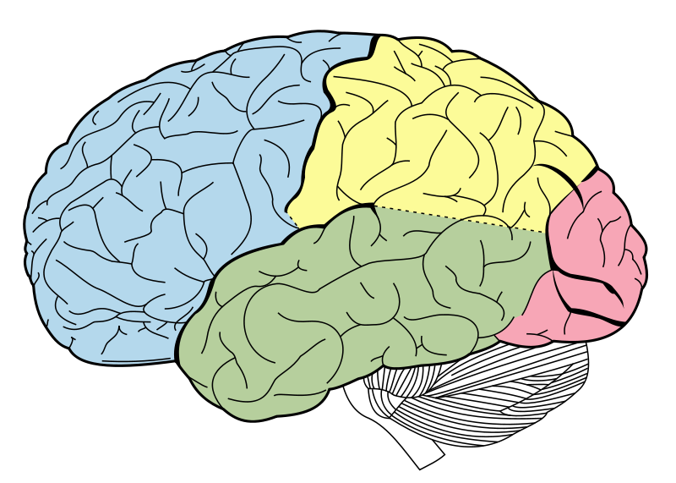
Language skills:
50% -- English
20% -- Spanish
20% -- Hindi (conversation)
10% -- Punjabi (conversation)
Motor Skills:
70% -- Fingers Coding
10% -- Jump Rope
5% -- Soccer
5% -- Dance/Freestyle
Bollywood
Popping
Waving
Animation
5% -- Gaming
5% -- Eating
Vision:
25% Jupyter Notebook
15% SQL Server
15% Tableau
5% Excel
10% Syntax Errors
5% Articles
5% YouTube/Twitch
Higher Cognition:
70% -- Coding
20% -- Planning
10% -- Reading
Emotional Processing:
60% -- Dopamine
25% -- Cortisol
10% -- Endorphins
5% -- Personal Satisfaction

