Slide 1
THE IG NOBEL PRIZE
"First make people LAUGH, then make them THINK"
WHAT IS IT?
CLASSIC EXAMPLE
OUR PROBLEM STATEMENT
Annual prizes for genuine scientific achievements that are simultaneously funny AND real.
• Real research, real journals, real scientists
• Administered by the Annals of Improbable Research since 1991
• Awarded at Harvard in an actual ceremony
• Categories: Medicine, Physics, Chemistry, Biology, Peace, Economics…
The humor comes FROM the scientific finding — not from how it is described.
The laugh must arrive BEFORE the explanation does.
2000 Ig Nobel Prize in Physics
“On the Possibility of a Frog to Be Levitated by a Magnet”
André Geim used high-field magnets to levitate a living frog against gravity.
→ Geim later won the 2010 Nobel Prize in Physics (for graphene!)
Other famous winners:
• Slipping on banana peels (Physics, 2014)
• Armadillos as leprosy transmitters (Medicine, 2012)
• Why woodpeckers don’t get headaches (Medicine, 2006)
Can a multi-agent AI pipeline autonomously generate and evaluate Ig Nobel-caliber research proposals?
Challenges:
• The “laugh then think” criterion is subtle — hard to encode in a prompt
• Requires novelty + scientific plausibility + inherent absurdity simultaneously
• Distinguishing genuinely funny from merely taboo, niche, or weird
• Novelty detection requires real-time web search
Our approach:
4 specialised agents with distinct roles, web search for novelty checking, and iterative critique–revision loops.

Slide 2
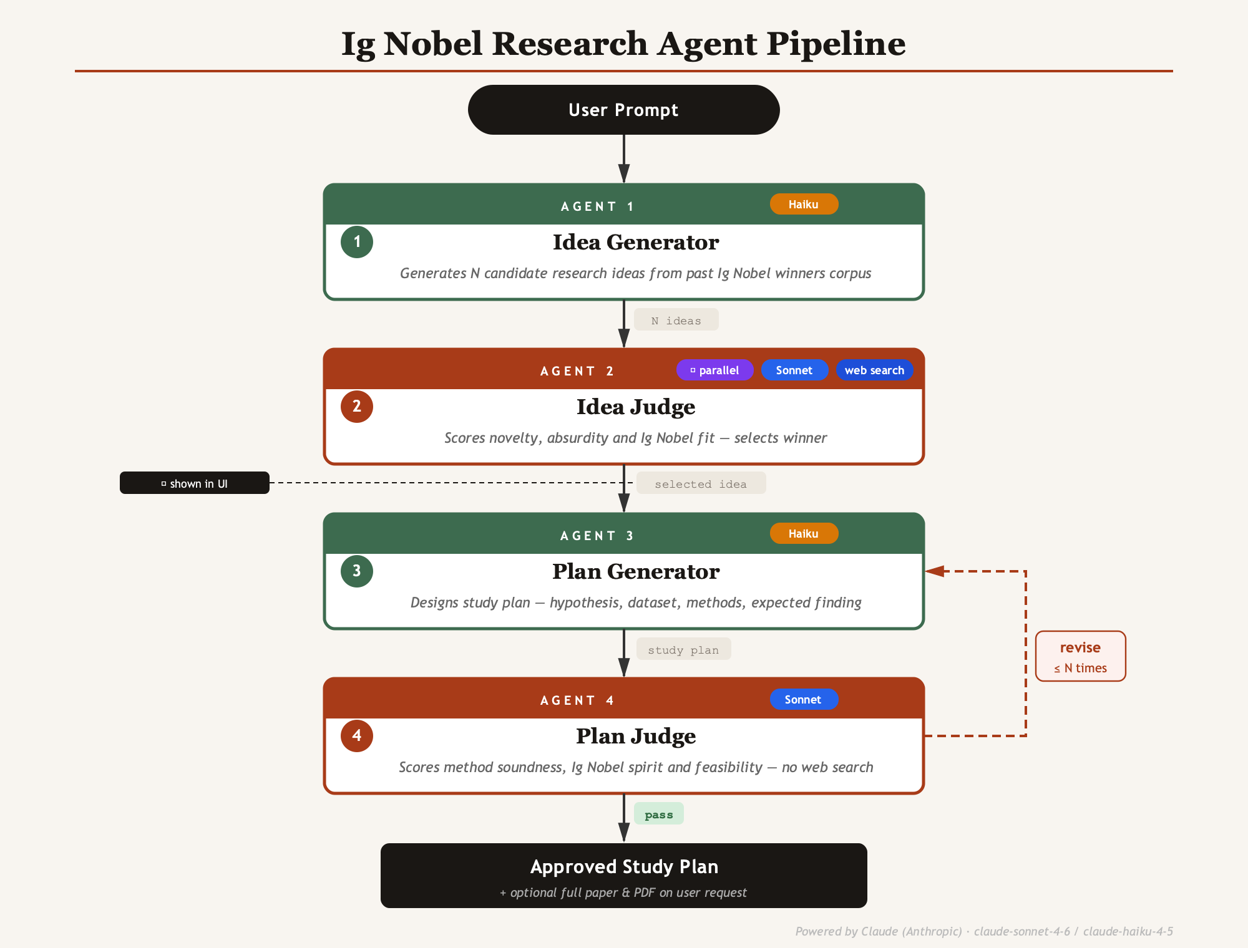
Our Multi-Agent Pipeline

