Slide 1

Fraud Detection in Medicare using Machine Learning
Project Proposal Presentation
by
Neema Martin Manadan( 2347134),Saisri B. ( 2347147),Silis Sebastian (2347158)
Project Guide
Dr. Helen K. Joy
Department of Computer Science
CHRIST(Deemed to be University), Bengaluru-29
MISSION
CHRIST is a nurturing ground for an individual’s holistic development to make effective contribution to the society in a dynamic environment
VISION
Excellence and Service
CORE VALUES
Faith in God | Moral Uprightness Love of Fellow Beings
Social Responsibility | Pursuit of Excellence

Slide 2
Introduction
CHRIST
Deemed to be University
Developing a machine learning-based Medicare fraud detection system can enhance the accuracy and efficiency of identifying fraudulent claims. Leveraging real-time data and predictive analytics, this project aims for proactive fraud prevention. It is vital for reducing financial losses and maintaining healthcare system integrity.

Slide 3
Alignment with SDG Goals
CHRIST
Deemed to be University
SDG 3: Good Health and Well-Being
SDG 16: Peace, Justice, and Strong Institutions
SDG 17: Partnerships for the Goals

Slide 4
Existing Systems
CHRIST
Deemed to be University
Sl. No. | Title | Author(Date) | Methodology | Limitations | Future Scope
1. | Big Data fraud detection using multiple medicare data sources | Matthew Herland (4 September 2018) | Random Forest, Gradient Boosted Trees, Logistic Regression | The paper could not fully explore all potential features, which could impact the models' performance | Employing data sampling techniques to combat the imbalanced nature of known fraud events in evaluating the different Medicare datasets
2. | Medicare Fraud Detection Using Neural Networks | Justin M. Johnson (18 July 2019) | Neural Networks | Data quality can be improved by checking NPI numbers that are currently missing from the LEIE database | Enhancing model interpretability to provide clear reasons for flagging certain claims as fraudulent, aiding human auditors in their decision-making.

Slide 5
CHRIST
Deemed to be University
3. | Medicare Fraud Detection Using Graph Analysis: A Comparative Study of Machine Learning and Graph Neural Networks | Yeeun Yon, Jinho Shin, Sunghyon Kyeong (17 August 2023 ) | Graph Neural Network | GNNs require significant computational resources for training and inference, which can be a barrier for some organizations. | Developing hybrid models that combine the strengths of traditional ML techniques and GNNs
4. | Explainable machine learning models for medicare fraud detection | John T. Hancock, Richard A. Bauder & Taghi M. Khoshgoftaar (9 October 2023) | Logistic Regression, Decision Tree, Random Forest, Extremely Randomized Trees, LightGBM, XGBoost | Only specific and limited attributes to be considered for better models | Applying the techniques discussed here to other Big Data in other application domains

Slide 6
CHRIST
Deemed to be University
5. | Gradient Boosted Decision Tree Algorithms for Medicare Fraud Detection | John T. Hancock (8 May 2021) | Gradient Boosted Decision Tree | Gradient Boosted Decision Tree (GBDT) algorithms heavily depends on the quality and comprehensiveness of the data | Future research can focus on integrating diverse data sources, such as electronic health records, social media, and unstructured data, to improve the robustness and accuracy of fraud detection models.

Slide 7
CHRIST
Deemed to be University
6. | An Anomaly Detection Method for Medicare Fraud Detection | Weijia Zhang, Xiaofeng He (2017) | Anomaly detection techniques (DBSCAN, KNN) | The DBSCAN algorithm can not be applied to new-coming data, the imLOF method is not able to run in the online environment | Intend to seek the help of medicare experts to get more labeled data and apply some supervised model.
7. | A Survey of Medicare Data Processing and Integration for Fraud Detection | Richard A. Bauder, Taghi M. Khoshgoftaar (2018) | Logistic Regression, Decision Tree, Clustering methods | Research is lacking in discussion on both data processing and integration (where it applies), thus making it difficult to understand what datasets are used and how they are used to produce fraud detection results. | We identify the gaps in these studies and provide some discussion on some important data processing issues, such as missing values and imputation and data filtering using provided flags.

Slide 8
CHRIST
Deemed to be University
8. | Medicare Fraud Detection using Machine Learning methods | Richard A. Bauder, Taghi M. Khoshgoftaar (2017) | Gradient Boosted Machine (GBM), Random Forest (RF), Deep Neural Network (DNN), and Naive Bayes (NB), KNN (supervised, unsupervised, and hybrid are all used ) | A large performance gap between the sampling methods. Overall, oversampling demonstrates poor performance for all learners. | Adding more Medicare datasets, with additional LEIE exclusion labels, as well as using different sampling methods for class imbalance, will be considered for future research
9. | Balancing the goals of health care provision and financing | Martin Feldstein (2015) | Balancing three goals: preventing the deprivation of care, avoiding wasteful spending, and allowing care to reflect the different tastes of individual patients | Requires modification if it is to strengthen incentives and avoid increasing the bad-debt problems of hospitals and physicians. | Requires modification if it is to strengthen incentives and avoid increasing the bad-debt problems of hospitals and physicians.

Slide 9
CHRIST
Deemed to be University
10. | Combating Fraud In Health Care: An Essential Component Of Any Cost Containment Strategy | Lewis Morris (2015 ) | Logistic Regression, Decision Tree, SVM, Random Forest, KNN | Assumes a linear relationship between the features and the log-odds of the outcome, which may not always hold true in complex datasets. | A comprehensive integrity strategy must be a key element of any systemic health reforms—to protect the integrity of the federal healthcare programs

Slide 10
Proposed System
CHRIST
Deemed to be University
The proposed system aims to identify fraudulent activities within the healthcare sector by leveraging advanced machine learning algorithms.
Key features include comprehensive data collection and preprocessing, ensuring high-quality, standardized datasets.
The system will develop robust models using a variety of algorithms, including Decision Trees, Random Forests, Logistic Regression, Gradient Boosting Machines, and Extra Tree Classifier, trained and validated with cross-validation techniques.
An application is being developed to predict whether activities in the medical sector are genuine or fraudulent.

Slide 11
Feasibility Analysis
CHRIST
Deemed to be University
Developing effective fraud detection models using advanced methods like Decision Trees and other Machine Learning Algorithms will also be a major focus.
By addressing current limitations and incorporating future improvements, this system aims to enhance the accuracy, interpretability, and reliability of fraud detection in the healthcare sector, ultimately supporting more effective and informed auditing processes.
Solving challenges such as making sure the data is accurate, improving how well the models detect fraud, and ensuring the system can handle more data as it grows will be key to making this work.

Slide 12
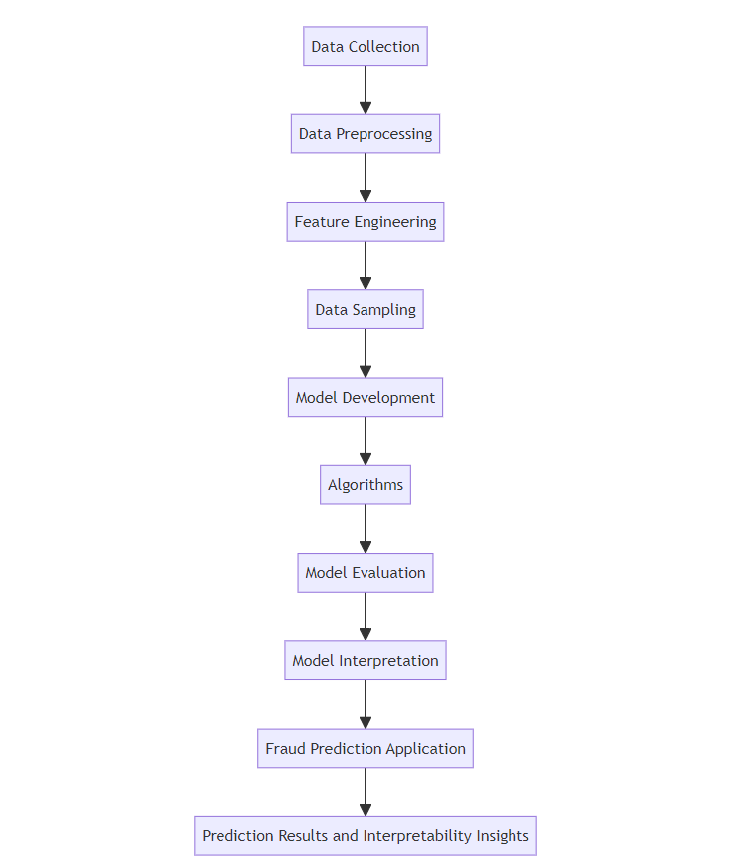
FLOW DIAGRAM

Slide 13
Benefits of Proposed System
CHRIST
Deemed to be University
The proposed healthcare fraud detection system aims to achieve several overarching goals and objectives, each contributing to its anticipated benefits and effectiveness.
Key objectives include comprehensive data collection and preprocessing to ensure high-quality datasets, and the development of robust models validated through cross-validation techniques.
The user-friendly interface of the application will provide intuitive navigation and clear visualizations of fraud detection insights, empowering healthcare professionals to make informed decisions swiftly and effectively.
The system aims to optimize operational efficiency, reduce fraudulent claims, ensure regulatory compliance, and foster transparency in healthcare fraud detection, thereby contributing to a more secure and sustainable healthcare environment.

Slide 14
Anticipated Outcomes
CHRIST
Deemed to be University
Enhanced Fraud Detection Accuracy
High-Quality Data Management
Robust Model Validation
Effective Anomaly Detection
User-Friendly Interface
Operational Efficiency and Compliance

Slide 15
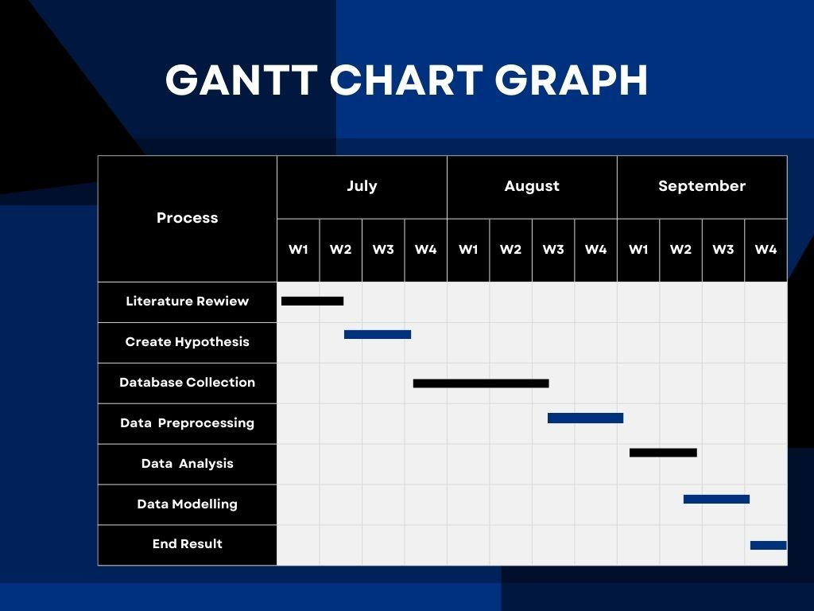
Plan of Work
CHRIST
Deemed to be University

Slide 16
References
CHRIST
Deemed to be University
[1] Herland, M., Khoshgoftaar, T.M. & Bauder, R.A. Big Data fraud detection using multiple medicare data sources. J Big Data 5, 29 (2018). https://doi.org/10.1186/s40537-018-0138-3
[2]Johnson, J.M., Khoshgoftaar, T.M. Medicare fraud detection using neural networks. J Big Data 6, 63 (2019). https://doi.org/10.1186/s40537-019-0225-0
[3]Y. Yoo, J. Shin and S. Kyeong, "Medicare Fraud Detection Using Graph Analysis: A Comparative Study of Machine Learning and Graph Neural Networks," in IEEE Access, vol. 11, pp. 88278-88294, 2023, doi: 10.1109/ACCESS.2023.3305962.
[4] Hancock, J.T., Bauder, R.A., Wang, H. et al. Explainable machine learning models for Medicare fraud detection. J Big Data 10, 154 (2023). https://doi.org/10.1186/s40537-023-00821-5
[5] Hancock, J.T., Khoshgoftaar, T.M. Gradient Boosted Decision Tree Algorithms for Medicare Fraud Detection. SN COMPUT. SCI. 2, 268 (2021). https://doi.org/10.1007/s42979-021-00655-z

Slide 17
CHRIST
Deemed to be University
[6] Zhang, W., & He, X. (2017). An Anomaly Detection Method for Medicare Fraud Detection. 2017 IEEE International Conference on Big Knowledge (ICBK). doi:10.1109/icbk.2017.47
[7] Bauder, R., & Khoshgoftaar, T. (2018). A Survey of Medicare Data Processing and Integration for Fraud Detection. 2018 IEEE International Conference on Information Reuse and Integration (IRI). doi:10.1109/iri.2018.00010
[8] Bauder, R. A., & Khoshgoftaar, T. M. (2017). Medicare Fraud Detection Using Machine Learning Methods. 2017 16th IEEE International Conference on Machine Learning and Applications (ICMLA). doi:10.1109/icmla.2017.00-48
[9] Feldstein, M. (2006). Balancing The Goals Of Health Care Provision And Financing. Health Affairs, 25(6), 1603–1611. doi:10.1377/hlthaff.25.6.1603
[10] Morris, L. (2009). Combating Fraud In Health Care: An Essential Component Of Any Cost Containment Strategy. Health Affairs, 28(5), 1351–1356. doi:10.1377/hlthaff.28.5.1351

Slide 18

This Photo by Unknown Author is licensed under CC BY-SA

