Slide 1
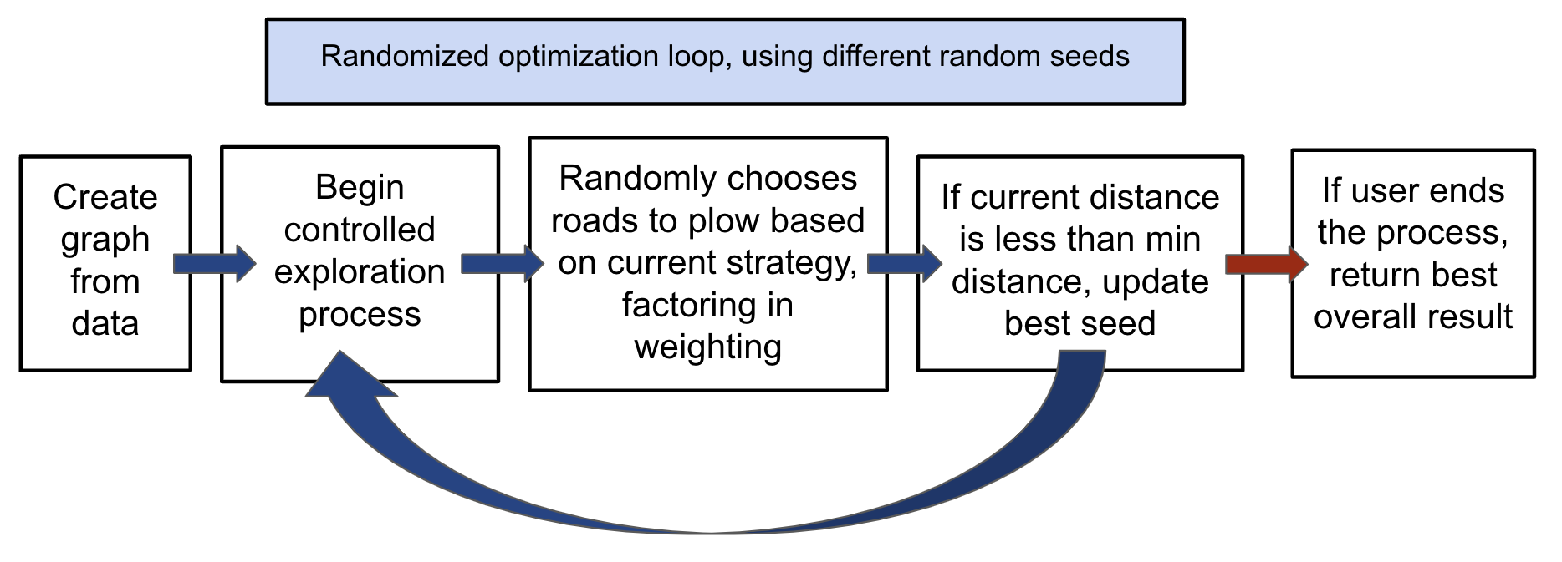
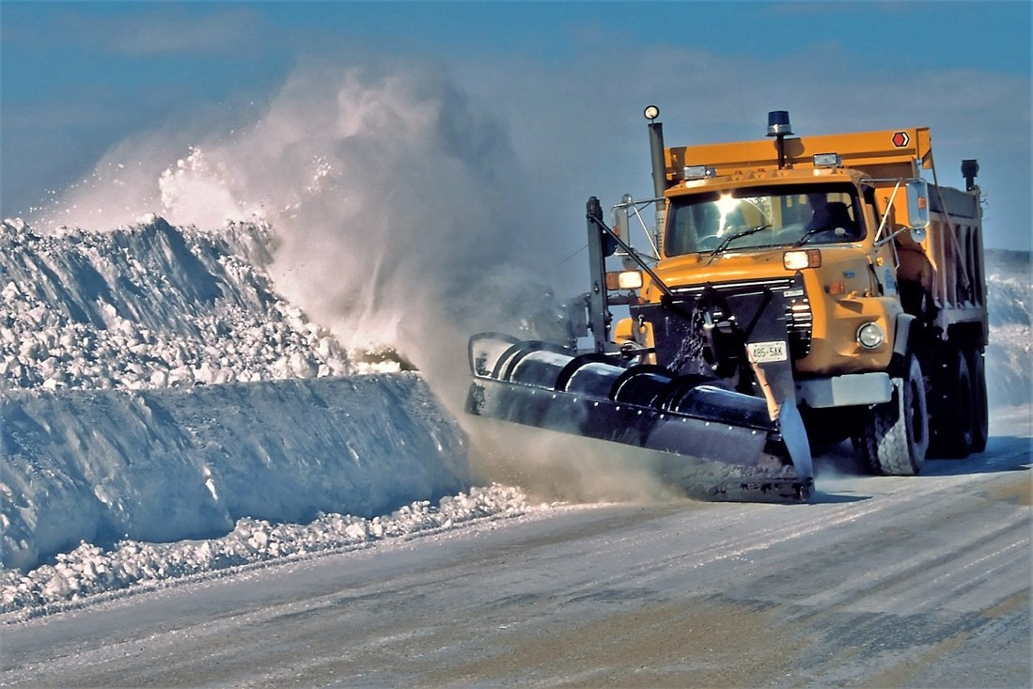
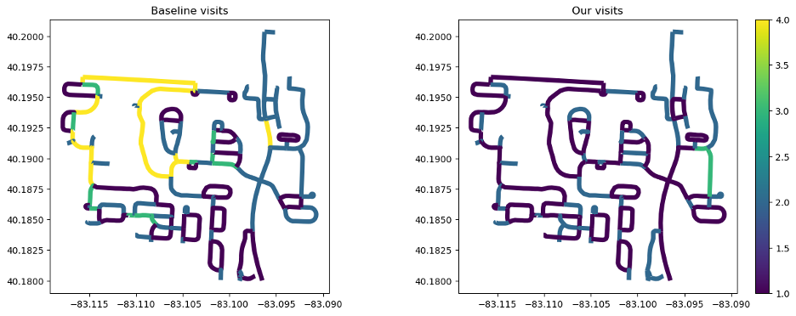
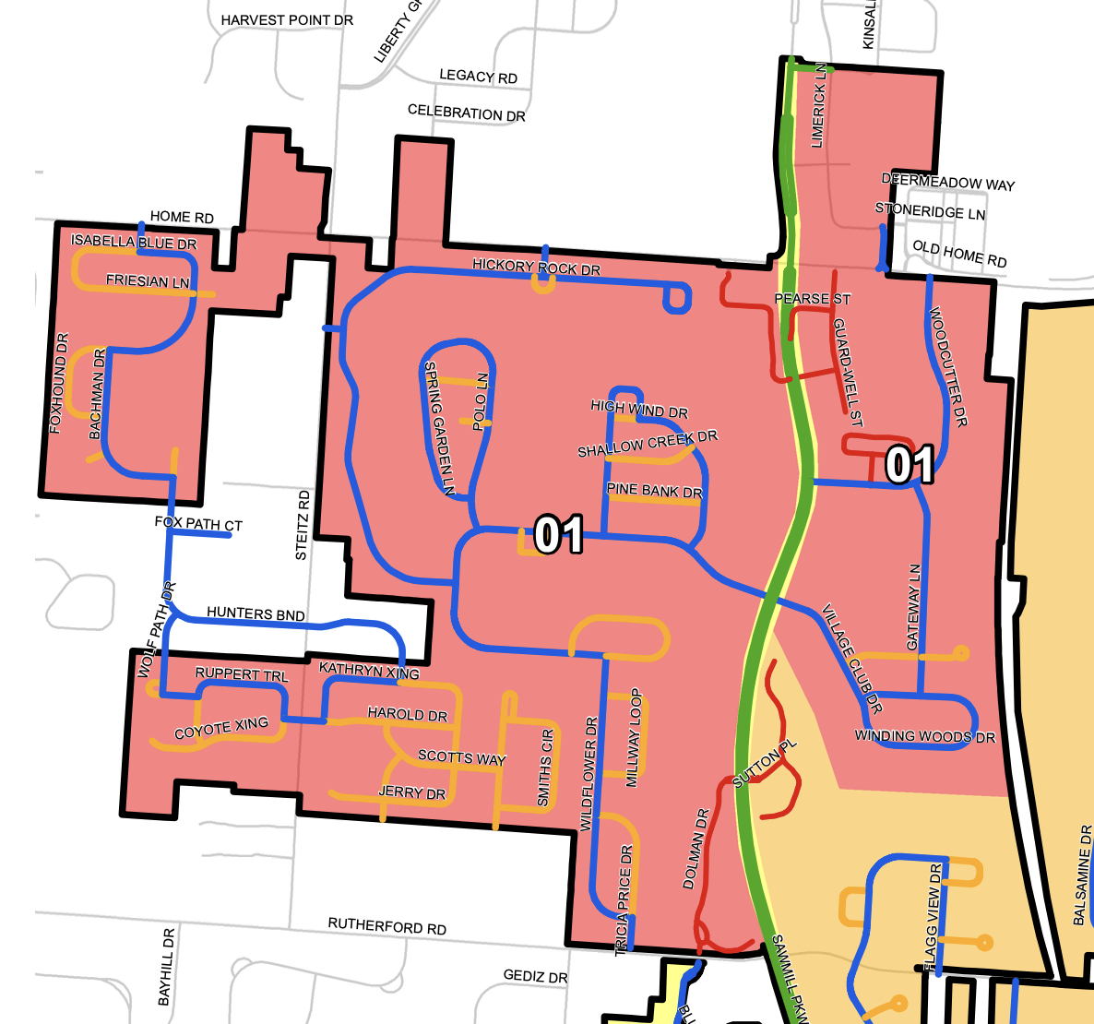
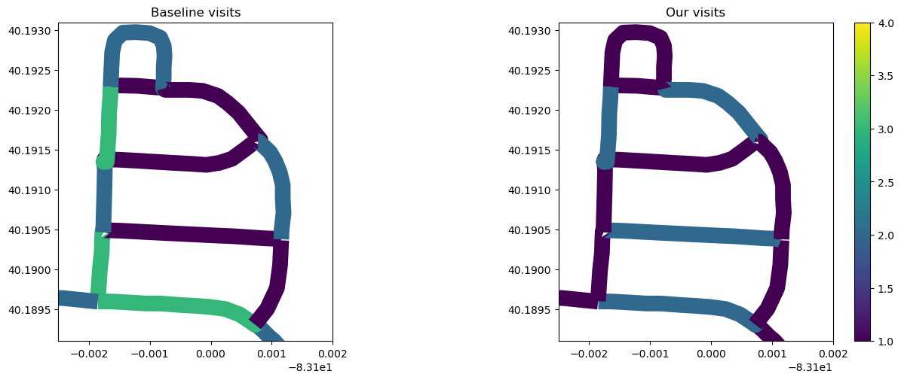


1 Olentangy Liberty High School
2 Department of Civil, Environmental and Geodetic Engineering​, The Ohio State University
3 Department of Electrical and Computer Engineering​, The Ohio State University
4 Geospatial Data Analytics, The Ohio State University
5 Translational Data Analytics Institute, The Ohio State University
Greedy-Driven Algorithm for Snow Plow Route Optimization
– A case study in Powell, OH
Neena Naikar^{1,4}, Shuang Song^{2,4}, Rongjun Qin^{2,3,4,5}
1. Introduction
Winter road preparation is difficult, in both timely implementation and cost-efficiency to the taxpayer. Currently the City of Powell has separated the city into districts, with each district assigned to a driver. The roads are assigned priorities ranging from 1-4 (4 being the highest), ideally the driver would choose a road with a higher priority over a road with a lower priority, but it is not a requirement. The current approach involves drivers using their discretion to navigate the roads without a premeditated route, leading to an inconsistent and less efficient process.
4. Method
This problem requires the driver to travel all the roads in the district at least once and should aim to prioritize roads with a higher priority designation. This problem differs from the Travelling Salesman Problem, because although TSP requires all edges in the graph to be traversed, there is no prioritization. We created weights for the edges that considers road distance and priority (distance / priority).
7. Conclusion
The purpose of this project was to create an optimal route planning program, so the City of Powell could have a predetermined route for their snow plowing and road salting, that would consider priority and road distance. This project proves that our route planning program reduces the total distance travelled by 31.25%. Furthermore, it creates a scalable program to apply to the other districts and other cities.
Our program with its controlled exploration process performs better than our driver simulation, where priority and distance were factors.
In the controlled exploration process, priority and distance was combined to create an edge weight.
In Ohio, around 50 million dollars are spent on snow and ice control each year, our program has the possibility to make the process more efficient and reduce the cost to the taxpayers.
A drawback to scaling this program would be that you have to manually create a file with all of the nodes to create the district and city graphs.
8. Future Work
We would like to integrate reinforcement learning, specifically a Q-learning model to see if the total distance can be reduced. We would use our algorithm on the entire city and possibly increase our scope to the county level, to do this we would need to find a way to input the maps automatically.
5. Experiment Setup
Currently the process is up to the driver’s discretion, with the priority designated roads as a guideline. We created the optimal program and the intuitive driver route program, which prioritizes the designated road priority and then the road distance. While the optimal program uses the weighted edges as guidelines in its controlled exploration process.
Jeroen Kransen, Netherlands - CC BY-SA 2.5
6. Experiment
We compared the distances that each route traveled to traverse all the edges in the district. The optimal program was able to traverse all the edges in the district through less passes, compared to the baseline program.
2. Aim
Prototyping an optimal predetermined route for the snow plowing/ salting process that takes into account:
Priority
Road distance
Cost
3. Objective
Determine an optimal route that will traverse all the roads in a district that considers priority, distance, and cost.
Compare the optimal route to the current process and compare the estimated distance traveled for each route.
This is the map of District 1 with the priorities designated to the roads:
In this neighborhood specifically, we can see how our program reduces the number of second and third passes.
Reference:​
ODOT. (n.d.). Snow and ice practices - Ohio. Snow and Ice Practices . https://www.transportation.ohio.gov/programs/snow-and-ice/snow-ice-practices ​
​
Reference:
ODOT. (n.d.). Snow and ice practices - Ohio. Snow and Ice Practices . https://www.transportation.ohio.gov/programs/snow-and-ice/snow-ice-practices
https://ceg.osu.edu/

