Slide 1


{{PROJECT_NAME}}
{{TEASER_TITLE}}

Slide 2













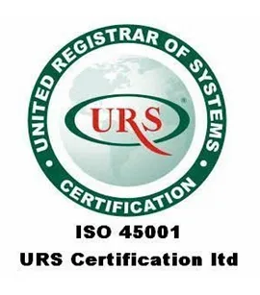





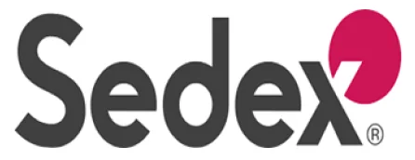

Business Overview
Business Overview:
Key Select Customers
{{BUSINESS_SUMMARY}}
2 Facilities
Located near raw material belts + 1 upcoming
55+ Grades
Customized viscosity & hydration profiles
R&D Offerings
In-house applications lab for food texture analysis
…and others
Product Portfolio
{{KEY_PRODUCTS}}
Industrial Grade Thickeners
Applications
{{KEY_PRODUCTS}}
{{KEY_PRODUCTS}}
Fast Hydration Derivatives
Purified Splits
Oil & Gas
Cationic Conditioner
Blended Stabilizers
Strictly Private & Confidential – Prepared by Kelp M&A Team

Slide 3
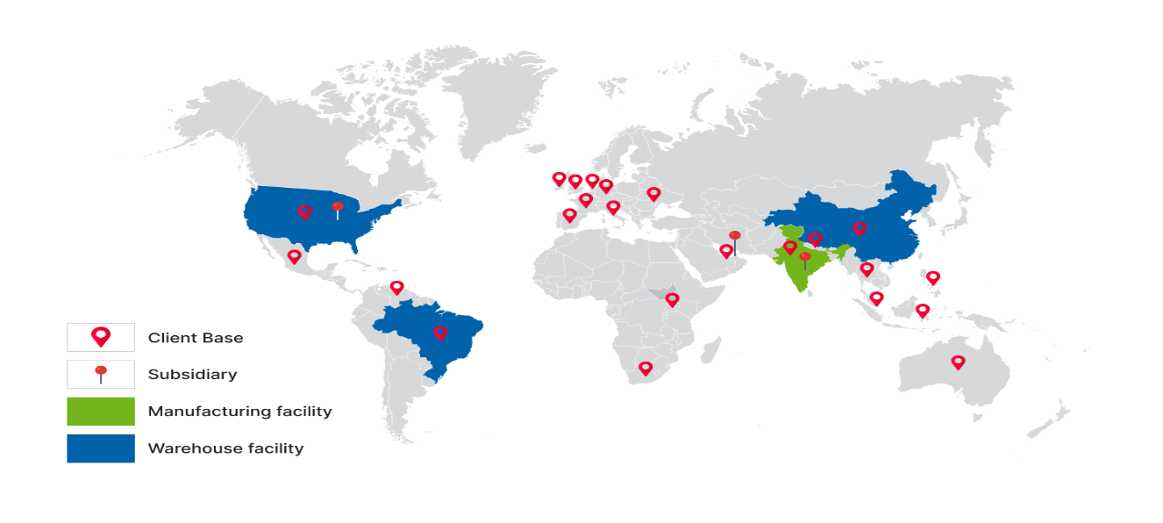
Key Financial Metrics and Growth Story
Key Financial Metrics (FY24)
{{KEY_METRICS}}
{{KEY_METRICS}}
{{EBITDA}}
{{KEY_METRICS}}
{{EBITDA}}
Company has launched a "Stabilizer Solutions" division, offering pre-mixed blends to food clients, increasing customer stickiness and wallet share
{{REVENUE_CAGR}}
Contract farming initiatives with 5,000+ farmers in Rajasthan ensure raw material traceability and price stability against market fluctuations.
{{KEY_METRICS}}
{{REVENUE_CAGR}}
Strictly Private & Confidential – Prepared by Kelp M&A Team

Slide 4






Investment Highlights
Leading global player in natural hydrocolloids with proprietary processing tech - Ranked among the top 5 exporters of cassia gum globally; offering 50+ customized mesh sizes.
Catering to recession-resistant industries like Processed Food and Pharma - Deep integration with clients' R&D teams has resulted in a 90% client retention rate over the last decade.
Strategically located manufacturing in the heart of the "Guar Belt" (Rajasthan/Gujarat) - Minimal logistics cost for raw material procurement; fully automated pulverizing and sterilization units.
Established footprint in high-compliance markets (USA, EU) - ~70% of revenue derived from exports; fully REACH compliant for European customers.
{{INVESTMENT_THESIS}}
Strictly Private & Confidential – Prepared by Kelp M&A Team

Slide 5
Important Notice & Disclaimer
Strictly Private & Confidential. This presentation is prepared by Kelp Global exclusively for the intended recipient and may not be reproduced or distributed without prior written consent. This document is for informational purposes only and does not constitute an offer to sell or a solicitation of an offer to buy any securities. While all information is obtained from sources believed to be reliable, Kelp Global makes no representation or warranty regarding its accuracy or completeness and accepts no liability for any loss arising from its use. This presentation contains forward-looking statements and financial projections (e.g., FY26–FY28E) based on current assumptions; actual results may vary materially.
Strictly Private & Confidential – Prepared by Kelp M&A Team

