Slide 1
The Evolution of Cloud Computing
Hardware Evolution
First-Generation Computers- vacuum tubes
Second-Generation Computers-transistors
Third-Generation Computers-integrated circuits
Fourth-Generation Computers-LSI
Fifth-Generation Computers-VLSI
Software Generations
History of Internet Software Evolution
Server Virtualization

Slide 2
First-Generation Computers: 1940-1956
The first computers used vacuum tubes for circuitry and magnetic drums for memory.
They were often enormous and taking up entire room.
First generation computers relied on machine language.
.They were very expensive to operate and in addition to using a great deal of electricity, generated a lot of heat, which was often the cause of malfunctions.
The UNIVAC and ENIAC computers are examples of first-generation computing devices.

Slide 3

First-Generation Computers
UNIVAC (Universal Automatic Computer) – a tabulating machine which won the contest for the fastest machine which could count the US 1890 census.
VACUUM TUBES – electronic tubes about the size of light bulbs.

Slide 4
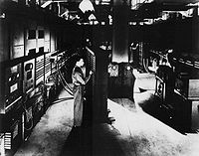
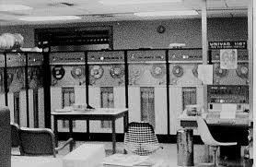
First-Generation Computers
1940-1956

Slide 5
Second-Generation Computers:1956-1963
Transistors replaced vacuum tubes and ushered in the second generation of computers.
Second-generation computers moved from cryptic binary machine language to symbolic.
High-level programming languages were also being developed at this time, such as early versions of COBOL and FORTRAN.
These were also the first computers that stored their instructions in their memory.

Slide 6
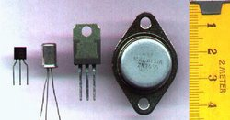
Second-Generation Computers:1956-1963
TRANSISTOR – was a three-legged component which shrunk the size of the first generation computers. Occupied only 1/100th of the space occupied by a vacuum tube
Benefits: More reliable, had greater computational speed, required no warm-up time and consumed far less electricity.

Slide 7
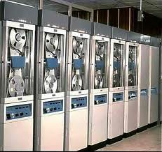
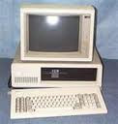
Second-Generation Computers:1956-1963
Figs

Slide 8
Third generation computers:1964-1971
The development of the integrated circuit was the hallmark of the third generation of computers.
Transistors were miniaturized and placed on silicon chips, called semiconductors.
Instead of punched cards and printouts, users interacted with third generation computers through keyboards and monitors and interfaced with an operating system.
Allowed the device to run many different applications at one time.

Slide 9

Third generation computers:1964-1971
INTEGRATED CIRCUITS – are square silicon chips containing circuitry that can perform the functions of hundreds of transistors.

Slide 10
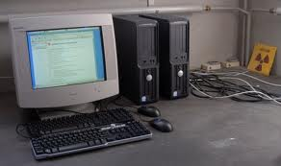
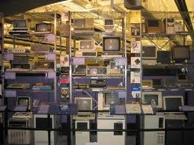
Third generation computers:1964-1971

Slide 11
Fourth generation computers: 1971-present
The microprocessor brought the fourth generation of computers, as thousands of integrated circuits were built onto a single silicon chip.
The Intel 4004 chip, developed in 1971, located all the components of the computer.
From the central processing unit and memory to input/output controls—on a single chip.
Fourth generation computers also saw the development of GUIs, the mouse and handheld devices.

Slide 12

Fourth generation computers: 1971-present
MICROPROCESSOR – is a silicon chip that contains the CPU – part of the computer where all processing takes place.
4004 chip – was the first microprocessor introduced by Intel Corporation.

Slide 13
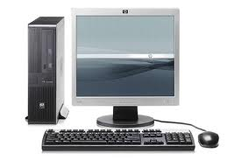
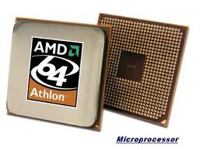
Fourth generation computers
1971-present

Slide 14
The laws influencing Information Technology
The laws that are generally accepted as governing the spread of technology:
Moore's Law
Gilder's Law
Metcalfe's Law
Disk Law

Slide 15
Putting together network, storage and computing speed …rates of growth of digital power
Moore’s Law.
Transistors on a single chip doubles approximately every 18–24 months.
Gilder’s Law.
Aggregate bandwidth triples approximately every year.
Metcalfe’s Law.
The value of a network may grow exponentially with the number of participants(community Law).
Disk Law
Storage doubles every 12 months

Slide 16
Fifth generation computers
The Fifth Generation Computer Systems project (FGCS) was an initiative by Japan's Ministry of International Trade and Industry, begun in 1982, to create a computer using massively parallel computing/processing. It was to be the result of a massive government/industry research project in Japan during the 1980s. It aimed to create an "epoch-making computer" with-supercomputer-like performance and to provide a platform for future developments in artificial intelligence.

Slide 17
Fifth generation computers (present and beyond)
Fifth generation computing devices, based on artificial intelligence.
Are still in development, though there are some applications, such as voice recognition.
The use of parallel processing and superconductors is helping to make artificial intelligence a reality.
The goal of fifth-generation computing is to develop devices that respond to natural language input and are capable of learning and self-organization.

Slide 18
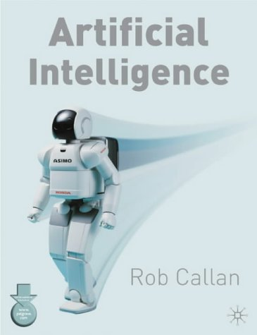
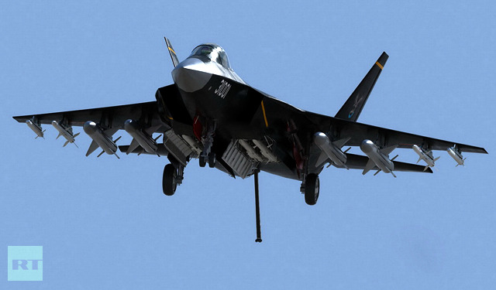
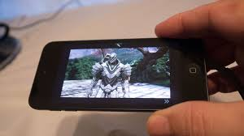
Fifth generation computers

Slide 19
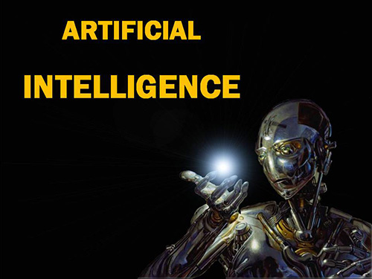
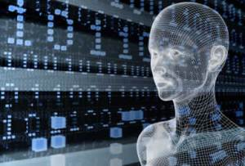
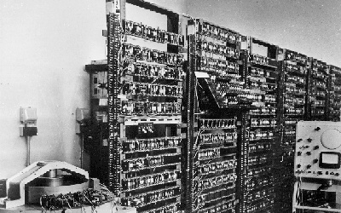
Fifth generation computers

Slide 20
Software Generations
There was also a parallel set of generations for software:
First generation: Machine language.
Second generation: Assembly language.
Third generation: Structured programming languages such as C, COBOL and FORTRAN.
Fourth generation: Domain-specific languages such as SQL (for database access) and TeX (for text formatting),object oriented languages

