Slide 1
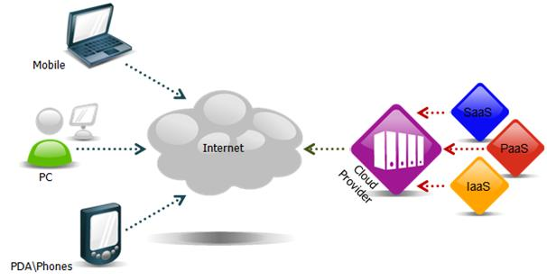
Cloud Definition
The name cloud computing was inspired by the cloud symbol that is often used to represent the Internet in flowcharts and diagrams.

Slide 2
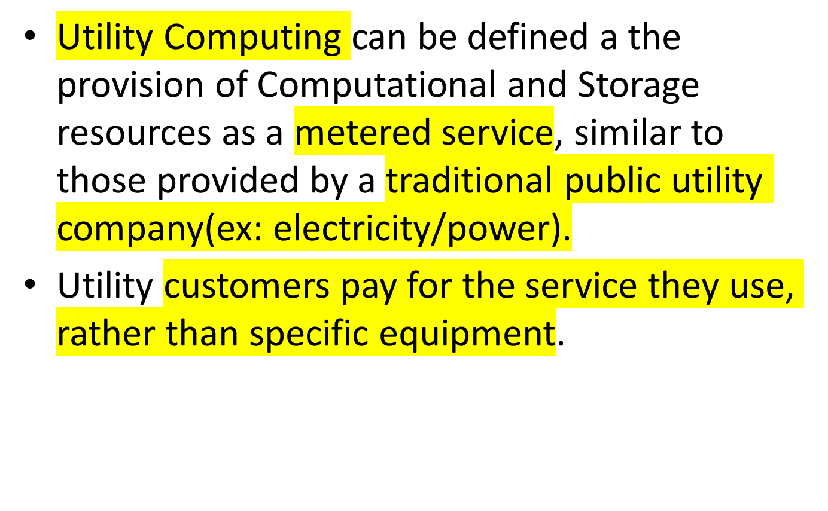
Utility Computing

Slide 3
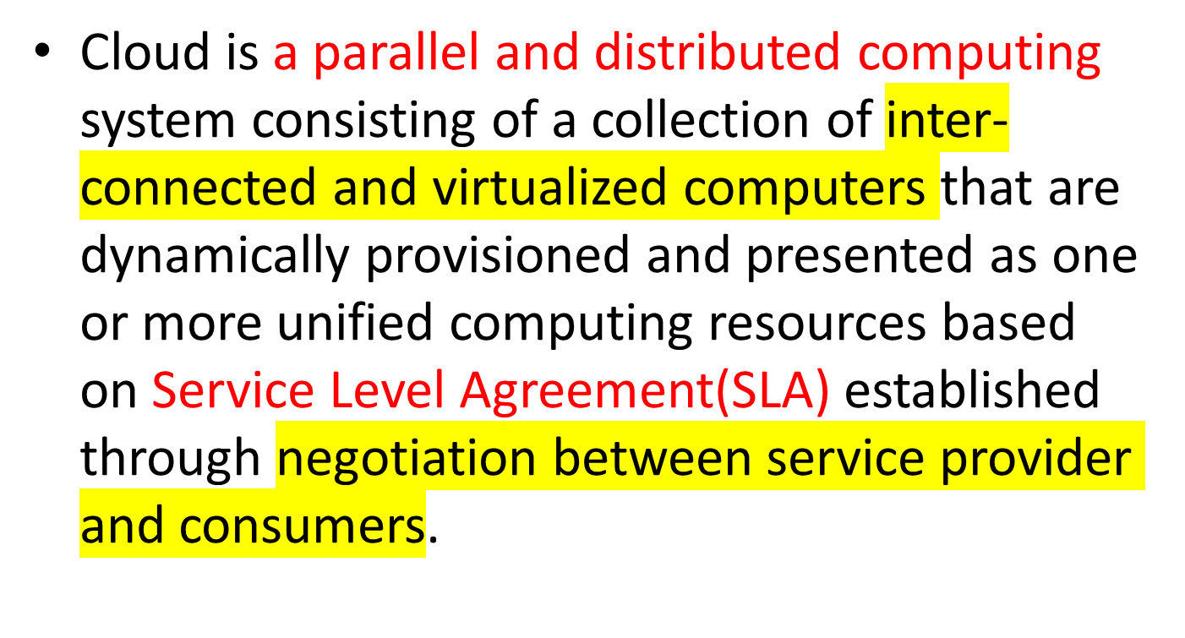
Cloud Definition -Buyya

Slide 4
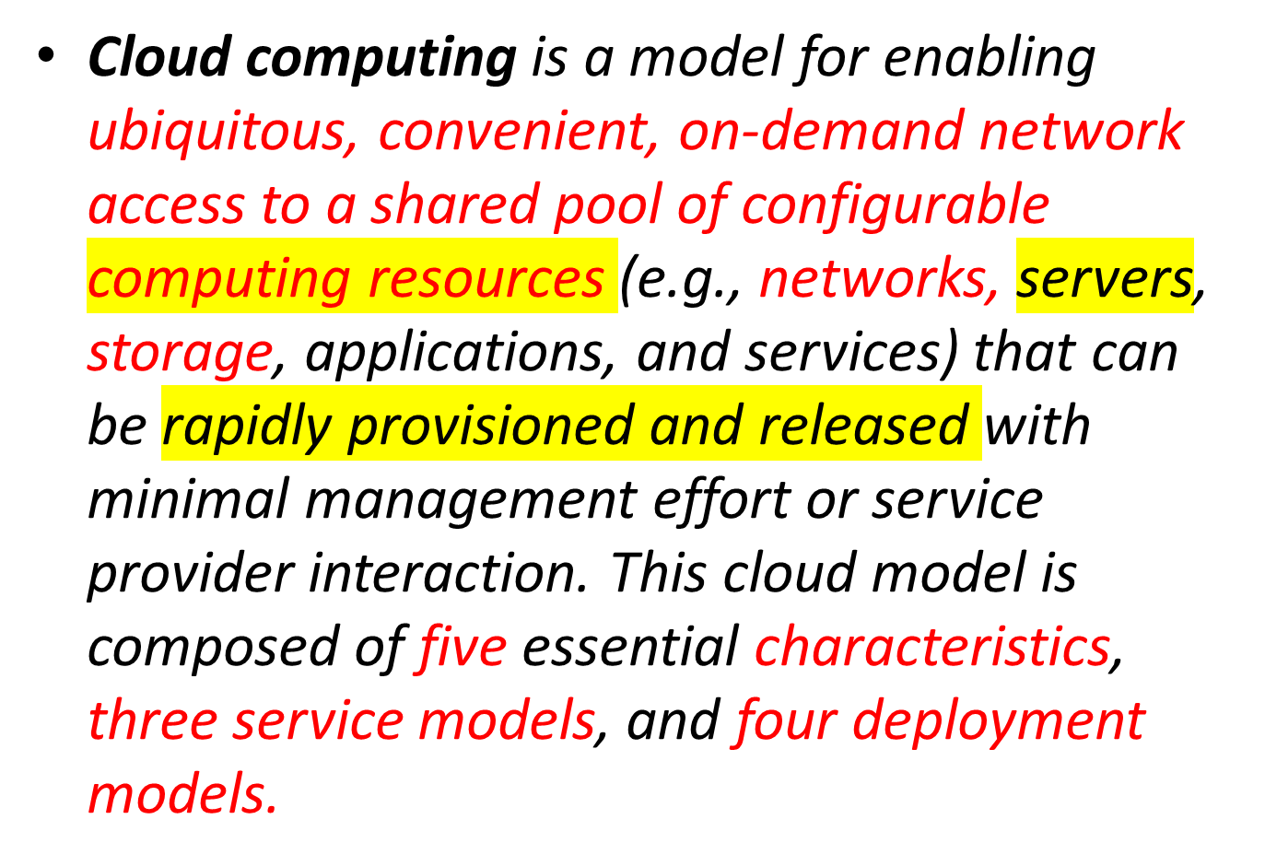
Cloud Definition

Slide 5
Cloud Computing Definition
Cloud computing is Internet-based computing, whereby shared resources, software and information are provided to computers and other devices on-demand, like the electricity grid.
Globalization of Computing Assets may be the biggest contribution the cloud has made to date

Slide 6
Cloud Computing Definition
Cloud computing is a model for enabling convenient, on-demand network access to a shared pool of configurable computing resources (e.g., networks, servers, storage, applications, and services) that can be rapidly provisioned and released with minimal management effort or service provider interaction.
The cloud model promotes availability and is composed of five essential characteristics, three service models, and four deployment models.

Slide 7
Cloud Computing Objectives
Elasticity: Ability to scale virtual machines resources up or down
On-demand usage: Ability to add or delete computing power (CPU, memory), and storage according to demand
Pay-per-use: Pay only for what you use
Multitenancy: Ability to have multiple customers access their servers in the data center in an isolated manner

Slide 8
Five Essential Characteristics of Cloud Computing
On-demand self-service
Broad network access
Resource pooling
  Location independence
Rapid elasticity
Measured service

Slide 9
Cloud based Service Models
  Software as a Service (SaaS)
  Platform as a Service (PaaS)
  Infrastructure as a Service (IaaS)

Slide 10
Software as a Service (SaaS)
SaaS capability provided to the consumer is to use the provider’s applications running on a cloud infrastructure and accessible from various client devices through a thin client interface such as a Web browser (e.g., web-based email).
The consumer does not manage or control the underlying cloud infrastructure, network, servers, operating systems, storage, or even individual application capabilities, with the possible exception of limited user-specific application configuration settings.

Slide 11
Platform as a Service (PaaS)
  PaaS capability provided to the consumer is to deploy onto the cloud infrastructure consumer-created applications using programming languages and tools supported by the provider (e.g., Java, Python, .Net).
  The consumer does not manage or control the underlying cloud infrastructure, network, servers, operating systems, or storage, but the consumer has control over the deployed applications and possibly application hosting environment configurations.

Slide 12
Infrastructure as a Service (IaaS)
  IaaS capability provided to the consumer is to rent processing, storage, networks, and other fundamental computing resources where the consumer is able to deploy and run arbitrary software, which can include operating systems and applications.
  The consumer does not manage or control the underlying cloud infrastructure but has control over operating systems, storage, deployed applications, and possibly select networking components (e.g., firewalls, load balancers)

Slide 13
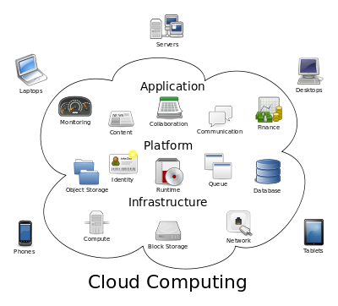
Cloud Service Models

Slide 14
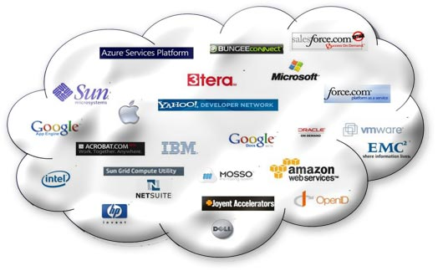
Cloud Service Providers

Slide 15
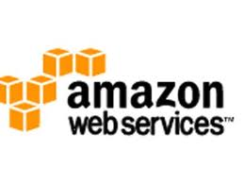


Cloud Service Leaders
Key Players in Cloud Computing Platforms (adapted from Lakshmanan (2009))
Company |  | Cloud Computing Platform | Year of Launch | Key Offering
Amazon.com |  | AWS (Amazon Web Services) | 2006 | Infrastructure as a service (Storage Computing), Datasets and Content Distribution
Microsoft |  | Azure | 2009 | Application platform as a service (.Net, SQL data services )
Google |  | Google App. Engine | 2008 | Web Application Platform as Service
IBM Salesforce.com | Blue Cloud Force.com |  | 2008 | Proprietary 4GL Web application as an demand platform
Notes:
Add slides to each topic section as necessary, including slides with tables, graphs, and images.
See next section for sample table, graph, image, and video layouts.

Slide 16
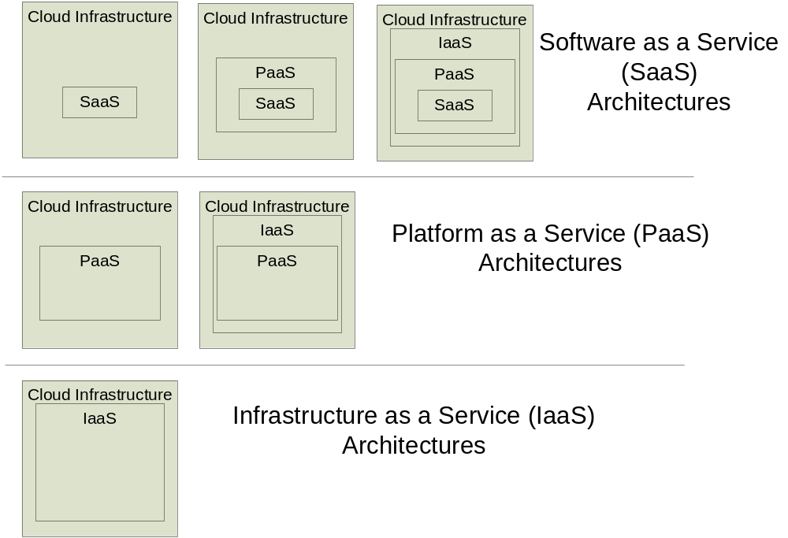
Architecture of Cloud Service Models

Slide 17
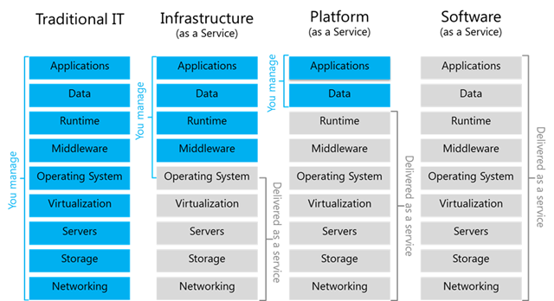
Comparison of Service Models

Slide 18
Features of a Mature SaaS Model
Scalable
  Handle growing amounts of work in a graceful manner
Multi-tenancy
  One application instance may be serving hundreds of companies
  Opposite of multi-instance where each customer is provisioned their own server running one instance
Metadata driven configurability
  Instead of customizing the application for a customer (requiring code changes), one allows the user to configure the application through metadata

Slide 19
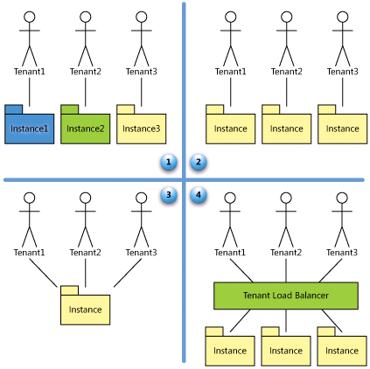
SaaS Maturity Levels
Level 1: Ad-Hoc/Custom
Level 2: Configurable
Level 3: Configurable,
Multi-Tenant-Efficient
Level 4: Scalable,
Configurable,
Multi-Tenant-Efficient

Slide 20


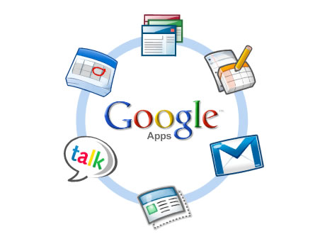

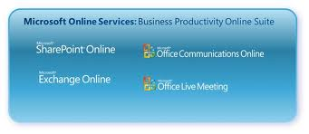

SaaS Examples
SaaS

Slide 21

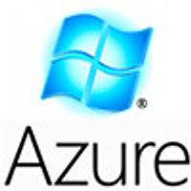



PaaS Examples
PaaS

Slide 22






IaaS Examples
IaaS

Slide 23
Cloud Deployment Models
Private cloud
Community cloud
Public cloud
Hybrid cloud

Slide 24
Private and Community Clouds
Private cloud
  The cloud infrastructure is operated solely for an organization. It may be managed by the organization or a third party and may exist on premise or off premise.
Community cloud
A community cloud is formed when several organizations with similar requirements share common infrastructure. Costs are spread over fewer users than a public cloud but more than a single tenant.

Slide 25
Public and Hybrid Clouds
Public cloud
    Mega-scale cloud infrastructure is made available to the general public or a large industry group and is owned by an organization selling cloud services.
Hybrid cloud
    The cloud infrastructure is a composition of two or more clouds (private or public) that remain unique entities but are bound together by standardized or proprietary technology that enables data and application portability

Slide 26
Cloud Computing Glossary
Cloud - A metaphor for a global network, first used in reference to the telephone network and now commonly used to represent the Internet.
Cloud provider – makes storage or software available to others over a private network or public network (like the Internet).
Cloud Storage – also called online storage, Internet storage or hosted storage, it is a data storage management solution that enables individuals or organisations to store their data on the Internet using a service provider, rather than storing the data locally on a physical disk, such as a hard drive or tape backup.
Elastic computing – The ability to scale resources both up and down as needed. To the consumer, the cloud appears to be infinite, and the consumer can buy as much or as little computing power as they need.
Hybrid cloud – A computing environment that combines both private and public cloud computing environments.
Hosted application – An Internet-based or Web-based application software programme that runs on a remote server and can be accessed via an Internet-connected PC or thin client.

