Slide 1
History Internet Software Evolution
Internet Software Evolution
Establishing a Common Protocol for the Internet
Evolution of Ipv6
Finding a Common Method to Communicate Using the Internet Protocol
Building a Common Interface to the Internet
The Appearance of Cloud Formations

Slide 2
Internet Software Evolution
The conceptual foundation for creation of the Internet was significantly developed by three individuals.
Vannevar Bush
Wrote a visionary description of an automated library system named MEMEX
Wrote an essay entitled “As We May Think” in 1936
Norbert Wiener
Founded the field of cybernetics.
Marshall McLuhan
Put forth the idea of a global village that was interconnected by an electronic nervous system

Slide 3
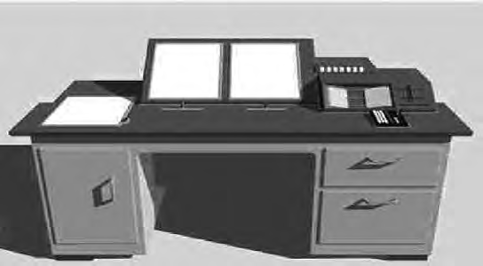
MEMEX
Bush introduced the concept of the MEMEX in the 1930s as a microfilm-based “device in which an individual stores all his books, records, and communications, and which is mechanized so that it may be consulted with exceeding speed and flexibility

Slide 4
Internet Software Evolution
The Soviet Union launched the first satellite called “Sputnik I” in 1957
The Advanced Research Projects Agency (ARPA) is created by U.S. President Dwight Eisenhower to regain the technological lead in the arms race.
ARPA appointed J. C. R. Licklider to head the new Information Processing Techniques Office (IPTO).
Licklider lead the research of the SAGE (Semi-Automatic Ground Environment) system
ARPA was renamed as DARPA, the Defense Advanced Research Projects Agency, in 1972

Slide 5
Licklider Ideas(vision)
First to propose and talk about wayback in 1972
need for networked computers with easy user interface.
Graphical Computing
Point and Click interface
Digital Libraries
E-commerce
On-line Banking
Software that would exist on network and migrate whenever it was needed.

Slide 6
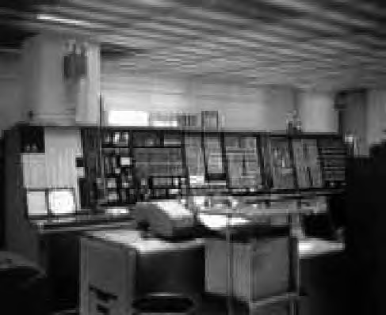
Semi-Automatic Ground Environment
The SAGE system was a continental air-defense network commissioned by the U.S. military and designed to help protect the United States against a space based nuclear attack.
SAGE, started in the 1950s, became operational in 1963 and remained in continuous operation for over 20 years, until 1983.

Slide 7
Internet Software Evolution
Licklider (Head IPTO ) evangelized the potential benefits of a country-wide communications network.
He foresaw the need for networked computers with easy user interfaces. His ideas foretold of graphical computing, point-and-click interfaces, digital libraries, e-commerce, online banking, and software that would exist on a network and migrate to wherever it was needed.
Licklider worked for several years at ARPA, where he set the stage for the creation of the ARPANET.

Slide 8
Internet Software Evolution
Lawrence Roberts, the successor to Licklider at ARPA, set up an ARPANET design session in April 1967.
The idea for a common interface to the ARPANET was first suggested by Wesley Clark in the session.
Clark elaborated on his concept to deploy a minicomputer called an Interface Message Processor (IMP) at each site.
The IMP would handle the interface to the ARPANET network.

Slide 9
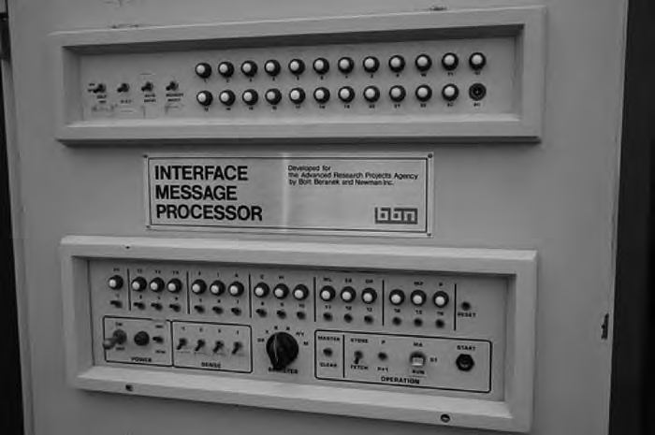
Interface Message Processor (IMP)
The physical layer, the data link layer, and the network layer protocols used internally on the ARPANET were implemented on this IMP. Using this approach, each site would only have to write one interface to the commonly deployed IMP.

Slide 10
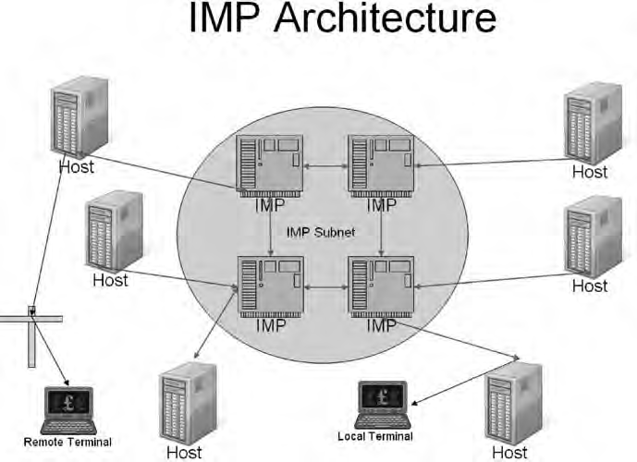
IMP Architecture
A minicomputer was created specifically to realize the design of the IMP to provide a system-independent interface to the ARPANET.
The IMP for the ARPANET went live in early October 1969.

Slide 11
Internet Software Evolution
The first networking protocol that was used on the ARPANET was the Network Control Program (NCP). The NCP provided the middle layers of a protocol stack running on an ARPANET-connected host computer.
The NCP managed the connections and flow control among the various processes running on different ARPANET host computers.
An application layer, built on top of the NCP, provided services such as email and file transfer. These applications used the NCP to handle connections to other host computers.

Slide 12
Establishing a Common Protocol for the Internet
IMP at each site will handle Interface to ARPA Network.
The IMP host interface provided the lower-level protocol layers
The NCP essentially provided a transport layer consisting of the ARPANET Host-to-Host Protocol (AHHP) and the Initial Connection Protocol (ICP).
The AHHP specified how to transmit a unidirectional, flow-controlled data stream between two hosts.
The ICP specified how to establish a bidirectional pair of data streams between a pair of connected host processes.

Slide 13
Each site would only have to one interface to the commonly deployed IMP.
The host at each site connects iteself using another type of interface that had different physical, data link and network layer specification.
The first network protocol used in ARPANet was NCP
NCP managed connections and flow control among various processes running on different host computers.
Application protocols such as File Transfer Protocol (FTP) and Simple Mail Transfer Protocol (SMTP) accessed network services through an interface of top layer of the NCP.

Slide 14
Common Protocol for the Internet
Robert Kahn and Vinton Cerf developed the TCP/IP networking protocol.
On January 1, 1983, NCP was rendered obsolete when the ARPANET changed its core networking protocols from NCP to the more flexible and powerful TCP/IP protocol suite.
Over time, there evolved four increasingly better versions of TCP/IP (TCP v1, TCP v2, a split into TCP v3 and IP v3, and TCP v4 and IPv4).
IPv4 is in the process of being replaced by IPv6.
By 1990, the ARPANET was retired and transferred to the NSFNET ( National Science Foundation NET)

Slide 15
Evolution of Ipv6
The amazing growth of the Internet throughout the 1990s caused a vast reduction in the number of free IP addresses available under IPv4.
Need for longer IP address.
The Internet Engineering Task Force (IETF) settled on IPv6, which was released in January 1995
Ipv6 is sometimes called the Next Generation Internet Protocol (IPNG) or TCP/IP v6.
Need for the design, development, and implementation of a new architecture and new hardware to support IP v6.

Slide 16
Finding a Common Method to Communicate Using the Internet Protocol
In the 1960s, twenty years after Vannevar Bush proposed MEMEX, the word hypertext was coined by Ted Nelson.
Nelson popularized the hypertext concept, but it was Douglas Engelbart who developed the first working hypertext systems.
Douglas Engelbart was a U.S. Navy radar technician in the Philippines. One day, in a Red Cross library, he picked up a copy of the Atlantic Monthly dated July 1945. He happened to come across Vannevar Bush’s article about the MEMEX automated library system and was strongly influenced by this vision of the future of information technology.

Slide 17
Finding a Common Method to Communicate Using the Internet Protocol
Sixteen years later, Engelbart published his own version of Bush’s vision in a paper “Augmenting Human Intellect: A Conceptual Framework,”.
He described an advanced electronic information system.
Engelbart joined Stanford Research Institute in 1962.
His first project was Augment, and its purpose was to develop computer tools to augment human capabilities.

Slide 18
First working hypertext system
Part of the Augment, Engelbart developed the mouse, the graphical user interface (GUI), and the first working hypertext system, named NLS (derived from oN-Line System).
NLS provided groupware capabilities, screen sharing among remote users, and reference links for moving between sentences within a research paper and from one research paper to another.
In the 1990s, Marc Andreessen and a team at the National Center for Supercomputer Applications (NCSA), a research institute at the University of Illinois, developed the Mosaic and Netscape browsers.

Slide 19
Building a Common Interface to the Internet
In the fall of 1990, Berners-Lee developed the first web browser featuring an integrated editor that could create hypertext documents.
He installed the application on two computers, and they both began communicating via the world’s first web server, at info.cern.ch, on December 25, 1990.
Once this information hit the newsgroup, new web servers began appearing all over the world almost immediately.

Slide 20
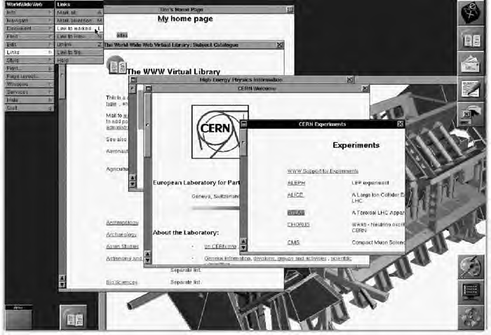
The first web browser

Slide 21
Browser
A browser is software that accesses and displays pages and files on the web. Browsers require a connection to the Internet (e.g., through a cable modem, a direct Ethernet connection, or Wi-Fi). Popular web browsers include Firefox, Internet Explorer, and Safari. Firefox is available for both Windows and Mac computers.

Slide 22
Browser
A web browser takes you anywhere on the internet. It retrieves information from other parts of the web and displays it on your desktop or mobile device. ... When the web browser fetches data from an internet connected server, it uses a piece of software called a rendering engine to translate that data into text and images.

Slide 23
Common Interface to the Internet
Marc Andreessen and Eric Bina of NCSA began work on a browser version for X-Windows on Unix computers, first released as version 0.5 on January 23, 1993.
Mosaic was the first widely popular web browser available to the general public. It helped spread use and knowledge of the web across the world.
Mosaic provided support for graphics, sound, and video clips.

Slide 24
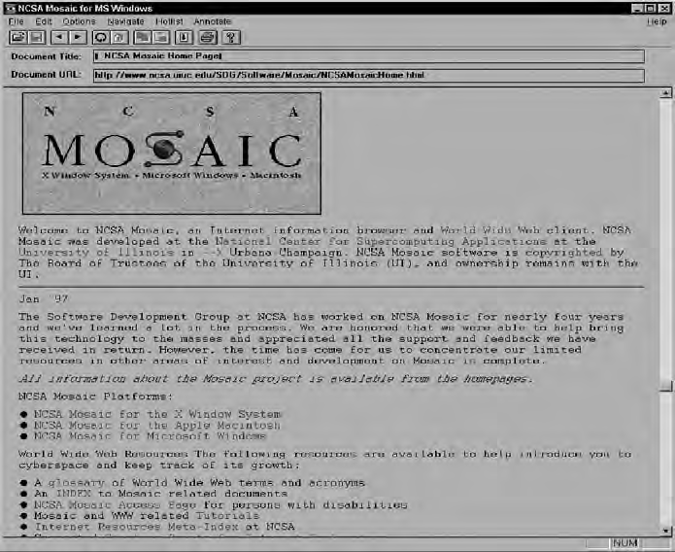
The original NCSA Mosaic browser

Slide 25
Common Interface to the Internet
In mid 1994, Silicon Graphics founder Jim Clark collaborated with Andreessen to found Mosaic Communications, which was later renamed Netscape Communications.
In October 1994, Netscape released the first beta version of its browser.
It became the very first commercial web browser.

Slide 26
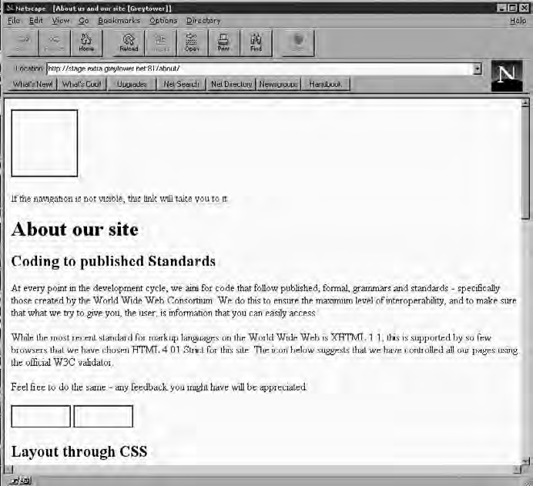
The original Netscape browser

Slide 27
Common Interface to the Internet
During this period, Microsoft was not asleep at the wheel. Bill Gates realized that the WWW was the future and focused vast resources to begin developing a product to compete with Netscape.
In 1995, Microsoft Internet Explorer arrived as both a graphical Web browser and the name for a set of technologies.
Internet Explorer 1.0 was included in Windows 95
Internet Explorer established lead by 1999 due to its distribution advantage ( because it was included in every version of Microsoft Windows.)

Slide 28
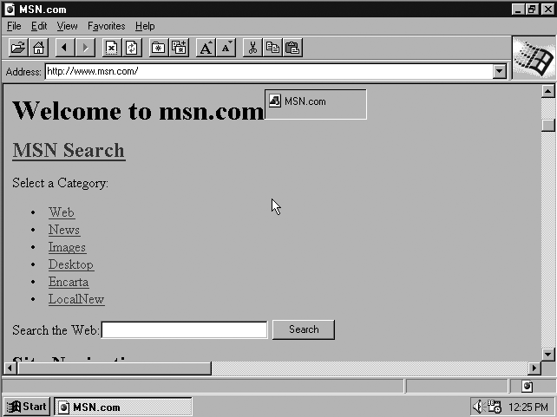
Internet Explorer version 1.0

Slide 29
Common Interface to the Internet
In response to Microsoft’s move, Netscape decided in 2002 to release a free, open source software version of Netscape named Mozilla.
Mozilla has steadily gained market share, particularly on non-Windows platforms such as Linux, largely because of its open source foundation.
Mozilla Firefox, released in November 2004, became very popular almost immediately.

Slide 30
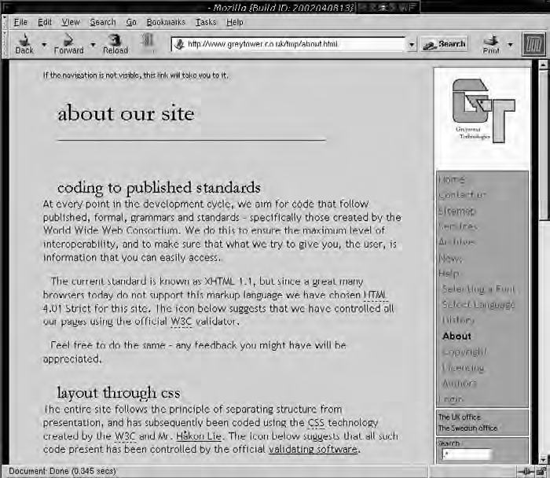
The open source version of Netscape, named Mozilla

Slide 31
The Appearance of Cloud Formations
Clustering
Clustering allowed one to configure computers using special protocols so they could “talk” to each other.
The purpose of Clustering was to balance the computational load across several machines
A key to efficient cluster management was engineering where the data was to be held (data residency).

Slide 32
The Appearance of Cloud Formations
In the early 1990s, Ian Foster and Carl Kesselman presented their concept of “The Grid.”
Grid Computing is a form of distributed computing that implements a Virtual Super Computer made up of a cluster of networked or internetworked computers acting in unison to perform very large task.
Users could plug in and use a (metered) utility service.
A major obstacle to overcome in the migration from a clustering model to grid computing was data residency.

Slide 33
The Appearance of Cloud Formations
The issues of storage management, migration of data, and security provisioning were key to any proposed solution in order for a grid model to succeed.
The Globus Toolkit is an open source software toolkit used for building grid systems and applications.
The toolkit provided by Globus allows people to share computing power, databases, instruments, and other online tools securely across corporate, institutional, and geographic boundaries without sacrificing local autonomy.

Slide 34
The Appearance of Cloud Formations
The cloud is helping to further propagate the grid computing model.
Cloud-resident entities such as data centers have taken the concepts of grid computing and bundled them into service offerings.
One of the most well known of the new cloud service providers is Amazon’s S3 (Simple Storage Service)
In 2002, EMC offered a Content Addressable Storage (CAS) solution called Centera as yet another cloud-based data storage service that competes with Amazon’s offering.
Amazon S3 suffered a “massive” outage in February 2008, which served to highlight the risks involved with adopting such cloud-based service offerings.

