Slide 1
Scalable Parallel Computer Architectures
Cluster computing
Cluster computing definition
Components of Cluster Computers
Cluster classification
Cluster Computer Architecture
Benefits of Clustering
Comparison of Clusters with MPP and Distributed Systems

Slide 2
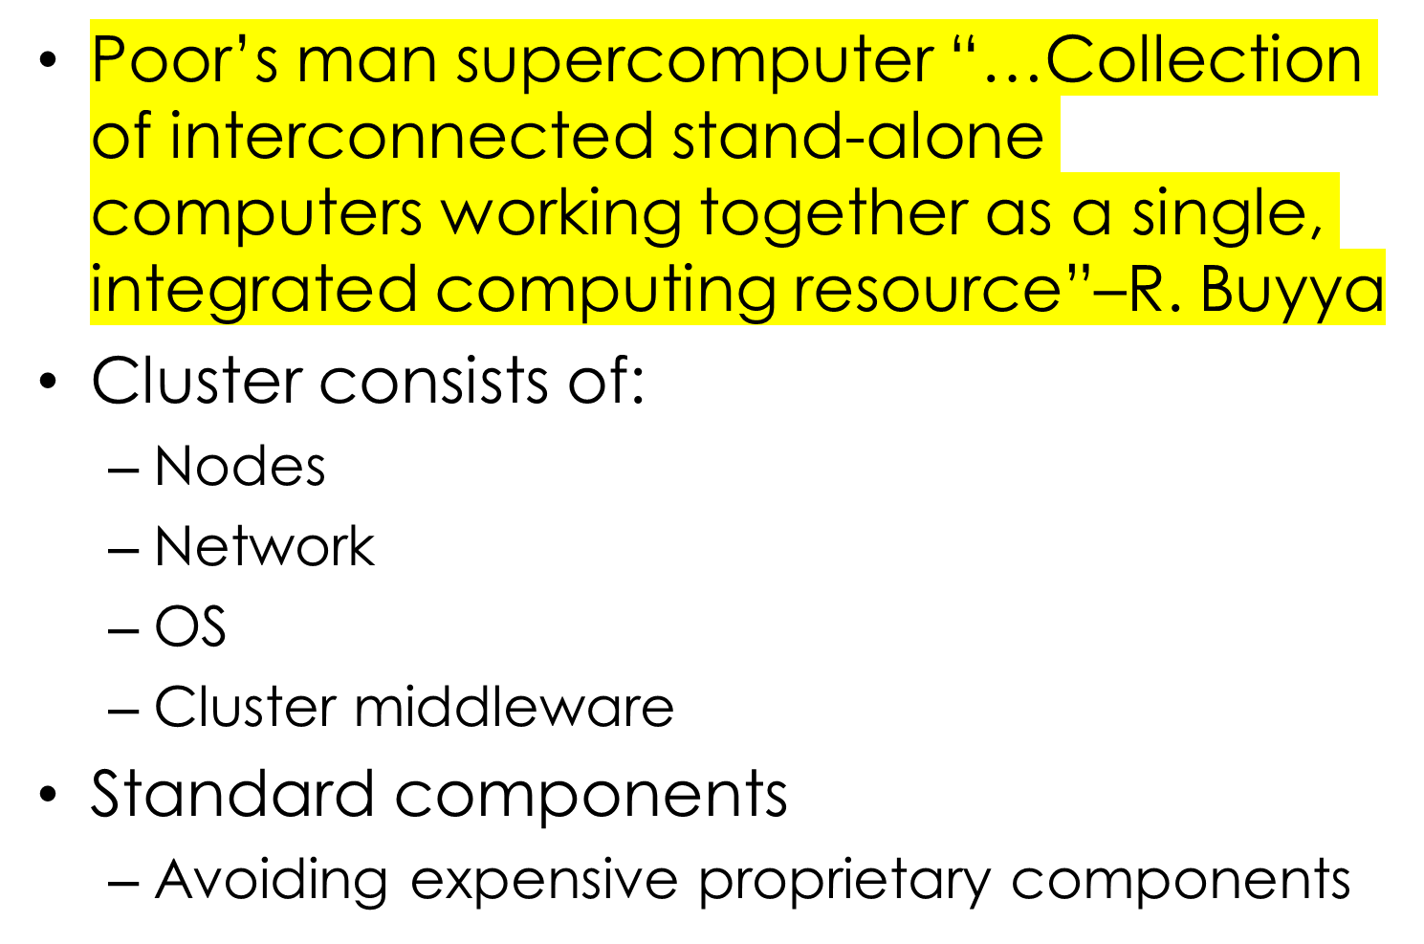
Clusters

Slide 3
A cluster architecture interconnects two or more computers using additional network and software technology to make a single virtual or logical server. Cluster architectures provide the opportunity for system architects to link together powerful commodity systems into even more powerful servers. And, since there are multiples of each component in a cluster, it is possible for the virtual server to continue to process information when a component fails or when system operators choose to maintain one component of the cluster.

Slide 4

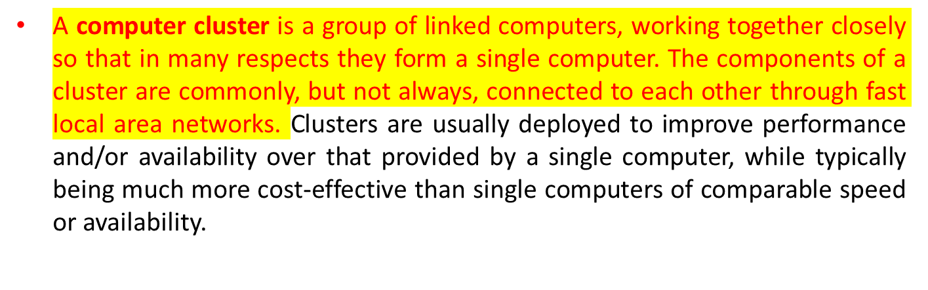

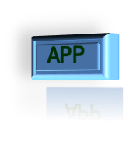







Cluster consists of:
Nodes(master +computing)
Network
OS
Cluster middleware: Middleware such as MPI which permits compute clustering programs to be portable to a wide variety of clusters
…
High Speed Local Network
CPU
CPU
…
CPU
Cluster

Slide 5
A Beowulf cluster is a computer cluster of what are normally identical, commodity-grade computers networked into a small local area network with libraries and programs installed which allow processing to be shared among them.

Slide 6
Prominent Components of
Cluster Computers
Multiple High Performance Computers
  PCs, Workstations
  SMPs (CLUMPS)-CLUsters of Multi-ProcesserS
  Clusters of SMPs with several network interfaces can be connected using high performance networks.
  Distributed HPC Systems leading to Meta-computing

Slide 7
Cluster classification
High performance clusters (HPC)
  Parallel, tightly coupled applications
High throughput clusters (HTC)
  Large number of independent tasks
High availability clusters (HA)
  Mission critical applications
Load balancing clusters
  Web servers, mail servers, …
Hybrid clusters
  Example: HPC+HA

Slide 8
Cluster Computing(high Performance Clusters)
With a high performance computing cluster, multiple computers, or nodes, are linked together through a local-area network (LAN) to create an HPC cluster architecture. The configuration of an HPC cluster is uniquely designed to solve one problem by spanning it across the nodes in a system. HPC clusters have a defined network topology and allow organizations to tackle advanced computations with uncompromised processing speeds.

Slide 9

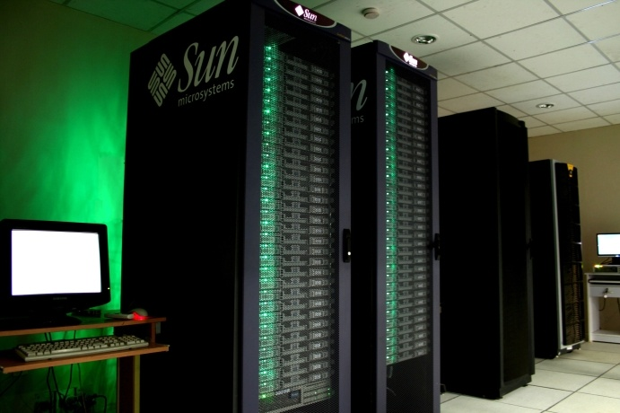

Slide 10

Brief Architectural information:
  Processor : AMD OPETRON 2218 DUAL CORE DUAL SOCKET
  NO. of Master Nodes : 1
  NO. of Computing Nodes : 64
  CLUSTER Software : ROCKS version 4.3
  Total Peak Performance : 1.3 T. F(Tera FLOPS)—Floating Point Operations per Second
  Peak Performance: In network performance management, a set of functions that evaluate and report the behavior of:
    telecommunications equipment
    Efffectiveness of the network or network element
    Other subfunctions, such as
      gathering statistical information,
      maintaining and examining historical logs,
      determining system performance under natural and artificial conditions
      altering system modes of operation.

Slide 11

Calculation procedure for peak performance:
  No of nodes 64
  Memory RAM 4 GB
  Hard Disk Capacity/each node : 250GB
  Storage Cap. 4 TB
  No .of processors and cores: 2 X 2 = 4(dual core + dual socket)
  CPU speed : 2.6 GHz(frequency of CPU)
  No. of floating point operations per seconds for AMD processor: 2 (since it is a dual core)
  Total peak performance : No of nodes X No .of processors and cores X CPU speed X No of floating point operations per second = 64 X 4 X 2.6GHz X 2 = 1.33 TF

Slide 12

Scheduler used: Sun Grid Engine: Job scheduler software tool.
Application software/s and compilers:
  Open MPI Lam MPI—Message Passing Interface.
  C, C++, FORTRAN compilers (both GNU AND INTEL)
  Bio roll: for Bio-Chemical applications

Slide 13

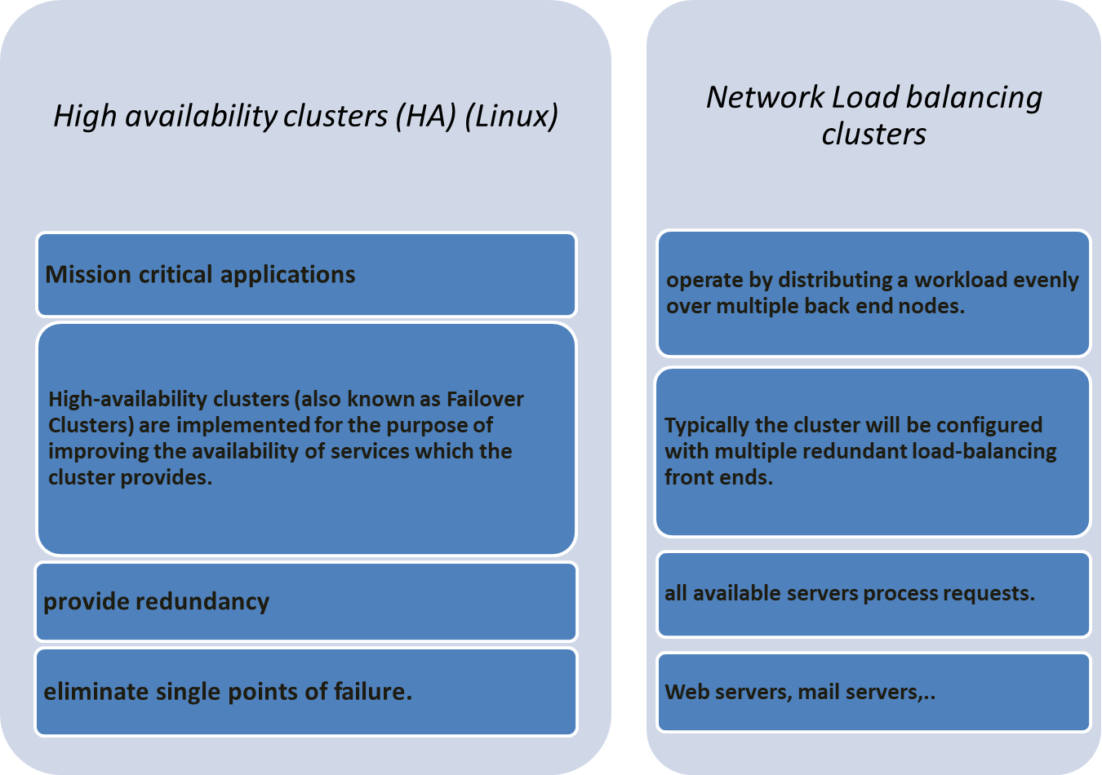

Slide 14
Cluster Computer and its Architecture
A cluster is a type of parallel or distributed processing system, which consists of a collection of interconnected stand-alone computers cooperatively working together as a single, integrated computing resource
A node
  a single or multiprocessor system with memory, I/O facilities, & OS
  generally 2 or more computers (nodes) connected together
  in a single cabinet, or physically separated & connected via a LAN
  appear as a single system to users and applications
  provide a cost-effective way to gain features and benefits

Slide 15
Cluster Computer Architecture
Parallel Applications
Parallel Applications
Parallel Applications
Sequential Applications
Sequential Applications
Sequential Applications
Parallel Programming Environment
Cluster Middleware
(Single System Image and Availability Infrastructure)
PC/Workstation
PC/Workstation
PC/Workstation
PC/Workstation
Communications
Software
Communications
Software
Communications
Software
Communications
Software
Network Interface Hardware
Network Interface Hardware
Network Interface Hardware
Network Interface Hardware
Cluster Interconnection Network/Switch

Slide 16
PVM-Parallel Virtual Machine
PVM is a software system that enables a collection of heterogeneous computers to be used as a coherent and flexible concurrent computational resource, or a "parallel virtual machine".
PVM consists of a run-time environment and library for message-passing, task and resource management, and fault notification. While PVM will not automatically make a commercial software package run faster, it does provide a powerful set of functions for manually parallelizing an existing source program, or for writing new parallel/distributed programs

Slide 17
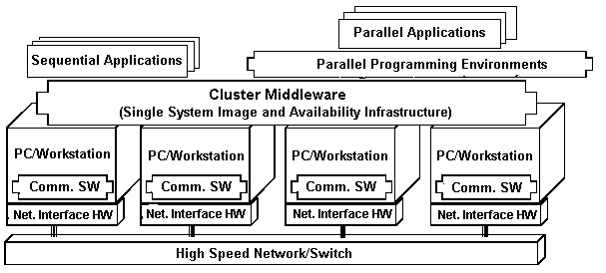
Parallel Environment
  Two of the most commonly used Parallel Interface Libraries:
    PVM (Parallel Virtual Machine)
    MPI (Message Passing Interface)
  Parallel Interface Libraries: provide a group of communication interface libraries that support message passing. Users can call these libraries directly in their Fortran and C programs.
Cluster Computer Architecture

Slide 18
Key Operational Benefits of Clustering
High Performance
Expandability and Scalability
High Throughput
High Availability

Slide 19
What is Single System Image (SSI) ?
A single system image is the illusion created by software or hardware, that presents a collection of resources as one, (single)more powerful resource.
SSI makes the cluster appear like a single machine to the user, to applications, and to the network.
A cluster without a SSI is not a cluster

Slide 20
Cluster Middleware & SSI
SSI
  Supported by a middleware layer that resides between the OS and user-level environment
  Middleware consists of essentially 2 sublayers of SW infrastructure
    SSI infrastructure
      Glue together OSs on all nodes to offer unified access to system resources
    System availability infrastructure
      Enable cluster services such as checkpointing, automatic failover, recovery from failure, & fault-tolerant support among all nodes of the cluster

Slide 21
Who Uses HPC ?
Scientific & Engineering Applications
    Simulation of physical phenomena
    Virtual Prototyping (Modeling)
    Data analysis
Business/ Industry Applications
    Data warehousing for financial sectors
    E-governance
    Medical Imaging
    Web servers, Search Engines, Digital libraries
    …etc …..
All face similar problems
    Not enough computational resources
    Remote facilities – Network becomes the bottleneck
    Heterogeneous and fast changing systems

Slide 22
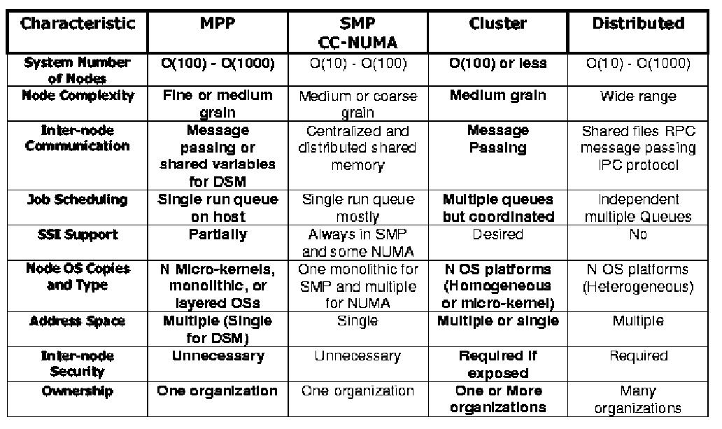
Key Characteristics of
Scalable Parallel Computers

