Slide 1
Grid Computing
What is Grid ?
Elements of Grid Computing
Grid Architecture
Grid Benefits & Applications
Grid Topologies & Grid Types
A typical view of Grid environment
Grid Components & Grid Middleware
From Grids to Cloud Computing

Slide 2
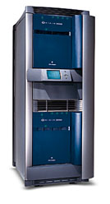


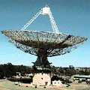

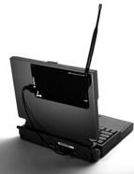

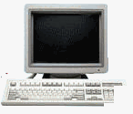
What is Grid ?
An infrastructure that couples:
Computers (PCs, workstations, clusters, traditional supercomputers, and even laptops, notebooks, mobile computers, PDA, and so on) …
Software ? (e.g., ASPs renting expensive special purpose applications on demand)
Catalogued Data/Databases (e.g., transparent access to human genome database)
Special Instruments (e.g., radio telescope--SETI@Home Searching for Life in galaxy, Austrophysics@Swinburne for pulsars)
People/collaborators (even animals who knows ?)
and offers a simple, consistent, dependable, & pervasive access across (local/wide-area) networks to present them as unified integrated resource.

Slide 3
Grid: at a glance

Slide 4
Grids
Similar to clusters but processors are more loosely coupled, tend to be heterogeneous, and are not all in a central location.
Can handle workloads similar to those on supercomputers, but grid computers connect over a network (Internet?) and supercomputers’ CPUs connect to a high-speed internal bus/network
Problems are broken up into parts and distributed across multiple computers in the grid – less communication between parts than in clusters.

Slide 6
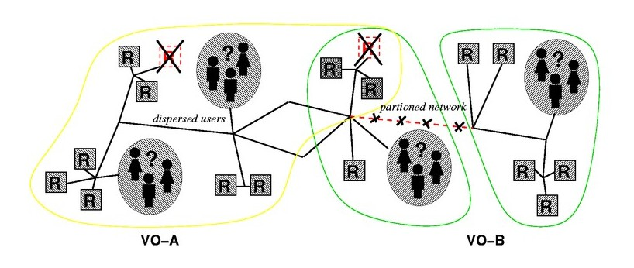
The Grid
“Resource sharing & coordinated problem solving in dynamic, multi-institutional virtual organizations”

Slide 7
Grid Computing Systems
Modeled loosely on the electrical grid.
Highly heterogeneous with respect to hardware, software, networks, security policies, etc.
Grids support virtual organizations: a collaboration of users who pool resources (servers, storage, databases) and share them
Grid software is concerned with managing sharing across administrative domains.

Slide 8
A Comparison
SERIAL
Fetch/Store
Compute
PARALLEL
Fetch/Store
Compute/ communicate
Cooperative game
GRID
Fetch/Store
Discovery of Resources
Interaction with remote application
Authentication / Authorization
Security
Compute/Communicate
Etc

Slide 9
Elements of Grid Computing
Resource sharing
Computers, data, storage, sensors, networks, …
Sharing always conditional: issues of trust, policy, negotiation, payment, …
Coordinated problem solving
Beyond client-server: distributed data analysis, computation, collaboration, …
Dynamic, multi-institutional virtual organizations
Community overlays on classic org structures
Large or small, static or dynamic

Slide 10
Virtual Organizations
A set of individuals and/or institutions defined by a set of sharing rules
The sharing is highly controlled, with resource providers and consumers defining clearly and carefully just what is shared
An example: the set of application service providers, storage service providers, cycle providers and consultants engaged by a car manufacturer to plan for a new factory
Another example: industrial consortium building a new aircraft

Slide 11
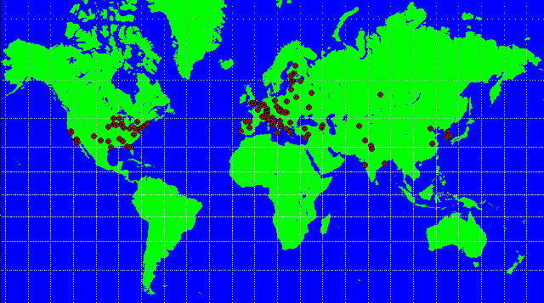
An Example Virtual Organization: CERN’s Large Hadron Collider
1800 Physicists, 150 Institutes, 32 Countries
100 PB of data by 2010; 50,000 CPUs?
The Large Hadron Collider (LHC) is the world’s largest and most powerful particle accelerator. It first started up on 10 September 2008, and remains the latest addition to CERN’s accelerator complex. The LHC consists of a 27-kilometre ring of superconducting magnets with a number of accelerating structures to boost the energy of the particles along the way.

Slide 12
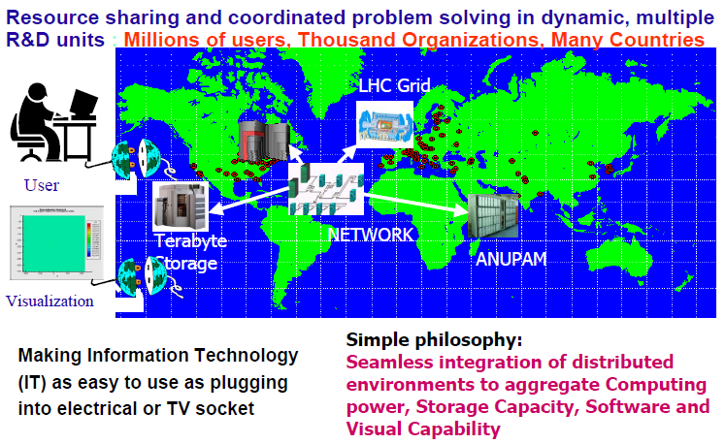
Virtual organizations: GRID
TIFR

Slide 13
Distributed Computing vs. GRID
Grid is an evolution of distributed computing
Dynamic
Geographically independent
Built around standards
Internet backbone
Distributed computing is an “older term”
Typically built around proprietary software and network
Tightly couples systems/organization

Slide 14
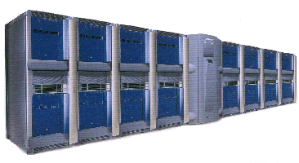
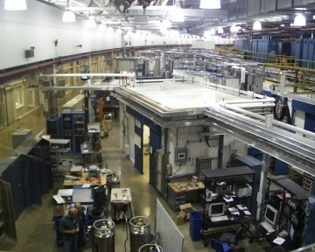
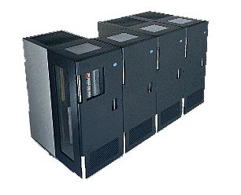
Web vs. GRID
Web
Uniform naming access to documents
Grid - Uniform, high performance access to computational resources
http://
http://
Software Catalogs
Sensor nets
Colleges/R&D Labs

Slide 15
Grid Architecture

Slide 16
The Hourglass Model
Focus on architecture issues
Propose set of core services as basic infrastructure
Used to construct high-level, domain-specific solutions (diverse)
Design principles
Keep participation cost low
Enable local control
Support for adaptation
“IP hourglass” model
A p p l i c a t i o n s
Diverse global services
Core
services
Local OS

Slide 17
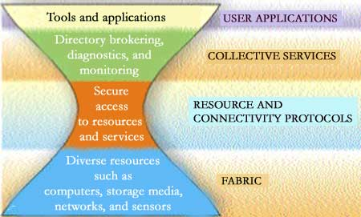
Forget Homogeneity!
Trying to force homogeneity on users is futile. Everyone has their own preferences, sometimes even dogma.
The Internet provides the model…

Slide 18
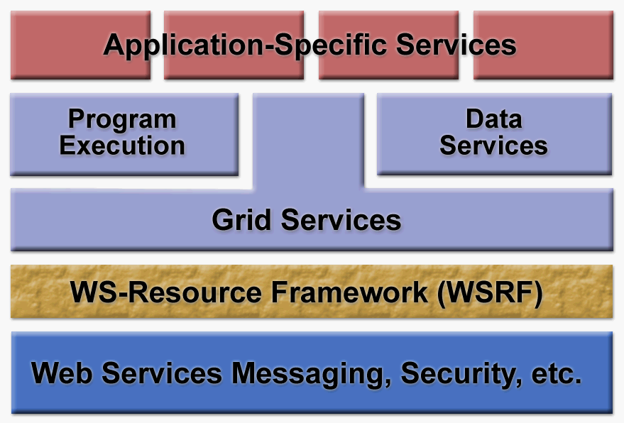
From Theory to Practice

Slide 19
Layered Grid Architecture (By Analogy to Internet Architecture)
Application
Application
Internet Protocol Architecture
“Coordinating multiple resources”: ubiquitous infrastructure services, app-specific distributed services
Collective
“Sharing single resources”: negotiating access, controlling use
Resource
“Talking to things”: communication (Internet protocols) & security
Connectivity
Transport
Internet
“Controlling things locally”: Access to, & control of, resources
Fabric
Link
Notes:
We define Grid architecture in terms of a layered collection of protocols.
Fabric layer includes the protocols and interfaces that provide access to the resources that are being shared, including computers, storage systems, datasets, programs, and networks. This layer is a logical view rather then a physical view. For example, the view of a cluster with a local resource manager is defined by the local resource manger, and not the cluster hardware. Likewise, the fabric provided by a storage system is defined by the file system that is available on that system, not the raw disk or tapes.
The connectivity layer defines core protocols required for Grid-specific network transactions. This layer includes the IP protocol stack (system level application protocols [e.g. DNS, RSVP, Routing], transport and internet layers), as well as core Grid security protocols for authentication and authorization.
Resource layer defines protocols to initiate and control sharing of (local) resources. Services defined at this level are gatekeeper, GRIS, along with some user oriented application protocols from the Internet protocol suite, such as file-transfer.
Collective layer defines protocols that provide system oriented capabilities that are expected to be wide scale in deployment and generic in function. This includes GIIS, bandwidth brokers, resource brokers,….
Application layer defines protocols and services that are parochial in nature, targeted towards a specific application domain or class of applications. These are are are … arrgh

Slide 20
Protocols, Services,and APIs Occur at Each Level
Applications
Languages/Frameworks
Collective Service APIs and SDKs
Collective Service Protocols
Collective Services
Resource APIs and SDKs
Resource Service Protocols
Resource Services
Connectivity APIs
Connectivity Protocols
Local Access APIs and Protocols
Fabric Layer
Notes:
This figure shows the relationship between APIs, services and protocols. At each protocol layer in the Grid architecture, one or more services are defined. Access to these services is provided by one or more APIs. More sophisticated interfaces, which we call software development toolkits (SDKs) provide complex functionality that may not map one to one onto service functions and may combine services and protocols at lower levels in the Grid protocol stack.
At the top of this figure, we include languages and frameworks, which utilize the various APIs and SDKs to provide programming environments to the Grid application.

Slide 21
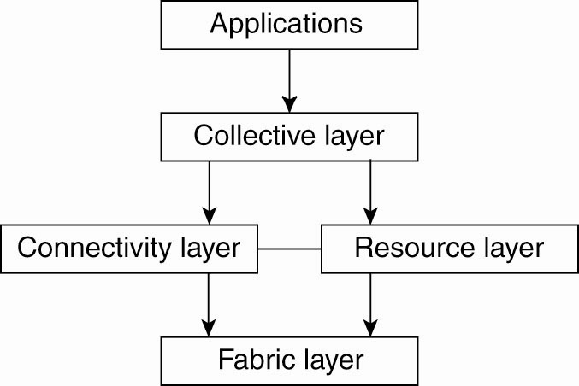
A Proposed Architecture for Grid Systems*
Fabric layer: interfaces to local resources at a specific site
Connectivity layer: protocols to support usage of multiple resources for a single application; e.g., access a remote resource or transfer data between resources; and protocols to provide security
Resource layer manages a single resource, using functions supplied by the connectivity layer
Collective layer: resource discovery, allocation, scheduling, etc.
Applications: use the grid resources
The collective, connectivity and resource layers together form the middleware layer for a grid
Figure 1-7. A layered architecture for grid computing systems

Slide 22
OGSA – Another Grid Architecture*
Open Grid Services Architecture (OGSA) is a service-oriented architecture
Sites that offer resources to share do so by offering specific Web services.
The architecture of the OGSA model is more complex than the previous layered model.

Slide 23
Benefits
Exploit Underutilized resources
Resource load Balancing
Virtualize resources across an enterprise
Data Grids, Compute Grids
Enable collaboration for virtual organizations

Slide 24
Grid Applications
Data and computationally intensive applications:
This technology has been applied to computationally-intensive scientific, mathematical, and academic problems like drug discovery, economic forecasting, seismic analysis back office data processing in support of e-commerce
A chemist may utilize hundreds of processors to screen thousands of compounds per hour.
Teams of engineers worldwide pool resources to analyze terabytes of structural data.
Meteorologists seek to visualize and analyze petabytes of climate data with enormous computational demands.
Resource sharing
Computers, storage, sensors, networks, …
Sharing always conditional: issues of trust, policy, negotiation, payment, …
Coordinated problem solving
distributed data analysis, computation, collaboration, …

Slide 25
Grid Topologies
• Intragrid
– Local grid within an organization
– Trust based on personal contracts
• Extragrid
– Resources of a consortium of organizations
connected through a (Virtual) Private Network
– Trust based on Business to Business(B2B) contracts
• Intergrid
– Global sharing of resources through the internet
– Trust based on certification

Slide 26
Computational Grid
“A computational grid is a hardware and software infrastructure that provides dependable, consistent, pervasive, and inexpensive access to high-end computational capabilities.”
”The Grid: Blueprint for a New Computing Infrastructure”, Kesselman & Foster
Example : Science Grid (US Department of Energy)

Slide 27
Data Grid
A data grid is a grid computing system that deals with data — the controlled sharing and management of large amounts of distributed data.
Data Grid is the storage component of a grid environment. Scientific and engineering applications require access to large amounts of data, and often this data is widely distributed. A data grid provides seamless access to the local or remote data required to complete compute intensive calculations.
Example :
Biomedical informatics Research Network (BIRN),
the Southern California earthquake Center (SCEC).

Slide 28
A typical view of Grid environment
Grid Information Service system collects the details of the available Grid resources and passes the information to the resource broker.
Grid Information Service
Details of Grid resources
1
Computational jobs
2
Grid application
4
3
Processed jobs
Computation result
User
Resource Broker
A User sends computation or data intensive application to Global Grids in order to speed up the execution of the application.
A Resource Broker distribute the jobs in an application to the Grid resources based on user’s QoS requirements and details of available Grid resources for further executions.
Grid Resources
Grid Resources (Cluster, PC, Supercomputer, database, instruments, etc.) in the Global Grid execute the user jobs.

Slide 29
Grid Middleware
Grids are typically managed by grid ware -
a special type of middleware that enable sharing and manage grid components based on user requirements and resource attributes (e.g., capacity, performance)
Software that connects other software components or applications to provide the following functions:
Run applications on suitable available resources
– Brokering, Scheduling
Provide uniform, high-level access to resources
– Semantic interfaces
– Web Services, Service Oriented Architectures
Address inter-domain issues of security, policy, etc.
– Federated Identities
Provide application-level status
monitoring and control

Slide 30
Middlewares
Globus –chicago Univ
Condor – Wisconsin Univ – High throughput computing
Legion – Virginia Univ – virtual workspaces- collaborative computing
IBP – Internet back pane – Tennesse Univ – logistical networking
NetSolve – solving scientific problems in heterogeneous env – high throughput & data intensive
Notes:
30

Slide 31
Two Key Grid Computing Groups
The Globus Alliance (www.globus.org)
Composed of people from:
Argonne National Labs, University of Chicago, University of Southern California Information Sciences Institute, University of Edinburgh and others.
OGSA/I standards initially proposed by the Globus Group
The Global Grid Forum (www.ggf.org)
Heavy involvement of Academic Groups and Industry
(e.g. IBM Grid Computing, HP, United Devices, Oracle, UK e-Science Programme, US DOE, US NSF, Indiana University, and many others)
Process
Meets three times annually
Solicits involvement from industry, research groups, and academics

Slide 32
Some of the Major Grid Projects
Name | URL/Sponsor | Focus
EuroGrid, Grid Interoperability (GRIP) | eurogrid.org European Union | Create tech for remote access to super comp resources & simulation codes; in GRIP, integrate with Globus Toolkit™
Fusion Collaboratory | fusiongrid.org DOE Off. Science | Create a national computational collaboratory for fusion research
Globus Project™ | globus.org DARPA, DOE, NSF, NASA, Msoft | Research on Grid technologies; development and support of Globus Toolkit™; application and deployment
GridLab | gridlab.org European Union | Grid technologies and applications
GridPP | gridpp.ac.uk U.K. eScience | Create & apply an operational grid within the U.K. for particle physics research
Grid Research Integration Dev. & Support Center | grids-center.org NSF | Integration, deployment, support of the NSF Middleware Infrastructure for research & education

Slide 33
Grid Components
Applications and Portals
…
Grid
Apps.
Scientific
Engineering
Collaboration
Prob. Solving Env.
Web enabled Apps
Development Environments and Tools
Grid
Tools
Languages
…
Web tools
Libraries
Debuggers
Monitoring
Resource Brokers
Distributed Resources Coupling Services
Grid
Middleware
…
Comm.
Security
Information
Process
Resource Trading
QoS
Local Resource Managers
Operating Systems
Queuing Systems
Libraries & App Kernels
…
TCP/IP & UDP
Grid
Fabric
Networked Resources across Organisations
Storage Systems
Data Sources
…
Scientific Instruments
Computers
Clusters

Slide 35
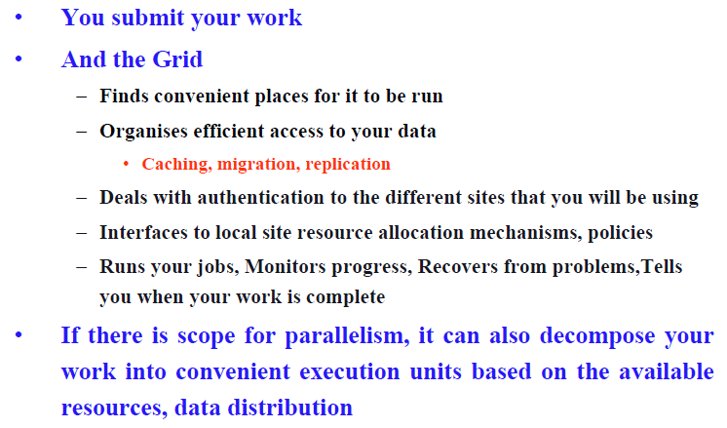
How does grid work?

Slide 36
Key Components The Hourglass Model
A p p l i c a t i o n s
Diverse global services
User Applications
Collective services
Core
Services and Abstractions
(e.g. TCP, HTTP)
Resource and Connectivity protocol
Fabric
Local OS

Slide 37
Key Components Layered Grid Architecture (By Analogy to Internet Architecture)
Internet Protocol Architecture
Application
Application
“Coordinating multiple resources”: ubiquitous infrastructure services, app-specific distributed services
Collective
“Sharing single resources”: negotiating access, controlling use
Resource
“Talking to things”: communication (Internet protocols) & security
Transport
Connectivity
Internet
“Controlling things locally”: Access to, & control of, resources
Link
Fabric

Slide 38
Key Components Layered Grid Architecture: Fabric Layer
Just what you would expect: the diverse mix of resources that may be shared
Individual computers, Condor pools, file systems, archives, metadata catalogs, networks, sensors, etc., etc.
Defined by interfaces, not physical characteristics

Slide 39
Key Components Layered Grid Architecture:Connectivity Layer
Communication
Internet protocols: IP, DNS, routing, etc.
Security: Grid Security Infrastructure (GSI)
Uniform authentication, authorization, and message protection mechanisms in multi-institutional setting
Single sign-on, delegation, identity mapping
Public key technology, SSL, X.509, GSS-API
Supporting infrastructure: Certificate Authorities, certificate & key management, …

Slide 40
Key Components Layered Grid Architecture:Resource Layer
The architecture is for the secure negotiation, initiation, monitoring, control, accounting, and payment of sharing operations on individual resources.
Information Protocols (inform about the structure and state of the resource)
Management Protocols (negotiate access to a shared resource)

Slide 41
Key Components Layered Grid Architecture:Resource Layer
Grid Resource Allocation Mgmt (GRAM)
Remote allocation, reservation, monitoring, control of compute resources
GridFTP protocol (FTP extensions)
High-performance data access & transport
Grid Resource Information Service (GRIS)
Access to structure & state information
Network reservation, monitoring, control
All built on connectivity layer: GSI & IP

Slide 42
Key Components Layered Grid Architecture:Collective layer
Coordinating multiple resources
Contains protocols and services that capture interactions among a collection of resources
It supports a variety of sharing behaviours without placing new requirements on the resources being shared
Sample services: directory services, co-allocation, brokering and scheduling services, data replication services, workload management services, collaboratory services

Slide 43
Key Components Layered Grid Architecture:Collective Layer
Index servers aka metadirectory services
Custom views on dynamic resource collections assembled by a community
Resource brokers (e.g., Condor Matchmaker)
Resource discovery and allocation
Replica catalogs
Replication services
Co-reservation and co-allocation services
Workflow management services

Slide 44
Key Components Layered Grid Architecture:Applications layer
There are user applications that operate within the VO environment
Applications are constructed by calling upon services defined at any layer
Each of the layers are well defined using protocols, provide access to services
Well-defined APIs also exist to work with these services

Slide 45
Key Components Where Are We With Architecture?
No “official” standards exist
But:
Globus Toolkit™ has emerged as the de facto standard for several important Connectivity, Resource, and Collective protocols
Technical specifications are being developed for architecture elements: e.g., security, data, resource management, information

Slide 46
From Grids to Cloud Computing
Logical steps:
Make the grids public
Provide much simpler interfaces (and more limited control)
Charge usage of resources
Instead of relying on implicit incentives from science collaborations
Ideally, a “pay-as-you-go” rate
In reality:
Different history
Cloud computing as utility computing (1966 paper)
However, the promise of cloud computing finds a great user base in science grids due to:
Intense computations
Huge amounts of storage needs
Much of the Grid research community is now working on clouds
How much of that is only rebranding is useful to understand

