Slide 1
Parallel & Distributed Systems Overview
Basic Computer and it’s Computing Elements
Parallel Computers
Architectures
Need
Taxonomy or Classification
Memory Architectures
Distributed Systems & their Goals

Slide 2
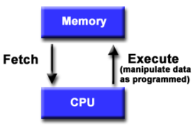
Basic Computer
Basic design
Memory is used to store both program and data instructions
Program instructions are coded data which tell the computer to do something
Data is simply information to be used by the program
A central processing unit (CPU) gets instructions and/or data from memory, decodes the instructions and then sequentially performs them.

Slide 3
Computing Elements
Applications
Programming paradigms
Threads Interface
Microkernel
Operating System
Multi-Processor Computing System
.
.
Hardware
P
P
P
P
P
P
P
Processor
Thread
Process

Slide 4
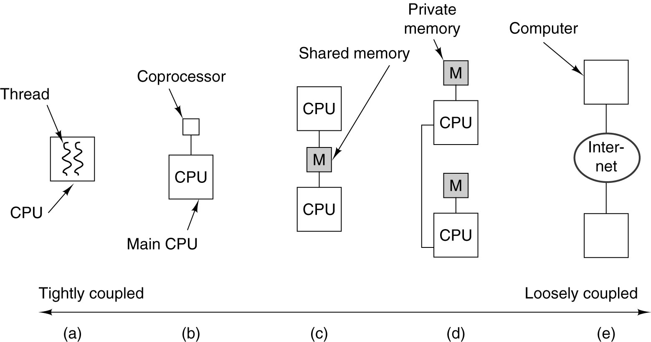
Parallel Computer Architectures
(a) On-chip parallelism. (b) A coprocessor. (c) A multiprocessor.
(d) A multicomputer. (e) A grid.

Slide 5
Why Parallel Processing?
Computation requirements are ever increasing -- visualization, distributed databases, simulations, scientific prediction (earthquake), etc.
Sequential architectures reaching physical limitation (speed of light, thermodynamics)

Slide 6
Human Architecture! Growth Performance
Vertical
Horizontal
Growth
5 10 15 20 25 30 35 40 45 . . . .
Age

Slide 7
Computational Power Improvement (CPI)
Multiprocessor
C.P.I.
Uniprocessor
1 2 . . . .
No. of Processors

Slide 8
Why Parallel Processing?
The Tech. of PP is mature and can be exploited commercially; significant R & D work on development of tools & environment.
Significant development in Networking technology is paving a way for heterogeneous computing.

Slide 9
Why Parallel Processing?
Hardware improvements like Pipelining, Superscalar, etc., are non-scalable and requires sophisticated Compiler Technology.
Vector Processing works well for certain kind of problems.
SCALAR instructions– ADD SUB MUL—examples
Superscalar-MOVM-superscalar
Mov CX,#5
MOVSB
VECTOR-instructions-VADD,VSUB, VMUL --

Slide 10
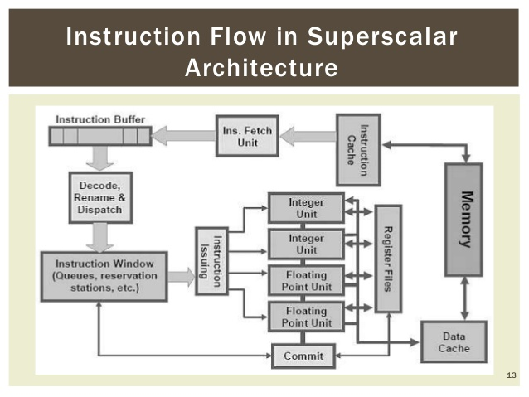
Super Scalar Architecture

Slide 11
Superscalar Architecture
Superscalar architecture is a method of parallel computing used in many processors. In a superscalar computer, the central processing unit (CPU) manages multiple instruction pipelines to execute several instructions concurrently during a clock cycle.
A superscalar processor is a CPU that implements a form of parallelism called instruction-level parallelism within a single processor. In contrast to a scalar processor that can execute at most one single instruction per clock cycle, a superscalar processor can execute more than one instruction during a clock cycle by simultaneously dispatching multiple instructions to different execution units on the processor. It therefore allows for more throughput (the number of instructions that can be executed in a unit of time) than would otherwise be possible at a given clock rate. Each execution unit is not a separate processor (or a core if the processor is a multi-core processor), but an execution resource within a single CPU such as an arithmetic logic unit.

Slide 12
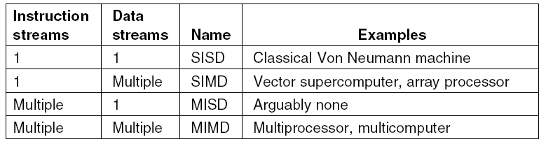
Taxonomy of Parallel Computers (1)
Flynn’s classification

Slide 13
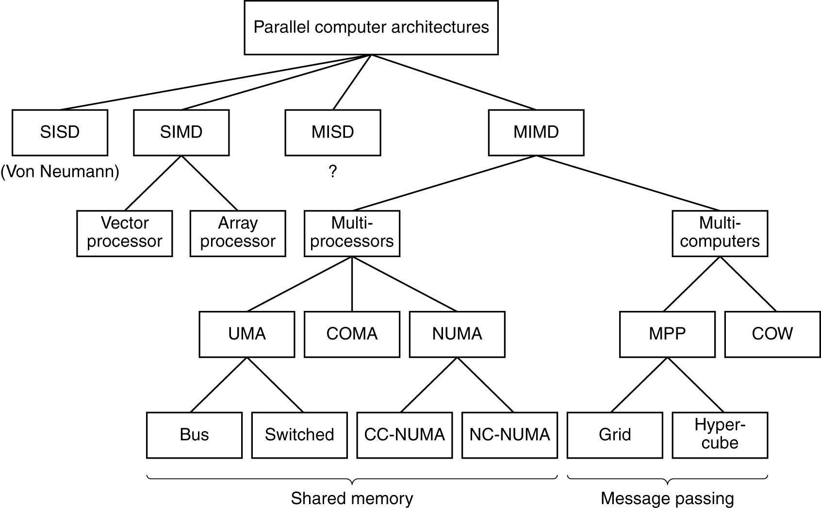
Taxonomy of Parallel Computers (2)

Slide 14
SISD : A Conventional Computer
Instructions
Processor
Data Input
Data Output
Speed is limited by the rate at which computer can transfer information internally.
Ex:PC, Macintosh, Workstations

Slide 15
The MISD Architecture
Instruction
Stream A
Instruction
Stream B
Instruction Stream C
Processor
A
Data
Output
Stream
Data
Input
Stream
Processor
B
Processor
C
More of an intellectual exercise than a practical configuration. Few built, but commercially not available

Slide 16
SIMD Architecture
Ex:Vector proc.
Instruction
Stream
Data Output
stream A
Data Input
stream A
Processor
A
Data Output
stream B
Data Input
stream B
Processor
B
Processor
C
Data Output
stream C
Data Input
stream C
C_{i}<= A_{i} * B_{i}

Slide 17
MIMD Architecture
Instruction
Stream A
Instruction
Stream B
Instruction
Stream C
Data Output
stream A
Data Input
stream A
Processor
A
Data Output
stream B
Data Input
stream B
Processor
B
Processor
C
Data Output
stream C
Data Input
stream C
Unlike SISD, MISD, MIMD computer works asynchronously.
Shared memory (tightly coupled) MIMD
Distributed memory (loosely coupled) MIMD

Slide 18
Shared Memory MIMD machine
Processor
A
Processor
B
Processor
C
MEMORY
MEMORY
MEMORY
BUS
BUS
BUS
Global Memory System
Comm: Source PE(processing element) writes data to GM & destination retrieves it
Easy to build, conventional OSes of SISD can be easily be ported
Limitation : reliability & expandibility. A memory component or any processor failure affects the whole system.
Increase of processors leads to memory contention.
Ex. : Silicon graphics supercomputers....

Slide 19
Distributed Memory MIMD
IPC
channel
IPC
channel
Processor
A
Processor
B
Processor
C
MEMORY
MEMORY
MEMORY
BUS
BUS
BUS
Memory
System A
Memory
System B
Memory
System C
Communication : IPC on High Speed Network.
Network can be configured to ... Tree, Mesh, Cube, etc.
Unlike Shared MIMD
easily/ readily expandable
Highly reliable (any CPU failure does not affect the whole system)

Slide 20
Laws of caution.....
Speed of computers is proportional to the square of their cost.
i.e. cost = Speed
Speedup by a parallel computer increases as the logarithm of the number of processors.
Speedup = log2(no. of processors)
C
(speed = cost²)
S
S
log₂P
P

Slide 21
Parallel Computer Memory Architectures

Slide 22
Memory architectures
Shared Memory
Distributed Memory
Hybrid Distributed-Shared Memory

Slide 23
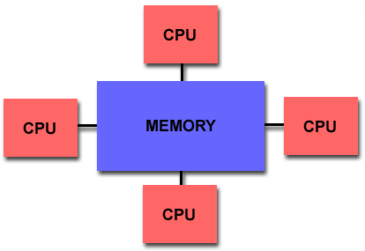
Shared Memory
Shared memory parallel computers vary widely, but generally have in common the ability for all processors to access all memory as global address space.
Multiple processors can operate independently but share the same memory resources.
Changes in a memory location effected by one processor are visible to all other processors.
Shared memory machines can be divided into two main classes based upon memory access times: UMA and NUMA.

Slide 24
Symmetric Multiple Processing
Two or more (64 today) processors
Each processor is equally capable
Shared-everything architecture
All processors share all the global resources available
Single copy of the OS runs on these systems
issues:
Scalability
Data propagation time increases in proportion to the number of processors added to SMP systems.
examples: UltraSparcII, Alpha ES, Generic Itanium, Opteron, Xeon, …

Slide 25
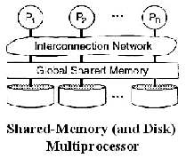
Shared Everything Architecture

Slide 26
Shared Memory : UMA vs. NUMA
Uniform Memory Access (UMA):
Most commonly represented today by Symmetric Multiprocessor (SMP) machines
Identical processors
Equal access and access times to memory
Sometimes called CC-UMA - Cache Coherent UMA. Cache coherent means if one processor updates a location in shared memory, all the other processors know about the update. Cache cohérence accomplished at the hardware level.
Non-Uniform Memory Access (NUMA):
Often made by physically linking two or more SMPs
One SMP can directly access memory of another SMP
Not all processors have equal access time to all memories
Memory access across link is slower
If cache coherency is maintained, then may also be called CC-NUMA - Cache Coherent NUMA

Slide 27
Shared Memory: Pro and Con
Advantages
Global address space provides a user-friendly programming perspective to memory
Data sharing between tasks is both fast and uniform due to the proximity of memory to CPUs
Disadvantages:
Primary disadvantage is the lack of scalability between memory and CPUs. Adding more CPUs can geometrically increases traffic on the shared memory-CPU path, and for cache coherent systems, geometrically increase traffic associated with cache/memory management.
Programmer responsibility for synchronization constructs that insure "correct" access of global memory.
Expense: it becomes increasingly difficult and expensive to design and produce shared memory machines with ever increasing numbers of processors.

Slide 28
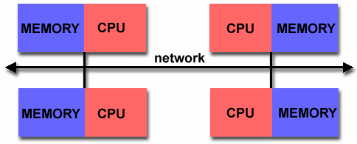
Distributed Memory
Like shared memory systems, distributed memory systems vary widely but share a common characteristic. Distributed memory systems require a communication network to connect inter-processor memory.
Processors have their own local memory. Memory addresses in one processor do not map to another processor, so there is no concept of global address space across all processors.
Because each processor has its own local memory, it operates independently. Changes it makes to its local memory have no effect on the memory of other processors. Hence, the concept of cache coherency does not apply.
When a processor needs access to data in another processor, it is usually the task of the programmer to explicitly define how and when data is communicated. Synchronization between tasks is likewise the programmer's responsibility.
The network "fabric" used for data transfer varies widely, though it can can be as simple as Ethernet.

Slide 29
Massively parallel processors
A large parallel processing system with a shared-nothing architecture
Consist of several hundred nodes with a high-speed interconnection network/switch
Each node consists of a main memory & one or more processors
Runs a separate copy of the OS
advantages: scalability, price
examples: ConnectionSystemsCM1 i CM2, GAAP (Geometric Array Parallel Processor)

Slide 30
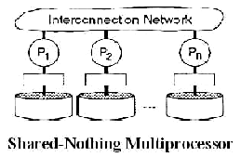
Shared Nothing Architecture

Slide 31
Distributed Memory: Pro and Con
Advantages
Memory is scalable with number of processors. Increase the number of processors and the size of memory increases proportionately.
Each processor can rapidly access its own memory without interference and without the overhead incurred with trying to maintain cache coherency.
Cost effectiveness: can use commodity, off-the-shelf processors and networking.
Disadvantages
The programmer is responsible for many of the details associated with data communication between processors.
It may be difficult to map existing data structures, based on global memory, to this memory organization.
Non-uniform memory access (NUMA) times

Slide 32
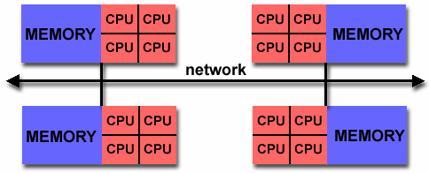
Hybrid Distributed-Shared Memory
The largest and fastest computers in the world today employ both shared and distributed memory architectures.
The shared memory component is usually a cache coherent SMP machine. Processors on a given SMP can address that machine's memory as global.
The distributed memory component is the networking of multiple SMPs. SMPs know only about their own memory - not the memory on another SMP. Therefore, network communications are required to move data from one SMP to another.
Current trends seem to indicate that this type of memory architecture will continue to prevail and increase at the high end of computing for the foreseeable future.
Advantages and Disadvantages: whatever is common to both shared and distributed memory architectures.

Slide 33
Summarizing a few of the key characteristics of shared and distributed memory machines
Comparison of Shared and Distributed Memory Architectures
Architecture | CC-UMA | CC-NUMA | Distributed memory
Examples | SMPs Sun Vexx DEC/Compaq SGI Challenge IBM POWER3 Intel xeon | Bull NovaScale SGI Origin Sequent HP Exemplar DEC/Compaq IBM POWER4 (MCM) | Cray T3E Maspar IBM SP2 IBM BlueGene
Communications | MPI –message passing Interface Threads OpenMP shmem | MPI Threads OpenMP shmem | MPI
Scalability | to 10s of processors | to 100s of processors | to 1000s of processors
Draw Backs | Memory-CPU bandwidth | Memory-CPU bandwidth Non-uniform access times | System administration Programming is hard to develop and maintain
Software Availability Hardware for ISV-independent software vendor | many 1000s ISVs | many 1000s ISVs | 100s ISVs

Slide 34
Distributed Systems
Definition
“A distributed system consists of multiple autonomous computers that communicate through a computer network.”
“Distributed computing utilizes a network of many computers, each accomplishing a portion of an overall task, to achieve a computational result much more quickly than with a single computer.”
“Distributed computing is any computing that involves multiple computers remote from each other that each have a role in a computation problem or information processing.”

Slide 35
Distributed Systems
A distributed system is one in which hardware or software components located at networked computers communicate and coordinate their actions only by message passing.
In the term distributed computing, the word distributed means spread out across space. Thus, distributed computing is an activity performed on a spatially distributed system.
These networked computers may be in the same room, same campus, same country, or in different continents

Slide 36




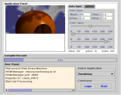

Introduction
Agent
Agent
Cooperation
Agent
Cooperation
Distribution
Distribution
Cooperation
Distribution
Internet
Agent
Subscription
Distribution
Job Request
Resource
Management
Large-scale
Application
Notes:
A distributed system consists of collection of autonomous computers, connected through a network and distributed operating system software, which enables computers to coordinate their activities and to share the resources of the system - hardware, software and data, so that users perceive the system as a single, integrated computing facility.
A distributed system is a collection of independent computers that appears to its users as a single coherent system.
This definition has several important aspects. The first one is that a distributed system consists of components (i.e., computers) that are autonomous.
A second aspect is that users (be they people or programs) think they are dealing with a single system.
This means that one way or the other the autonomous components need to collaborate. How to establish this collaboration lies at the heart of developing distributed systems.
Note that no assumptions are made concerning the type of computers.
In principle, even within a single system, they could range from high-performance mainframe computers to small nodes in sensor networks.
Likewise, no assumptions are made on the way that computers are interconnected.

Slide 37
Distributed System Goals
Resource Accessibility
Distribution Transparency
Openness
Scalability

Slide 38
Goal 1 – Resource Availability
Support user access to remote resources (printers, data files, web pages, CPU cycles) and the fair sharing of the resources
Economics of sharing expensive resources
Performance enhancement – due to multiple processors; also due to ease of collaboration and info exchange – access to remote services
Groupware: tools to support collaboration
Resource sharing introduces security problems.

Slide 39
Goal 2 – Distribution Transparency
Software hides some of the details of the distribution of system resources.
Makes the system more user friendly.
A distributed system that appears to its users & applications to be a single computer system is said to be transparent.
Users & apps should be able to access remote resources in the same way they access local resources.
Transparency has several dimensions.

Slide 40
Types of Transparency
Transparency | Description
Access | Hide differences in data representation & resource access (enables interoperability)
Location | Hide location of resource (can use resource without knowing its location)
Migration | Hide possibility that a system may change location of resource (no effect on access)
Replication | Hide the possibility that multiple copies of the resource exist (for reliability and/or availability)
Concurrency | Hide the possibility that the resource may be shared concurrently
Failure | Hide failure and recovery of the resource. How does one differentiate betw. slow and failed?
Relocation | Hide that resource may be moved during use
Figure 1-2. Different forms of transparency in a distributed system (ISO, 1995)

Slide 41
Goal 3 - Openness
An open distributed system “…offers services according to standard rules that describe the syntax and semantics of those services.” In other words, the interfaces to the system are clearly specified and freely available.
Compare to network protocols
Not proprietary
Interface Definition/Description Languages (IDL): used to describe the interfaces between software components, usually in a distributed system
Definitions are language & machine independent
Support communication between systems using different OS/programming languages; e.g. a C++ program running on Windows communicates with a Java program running on UNIX
Communication is usually RPC-based.

Slide 42
Examples of IDLs Goal 3-Openness
IDL: Interface Description Language
The original
WSDL: Web Services Description Language
Provides machine-readable descriptions of the services
OMG IDL: used for RPC in CORBA
OMG – Object Management Group
…

Slide 43
Open Systems Support …
Interoperability: the ability of two different systems or applications to work together
A process that needs a service should be able to talk to any process that provides the service.
Multiple implementations of the same service may be provided, as long as the interface is maintained
Portability: an application designed to run on one distributed system can run on another system which implements the same interface.
Extensibility: Easy to add new components & features

Slide 44
Goal 4 - Scalability
Dimensions that may scale:
With respect to size
With respect to geographical distribution
With respect to the number of administrative organizations spanned
A scalable system still performs well as it scales up along any of the three dimensions.

