Slide 1
Vector Processing
What is a Vector Processor?
History
Vector Processing Applications
Vector Programming Example, Instructions and Instruction Format
Advantages & Disadvantages
Pipelining : Example & Speedup

Slide 2
Normal computer system
ALU --- integer ALU1, ALU2, FPU--- SCALAR Execution units
ADD R1,R2,R3 --- R1<-- R2+R3 SCALAR instr R1,R2…R32
VECTOR REG VR[1..8]

Slide 3
Vector instructions
VADD VR1,VR2,VR3 VR3←VR1+VR2—SINGLE INSTRUCTION
f2 VSUM Vector summation S ∗ Σ A(I)
SUM=A[1]+A[2]….[A8]
C[I]=A[I]+B[I] for i=1 to8
B[i] ← A[i]

Slide 4
What is a Vector Processor?
Also called an Array Processor.
Runs multiple mathematical operations on multiple data elements simultaneously.
Common in supercomputers of the 1970’s 80’s and 90’s.
Today most CPU designs contains at least some vector processing instructions, typically referred to as SIMD.

Slide 5
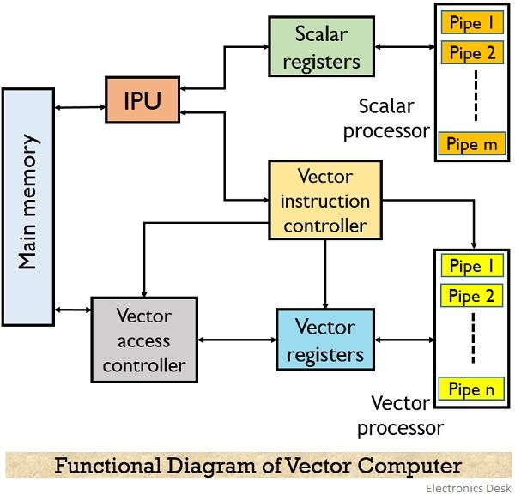

Slide 6
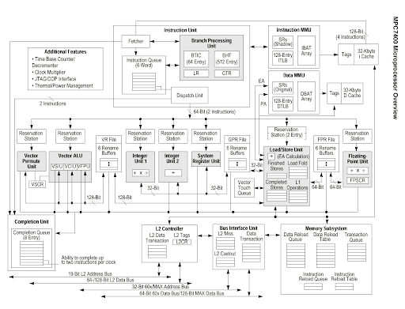

Slide 7
Vector Processor (computer)
Ability to process vectors, and related data structures such as matrices and multi-dimensional arrays, much faster than conventional computers
Vector Processors may also be pipelined
Typically operate on a few vectors elements per clock cycle in a pipeline.

Slide 8
History
1962 University of Illinois Illiac IV - completed 1972 with 64 ALUs 100-150 MFlops (massively parallel computer)
(1973) TI’s Advance Scientific Computer (ASC) 20-80 MFlops
(1975) Cray-1 first to have vector registers instead of keeping data in memory (8 registers with 64 64-bit words in each)
Cray-1 had separate pipelines for different instruction types allowing vector chaining. 80-240 MFlops

Slide 9
Vector Processing Applications
Problems that can be efficiently formulated in terms of vectors
  Long-range weather forecasting
  Petroleum explorations
  Seismic data analysis
  Medical diagnosis EX Ctscan,MRI scan
  Aerodynamics and space flight simulations
  Artificial intelligence and expert systems
  Mapping the human genome
  Image processing

Slide 10
VECTOR PROGRAMMING
Problem : Add two arrays of size 100
    DO 20 I = 1, 100
    20 C(I) = B(I) + A(I)
Conventional computer
    Initialize I = 0
    20 Read A(I)
    Read B(I)
    Store C(I) = A(I) + B(I)
    Increment I = i + 1
    If I ≤ 100 goto 20
Vector computer
    C(1:100) = A(1:100) + B(1:100)

Slide 11
VECTOR INSTRUCTIONS
  Type Mnemonic Description (I = 1, ..., n)
  f1 VSQR Vector square root B(I) ∗ SQR(A(I))
  VSIN Vector sine B(I) ∗ sin(A(I))
  VCOM Vector complement A(I) ∗ A(I)
  f2 VSUM Vector summation S ∗ Σ A(I)
  VMAX Vector maximum S ∗ max{A(I)}
  f3 VADD Vector add C(I) ∗ A(I) + B(I)
  VMPY Vector multiply C(I) ∗ A(I) * B(I)
  VAND Vector AND C(I) ∗ A(I) . B(I)
  VLAR Vector larger C(I) ∗ max(A(I),B(I))
  VTGE Vector test > C(I) ∗ 0 if A(I) < B(I)
  C(I) ∗ 1 if A(I) > B(I)
  f4 SADD Vector-scalar add B(I) ∗ S + A(I)
  SDIV Vector-scalar divide B(I) ∗ A(I) / S

Slide 12

VECTOR INSTRUCTION FORMAT

Slide 13
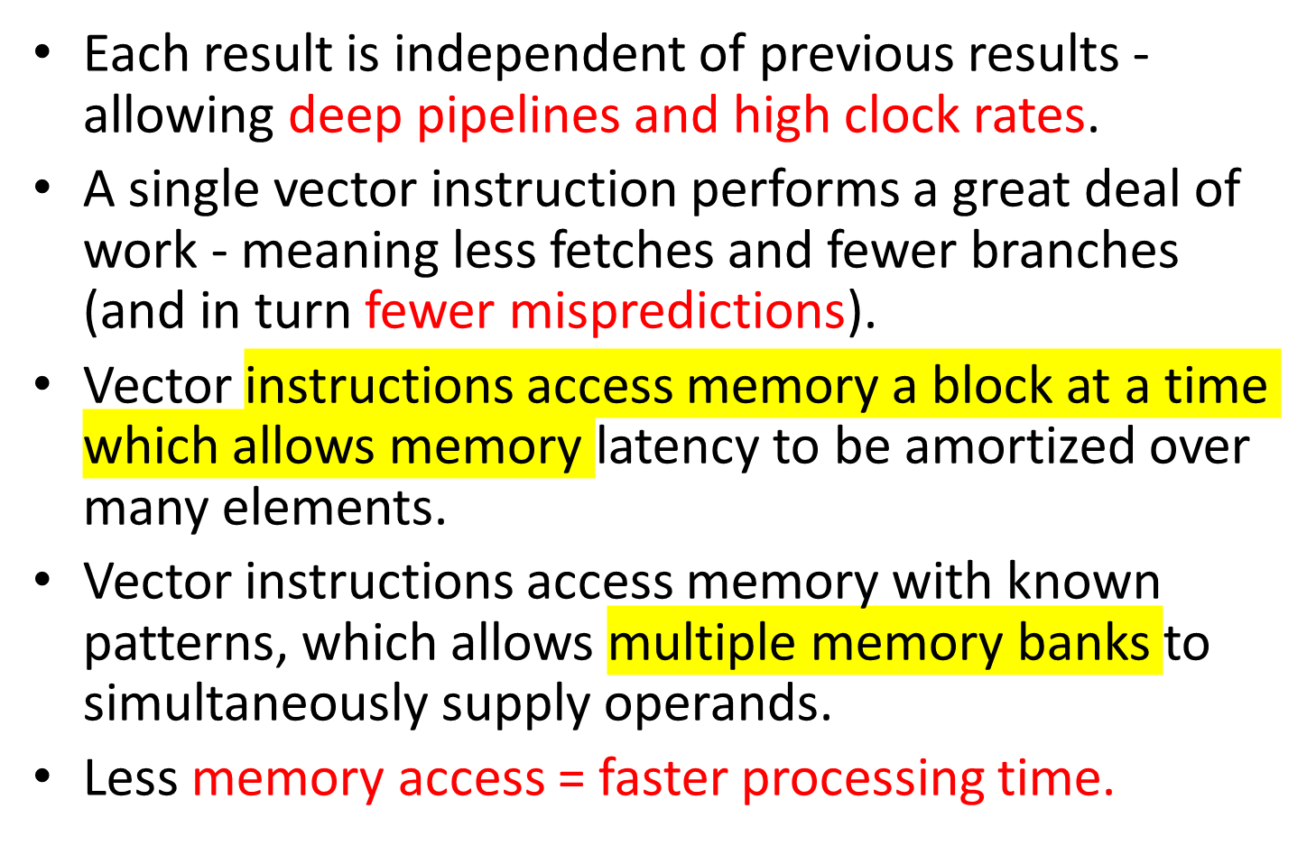
Advantages

Slide 14
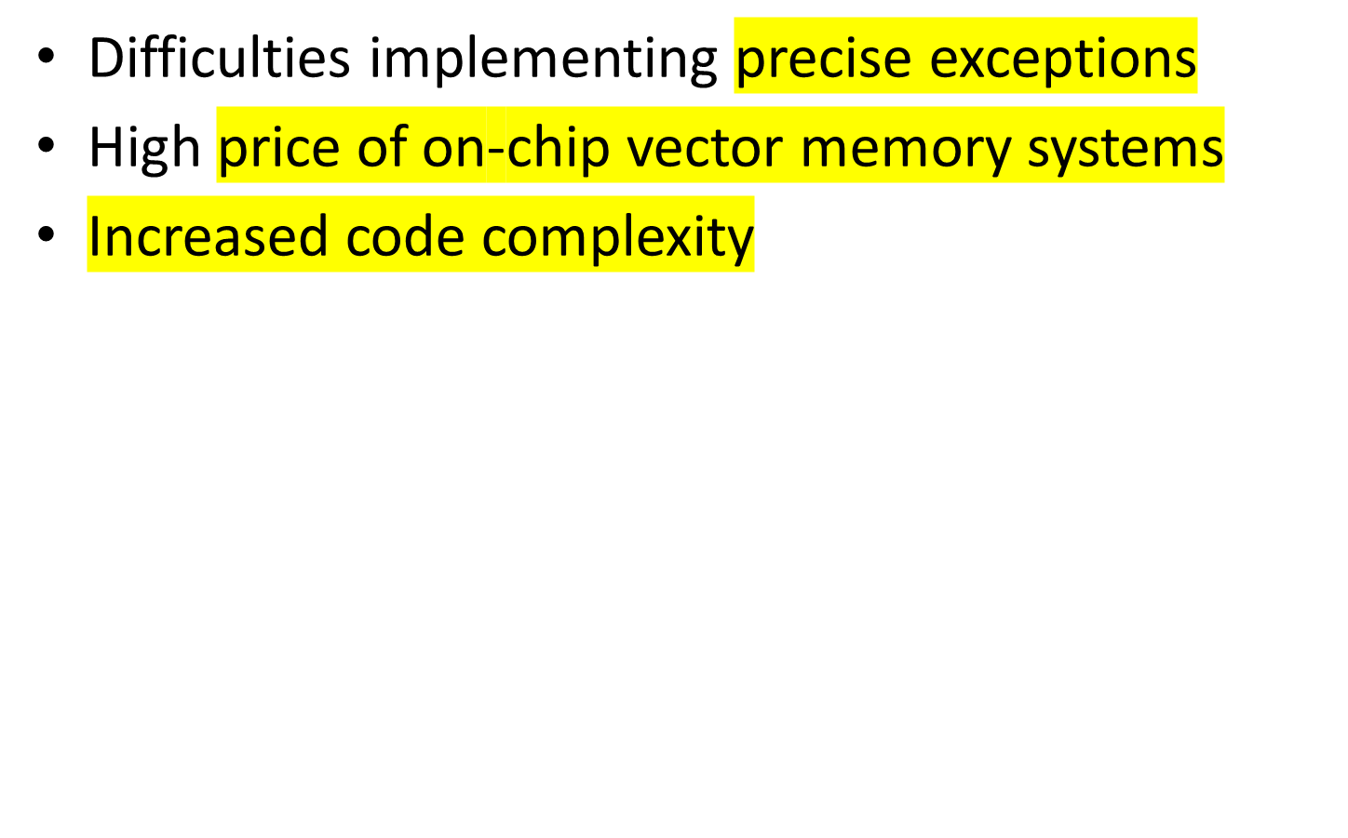
Disadvantages

Slide 15
PIPELINING
A technique of decomposing a sequential process into sub-operations, with each sub-process being executed in a partial dedicated segment that operates concurrently with all other segments.
Example
  A_{i} * B_{i} + C_{i} for i = 1, 2, 3, ... , 7
Implementation
  R1 ← A_{i}, R2 ← B_{i} Load A_{i} and B_{i}
  R3 ← R1 * R2, R4 ← C_{i} Multiply and load C_{i}
  R5 ← R3 + R4 Add

Slide 16
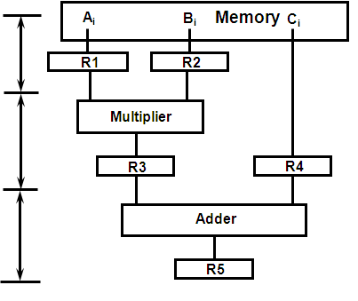
PIPELINING with three Stages S1, S2, S3 for performing A_{i} * B_{i} + C_{i}

Slide 17
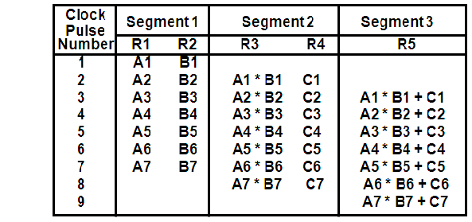
OPERATIONS IN EACH PIPELINE STAGE

Slide 18
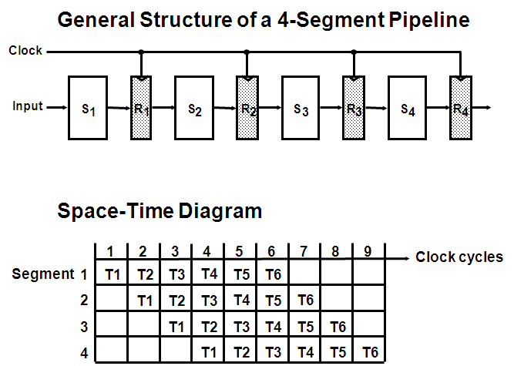
GENERAL PIPELINE

Slide 19
PIPELINE SPEEDUP
  n: Number of tasks to be performed
Conventional Machine (Non-Pipelined)
  t_{n}: Clock cycle
  t₁: Time required to complete the n tasks
  t₁ = n * t_{n}
Pipelined Machine (k stages)
  t_{p}: Clock cycle (time to complete each sub-operation)
  t_{k}: Time required to complete the n tasks
  t_{k} = (k + n - 1) * t_{p}
Speedup
  S_{k}: Speedup
S_{k} = n*t_{n} / (k + n - 1)*t_{p}

Slide 20
PIPELINE SPEEDUP
Example
- 4-stage pipeline
- subopertion in each stage; t_{p} = 20nS
- 100 tasks to be executed
- 1 task in non-pipelined system; 20*4 = 80nS
Pipelined System
(k + n - 1)*t_{p} = (4 + 99) * 20 = 2060nS
Non-Pipelined System
n*k*t_{p} = 100 * 80 = 8000nS
Speedup
S_{k} = 8000 / 2060 = 3.88

Slide 21
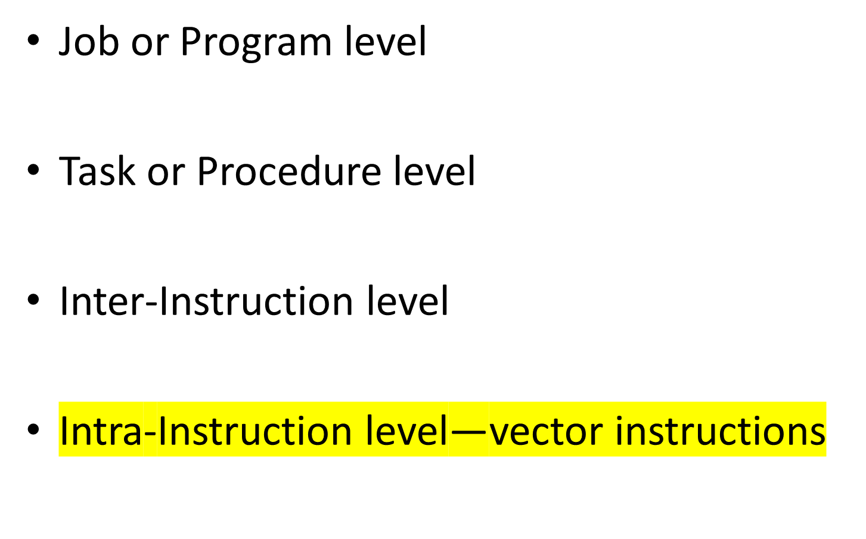
Levels of Parallel Processing

