Slide 1
Applied Machine Learning

Slide 2
Well-posed Learning Problem
Definition(Mitchell 1997):
A computer program is said to learn from experience E with respect to some class of tasks T and performance measure P, if its performance at tasks in T, as measured by P, improves with experience E.
Definition2(Hadamard 1902):
A (Machine learning) problem is a well-posed if a solution to it exists, if that solution is unique, and if that solution depends on the data/experience but it is not sensitive to changes in the data/experience

Slide 3
Example:
A computer program that learns to play checkers might improve its performance as measured by its ability to win at the class of tasks involving playing checkers games, through experience obtained by playing games against itself.
In general, to have a well-defined learning problem, we must identify three features:
  class of tasks
  the measure of performance to be improved, and
  the source of experience.

Slide 4
A checkers learning problem:
  Task T: playing checkers
  Performance measure P: percent of games won against opponents
  Training experience E: playing practice games against itself
A handwriting recognition learning problem:
  Task T: recognizing and classifying handwritten words within images
  Performance measure P: percent of words correctly classified
  Training experience E: a database of handwritten words with given classifications
A robot driving learning problem:
  Task T: driving on public four-lane highways using vision sensors
  Performance measure P: average distance travelled before an error (as judged by human overseer)
  Training experience E: a sequence of images and steering commands recorded while observing a human driver

Slide 5
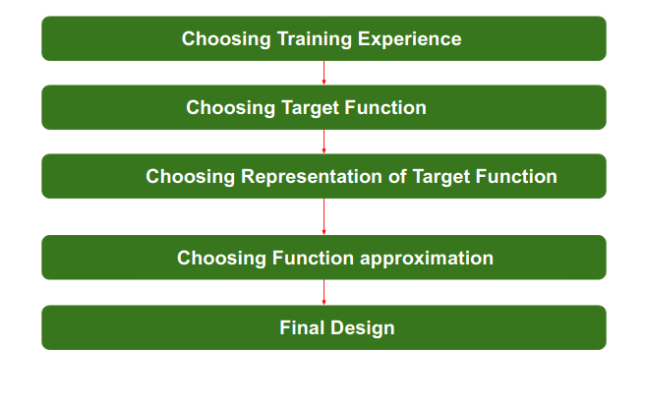
Designing a Learning Problem
Steps for Designing Learning System are :

Slide 6
Step 1) Choosing the Training Experience:
  The first design choice is to choose the type of training experience or training data from which our system will learn. The type of training experience available can have a significant impact on success or failure of the learner(Model).
  So Training data or experience should be chosen wisely.
  The attributes which will impact on Success and Failure of Data:
    The training experience will be able to provide direct or indirect feedback regarding choices. For example, in learning to play checkers, the system might learn from direct training examples consisting of individual checkers board states and the correct move for each. Alternatively, it might have available only indirect information consisting of the move sequences and final outcomes of various games played.
    Second important attribute is the degree to which the learner will control the sequences of training examples. For example, the learner might rely on the teacher to select informative board states and to provide the correct move for each. Alternatively, the learner might itself propose board states that it finds particularly confusing and ask the teacher for the correct move.

Slide 7
  Third important attribute is how it will represent the distribution of examples over which performance will be measured.
  For example, a Machine learning algorithm will get experience while going through a number of different cases and different examples. Thus, Machine Learning Algorithm will get more and more experience by passing through more and more examples and hence its performance will increase.
  In our checkers learning scenario, the performance metric P is the percent of games the system wins in the world tournament. If its training experience E consists only of games played against itself, there is an obvious danger that this training experience might not be fully representative of the distribution of situations over which it will later be tested. For example, the learner might never encounter certain crucial board states that are very likely to be played by the human checkers champion.
Step 2- Choosing target function:
  The next design choice is to determine exactly what type of knowledge will be learned and how this will be used by the performance program i.e., is choosing the target function.
  Let us begin with a checkers-playing program that can generate the legal moves from any board state. The program needs only to learn how to choose the best move from among these legal moves. This learning task is representative of a large class of tasks for which the legal moves that define some large search space are known a priori, but for which the best search strategy is not known.

Slide 8
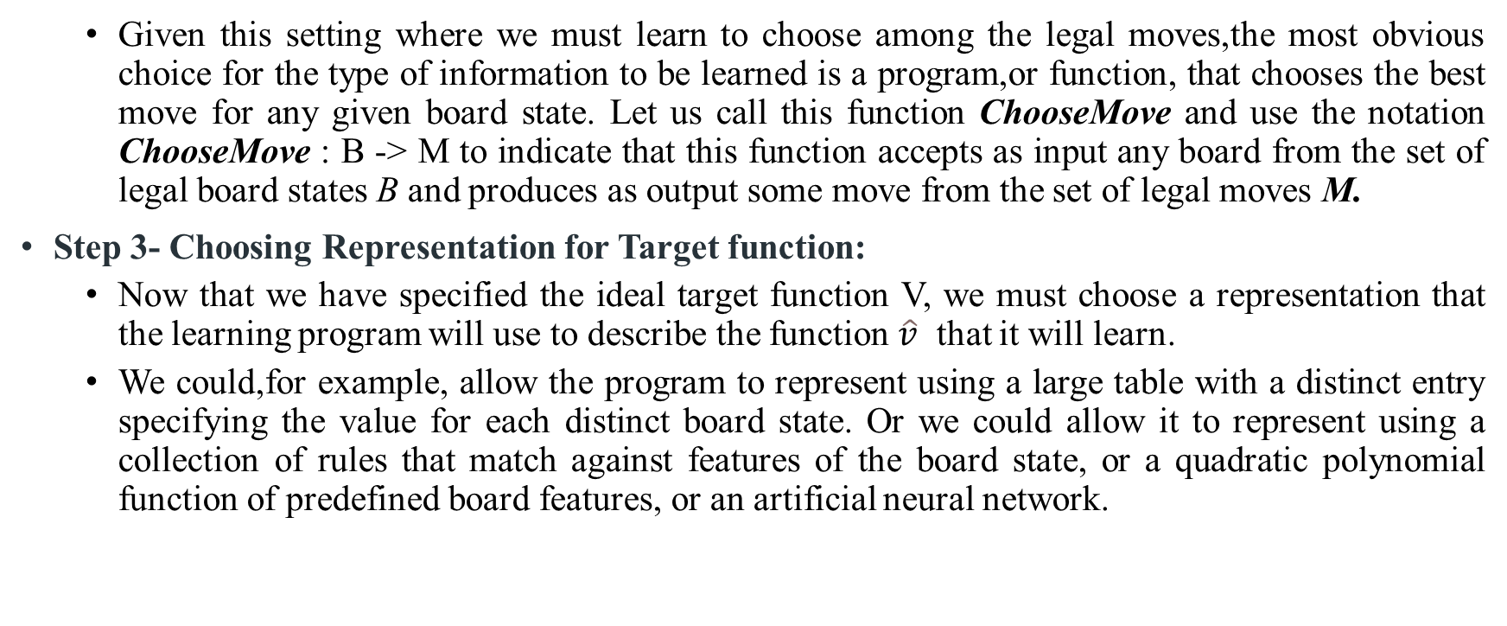
  Given this setting where we must learn to choose among the legal moves,the most obvious choice for the type of information to be learned is a program,or function, that chooses the best move for any given board state. Let us call this function ChooseMove and use the notation ChooseMove : B -> M to indicate that this function accepts as input any board from the set of legal board states B and produces as output some move from the set of legal moves M.
Step 3- Choosing Representation for Target function:
  Now that we have specified the ideal target function V, we must choose a representation that the learning program will use to describe the function $\hat{v}$ that it will learn.
  We could,for example, allow the program to represent using a large table with a distinct entry specifying the value for each distinct board state. Or we could allow it to represent using a collection of rules that match against features of the board state, or a quadratic polynomial function of predefined board features, or an artificial neural network.

Slide 9
We need to choose a representation that the learning algorithm will use to describe the function chooseMove.
The function chooseMove will be calculated as a linear combination of the following board features:
  xl: the number of black pieces on the board
  x2: the number of red pieces on the board
  x3: the number of black kings on the board
  x4: the number of red kings on the board
  x5: the number of black pieces threatened by red (i.e., which can be captured on red's next turn)
  x6: the number of red pieces threatened by black
  chooseMove = u0 + u1x1 + u2x2 + u3x3 + u4x4 + u5x5 + u6x6
Here u0, u1 up to u6 are the coefficients that will be chosen(learned) by the learning algorithm.

Slide 10
Step 4- Choosing Function Approximation Algorithm:
  An optimized move cannot be chosen just with the training data.
  The training data had to go through with set of example and through these examples the training data will approximates which steps are chosen and after that machine will provide feedback on it.
  For Example : When a training data of Playing checkers game is fed to algorithm so at that time it is not algorithm will fail or get success and again from that failure or success it will measure while next move what step should be chosen and what is its success rate.
  To learn the target function chooseMove, we require a set of training examples, each describing a specific board state b and the training value (Correct Move ) y for b. The training algorithm learns/approximate the coefficients u0, u1 up to u6 with the help of these training examples by estimating and adjusting these weights.

Slide 11
Step 5 :The Final Design
The final design of learning system can be naturally described by four distinct program modules that represent the central components in many learning systems.

Slide 12
The performance System — Takes a new board as input and outputs a trace of the game it played against itself.
The Critic — Takes the trace of a game as an input and outputs a set of training examples of the target function.
The Generalizer — Takes training examples as input and outputs a hypothesis that estimates the target function. Good generalization to new cases is crucial.
The Experiment Generator — Takes the current hypothesis (currently learned function) as input and outputs a new problem (an initial board state) for the performance system to explore.

Slide 13
Perspectives and Issues in Machine Learning
Perspective:
  It involves searching a very large space of possible hypothesis to determine the one that best fits the observed data.
Issues:
  What algorithms exist for learning general target functions from specific training examples?
  Which algorithms perform best for which types of problems and representations?
  How much training data is sufficient? What general bounds can be found to relate the confidence in learned hypotheses to the amount of training experience and the character of the learner's hypothesis space?
  When and how can prior knowledge held by the learner guide the process of generalizing from examples? Can prior knowledge be helpful even when it is only approximately correct?
  What is the best strategy for choosing a useful next training experience, and how does the choice of this strategy alter the complexity of the learning problem?
  What is the best way to reduce the learning task to one or more function approximation problems? Put another way, what specific functions should the system attempt to learn? Can this process itself be automated?
  How can the learner automatically alter its representation to improve its ability to represent and learn the target function?

Slide 14

Concept Learning
The problem of searching through a predefined space of potential hypotheses for the hypothesis that best fits the training examples.” — Tom Michell

Slide 15
Concept Learning
Much of human learning involves acquiring general concepts from past experiences.
For example, humans identify different vehicles among all the vehicles based on specific sets of features defined over a large set of features.
This special set of features differentiates the subset of cars in a set of vehicles.
This set of features that differentiate cars can be called a concept.
Similarly, machines can learn from concepts to identify whether an object belongs to a specific category by processing past/training data to find a hypothesis that best fits the training examples.

Slide 16
Concept Learning
Inducing general functions from specific training examples is a main issue of machine learning.
Concept Learning: Acquiring the definition of a general category from given sample positive and negative training examples of the category.
Concept Learning can seen as a problem of searching through a predefined space of potential hypotheses for the hypothesis that best fits the training examples.
The hypothesis space has a general-to-specific ordering of hypotheses, and the search can be efficiently organized by taking advantage of a naturally occurring structure over the hypothesis space.

Slide 17
A Formal Definition for Concept Learning: Inferring a boolean-valued function from training examples of its input and output.
An example for concept-learning is the learning of bird-concept from the given examples of birds (positive examples) and non-birds (negative examples).
We are trying to learn the definition of a concept from given examples

Slide 18
A set of example days, and each is described by six attributes.
The task is to learn to predict the value of EnjoySport for arbitrary day, based on the values of its attribute values.

Slide 19
Enjoy Sport – Hypothesis Representation
Each hypothesis consists of a conjunction of constraints on the instance attributes.
Each hypothesis will be a vector of six constraints, specifying the values of the six attributes
  (Sky, AirTemp, Humidity, Wind, Water, and Forecast).
Each attribute will be:
  ? - indicating any value is acceptable for the attribute (don’t care)
  single value – specifying a single required value (ex. Warm) (specific)
  0 - indicating no value is acceptable for the attribute (no value)

Slide 20
If some instance x satisfies all the constraints of hypothesis h, then h classifies x as a positive example (h(x) = 1).
h1(x=1): <Sunny, Warm, Normal, Strong, Warm, Same >
  Note: x=1 represents a positive hypothesis / Positive example
We want to find the most suitable hypothesis which can represent the concept. For example, Ramesh enjoys his favorite sport only on cold days with high humidity
  h(x=1) = <?, Cold, High, ?, ?, ?>
Here ? indicates that any value of the attribute is acceptable.
Note: The most generic hypothesis will be < ?, ?, ?, ?, ?, ?> where every day is a positive example and the most specific hypothesis will be <0,0,0,0,0,0> where no day is a positive example.

Slide 21
Concept Learning Task-Notation
The set of items over which the concept is defined is called the set of instances, which we denote by X.
  Example, X is the set of all possible days, each represented by the attributes Sky, AirTemp, Humidity, Wind, Water, and Forecast.
The concept or function to be learned is called the target concept, which we denote by c.
  In general, c can be any Boolean valued function defined over the instances X; that is, c : X -> {O, 1} .
  Example, the target concept corresponds to the value of the attribute EnjoySport (i.e., c(x) = 1 if EnjoySport = Yes, and c(x) = 0 if EnjoySport = No).
When learning the target concept, the learner is presented a set of training examples, each consisting of an instance x from X, along with its target concept value c(x) .
Instances for which c(x) = 1 are called positive examples, or members of the target concept. Instances for which c(x)=0 are called negative examples, or non members of the target concept.

Slide 22
Concept Learning Task-Notation
We will write the ordered pair (x, c(x)) to describe the training example consisting of the instance x and its target concept value c(x).
We use the symbol D to denote the set of available training examples.
Given a set of training examples of the target concept c, the problem faced by the learner is to hypothesize, or estimate, c.
We use the symbol H to denote the set of all possible hypotheses that the learner may consider regarding the identity of the target concept.
In general, each hypothesis h in H represents a boolean-valued function defined over X; that is, h : X ->{O, 1).
The goal of the learner is to find a hypothesis h such that h(x) = c(x) for all x in X.

Slide 23
Enjoy Sport Concept Learning Task
Given
  Instances X : set of all possible days, each described by the attributes
    Sky – (values: Sunny, Cloudy, Rainy)
    AirTemp – (values: Warm, Cold)
    Humidity – (values: Normal, High)
    Wind – (values: Strong, Weak)
    Water – (values: Warm, Cold)
    Forecast – (values: Same, Change)
  Target Concept (Function) c : EnjoySport : X -> {0,1}
  Hypotheses H : Each hypothesis is described by a conjunction of constraints on the attributes.
  Training Examples D : positive and negative examples of the target function
Determine
  A hypothesis h in H such that h(x) = c(x) for all x in D.

Slide 24
The Inductive Learning Hypothesis
• Although the learning task is to determine a hypothesis h identical to the target concept cover the entire set of instances X, the only information available about c is its value over the training examples.
  Inductive learning algorithms can at best guarantee that the output hypothesis fits the target concept over the training data.
  Lacking any further information, our assumption is that the best hypothesis regarding unseen instances is the hypothesis that best fits the observed training data. This is the fundamental assumption of inductive learning.
The Inductive Learning Hypothesis - Any hypothesis found to approximate the target function well over a sufficiently large set of training examples will also approximate the target function well over other unobserved examples

Slide 25
FIND-S: FINDING A MAXIMALLY SPECIFIC HYPOTHESIS
The find-S algorithm is a basic concept learning algorithm in machine learning.
FIND-S algorithm for finding the most specific hypothesis based on a given set of training data samples.
The find-S algorithm finds the most specific hypothesis that fits all the positive examples.
The find-S algorithm starts with the most specific hypothesis and generalizes this hypothesis each time it fails to classify an observed positive training data
Hence, the Find-S algorithm moves from the most specific hypothesis to the most general hypothesis.

Slide 26
Find-S Algorithm
Initialize h to the most specific hypothesis in H
For each positive training instance x
  For each attribute constraint a, in h
    If the constraint a, is satisfied by x
    Then do nothing
    Else replace a, in h by the next more general constraint that is satisfied by x
Output hypothesis h

Slide 27
To illustrate this algorithm, assume the learner is given the sequence of following training examples for the Enjoy Sport task.
Step-1: Initialize h to be more specific hypothesis in H
  h0=<Ø,Ø, Ø, Ø, Ø, Ø>

Slide 28
Step-2:
Iteration1:
  Now, consider the first training example
  X1 = <Sunny, Warm, Normal, Strong, Warm, Same>
  This is training positive example and it is clear that none of the attribute values in h0 is satisfied with attribute values in x1.
  So, each attribute in h is replaced with more general constraints-
  h1 =<Sunny, Warm, Normal, Strong, Warm, Same>

Slide 29
Iteration2:
  Consider the second training example
  X2= <Sunny, Warm, High, Strong, Warm, Same>
  This is positive training example. Now compare each attribute of h1 with the attribute of x2 and substitute “?” in place of any attribute value of h1 not satisfied with x2
  h1 =<Sunny, Warm, Normal, Strong, Warm, Same>
  X2= <Sunny, Warm, High, Strong, Warm, Same>
  h2 =<Sunny, Warm ,?,Strong, Warm, Same>
Iteration3:
  Consider the next training example
    X3 = <Rainy, Cold, High, Strong, Warm, Change>
    This is negative training example and so ignored
    h3 =< Sunny, Warm,?, Strong, Warm, Same>

Slide 30
Iteration4:
  Consider the next training example
    X4 = <Sunny, Warm, High, Strong, Cool, Change>
    This is positive training example. Now compare each attribute of h3 with the attribute of x4 and substitute “?” in place of any attribute value of h3 not satisfied with x4
    h3 =<Sunny, Warm ,?,Strong , Warm ,Same>
    X4 = <Sunny, Warm, High, Strong, Cool, Change>
    h4=<Sunny ,Warm ,?,Strong , ?,?>
Step 3
  The final maximally specific hypothesis is <Sunny, Warm, ?, Strong, ?, ?>

Slide 31
Unanswered Questions by FIND-S Algorithm
Has FIND-S converged to the correct target concept?
  Although FIND-S will find a hypothesis consistent with the training data, it has no way to determine whether it has found the only hypothesis in H consistent with the data (i.e., the correct target concept), or whether there are many other consistent hypotheses as well.
  We would prefer a learning algorithm that could determine whether it had converged and, if not, at least characterize its uncertainty regarding the true identity of the target concept
Why prefer the most specific hypothesis?
  In case there are multiple hypotheses consistent with the training examples, FIND-S will find the most specific.
  It is unclear whether we should prefer this hypothesis over, say, the most general, or some other hypothesis of intermediate generality.

Slide 32
Unanswered Questions by FIND-S Algorithm
Are the training examples consistent?
  In most practical learning problems there is some chance that the training examples will contain at least some errors or noise.
  Such inconsistent sets of training examples can severely mislead FIND-S, given the fact that it ignores negative examples.
  We would prefer an algorithm that could at least detect when the training data is inconsistent and, preferably, accommodate such errors.
What if there are several maximally specific consistent hypotheses?
  In the hypothesis language H for the EnjoySport task, there is always a unique, most specific hypothesis consistent with any set of positive examples.
  However, for other hypothesis spaces there can be several maximally specific hypotheses consistent with the data.
  In this case, FIND-S must be extended to allow it to backtrack on its choices of how to generalize the hypothesis, to accommodate the possibility that the target concept lies along a different branch of the partial ordering than the branch it has selected

Slide 33
VERSION SPACES AND THE CANDIDATE-ELIMINATION
ALGORITHM
FIND-S outputs a hypothesis from H, that is consistent with the training examples, this is just one of many hypotheses from H that might fit the training data equally well.
The key idea in the Candidate-Elimination algorithm is to output a description of the set of all hypotheses consistent with the training examples.
  Candidate-Elimination algorithm computes the description of this set without explicitly enumerating all of its members.
  This is accomplished by using the more-general-than partial ordering and maintaining a compact representation of the set of consistent hypotheses.

Slide 34
The CANDIDATE-ELIMINATION Algorithm finds all describable hypothesis that are consistent with the observed training examples.
Consistent Hypothesis:
  A hypothesis h is consistent with a set of training examples D if and only if h(x) = c(x) for each example (x, c(x)) in D.
Version space:
  The version space, denoted VS_H,D with respect to hypothesis space H and training examples D, is the subset of hypotheses from H consistent with the training examples in D

Slide 35
The List-Then-Eliminate algorithm
  One obvious way to represent the version space is simply to list all of its members. This leads to a simple learning algorithm, which we might call the List-Then-Eliminate algorithm. The algorithm is as follows :
    VersionSpace ← a list containing every hypothesis in H
    For each training example, (x, c(x))
    remove from VersionSpace any hypothesis h for which h(x) # c(x)
    3. Output the list of hypotheses in VersionSpace
  The LIST-THEN-ELIMINATE algorithm first initializes the version space to contain all hypotheses in H and then eliminates any hypothesis found inconsistent with any training example.

Slide 36
A version space can be represented with its general and specific boundary sets.
The Candidate-Elimination algorithm represents the version space by storing only its most general members G and its most specific members S.
Given only these two sets S and G, it is possible to enumerate all members of a version space by generating hypotheses that lie between these two sets in general-to-specific partial ordering over hypotheses.
Definition — G
  The general boundary G, with respect to hypothesis space H and training data D, is the set of maximally general members of H consistent with D.
Definition — S
  The specific boundary S, with respect to hypothesis space H and training data D, is the set of minimally general (i.e., maximally specific) members of H consistent with D.

Slide 37
Version Space representation theorem —
  Let X be an arbitrary set of instances and Let H be a set of Boolean-valued hypotheses defined over X. Let c: X →{O, 1} be an arbitrary target concept defined over X, and let D be an arbitrary set of training examples {(x, c(x))). For all X, H, c, and D such that S and G are well defined,

Slide 38
Candidate Elimination algorithm
  The Candidate-Elimination algorithm computes the version space containing all hypotheses from H that are consistent with an observed sequence of training examples.
  It begins by initializing the version space to the set of all hypotheses in H; that is, by initializing the G boundary set to contain the most general hypothesis in H as
    G0 ← { <?, ?, ?, ?, ?, ?> }
  and initializing the S boundary set to contain the most specific hypothesis as
    S0 ← { <0, 0, 0, 0, 0, 0> }
  These two boundary sets delimit the entire hypothesis space, because every other hypothesis in H is both more general than S0 and more specific than G0

Slide 39
  As each training example is considered, the S and G boundary sets are generalized and specialized, respectively, to eliminate from the version space any hypotheses found inconsistent with the new training example.
  After all examples have been processed, the computed version space contains all the hypotheses consistent with these examples and only these hypotheses.

Slide 40
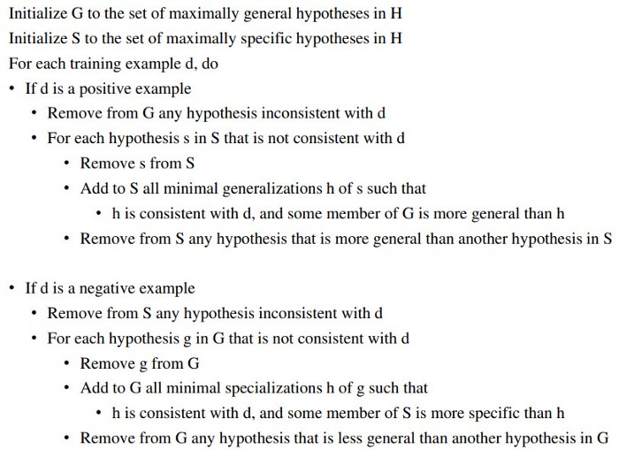
Candidate-Elimination Algorithm

Slide 41
Example | Sky | AirTemp | Humidity | Wind | Water | Forecast | EnjoySport
1 | Sunny | Warm | Normal | Strong | Warm | Same | Yes
2 | Sunny | Warm | High | Strong | Warm | Same | Yes
3 | Rain | Cold | High | Strong | Warm | Change | No
4 | Sunny | Warm | High | Strong | Cool | Change | Yes

Slide 42
  S0: (ø, ø, ø, ø, ø, ø) Most Specific Boundary
  G0: (?, ?, ?, ?, ?, ?) Most Generic Boundary
The first example is positive, the hypothesis at the specific boundary is inconsistent, hence we extend the specific boundary, and the hypothesis at the generic boundary is consistent hence we retain it.
  S1: (Sunny , Warm, Normal, Strong, Warm, Same)
  G1: (?, ?, ?, ?, ?, ?)

Slide 43
The second example is positive, again the hypothesis at the specific boundary is inconsistent, hence we extend the specific boundary, and the hypothesis at the generic boundary is consistent hence we retain it.
  S2: (Sunny , Warm, ?, Strong, Warm, Same)
  G2: (?, ?, ?, ?, ?, ?)

Slide 44
The third example is negative, the hypothesis at the specific boundary is consistent, hence we retain it, and hypothesis at the generic boundary is inconsistent hence we write all consistent hypotheses by removing one “?” (question mark) at time.
  S3: (Sunny , Warm, ?, Strong, Warm, Same)
  G3: (Sunny,?,?,?,?,?) (?,Warm,?,?,?,?) (?,?,?,?,?,Same)

Slide 45
The fourth example is positive, the hypothesis at the specific boundary is inconsistent, hence we extend the specific boundary, and the consistent hypothesis at the generic boundary are retained.
  S4: (Sunny, Warm, ?, Strong, ?, ?)
  G4: (Sunny,?,?,?,?,?) (?,Warm,?,?,?,?)

Slide 46
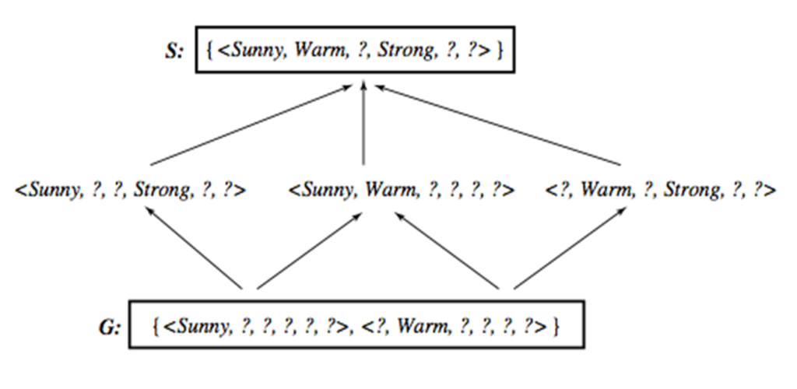

Slide 47
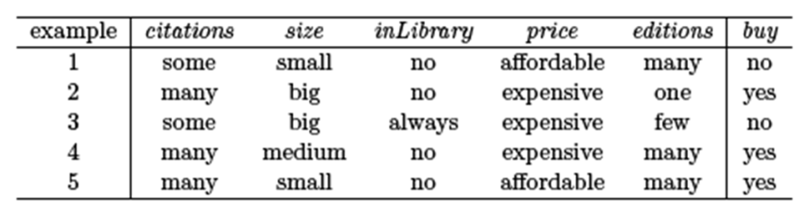

Slide 48
Will Candidate-Elimination Algorithm
Converge to Correct Hypothesis?
The version space learned by the Candidate-Elimination Algorithm will converge toward the hypothesis that correctly describes the target concept, provided
  There are no errors in the training examples, and
  there is some hypothesis in H that correctly describes the target concept.
What will happen if the training data contains errors?
  The algorithm removes the correct target concept from the version space.
  S and G boundary sets eventually converge to an empty version space if sufficient additional training data is available.
  Such an empty version space indicates that there is no hypothesis in H consistent with all observed training examples.
A similar symptom will appear when the training examples are correct but the target concept cannot be described in the hypothesis representation.
  e.g., if the target concept is a disjunction of of feature attributes and the hypothesis space supports only conjunctive descriptions

Slide 49
Inductive Bias - Fundamental Questions for Inductive Inference
The Candidate-Elimination Algorithm will converge toward the true target concept provided it is given accurate training examples and provided its initial hypothesis space contains the target concept.
  What if the target concept is not contained in the hypothesis space?
  Can we avoid this difficulty by using a hypothesis space that includes every possible hypothesis?
  How does the size of this hypothesis space influence the ability of the algorithm to generalize to unobserved instances?
  How does the size of the hypothesis space influence the number of training examples that must be observed?

Slide 50
Inductive Bias - A Biased Hypothesis Space
To assure that the hypothesis space contains the unknown target concept. The obvious solution is to enrich the hypothesis space to include every possible hypothesis.
In EnjoySport example, we restricted the hypothesis space to include only conjunctions of attribute values.
  Because of this restriction, the hypothesis space is unable to represent even simple disjunctive target concepts such as "Sky = Sunny or Sky = Cloudy.“
  From first two examples : S2 : <?, Warm, Normal, Strong, Cool, Change>
    This is inconsistent with third examples, and there are no hypotheses consistent with these three examples

Slide 52
This hypothesis, although it is the maximally specific hypothesis from H that is consistent with the first two examples, is already overly general: it incorrectly covers the third (negative) training example.
  The problem is that we have biased the learner to consider only conjunctive hypotheses. In this case we require a more expressive hypothesis space
PROBLEM: We have biased the learner to consider only conjunctive hypotheses.
  We require a more expressive hypothesis space.

Slide 53
Inductive Bias - An Unbiased Learner
The obvious solution to the problem of assuring that the target concept is in the hypothesis space H is to provide a hypothesis space capable of representing every teachable concept.
  Representing every possible subset of the instances X → the power set of X.
What is the size of the hypothesis space H (the power set of X) ?
  In EnjoySport, the size of the instance space X is 96.
  The size of the power set of X is 2|X| → The size of H is 296
  Our conjunctive hypothesis space is able to represent only 973of these hypotheses.
    a very biased hypothesis space

Slide 54
Let us reformulate the Enjoysport learning task in an unbiased way by defining a new hypothesis space H' that can represent every subset of instances;that is, let H' correspond to the power set of X.
One way to define such an H' is to allow arbitrary disjunctions, conjunctions, and negations of our earlier hypotheses
  A hypothesis can be represented with disjunctions, conjunctions, and negations of our earlier hypotheses.
The target concept "Sky = Sunny or Sky = Cloudy" could then be described as
  <Sunny, ?, ?, ?, ?, ?> V <Cloudy, ?, ?, ?, ?, ?>
However, while this hypothesis space eliminates any problems of expressibility, it unfortunately raises a new, equally difficult problem

Slide 55
NEW PROBLEM: our concept learning algorithm is now completely unable to generalize beyond the observed examples.
  three positive examples (xl,x2,x3) and two negative examples (x4,x5) to the learner.
  S : { x1 v x2 v x3 } and G : { ¬ (x4 v x5) } → NO GENERALIZATION
  Therefore, the only examples that will be unambiguously classified by S and G are the observed training examples themselves.

Slide 56
Inductive Bias –
Fundamental Property of Inductive Inference
A learner that makes no a priori assumptions regarding the identity of the target concept has no rational basis for classifying any unseen instances.
Inductive Leap: A learner should be able to generalize training data using prior assumptions in order to classify unseen instances.
The generalization is known as inductive leap and our prior assumptions are the inductive bias of the learner.
Inductive Bias (prior assumptions) of Candidate-Elimination Algorithm is that the target concept can be represented by a conjunction of attribute values, the target concept is contained in the hypothesis space and training examples are correct.

