Slide 1

Decision Tree Learning

Slide 2
Decision tree learning
Decision tree learning is one of the most widely used and practical methods for inductive inference.
Inductive inference is the process of reaching a general conclusion from a specific examples.
Decision tree learning is a method for approximating discrete-valued target function.
The learned function is represented by a decision tree
Decision tree can also be re-represented as if-then rules to improve human readability

Slide 3
Decision tree Representation
Decision trees classify instances by sorting them down the tree from the root to some leaf node
A node
Specifies some attribute of an instance to be tested
A branch
Corresponds to one of the possible values for an attribute
An instance is classified by starting at the root node of the tree, testing the attribute specified by this node, then moving down the tree branch corresponding to the value of the attribute.
This process is then repeated for the subtree rooted at the new node.

Slide 4
Decision Tree Representation
Consider a decision tree for the concept PlayTennis.
An example is classified by sorting it through the tree to the appropriate leaf node, then returning the classification associated with this leaf (in this case, Yes or No).
This tree classifies Saturday mornings according to whether or not they are suitable for playing tennis.

Slide 5
Decision Tree Representation
Each path corresponds to a conjunction of attribute tests.
For example, if the instance is (Outlook=sunny, Temperature=Hot, Humidity=high, Wind=Strong) then the path of (Outlook=Sunny ∧ Humidity=High) is matched so that the target value would be NO as shown in the tree.
A decision tree represents a disjunction of conjunction of constraints on the attribute values of instances.
For example, three positive instances can be represented as (Outlook=Sunny ∧ Humidity=normal) ∨ (Outlook=Overcast) ∨ (Outlook=Rain ∧Wind=Weak) as shown in the tree.

Slide 6
APPROPRIATE PROBLEMS FOR DECISION TREE LEARNING
Decision tree learning is generally best suited to problems with the following characteristics:
Instances are represented by attribute-value pairs
Instances are described by a fixed set of attributes (e.g., Temperature) and their values (e.g., Hot).
The target function has discrete output values
The decision tree assigns a boolean classification (e.g., yes or no) to each example . Decision tree methods easily extend to learning functions with more than two possible output values.
Disjunctive descriptions may be required
decision trees naturally represent disjunctive expressions
The training data may contain errors
Decision tree learning methods are robust to errors, both errors in classifications of the training examples and
errors in the attribute values that describe these examples
The training data may contain missing attribute values
Decision tree methods can be used even when some training examples have unknown values
Decision tree learning has therefore been applied to problems such as learning to classify medical patients by their disease, equipment malfunctions by their cause,and loan applicants by their likelihood of defaulting on payments.
Suitable for classification

Slide 7
Basic Decision Tree Algorithm
Most algorithms that have been developed for learning decision trees are variations on a core algorithm that employs a top-down, greedy search through the space of possible decision trees.
This approach is exemplified by the ID3 algorithm and its successor C4.5
Our basic algorithm, ID3, learns decision trees by constructing them top-down , beginning with the question "which attribute should be tested at the root of the tree?'

Slide 8
Each instance attribute is evaluated using a statistical test to determine how well it alone classifies the training examples.
The best attribute is selected and used as the test at the root node of the tree.
A descendant of the root node is then created for each possible value of this attribute, and the training examples are sorted to the appropriate descendant node
The entire process is then repeated using the training examples associated with each descendant node to select the best attribute to test at that point in the tree.
This forms a greedy search for an acceptable decision tree, in which the algorithm never backtracks to reconsider earlier choices

Slide 9
Which Attribute Is the Best Classifier?
The central choice in the ID3 algorithm is selecting which attribute to test at each node in the tree.
A statistical property, called information gain, that measures how well a given attribute separates the training examples according to their target classification
ID3 uses this information gain measure to select among the candidate attributes at each step while growing the tree.

Slide 10
To define information gain , we begin by defining a measure called entropy
Entropy characterizes the (im)purity of an arbitrary collection of examples
Entropy basically tells us how impure a collection of data is. The term impure here defines non-homogeneity. In other word we can say, “Entropy is the measurement of homogeneity. It returns us the information about an arbitrary dataset that how impure/non-homogeneous the data set is.”
Given a collection S, containing positive and negative examples of some target concept, the entropy of S relative to this Boolean classification is
Where
is the proportion of positive examples in S
is the proportion of negative examples in S.

Slide 11
Example: Entropy
Suppose S is a collection of 14 examples of some Boolean concept, including 9 positive and 5 negative examples
Then the entropy of S relative to this Boolean classification is
Which concludes that 94% impure or 94% non-homogenous

Slide 12
The entropy is 0 if all members of S belong to the same class
The entropy is 1 when the collection contains an equal number of positive and negative examples
If the collection contains unequal numbers of positive and negative examples, the entropy is between 0 and 1
It clearly shows that the Entropy is lowest when the data set is homogeneous and highest when the data set is completely non-homogeneous.

Slide 13
Entropy specifies the minimum number of bits of information needed to encode the classification of an arbitrary member of S .
For example, if p+ is 1, the receiver knows the drawn example will be positive, so no message need be sent, and the entropy is zero.
On the other hand, if p+ is 0.5, one bit is required to indicate whether the drawn example is positive or negative.
If p+ is 0.8, then a collection of messages can be encoded using on average less than 1 bit per message by assigning shorter codes to collections of positive examples and longer codes to less likely negative examples

Slide 14
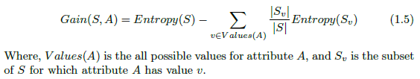
Information Gain:
Given Entropy is the measure of impurity in a collection of a dataset, now we can measure the effectiveness of an attribute in classifying the training set.
The measure we will use called information gain, is simply the expected reduction in entropy caused by partitioning the data set according to this attribute.
The information gain (Gain(S,A) of an attribute A relative to a collection of data set S, is defined as-

Slide 15
For example, suppose S is a collection of training-example days described by attributes including Wind, which can have the values Weak or Strong.
The dataset has 14 instances, so the sample space is 14 where the sample has 9 positive and 5 negative instances. The Attribute Wind can have the values Weak or Strong.
Of these 14 examples, suppose 6 of the positive and 2 of the negative examples have Wind = Weak, and the remainder have Wind = Strong.
The information gain due to sorting the original 14 examples by the attribute Wind may then be calculated as

Slide 16
Therefore,
Values(Wind) = Weak, Strong
S=[9+,5-]
S _{weak} =[6+,2-]
S _{Strong} =[3+,3-]
= Entropy(S)- (8/14 Entropy(S _{weak})+ 6/14Entropy(S _{Strong}))

Slide 17
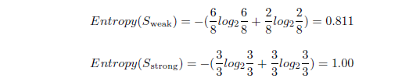
Gain(S , Wind)= Entropy(S)-(8/14*0.811+6/14*1.00)
= 0.940-(0.463+0.429)
= 0.048
So, the information gain by the Wind attribute is 0.048.

Slide 18
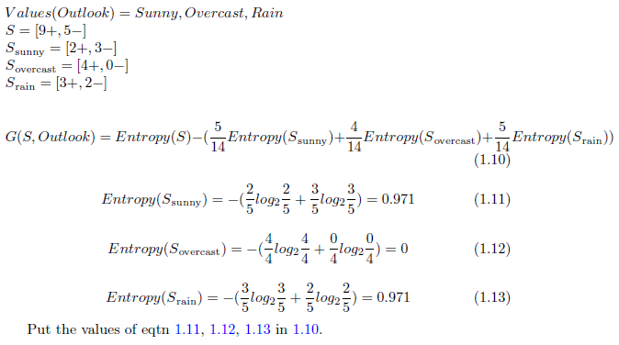
Let’s calculate the information gain by the Outlook attribute.

Slide 19
The information gain values for all four attributes are
Gain(S, Outlook) = 0.246
Gain(S, Humidity) = 0.151
Gain(S, Wind) = 0.048
Gain(S, Temperature) = 0.029
The main goal of measuring information gain is to find the attribute which is most useful to classify training set.
The Outlook attribute provides the best prediction of the target attribute, PlayTennis, over the training examples.
Therefore, Outlook is selected as the decision attribute for the root node, and branches are created below the root for each of its possible values(i.e., Sunny, Overcast, and Rain)

Slide 20
The resulting partial decision tree is :

Slide 21
The training examples are sorted to the corresponding descendant nodes.
The Overcast descendant has only positive instances and therefore becomes a leaf node with classification Yes.
For other two nodes, the question again arises which attribute should be tested? These two nodes will be further expanded by selecting the attributes with the highest information gain relative to the new subset of examples.
Let’s find the attribute that should be tested at the Sunny descendant.
The Dataset has the value Sunny on Day1, Day2, Day8, Day9, Day11. So the Sample Space S=5 here.

Slide 22
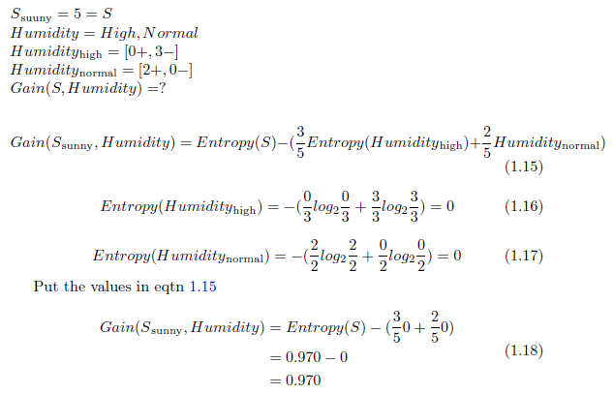

Slide 23

We can now measure the information gain of Temperature and Wind by following the same way we measured Gain(S, Humidity). Finally, we will get:
So Humidity gives us the most information at this stage. The node after “Outlook” at Sunny descendant will be Humidity.
The High descendant has only negative examples and the Normal descendant has only positive examples.
So both of them become the leaf node and can not be furthered expanded

Slide 24
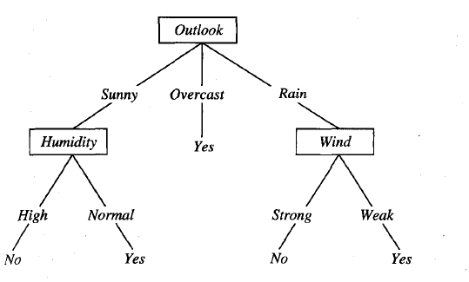
If we expand the Rain descendant by the same procedure we will see that the Wind attribute is providing most information.
Therefor the final decision tree looks like:

Slide 25
HYPOTHESIS SPACE SEARCH IN DECISION TREE LEARNING
ID3 can be characterized as searching a space of hypotheses for one that fits the training examples.
The hypothesis space searched by ID3 is the set of possible decision trees.
ID3 performs a simple-to-complex, hill-climbing search through this hypothesis space, beginning with the empty tree, then considering progressively more elaborate hypotheses in search of a decision tree that correctly classifies the training data

Slide 26
Hypothesis space search by ID3.
ID3 searches through the space of possible decision trees from simplest to increasingly complex, guided by the information gain heuristic.

Slide 27
HYPOTHESIS SPACE SEARCH IN DECISION TREE LEARNING
By viewing ID3 in terms of its search space and search strategy, we can get some insight into its capabilities and limitations.
ID3’s hypothesis space of all decision trees is a complete space of finite discrete-valued functions, relative to the available attributes. Because every finite discrete-valued function can be represented by some decision tree, ID3 avoids one of the major risks of methods that search incomplete hypothesis spaces (such as methods that consider only conjunctive hypotheses): that the hypothesis space might not contain the target function.

Slide 28
HYPOTHESIS SPACE SEARCH IN DECISION TREE LEARNING
2. ID3 maintains only a single current hypothesis as it searches through the space of decision trees.
For example, with the earlier version space candidate-eliminate method, which maintains the set of all hypotheses consistent with the available training examples.
By determining only a single hypothesis, ID3 loses the capabilities that follow from explicitly representing all consistent hypotheses.
For example, it does not have the ability to determine how many alternative decision trees are consistent with the available training data, or to pose new instance queries that optimally resolve among these competing hypotheses.

Slide 29
HYPOTHESIS SPACE SEARCH IN DECISION TREE LEARNING
3. ID3 in its pure form performs no backtracking in its search. Once it, selects an attribute to test at a particular level in the tree, it never backtracks to reconsider this choice.
Therefore, it is susceptible to the usual risks of hill-climbing search without backtracking: converging to locally optimal solutions that are not globally optimal.
In the case of ID3, a locally optimal solution corresponds to the decision tree it selects along the single search path it explores. However, this locally optimal solution may be less desirable than trees that would have been encountered along a different branch of the search.

Slide 30
HYPOTHESIS SPACE SEARCH IN DECISION TREE LEARNING
4. ID3 uses all training examples at each step in the search to make statistically based decisions regarding how to refine its current hypothesis.
This contrasts with methods that make decisions incrementally, based on individual training examples (e.g., FIND-S or CANDIDATE-ELIMINATION ).
One advantage of using statistical properties of all the examples (e.g., information gain) is that the resulting search is much less sensitive to errors in individual training examples.
ID3 can be easily extended to handle noisy training data by modifying its termination criterion to accept hypotheses that imperfectly fit the training data.

Slide 31
INDUCTIVE BIAS IN DECISION TREE LEARNING
Inductive bias is the set of assumptions that, together with the training data, deductively justify the classifications assigned by the learner to future instances.
What is the inductive bias of ID3?
How ID3 generalizes from observed training examples to classify unseen instances

Slide 32
Issues in Decision Tree Learning
Practical issues in learning decision trees
Determining how deeply to grow the decision tree
Handling continuous attributes
Choosing an appropriate attribute selection measure
Handling training data with missing attribute values
Handling attributes with differing costs
Improving computational efficiency.

Slide 33
1. Avoiding Overfitting the Data
Decision Tree learning grows each branch of the tree just deeply enough to perfectly classify the training examples.
It can lead to difficulties when there is noise in the data,or when the number of training examples is too small to produce a representative sample of the true target function
Algorithm can produce trees that overfit the training examples.
a hypothesis overfits the training examples if some other hypothesis that fits the training examples less well actually performs better over the entire distribution of instances

Slide 34
Definition: Given a hypothesis space H, a hypothesis h ϵ H is said to overfit the training data if there exists some alternative hypothesis h' ϵ H, such that h has smaller error than h' over the training examples, but h' has a smaller error than h over the entire distribution of instances.
overfitting is possible even when the training data are noise-free, especially when small numbers of examples are associated with leaf nodes.
Avoiding Overfitting: —There are several approaches for avoiding overfitting in decision tree learning. These can be grouped into two classes:
Pre-pruning (avoidance): Stop growing the tree earlier, before it reaches the point where it perfectly classifies the training data
Post-pruning (recovery): Allow the tree to overfit the data, and then post-prune the tree

Slide 35
Regardless of whether the correct tree size is found by stopping early or by post-pruning, a key question is what criterion is to be used to determine the correct final tree size.
Approaches include:
Use a separate set of examples, distinct from the training examples, to evaluate the utility of post-pruning nodes from the tree.
Use all the available data for training, but apply a statistical test to estimate whether expanding (or pruning) a particular node is likely to produce an improvement beyond the training set.
Use an explicit measure of the complexity for encoding the training examples and the decision tree, halting growth of the tree when this encoding size is minimized. This approach is called the Minimum Description Length principle

Slide 36
In the first approach, the available data are separated into two sets of examples: a training set, which is used to form the learned hypothesis, and a separate validation set, which is used to evaluate the accuracy of this hypothesis over subsequent data and, in particular, to evaluate the impact of pruning this hypothesis

Slide 37
Reduced Error Pruning
How exactly might we use a validation set to prevent overfitting? One approach, called reduced-error pruning, is to consider each of the decision nodes in the tree to be candidates for pruning.
Reduced-error pruning, is to consider each of the decision nodes in the tree to be candidates for pruning.
Pruning a decision node consists of removing the subtree rooted at that node, making it a leaf node, and assigning it the most common classification of the training examples affiliated with that node.
Nodes are removed only if the resulting pruned tree performs no worse than-the original over the validation set.
Reduced error pruning has the effect that any leaf node added due to coincidental regularities in the training set is likely to be pruned because these same coincidences are unlikely to occur in the validation set,

