Slide 1
Evaluation Hypothesis
Empirically evaluating the accuracy of hypotheses is fundamental to machine learning.
Statistical methods are used for estimating hypothesis accuracy, focusing on three questions.
First, given the observed accuracy of a hypothesis over a limited sample of data, how well does this estimate its accuracy over additional examples?
Second, given that one hypothesis outperforms another over some sample of data, how probable is it that this hypothesis is more accurate in general?
Third, when data is limited what is the best way to use this data to both learn a hypothesis and estimate its accuracy?

Slide 2
Motivation of Evaluating Hypothesis
It is important to evaluate the performance of learned hypotheses as precisely as possible.
One reason is simply to understand whether to use the hypothesis.
For instance, when learning from a limited-size database indicating the effectiveness of different medical treatments, it is important to understand as precisely as possible the accuracy of the learned hypotheses.
A second reason is that evaluating hypotheses is an integral component of many learning methods.
For example, in post-pruning decision trees to avoid overfitting, we must evaluate the impact of possible pruning steps on the accuracy of the resulting decision tree.

Slide 3
Estimating the accuracy of a hypothesis is relatively straightforward when data is plentiful. However, when we must learn a hypothesis and estimate its future accuracy given only a limited set of data, two key difficulties arise:
Bias in the estimate. The observed accuracy of the learned hypothesis over the training examples is often a poor estimator of its accuracy over future examples. Because the learned hypothesis was derived from these examples, they will typically provide an optimistically biased estimate of hypothesis accuracy over future examples. To obtain an unbiased estimate of future accuracy, we typically test the hypothesis on some set of test examples chosen independently of the training examples and the hypothesis

Slide 4
Variance in the estimate: Even if the hypothesis accuracy is measured over an unbiased set of test examples independent of the training examples, the measured accuracy can still vary from the true accuracy, depending on the makeup of the particular set of test examples. The smaller the set of test examples, the greater the expected variance

Slide 5
Estimating Hypothesis Accuracy
When evaluating a learning hypothesis involves estimating the accuracy with which it will classify future instances.
Also would like to know the probable error in this accuracy estimate
There is some space of instances X over which various target functions may be defined.
Different instances will have different frequencies.
Based on the frequency, each instance in X will have some unknown probability
Trainer will teach the machine about the training examples of target function.
Send a particular instance xi along with target function f(x)
Target Function f:x->{0,1}

Slide 6
Classifies each instance into different categories based on requirement.
Now, after classification what is the probable error in the estimation we made error of 2 types:
Sample error
True Error

Slide 7
Sample error:
The error rate of hypothesis over a sample of data
The sample error (denoted errors(h)) of hypothesis h with respect to target function f and data sample S is
Where n is the number of examples in S, and the quantity S(f (x), h(x)) is 1 if
f (x) ≠ h(x), and 0 otherwise.

Slide 8
True Error
The true error of a hypothesis is the probability that it will misclassify a single randomly drawn instance from the distribution D.
The error rate of hypothesis over the entire distribution d.
The true error (denoted errorD(h)) of hypothesis h with respect to target function f and distribution D, is the probability that h will misclassify an instance drawn at random according to D.

Slide 9
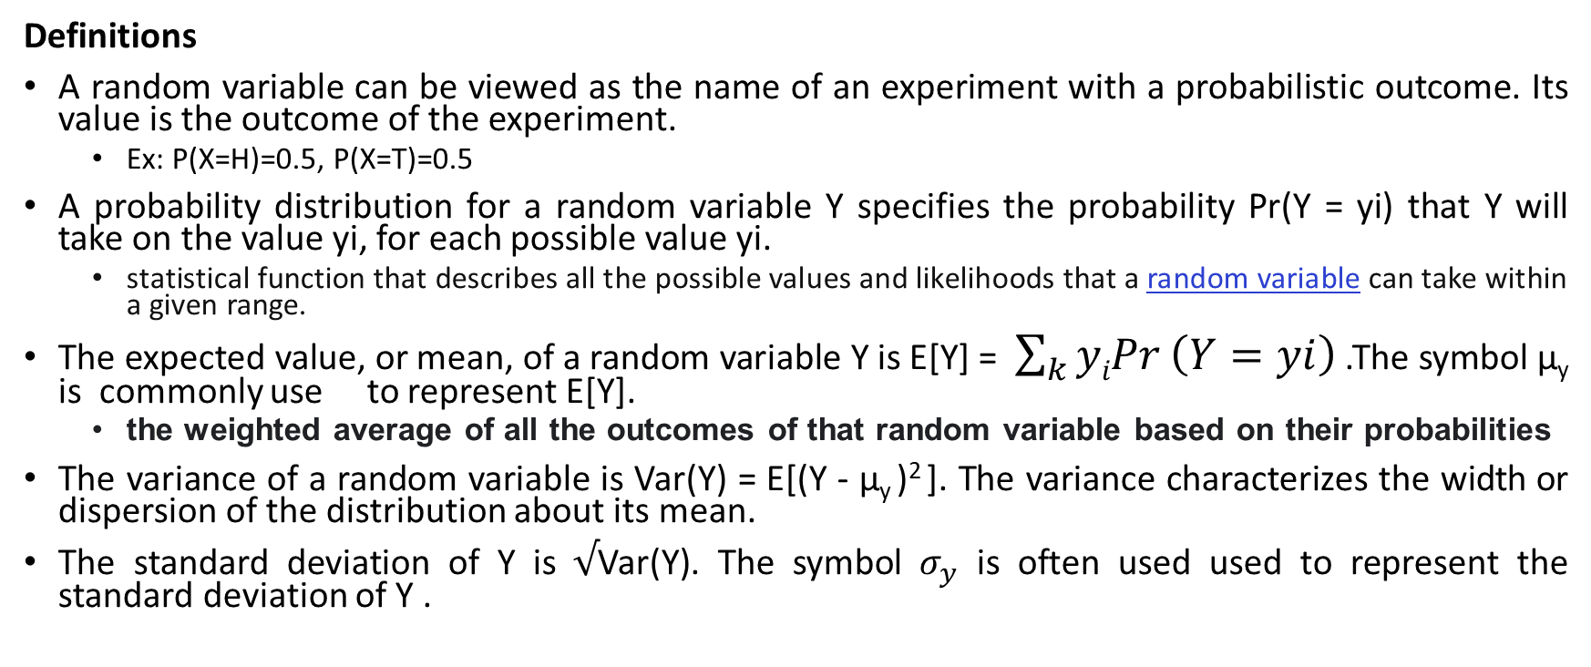
BASICS OF SAMPLING THEORY
Definitions
A random variable can be viewed as the name of an experiment with a probabilistic outcome. Its value is the outcome of the experiment.
Ex: P(X=H)=0.5, P(X=T)=0.5
A probability distribution for a random variable Y specifies the probability Pr(Y = yi) that Y will take on the value yi, for each possible value yi.
statistical function that describes all the possible values and likelihoods that a random variable can take within a given range.
The expected value, or mean, of a random variable Y is E[Y] = $\sum_{k}{yiPr}\left(Y=yi\right)$ .The symbol µ_{y} is commonly use to represent E[Y].
the weighted average of all the outcomes of that random variable based on their probabilities
The variance of a random variable is Var(Y) = E[(Y - µ_{y} )² ]. The variance characterizes the width or dispersion of the distribution about its mean.
The standard deviation of Y is $√$Var(Y). The symbol $σ_{y}$ is often used used to represent the standard deviation of Y .

Slide 10
The Binomial distribution gives the probability of observing r heads in a series of n independent coin tosses, if the probability of heads in a single toss is p.
A binomial distribution can be thought of as simply the probability of a SUCCESS or FAILURE outcome in an experiment or survey that is repeated multiple times
The Normal distribution is a bell-shaped probability distribution that covers many natural phenomena.
The Central Limit Theorem is a theorem stating that the sum of a large number of independent, identically distributed random variables approximately follows a Normal distribution.
An estimator is a random variable Y used to estimate some parameter p of an underlying population.
An estimator is a statistic that estimates some fact about the population.
The estimation bias of Y as an estimator for p is the quantity (E[Y] - p). An unbiased estimator is one for which the bias is zero.
A N% confidence interval estimate for parameter p is an interval that includes p with probability N%.

Slide 11
Error Estimation and Estimating Binomial Proportions
when we measure the sample error we are performing an experiment with a random outcome.
We first collect a random sample S of n independently drawn instances from the distribution D, and then measure the sample error error_{s}(h).
If we were to repeat this experiment many times, each time drawing a different random sample S_{i} of size n, we would expect to observe different values for the various error_{Si}(h), depending on random differences in the makeup of the various S_{i}
The outcome of the ith such experiment error_{Si}(h) , is a random variable.

Slide 12
Imagine that we were to run k such random experiments, measuring the random variables error_{s1} (h), error_{s2} (h) ,…error_{sk} (h)
Imagine further that we then plotted a histogram displaying the frequency with which we observed each possible error value.
As k grows, the histogram would approach a particular probability distribution called the Binomial distribution which is shown in the figure.

Slide 13
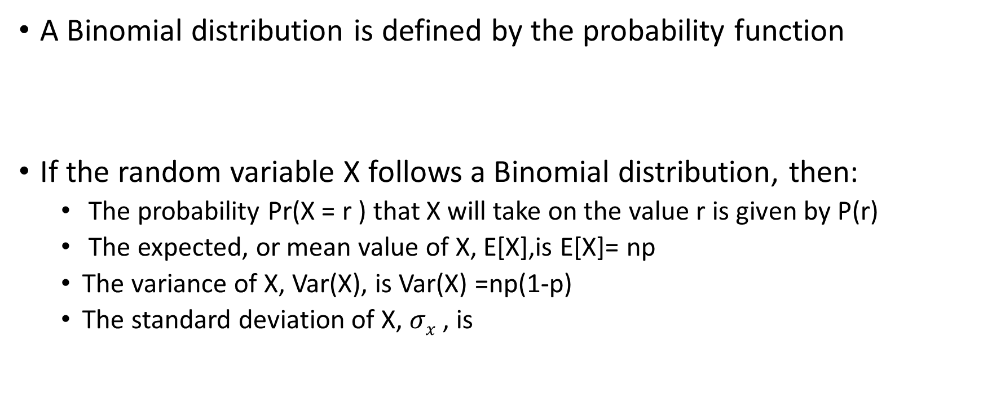
A Binomial distribution is defined by the probability function
If the random variable X follows a Binomial distribution, then:
The probability Pr(X = r ) that X will take on the value r is given by P(r)
The expected, or mean value of X, E[X],is E[X]= np
The variance of X, Var(X), is Var(X) =np(1-p)
The standard deviation of X, $σx$ , is

Slide 14
Binomial Distribution
Consider the following problem for better understanding of Binomial Distribution
Given a worn and bent coin and estimate the probability that the coin will turn up heads when tossed.
Unknown probability of heads p. Toss the coin n times and record the number of times r that it turns up heads.
Estimate of p = r / n
If the experiment were rerun, generating a new set of n coin tosses, we might expect the number of heads r to vary somewhat from the value measured in the first experiment, yielding a somewhat different estimate for p.
The Binomial distribution describes for each possible value of r (i.e., from 0 to n), the probability of observing exactly r heads given a sample of n independent tosses of a coin whose true probability of heads is p.

Slide 15
The general setting to which the Binomial distribution applies is:
There is a base experiment (e.g., toss of the coin) whose outcome can be described by a random variable ‘Y’. The random variable Y can take on two possible values (e.g., Y = 1 if heads, Y = 0 if tails).
The probability that Y = 1 on any single trial of the base experiment is given by some constant p, independent of the outcome of any other experiment. The probability that Y= 0 is therefore (1 - p). Typically, p is not known in advance, and the problem is to estimate it.
A series of n independent trials of the underlying experiment is performed (e.g., n independent coin tosses), producing the sequence of independent, identically distributed random variables Y1, Y2, . . . , Yn. Let R denote the number of trials for which Yi = 1 in this series of n experiments

Slide 16
4. The probability that the random variable R will take on a specific value r (e.g., the probability of observing exactly r heads) is given by the Binomial distribution

Slide 17
Mean, Variance and Standard Deviation
Two properties of a random variable that are often of interest are its expected value (also called its mean value) and its variance.
The expected value is the average of the values taken on by repeatedly sampling the random variable
Definition: Consider a random variable Y that takes on the possible values y1, . . . yn. The expected value (Mean) of Y, E[Y], is

Slide 18
The Variance captures how far the random variable is expected to vary from its mean value.
Definition: The variance of a random variable Y, Var[Y], is
The variance describes the expected squared error in using a single observation of Y to estimate its mean E[Y].
The square root of the variance is called the standard deviation of Y, denoted σy
Definition: The standard deviation of a random variable Y, σy, is

Slide 19
In case the random variable Y is governed by a Binomial distribution, then the Mean, Variance and standard deviation are given by

Slide 20
Estimators, Bias, and Variance
Let us describe errors(h) and errorD(h) using the terms defining the Binomial distribution. We then have
Where,
n is the number of instances in the sample S,
r is the number of instances from S misclassified by h
p is the probability of misclassifying a single instance drawn from D

Slide 21
Estimator:
error_{s}(h) an estimator for the true error error_{D}(h): An estimator is any random variable used to estimate some parameter of the underlying population from which the sample is drawn
Estimation bias: is the difference between the expected value of the estimator and the true value of the parameter.
Definition: The estimation bias of an estimator Y for an arbitrary parameter p is

