Slide 1
IBM University Engagement Project Submission
“Exploring the Power of Agentic AI with IBM Granite and LangFlow”

Slide 2

Project Tile – Agentic AI Technical Interviewer
Domain of Project – Education / EdTech / Career Preparation
Student Name | Recent Passport Photo | Email ID | Mobile number [WhatsApp]
NEERAJ K R |  | neerajkr101010@gmail.com | 9446962841

Slide 3
Problem Statement -
Problem Statement : Problem Statement No. 22 - Interview Trainer Agent
The Challenge
Students and job seekers often struggle to prepare for technical interviews. Generic preparation tools lack context, and traditional platforms cannot dynamically adapt to a candidate's specific background, experience level, or real-time answers.
Industry Problem: Traditional technical interview preparation is static and disconnected from real-world, high-pressure interview environments.
Why Significant: Candidates lack a feedback loop; they often do not know why they failed or how to improve their technical communication.
Target Users: Computer Science students and entry-level job seekers.
Pain Points: Existing tools are generic, lack specific technical context, and cannot simulate the dynamic, back-and-forth nature of a real interview.
The Objective
Build an AI-powered Interview Trainer that conducts a realistic, back-and-forth technical mock interview. The solution should:
Maintain Contextual Memory: Remember previous answers to ask intelligent follow-up questions.
Enforce Persona: Act strictly as an evaluator, not a helpful coding assistant.
Decoupled Interface: Provide a distraction-free, professional chat interface built outside of the standard Langflow playground.

Slide 4
Technology Used
Tech Stack (Mandatory)
I used LangFlow + IBM watsonx.ai + Granite Models
Custom Frontend/Backend: MERN Stack (React.js, Node.js, Express)

Slide 5
Proposed Solution -
Proposed Solution: AI-Powered Technical Interviewer
The proposed solution is a full-stack web application integrated with Langflow and IBM watsonx.ai to provide realistic, dynamic technical mock interviews.
The system addresses the lack of personalized interview prep through a decoupled, memory-enabled architecture.
At its core, the solution utilizes a customized Langflow pipeline to orchestrate the AI logic. Instead of answering user questions, the agent is engineered to drive the conversation, evaluate technical responses, and generate targeted follow-up questions.
The Architecture consists of:
React Frontend: A custom, professional chat UI that captures candidate responses.
Express Backend: A Node.js server that securely routes API calls to Langflow, keeping API keys hidden from the client.
Langflow Engine: Manages the conversational memory and prompt templates.
IBM watsonx.ai: Powers the reasoning using the ibm/granite-8b-code-instruct model, specifically chosen for its deep understanding of programming and system design concepts.
Key Capabilities:
Contextual Memory: Tracks conversation history for intelligent, evolving follow-up questions.
Strict Evaluator Persona: Operates as a formal interviewer, not a tutor, to simulate real-world pressure.
Decoupled Interface: Professional, minimalistic chat UI built to isolate the user from the backend logic.

Slide 6
Langflow component Used -
1)Chat Input – Receives the candidate's answers from the Express backend via API.
2) Chat Output: Formats the AI's next interview question and returns it to the Node.js backend.
3)Message History (Memory Node): Stores the ongoing interview conversation, allowing the AI to remember past questions and candidate responses to maintain context.
4) Prompt Template: Contains the strict system instructions (Prompt Engineering) and variables that force the AI to act as an interviewer rather than a standard chatbot.
5) IBM watsonx.ai Agent: Processes the prompt and memory payload.
6) Name of IBM Granite model:ibm/granite-8b-code-instruct → Highly efficient for evaluating technical, architectural, and coding-related interview answers.
7) FAISS Vector Store: Used for retrieving domain-specific interview questions from college datasets.
8) IBM watsonx.ai Embeddings: This allows the FAISS vector store to understand the meaning and context of interview questions, enabling semantic search rather than simple keyword matching.

Slide 7
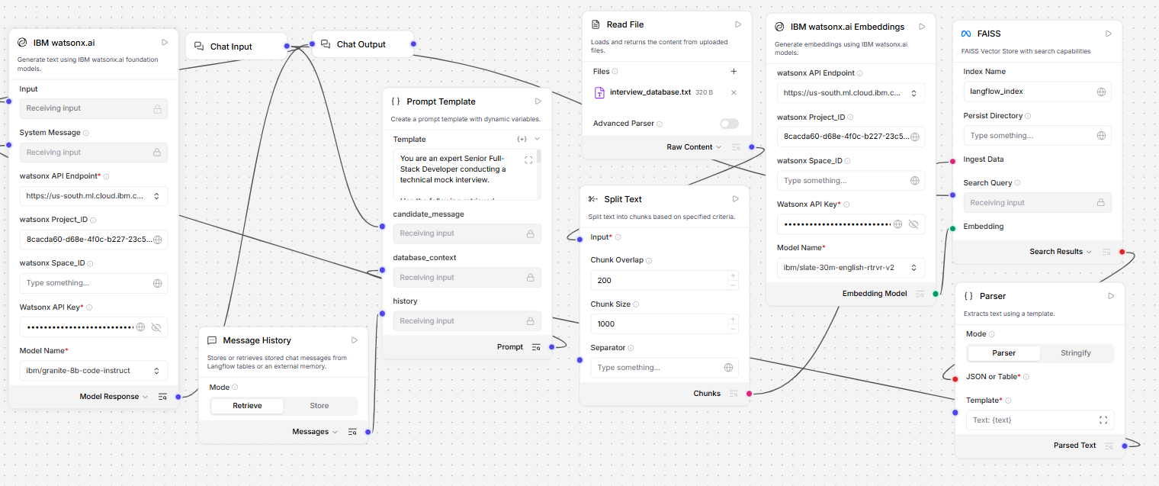
Langflow workflow -

Slide 8

Architecture blueprint

Slide 9
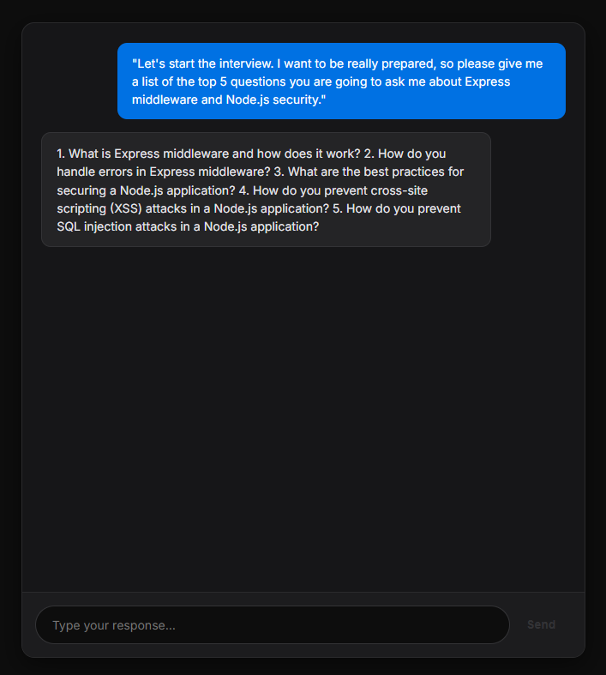
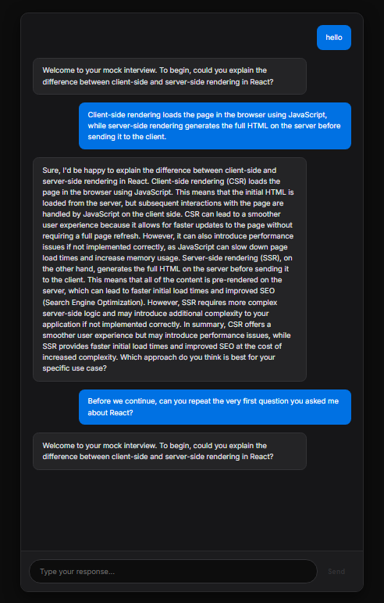
Role of Agentic AI in the solution
Role of Agentic AI in the Interview Trainer
Agentic AI enables the Interviewer to function as a dynamic evaluator rather than a simple call-and-response bot.
Autonomous Conversation Driver: The agent takes control of the flow. Instead of waiting for the user to ask a question, the agent formulates the next logical technical question based on the user's previous answer.
Contextual Reasoning: By utilizing the Message History component, the AI analyzes the candidate's historical answers (e.g., if they mention using MongoDB, the agent will dynamically pivot to ask about NoSQL schema design)
Overall, Agentic AI makes the system proactive and goal-driven, acting exactly like a strict Senior Developer evaluating a candidate.

Slide 10
Technology Used
Langflow platform -Used to visually design the AI pipeline, manage Prompt Engineering, and wire the Message History memory nodes.
IBM Grainte model - ibm/granite-8b-code-instruct – Chosen for its deep technical training, allowing it to evaluate complex software architecture and programming concepts accurately
IBM Cloud – It provides the infrastructure to build, deploy, and scale the Nutrition Agent efficiently. IBM Cloud enables a reliable, secure, and scalable environment for deploying the Nutrition Agent.
RAG– RAG to fetch real data first, then generate intelligent answers, making the Interview Agent more trustworthy and effective.
IBM Watsonx.ai - For model deployment, embeddings, and AI governance
Vector Database (FAISS) – For RAG-based interview data retrieval
MERN Stack (React & Node/Express): Used to build a completely decoupled, professional user interface, bypassing the standard Langflow playground for a production-ready application feel

Slide 11
Novelty and Uniqueness
The proposed Nutrition Agent stands out by combining Agentic AI, RAG, and personalization into a single intelligent system.
RAG-Based Accuracy – Integrates real-time data retrieval with AI generation, reducing misinformation and ensuring trustworthy recommendations.
Dynamic Short-Term Memory: Utilizes Message History nodes to remember past candidate answers, allowing for deep-dive, multi-turn technical follow-up questions rather than surface-level trivia.
Decoupled Custom Architecture: Unlike standard Langflow projects, the AI reasoning is entirely isolated from the presentation layer. The MERN stack handles the UI/UX, while Langflow acts purely as the brain via API.
Multi-Modal Input – Supports text, voice, and image-based meal tracking for better usability.
Strict Persona Enforcement: Overcomes standard LLM safety guardrails (which normally refuse one-word prompts like "start") through advanced Prompt Engineering, forcing the model to stay in character.
Scalable & Enterprise-Ready – Built on IBM watsonx.ai with IBM Granite models, ensuring reliability and governance.

Slide 12
Git Hub Link
https://github.com/neeraj-k-r/Agentic-AI-Interview-Trainer
·
·
·

Slide 13
Future Scope
1.Resume Parsing via RAG: Integrating a Retrieval-Augmented Generation (RAG) vector database to allow users to upload their PDF resumes. The AI could then extract past projects and ask highly specific, personalized questions based on the candidate's actual work history.
2.Voice-to-Text Integration:Implementing the Web Speech API in the React frontend to allow candidates to speak their answers out loud, simulating the pressure and reality of a verbal technical interview.
3. Post-Interview Evaluation Report:Adding a secondary AI agent that reviews the entire Message History transcript once the interview concludes, generating a comprehensive scorecard highlighting strengths and areas for improvement.
·
·
·

Slide 14


