Slide 1

ENGINEERING MATHEMATICS-II
MATLAB
Department of Science and Humanities

Slide 2


Finding Jacobian:
If $u=xyz, v=y^{2},w=x+z,$ then evaluate the Jacobian J.
>>syms x y z
>>J=jacobian([x*y*z, y^2, x + z], [x, y, z])
>>d = det(J) password: @nsys@123
Out Put: J= $\left[\begin{matrix}yz & xz & xy \\ 0 & 2y & 0 \\ 1 & 0 & 1\end{matrix}\right]$
d = 2*y^2*z - 2*x*y^2

Slide 3

Finding Jacobian Continuation:
If $u=x^{2}−2y, v=x+y+z, w=x−2y+3z,\text{then} \text{evaluate} \text{the} \text{Jacobian} \text{J}\text{.}$
>>syms x y z
>>J=jacobian([x.^2-2*y x+y+z x-2*y+3*z], [x, y, z])
>>d = det(J)
Out Put: j =[ 2*x, -2, 0][ 1, 1, 1][ 1, -2, 3]
d =10*x + 4

Slide 4

Finding Jacobian Continuation:
If $u=x^{2}−2y^{2}, v={2x}^{2}−y^{2},$where $x=rcosθ,y=rsinθ$, then evaluate the Jacobian J.
>>syms x y r theta
>>x=r*cos(theta);
>>y=r*sin(theta);
>>j=jacobian([x^2-2*y^2, 2*x^2-y^2 ], [r, theta])
>>d = det(j)
>>simplify(d)

Slide 5
Finding Jacobian Continuation:
Out Put:
j =[ 2*r*cos(theta)^2 - 4*r*sin(theta)^2, -6*r^2*cos(theta)*sin(theta)]
[ 4*r*cos(theta)^2 - 2*r*sin(theta)^2, -6*r^2*cos(theta)*sin(theta)]
d =
12*r^3*cos(theta)*sin(theta)^3 + 12*r^3*cos(theta)^3*sin(theta)
ans =
6*r^3*sin(2*theta)

Slide 6
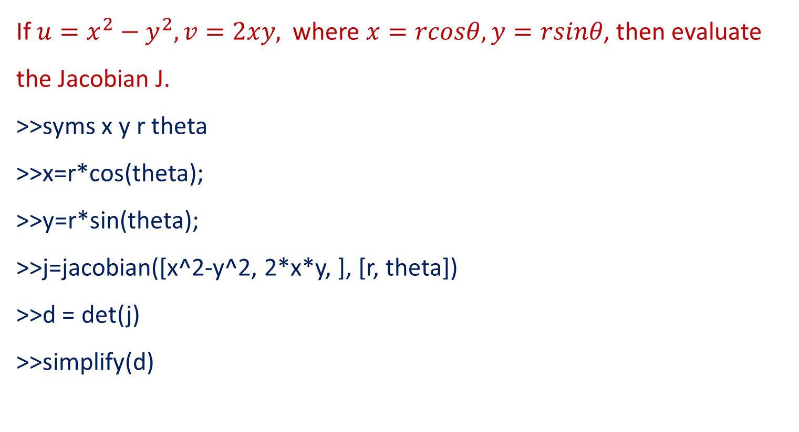
Finding Jacobian Continuation:
If $u=x^{2}−y^{2}, v=2xy,$where $x=rcosθ,y=rsinθ$, then evaluate the Jacobian J.
>>syms x y r theta
>>x=r*cos(theta);
>>y=r*sin(theta);
>>j=jacobian([x^2-y^2, 2*x*y, ], [r, theta])
>>d = det(j)
>>simplify(d)

Slide 7
Finding Jacobian Continuation:
Out Put:
j =
[ 2*r*cos(theta)^2 - 2*r*sin(theta)^2, -4*r^2*cos(theta)*sin(theta)]
[ 4*r*cos(theta)*sin(theta), 2*r^2*cos(theta)^2 - 2*r^2*sin(theta)^2]
d =
4*r^3*cos(theta)^4++4*r^3*sin(theta)^4+8*r^3*cos(theta)^2*sin(theta)^2
ans =4*r^3

Slide 8

Finding Jacobian Continuation:
If $x=u\left(1−v\right), y=uv,$prove that ${JJ}^{′}=1$
>>syms u v
>>J=jacobian([u*(1-v), u*v,], [u, v, ])
>>inv(J)
>>J*inv(J)
>>det(J*inv(J))

Slide 9
Finding Jacobian Continuation:
Out Put:
J =[ 1 - v, -u] [ v, u]
ans = [ 1, 1] [ -v/u, -(v - 1)/u]
ans = [ 1, 0] [ 0, 1]
ans =1

Slide 10
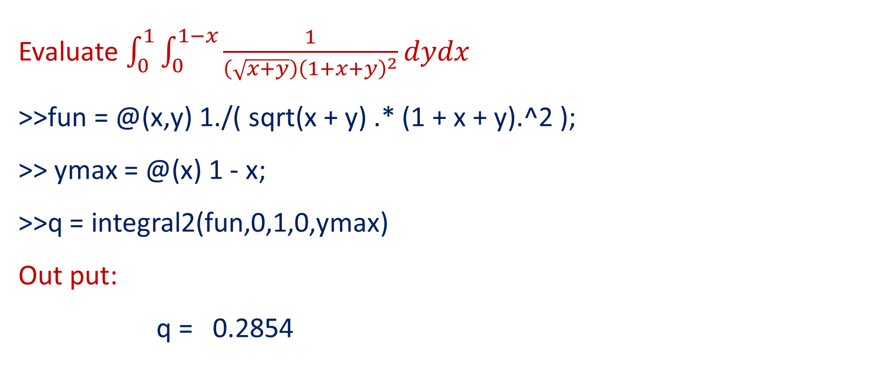
Evaluation of Double Integral :
Evaluate $\int_{0}^{1}{\int_{0}^{1−x}{\frac{1}{\left(\sqrt{x+y}\right){\left(1+x+y\right)}^{2}}}dydx}$
>>fun = @(x,y) 1./( sqrt(x + y) .* (1 + x + y).^2 );
>> ymax = @(x) 1 - x;
>>q = integral2(fun,0,1,0,ymax)
Out put:
q = 0.2854

Slide 11

Evaluation of Double Integral Continuation:
Evaluate $\int_{−π}^{2π}{\int_{0}^{π}{\left[ysin\left(x\right)+xcos(y)\right]}dydx.}$
>>fun = @(x,y) y.*sin(x)+x.*cos(y);
>>q = integral2(fun,-pi,2*pi,0,pi);
Out put:
q =
-9.8696

Slide 12

Evaluation of Double Integral Continuation:
Evaluate $\int_{0}^{5}{\int_{0}^{x^{2}}{x\left(x^{2}+y^{2}\right)dydx}.}$
>>fun = @(x,y) x.*(x.^2+y.^2);
>>ymax = @(x) x.^2;
>>q = integral2(fun,0,5,0,ymax)
Out put:
q = 1.8880e+04

Slide 13

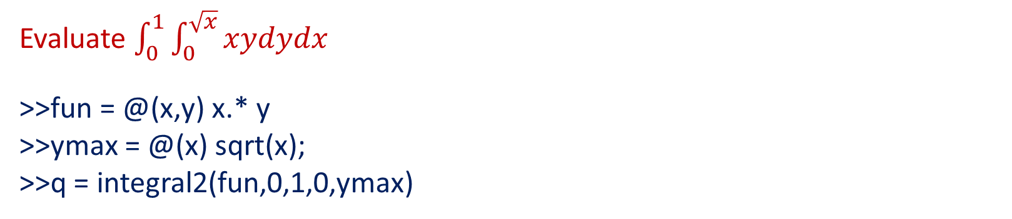
Evaluation of Double Integral Continuation:
Evaluate $\int_{0}^{1}{\int_{0}^{\sqrt{x}}{xydydx}}$
>>fun = @(x,y) x.* y
>>ymax = @(x) sqrt(x);
>>q = integral2(fun,0,1,0,ymax)
q =
0.1667

Slide 14
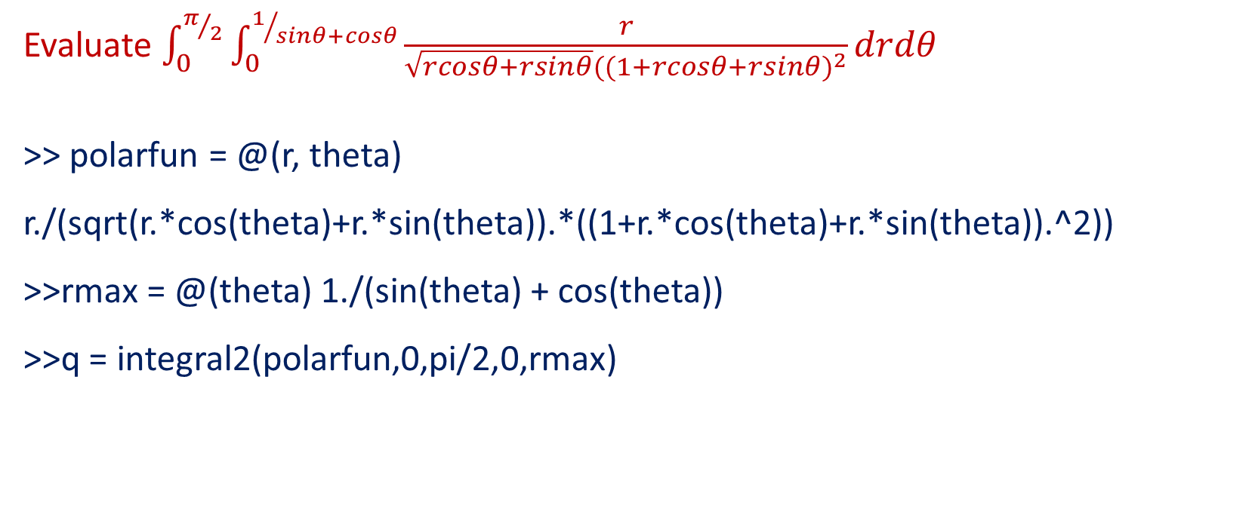
Evaluation of Double Integral Continuation:
Evaluate $\int_{0}^{π/2}{\int_{0}^{1/{sinθ+cosθ}}{\frac{r}{\sqrt{rcosθ+rsinθ}{((1+rcosθ+rsinθ)}^{2}}}}drdθ$
>> polarfun = @(r, theta) r./(sqrt(r.*cos(theta)+r.*sin(theta)).*((1+r.*cos(theta)+r.*sin(theta)).^2))
>>rmax = @(theta) 1./(sin(theta) + cos(theta))
>>q = integral2(polarfun,0,pi/2,0,rmax)
q = 0.2385

Slide 15
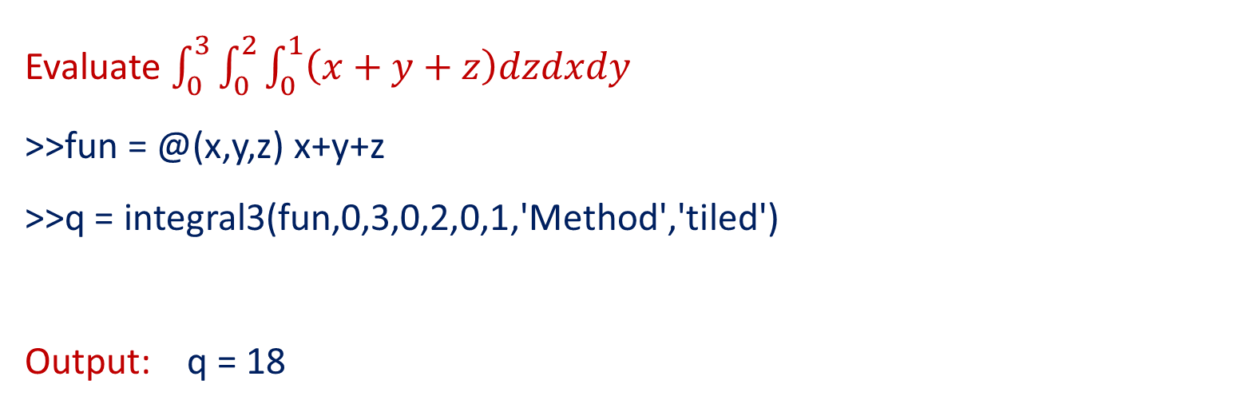
Evaluation of Triple Integral:
Evaluate $\int_{0}^{3}{\int_{0}^{2}{\int_{0}^{1}{\left(x+y+z\right)dzdxdy}}}$
>>fun = @(x,y,z) x+y+z
>>q = integral3(fun,0,3,0,2,0,1,'Method','tiled')
Output: q = 18

Slide 16
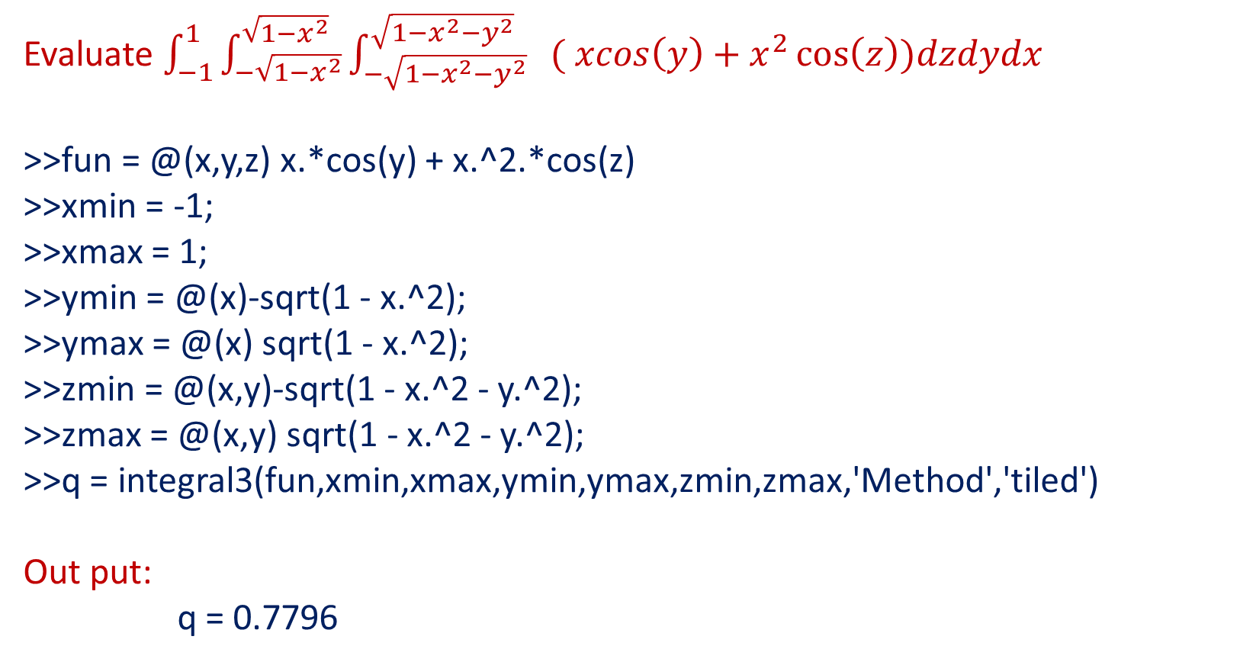
Evaluation of Triple Integral Continuation:
Evaluate $\int_{−1}^{1}{\int_{−\sqrt{1−x^{2}}}^{\sqrt{1−x^{2}}}{\int_{−\sqrt{1−x^{2}−y^{2}}}^{\sqrt{1−x^{2}−y^{2}}}{ ( xcos\left(y\right)+x^{2}\cos\left(z\right))dzdydx}}}$
>>fun = @(x,y,z) x.*cos(y) + x.^2.*cos(z)
>>xmin = -1;
>>xmax = 1;
>>ymin = @(x)-sqrt(1 - x.^2);
>>ymax = @(x) sqrt(1 - x.^2);
>>zmin = @(x,y)-sqrt(1 - x.^2 - y.^2);
>>zmax = @(x,y) sqrt(1 - x.^2 - y.^2);
>>q = integral3(fun,xmin,xmax,ymin,ymax,zmin,zmax,'Method','tiled')
Out put:
q = 0.7796

Slide 17
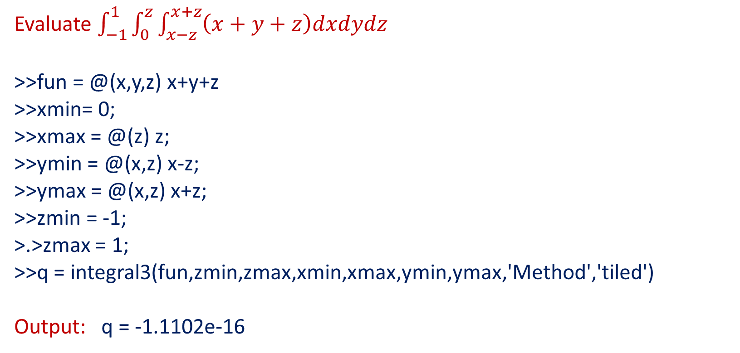
Evaluation of Triple Integral Continuation:
Evaluate $\int_{−1}^{1}{\int_{0}^{z}{\int_{x−z}^{x+z}{\left(x+y+z\right)dxdydz}}}$
>>fun = @(x,y,z) x+y+z
>>xmin= 0;
>>xmax = @(z) z;
>>ymin = @(x,z) x-z;
>>ymax = @(x,z) x+z;
>>zmin = -1;
>.>zmax = 1;
>>q = integral3(fun,zmin,zmax,xmin,xmax,ymin,ymax,'Method','tiled')
Output: q = -1.1102e-16

Slide 18
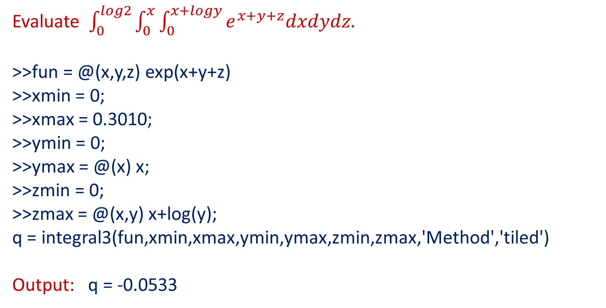
Evaluation of Triple Integral Continuation:
Evaluate $\int_{0}^{log2}{\int_{0}^{x}{\int_{0}^{x+logy}{e^{x+y+z}dxdydz.}}}$
>>fun = @(x,y,z) exp(x+y+z)
>>xmin = 0;
>>xmax = 0.3010;
>>ymin = 0;
>>ymax = @(x) x;
>>zmin = 0;
>>zmax = @(x,y) x+log(y);
q = integral3(fun,xmin,xmax,ymin,ymax,zmin,zmax,'Method','tiled')
Output: q = -0.0533

Slide 19
THANK YOU

