Slide 1

ENGINEERING MATHEMATICS-II
MATLAB
Department of Science and Humanities

Slide 2

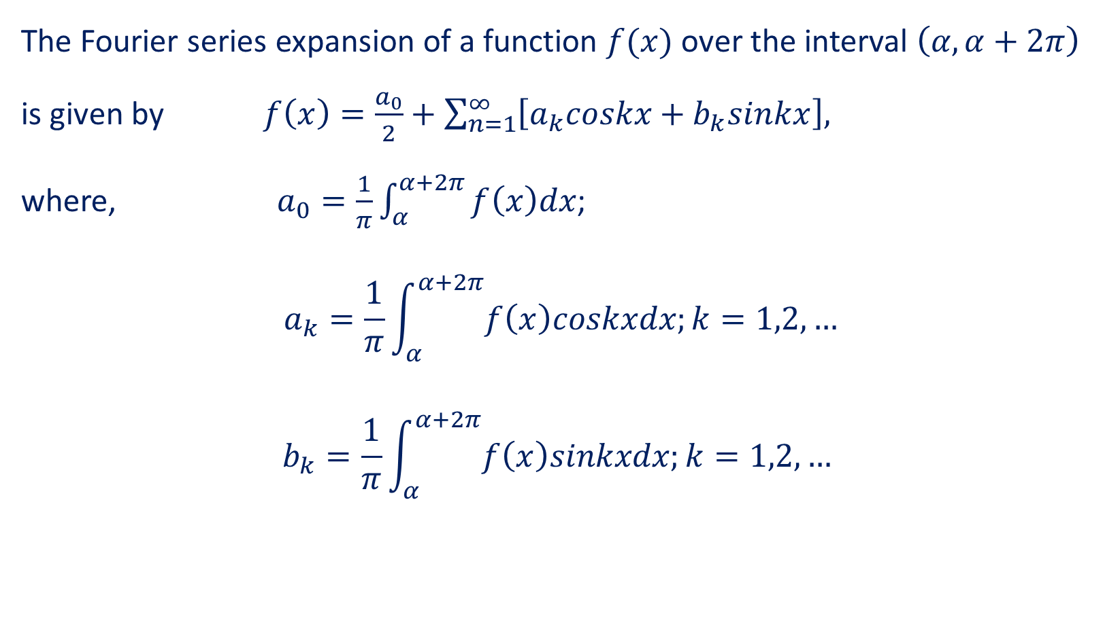
Fourier Series
The Fourier series expansion of a function $f(x)$ over the interval $\left(α,α+2π\right)$ is given by $f\left(x\right)=\frac{a_{0}}{2}+\sum_{n=1}^{∞}{\left[a_{k}coskx+b_{k}sinkx\right],}$
where, $a_{0}=\frac{1}{π}\int_{α}^{α+2π}{f\left(x\right)dx}$;
$$a_{k}=\frac{1}{π}\int_{α}^{α+2π}{f\left(x\right)coskxdx;k=1,2,…}$$
$$b_{k}=\frac{1}{π}\int_{α}^{α+2π}{f\left(x\right)sinkxdx;k=1,2,…}$$

Slide 3
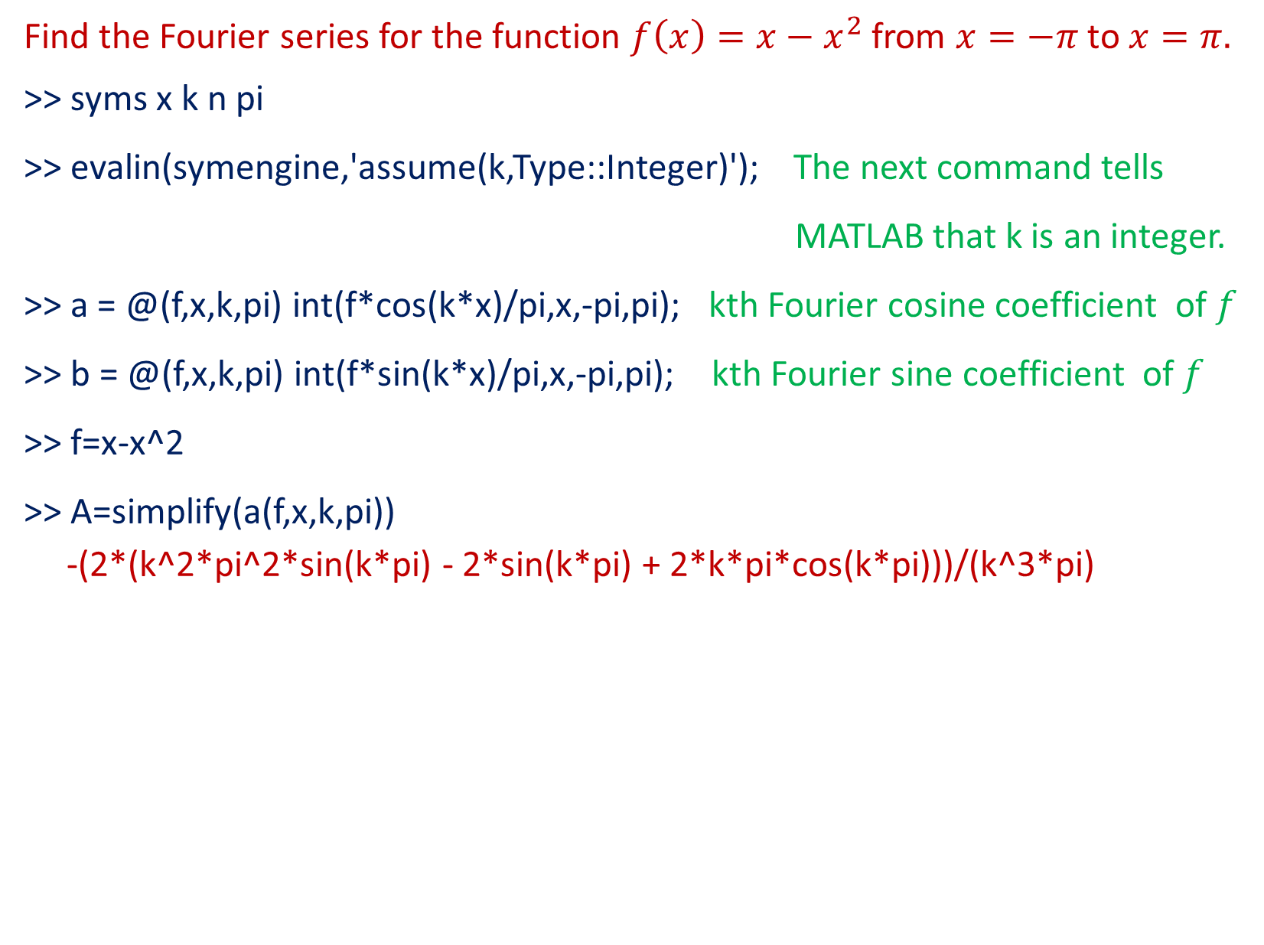
Problem
Find the Fourier series for the function $f\left(x\right)=x−x^{2}$from $x=−π$ to $x=π.$
>> syms x k n pi
>> evalin(symengine,'assume(k,Type::Integer)'); The next command tells
MATLAB that k is an integer.
>> a = @(f,x,k,pi) int(f*cos(k*x)/pi,x,-pi,pi); kth Fourier cosine coefficient of $f$
>> b = @(f,x,k,pi) int(f*sin(k*x)/pi,x,-pi,pi); kth Fourier sine coefficient of $f$
>> f=x-x^2
>> A=simplify(a(f,x,k,pi))
-(2*(k^2*pi^2*sin(k*pi) - 2*sin(k*pi) + 2*k*pi*cos(k*pi)))/(k^3*pi)

Slide 4


>> pretty(A)
>> B=simplify(b(f,x,k,pi))
B = (2*(sin(k*pi) - k*pi*cos(k*pi)))/(k^2*pi)
>> pretty(B)

Slide 5
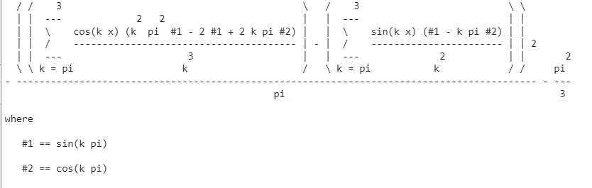
The nth partial sum
>> fs = @(f,x,n,pi) a(f,x,0,pi)/2 + ...
symsum(a(f,x,k,pi)*cos(k*x) + b(f,x,k,pi)*sin(k*x),k,pi,n);
>> pretty(fs(f,x,3,pi))

Slide 6
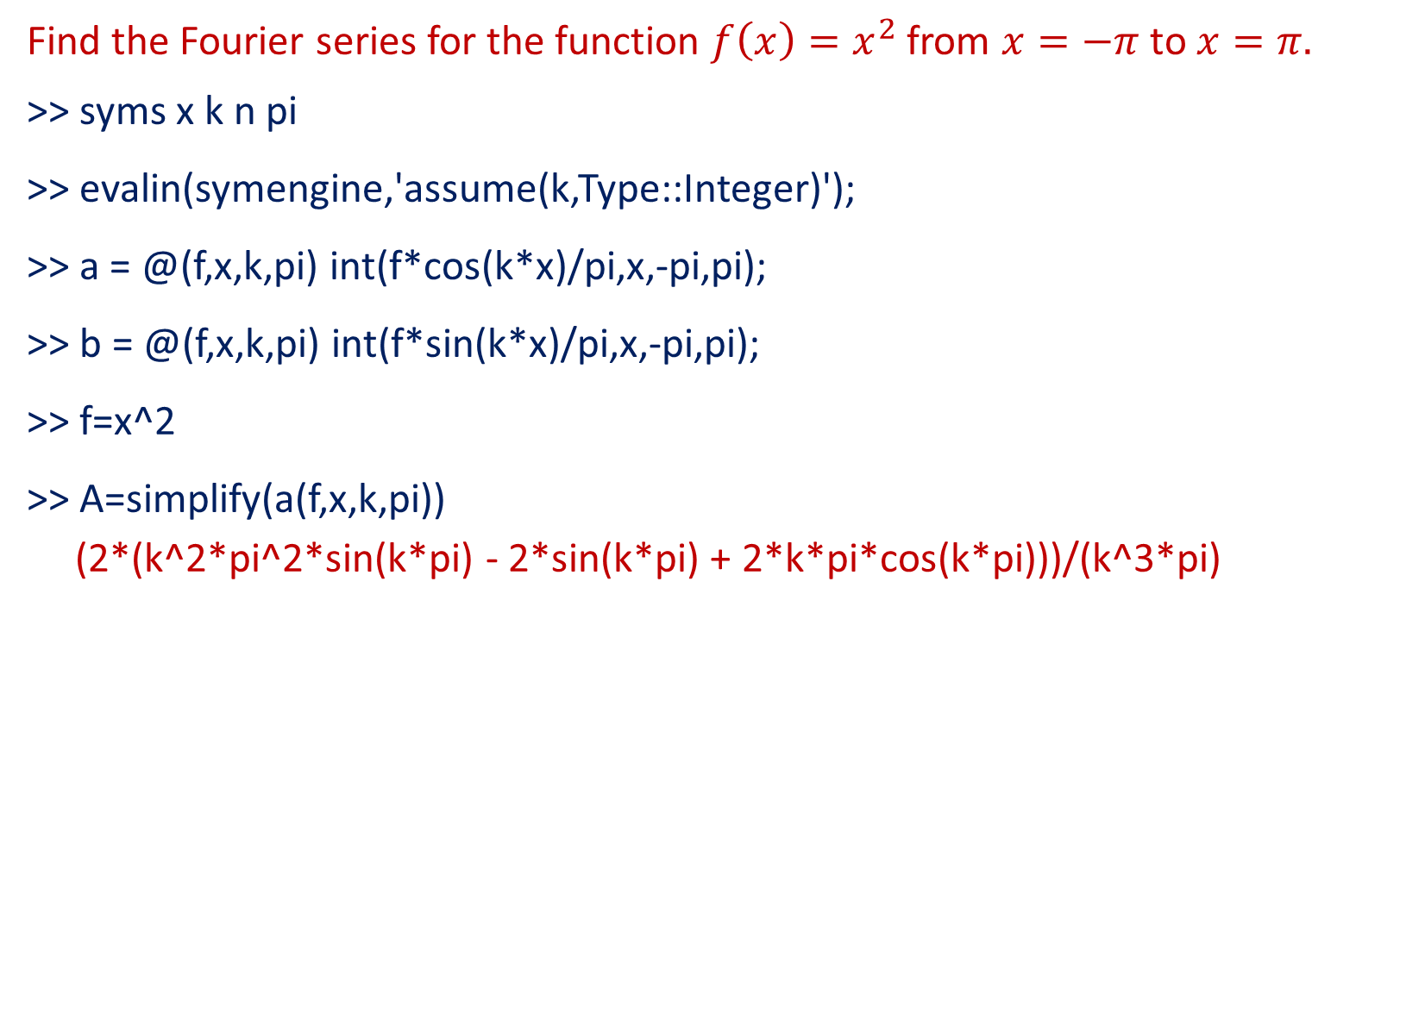
Problem
Find the Fourier series for the function $f\left(x\right)=x^{2}$from $x=−π$ to $x=π.$
>> syms x k n pi
>> evalin(symengine,'assume(k,Type::Integer)');
>> a = @(f,x,k,pi) int(f*cos(k*x)/pi,x,-pi,pi);
>> b = @(f,x,k,pi) int(f*sin(k*x)/pi,x,-pi,pi);
>> f=x^2
>> A=simplify(a(f,x,k,pi))
(2*(k^2*pi^2*sin(k*pi) - 2*sin(k*pi) + 2*k*pi*cos(k*pi)))/(k^3*pi)

Slide 7
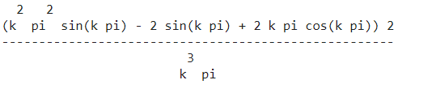
>> pretty(A)
>> B=simplify(b(f,x,k,pi))
B = 0

Slide 8
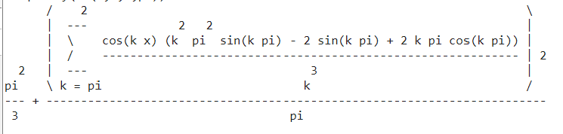
>> fs = @(f,x,n,pi) a(f,x,0,pi)/2 + ...
symsum(a(f,x,k,pi)*cos(k*x) + b(f,x,k,pi)*sin(k*x),k,pi,n);
>> pretty(fs(f,x,2,pi))

Slide 9
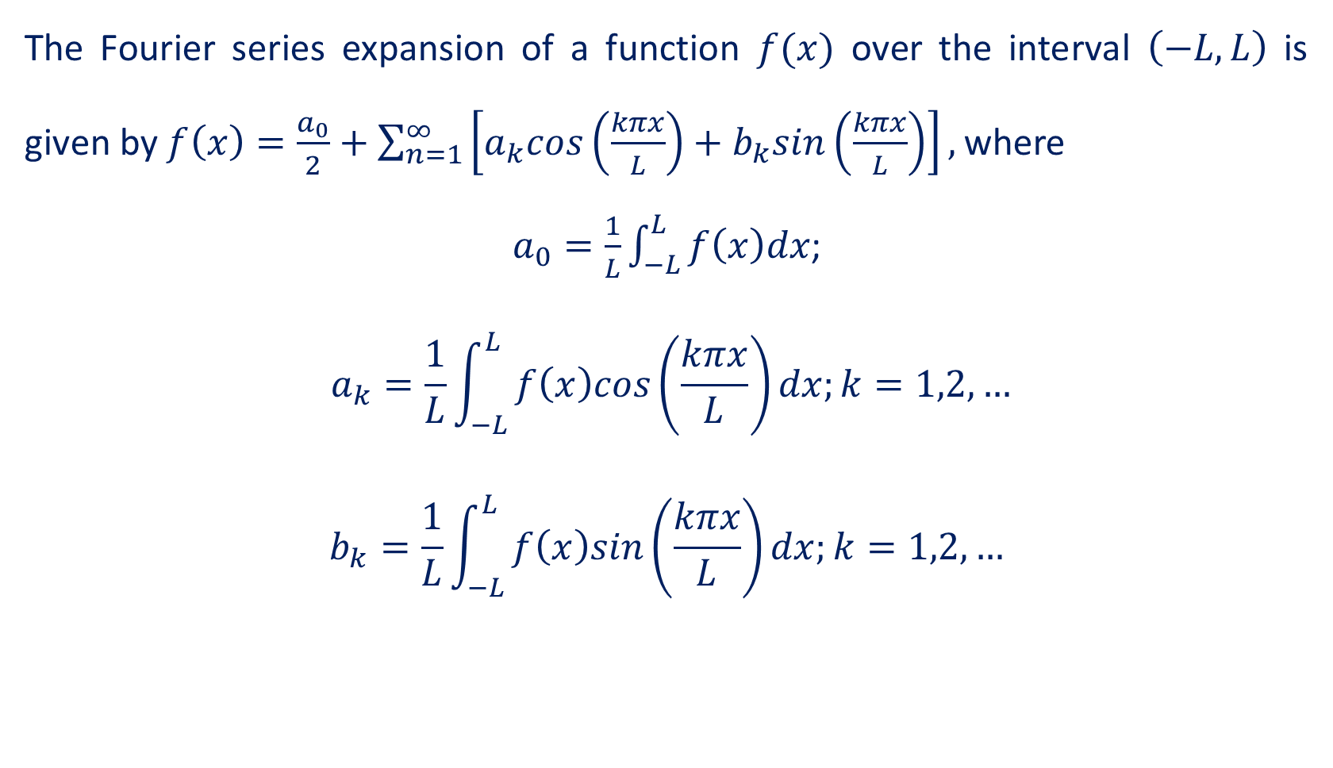
Fourier Series over an arbitrary interval
The Fourier series expansion of a function $f(x)$ over the interval $\left(−L,L\right)$ is given by $f\left(x\right)=\frac{a_{0}}{2}+\sum_{n=1}^{∞}{\left[a_{k}cos\left(\frac{kπx}{L}\right)+b_{k}sin\left(\frac{kπx}{L}\right)\right],}$where
$a_{0}=\frac{1}{L}\int_{−L}^{L}{f\left(x\right)dx}$;
$$a_{k}=\frac{1}{L}\int_{−L}^{L}{f\left(x\right)cos\left(\frac{kπx}{L}\right)dx;k=1,2,…}$$
$$b_{k}=\frac{1}{L}\int_{−L}^{L}{f\left(x\right)sin\left(\frac{kπx}{L}\right)dx;k=1,2,…}$$

Slide 10
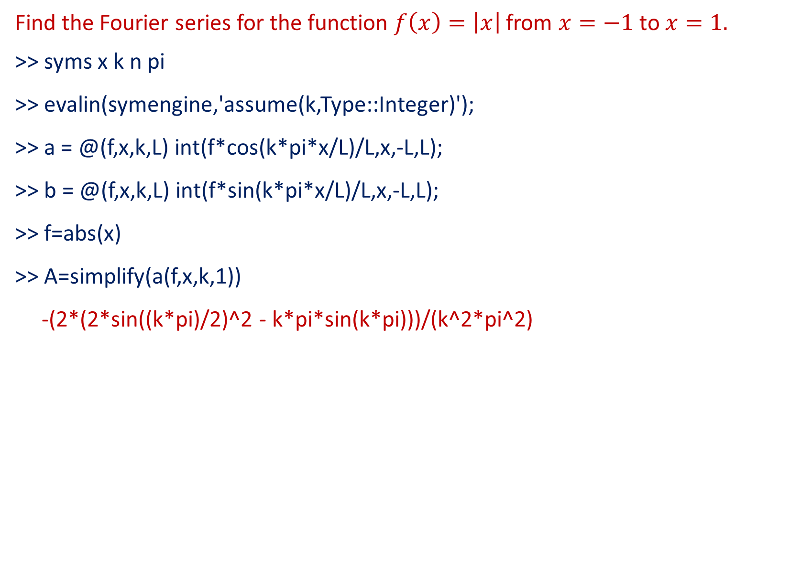
Problem
Find the Fourier series for the function $f\left(x\right)=\left|x\right|$from $x=−1$ to $x=1.$
>> syms x k n pi
>> evalin(symengine,'assume(k,Type::Integer)');
>> a = @(f,x,k,L) int(f*cos(k*pi*x/L)/L,x,-L,L);
>> b = @(f,x,k,L) int(f*sin(k*pi*x/L)/L,x,-L,L);
>> f=abs(x)
>> A=simplify(a(f,x,k,1))
-(2*(2*sin((k*pi)/2)^2 - k*pi*sin(k*pi)))/(k^2*pi^2)

Slide 11
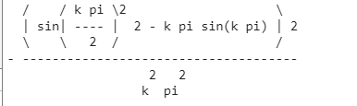
>> pretty(A)
>> B=simplify(b(f,x,k,1))
B = 0

Slide 12
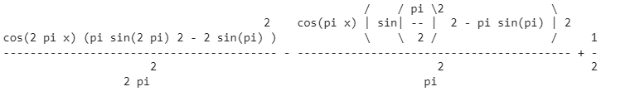
>> fs = @(f,x,n,L) a(f,x,0,L)/2 + ...
symsum(a(f,x,k,L)*cos(k*pi*x/L) + b(f,x,k,L)*sin(k*pi*x/L),k,1,n);
>> pretty(fs(f,x,2,1))

Slide 13
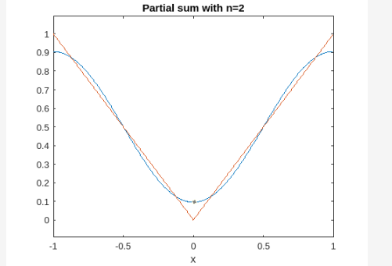

Here are the plots of the partial sums for n=2,5,10. The plot also shows the function $f$.
>> ezplot(fs(f,x,2,1),-1,1)
>> hold on
>> ezplot(f,-1,1)
>> hold off
>> title('Partial sum with n=2')

Slide 14
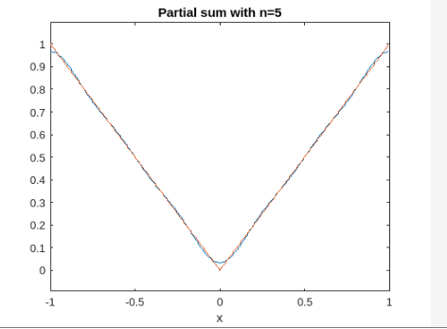
>> ezplot(fs(f,x,5,1),-1,1)
>> hold on
>> ezplot(f,-1,1)
>> hold off
>> title('Partial sum with n=5')

Slide 15
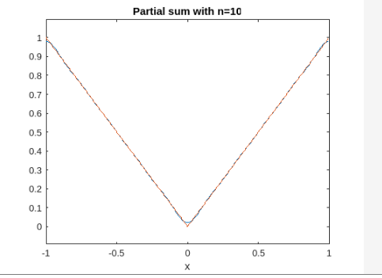
>> ezplot(fs(f,x,10,1),-1,1)
>> hold on
>> ezplot(f,-1,1)
>> hold off
>> title('Partial sum with n=10')

Slide 16
THANK YOU

