Slide 1

ENGINEERING MATHEMATICS-II
MATLAB
Department of Science and Humanities

Slide 2

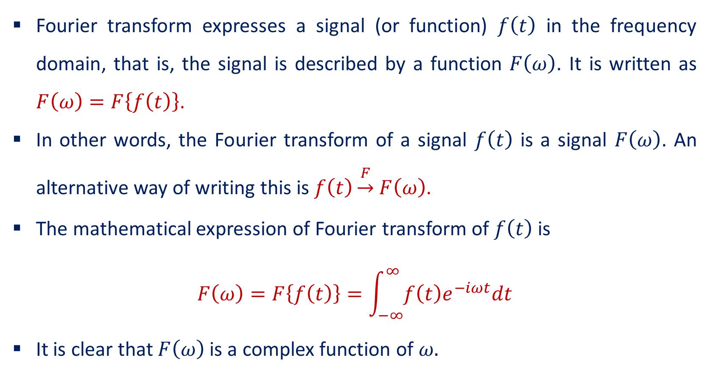
Fourier Transform
Fourier transform expresses a signal (or function) $f\left(t\right)$ in the frequency domain, that is, the signal is described by a function $F\left(ω\right)$. It is written as $F\left(ω\right)=F\left\{f\left(t\right)\right\}$.
In other words, the Fourier transform of a signal $f\left(t\right)$ is a signal $F\left(ω\right)$. An alternative way of writing this is $f\left(t\right)\underset{→}{F}$ $F\left(ω\right)$.
The mathematical expression of Fourier transform of $f\left(t\right)$ is
$$F\left(ω\right)=F\left\{f\left(t\right)\right\}=\int_{−∞}^{∞}{f\left(t\right)e^{−iωt}dt}$$
It is clear that $F\left(ω\right)$ is a complex function of $ω.$

Slide 3
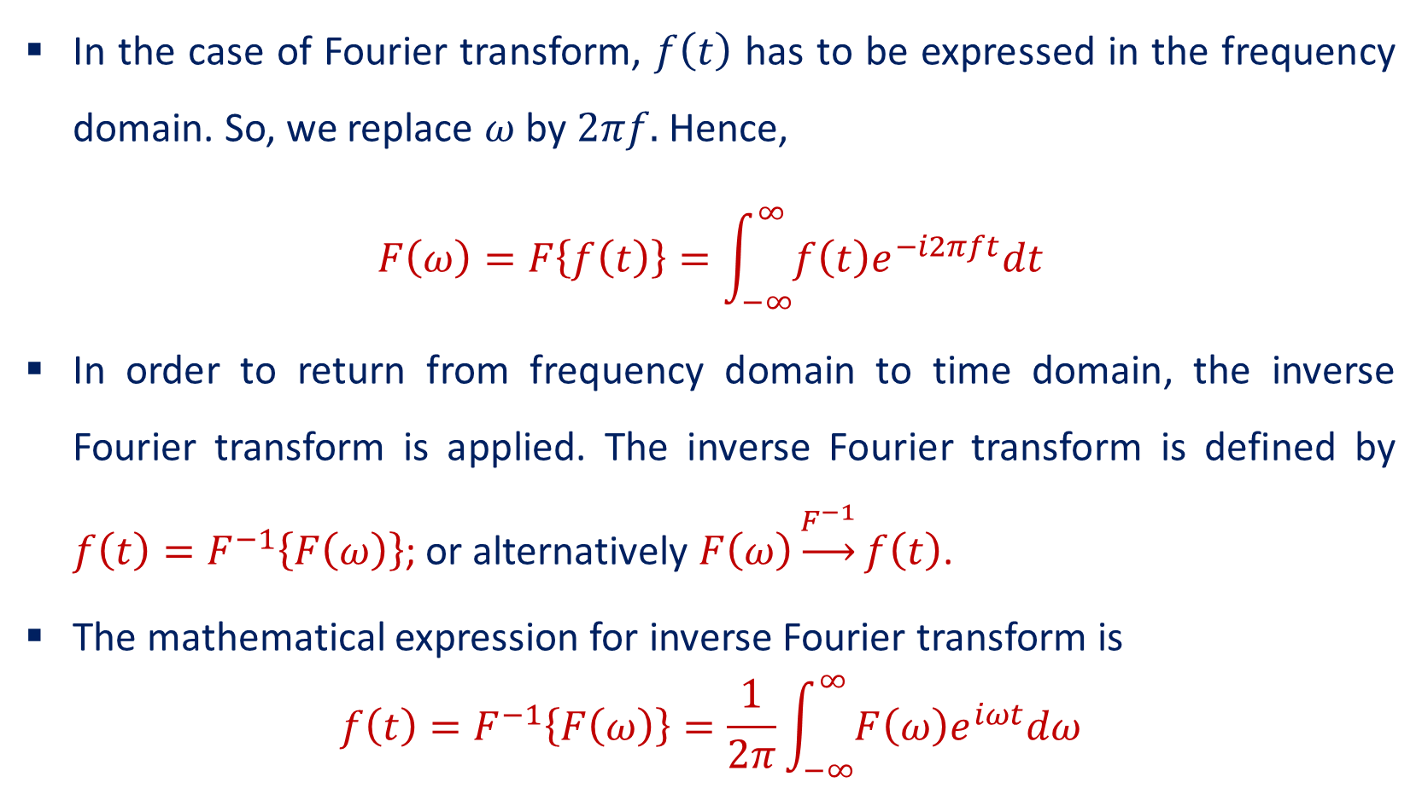
Fourier Transform
In the case of Fourier transform, $f\left(t\right)$ has to be expressed in the frequency domain. So, we replace $ω$ by $2πf.$ Hence,
$$F\left(ω\right)=F\left\{f\left(t\right)\right\}=\int_{−∞}^{∞}{f\left(t\right)e^{−i2πft}dt}$$
In order to return from frequency domain to time domain, the inverse Fourier transform is applied. The inverse Fourier transform is defined by $f\left(t\right)=F^{−1}\left\{F\left(ω\right)\right\}$; or alternatively $F\left(ω\right)\underset{→}{F^{−1}}f\left(t\right)$.
The mathematical expression for inverse Fourier transform is
$$f\left(t\right)=F^{−1}\left\{F\left(ω\right)\right\}=\frac{1}{2π}\int_{−∞}^{∞}{F\left(ω\right)e^{iωt}dω}$$

Slide 4
Plotting of Fourier transform of a function $f\left(t\right)$=1
>> clf
>> clear all
>> f=-4:0.01:4;
>> syms t
>> F=int(1*exp(-i*2*pi*f*t),t,-0.5,0.5);
>> F1=double(F);
>> subplot(211)
>> plot(f,abs(F1))
>> subplot(212)
>> plot(f,angle(F1))
>> grid on

Slide 5
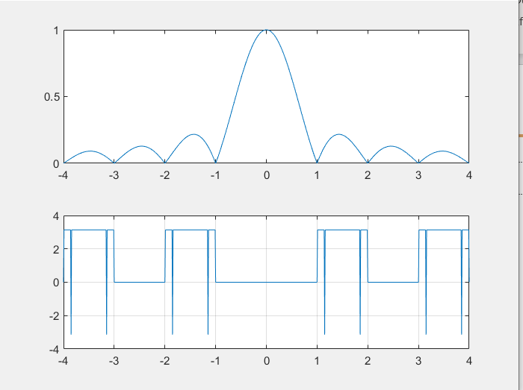
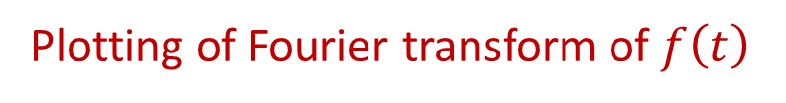
Plotting of Fourier transform of $f\left(t\right)$

Slide 6

Plotting of Fourier transform of $f\left(t\right)=2t$
>> f=-4:0.01:4;
>> syms t
>> F=int((2*t)*exp(-i*2*pi*f*t),t,-0.5,0.5);
>> F1=double(F);
>> subplot(211)
>> plot(f,abs(F1))
>> subplot(212)
>> plot(f,angle(F1))
>> grid on

Slide 7
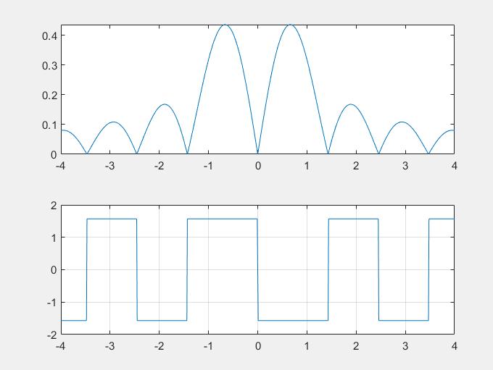
Plotting of Fourier transform of $f\left(t\right)$

Slide 8
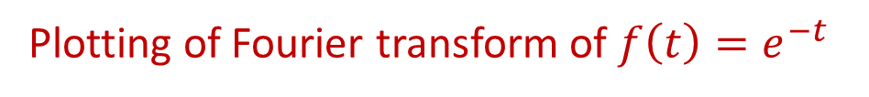
Plotting of Fourier transform of $f\left(t\right)=e^{−t}$
>> f=-4:0.01:4;
>> syms t
>> F=int(exp(-t)*exp(-i*2*pi*f*t),t,-0.5,0.5);
>> F1=double(F);
>> subplot(211)
>> plot(f,abs(F1))
>> subplot(212)
>> plot(f,angle(F1))
>> grid on

Slide 9
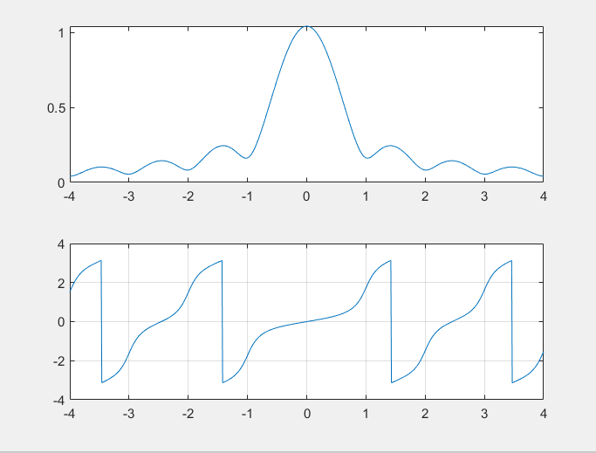
Plotting of Fourier transform of $f\left(t\right)$

Slide 10
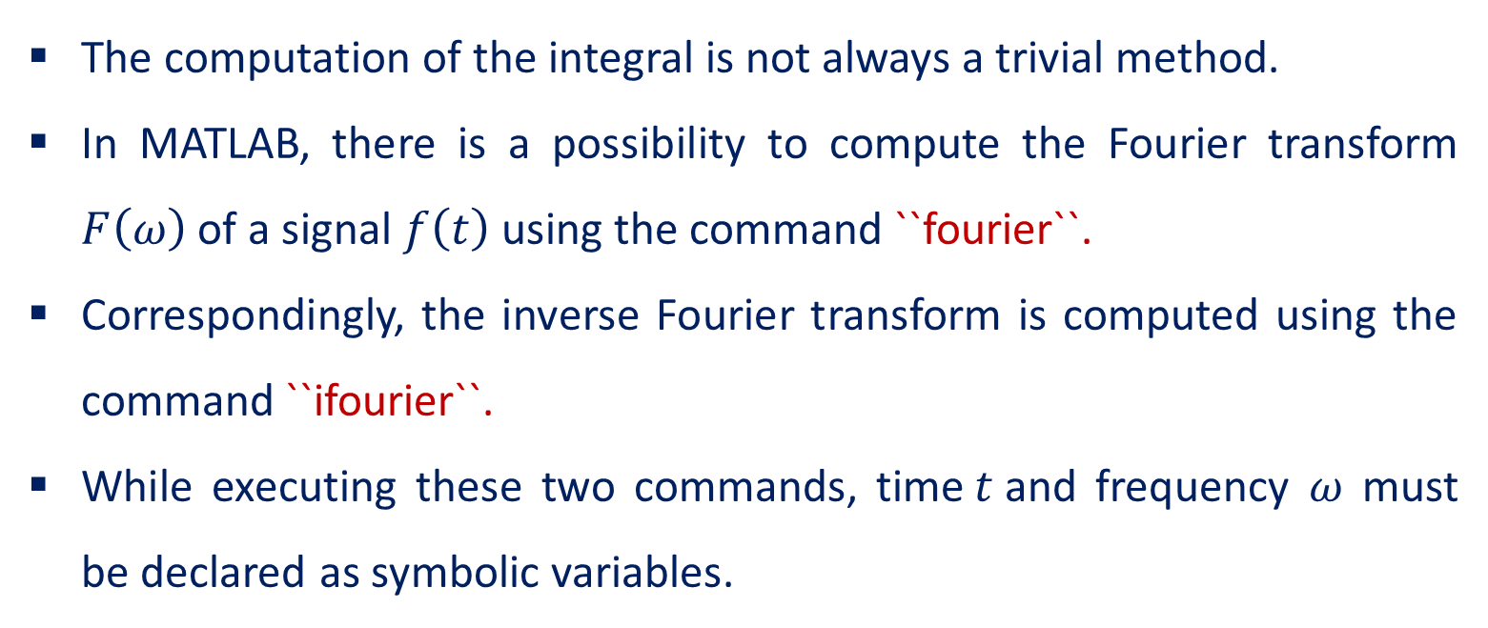
The command ``fourier`` and ``ifourier``
The computation of the integral is not always a trivial method.
In MATLAB, there is a possibility to compute the Fourier transform $F\left(ω\right)$ of a signal $f\left(t\right)$ using the command ``fourier``.
Correspondingly, the inverse Fourier transform is computed using the command ``ifourier``.
While executing these two commands, time$t$and frequency $ω$ must be declared as symbolic variables.

Slide 11

Problems:
Compute the Fourier transform of $f\left(x\right)=e^{−\left(t^{2}+x^{2}\right)}$
>> syms t x
>> f = exp(-t^2-x^2);
>> fourier(f)
ans = pi^(1/2)*exp(- t^2 - w^2/4)

Slide 12
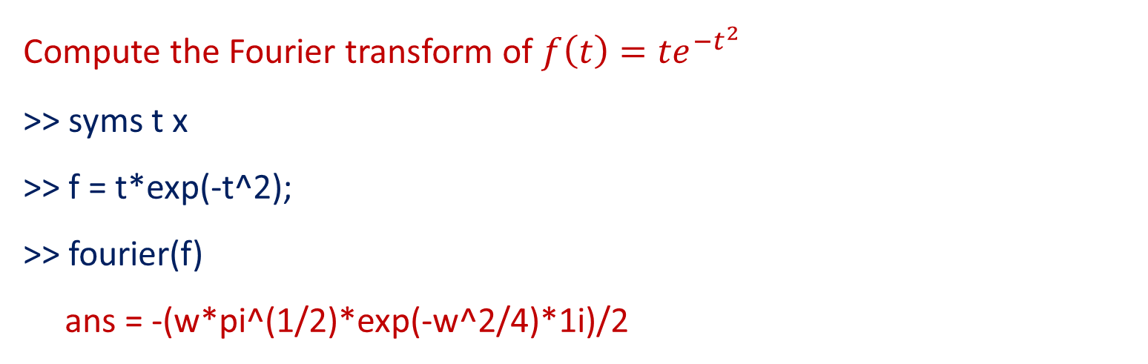
Problems:
Compute the Fourier transform of $f\left(t\right)={te}^{−t^{2}}$
>> syms t x
>> f = t*exp(-t^2);
>> fourier(f)
ans = -(w*pi^(1/2)*exp(-w^2/4)*1i)/2

Slide 13
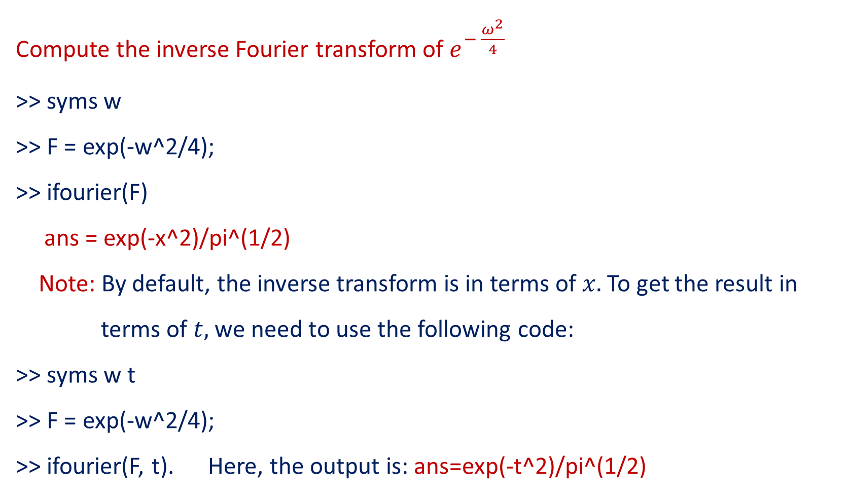
Problems:
Compute the inverse Fourier transform of $e^{− \frac{ω^{2}}{4}}$
>> syms w
>> F = exp(-w^2/4);
>> ifourier(F)
ans = exp(-x^2)/pi^(1/2)
Note: By default, the inverse transform is in terms of $x.$To get the result in
terms of $t,$ we need to use the following code:
>> syms w t
>> F = exp(-w^2/4);
>> ifourier(F, t). Here, the output is: ans=exp(-t^2)/pi^(1/2)

Slide 14
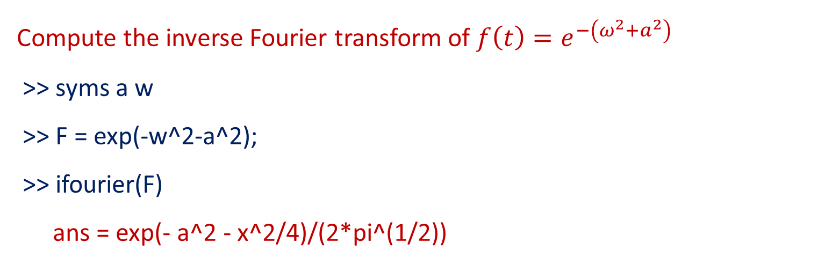
Problems:
Compute the inverse Fourier transform of $f\left(t\right)=e^{−\left(ω^{2}+a^{2}\right)}$
>> syms a w
>> F = exp(-w^2-a^2);
>> ifourier(F)
ans = exp(- a^2 - x^2/4)/(2*pi^(1/2))

Slide 15
THANK YOU

