Slide 2


Finding Jacobian:
If $u=xyz, v=y^{2},w=x+z,$ then evaluate the Jacobian J.
>>syms x y z
>>J=jacobian([x*y*z, y^2, x + z], [x, y, z])
>>d = det(J) password: @nsys@123
Out Put: J= $\left[\begin{matrix}yz & xz & xy \\ 0 & 2y & 0 \\ 1 & 0 & 1\end{matrix}\right]$
d = 2*y^2*z - 2*x*y^2

Slide 3

Finding Jacobian Continuation:
If $u=x^{2}−2y, v=x+y+z, w=x−2y+3z,\text{then} \text{evaluate} \text{the} \text{Jacobian} \text{J}\text{.}$
>>syms x y z
>>J=jacobian([x.^2-2*y x+y+z x-2*y+3*z], [x, y, z])
>>d = det(J)
Out Put: j =[ 2*x, -2, 0][ 1, 1, 1][ 1, -2, 3]
d =10*x + 4

Slide 4

Finding Jacobian Continuation:
If $u=x^{2}−2y^{2}, v={2x}^{2}−y^{2},$where $x=rcosθ,y=rsinθ$, then evaluate the Jacobian J.
>>syms x y r theta
>>x=r*cos(theta);
>>y=r*sin(theta);
>>j=jacobian([x^2-2*y^2, 2*x^2-y^2 ], [r, theta])
>>d = det(j)
>>simplify(d)

Slide 5
Finding Jacobian Continuation:
Out Put:
j =[ 2*r*cos(theta)^2 - 4*r*sin(theta)^2, -6*r^2*cos(theta)*sin(theta)]
[ 4*r*cos(theta)^2 - 2*r*sin(theta)^2, -6*r^2*cos(theta)*sin(theta)]
d =
12*r^3*cos(theta)*sin(theta)^3 + 12*r^3*cos(theta)^3*sin(theta)
ans =
6*r^3*sin(2*theta)

Slide 6
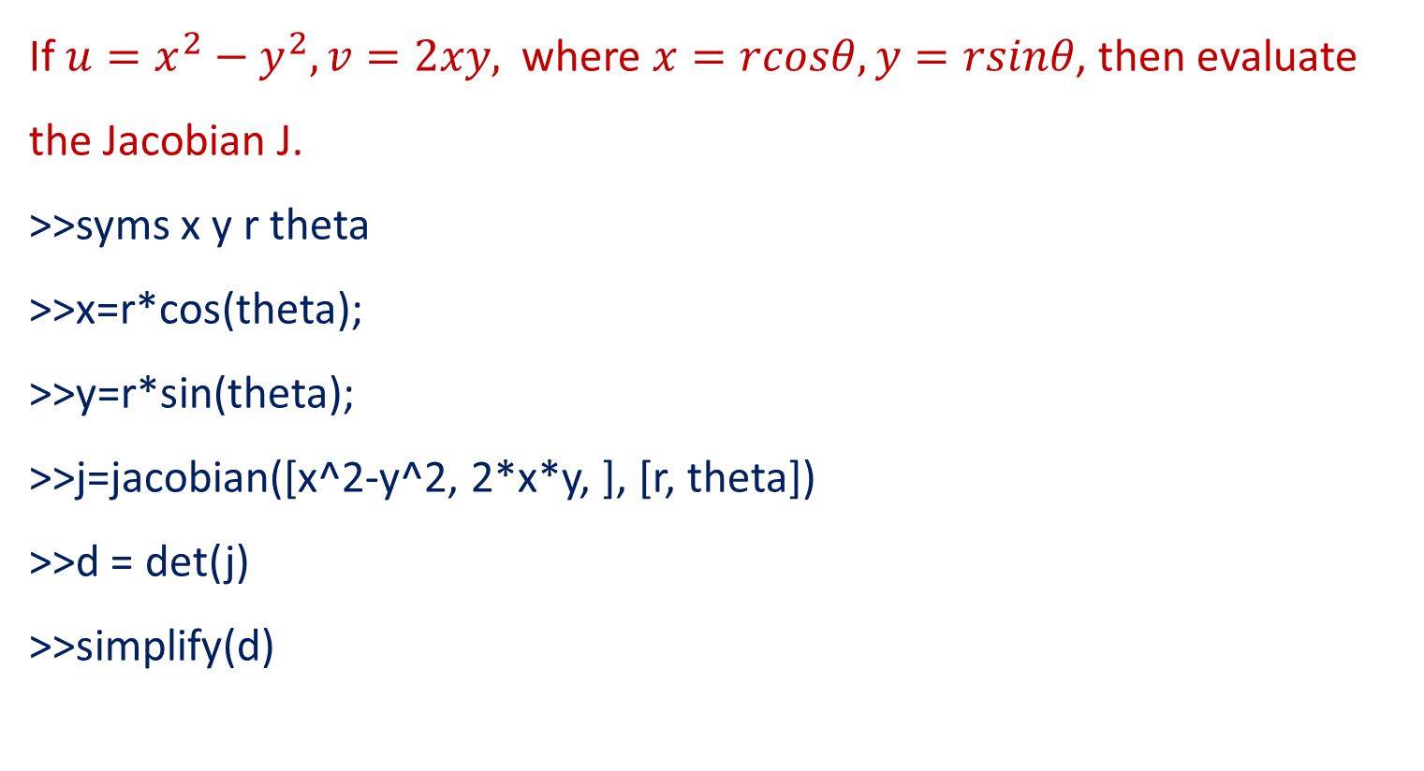
Finding Jacobian Continuation:
If $u=x^{2}−y^{2}, v=2xy,$where $x=rcosθ,y=rsinθ$, then evaluate the Jacobian J.
>>syms x y r theta
>>x=r*cos(theta);
>>y=r*sin(theta);
>>j=jacobian([x^2-y^2, 2*x*y, ], [r, theta])
>>d = det(j)
>>simplify(d)

Slide 7
Finding Jacobian Continuation:
Out Put:
j =
[ 2*r*cos(theta)^2 - 2*r*sin(theta)^2, -4*r^2*cos(theta)*sin(theta)]
[ 4*r*cos(theta)*sin(theta), 2*r^2*cos(theta)^2 - 2*r^2*sin(theta)^2]
d =
4*r^3*cos(theta)^4++4*r^3*sin(theta)^4+8*r^3*cos(theta)^2*sin(theta)^2
ans =4*r^3

Slide 8

Finding Jacobian Continuation:
If $x=u\left(1−v\right), y=uv,$prove that ${JJ}^{′}=1$
>>syms u v
>>J=jacobian([u*(1-v), u*v,], [u, v, ])
>>inv(J)
>>J*inv(J)
>>det(J*inv(J))

Slide 9
Finding Jacobian Continuation:
Out Put:
J =[ 1 - v, -u] [ v, u]
ans = [ 1, 1] [ -v/u, -(v - 1)/u]
ans = [ 1, 0] [ 0, 1]
ans =1

Slide 10
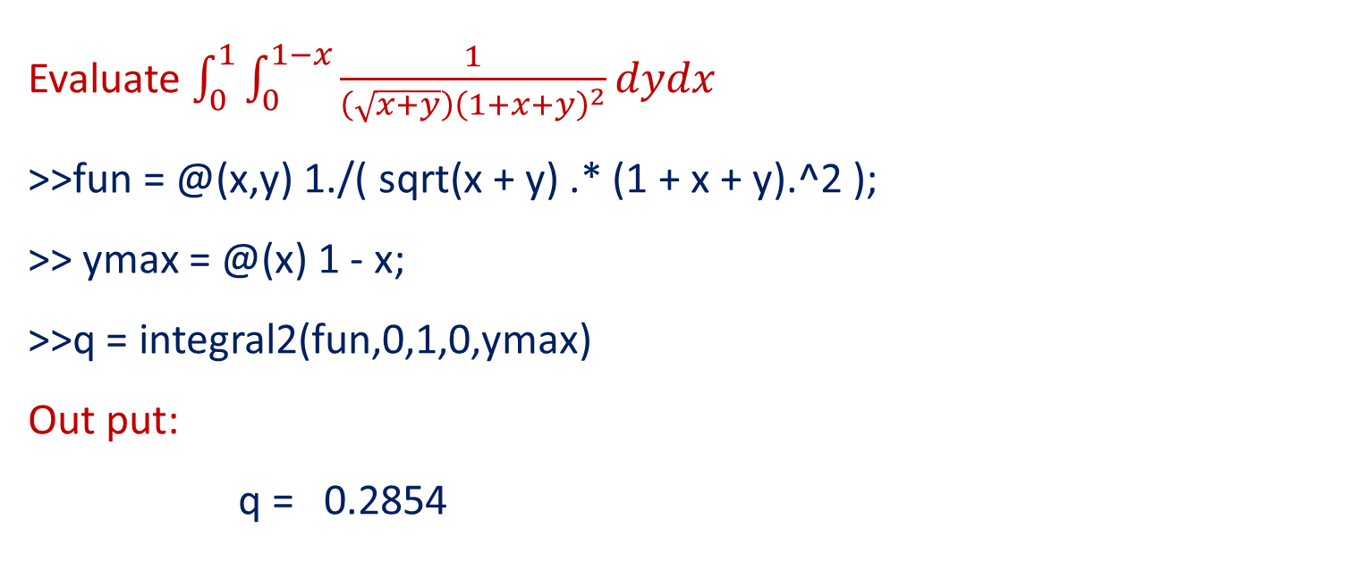
Evaluation of Double Integral :
Evaluate $\int_{0}^{1}{\int_{0}^{1−x}{\frac{1}{\left(\sqrt{x+y}\right){\left(1+x+y\right)}^{2}}}dydx}$
>>fun = @(x,y) 1./( sqrt(x + y) .* (1 + x + y).^2 );
>> ymax = @(x) 1 - x;
>>q = integral2(fun,0,1,0,ymax)
Out put:
q = 0.2854

Slide 11

Evaluation of Double Integral Continuation:
Evaluate $\int_{−π}^{2π}{\int_{0}^{π}{\left[ysin\left(x\right)+xcos(y)\right]}dydx.}$
>>fun = @(x,y) y.*sin(x)+x.*cos(y);
>>q = integral2(fun,-pi,2*pi,0,pi);
Out put:
q =
-9.8696

Slide 12

Evaluation of Double Integral Continuation:
Evaluate $\int_{0}^{5}{\int_{0}^{x^{2}}{x\left(x^{2}+y^{2}\right)dydx}.}$
>>fun = @(x,y) x.*(x.^2+y.^2);
>>ymax = @(x) x.^2;
>>q = integral2(fun,0,5,0,ymax)
Out put:
q = 1.8880e+04

Slide 13

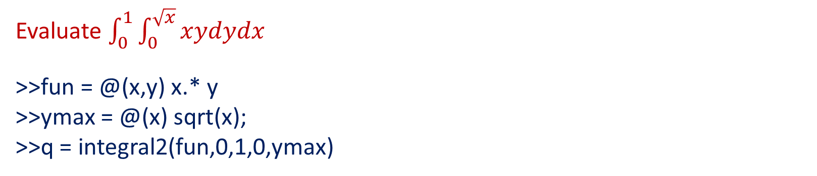
Evaluation of Double Integral Continuation:
Evaluate $\int_{0}^{1}{\int_{0}^{\sqrt{x}}{xydydx}}$
>>fun = @(x,y) x.* y
>>ymax = @(x) sqrt(x);
>>q = integral2(fun,0,1,0,ymax)
q =
0.1667

Slide 14
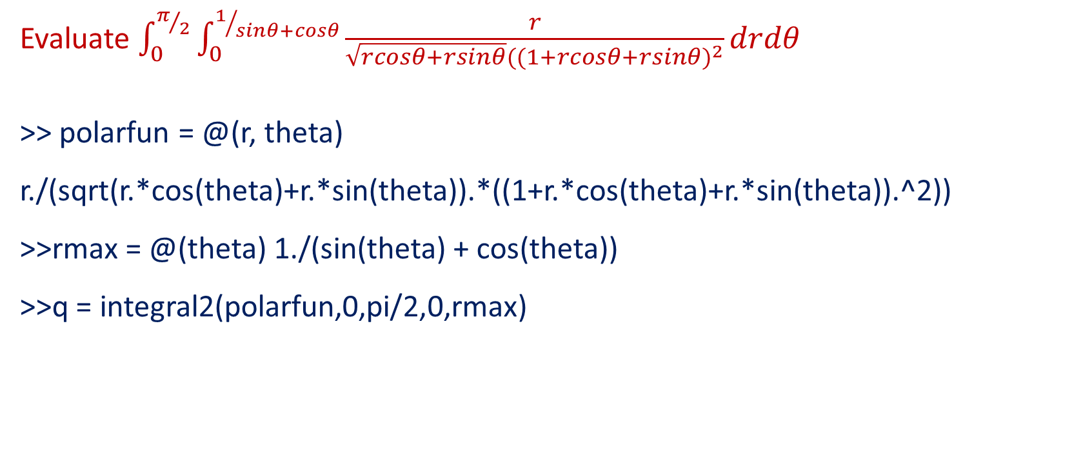
Evaluation of Double Integral Continuation:
Evaluate $\int_{0}^{π/2}{\int_{0}^{1/{sinθ+cosθ}}{\frac{r}{\sqrt{rcosθ+rsinθ}{((1+rcosθ+rsinθ)}^{2}}}}drdθ$
>> polarfun = @(r, theta) r./(sqrt(r.*cos(theta)+r.*sin(theta)).*((1+r.*cos(theta)+r.*sin(theta)).^2))
>>rmax = @(theta) 1./(sin(theta) + cos(theta))
>>q = integral2(polarfun,0,pi/2,0,rmax)
q = 0.2385

Slide 15
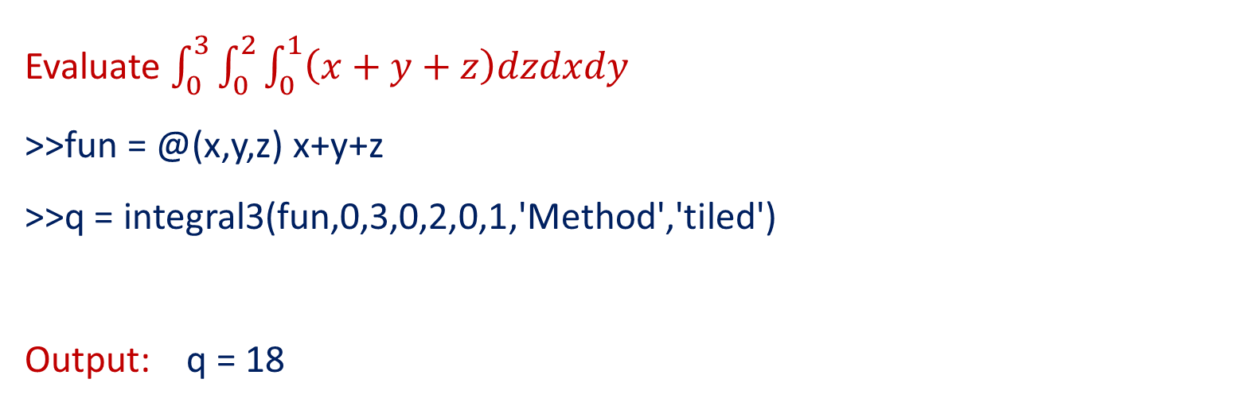
Evaluation of Triple Integral:
Evaluate $\int_{0}^{3}{\int_{0}^{2}{\int_{0}^{1}{\left(x+y+z\right)dzdxdy}}}$
>>fun = @(x,y,z) x+y+z
>>q = integral3(fun,0,3,0,2,0,1,'Method','tiled')
Output: q = 18

Slide 16
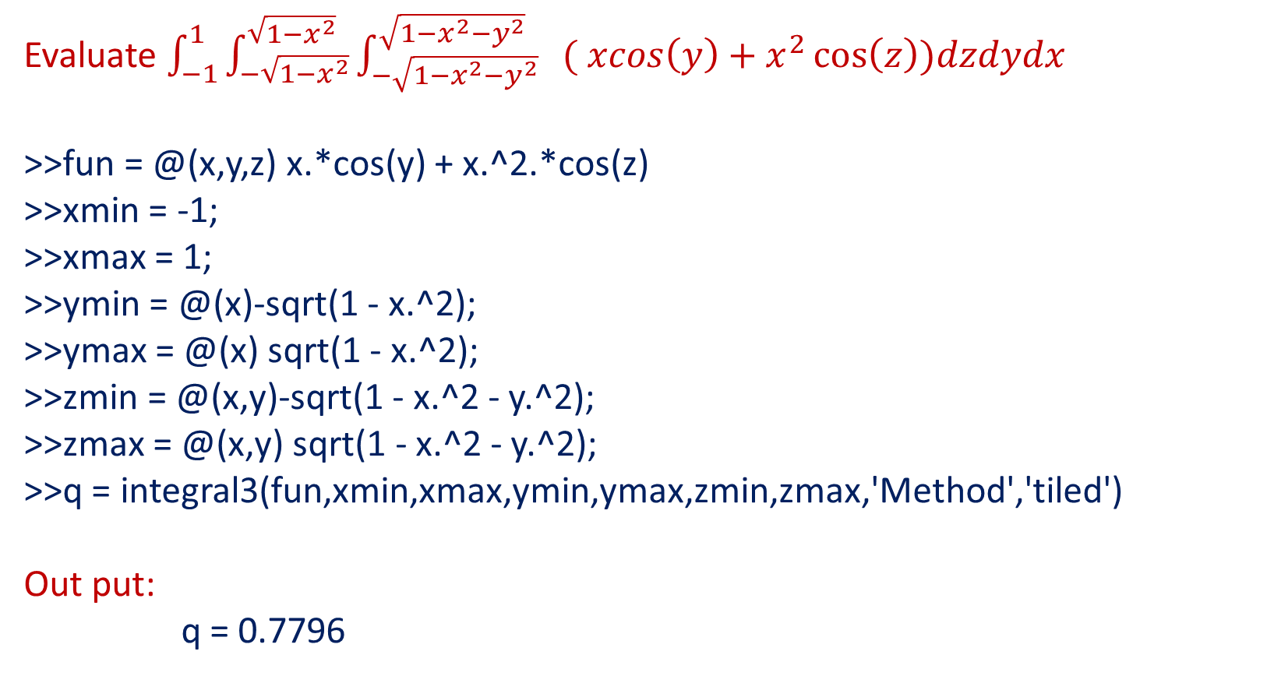
Evaluation of Triple Integral Continuation:
Evaluate $\int_{−1}^{1}{\int_{−\sqrt{1−x^{2}}}^{\sqrt{1−x^{2}}}{\int_{−\sqrt{1−x^{2}−y^{2}}}^{\sqrt{1−x^{2}−y^{2}}}{ ( xcos\left(y\right)+x^{2}\cos\left(z\right))dzdydx}}}$
>>fun = @(x,y,z) x.*cos(y) + x.^2.*cos(z)
>>xmin = -1;
>>xmax = 1;
>>ymin = @(x)-sqrt(1 - x.^2);
>>ymax = @(x) sqrt(1 - x.^2);
>>zmin = @(x,y)-sqrt(1 - x.^2 - y.^2);
>>zmax = @(x,y) sqrt(1 - x.^2 - y.^2);
>>q = integral3(fun,xmin,xmax,ymin,ymax,zmin,zmax,'Method','tiled')
Out put:
q = 0.7796

Slide 17
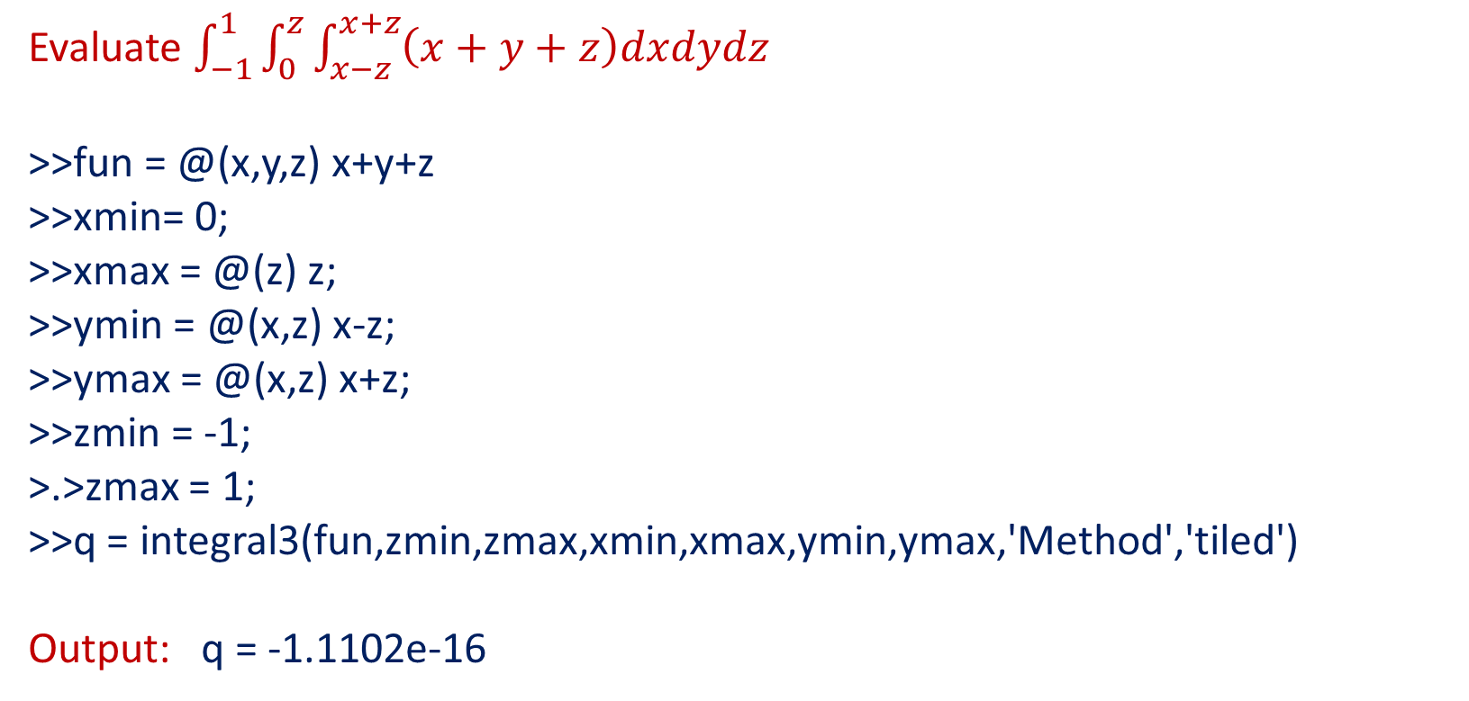
Evaluation of Triple Integral Continuation:
Evaluate $\int_{−1}^{1}{\int_{0}^{z}{\int_{x−z}^{x+z}{\left(x+y+z\right)dxdydz}}}$
>>fun = @(x,y,z) x+y+z
>>xmin= 0;
>>xmax = @(z) z;
>>ymin = @(x,z) x-z;
>>ymax = @(x,z) x+z;
>>zmin = -1;
>.>zmax = 1;
>>q = integral3(fun,zmin,zmax,xmin,xmax,ymin,ymax,'Method','tiled')
Output: q = -1.1102e-16

Slide 18
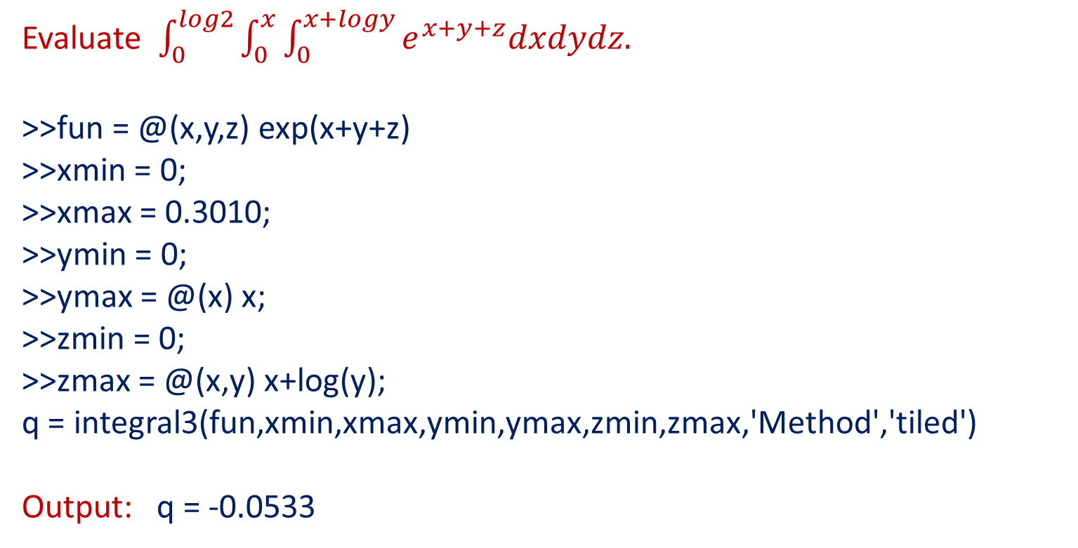
Evaluation of Triple Integral Continuation:
Evaluate $\int_{0}^{log2}{\int_{0}^{x}{\int_{0}^{x+logy}{e^{x+y+z}dxdydz.}}}$
>>fun = @(x,y,z) exp(x+y+z)
>>xmin = 0;
>>xmax = 0.3010;
>>ymin = 0;
>>ymax = @(x) x;
>>zmin = 0;
>>zmax = @(x,y) x+log(y);
q = integral3(fun,xmin,xmax,ymin,ymax,zmin,zmax,'Method','tiled')
Output: q = -0.0533

Slide 19

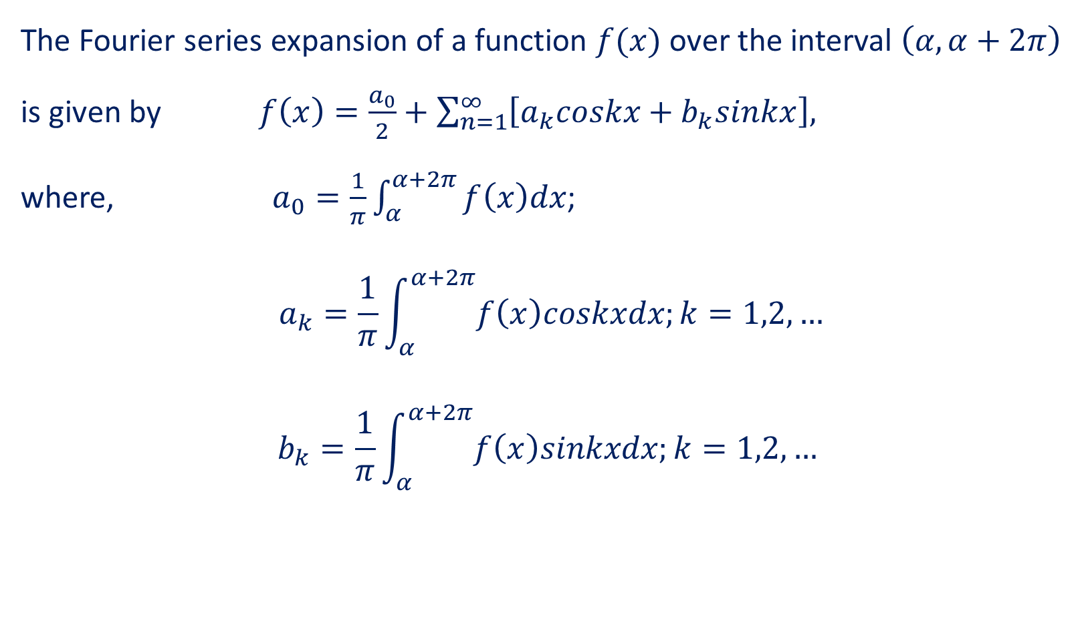
Fourier Series
The Fourier series expansion of a function $f(x)$ over the interval $\left(α,α+2π\right)$ is given by $f\left(x\right)=\frac{a_{0}}{2}+\sum_{n=1}^{∞}{\left[a_{k}coskx+b_{k}sinkx\right],}$
where, $a_{0}=\frac{1}{π}\int_{α}^{α+2π}{f\left(x\right)dx}$;
$$a_{k}=\frac{1}{π}\int_{α}^{α+2π}{f\left(x\right)coskxdx;k=1,2,…}$$
$$b_{k}=\frac{1}{π}\int_{α}^{α+2π}{f\left(x\right)sinkxdx;k=1,2,…}$$

Slide 20
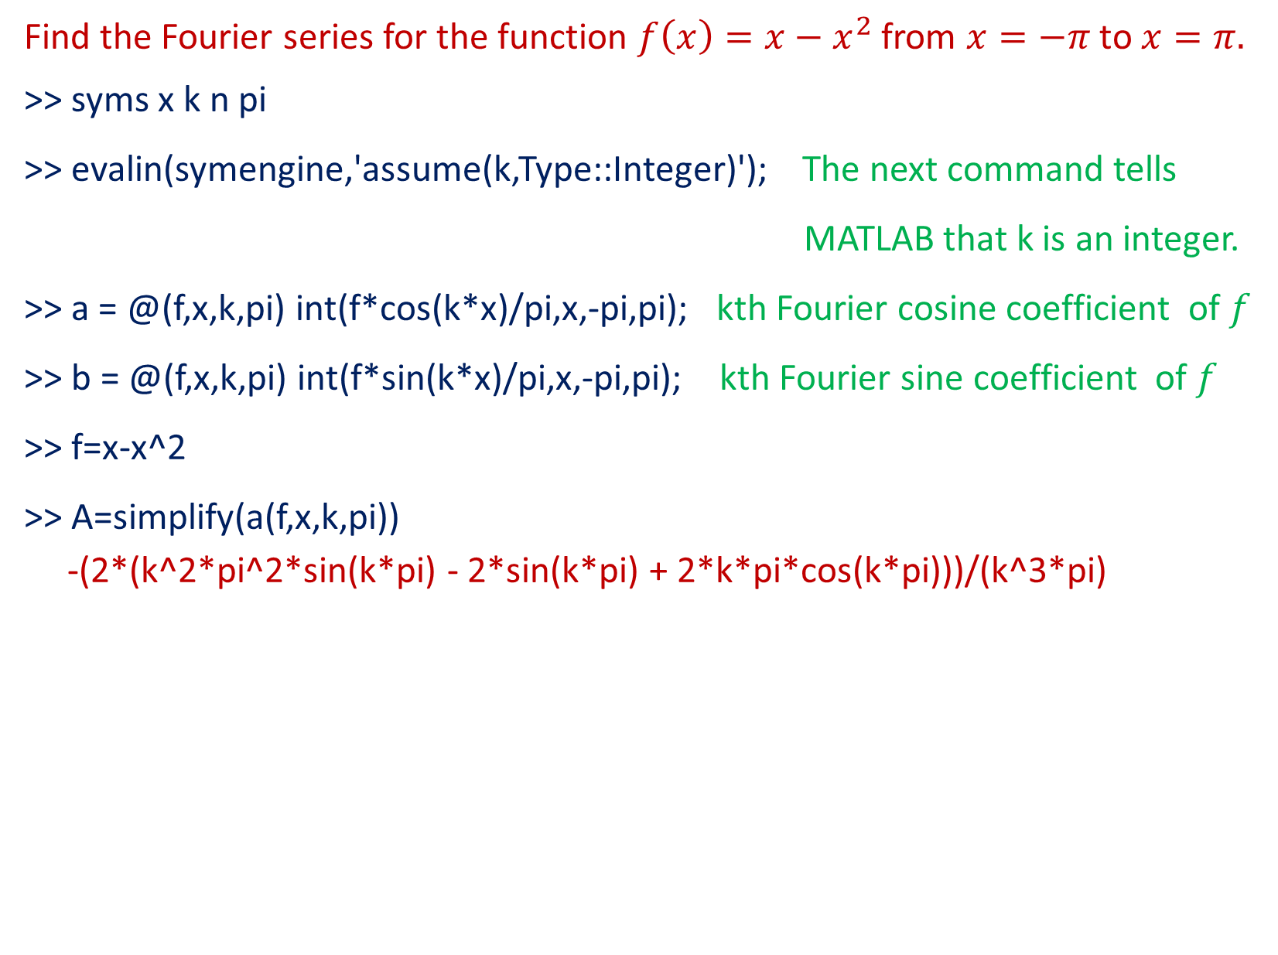
Problem
Find the Fourier series for the function $f\left(x\right)=x−x^{2}$from $x=−π$ to $x=π.$
>> syms x k n pi
>> evalin(symengine,'assume(k,Type::Integer)'); The next command tells
MATLAB that k is an integer.
>> a = @(f,x,k,pi) int(f*cos(k*x)/pi,x,-pi,pi); kth Fourier cosine coefficient of $f$
>> b = @(f,x,k,pi) int(f*sin(k*x)/pi,x,-pi,pi); kth Fourier sine coefficient of $f$
>> f=x-x^2
>> A=simplify(a(f,x,k,pi))
-(2*(k^2*pi^2*sin(k*pi) - 2*sin(k*pi) + 2*k*pi*cos(k*pi)))/(k^3*pi)

Slide 21


>> pretty(A)
>> B=simplify(b(f,x,k,pi))
B = (2*(sin(k*pi) - k*pi*cos(k*pi)))/(k^2*pi)
>> pretty(B)

Slide 22
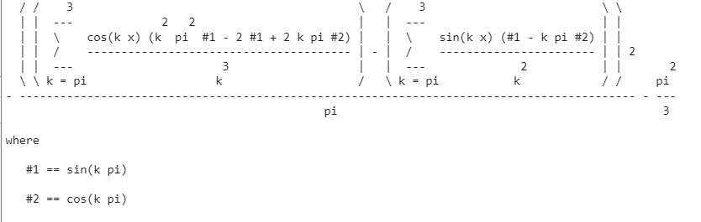
The nth partial sum
>> fs = @(f,x,n,pi) a(f,x,0,pi)/2 + ...
symsum(a(f,x,k,pi)*cos(k*x) + b(f,x,k,pi)*sin(k*x),k,pi,n);
>> pretty(fs(f,x,3,pi))

Slide 23
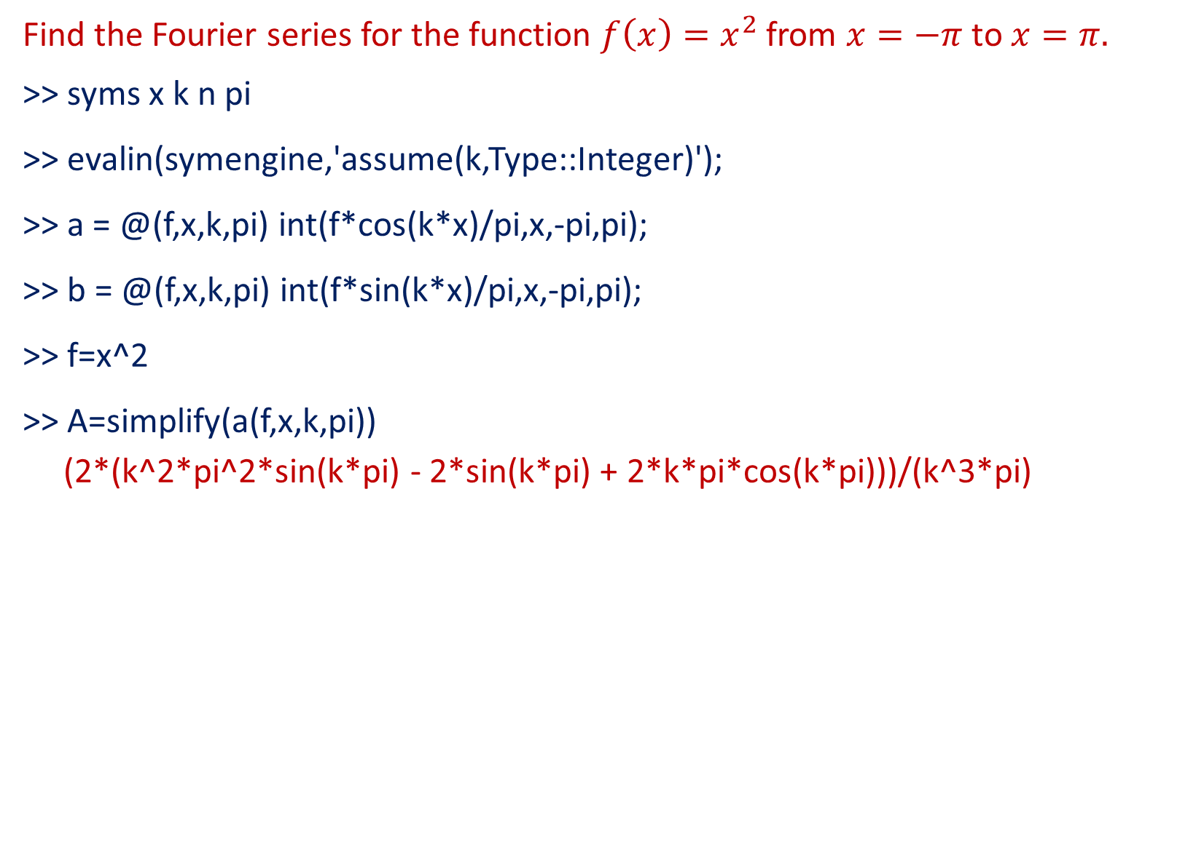
Problem
Find the Fourier series for the function $f\left(x\right)=x^{2}$from $x=−π$ to $x=π.$
>> syms x k n pi
>> evalin(symengine,'assume(k,Type::Integer)');
>> a = @(f,x,k,pi) int(f*cos(k*x)/pi,x,-pi,pi);
>> b = @(f,x,k,pi) int(f*sin(k*x)/pi,x,-pi,pi);
>> f=x^2
>> A=simplify(a(f,x,k,pi))
(2*(k^2*pi^2*sin(k*pi) - 2*sin(k*pi) + 2*k*pi*cos(k*pi)))/(k^3*pi)

Slide 24
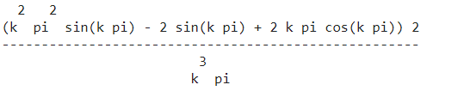
>> pretty(A)
>> B=simplify(b(f,x,k,pi))
B = 0

Slide 25
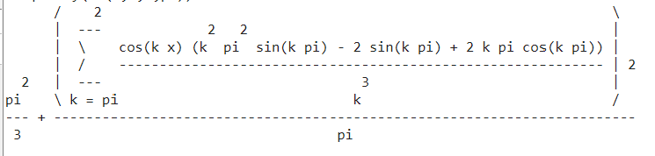
>> fs = @(f,x,n,pi) a(f,x,0,pi)/2 + ...
symsum(a(f,x,k,pi)*cos(k*x) + b(f,x,k,pi)*sin(k*x),k,pi,n);
>> pretty(fs(f,x,2,pi))

Slide 26
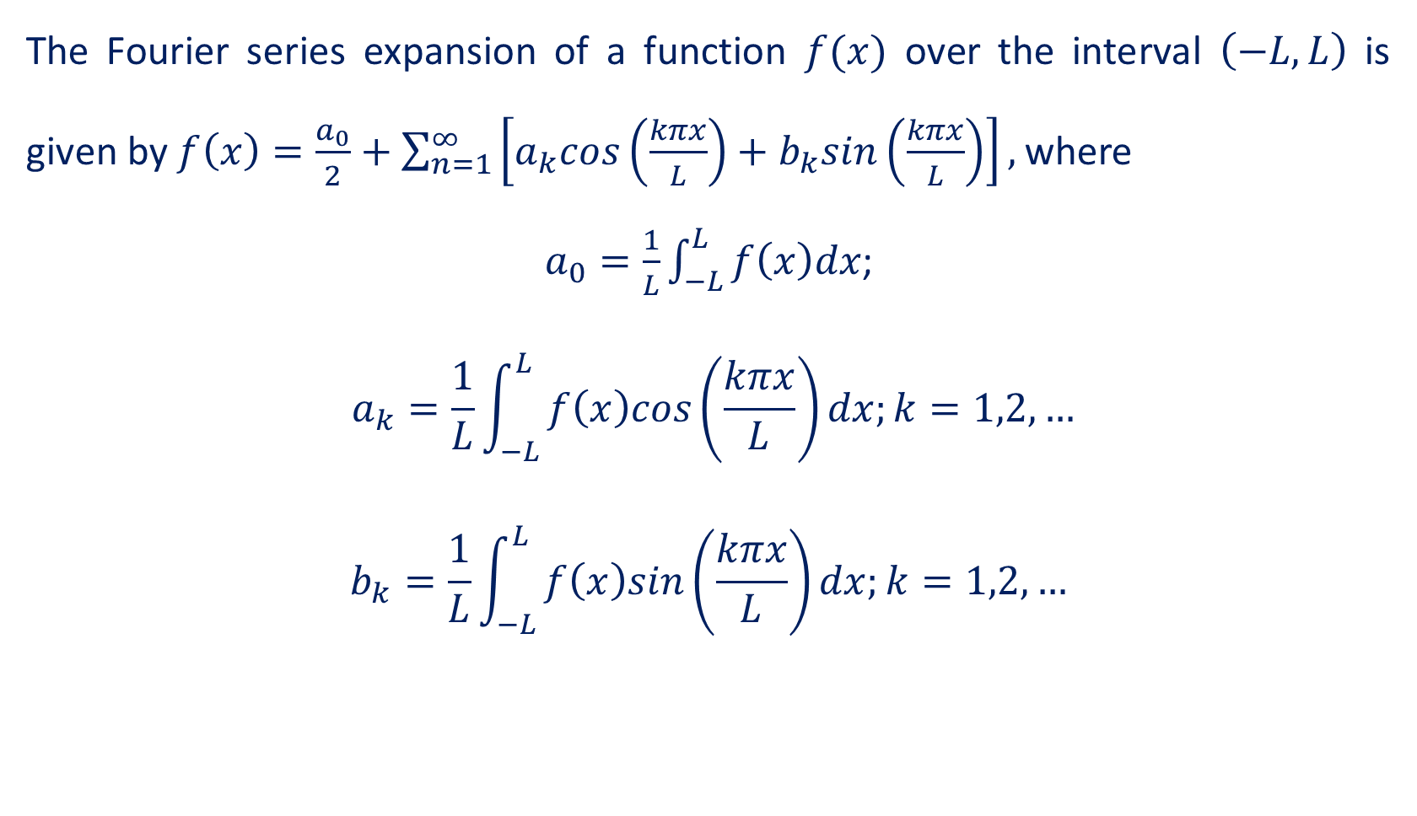
Fourier Series over an arbitrary interval
The Fourier series expansion of a function $f(x)$ over the interval $\left(−L,L\right)$ is given by $f\left(x\right)=\frac{a_{0}}{2}+\sum_{n=1}^{∞}{\left[a_{k}cos\left(\frac{kπx}{L}\right)+b_{k}sin\left(\frac{kπx}{L}\right)\right],}$where
$a_{0}=\frac{1}{L}\int_{−L}^{L}{f\left(x\right)dx}$;
$$a_{k}=\frac{1}{L}\int_{−L}^{L}{f\left(x\right)cos\left(\frac{kπx}{L}\right)dx;k=1,2,…}$$
$$b_{k}=\frac{1}{L}\int_{−L}^{L}{f\left(x\right)sin\left(\frac{kπx}{L}\right)dx;k=1,2,…}$$

Slide 27
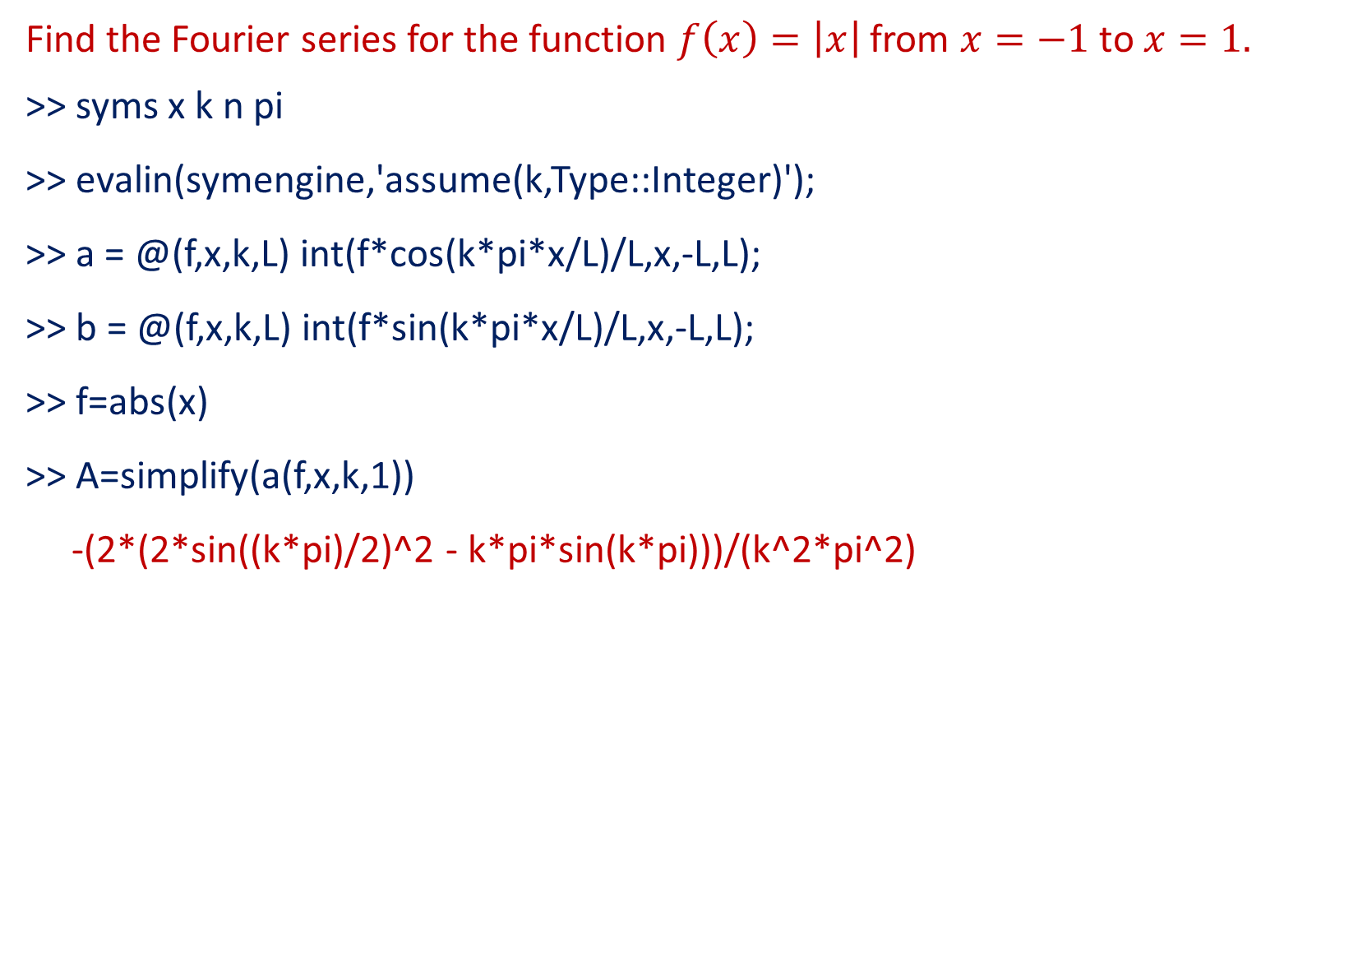
Problem
Find the Fourier series for the function $f\left(x\right)=\left|x\right|$from $x=−1$ to $x=1.$
>> syms x k n pi
>> evalin(symengine,'assume(k,Type::Integer)');
>> a = @(f,x,k,L) int(f*cos(k*pi*x/L)/L,x,-L,L);
>> b = @(f,x,k,L) int(f*sin(k*pi*x/L)/L,x,-L,L);
>> f=abs(x)
>> A=simplify(a(f,x,k,1))
-(2*(2*sin((k*pi)/2)^2 - k*pi*sin(k*pi)))/(k^2*pi^2)

Slide 28
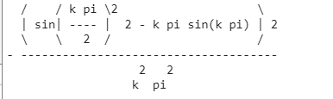
>> pretty(A)
>> B=simplify(b(f,x,k,1))
B = 0

Slide 29
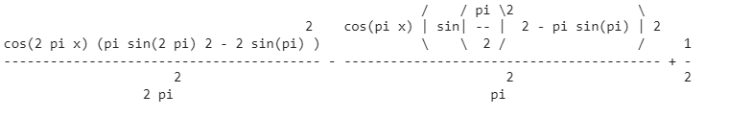
>> fs = @(f,x,n,L) a(f,x,0,L)/2 + ...
symsum(a(f,x,k,L)*cos(k*pi*x/L) + b(f,x,k,L)*sin(k*pi*x/L),k,1,n);
>> pretty(fs(f,x,2,1))

Slide 30
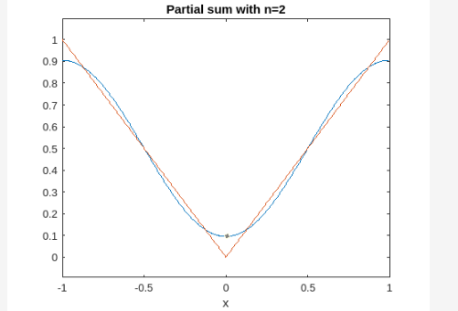

Here are the plots of the partial sums for n=2,5,10. The plot also shows the function $f$.
>> ezplot(fs(f,x,2,1),-1,1)
>> hold on
>> ezplot(f,-1,1)
>> hold off
>> title('Partial sum with n=2')

Slide 31
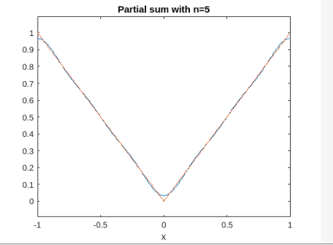
>> ezplot(fs(f,x,5,1),-1,1)
>> hold on
>> ezplot(f,-1,1)
>> hold off
>> title('Partial sum with n=5')

Slide 32
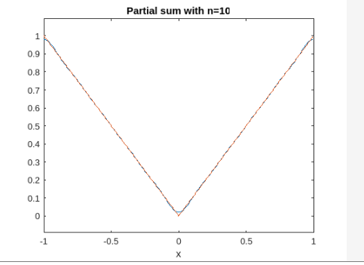
>> ezplot(fs(f,x,10,1),-1,1)
>> hold on
>> ezplot(f,-1,1)
>> hold off
>> title('Partial sum with n=10')

Slide 33
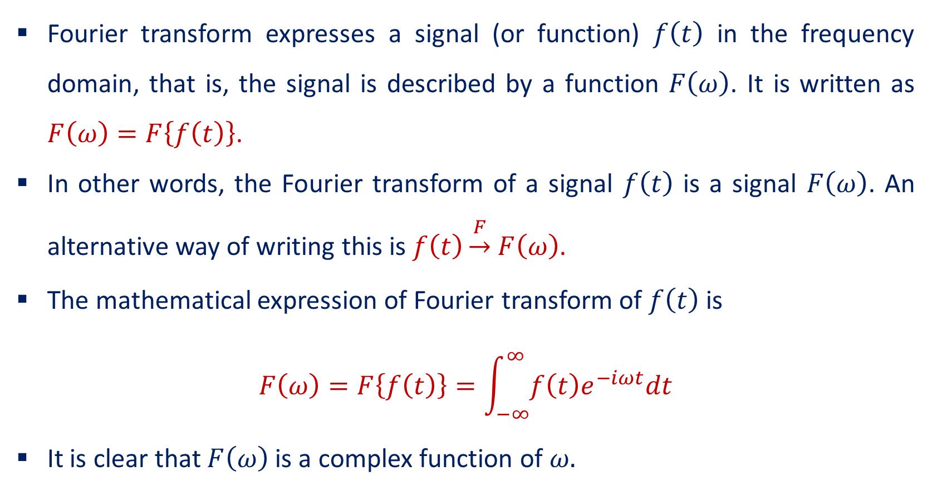
Fourier Transform
Fourier transform expresses a signal (or function) $f\left(t\right)$ in the frequency domain, that is, the signal is described by a function $F\left(ω\right)$. It is written as $F\left(ω\right)=F\left\{f\left(t\right)\right\}$.
In other words, the Fourier transform of a signal $f\left(t\right)$ is a signal $F\left(ω\right)$. An alternative way of writing this is $f\left(t\right)\underset{→}{F}$ $F\left(ω\right)$.
The mathematical expression of Fourier transform of $f\left(t\right)$ is
$$F\left(ω\right)=F\left\{f\left(t\right)\right\}=\int_{−∞}^{∞}{f\left(t\right)e^{−iωt}dt}$$
It is clear that $F\left(ω\right)$ is a complex function of $ω.$

Slide 34
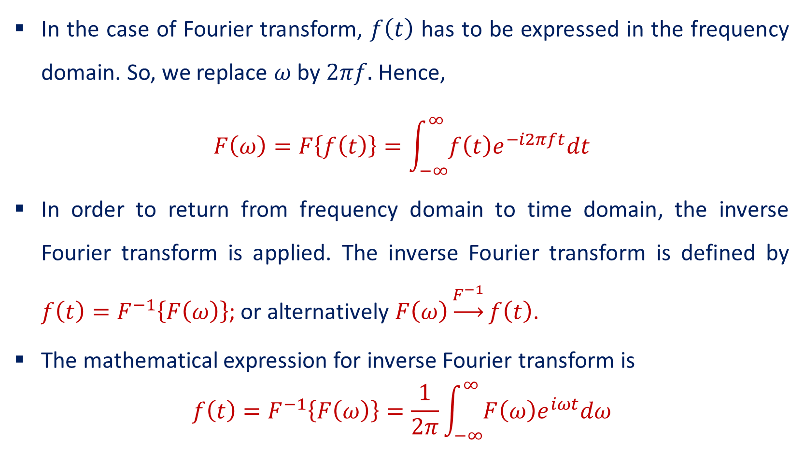
Fourier Transform
In the case of Fourier transform, $f\left(t\right)$ has to be expressed in the frequency domain. So, we replace $ω$ by $2πf.$ Hence,
$$F\left(ω\right)=F\left\{f\left(t\right)\right\}=\int_{−∞}^{∞}{f\left(t\right)e^{−i2πft}dt}$$
In order to return from frequency domain to time domain, the inverse Fourier transform is applied. The inverse Fourier transform is defined by $f\left(t\right)=F^{−1}\left\{F\left(ω\right)\right\}$; or alternatively $F\left(ω\right)\underset{→}{F^{−1}}f\left(t\right)$.
The mathematical expression for inverse Fourier transform is
$$f\left(t\right)=F^{−1}\left\{F\left(ω\right)\right\}=\frac{1}{2π}\int_{−∞}^{∞}{F\left(ω\right)e^{iωt}dω}$$

Slide 35
Plotting of Fourier transform of a function $f\left(t\right)$=1
>> clf
>> clear all
>> f=-4:0.01:4;
>> syms t
>> F=int(1*exp(-i*2*pi*f*t),t,-0.5,0.5);
>> F1=double(F);
>> subplot(211)
>> plot(f,abs(F1))
>> subplot(212)
>> plot(f,angle(F1))
>> grid on

Slide 36
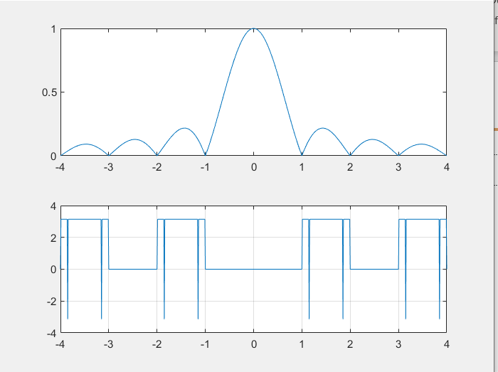
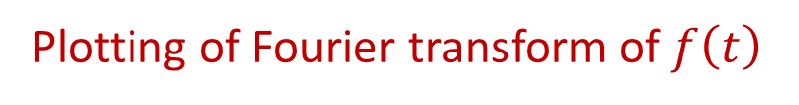
Plotting of Fourier transform of $f\left(t\right)$

Slide 37

Plotting of Fourier transform of $f\left(t\right)=2t$
>> f=-4:0.01:4;
>> syms t
>> F=int((2*t)*exp(-i*2*pi*f*t),t,-0.5,0.5);
>> F1=double(F);
>> subplot(211)
>> plot(f,abs(F1))
>> subplot(212)
>> plot(f,angle(F1))
>> grid on

Slide 38
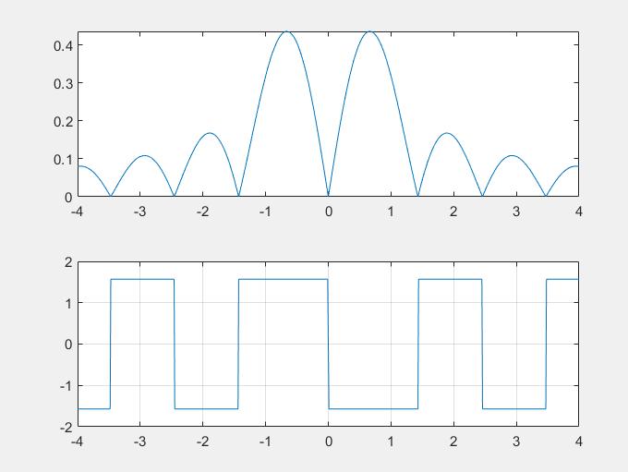
Plotting of Fourier transform of $f\left(t\right)$

Slide 39
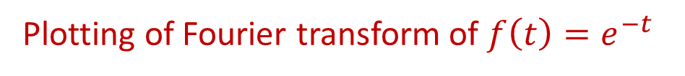
Plotting of Fourier transform of $f\left(t\right)=e^{−t}$
>> f=-4:0.01:4;
>> syms t
>> F=int(exp(-t)*exp(-i*2*pi*f*t),t,-0.5,0.5);
>> F1=double(F);
>> subplot(211)
>> plot(f,abs(F1))
>> subplot(212)
>> plot(f,angle(F1))
>> grid on

Slide 40
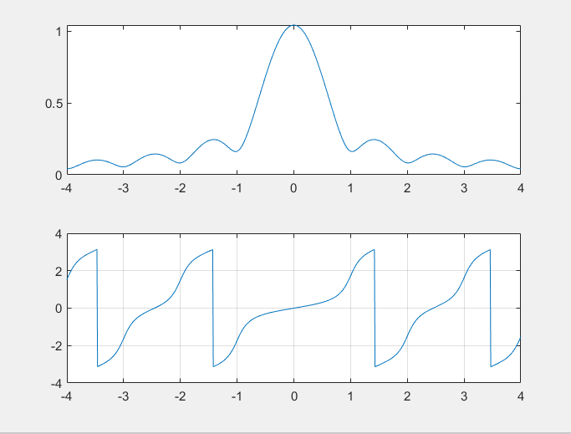
Plotting of Fourier transform of $f\left(t\right)$

Slide 41
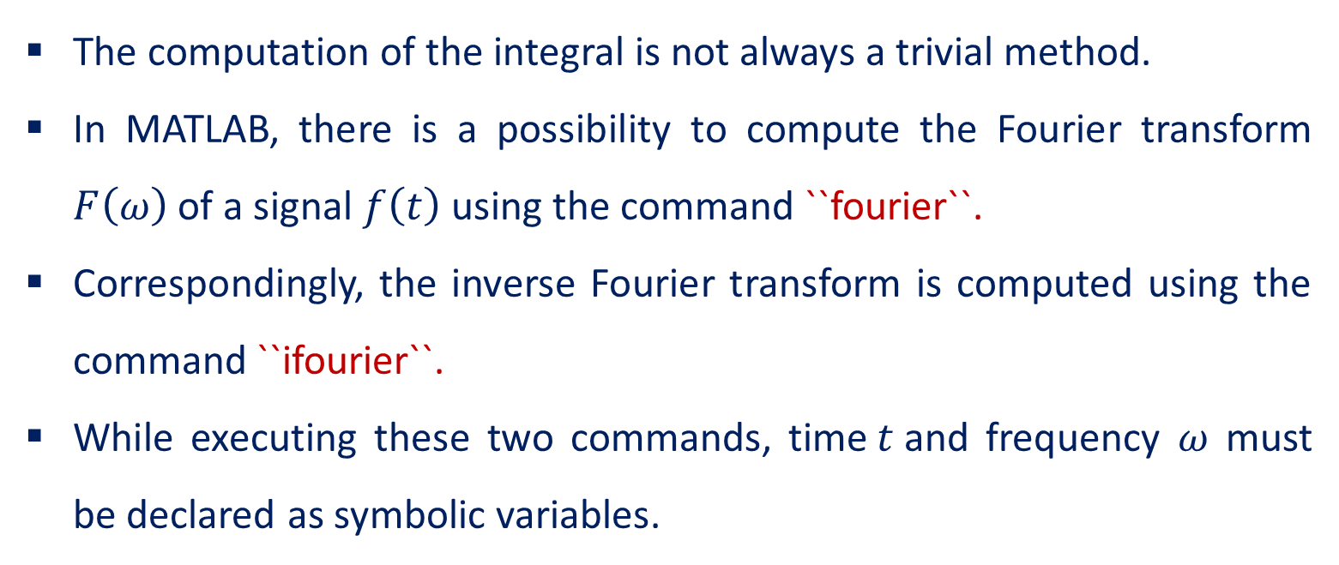
The command ``fourier`` and ``ifourier``
The computation of the integral is not always a trivial method.
In MATLAB, there is a possibility to compute the Fourier transform $F\left(ω\right)$ of a signal $f\left(t\right)$ using the command ``fourier``.
Correspondingly, the inverse Fourier transform is computed using the command ``ifourier``.
While executing these two commands, time$t$and frequency $ω$ must be declared as symbolic variables.

Slide 42

Problems:
Compute the Fourier transform of $f\left(x\right)=e^{−\left(t^{2}+x^{2}\right)}$
>> syms t x
>> f = exp(-t^2-x^2);
>> fourier(f)
ans = pi^(1/2)*exp(- t^2 - w^2/4)

Slide 43
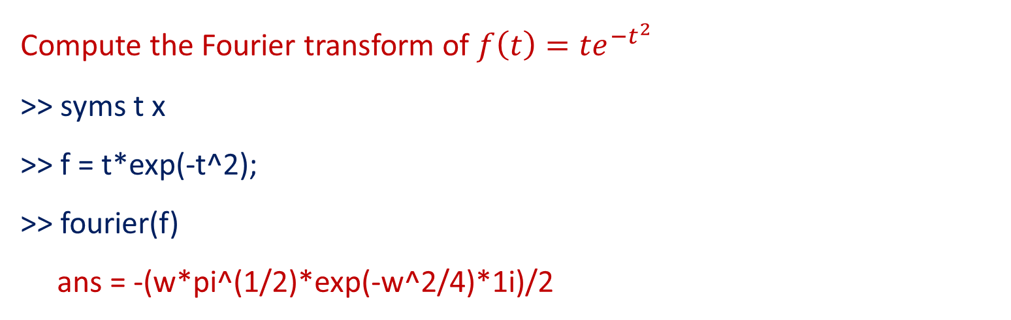
Problems:
Compute the Fourier transform of $f\left(t\right)={te}^{−t^{2}}$
>> syms t x
>> f = t*exp(-t^2);
>> fourier(f)
ans = -(w*pi^(1/2)*exp(-w^2/4)*1i)/2

Slide 44
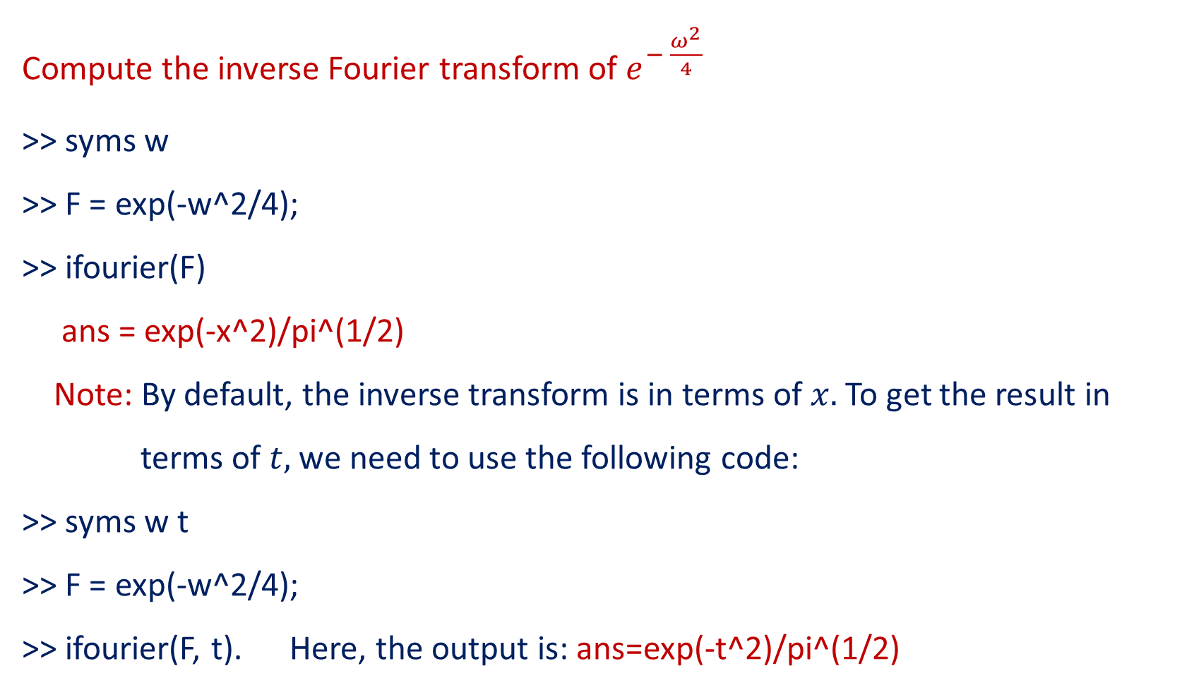
Problems:
Compute the inverse Fourier transform of $e^{− \frac{ω^{2}}{4}}$
>> syms w
>> F = exp(-w^2/4);
>> ifourier(F)
ans = exp(-x^2)/pi^(1/2)
Note: By default, the inverse transform is in terms of $x.$To get the result in
terms of $t,$ we need to use the following code:
>> syms w t
>> F = exp(-w^2/4);
>> ifourier(F, t). Here, the output is: ans=exp(-t^2)/pi^(1/2)

Slide 45
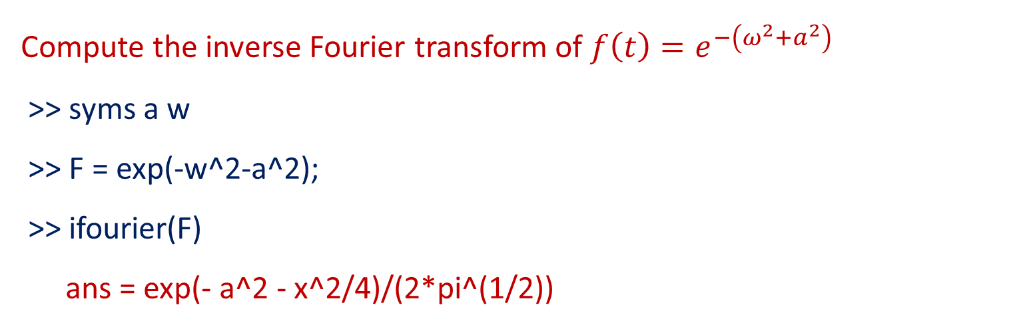
Problems:
Compute the inverse Fourier transform of $f\left(t\right)=e^{−\left(ω^{2}+a^{2}\right)}$
>> syms a w
>> F = exp(-w^2-a^2);
>> ifourier(F)
ans = exp(- a^2 - x^2/4)/(2*pi^(1/2))

Slide 46

THANK YOU

