Slide 1

ENVIRONMENTAL STUDIES & LIFE SCIENCES
Faculty Name
Department of Biotechnology
1

Slide 2

ENVIRONMENTAL STUDIES & LIFE SCIENCES
Basic Concepts of Ecosystem
Faculty Name
Department of Biotechnology

Slide 3
ENVIRONMENTAL STUDIES & LIFE SCIENCES
Concept of ecosystem
The meaning of the word ecology was given by German Biologist Ernst Haeckel in 1869.
The term ‘Ecology’ was derived from two Greek words, OIKOS (means house) and LOGUS (means study of) to denote the relationship between the organisms and their environment.
Definition: The living community of plants and animals in any area together with the non-living components of the environment such as soil, air and water, constitute the ecosystem.
3

Slide 4
ENVIRONMENTAL STUDIES & LIFE SCIENCES
Concept of ecosystem
An ecosystem is a geographic area where plants, animals, and other organisms, as well as weather and landscape, work together to form a bubble of life.
Ecosystems contain biotic or living, parts, as well as abiotic factors, or nonliving parts.
Biotic factors include plants, animals, and other organisms. Abiotic factors include rocks, temperature, and humidity.
4

Slide 5
ENVIRONMENTAL STUDIES & LIFE SCIENCES
Concept of ecosystem
Every factor in an ecosystem depends on every other factor, either directly or indirectly.
A change in the temperature of an ecosystem will often affect what plants will grow there, for instance.
Animals that depend on plants for food and shelter will have to adapt to the changes, move to another ecosystem, or perish.
5

Slide 6
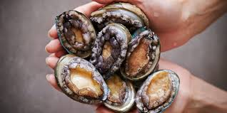
ENVIRONMENTAL STUDIES & LIFE SCIENCES
Concept of ecosystem
Ecosystems can be very large or very small.
Tide pools, the ponds left by the ocean as the tide goes out, are complete, tiny ecosystems.
Tide pools contain seaweed, a kind of algae, which uses photosynthesis to create food.
Herbivores such as abalone eat the seaweed.
Carnivores such as sea stars eat other animals in the tide pool, such as clams or mussels.
Abalone
6
Image source: National Geographic

Slide 7
ENVIRONMENTAL STUDIES & LIFE SCIENCES
Concept of ecosystem
Tide pools depend on the changing level of ocean water. Some organisms, such as seaweed, thrive in an aquatic environment, when the tide is in and the pool is full.
Other organisms, such as hermit crabs, cannot live underwater and depend on the shallow pools left by low tides.
In this way, the biotic parts of the ecosystem depend on abiotic factors.
7

Slide 8
ENVIRONMENTAL STUDIES & LIFE SCIENCES
Concept of ecosystem
The whole surface of Earth is a series of connected ecosystems. Ecosystems are often connected in a larger biome. Biomes are large sections of land, sea, or atmosphere.
Forests, ponds, reefs, and tundra are all types of biomes, for example. They're organized very generally, based on the types of plants and animals that live in them. Within each forest, each pond, each reef, or each section of tundra, you'll find many different ecosystems.
8

Slide 9
ENVIRONMENTAL STUDIES & LIFE SCIENCES
Concept of ecosystem
The biome of the Sahara Desert, for instance, includes a wide variety of ecosystems.
The arid climate and hot weather characterize the biome. Within the Sahara are oasis ecosystems, which have date palm trees, freshwater, and animals such as crocodiles.
The Sahara also has dune ecosystems, with the changing landscape determined by the wind. Organisms in these ecosystems, such as snakes or scorpions, must be able to survive in sand dunes for long periods of time.
9

Slide 10
ENVIRONMENTAL STUDIES & LIFE SCIENCES
Concept of ecosystem
Even similar-sounding biomes could have completely different ecosystems.
The biome of the Sahara Desert, for instance, is very different from the biome of the Gobi Desert in Mongolia and China.
The Gobi is a cold desert, with frequent snowfall and freezing temperatures. Unlike the Sahara, the Gobi has ecosystems based not in sand, but kilometers of bare rock.
10

Slide 11
ENVIRONMENTAL STUDIES & LIFE SCIENCES
Concept of ecosystem
Some grasses are able to grow in the cold, dry climate. As a result, these Gobi ecosystems have grazing animals such as gazelles and even takhi, an endangered species of wild horse.
Even the cold desert ecosystems of the Gobi are distinct from the freezing desert ecosystems of Antarctica. Antarctica’s thick ice sheet covers a continent made almost entirely of dry, bare rock. Only a few mosses grow in this desert ecosystem, supporting only a few birds, such as skuas.
11

Slide 12
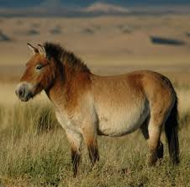
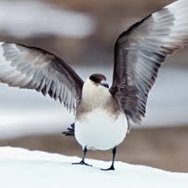
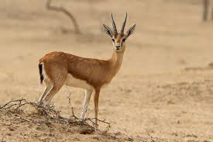
ENVIRONMENTAL STUDIES & LIFE SCIENCES
Concept of ecosystem
Gazelle
Takhi
Skua
12
Image source: National Geographic

Slide 13
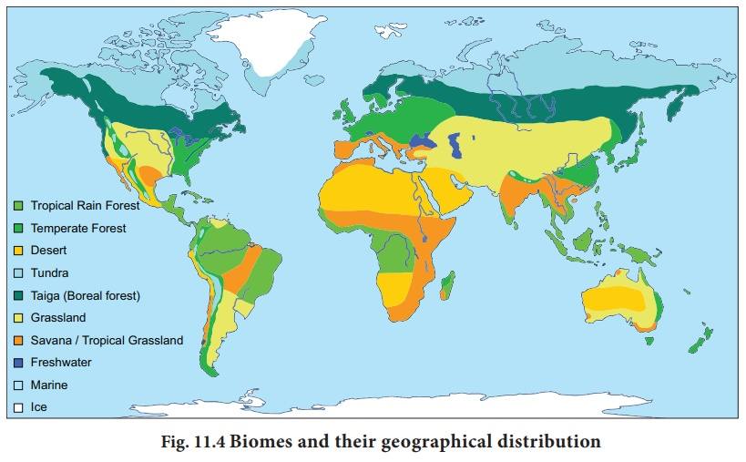
ENVIRONMENTAL STUDIES & LIFE SCIENCES
Concept of ecosystem
Biomes and their geographical distribution
13
Image source: Brainkart

Slide 14
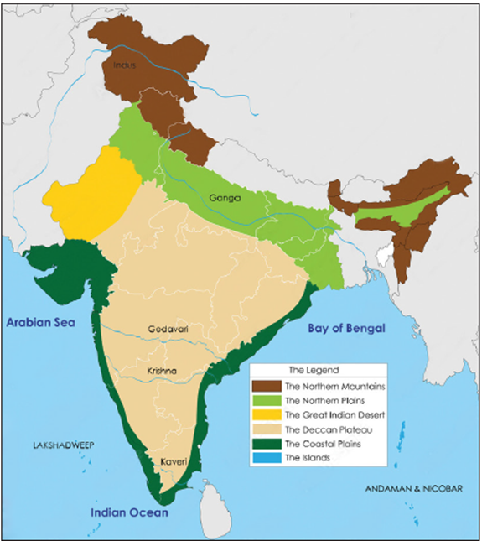
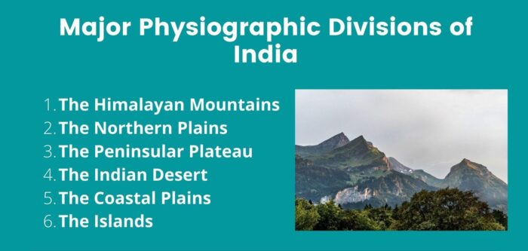
ENVIRONMENTAL STUDIES & LIFE SCIENCES
Concept of ecosystem
Distinctive geographical regions in India
14
Image source: Brainkart

Slide 15
ENVIRONMENTAL STUDIES & LIFE SCIENCES
Classification of ecosystem
The ecosystems are classified into many types and are classified based on a number of factors.
Ecosystems can generally be classified into two classes such as natural and artificial.
Artificial ecosystems are natural regions affected by man’s interferences. They are artificial lakes, reservoirs, townships, and cities. Natural ecosystems are basically classified into two major types. They are aquatic ecosystem and terrestrial ecosystem.
15

Slide 16
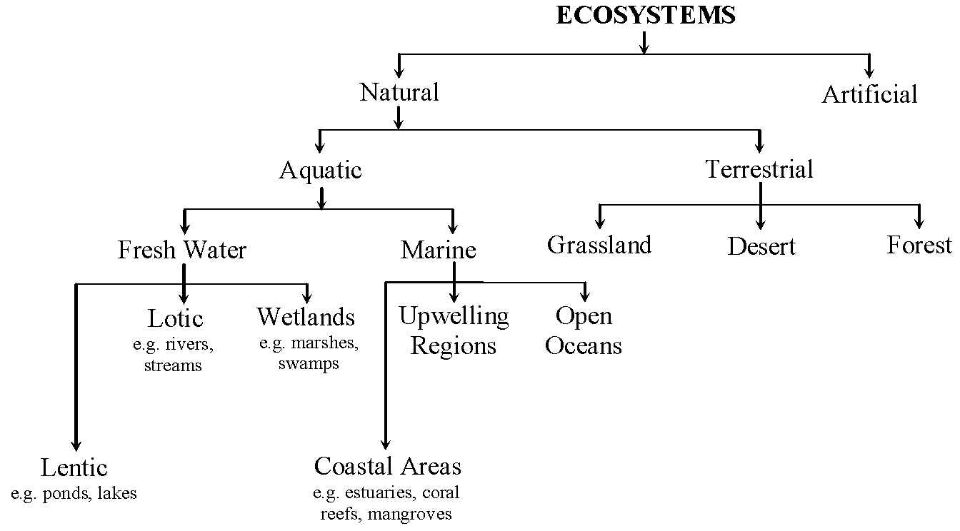
ENVIRONMENTAL STUDIES & LIFE SCIENCES
Classification of ecosystem
16

Slide 17
ENVIRONMENTAL STUDIES & LIFE SCIENCES
Classification of ecosystem
Based on study area:
Autecology : It deals with the study of an individual species of organisms and it’s population. It is also called the Species ecology.
Synecology : It deals with the study of communities, their composition, their behaviour and relation with the environment. It is further divided into 3 types:
Population Ecology
Community Ecology
Ecosystem Ecology
17

Slide 18
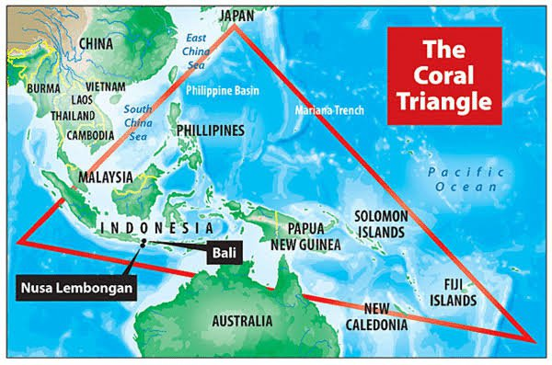
ENVIRONMENTAL STUDIES & LIFE SCIENCES
Classification of ecosystem
The most diverse ecosystem in the world is the huge Coral Triangle in Southeast Asia. The Coral Triangle stretches from the Philippines in the north to the Solomon Islands in the east to the islands of Indonesia and Papua in the west.
18
Image source: Brainkart

Slide 19
ENVIRONMENTAL STUDIES & LIFE SCIENCES
Ecosystem degradation
Threats to Ecosystems
For thousands of years, people have interacted with ecosystems. Many cultures developed around nearby ecosystems. Many Native American tribes of North Americas Great Plains developed a complex lifestyle based on the native plants and animals of plains ecosystems, for instance.
As human populations have grown, however, people have overtaken many ecosystems.
19

Slide 20
ENVIRONMENTAL STUDIES & LIFE SCIENCES
Ecosystem degradation
The tallgrass prairie of the Great Plains, for instance, became farmland.
In the tropical rain forest ecosystems surrounding the Amazon River in South America, a similar situation is taking place. The Amazon rain forest includes hundreds of ecosystems, including canopies, understories, and forest floors. These ecosystems support vast food webs.
Human activity threatens all these rain forest ecosystems such as the Amazon.
20

Slide 21
ENVIRONMENTAL STUDIES & LIFE SCIENCES
Ecosystem degradation
Ecosystems can recover from destruction, however. The delicate coral reef ecosystems in the South Pacific are at risk due to rising ocean temperatures and decreased salinity.
Corals bleach, or lose their bright colors, in water that is too warm. They die in water that is not salty enough. Without the reef structure, the ecosystem collapses. Organisms such as algae, plants such as seagrass, and animals such as fish, snakes, and shrimp disappear.
21

Slide 22
ENVIRONMENTAL STUDIES & LIFE SCIENCES
Ecosystem degradation
The destruction of entire ecosystems by human beings has been called ecocide, or murder of the environment.
Great Barrier Reef in Australia- It’s one of the most biodiverse ecosystems on the planet, home to an incredible array of marine plants and animals. Sadly, the health of the Reef has significantly declined over the past three decades. Coastal developments, pollution and human interference all pose major threats, and the Reef has also suffered multiple mass coral bleaching events as a result of global warming.
22

Slide 23
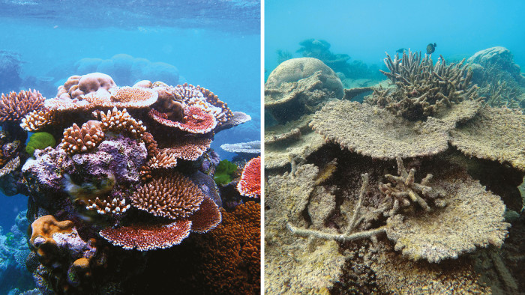
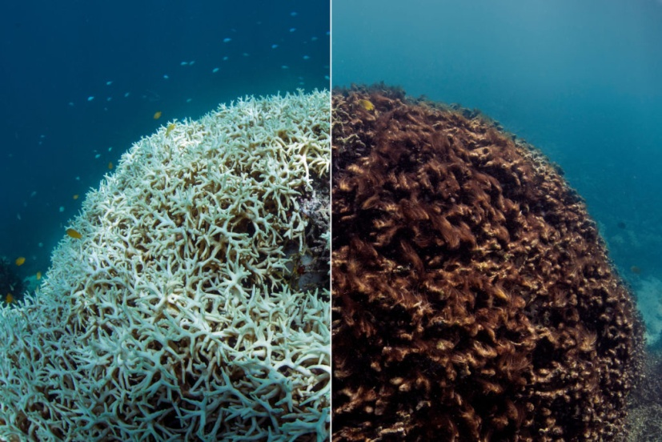
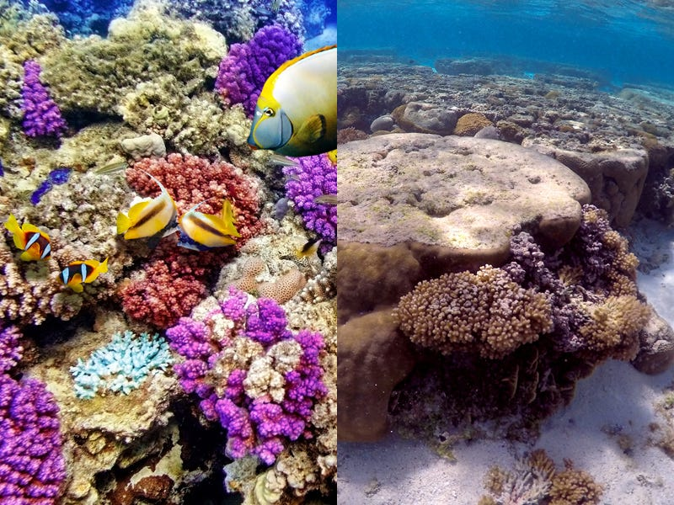
ENVIRONMENTAL STUDIES & LIFE SCIENCES
Concept of ecosystem
Great Barrier Reef: Before and After Climate Change
23
Image source: Nat Geo

Slide 24
ENVIRONMENTAL STUDIES & LIFE SCIENCES
Ecosystem degradation
Keystone species
Some species if eliminated seriously affect the ecosystem. These are called ‘Keystone species’.
In the 1960s, renowned ecologist Robert Paine disrupted a patch of Washington State coastline—and made a huge environmental breakthrough.
In an effort to understand the food web in a tidal ecosystem in Makaw Bay, he removed all of a single starfish species in one area.
24

Slide 25
ENVIRONMENTAL STUDIES & LIFE SCIENCES
Ecosystem degradation
Rapidly the entire ecosystem changed, leading him to the realization that certain species play outsize roles in the overall structure and function of their environment.
Paine coined a term for these critical organisms: keystone species.
They are nearly always a critical component of the local food web. One of the defining characteristics of a keystone species is that it fills a critical ecological role that no other species can.
25

Slide 26
ENVIRONMENTAL STUDIES & LIFE SCIENCES
Ecosystem degradation
EXAMPLES OF KEYSTONE SPECIES:
Star fish- By keeping populations of mussels and barnacles in check, this sea star helps ensure healthy populations of seaweeds and the communities that feed on them.
Sea otters- Role as a top predator in the nearshore marine ecosystem.
Beavers- Builds well-maintained dams. These dams turn small streams into ponds and lakes which provide excellent areas for other animals to use and thrive.
26

Slide 27
ENVIRONMENTAL STUDIES & LIFE SCIENCES
Ecosystem degradation
Wolves- By regulating prey populations, wolves enable many other species of plants and animals to flourish.
Bees- It is predicted that if honey bees disappear, more than 50% of plant species will become extinct. Honey bees do not only produce cross-pollination which assists with genetic diversity of plants and possibly other animal species and accordingly biodiversity relates to healthy ecosystems.
27

Slide 28
ENVIRONMENTAL STUDIES & LIFE SCIENCES
Ecosystem degradation
Humming birds- Key agents of pollination and by doing so, aid in the growth and spread of certain plant species.
American alligators- high level predators, it modifies their surroundings by their food consumption alone.
Tiger sharks- control the populations of primary consumers, it is a top predator in the ocean.
28

Slide 29
ENVIRONMENTAL STUDIES & LIFE SCIENCES
Food chain
The food chain describes who eats whom in the wild. A food web is all of the food chains in an ecosystem.
Different habitats and ecosystems provide many possible food chains that make up a food web.
Organisms in food chains are grouped into categories called trophic levels. Roughly speaking, these levels are divided into producers (first trophic level), consumers (second, third, and fourth trophic levels), and decomposers.
29

Slide 30
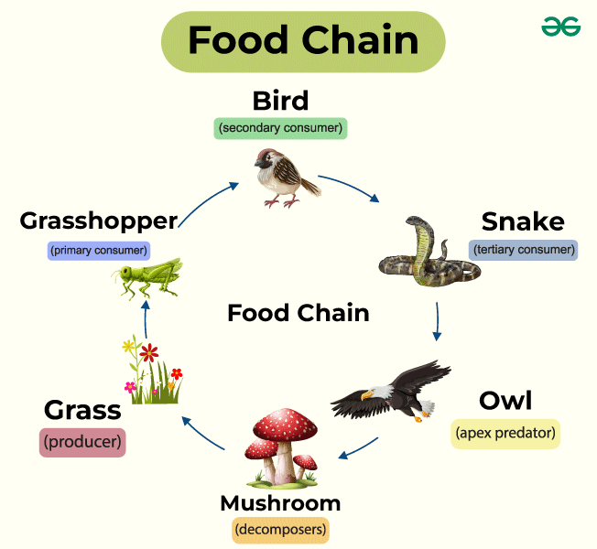
ENVIRONMENTAL STUDIES & LIFE SCIENCES
30
Image source: GeeksforGeeks

Slide 31
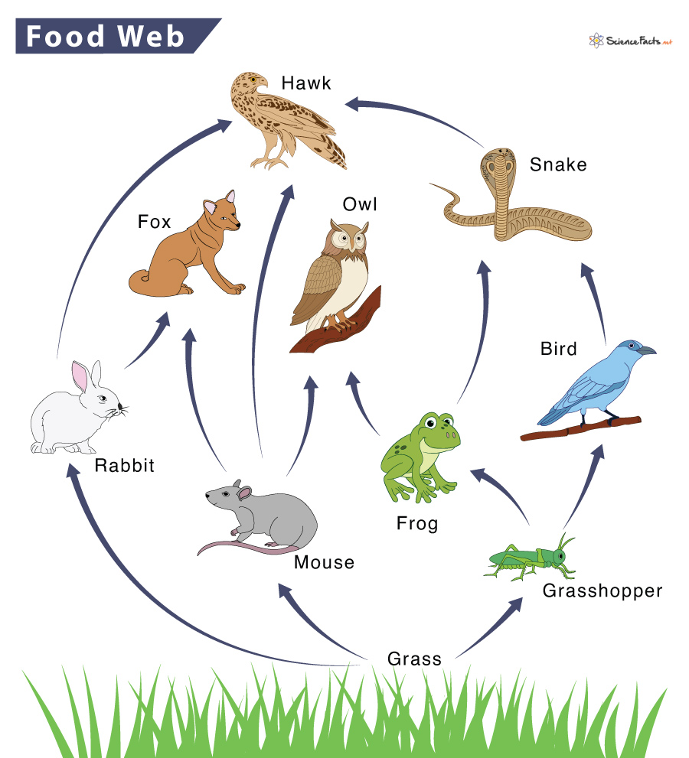
ENVIRONMENTAL STUDIES & LIFE SCIENCES
Food web
31
Image source: Wikipedia

Slide 32
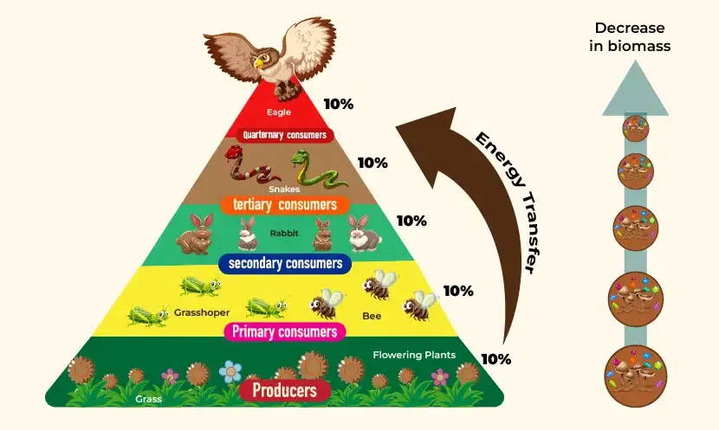
ENVIRONMENTAL STUDIES & LIFE SCIENCES
Ecological pyramid
Ecological pyramid
A model that represents the relative amount of matter and energy contained within each trophic level of an ecosystem
32
Image source: GeeksforGeeks

Slide 33
ENVIRONMENTAL STUDIES & LIFE SCIENCES
Energy flow in the ecosystem
Energy flows through an ecosystem, while matter cycles within it.
These organic molecules can power the producers’ life processes via cellular respiration (which releases and heat), or they can be stored as biomass.
Next, energy and matter move up the trophic levels of an ecosystem as producers are eaten by primary consumers, which are then eaten by secondary consumers, and so on.
Decomposers transform matter back into inorganic forms that can be recycled within the ecosystem.
33

Slide 34
ENVIRONMENTAL STUDIES & LIFE SCIENCES
Energy flow in the ecosystem
So, the energy that enters an ecosystem as sunlight eventually flows out of the ecosystem in the form of heat.
In contrast, the matter in an ecosystem is continuously recycled as atoms are combined and recombined in different ways.
Biogeochemical cycles mainly refer to the movement of nutrients and other elements between biotic and abiotic factors. They keep essential elements available to plants and other organisms.
34

Slide 35
ENVIRONMENTAL STUDIES & LIFE SCIENCES
Carbon cycle
Carbon is constantly recycled in the dynamic processes taking place in the atmosphere, at the surface and in the crust of the earth.
The carbon cycle is actually comprised of several interconnected cycles: one dealing with rapid carbon exchange among living organisms and the other dealing with the long-term cycling of carbon through geologic processes. If not for the recycling processes, carbon might long ago have become completely sequestered in crustal rocks and sediments, and life would no longer exist.
35

Slide 36
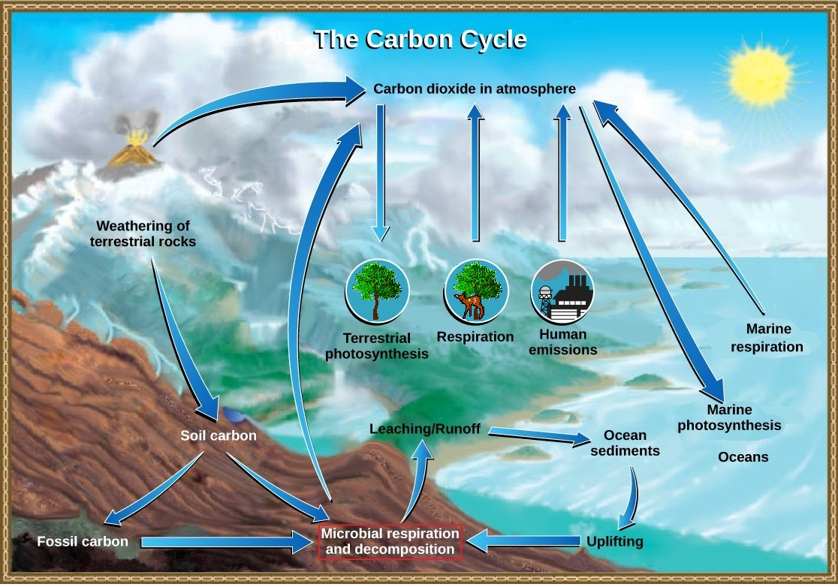
ENVIRONMENTAL STUDIES & LIFE SCIENCES
Carbon cycle
36
Image source: Biolibretexts

Slide 37
ENVIRONMENTAL STUDIES & LIFE SCIENCES
Nitrogen cycle
All organisms require nitrogen because it is an important component of nucleic acids, proteins, and other organic molecules.
The nitrogen molecule (N₂) is quite inert. To break it apart so that its atoms can combine with other atoms requires the input of substantial amounts of energy. Nitrogen fixation is the process of converting nitrogen gas into ammonia (NH₃), which spontaneously becomes ammonium (NH⁴⁺). Ammonium is found in bodies of water and in the soil.
37

Slide 38
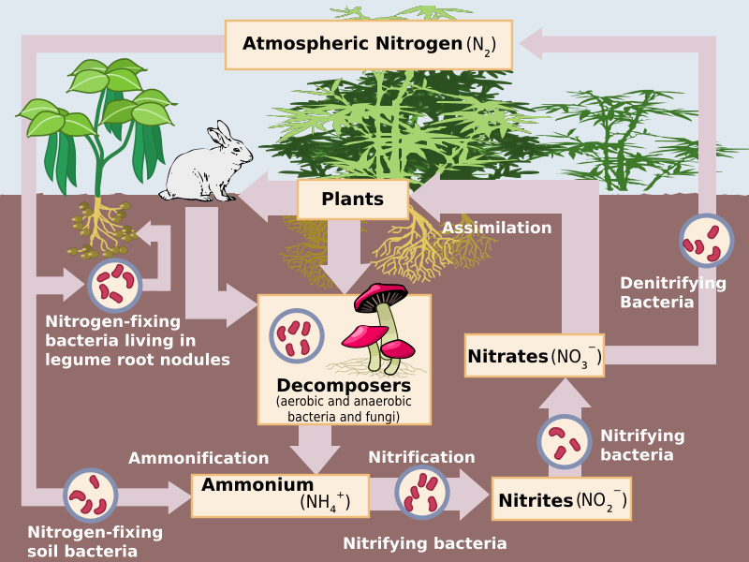
ENVIRONMENTAL STUDIES & LIFE SCIENCES
Nitrogen cycle
38
Image source: Biolibretexts

Slide 39
ENVIRONMENTAL STUDIES & LIFE SCIENCES
Oxygen cycle
The oxygen cycle is a biological process that serves to maintain oxygen levels by traveling through the atmosphere, lithosphere, and biosphere. This biogeochemical cycle explains the movement of oxygen gas within the atmosphere, ecosystem, biosphere, and lithosphere.
Both the oxygen cycle and the carbon cycle are interconnected. The lithosphere, along with the earth’s crust, contains the most oxygen on the planet.
39

Slide 40
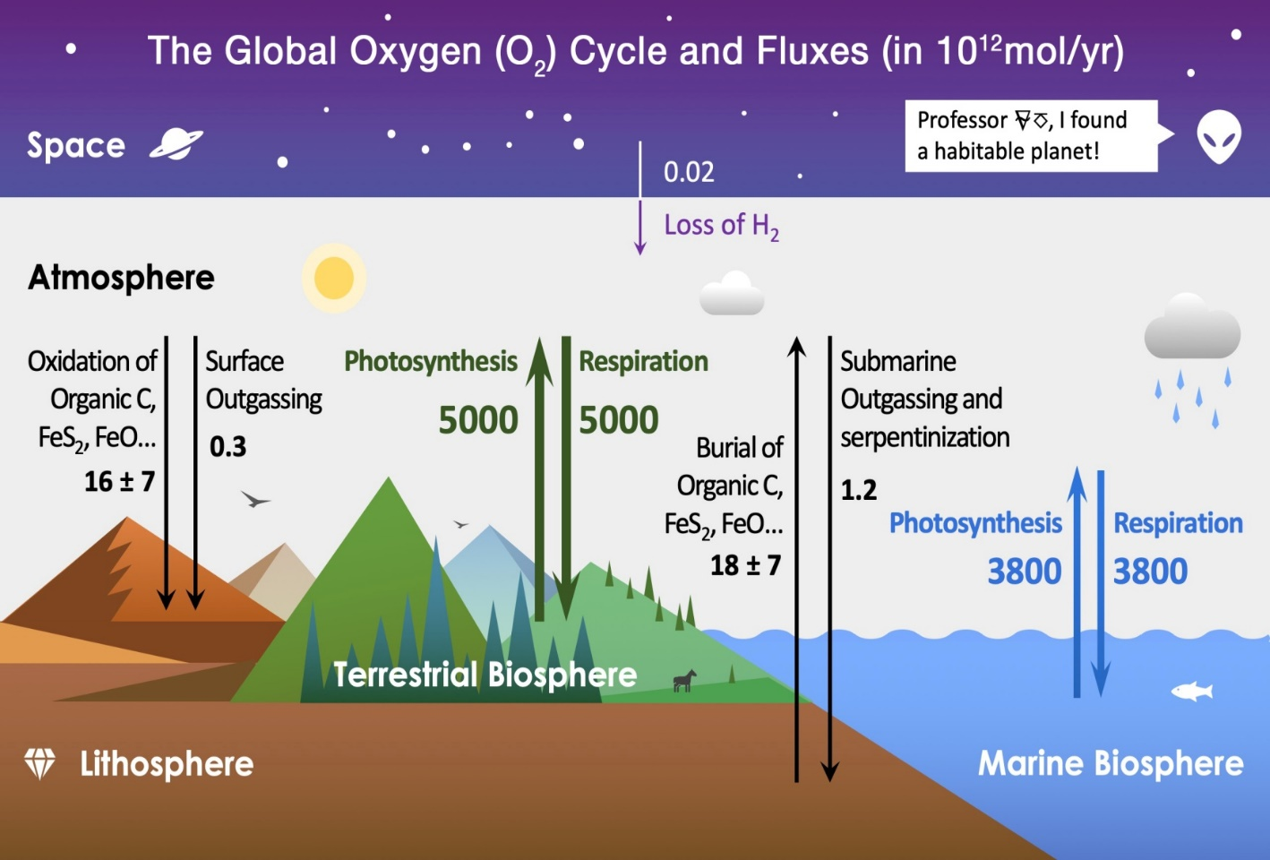
ENVIRONMENTAL STUDIES & LIFE SCIENCES
Oxygen cycle
40
Image source: Wikipedia

Slide 41
ENVIRONMENTAL STUDIES & LIFE SCIENCES
Biodiversity
Biodiversity is all the different kinds of life you’ll find in one area—the variety of animals, plants, fungi, and even microorganisms like bacteria that make up our natural world. Each of these species and organisms work together in ecosystems, like an intricate web, to maintain balance and support life.
One of the most beautiful things about biodiversity is its resilience. Ease up on the pressure, manage resources well, give it time, and the ecosystem will adapt. Nature and biodiversity will recover.
41

Slide 42
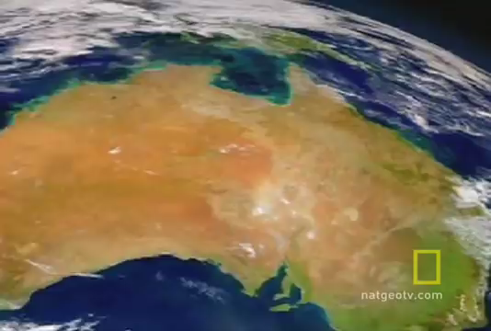
ENVIRONMENTAL STUDIES & LIFE SCIENCES
Biodiversity
https://www.youtube.com/watch?v=wbNeIn3vVKM- Click on the link to watch the video

Slide 43
THANK YOU
Faculty Name
Department of Biotechnology
---------------------@pes.edu
+91 80 2672 6672 Ext 358
43

