Slide 1

ENVIRONMENTAL STUDIES & LIFE SCIENCES
Faculty Name
Department of Biotechnology
1

Slide 2

ENVIRONMENTAL STUDIES & LIFE SCIENCES
Natural and man-made disasters
Faculty Name
Department of Biotechnology

Slide 3
ENVIRONMENTAL STUDIES & LIFE SCIENCES
Natural and man-made disasters
A Disaster is a serious disruption of the functioning of a society involving widespread human, material, economic or environmental losses & impacts which exceeds the ability of the affected community or society to cope using it’s own resources
Natural Disasters
Man-made Disasters
Earthquake/ Floods/ Landslides/ Avalanche/ Cyclone/ Tsunami/
Heat waves/ Drought
Nuclear Disasters/ Chemical Disasters/ Biological Disasters/ Accidental or Ignorance Disasters
3

Slide 4
ENVIRONMENTAL STUDIES & LIFE SCIENCES
Natural and man-made disasters
Natural disasters
Any calamitous occurrence generated by the effects of natural, rather than human-driven, phenomena that produces great loss of human life or destruction of the natural environment, private property, or public infrastructure
A natural disaster may be caused by weather and climate events or by earthquakes, landslides, and other occurrences that originate at Earth’s surface or within the planet itself.
4

Slide 5
ENVIRONMENTAL STUDIES & LIFE SCIENCES
Natural and man-made disasters
The World Meteorological Organization (WMO)—a United Nations (UN) agency, monitors Earth’s land, water, and atmosphere
Though many natural disasters are neither preventable nor largely predictable, the WMO report notes that global warming is increasing the frequency of weather- and climate-related natural disasters, such as droughts, heat waves, increasingly intense hurricanes, and flooding due to sea-level rise.
5

Slide 6
ENVIRONMENTAL STUDIES & LIFE SCIENCES
Natural and man-made disasters
Warmer temperatures are causing more extreme weather events by delivering more precipitation to some areas while delivering less to other areas that rely on it, increasing drought risk.
Sources of rainfall, such as the South Asian monsoon, on which agriculture of the Indian subcontinent has long depended, are becoming less predictable, and rain events have become more violent and dangerous, damaging crops and producing more intense flooding.
6

Slide 7
ENVIRONMENTAL STUDIES & LIFE SCIENCES
Natural and man-made disasters
1. Earthquake
An earthquake is the result of a sudden release of energy in Earth's crust that creates seismic waves.
At the Earth's surface, earthquakes manifest themselves by shaking & sometimes displacement of the ground.
Seismic activity of an area refers to the frequency, type & size of earthquakes experienced over a period of time & are measured using seismometers. The moment magnitude is expressed in terms of Richter scale.
7

Slide 8

ENVIRONMENTAL STUDIES & LIFE SCIENCES
Natural and man-made disasters
You tube videos
8

Slide 9
ENVIRONMENTAL STUDIES & LIFE SCIENCES
Natural and man-made disasters
Gujarat was hit by the worst earthquake of 21st century in India on January 26, 2001 of magnitude 7.7 and it lasted for two minutes.
A large-scale devastation occurred in several towns and villages. Bhuj was among the worst-affected areas as it was close to the epicenter.
It is also called as the Bhuj earthquake. Around 18,600 people died and 1,67,000 were injured. Nearly 1.2 million houses were damaged. (National Information Centre of Earthquake Engineering, IIT Kanpur, INDIA)
9

Slide 10
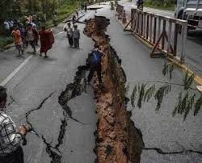
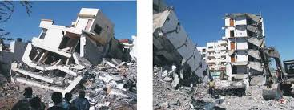
ENVIRONMENTAL STUDIES & LIFE SCIENCES
Natural and man-made disasters
Gujarat earthquake, 2001
Image source: The Indian Express
10

Slide 11
ENVIRONMENTAL STUDIES & LIFE SCIENCES
Natural and man-made disasters
2. Flood
A flood is an overflow of water that submerges land, may occur as an overflow of water from water bodies, such as a river or lake, in which the water overtops, resulting in some of that water escaping it’s usual boundaries or it may occur due to accumulation of rainwater on saturated ground in an areal flood.
Flash floods can develop within hours of heavy rainfall.
Deserts are vulnerable to flash floods. Wadis (Arroyos) are dry river beds that only flow during heavy rains.
11

Slide 12
ENVIRONMENTAL STUDIES & LIFE SCIENCES
Natural and man-made disasters
Floods are a common occurrence in India, especially during June to September.
One of the worst floods in India’s recent history occurred in Uttarakhand in June 2013. Heavy rain due to a cloudburst led to sudden flash floods and landslides in the northern part of Uttarakhand. While the military was able to evacuate more than 100,000 people trapped in landslides, an estimated 4,094 were killed and over 5,700 were missing (and eventually presumed dead).
12

Slide 13
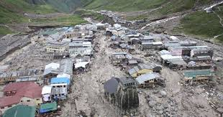
ENVIRONMENTAL STUDIES & LIFE SCIENCES
Natural and man-made disasters
Uttarakhand floods, 2013
Image source: First Post
13

Slide 14
ENVIRONMENTAL STUDIES & LIFE SCIENCES
Natural and man-made disasters
3. Landslide
A landslide is a geological phenomenon that includes a wide range of ground movements, such as rock falls, deep failure of slopes & shallow debris flows.
Landslides can occur in offshore, coastal & onshore environments.
Landslides are caused by rain, earthquakes, volcanoes, or other factors that make the slope unstable.
14

Slide 15
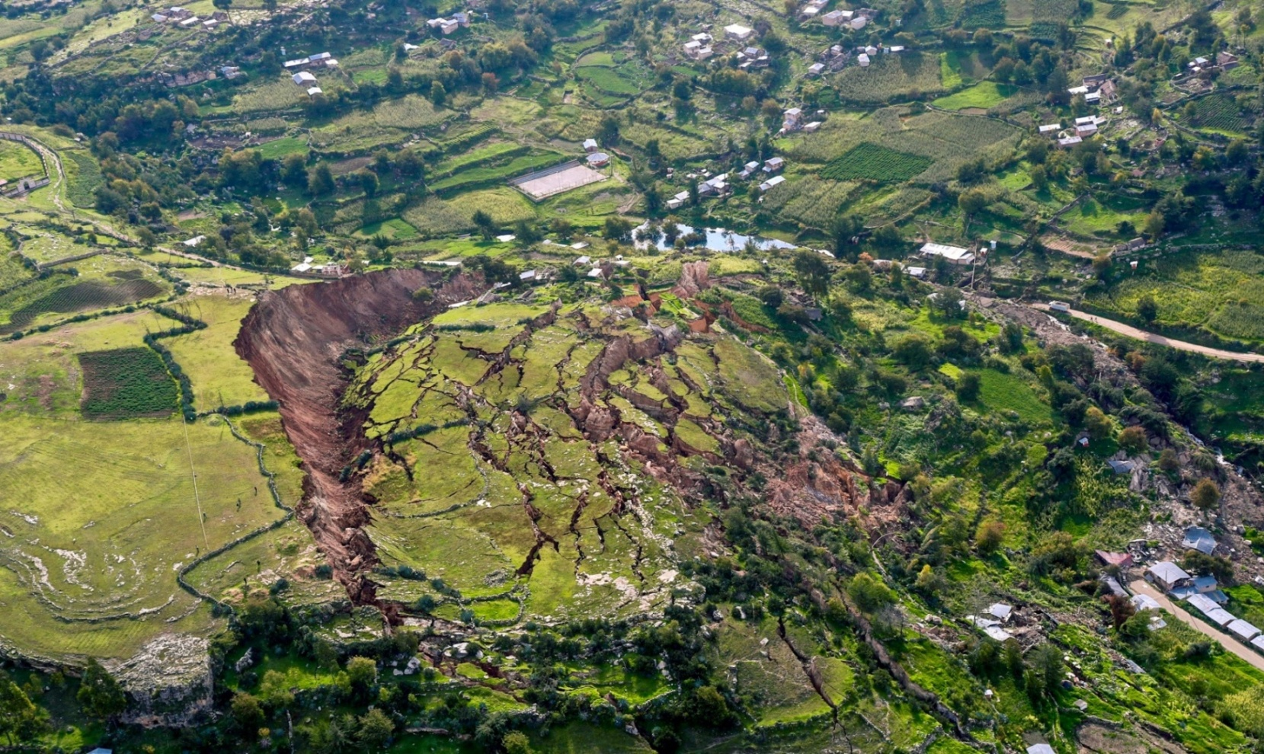
ENVIRONMENTAL STUDIES & LIFE SCIENCES
Natural and man-made disasters
A landslide near Peru, 2018
15
https://en.wikipedia.org/wiki/Landslide

Slide 16
ENVIRONMENTAL STUDIES & LIFE SCIENCES
Natural and man-made disasters
There are several ways of describing how a landslide moves. These include falls, topples, translational slides, lateral spreads, and flows.
Falls & topples-heavy blocks of material fall after separating from a very steep slope or cliff.
In translational slides, surface material is separated from the more stable underlying layer of a slope.
A lateral spread or flow is the movement of material sideways, or laterally.
16

Slide 17
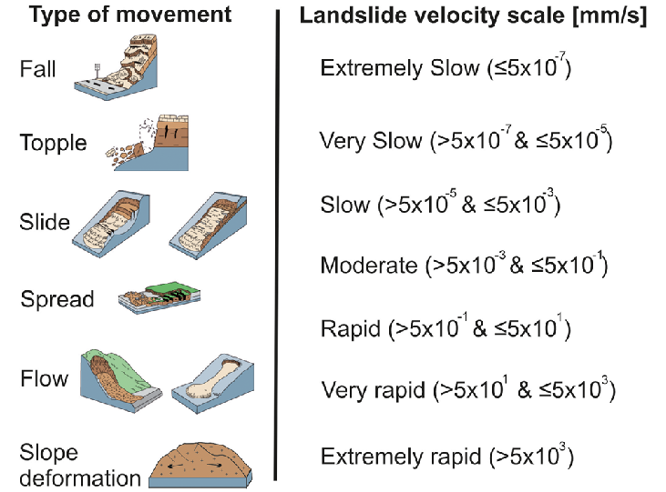
ENVIRONMENTAL STUDIES & LIFE SCIENCES
Natural and man-made disasters
17
Image source: Research gate

Slide 18
ENVIRONMENTAL STUDIES & LIFE SCIENCES
Natural and man-made disasters
4. Avalanche
Avalanche, a mass of material moving rapidly down a slope. An avalanche is typically triggered when material on a slope breaks loose from its surroundings; this material then quickly collects and carries additional material down the slope.
18

Slide 19
ENVIRONMENTAL STUDIES & LIFE SCIENCES
Natural and man-made disasters
There are two main types of snow avalanches—sluffs and slabs.
Sluff avalanches occur when the weak layer of a snowpack is on the top. A sluff is a small slide of dry, powdery snow that moves as a formless mass
A slab avalanche occurs when the weak layer lies lower down in a snowpack. This layer is covered with other layers of compressed snow. When the avalanche is triggered, the weak layer breaks off, pulling all the layers on top of it down the slope.
19

Slide 20
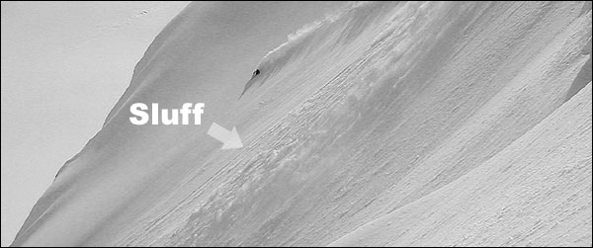
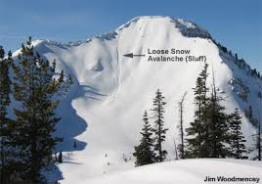
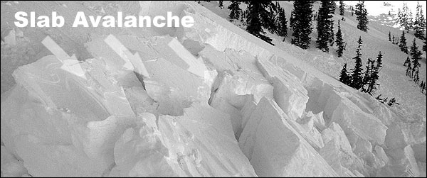
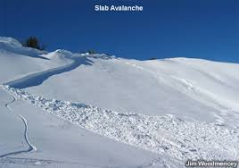
ENVIRONMENTAL STUDIES & LIFE SCIENCES
Natural and man-made disasters
20

Slide 21
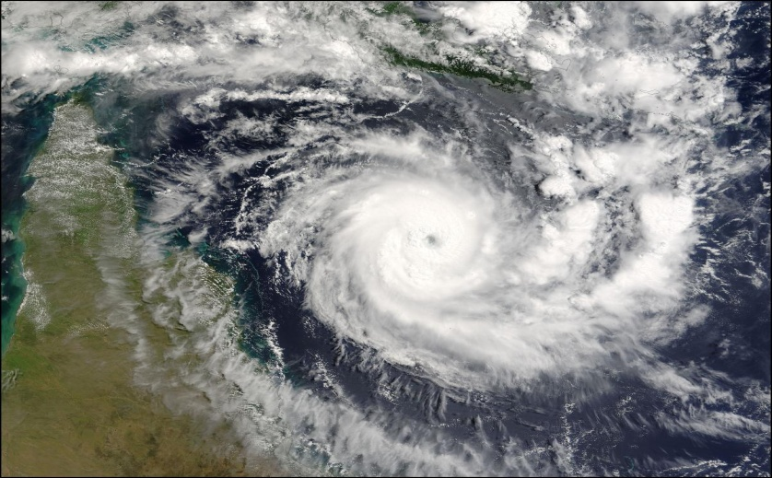
ENVIRONMENTAL STUDIES & LIFE SCIENCES
Natural and man-made disasters
5. Cyclone
A cyclone is an area of closed, circular fluid motion rotating in the same direction as the Earth.
This is usually characterized by inward circular winds that rotate anti-clockwise in the Northern Hemisphere & clockwise in the Southern Hemisphere of the Earth.
An anticyclone is the opposite of a cyclone. An anticyclone’s winds rotate clockwise in the Northern Hemisphere around a center of high pressure. Air comes in from above and sinks to the ground.
21

Slide 22
ENVIRONMENTAL STUDIES & LIFE SCIENCES
Natural and man-made disasters
Most large-scale cyclonic circulations are centered on areas of low atmospheric pressure.
There are two types of cyclones: Mid-latitude cyclones are the main cause of winter storms in the middle latitudes.
Tropical cyclones are also known as hurricanes. “Hurricane Mitch” devastated Central America, particularly Honduras and Nicaragua, in late October 1998. It was recognized as the second deadliest Atlantic hurricane on record, after the Great Hurricane of 1780.
22

Slide 23
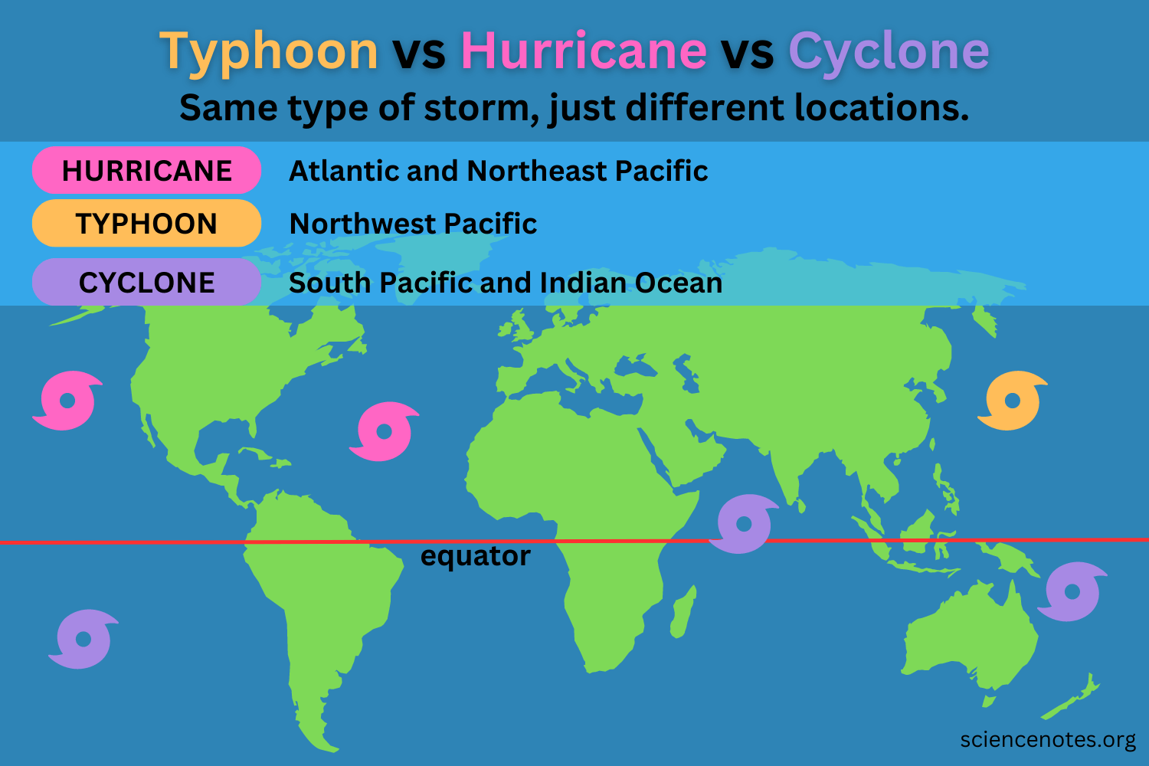
ENVIRONMENTAL STUDIES & LIFE SCIENCES
Natural and man-made disasters
More severe tropical cyclones are called tropical storms. The most severe tropical cyclones are called either hurricanes or typhoons depending on where they occur. Tornadoes are rotating funnel clouds that only form over land, and they're much, much smaller than hurricanes.
23

Slide 24
ENVIRONMENTAL STUDIES & LIFE SCIENCES
Natural and man-made disasters
6. Tsunami
In Japanese, tsunami means "harbor wave."
A Tsunami also known as seismic sea wave; it is a series of water waves caused by displacement of a large volume of a body of water, generally an ocean or a large lake.
Tsunamis race across the sea at up to 500 miles (805 kilometers) an hour—about as fast as a jet airplane. At that pace, they can cross the entire expanse of the Pacific Ocean in less than a day.
24

Slide 25
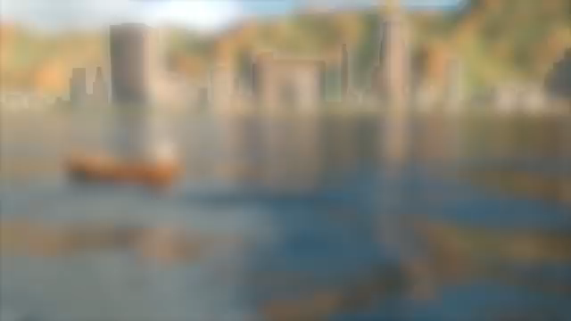
ENVIRONMENTAL STUDIES & LIFE SCIENCES
Natural and man-made disasters
https://www.youtube.com/watch?v=DI9Y24SKPEg –Click on the link to watch the interesting video
You tube videos
25

Slide 26
ENVIRONMENTAL STUDIES & LIFE SCIENCES
Natural and man-made disasters
7. Drought
Drought is an extended period when a region receives a deficiency in its water supply, whether atmospheric, surface or ground water.
A drought can last for months or years, or may be declared after as few as 15 days, this occurs when a region receives consistently below average precipitation.
A drought can have a substantial impact on the ecosystem & agriculture of the affected region.
26

Slide 27
ENVIRONMENTAL STUDIES & LIFE SCIENCES
Natural and man-made disasters
8. Heat wave
A heat wave is a prolonged period of excessively hot weather accompanied by high humidity, especially in oceanic climate countries.
It occurs during the summer season in the North-Western parts of India.
The extreme temperatures and resultant atmospheric conditions adversely affect people living in these regions as they cause physiological stress, sometimes resulting in death.
27

Slide 28
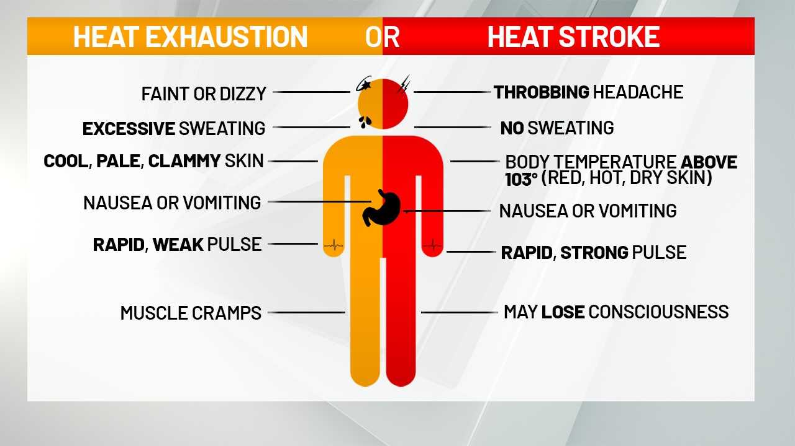
ENVIRONMENTAL STUDIES & LIFE SCIENCES
Natural and man-made disasters
Image source: https://www.news10.com/news/
28

Slide 29
ENVIRONMENTAL STUDIES & LIFE SCIENCES
Natural and man-made disasters
Man-made disasters
Disasters having elements of human intent, negligence, error, failure of human-made systems.
Such events result in huge losses of life & property along with damage to people’s mental, physical & social well-being.
Such man-made disasters are nuclear disaster, biological/chemical threat, accidental, terrorism, etc.
29

Slide 30
ENVIRONMENTAL STUDIES & LIFE SCIENCES
Natural and man-made disasters
Nuclear disaster
An accident taking place in any nuclear facility of the nuclear fuel cycle including the nuclear reactor, or in a facility using radioactive sources, leading to a large-scale release of radioactivity in the environment.
A ‘criticality’ accident in a nuclear fuel cycle facility where an uncontrolled nuclear chain reaction takes place inadvertently leading to bursts of neutrons and gamma radiation (as had happened at Tokaimura, Japan).
30

Slide 31
ENVIRONMENTAL STUDIES & LIFE SCIENCES
Natural and man-made disasters
An accident during the transportation of radioactive material.
The malevolent use of radioactive material as Radiological Dispersal Device (RDD) by terrorists for dispersing radioactive material in the environment.
A large-scale nuclear disaster resulting from a nuclear weapon attack (as had happened at Hiroshima and Nagasaki in Japan) which would lead to mass casualties and destruction of large areas and properties.
31

Slide 32
ENVIRONMENTAL STUDIES & LIFE SCIENCES
Natural and man-made disasters
The Chernobyl disaster began on 26th April 1986 with the explosion of the No. 4 reactor of the Chernobyl Nuclear Power Plant near the city of Pripyat in the north of the Ukrainian SSR, in the Soviet Union.
It was the worst nuclear disaster in history, and the costliest disaster in human history, costing an estimated US$700 billion.
It was the result of a flawed reactor design that was operated with inadequately trained personnel.
32

Slide 33
ENVIRONMENTAL STUDIES & LIFE SCIENCES
Natural and man-made disasters
The resulting steam explosion and fires released at least 5 % of the radioactive reactor core into the environment, with the deposition of radioactive materials in many parts of Europe.
Two Chernobyl plant workers died due to the explosion on the night of the accident, and a further 28 people died within a few weeks as a result of acute radiation syndrome.
Some 350,000 people were evacuated as a result of the accident.
33

Slide 34
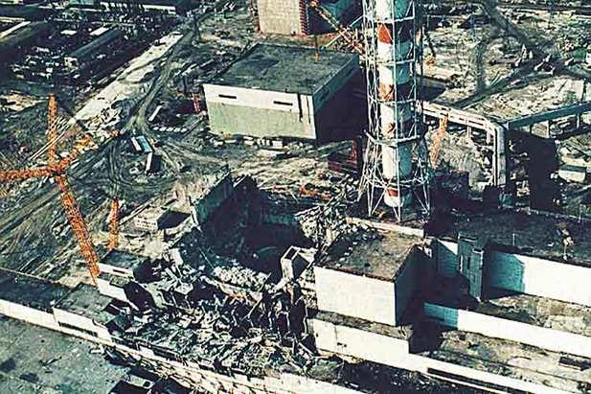
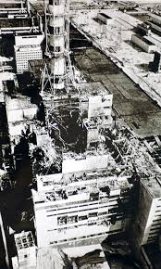
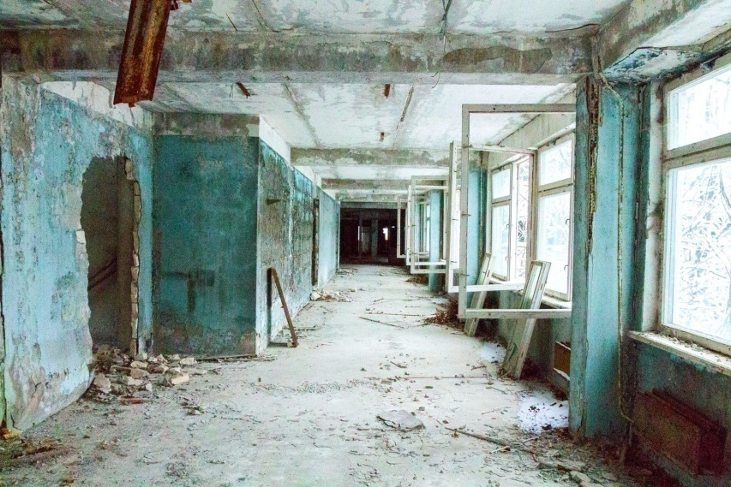
ENVIRONMENTAL STUDIES & LIFE SCIENCES
Chernobyl disaster
34
Image source: Britannica

Slide 35
ENVIRONMENTAL STUDIES & LIFE SCIENCES
Natural and man-made disasters
Chemical disaster
Chemical, being at the core of modern industrial systems, has attained a very serious concern for disaster management.
The elements which are at highest risks due to chemical disaster primarily include the industrial plant, its employees & workers, hazardous chemicals vehicles, the residents of nearby settlements, adjacent buildings, occupants and surrounding community.
35

Slide 36
ENVIRONMENTAL STUDIES & LIFE SCIENCES
Natural and man-made disasters
Chemical disasters may arise in number of ways, such as:-
Process and safety systems failures: Human errors, Technical errors, Management errors
Induced effect of natural calamities
Accidents during the transportation
Hazardous waste processing/ disposal
Terrorist attack/ unrest leading to sabotage
36

Slide 37
ENVIRONMENTAL STUDIES & LIFE SCIENCES
Natural and man-made disasters
India witnessed the world’s worst chemical (industrial) disaster “Bhopal Gas Tragedy” in the year 1984.
The Bhopal Gas tragedy was most devastating chemical accident in history, where over 2500 people died due to accidental release of toxic gas Methyl Iso Cyanate (MIC) from Union Carbide India Ltd.’s (UCIL’s) pesticide factory.
Bhopal became a colossal gas chamber, killing thousands of people immediately and creating a panic as tens of thousands of others attempted to flee Bhopal.
37

Slide 38
ENVIRONMENTAL STUDIES & LIFE SCIENCES
Natural and man-made disasters
The final death toll was estimated to be between 15,000 and 20,000.
Some half a million survivors suffered respiratory problems, eye irritation or blindness, and other maladies resulting from exposure to the toxic gas; many were awarded compensation of a few hundred dollars.
Investigations later established that substandard operating and safety procedures at the understaffed plant had led to the disaster.
38

Slide 39
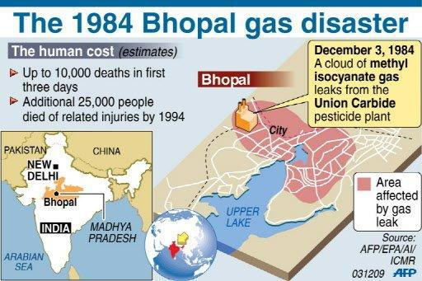
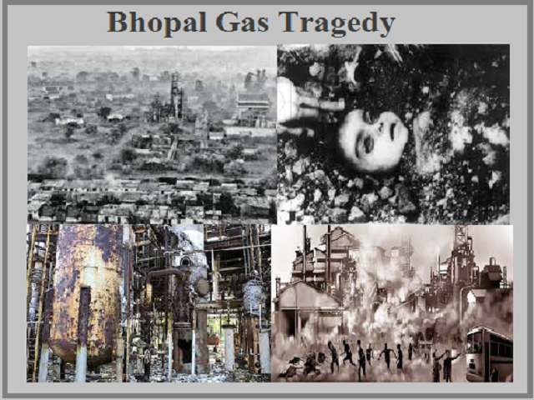
ENVIRONMENTAL STUDIES & LIFE SCIENCES
Natural and man-made disasters
Image source: https://prevencontrol.com/prevenblog/lessons-learned
39

Slide 40

ENVIRONMENTAL STUDIES & LIFE SCIENCES
Natural and man-made disasters
Biological disasters
Charles Baldwin developed the symbol for biohazard in 1966.
Biological disasters are natural scenarios involving disease, disability, or death on a large scale among humans, animals, and plants due to micro-organisms like bacteria, or viruses, or toxins.
Atomic Biological Chemical
40

Slide 41
ENVIRONMENTAL STUDIES & LIFE SCIENCES
Natural and man-made disasters
The US Center for Disease Control classifies biohazards into four biosafety levels (BSL) as follows:
BSL 1: Microbes that are not known to cause disease in healthy adults and present minimal potential hazard to laboratorians and the environment. Example- Non pathogenic strain of Escherichia coli, Bacillus subtilis etc. Protection is only facial protection and gloves.
41

Slide 42
ENVIRONMENTAL STUDIES & LIFE SCIENCES
Natural and man-made disasters
BSL 2: Microbes pose moderate hazards to laboratorians and the environment. The microbes are typically indigenous and associated with diseases of varying severity. Examples- Staphylococcus aureus, human adenoviruses, Hepatitis virus, HIV. Protection – use of autoclaves for sterilizing and biological safety cabinets.
42

Slide 43
ENVIRONMENTAL STUDIES & LIFE SCIENCES
Natural and man-made disasters
BSL 3: Bacteria and viruses causing severe to fatal disease in humans. Example: West Nile virus, anthrax, MERS coronavirus. Protection – Stringent safety protocols such as the use of respirators to prevent airborne infection.
BSL 4: Potentially fatal (to human beings) viruses like Ebola virus, Marburg virus, Lassa fever virus, etc. Protection – use of a positive pressure personnel suit, with a segregated air supply.
43

Slide 44

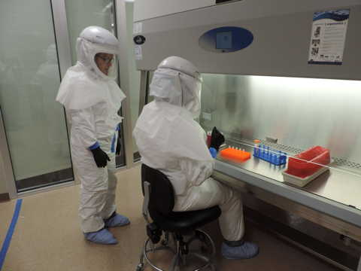
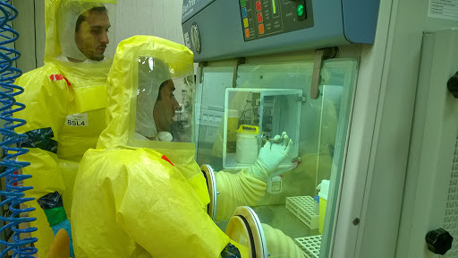
ENVIRONMENTAL STUDIES & LIFE SCIENCES
Natural and man-made disasters
Biological safety cabinet
BSL - 2
BSL - 4
BSL - 3
Image source: Microbe notes
44

Slide 45
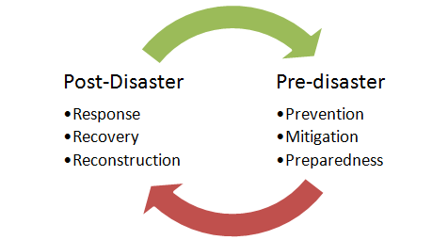
ENVIRONMENTAL STUDIES & LIFE SCIENCES
Natural and man-made disasters
Pre and post disaster management
Image source: GK Today
45

Slide 46
ENVIRONMENTAL STUDIES & LIFE SCIENCES
Natural and man-made disasters
Pre-disaster management
Disaster prevention and mitigation refers to the activities which are undertaken to prevent or mitigate the adverse effects of a disaster in short and long term.
On the one hand they include political, legal, administrative and infrastructural measures; while on the other hand it includes educating vulnerable communities influencing their lifestyle and behaviour in order to reduce their disaster risk.
46

Slide 47
ENVIRONMENTAL STUDIES & LIFE SCIENCES
Natural and man-made disasters
Disaster Preparedness
The intention of Disaster preparedness is to prevent or minimize the losses and damage in case of a disaster.
This would include the preparedness of all civic bodies such as civil administration, fire-brigade, hospitals, police etc. Preparedness denotes the third phase of emergency management.
47

Slide 48
ENVIRONMENTAL STUDIES & LIFE SCIENCES
Natural and man-made disasters
Post-disaster management
Response, Recovery and Reconstruction
The response phase includes the search and rescue; fulfilling basic humanitarian needs of victims ; assistance by regional, national and international bodies etc. Recovery phase starts after the immediate threat to human life has subsided.
The immediate goal of the recovery phase is to bring the affected area back to some degree of normalcy.
48

Slide 49
ENVIRONMENTAL STUDIES & LIFE SCIENCES
Natural and man-made disasters
Bioterrorism
A biological attack, or bioterrorism, is the intentional release of viruses, bacteria, or other germs that can sicken or kill people, livestock, or crops.
Biological warfare: intentional use of microorganisms and toxins usually of microbial, plant or animal origin to produce disease and death among humans, live stock and crops.
49

Slide 50
ENVIRONMENTAL STUDIES & LIFE SCIENCES
Natural and man-made disasters
Year | Attack
1155 | Emperor Barbarossa poisons water wells with human bodies, Tortona, Italy
1346 | Mongols catapult bodies of plague victims over the city walls of Caffa, Crimean Peninsula
1763 | British distribute blankets from smallpox patients to native Americans
First World War, Second World War, Soviet Union 1979, Japan 1995, USA 2001 | Bacillus anthracis In September 2001, the American public was exposed to anthrax spores as a bioweapon delivered through the US postal system, called the case of the 'anthrax letters' in the aftermath of the World Trade Center attack.
50

Slide 51
ENVIRONMENTAL STUDIES & LIFE SCIENCES
Natural and man-made disasters
Features of a bioterrorist agent:
Consistently produces a given effect, death or disease, at low concentrations.
Highly contagious.
Short and predictable incubation period.
Target population has little or no immunity against the organism.
Little or no prophylaxis or treatment available with the native population.
51

Slide 52
ENVIRONMENTAL STUDIES & LIFE SCIENCES
Natural and man-made disasters
The bioterrorist agents with highest priority are
Anthrax (Bacillus anthracis),
Botulism (Clostridium botulinum),
Plague (Yersinia pestis),
Smallpox (Variola major),
Tularaemia (Francisella tularensis) and
Viral haemorrhagic fevers (Filoviruses and Arena viruses).
52

Slide 53
ENVIRONMENTAL STUDIES & LIFE SCIENCES
Natural and man-made disasters
Delivery Mechanisms
Aerosol spray : easiest method of dispersal. Highest number of people victimized
Food & Water contamination : more cumbersome. People victimized are less & large quantities of agent required
Spores : Through envelops (Anthrax) easy dispersal.
Infected People/ Animals : People or animals in the prodromal or latent illness where the organism can’t be identified. Very difficult and very few people will be infected.
53

Slide 54
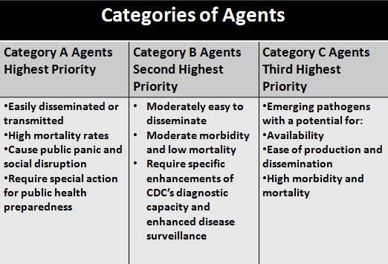
ENVIRONMENTAL STUDIES & LIFE SCIENCES
Natural and man-made disasters
Image source: Medscape
54

Slide 55
THANK YOU
Faculty Name
Department of Biotechnology
--------------------@pes.edu
+91 80 2672 6672 Extn 358
55

