Slide 1
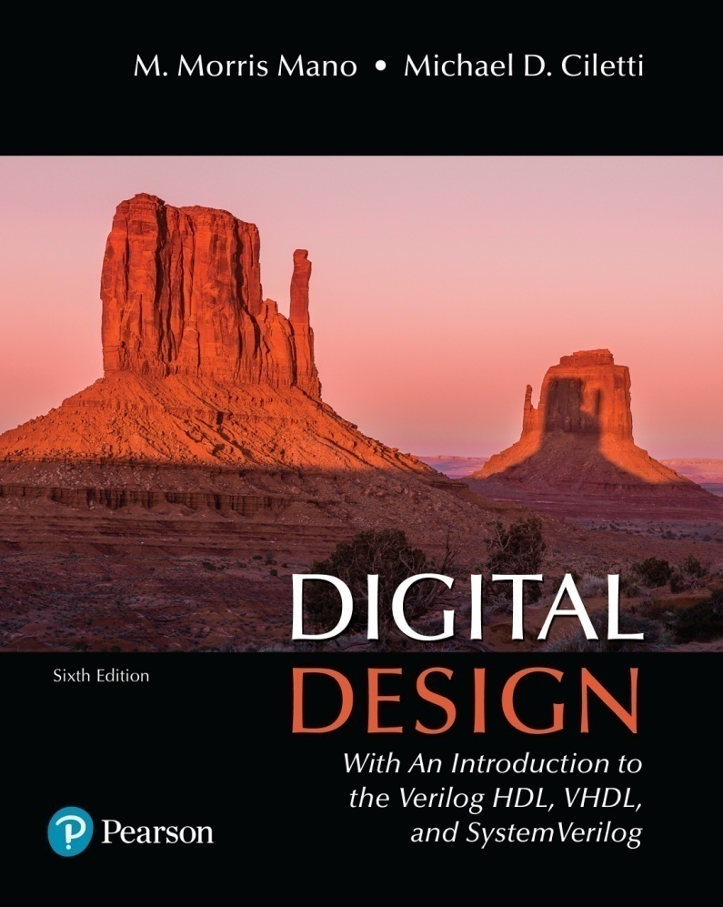
Digital Design
With an Introduction to the Verilog HDL, VHDL, and SystemVerilog
6th Edition
Appendix
Semiconductors and CMOS Integrated Circuits

Slide 2
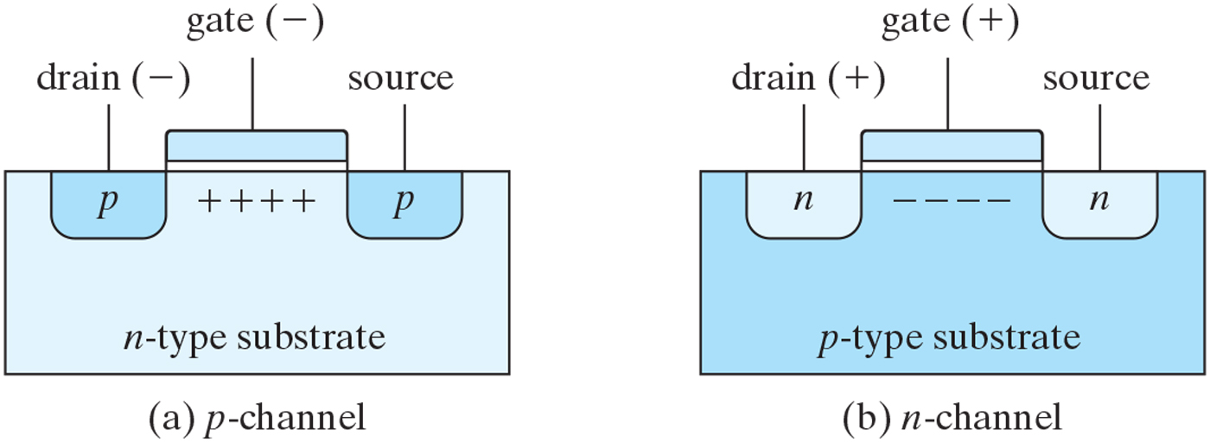
FIGURE A.1
Basic structure of MOS transistor.

Slide 3
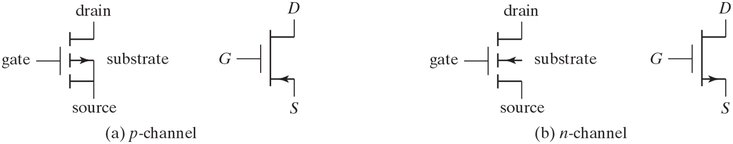
FIGURE A.2
Symbols for MOS transistors.

Slide 4
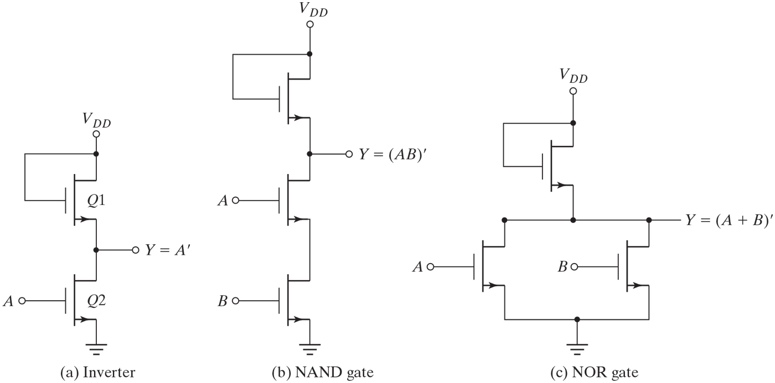
FIGURE A.3
n-channel MOS logic circuits.

Slide 5
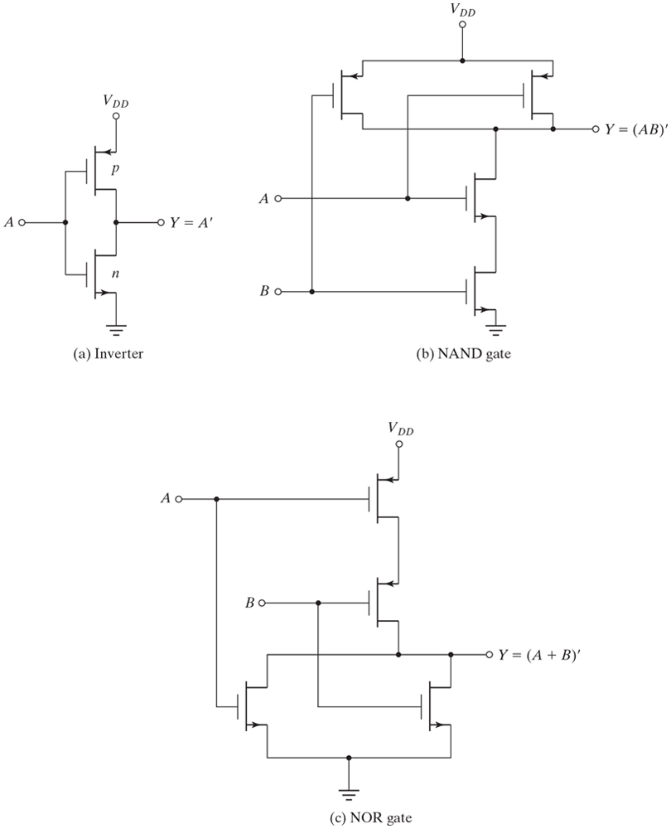
FIGURE A.4
CMOS logic circuits.

Slide 6
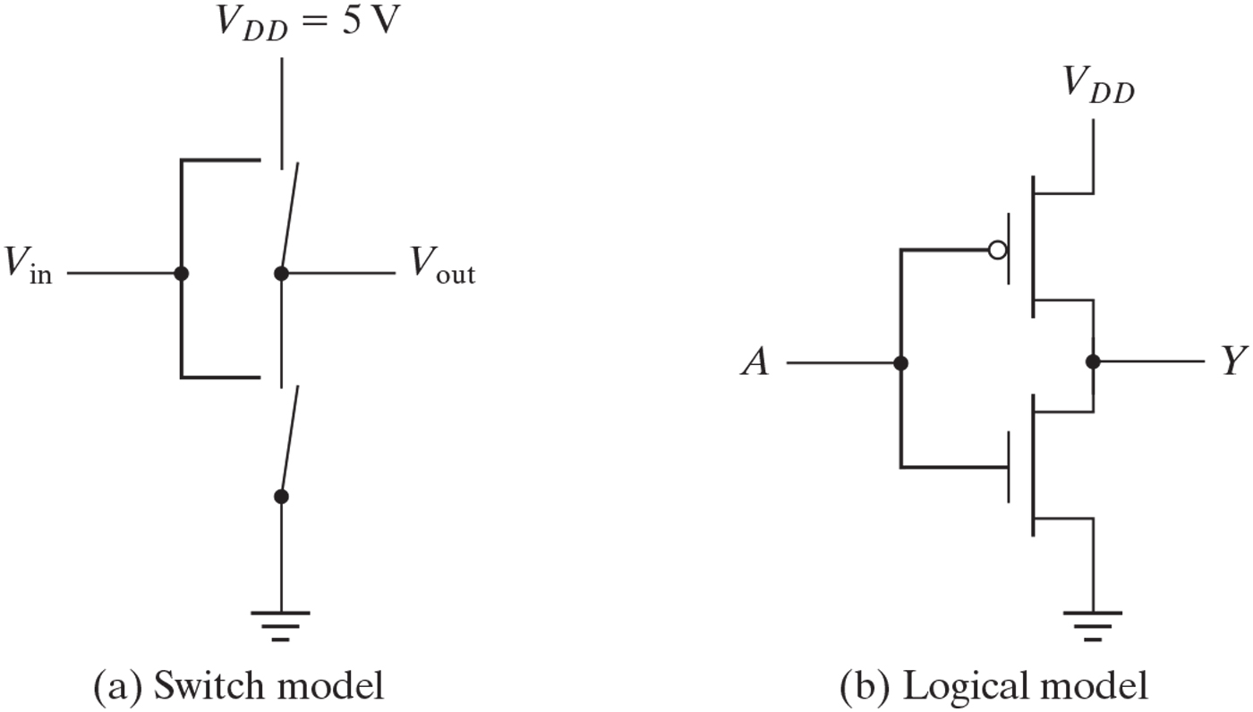
FIGURE A.5
CMOS inverter.

Slide 7
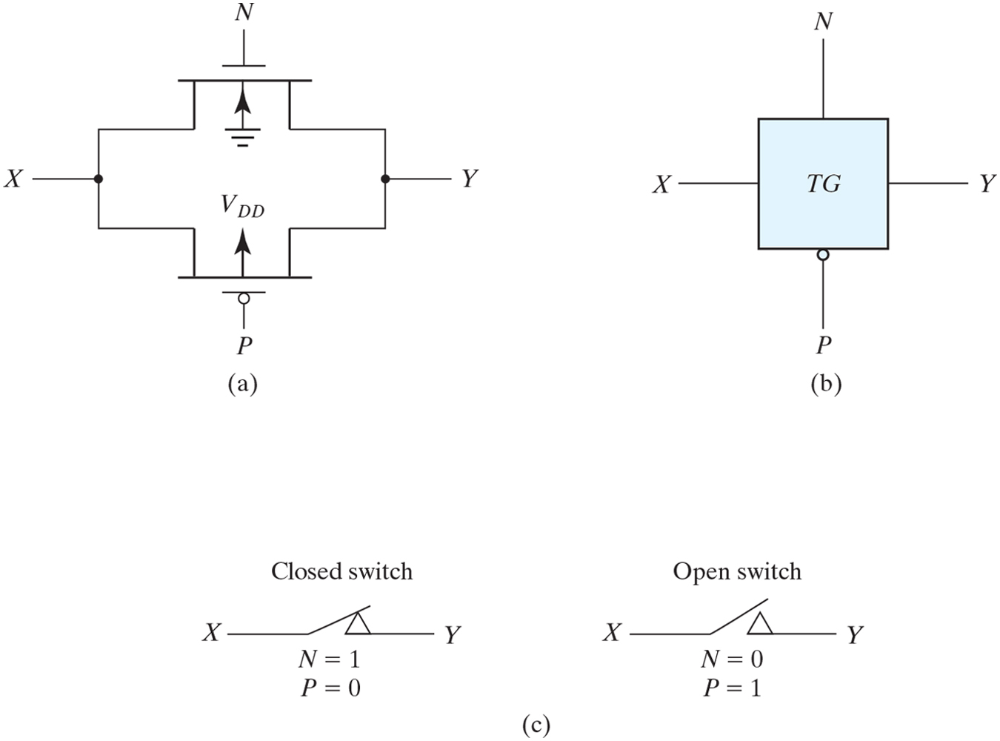
FIGURE A.6
Transmission gate (TG).

Slide 8
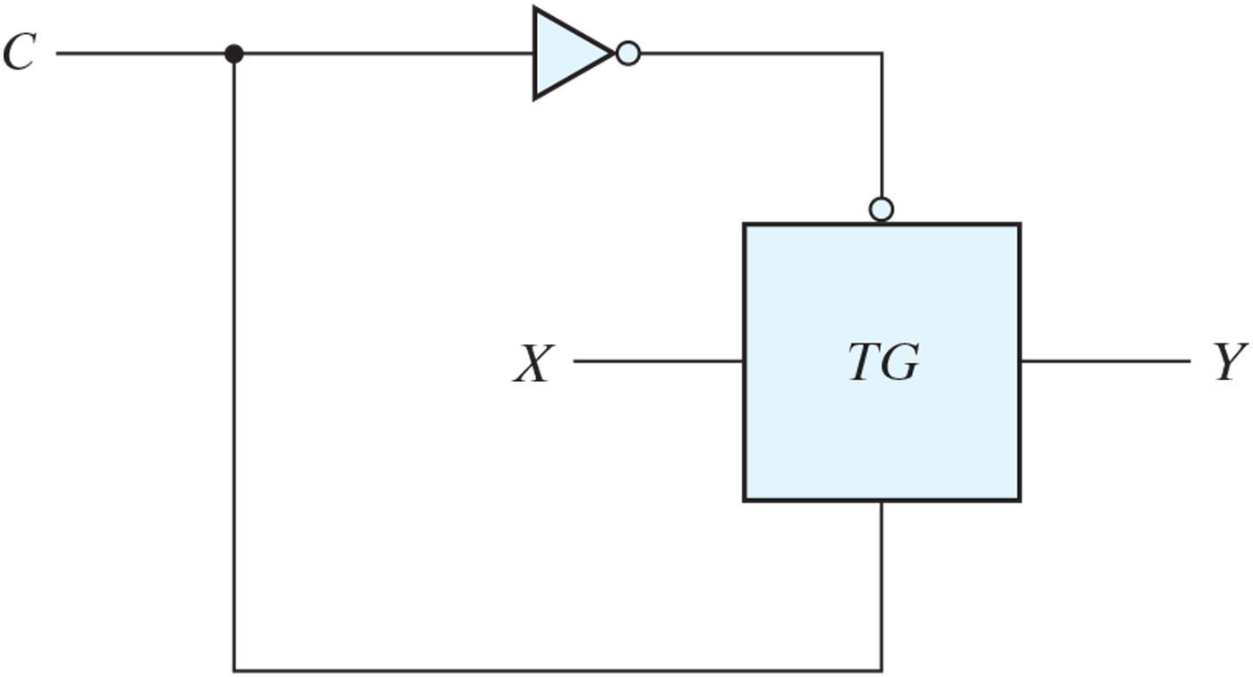
FIGURE A.7
Bilateral switch.

Slide 9
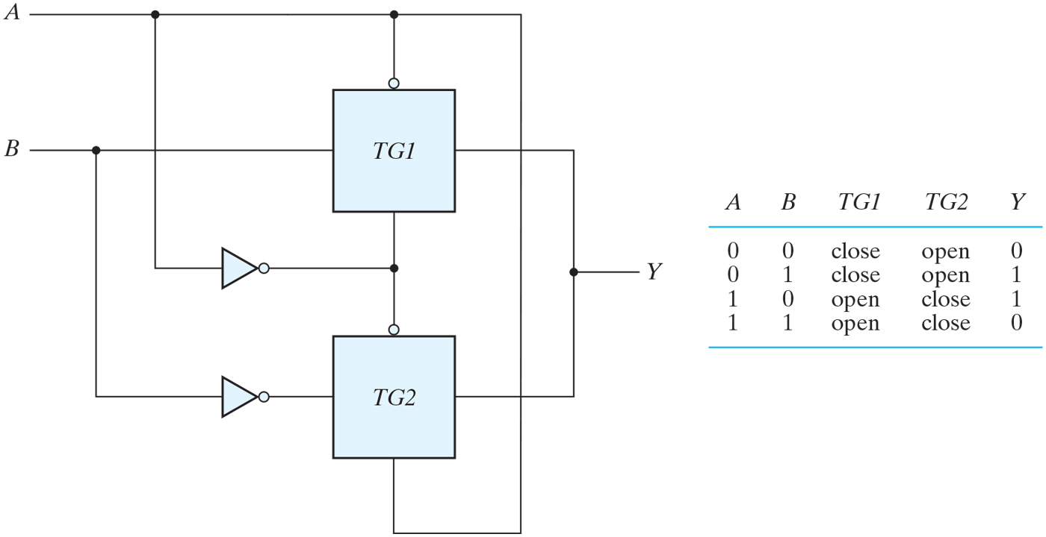
FIGURE A.8
Exclusive-OR constructed with transmission gates.

Slide 10
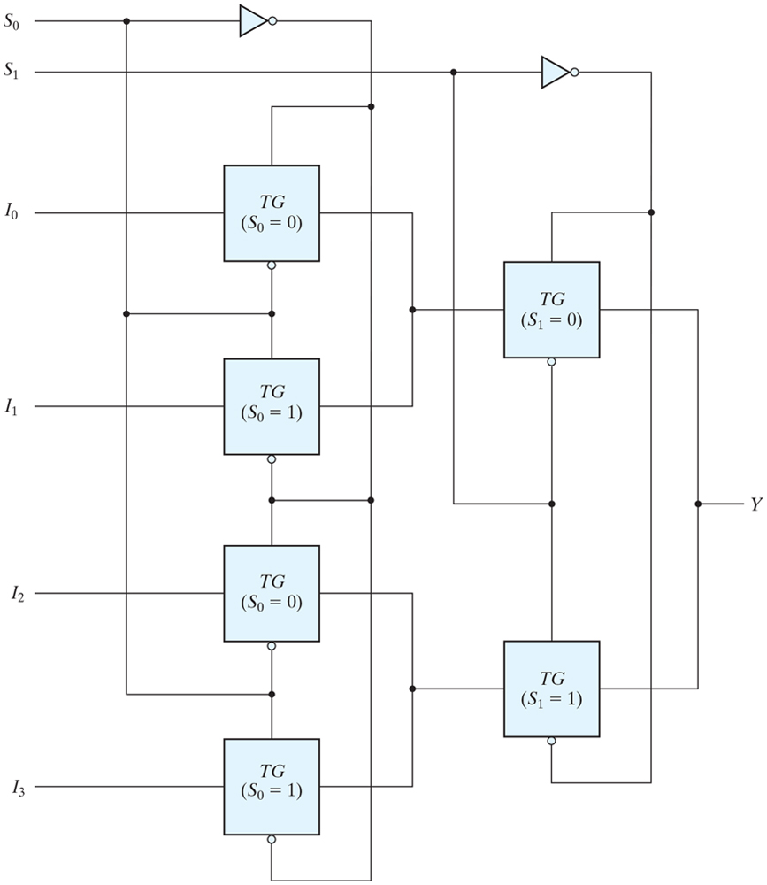
FIGURE A.9
Multiplexer with transmission gates.

Slide 11
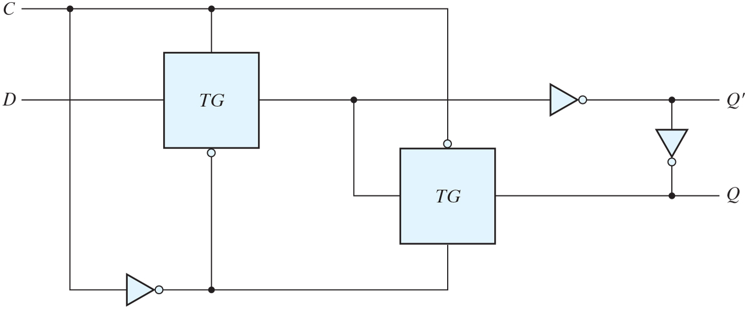
FIGURE A.10
Gated D latch with transmission gates.

