Slide 1
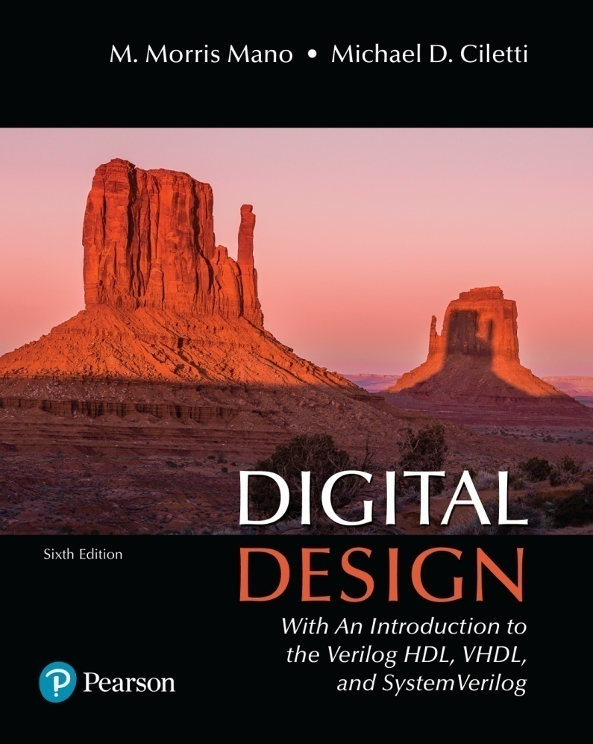
Digital Design
With an Introduction to the Verilog HDL, VHDL, and SystemVerilog
6th Edition
Chapter 01
Digital Systems and Binary Numbers

Slide 2
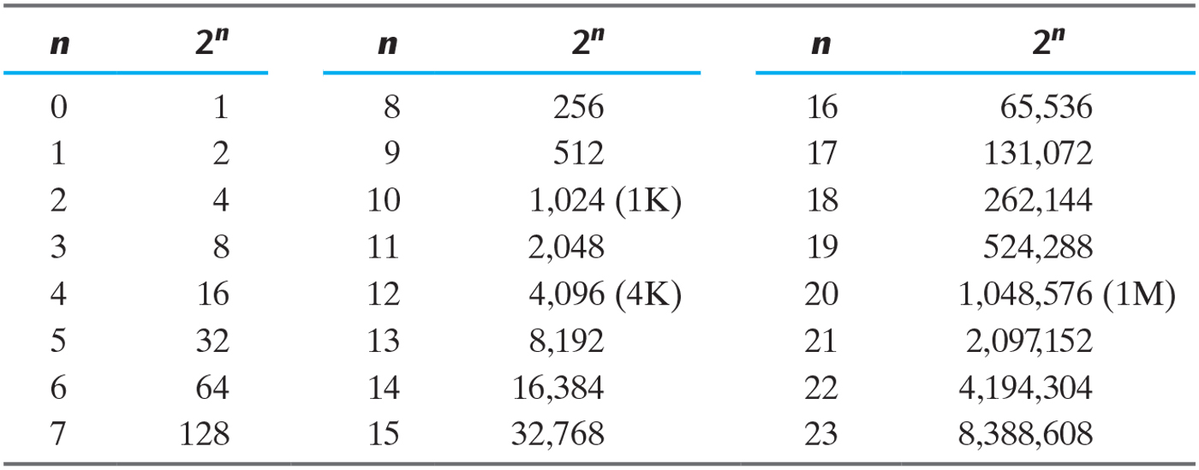
Table 1.1 Powers of Two.

Slide 3
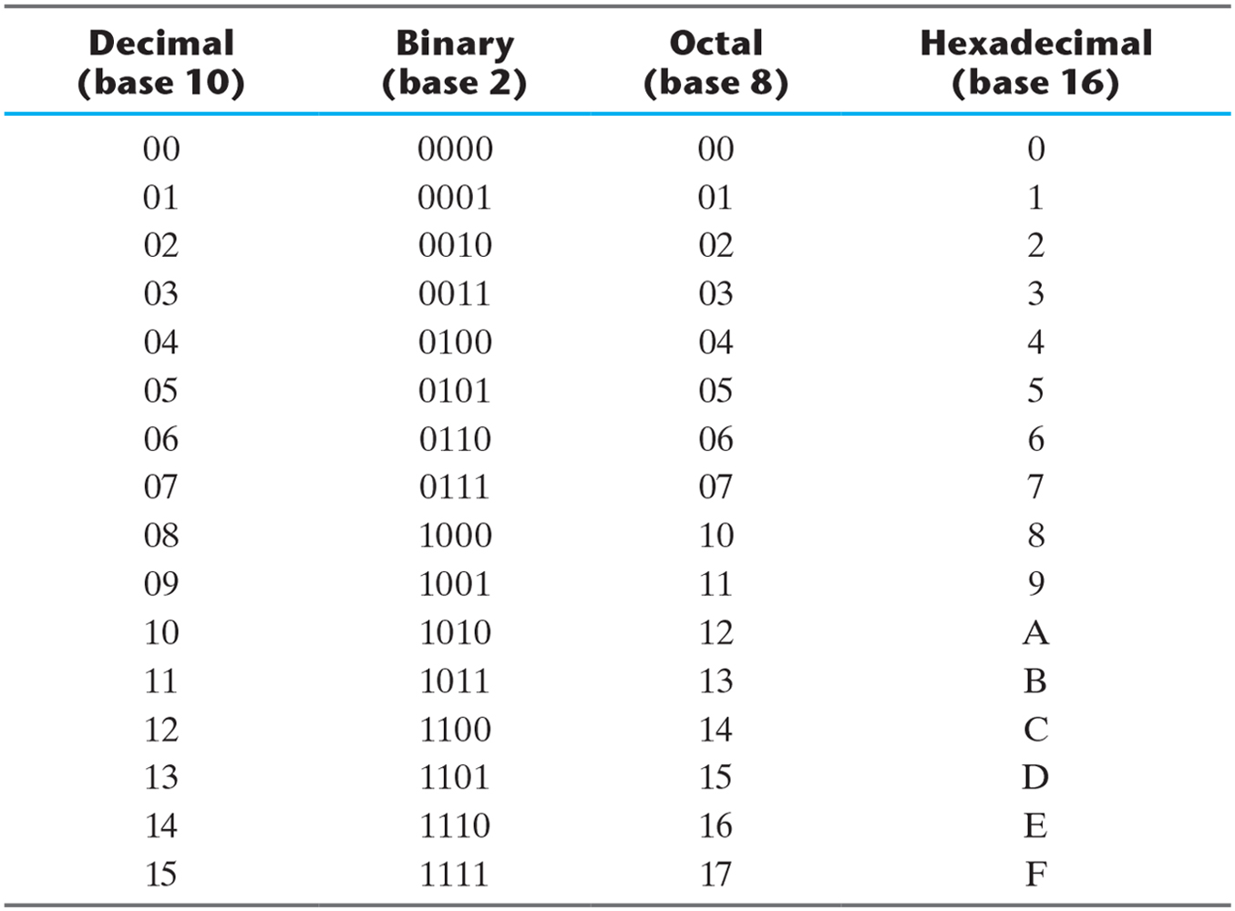
Table 1.2 Numbers with Different Bases.

Slide 4
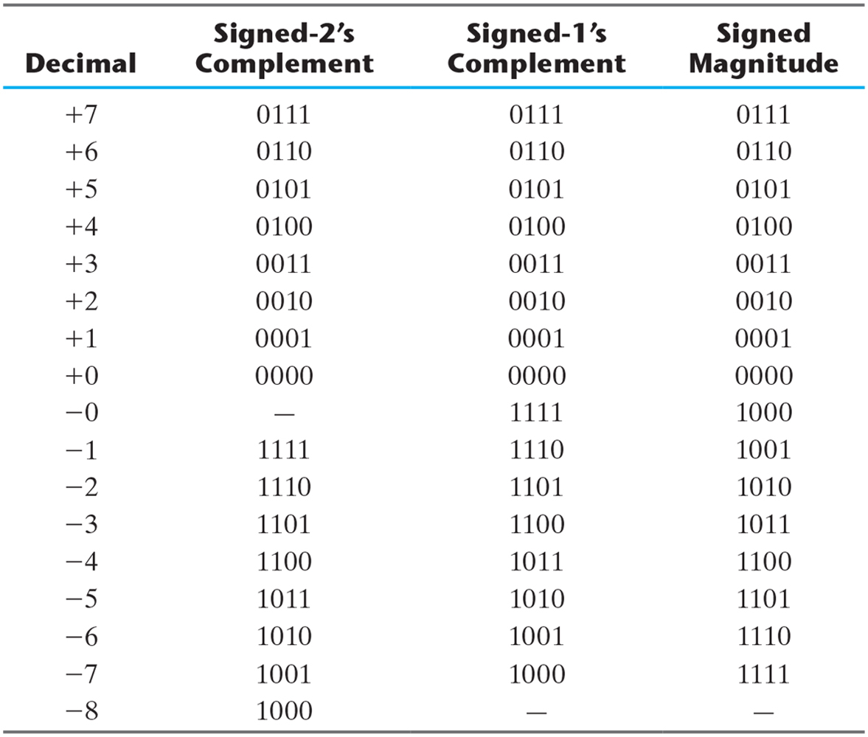
Table 1.3 Signed Binary Numbers.

Slide 5
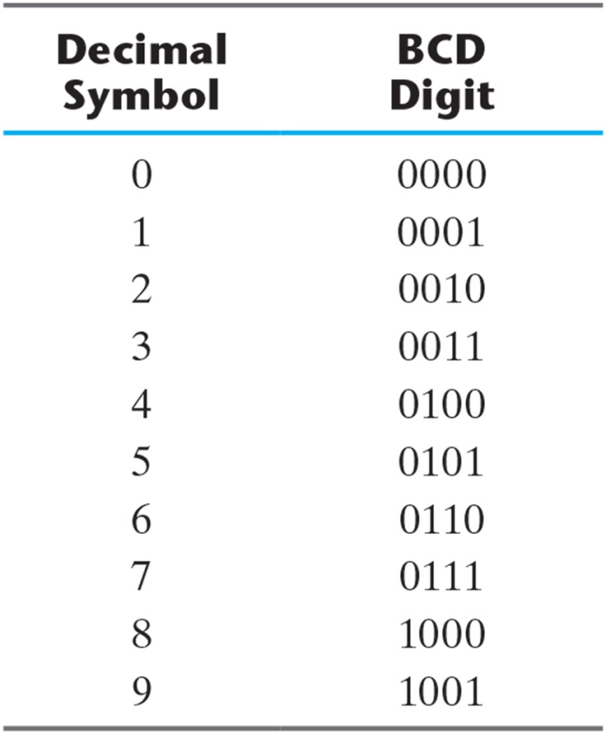
Table 1.4 Binary-Coded Decimal (BCD).

Slide 6
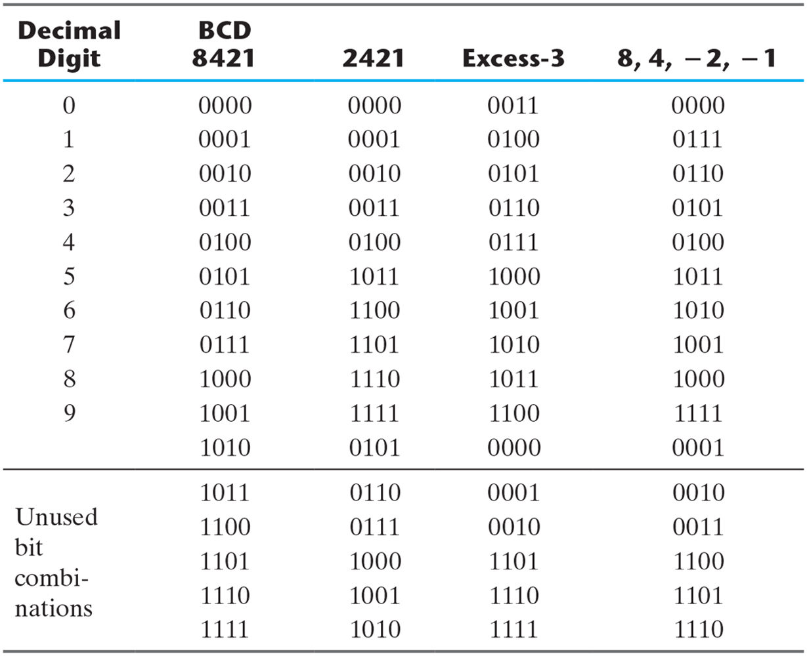
Table 1.5 Four Different Binary Codes for the Decimal Digits.

Slide 7
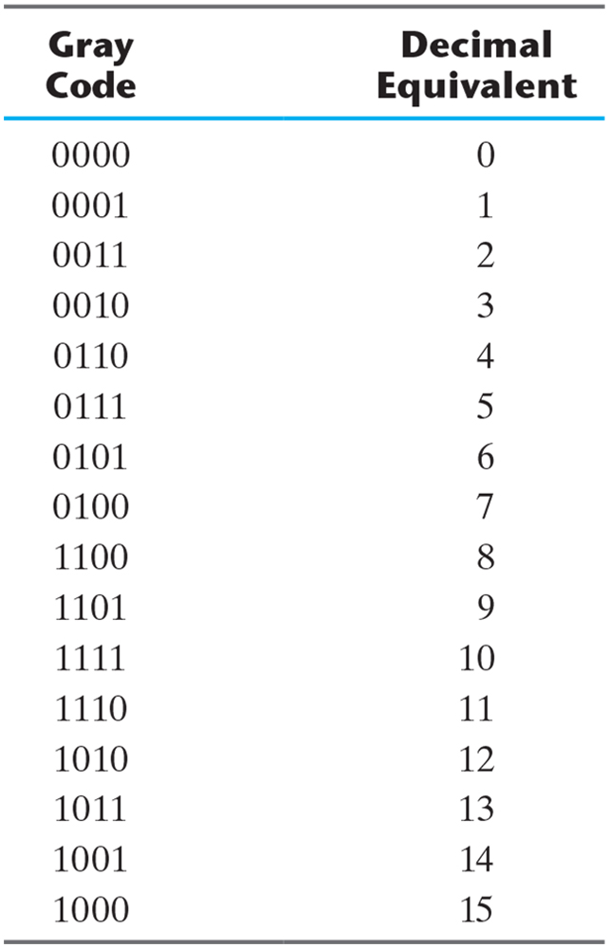
Table 1.6 Gray Code.

Slide 8
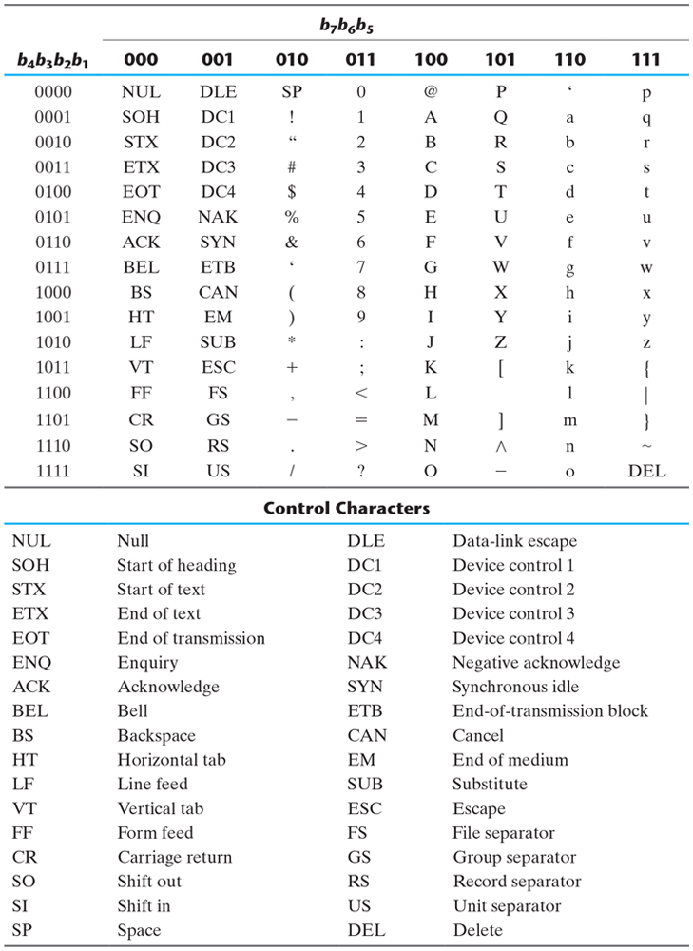
Table 1.7 American Standard Code for Information Interchange (ASCII).

Slide 9
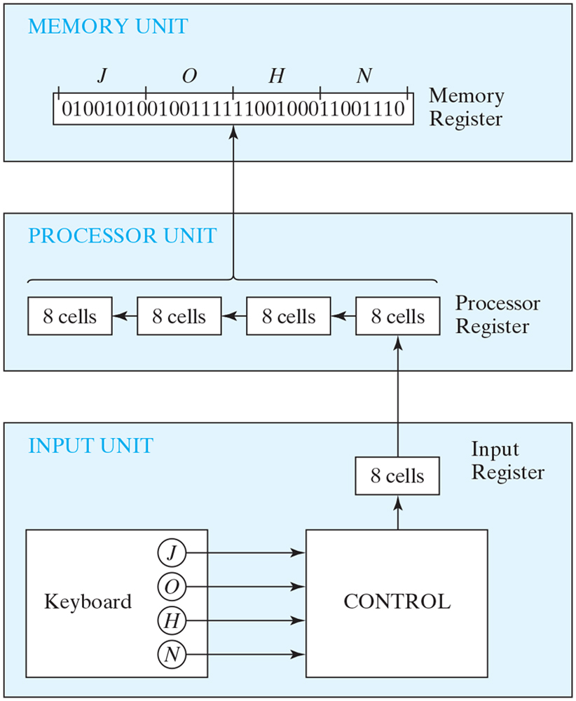
Figure 1.1 Transfer of information among registers.

Slide 10
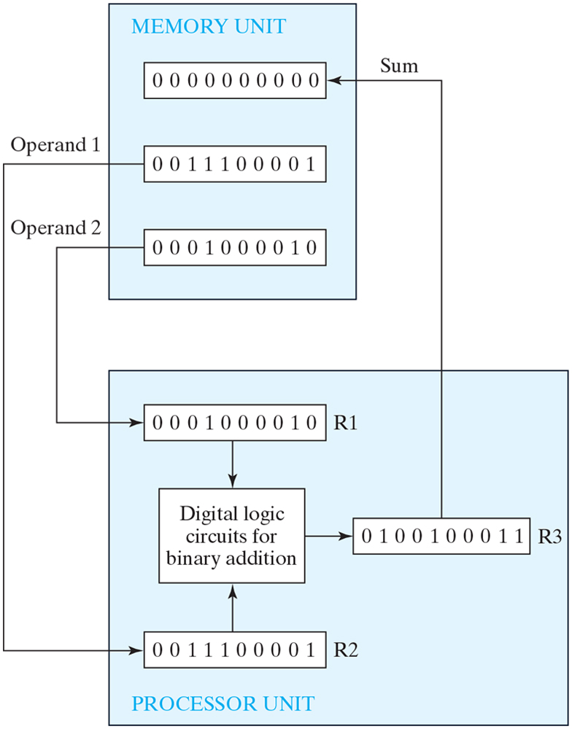
Figure 1.2 Example of registers in binary information processing.

Slide 11
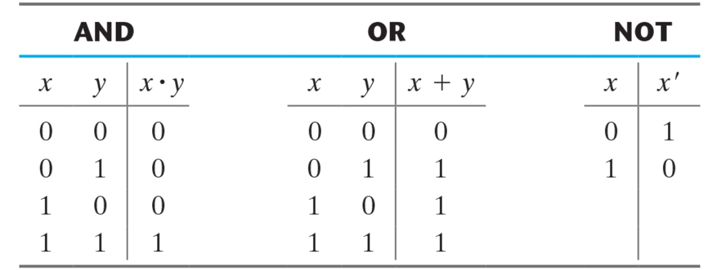
Table 1.8 Truth Tables of Logical Operations

Slide 12
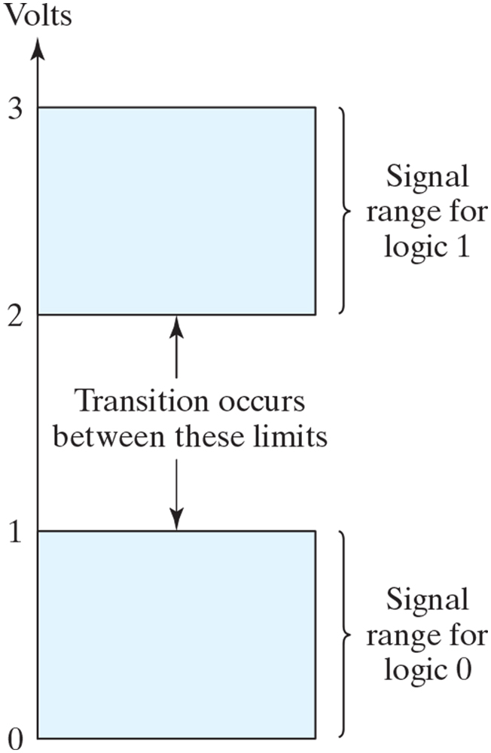
Figure 1.3 Signal levels for binary logic values.

Slide 13
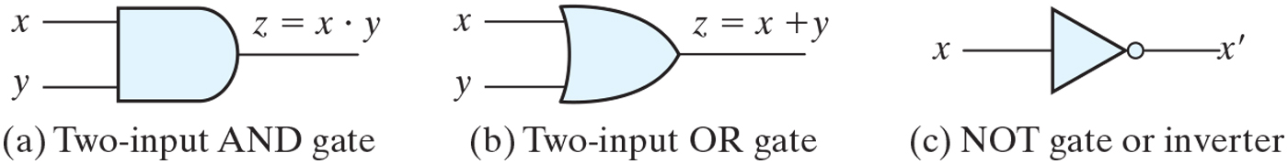
Figure 1.4 Symbols for digital logic circuits.

Slide 14
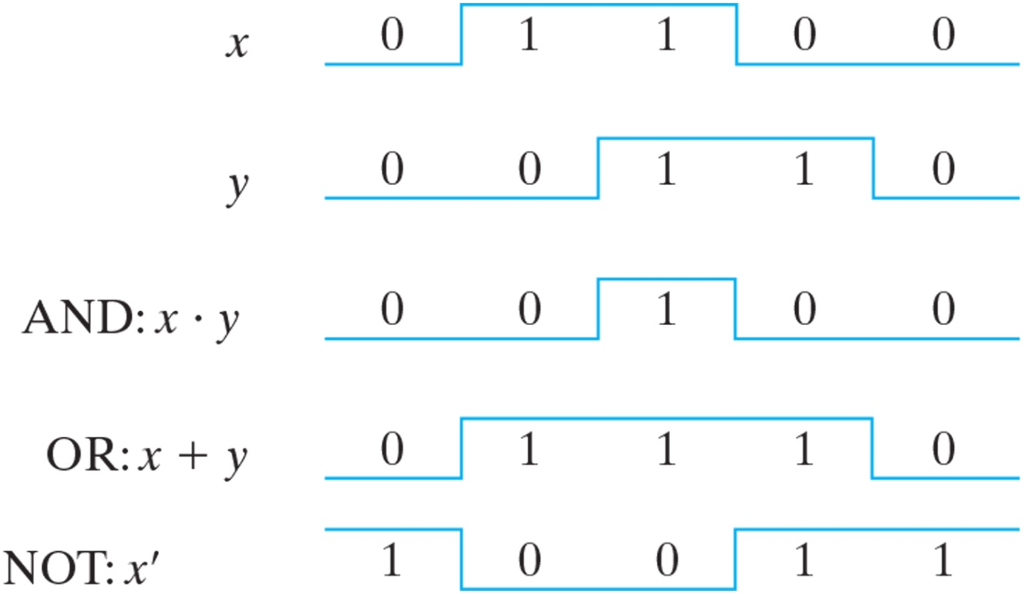
Figure 1.5 Input–output signals for gates.

Slide 15
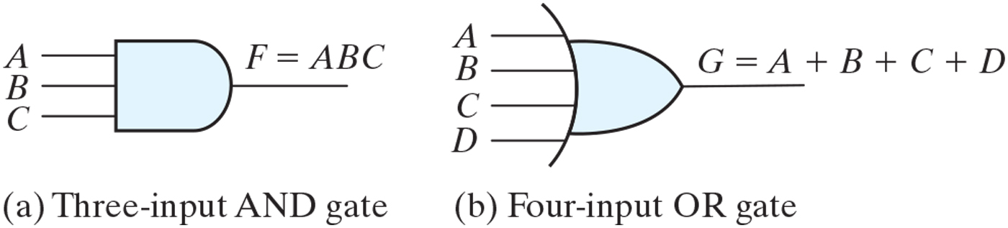
Figure 1.6 Gates with multiple inputs.

