Slide 1

Digital Design
With an Introduction to the Verilog HDL, VHDL, and SystemVerilog
6th Edition
Chapter 02
Boolean Algebra and Logic Gates

Slide 2
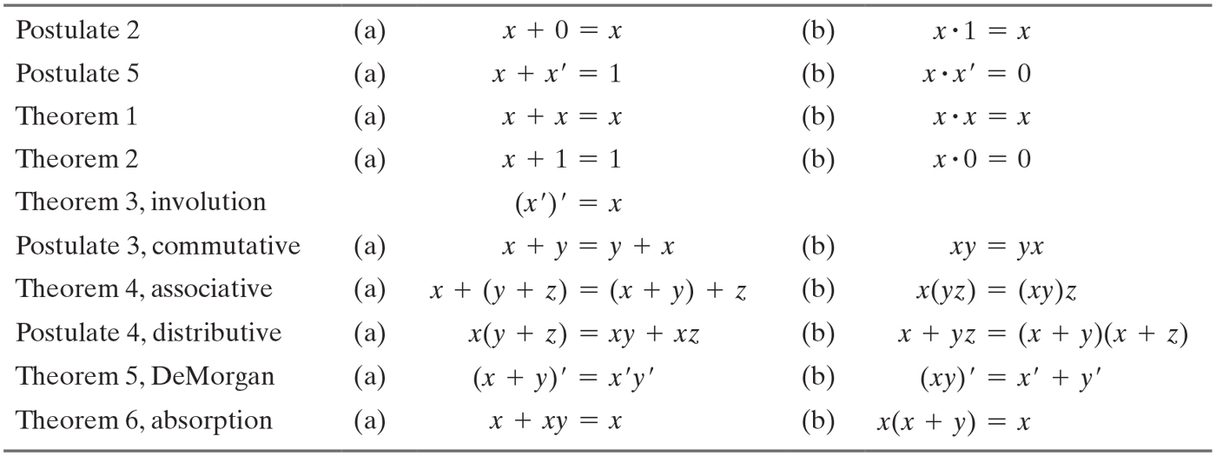
Table 2.1 Postulates and Theorems of Boolean Algebra.

Slide 3
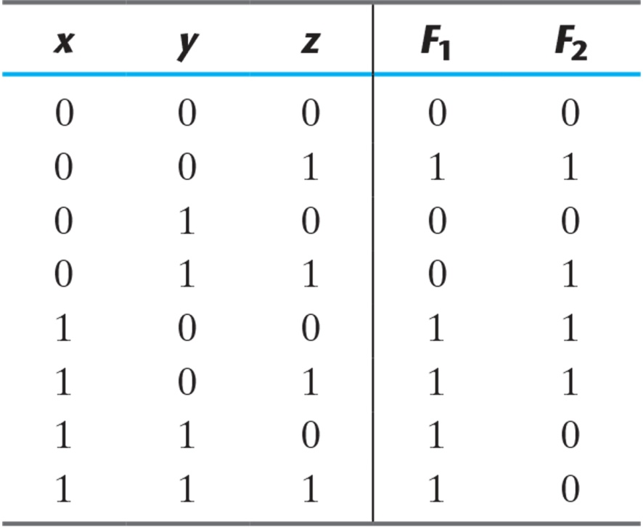
Table 2.2 Truth Tables for F₁ and F_{2.}

Slide 4
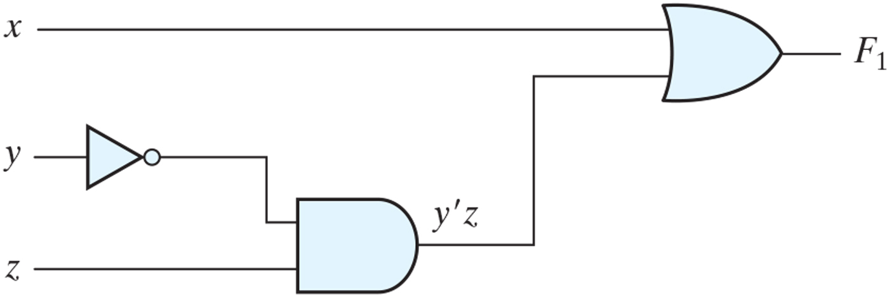
Figure 2.1 Logic diagram for the Boolean function F₁ = x + y'z.

Slide 5
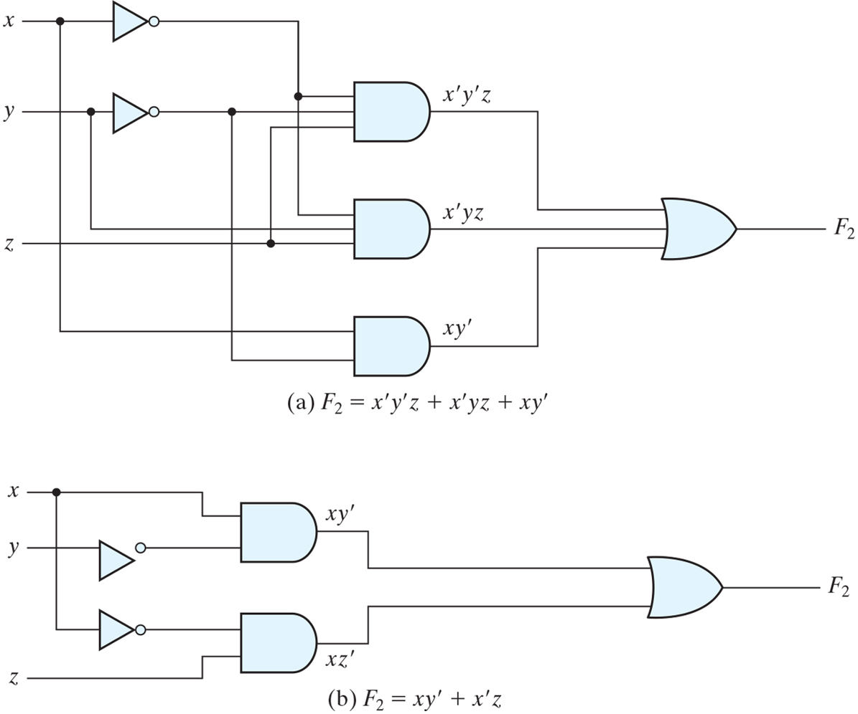
Figure 2.2 Implementation of Boolean function F₂ with gates.

Slide 6
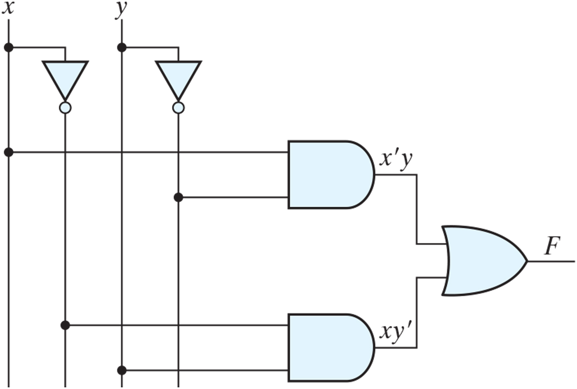
Practice Exercise 2.3

Slide 7

Figure PE2.4

Slide 8
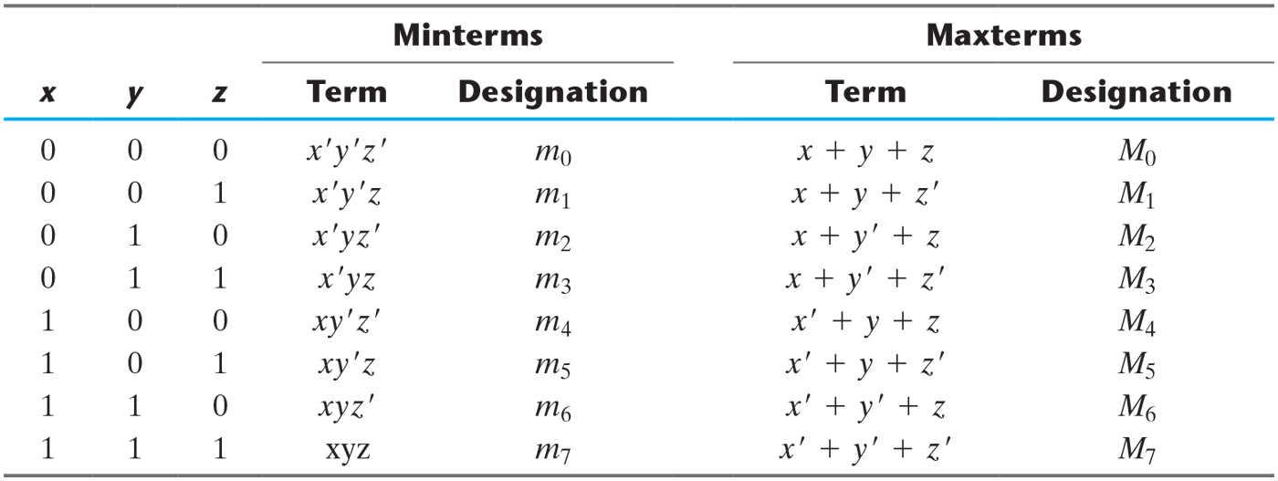
Table 2.3 Minterms and Maxterms for Three Binary Variables.

Slide 9
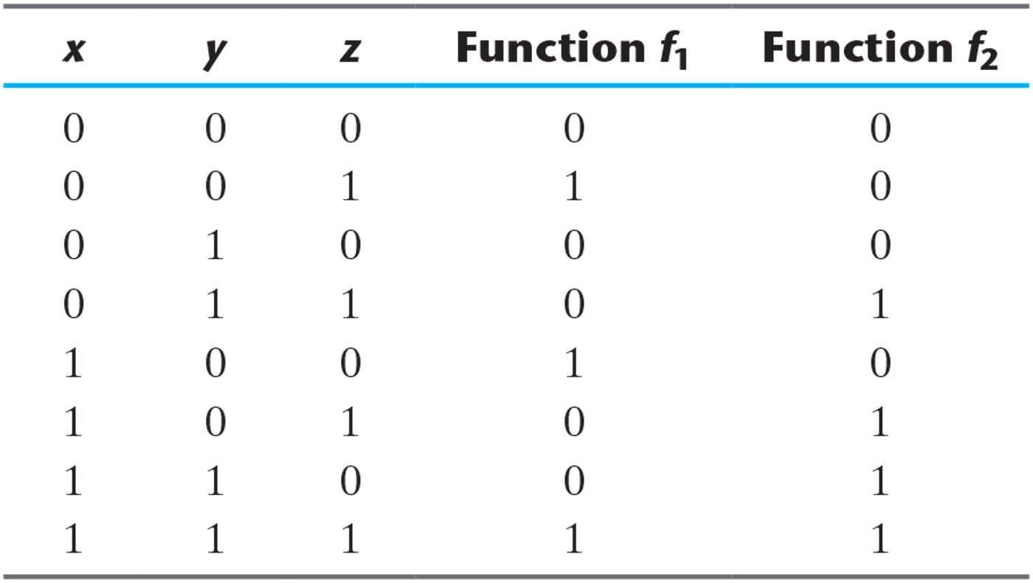
Table 2.4 Functions of Three Variables.

Slide 10
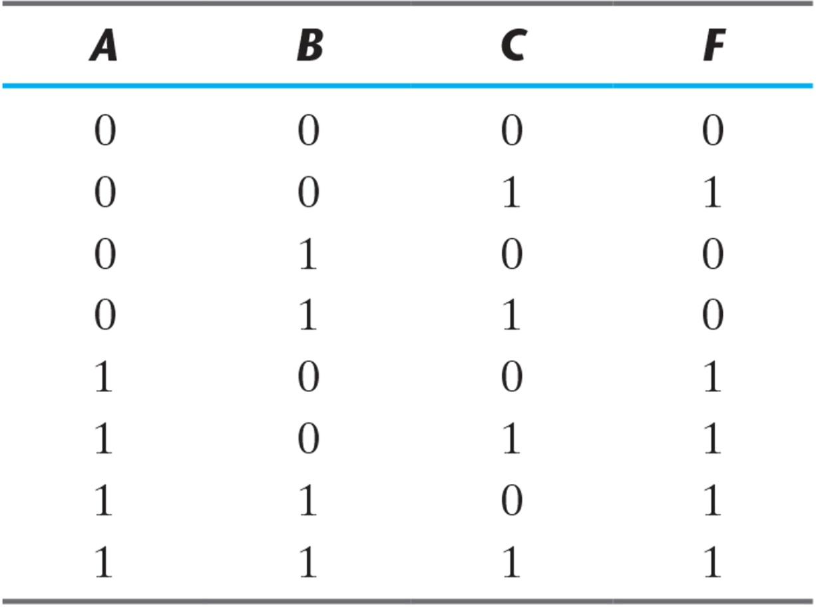
Table 2.5 Truth Table for F = A + B'C.

Slide 11
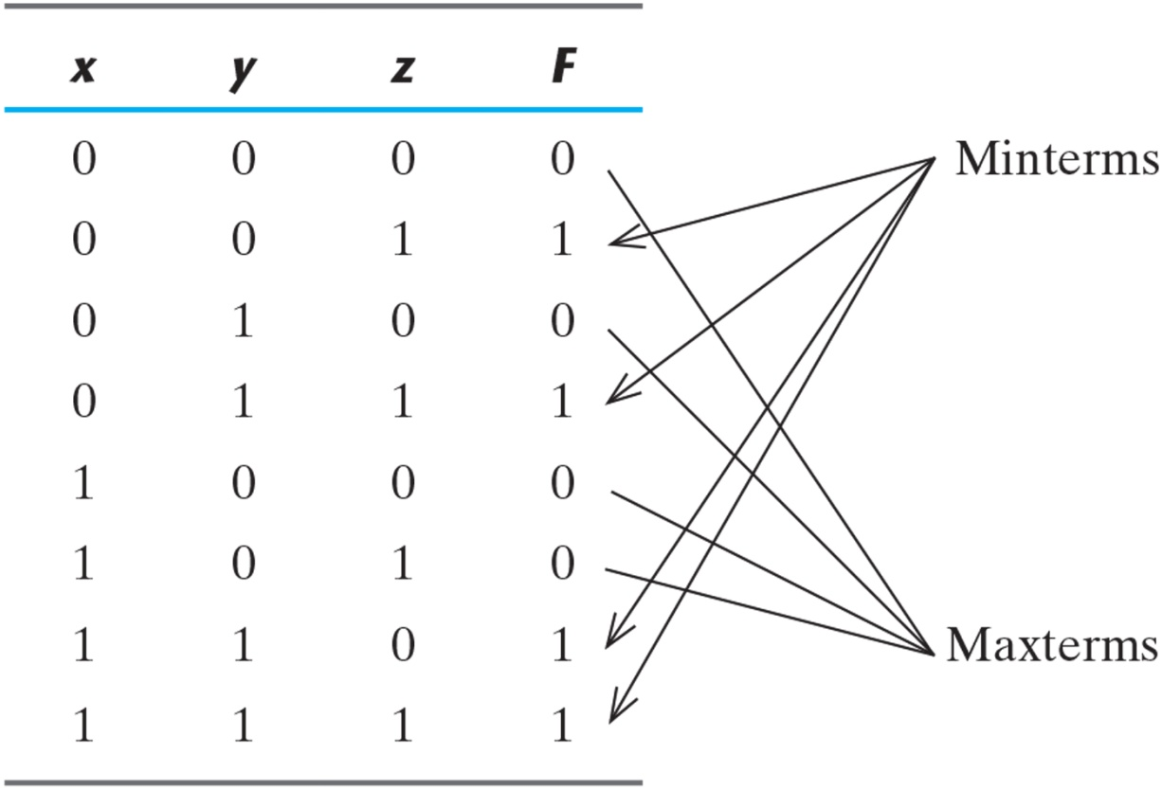
Table 2.6 Truth Table for F = xy + x'z.

Slide 12
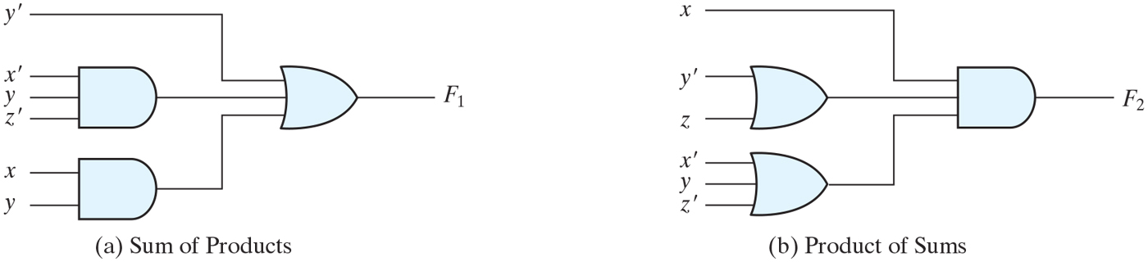
Figure 2.3 Two-level implementation.

Slide 13
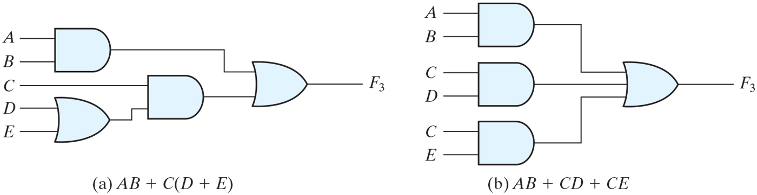
Figure 2.4 Three- and two-level implementation.

Slide 14
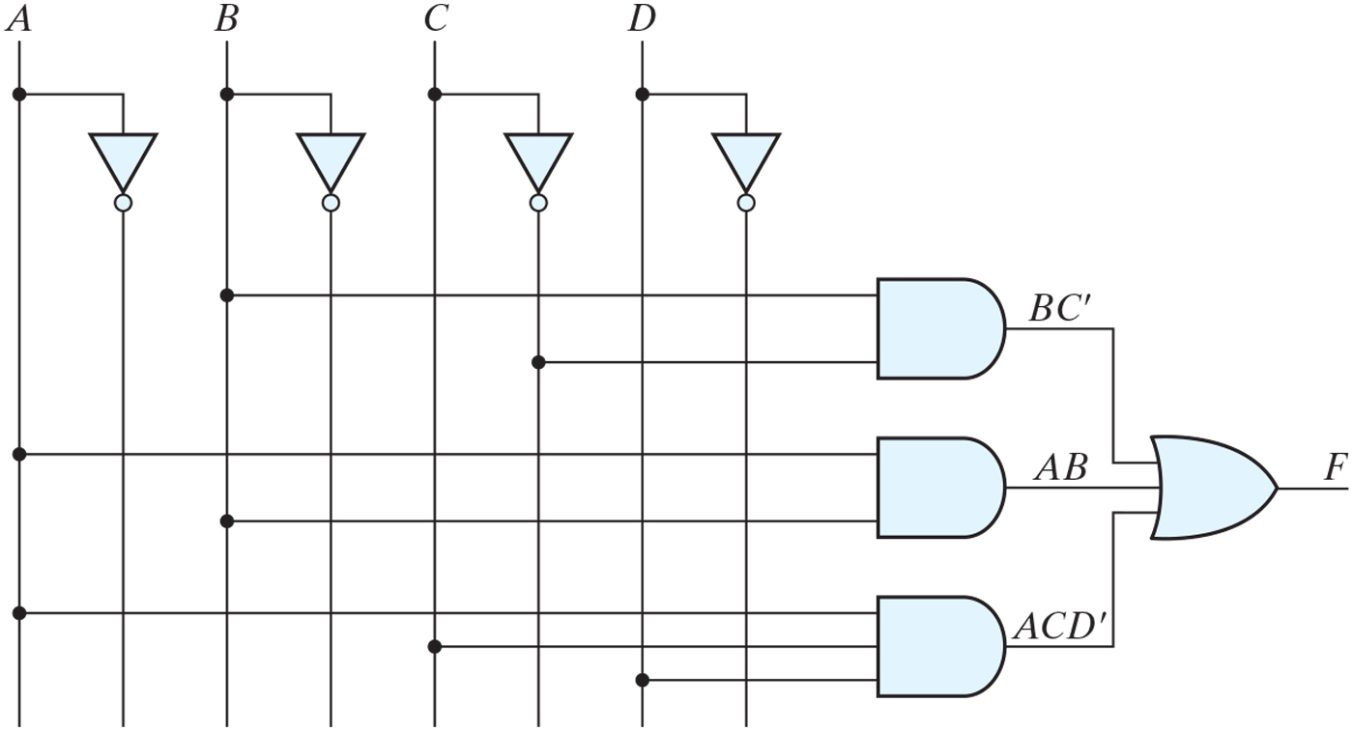
Practice Exercise 2.12

Slide 15
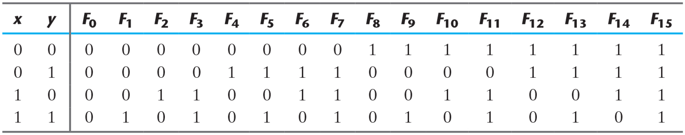
Table 2.7 Truth Tables for the 16 Functions of Two Binary Variables.

Slide 16
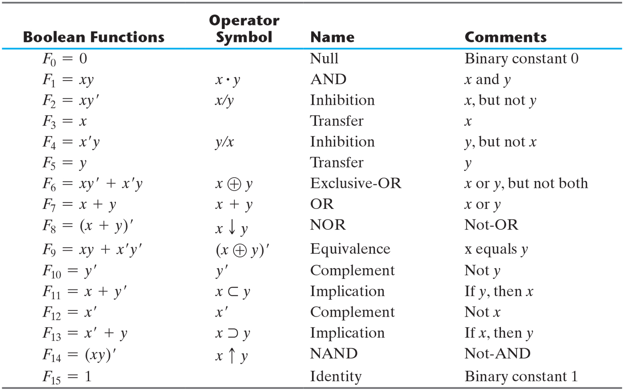
Table 2.8 Boolean Expressions for the 16 Functions of Two Variables.

Slide 17
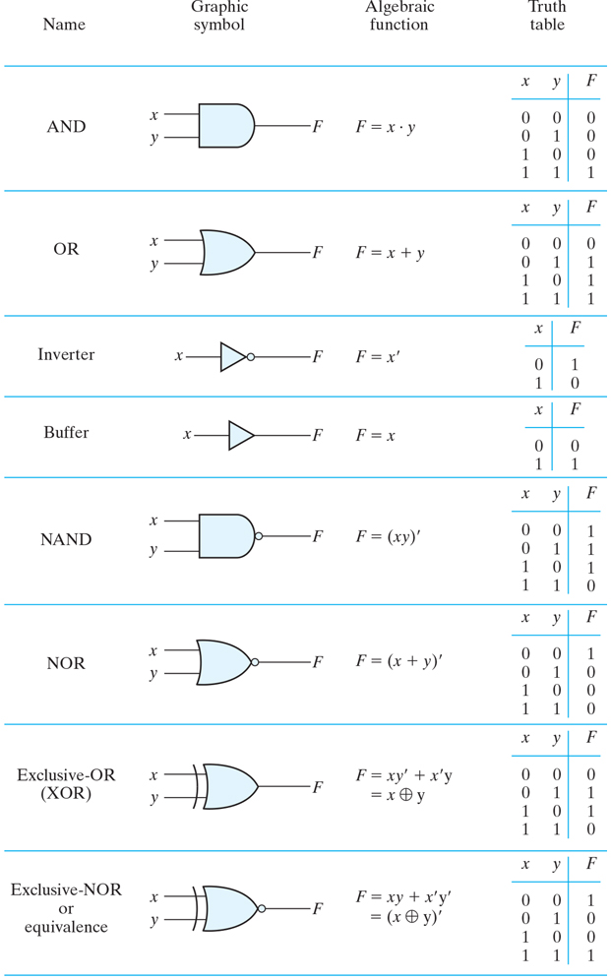
Figure 2.5 Digital logic gates.

Slide 18
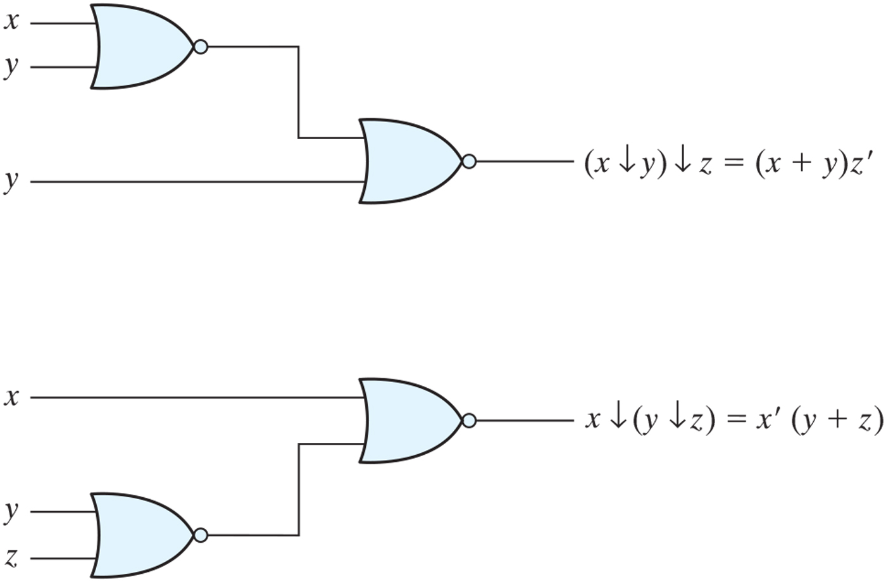
Figure 2.6 Demonstrating the nonassociativity of the NOR operator: (x ↓ y) ↓ z ≠ x ↓(y ↓ z).

Slide 19
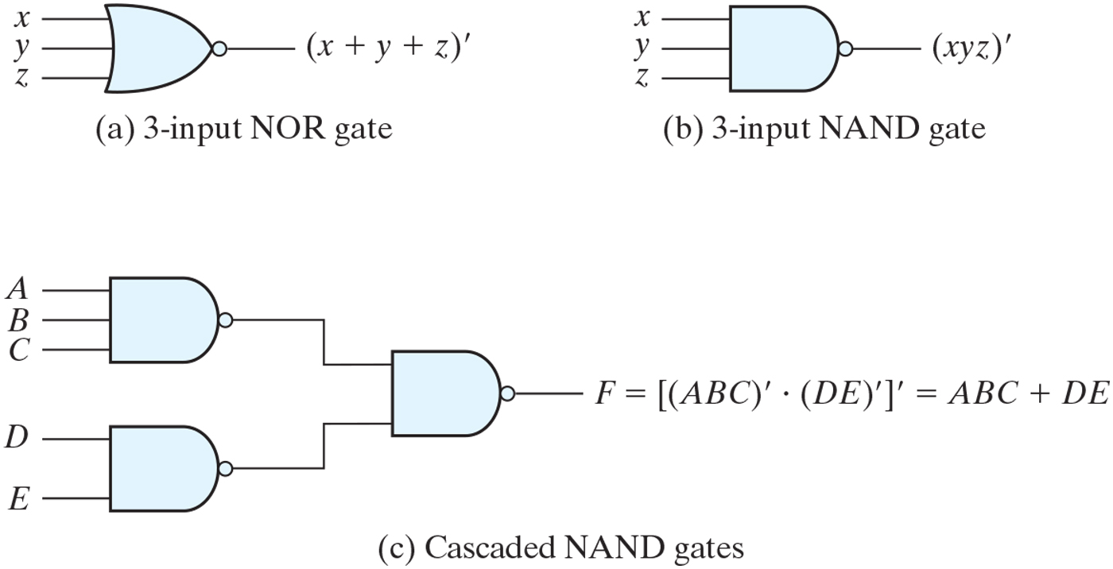
Figure 2.7 Multiple-input and cascaded NOR and NAND gates.

Slide 20
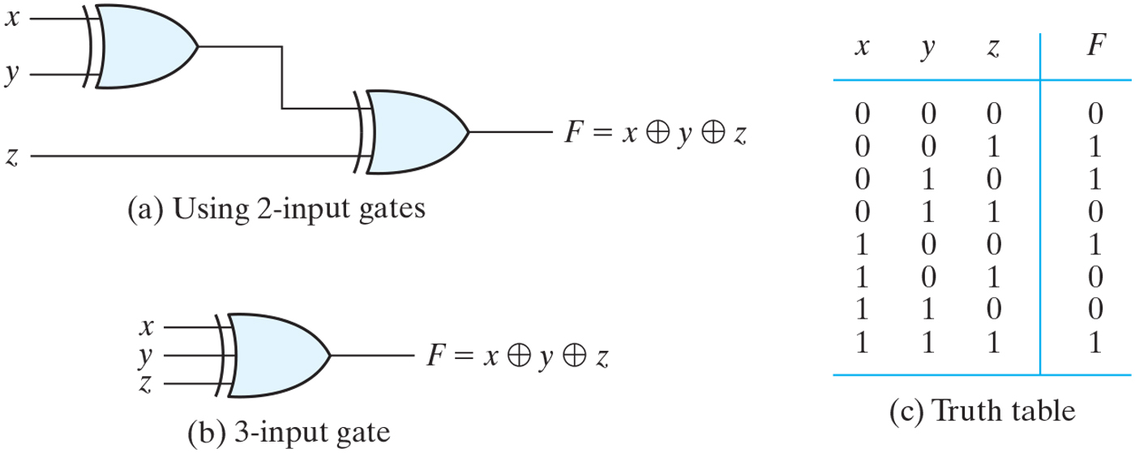
Figure 2.8 Three-input exclusive-OR gate.

Slide 21
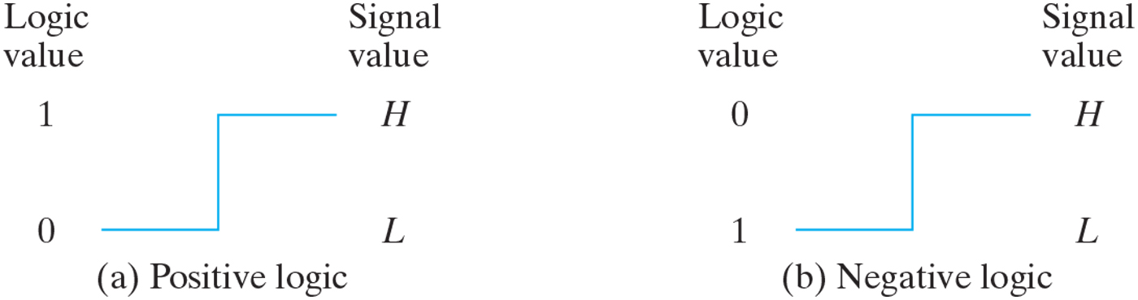
Figure 2.9 Signal assignment and logic polarity.

Slide 22
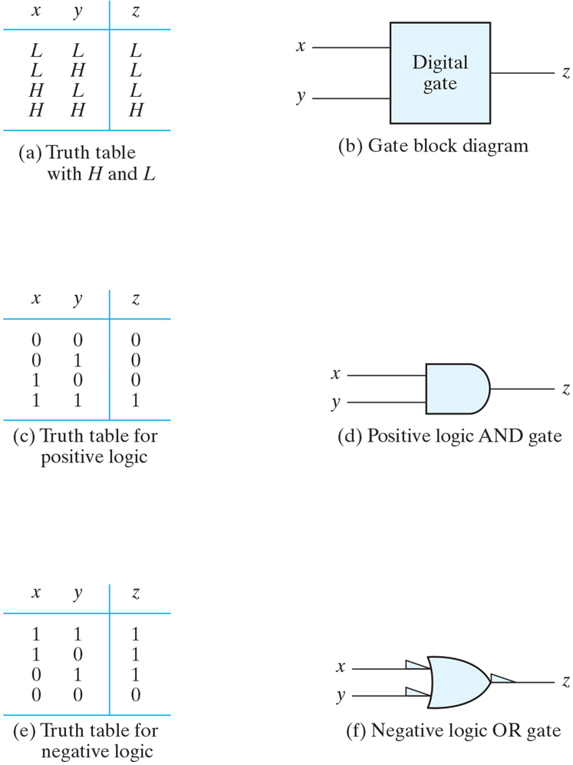
Figure 2.10 Demonstration of positive and negative logic.

Slide 23
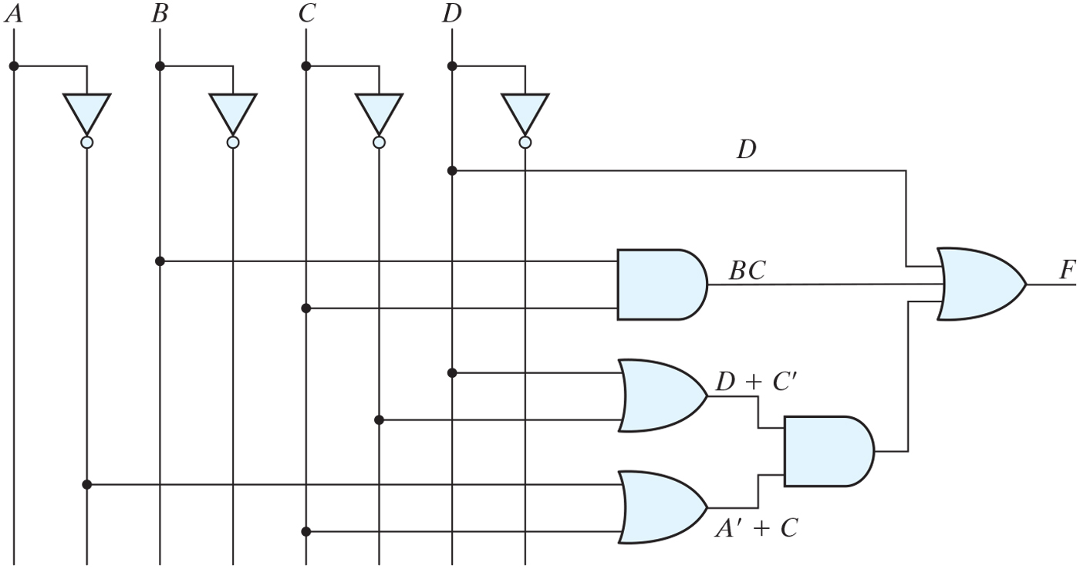
Practice Exercise 2.13

Slide 24
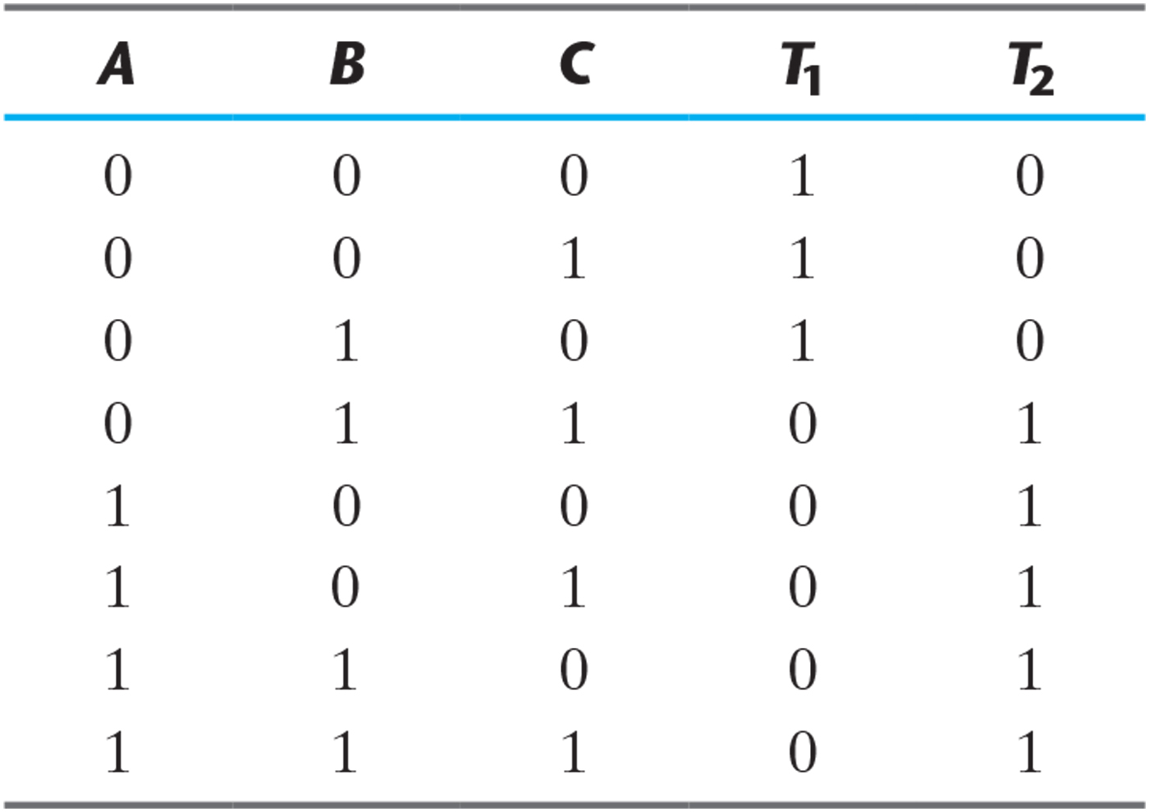
Problem 2.15

Slide 25
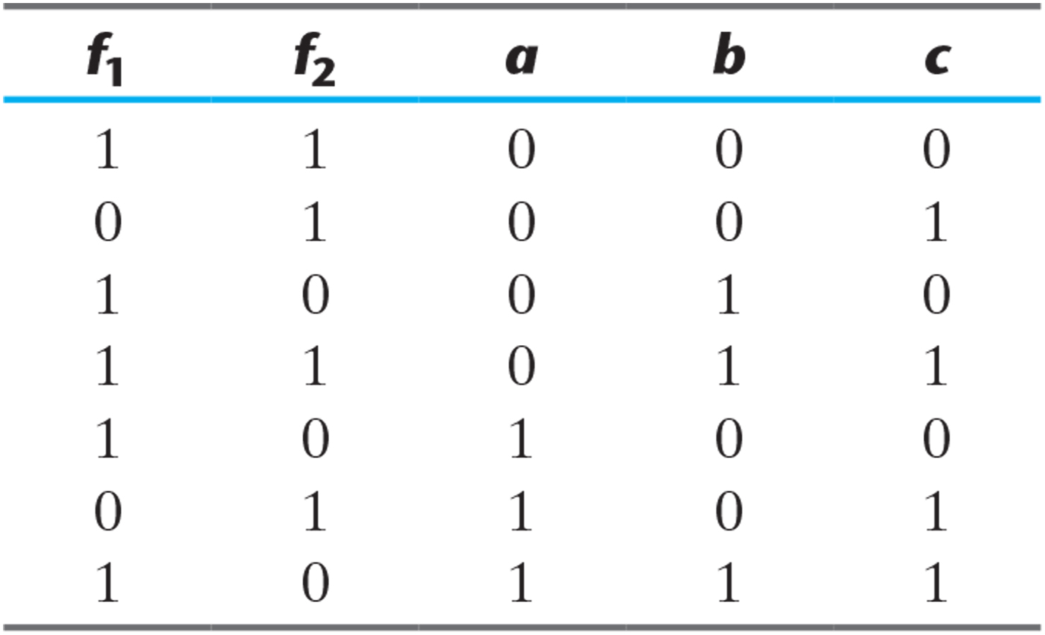
Table P2.27

Slide 26
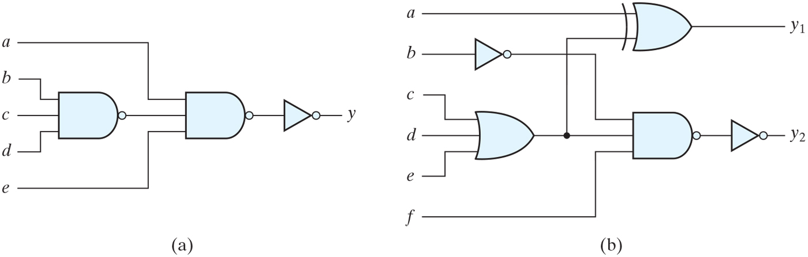
Figure P2.28

Slide 27
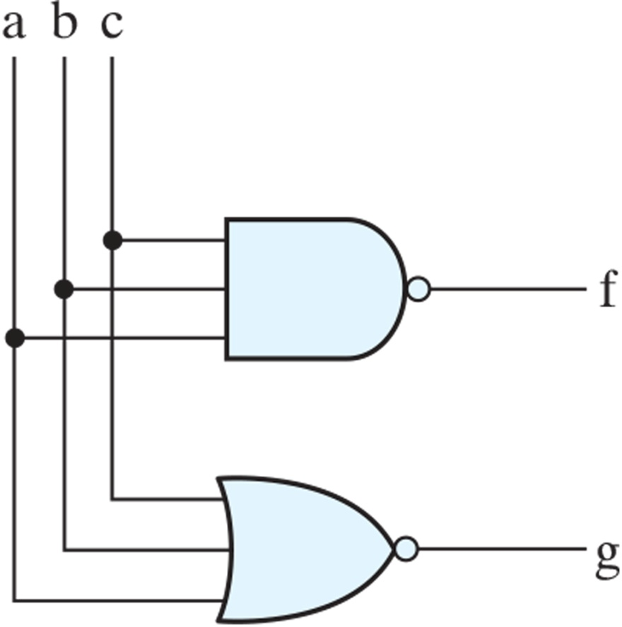
Figure P2.32

Slide 28
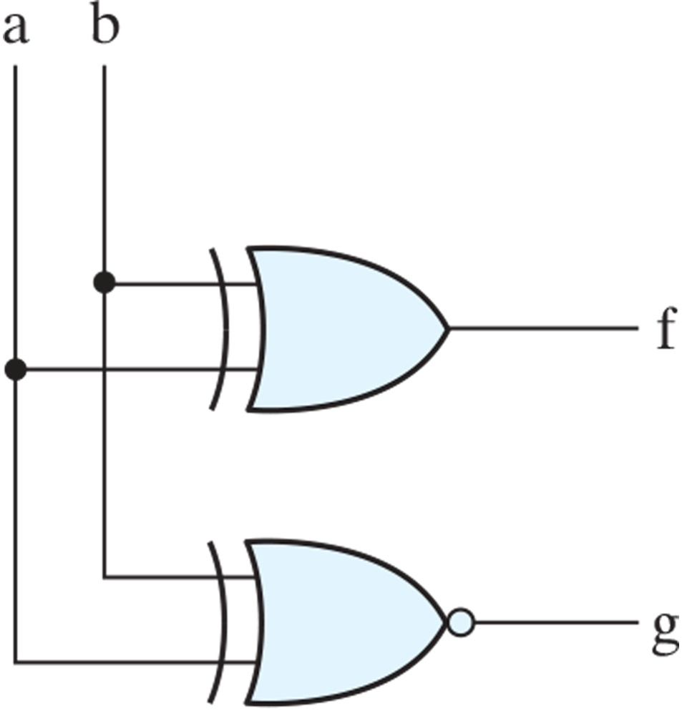
Figure P2.33

